Slide 1
IOT IMPLEMENTATION RESOURCES
H Anandkumar Singh
Technical Specialist

Slide 2
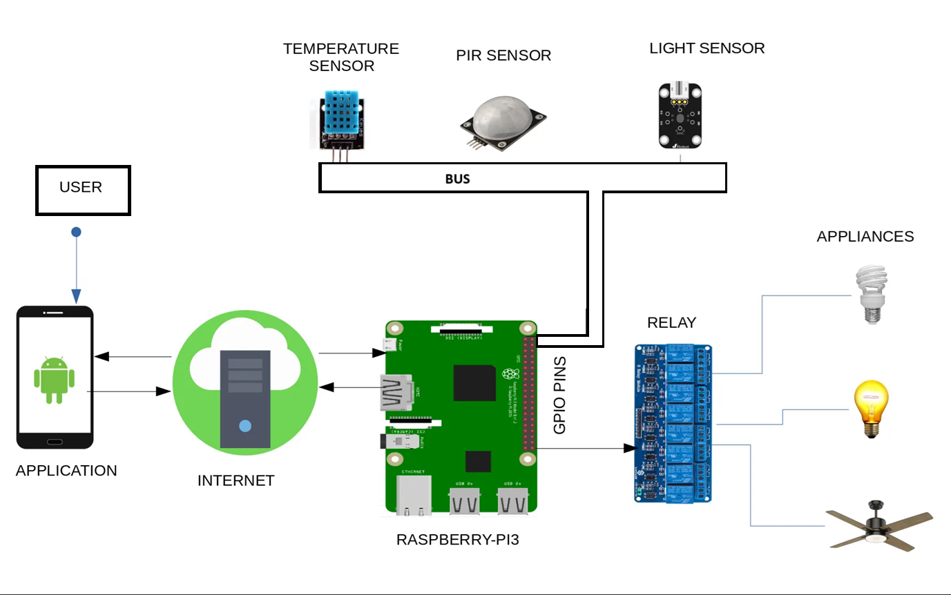
What is IOT
Internet of Things:
Example:
smart thermostat
fitness tracker
smart fridge

Slide 3
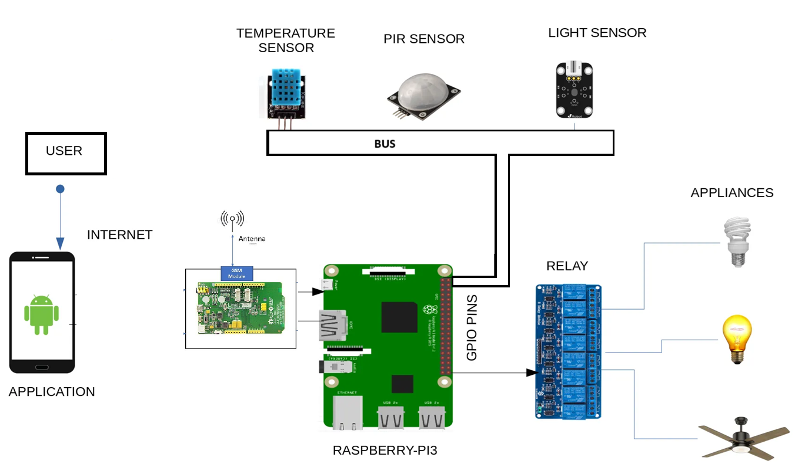
Can you Make IOT Product without Cloud?
Local Communication (Edge Computing)
Offline Mode with Local Storage
Direct Device-to-Device Communication (P2P)
Edge Computing Devices
Wi-Fi-Only or Local Network Solutions
Key Considerations When Building IoT Without Cloud:
Security
Data Storage
Power Consumption
Scalability

Slide 4
What is Python?
1. Python is a high-level, interpreted programming language known for its simplicity and readability.
2. Here are some key features of Python:
a. Easy to Learn and Use
b. Dynamically Typed
c.Interpreted Language
d. Versatile and Cross-Platform
e. Extensive Standard Library
f. Object-Oriented and Functional
g. Wide Range of Applications
h. Large Community and Ecosystem
Example Code of Python

Slide 5
Python Code
# A simple Python program to print "Hello, World!" and add two numbers
def add_numbers(a, b):
return a + b
print("Hello, World!")
result = add_numbers(10, 20)
print(f"The result of adding 10 and 20 is: {result}")
Why Use Python?
Beginner-Friendly: Python’s readable syntax and simplicity make it an excellent choice for newcomers.
Rapid Development: Python allows developers to quickly prototype and develop applications.
Versatile: Python is used for a variety of applications across different domains, from web development to machine learning.

Slide 6
How Python Different from C++?
Feature | C++ (Compiled) | Python (Interpreted)
Execution | Compiled to machine code (faster execution) | Interpreted line-by-line at runtime (slower execution)
Compilation | Requires a compiler (e.g., g++) | No compilation step, interpreted directly by the Python interpreter
Performance | Generally faster due to direct machine code execution | Slower, since the interpreter processes each line during runtime
Platform Dependency | Machine code is platform-specific; needs recompilation for different platforms | Platform-independent (as long as the interpreter is available)

Slide 7
Why Use Python
Beginner-Friendly: Python’s readable syntax and simplicity make it an excellent choice for newcomers.
Rapid Development: Python allows developers to quickly prototype and develop applications.
Versatile: Python is used for a variety of applications across different domains, from web development to machine learning.
3. Performance and Efficiency
C/C++ is compiled and optimized for performance, making it the preferred choice for high-performance or real-time systems where speed and resource efficiency are critical (e.g., in battery-powered or resource-constrained devices).
Python is an interpreted language, which makes it slower than C/C++ for CPU-intensive tasks. However, in many IoT use cases, the performance gap is often negligible, especially if Python is running on relatively powerful platforms (like Raspberry Pi or Intel NUC).
C/C++ Advantage: Better for performance-critical applications and systems with stringent real-time constraints.
Python Advantage: Adequate performance for many IoT applications, especially when working with higher-level tasks like data processing or cloud communication.

Slide 8
Introduction to IOT Tools
IoT Development Platforms
IoT Hardware and Development Kits
IoT Communication Protocols
IoT Device Management Tools
IoT Analytics and Data Visualization Tools
IoT Security Tools
Cloud IoT Platforms
Edge Computing Tools for IoT

Slide 9
IoT Development Platforms
IoT development platforms provide the necessary environment to design, build, and deploy IoT applications.
Example:
Arduino IDE:
Raspberry Pi:
Microsoft Azure IoT:
Google Cloud IoT:
ThingSpeak:

Slide 10
IoT Hardware and Development Kits
To build IoT solutions, you need hardware that includes sensors, actuators, and communication modules.
Examples:
Arduino:
An open-source platform for creating IoT projects. It offers a variety of Arduino boards and sensor modules like temperature, humidity, and motion sensors.
Raspberry Pi:
A low-cost, compact single-board computer used in many IoT projects. It supports GPIO (General Purpose Input/Output) pins for connecting sensors and actuators.
ESP8266 and ESP32:
These are Wi-Fi enabled microcontrollers used in many IoT applications. The ESP8266 is often used for basic IoT devices, while the ESP32 has Bluetooth and Wi-Fi capabilities.
Adafruit Feather:
A development board series that supports various sensors and modules. The Feather series is designed for low-power IoT applications.

Slide 11
IoT Communication Protocols
Communication between devices is central to IoT, and there are various protocols used to exchange data.
Examples:
MQTT (Message Queuing Telemetry Transport):
A lightweight, publish/subscribe messaging protocol used for efficient communication between IoT devices. It's widely used in IoT due to its low bandwidth and ease of implementation.
CoAP (Constrained Application Protocol):
Designed for low-power and resource-constrained devices. It is used in applications where devices communicate over the internet with minimal overhead.
HTTP/HTTPS:
Though not as efficient for IoT in real-time applications, HTTP is still used for basic communication, especially for cloud-based IoT systems.
Bluetooth Low Energy (BLE):
A low-power wireless communication standard used for devices like wearables, home automation products, and healthcare sensors.
LoRaWAN (Long Range Wide Area Network):
A low-power, wide-area network protocol for long-range communication, commonly used in agriculture, smart cities, and industrial IoT applications.

Slide 12
IoT Analytics and Data Visualization Tools
IoT solutions generate massive amounts of data that need to be analyzed and visualized for decision-making.
Examples:
Power BI:
A Microsoft tool for business analytics. It allows IoT data to be visualized in the form of interactive dashboards and reports.
Grafana:
A popular open-source platform used to monitor and visualize data. It integrates with IoT platforms to display real-time data from IoT devices.
Kibana:
Used with the Elasticsearch stack to analyze and visualize log and metric data. It's useful for IoT data management and monitoring.
Tableau:
A widely used tool for visualizing and analyzing IoT data. It provides rich, interactive charts, graphs, and dashboards.

Slide 13
IoT Device Management Tools
Device management is crucial for large-scale IoT deployments, as it involves monitoring device health, software updates, and security.
Examples:
Losant:
A comprehensive IoT platform for building applications that includes device management, real-time data collection, and analytics. It simplifies managing large IoT networks.
AWS IoT Device Management:
Amazon's service that allows users to manage IoT devices, perform remote diagnostics, push software updates, and ensure device security.
Particle:
An IoT platform that provides end-to-end solutions, including device management and cloud integration. Particle offers hardware, software, and cloud tools to develop IoT applications.

Slide 14
IoT Security Tools
IoT security is a critical aspect of any IoT solution to protect devices, networks, and the data they generate.
Examples:
Cisco IoT Security:
A suite of IoT security products that protect IoT devices and networks against cyber threats. It offers network security, data protection, and device authentication.
Armis:
An IoT security platform that provides visibility into unmanaged devices and protects IoT and other devices from cyber threats.
Trend Micro IoT Security:
An IoT security tool that provides endpoint protection and secure connectivity for IoT devices and networks.

Slide 15
Cloud IoT Platforms
Cloud platforms are essential for managing, storing, and analysing data from IoT devices.
Examples:
AWS IoT Core:
A fully managed cloud service provided by Amazon Web Services to connect IoT devices to the cloud, process and store data, and integrate with other AWS services.
Google Cloud IoT Core:
A fully managed service from Google to securely connect, manage, and ingest data from IoT devices for analysis and integration with machine learning services.
IBM Watson IoT:
IBM’s cloud platform for connecting IoT devices, processing data, and using artificial intelligence (AI) and machine learning (ML) for insights.

Slide 16
Edge Computing Tools for IoT
Edge computing brings computation and data storage closer to the location where it is needed, improving response time and saving bandwidth.
Examples:
Microsoft Azure IoT Edge:
An edge computing service that extends Azure IoT services to local devices, enabling real-time processing of IoT data.
EdgeX Foundry:
An open-source platform for edge computing in IoT, designed to enable the development of IoT edge solutions.

Slide 17
Developing Application through IOT Tools
Step-1 : Define the IoT Application Use Case
Step-2: Choose the IoT Hardware (Sensors & Actuators)
Step-3: Set Up Development Environment
Step-4: Connect Sensors to Hardware
Step-5: Write the Code for Data Collection
Step-6: Communication protocol for Sending Data from Device to Cloud or From Cloud to Device
Step-7: Set Up Cloud Platform for Data Storage and Analysis
Step-8: Visualize and Analyze the Data
Step-9: Secure Your IoT Application
Step-10: Add Additional Features (Optional)

Slide 18
Step-1 : Define the IoT Application Use Case
Let’s say you're building a temperature and humidity monitoring system using IoT devices. The application will:
1. Collect data from a sensor (e.g., temperature and humidity sensor).
2. Send data to a cloud platform for storage and analysis.
3. Provide real-time analytics and visualization of the data.

Slide 19
Step-2: Choose the IoT Hardware (Sensors & Actuators)
Select the sensors or actuators you will need to collect data from the physical world.
Example Hardware:
1. Sensor: A DHT11/DHT22 sensor (temperature and humidity sensor).
2. Microcontroller/Development Board: An Arduino or Raspberry Pi.
3. Connectivity Module: A Wi-Fi module like the ESP8266 or ESP32 to send data over the internet.

Slide 20
Step-3: Set Up Development Environment
Install necessary software tools for programming and testing your IoT hardware.
Development Platforms and Tools:
1. Arduino IDE (for Arduino-based development).
2. Thonny or PyCharm (for Python development on Raspberry Pi).
3. Visual Studio Code (for general-purpose development with IoT libraries).
For Raspberry Pi or ESP32, you might need to install specific libraries or SDKs to work with sensors.

Slide 21
Step-4: Connect Sensors to Hardware
You need to physically connect the sensors to the microcontroller (e.g., Arduino or Raspberry Pi). The wiring and pin configuration depend on the sensor and the board you are using.
Example (Connecting a DHT11 sensor to Arduino):
DHT11 has three pins: VCC, GND, and DATA.
Connect VCC to 5V on the Arduino, GND to GND, and DATA to an available digital pin (e.g., D2).

Slide 22
Step-5: Write the Code for Data Collection
Arduino Code:
Raspberypi Code:
Library: pip install Adafruit_DHT
This code reads the temperature and humidity values from the DHT11 sensor and prints them to the serial monitor. For cloud communication, you will need to add a networking module like Wi-Fi.

Slide 23
Step 6: Set Up Cloud Platform for Data Storage and Analysis
Once the sensor data is collected, you will need a platform to send and store the data for further analysis.
Cloud Platforms to Consider:
ThingSpeak: Simple to set up and can display data with built-in visualization tools.
AWS IoT Core: For scalable solutions, where you can store and analyze data on AWS cloud services.
Google Cloud IoT: For integrating with Google’s cloud tools and machine learning capabilities.
Microsoft Azure IoT: For creating end-to-end IoT solutions with device management, analytics, and storage.

Slide 24
Step 6: Set Up Cloud Platform for Data Storage and Analysis
Example: Sending Data to ThingSpeak
This code sends the temperature and humidity data to ThingSpeak using the ESP8266. You will need to have your ThingSpeak channel set up and an API key to write data.

Slide 25
Step 7: Visualize and Analyze the Data
Once data is collected and sent to the cloud, use data visualization tools to present the data in a meaningful way.
ThingSpeak has built-in dashboards for plotting data in real-time.
For more advanced analytics, you can use platforms like Grafana or Power BI.
Example: Visualizing Data with ThingSpeak
After uploading the code and collecting data, log into ThingSpeak and configure Live Dashboards to visualize the data in real-time. You can create:
Line charts for temperature and humidity over time.
Widgets showing current values.
Historical analysis based on data collected over days/weeks.

Slide 26
Step 9: Secure Your IoT Application
Security is a critical aspect of IoT. Ensure the following:
Device Authentication: Ensure devices are properly authenticated before sending data to the cloud.
Data Encryption: Use SSL/TLS to encrypt data while in transit to prevent eavesdropping.
Firmware Updates: Regularly update the firmware on IoT devices to patch security vulnerabilities.

Slide 27
Conclusion
By following these steps and using IoT tools like Arduino IDE, Raspberry Pi, ThingSpeak, and ESP8266/ESP32, you can create a powerful IoT application.
These tools and platforms help you from hardware development to cloud integration, enabling you to collect, store, and analyse data from IoT devices effectively.
Download Resource from:
https://github.com/heikhama/IOT.git

Slide 28
Example: Of a IOT Product
In this IoT project, you:
Connected a temperature sensor to the Raspberry Pi.
Created a Python script to read data from the sensor.
Stored the data in a MySQL database.
Set up a Flask web server to display the data on a web page using HTML templates.

Slide 29
Here’s a breakdown of how to achieve this project:
Hardware Requirements:
Raspberry Pi (any model with GPIO support)
LED with a resistor (e.g., 220Ω)
DHT11 or DHT22 temperature sensor
Jumper wires

Slide 30
Software Setup:
Install Required Packages on Raspberry Pi:
sudo apt update
sudo apt install python3-pip mysql-server
pip3 install flask flask-mysqldb RPi.GPIO Adafruit_DHT

Slide 31
Setup MySQL Database
CREATE DATABASE sensor_data;
USE sensor_data;
CREATE TABLE status (
id INT AUTO_INCREMENT PRIMARY KEY,
temperature FLOAT,
led_status VARCHAR(3),
timestamp TIMESTAMP DEFAULT CURRENT_TIMESTAMP
);

Slide 32
Code Implementation
Flask Backend (app.py)
Frontend (templates/index.html)
Running the Application
Start the Flask Server:
python3 app.py
Access the Web Interface Open a browser and go to
http://<raspberry-pi-ip>:5000

