Slide 1
WebThings Documentation
H Anandkumar Singh
HCLTech
Technical Specialist

Slide 2
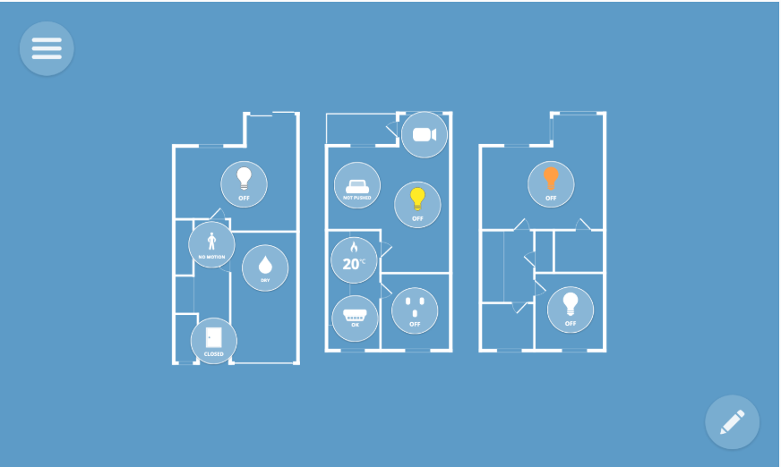
WebThings Gateway
Host your own private smart home.
WebThings Gateway is a software distribution for smart home hubs focused on privacy, security and interoperability. It enables you to securely monitor and control your home over the web, without a middleman.

Slide 3
Features include
Monitor and control all of your smart home devices from a unified web interface
Create "if this then that" style rules to automate your home with a simple drag and drop interface
Log and visualise sensor data over time
Lay out all your devices on an interactive floorplan of your home for at-a-glance status and control
Add compatibility with more devices and protocols with adapter add-ons.
The gateway bridges a range of different smart home protocols to a standardised Web of Things API.

Slide 4
Installation
The recommended ways to install WebThings Gateway are to either use a pre-built OS image for a Raspberry Pi, or install the Docker image. Alternatively you can build it from the source code yourself.
To install WebThings Gateway on a Raspberry Pi you will need:
A Raspberry Pi® single board computer (Raspberry Pi 3 or 4 recommended, Pi 5 not yet supported) and power supply
A microSD card (At least 8GB, class 10 recommended)
USB dongles (Optional, see the list of supported hardware)
1. Download Image
First download the latest gateway image from the WebThings website.

Slide 5
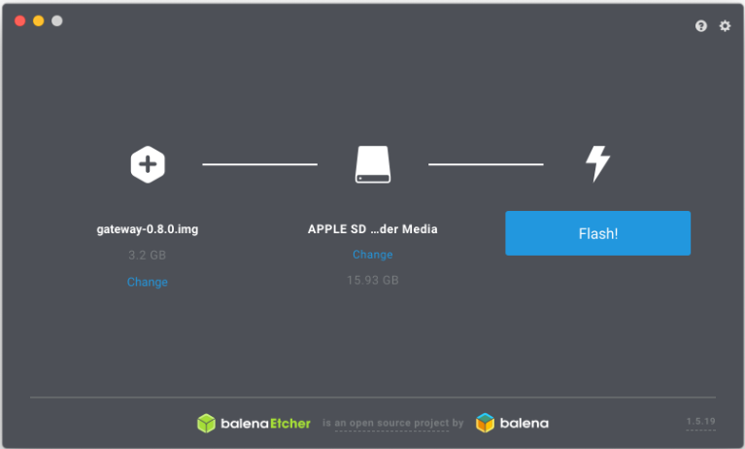
Flash Image
Next you will need to flash the downloaded image onto your microSD card. There are various methods of doing this but we recommend using Etcher.

Slide 6
Flash Image
Open Etcher
Insert your SD card into an SD card reader attached to your computer
Select the downloaded image as the source file
Select your SD card as the target
Click "Flash!"
Once flashing is complete, remove the microSD card.

Slide 7
Raspbery Pi Booting
Insert the flashed microSD card into your Raspberry Pi
Plug in any USB dongles
Connect the power supply to boot the Pi
Check that the LEDs light up: red indicates power, green indicates activity
Wait a few minutes for the software to boot

Slide 8
First Time Setup
Connect Wi-Fi (Optional)
A captive portal page will appear, showing nearby Wi-Fi networks.
Select the desired network and enter a password if prompted. The "Connecting to Wi-Fi..." page should automatically disappear.
Register a Subdomain (Optional)
When you load "http://gateway.local" for the first time, you will be given the option to register a free subdomain to safely access your gateway over the Internet using a secure tunnelling service.
OR
SKIP

Slide 9
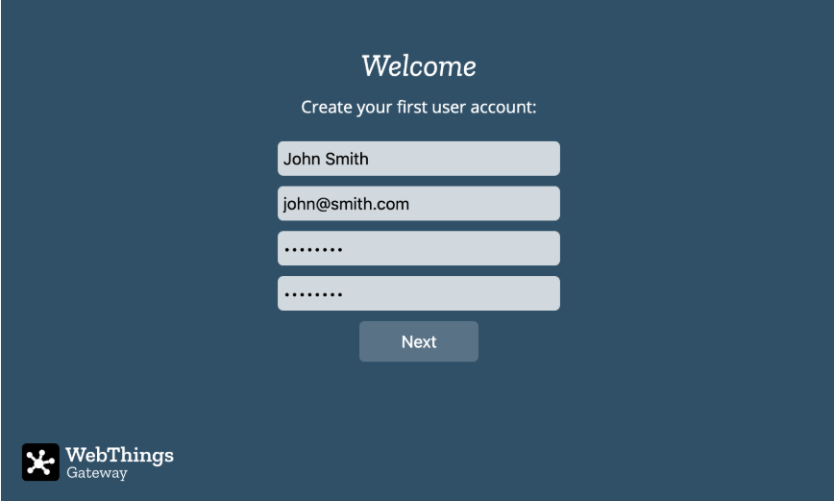
Create a User Account
The gateway will next prompt you to create your first user account. Enter a name, email address and a password and click "Next".

Slide 10
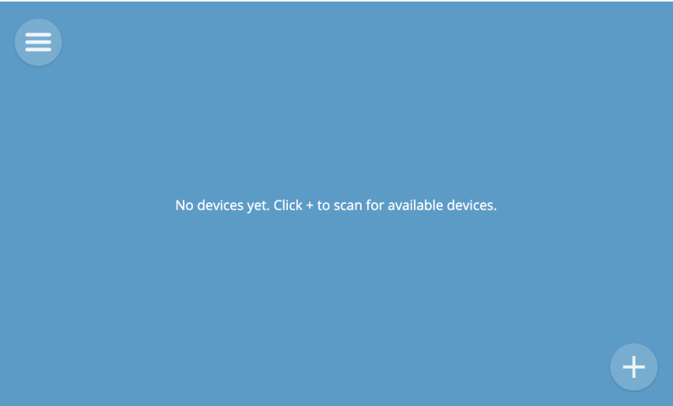
Success! Once your user account has been successfully created, you will be automatically logged in to the gateway and you should see an empty Things screen, ready for you to start adding devices.

Slide 11
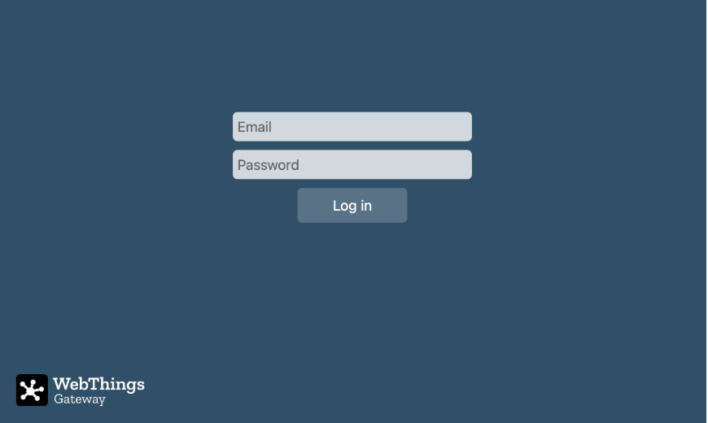
Log In
To log into the gateway from a new device, navigate to "http://gateway.local" (whilst connected to the same local network), or your unique subdomain (e.g. "https://foo.webthings.io"), and enter your email address and password.

Slide 12
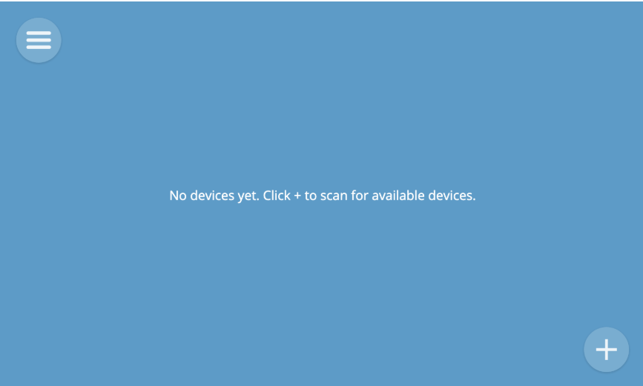
Things ADD Things
To add a thing to your gateway, click the "+" button on the Things screen. This will tell the gateway to start scanning for new devices.

Slide 13
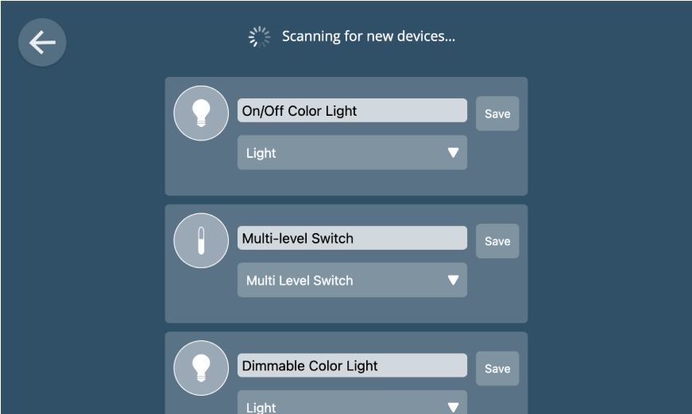
Things ADD Things
A preview of any discovered devices will appear on the screen.

Slide 14
Things ADD Things
When a device has multiple capabilities (e.g. it acts as both an on/off switch and an energy monitor) you can choose the primary function to display in the user interface from a drop-down menu.
You can also change the name of the device to something meaningful to you (e.g. "Kitchen Light") before clicking "Save" to add it to the gateway.
If you click the back button at the top left of the screen to go back to the Things screen, you should now see an icon representing the device you added.

Slide 15
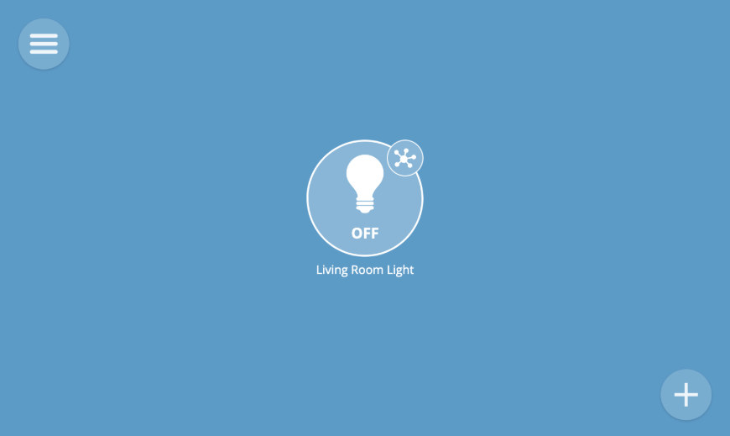
Things ADD Things

Slide 16
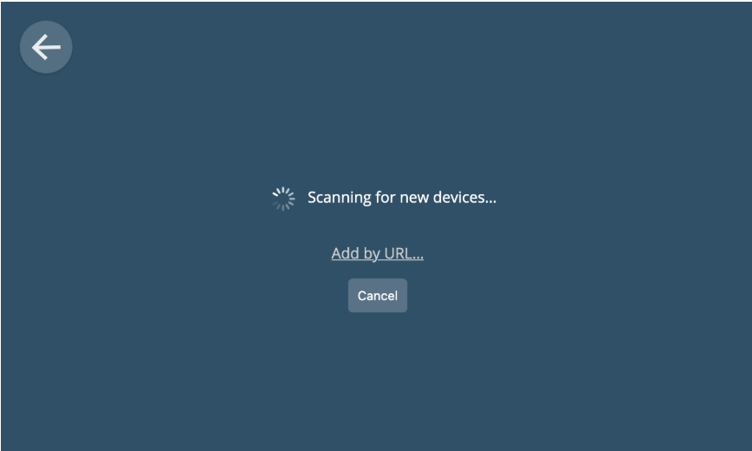
Add Thing by URL
In addition to scanning for new devices, you can manually add a new thing by its "web thing URL". That is the URL of a Web Thing Description.
To add a thing by a web thing URL, click the "Add by URL" link on the Add Thing screen.

Slide 17
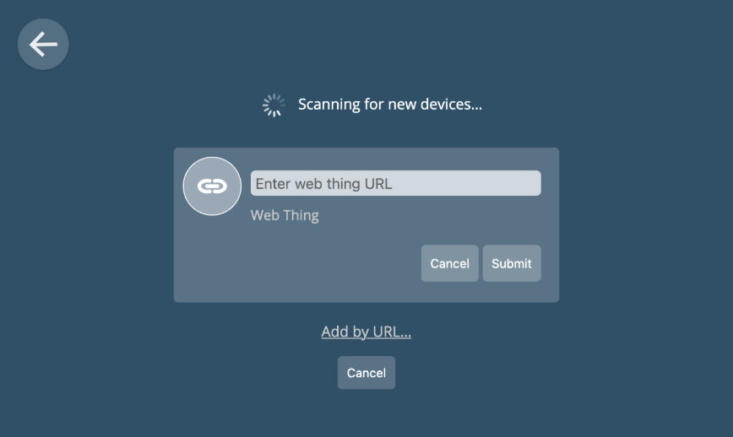
Add Thing by URL
A form will then appear with a text box into which you can paste a web thing URL. Click "Submit" to retrieve details about the Thing, then click "Save" to add it to the gateway.

Slide 18
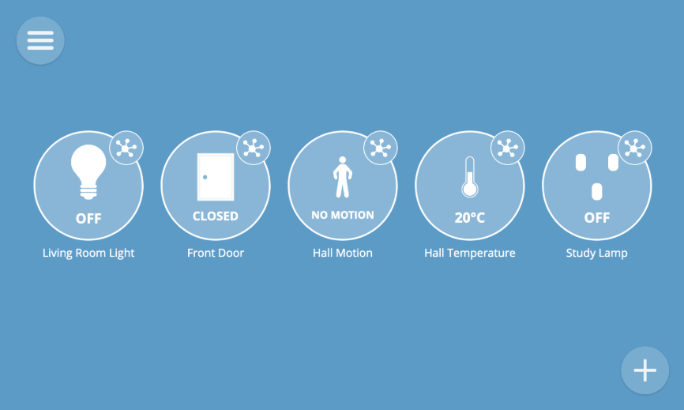
View Things
To view all of your things, select the "Things" option from the main menu.Each thing is represented by an icon. The icon shows a live overview of the current state of the thing (e.g. its on/off state or the current value of a key property). Different styles of icon are used for different types of devices.

Slide 19
webthing-python
Installation
$ pip install webthing
Example Code in Text: Python

Slide 20
Controlling the Lamp with Raspberry Pi
Since your script is running a Web of Things (WoT) server, you will need to control the lamp via GPIO (General Purpose Input/Output) pins on the Raspberry Pi.

Slide 21
Connect the Lamp to Raspberry Pi GPIO
To control a physical lamp (or an LED) with the Raspberry Pi:
Use a relay module to switch a high-power lamp.
Use GPIO pins if controlling an LED directly.
Wiring for an LED (Test Setup)
Raspberry Pi Pin | LED Component
GPIO 17 (Pin 11) | LED + (Anode)
GND (Pin 6) | LED - (Cathode) (via 330Ω resistor)

Slide 22
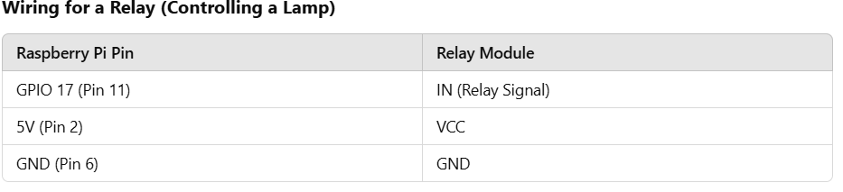
Wiring for a Relay (Controlling a Lamp)
WARNING: If using a 220V AC lamp, use a relay module instead of directly wiring the lamp to GPIO.

Slide 23
Modify Your Python Script to Control GPIO
Install GPIO Library (if not installed)
pip install RPi.GPIO
Add the following code to handle GPIO:
Code as ModifyWebthing.py

Slide 24
Deploy on Raspberry Pi
Transfer the script to your Raspberry Pi.
scp webThing.py pi@raspberrypi.local:~/webthing/
Run the script on Raspberry Pi:
python3 webThing.py

Slide 25
Control the Lamp via Web Browser
Once the script is running, open a browser and go to:
http://<raspberry_pi_ip>:8888/properties
To turn ON the lamp, send:
curl -X PUT -H "Content-Type: application/json" -d '{"on": true}' http://<raspberry_pi_ip>:8888/properties/on
To turn OFF the lamp, send:
curl -X PUT -H "Content-Type: application/json" -d '{"on": false}' http://<raspberry_pi_ip>:8888/properties/on

Slide 26
Final Summary
Use GPIO Pin 17 (BCM) for controlling the lamp.
Use port 8888 to communicate via the web interface.
Use a relay module if controlling a 220V AC lamp.
Test with curl or a web browser

