Slide 1
Live Dashboard

Slide 2
You’re here to learn my Time Based Ranges & trade profitably starting tomorrow, right?

Slide 3
Give me a “YES” in the chat if that sounds like you

Slide 4
So I just showed you my PnL…

Slide 5
But obviously, number on a screen doesn't mean much on its own…

Slide 6
That's why I wanted to show you where it actually came from…

Slide 7
Because nearly all of it came from the same trade, at the same time of day, over and over

Slide 8
Here's 3 of them:

Slide 9
Trade 1: Monday - Live showing (created this box, takes out one side, I’m in)
Trade 2: Tuesday - Live showing (created this box, takes out one side, I’m in)
Trade 3: Friday - Live showing (created this box, takes out one side, I’m in)

Slide 10
I didn’t just cherry pick some random trades…

Slide 11
This was all within [5] trading days, from [DATE to DATE]...

Slide 12
All at the same window on the clock

Slide 13
That window is what I call a
Time Based Range.

Slide 14
In a minute I'll show you how I found them and HOW & WHY it keeps working.

Slide 15
Now, obviously I’m not going to sit here & tell you it works every single day.

Slide 16
Nobody knows everything about the markets, and anyone who tells you otherwise is lying to you.

Slide 17
What I can tell you is that my setup shows up 1 to 3 times a week…

Slide 18
And that's been enough for months like these:

Slide 19
January - August PNLs

Slide 20
And if you’re asking yourself whether you can actually do it too…

Slide 21
Well… it’s not just me…

Slide 22
CASE STUDIES

Slide 23
And honestly, they were all pretty much exactly like me after my first year or two of trading.

Slide 24
So real quick, in case you don't know me…

Slide 25
My name's Rauf, I've been trading for 6 years now, and I've made multiple 5 & 6 figures from these markets…

Slide 26
So real quick, in case you don't know me…
My name's Rauf, I've been trading for 6 years now, and I've made multiple 7 figures from these markets…
Worked with hundreds of traders and helped them become consistently profitable too…

Slide 27
SHOW MASTERMIND IMAGES…

Slide 28
But a couple of years ago I was sat exactly where those guys were, and probably exactly where you are right now watching this.

Slide 29
Months, of being inconsistent and unprofitable.

Slide 30
I tried dozens of strategies, but always knew there was another way

Slide 31
But here's the part that actually messed me up.

Slide 32
Every one of those people had me believing it was my psychology.

Slide 33
That I was the problem, and I just needed to fix myself.

Slide 34
And that's simply not true.

Slide 35
All of that inconsistency came from the strategies they were teaching me, because those strategies had no real edge behind them.

Slide 36
I mean, just think about it for a second.

Slide 37
Psychology problems are really strategy problems.

Slide 38
Because what a good strategy actually does is take the big decisions away from you.

Slide 39
If the market is telling you what to do, there's nothing left to be disciplined about.

Slide 40
You see A, you do B.
You see B, you do A.

Slide 41
And that's exactly what my time based ranges are, with real data behind them…

Slide 42
I'll show you Monday through Friday in a second and you'll see it all come together.

Slide 43
And the way I found it was exactly that.

Slide 44
I basically started looking for something that actually repeats within the markets.

Slide 45
Because that's all a strategy really is:

Slide 46
It's a bet you're making, because you believe the same thing is going to keep happening day after day.

Slide 47
So that became the only question that mattered to me.

Slide 48
What actually repeats?

Slide 49
TIME

Slide 50
You have no idea what that next candle is going to do, but you know exactly when it prints.

Slide 51
To the second, every day, forever.

Slide 52
And people work to a schedule.

Slide 53
The market works in the same way, because the same people keep showing up at the same times.

Slide 54
The bond market opens at 8:20 in the morning.

Slide 55
The bond market opens at 8:20 in the morning.
Not 8:00.

Slide 56
The bond market opens at 8:20 in the morning.
Not 8:00.
8:20.

Slide 57
Somebody decided that decades ago and it hasn't moved since.

Slide 58
So that's all a time based range really is… A window where the same thing keeps happening.

Slide 59
Instead of reacting to the market you can predict it before it even happens..

Slide 60
And that's exactly why it fixed the psychology problem that was never a psychology problem.

Slide 61
The market tells me what to do now.

Slide 62
There's nothing left for me to be disciplined about.

Slide 63
Makes sense?
Put a yes in the chat.

Slide 64
So let’s get into it, here’s what we’ll be covering in the next 60 minutes:

Slide 65
So let’s get into it, here’s what we’ll be covering in the next 60 minutes:
1.
2 of my best time based ranges, down to the exact minute, so you can go and use them tomorrow morning.

Slide 66
So let’s get into it, here’s what we’ll be covering in the next 60 minutes:
1.
2 of my best time based ranges, down to the exact minute, so you can go and use them tomorrow morning.
2.
How to predict where the market's going that day, by letting the market do it for you.

Slide 67
So let’s get into it, here’s what we’ll be covering in the next 60 minutes:
1.
2 of my best time based ranges, down to the exact minute, so you can go and use them tomorrow morning.
2.
How to predict where the market's going that day, by letting the market do it for you.
3.
Exactly where to buy, including the entries I take most often, right down to which single candle on your chart it is.

Slide 68
So let’s get into it, here’s what we’ll be covering in the next 60 minutes:
1.
2 of my best time based ranges, down to the exact minute, so you can go and use them tomorrow morning.
2.
How to predict where the market's going that day, by letting the market do it for you.
3.
Exactly where to buy, including the entries I take most often, right down to which single candle on your chart it is.
4.
Where your stop goes, when to move it, and when to take your money.

Slide 69
So let’s get into it, here’s what we’ll be covering in the next 60 minutes:
1.
2 of my best time based ranges, down to the exact minute, so you can go and use them tomorrow morning.
2.
How to predict where the market's going that day, by letting the market do it for you.
3.
Exactly where to buy, including the entries I take most often, right down to which single candle on your chart it is.
4.
Where your stop goes, when to move it, and when to take your money.
5.
Multiple full trades from start to finish, so you can see that the same thing keeps happening over and over and over and over again.

Slide 70
My goal today is to give you everything you need to go ahead and execute my TBR consistently starting tomorrow.

Slide 71
And of course, help you make a shit ton of money, just like all these people have:

Slide 72
TESTIMONIAL SCREENSHOTS DUMP

Slide 73
Now, I have a little request for you:

Slide 74
Everyone you just saw paid me thousands to learn what I'm about to share with you today... for free

Slide 75
It’s a well-known psychological principle:

Slide 76
When people pay, they pay more attention.

Slide 77
So here’s the deal…

Slide 78
Pretend you just paid $5,000 for this Live Training.

Slide 79
Because the insights I’m about to share are worth at least that… if you actually pay attention and use them.

Slide 80
Sound fair enough?

Slide 81
Put a “Yes” in the chat

Slide 82
So put away your phone, grab a notebook and take notes... we're covering a lot today

Slide 83
I’m now going to show you how this model works step by step…

Slide 84
Then I’ll make you an offer at the end to help you implement it.

Slide 85
Sound good?

Slide 86
Let’s dive in…

Slide 87
1-
THE TIME BASED RANGES
— when you mark your levels
2-
THE BIAS
— which way you're trading today
3-
THE ENTRY
— where you buy
4-
THE EXIT
— where you get out
5-
ONE FULL TRADE
— all of it on one chart

Slide 88
STEP 1:
1
THE TIME BASED RANGES

Slide 89
STEP 1: THE TIME BASED RANGES
I just showed you that we’re working based on specific time windows and ranges within the markets…

Slide 90
STEP 1: THE TIME BASED RANGES
Now I've got a number of time based ranges, and today I'm leaking 2 of them since you're live with me…

Slide 91
STEP 1: THE TIME BASED RANGES
One for New York, one for London.

Slide 92
STEP 1: THE TIME BASED RANGES
The rest are reserved for my private students who sign an NDA, so those stay with me.

Slide 93
STEP 1: THE TIME BASED RANGES
But every single one of them sits inside something called a dealing range.

Slide 94
STEP 1: THE TIME BASED RANGES
So before I give you the times, I have to show you how I find those.

Slide 95
STEP 1: THE TIME BASED RANGES
A dealing range is just the space between a significant swing high and a swing low…

Slide 96
STEP 1: THE TIME BASED RANGES
And a swing high or low simply means a point where the market turned around.

Slide 97
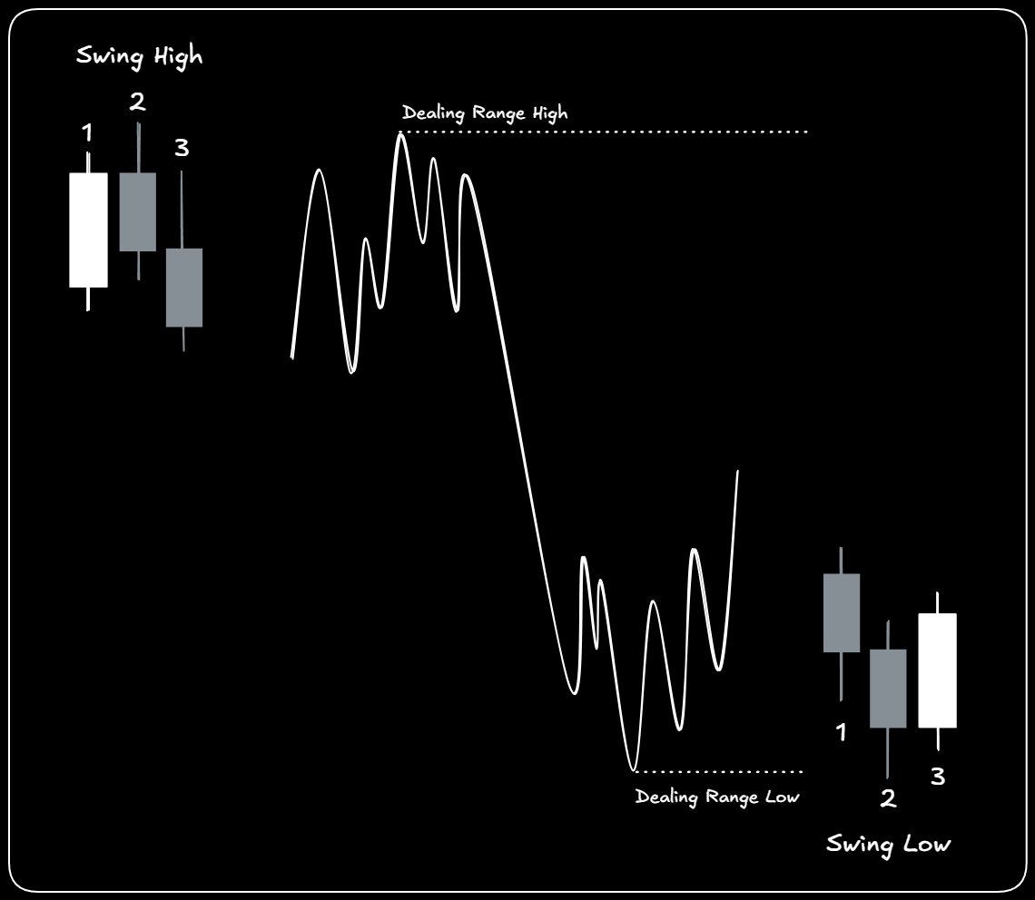
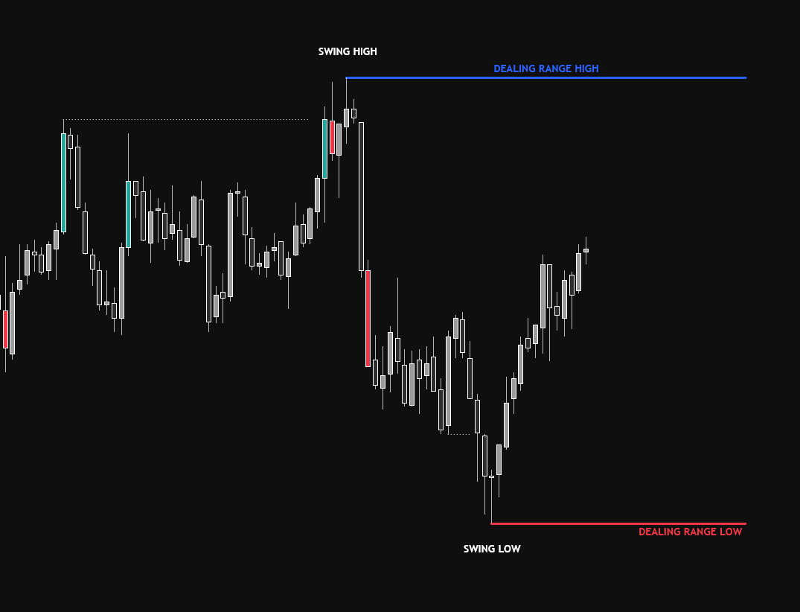
STEP 1: THE TIME BASED RANGES
LIVE

Slide 98
STEP 1: THE TIME BASED RANGES
So this was the low that pushed the market higher, and this was the high that pushed the market lower.
Draw a line at each, and automatically that becomes a range to the market.

Slide 99
STEP 1: THE TIME BASED RANGES
That's it, super easy.
Now why does that actually matter? Because of what sits above and below those 2 lines.

Slide 100
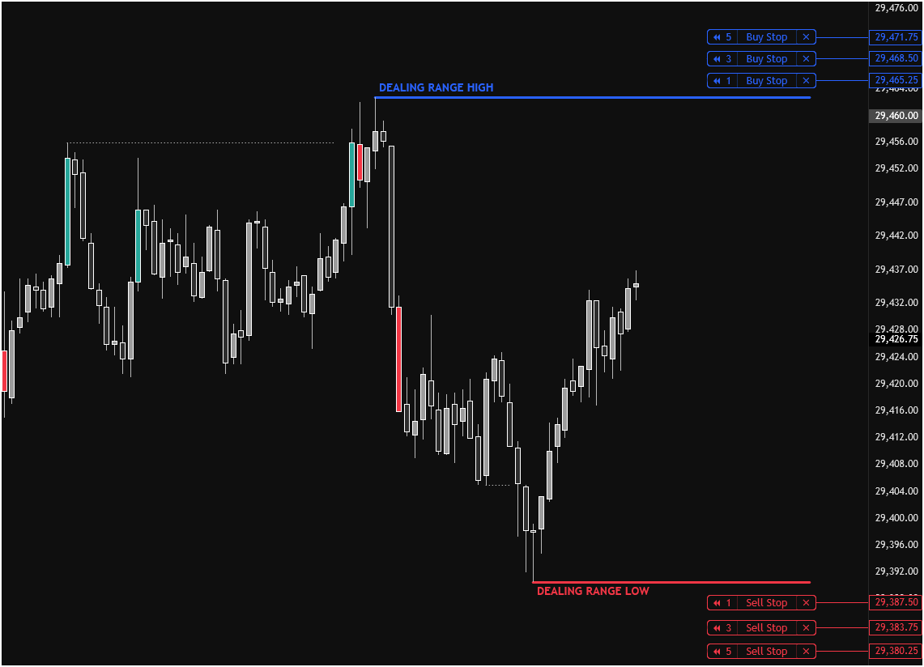
STEP 1: THE TIME BASED RANGES
LIVE

Slide 101
STEP 1: THE TIME BASED RANGES
An order is just you telling the market "if price gets here, I'm in"...
You set it…
You walk away, and it fires by itself when price arrives.

Slide 102
STEP 1: THE TIME BASED RANGES
And everyone looking at this chart can see that high and that low, same as you can, so they all leave their orders in roughly the same place.
Which means there's a stack of them sat right there, waiting to get filled.

Slide 103
STEP 1: THE TIME BASED RANGES
That's all liquidity means…
Orders waiting to get filled.

Slide 104
STEP 1: THE TIME BASED RANGES
And the market doesn't move to random places, it moves to where those orders are.

Slide 105
STEP 1: THE TIME BASED RANGES
Now, those 2 lines still don't tell you when any of it happens, because that box could be days wide.

Slide 106
STEP 1: THE TIME BASED RANGES
And that's exactly where my time based ranges come in.

Slide 107
STEP 1: THE TIME BASED RANGES
TESTIMONIALS

Slide 108
STEP 1: THE TIME BASED RANGES
So here are the times for 2 of them, for free.

Slide 109
STEP 1: THE TIME BASED RANGES
London range — 1:12-2:12 EST
New York — 8:12-9:12 EST

Slide 110
STEP 1: THE TIME BASED RANGES
I'll work in New York today, because that's the one most of you can be awake for.

Slide 111
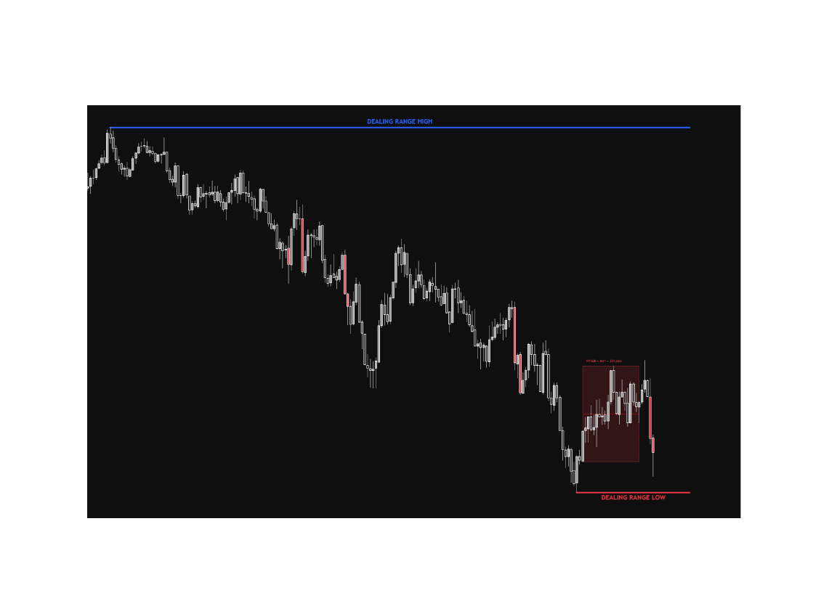
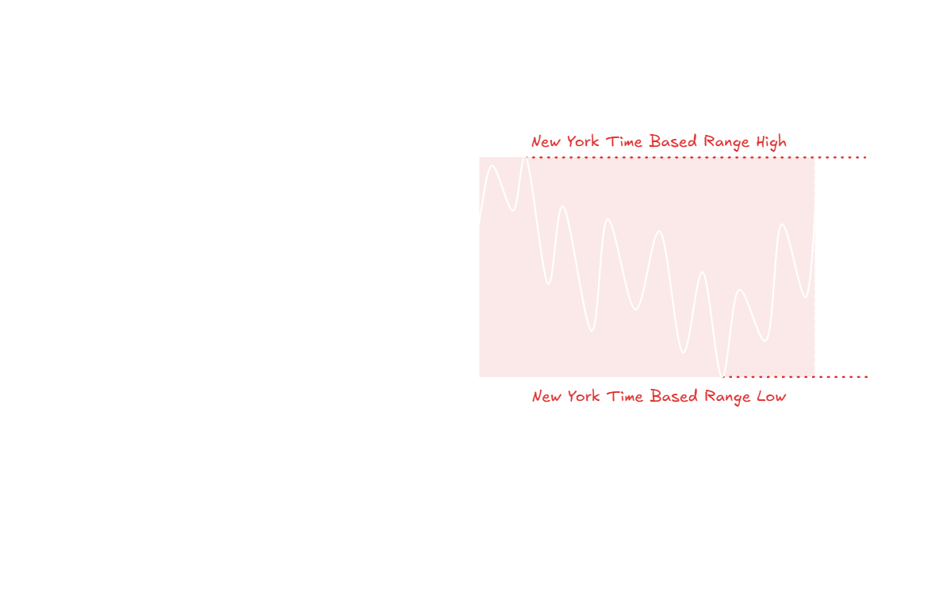
STEP 1: THE TIME BASED RANGES
LIVE

Slide 112
STEP 1: THE TIME BASED RANGES
8:12 it starts, 9:12 it's done.
High there, low there. 2 more lines, and that's your time based range.

Slide 113
STEP 1: THE TIME BASED RANGES
Now here's the rule that connects the 2 boxes, and it's the only rule in this step.

Slide 114
STEP 1: THE TIME BASED RANGES
I want to see my time based range form INSIDE the dealing range…

Slide 115
STEP 1: THE TIME BASED RANGES
If it hasn’t, I’m waiting (A+ setup)

Slide 116
STEP 1: THE TIME BASED RANGES
Because remember what the dealing range gave you…

Slide 117
STEP 1: THE TIME BASED RANGES
A stack of orders at the top and a stack at the bottom.

Slide 118
STEP 1: THE TIME BASED RANGES
When my hour forms inside it, both of those stacks are still sitting there untouched…

Slide 119
STEP 1: THE TIME BASED RANGES
Which means there's something above me to go and take, and something below me to go and take.

Slide 120
STEP 1: THE TIME BASED RANGES
That's the trade.

Slide 121
STEP 1: THE TIME BASED RANGES
Makes sense?
Put a yes in the chat.

Slide 122
STEP 1: THE TIME BASED RANGES
So now you've got a box inside a box, and between them they tell you where the orders are and when the market's going to go for them.

Slide 123
STEP 1: THE TIME BASED RANGES
But neither one tells you which way the market is actually going…

Slide 124
STEP 1: THE TIME BASED RANGES
So let's get into step 2, the bias….

Slide 125
STEP 1: THE TIME BASED RANGES
We’ll just let the market tell us where it’s headed.

Slide 126
STEP 2:
2
THE BIAS

Slide 127
STEP 2: THE BIAS
So we've got our 2 boxes, and they tell us where the orders are and when the market's going to go for them.

Slide 128
STEP 2: THE BIAS
What they don't tell us yet is which way we're trading.

Slide 129
STEP 2: THE BIAS
And this is the part everyone assumes is the hard part, because everybody will tell you that you can't predict the market.

Slide 130
STEP 2: THE BIAS
That's not true...

Slide 131
STEP 2: THE BIAS
Predicting is exactly what we're doing here… it's the whole point.

Slide 132
STEP 2: THE BIAS
The difference is WHAT you're predicting from.

Slide 133
STEP 2: THE BIAS
Most traders just predict from an opinion…

Slide 134
STEP 2: THE BIAS
They check the news, glance at a higher timeframe, decide the market feels bearish, and hope they're right.

Slide 135
STEP 2: THE BIAS
That's not a prediction.

Slide 136
STEP 2: THE BIAS
That's a guess with a nicer word on it.

Slide 137
STEP 2: THE BIAS
And here's what that actually looked like on a normal day a couple of years ago:

Slide 138
STEP 2: THE BIAS
And here's what that actually looked like on a normal day a couple of years ago:
Market spikes

Slide 139
STEP 2: THE BIAS
And here's what that actually looked like on a normal day a couple of years ago:
Market spikes
You buy

Slide 140
STEP 2: THE BIAS
And here's what that actually looked like on a normal day a couple of years ago:
Market spikes
You buy
It reverses

Slide 141
STEP 2: THE BIAS
And here's what that actually looked like on a normal day a couple of years ago:
Market spikes
You buy
It reverses
Stops you out

Slide 142
STEP 2: THE BIAS
And here's what that actually looked like on a normal day a couple of years ago:
Market spikes
You buy
It reverses
Stops you out
You're annoyed, so you flip and sell

Slide 143
STEP 2: THE BIAS
And here's what that actually looked like on a normal day a couple of years ago:
Market spikes
You buy
It reverses
Stops you out
You're annoyed, so you flip and sell
And it reverses again

Slide 144
STEP 2: THE BIAS
Anyone done that?
Put a 1 in the chat.

Slide 145
STEP 2: THE BIAS
The problem is you're picking a direction in the most violent 30 seconds of the session…

Slide 146
STEP 2: THE BIAS
With nothing in front of you to base it on.

Slide 147
STEP 2: THE BIAS
Long or short… Biggest decision of your day, and you're making it under that kind of pressure.

Slide 148
STEP 2: THE BIAS
Nobody gets that right consistently.

Slide 149
STEP 2: THE BIAS
So we don't pick a direction at all…
We let the market pick it for us.

Slide 150
STEP 2: THE BIAS
Because before the market can go anywhere, it has to go and collect the orders sitting on one side first.

Slide 151
STEP 2: THE BIAS
And you already know exactly where those orders are, because you marked them in step 1.

Slide 152
STEP 2: THE BIAS
So the market walks into one of your boxes, and the second it does, it's told you which way you're going.

Slide 153
STEP 2: THE BIAS
So by the end of this section you'll sit down at 9:29 tomorrow, watch one thing happen…

Slide 154
STEP 2: THE BIAS
And know whether you're a buyer or a seller today.

Slide 155
STEP 2: THE BIAS
Sounds good?

Slide 156
STEP 2: THE BIAS
Now, 2 things have to happen, and they happen in this order.

Slide 157
STEP 2: THE BIAS
Now, 2 things have to happen, and they happen in this order.
1-
One side of your time based range gets taken… that's your bias

Slide 158
STEP 2: THE BIAS
Now, 2 things have to happen, and they happen in this order.
1-
One side of your time based range gets taken… that's your bias
2-
Then the dealing range extreme has to go too

Slide 159
STEP 2: THE BIAS
We start with the inner box, because that's the one that gets hit first.

Slide 160
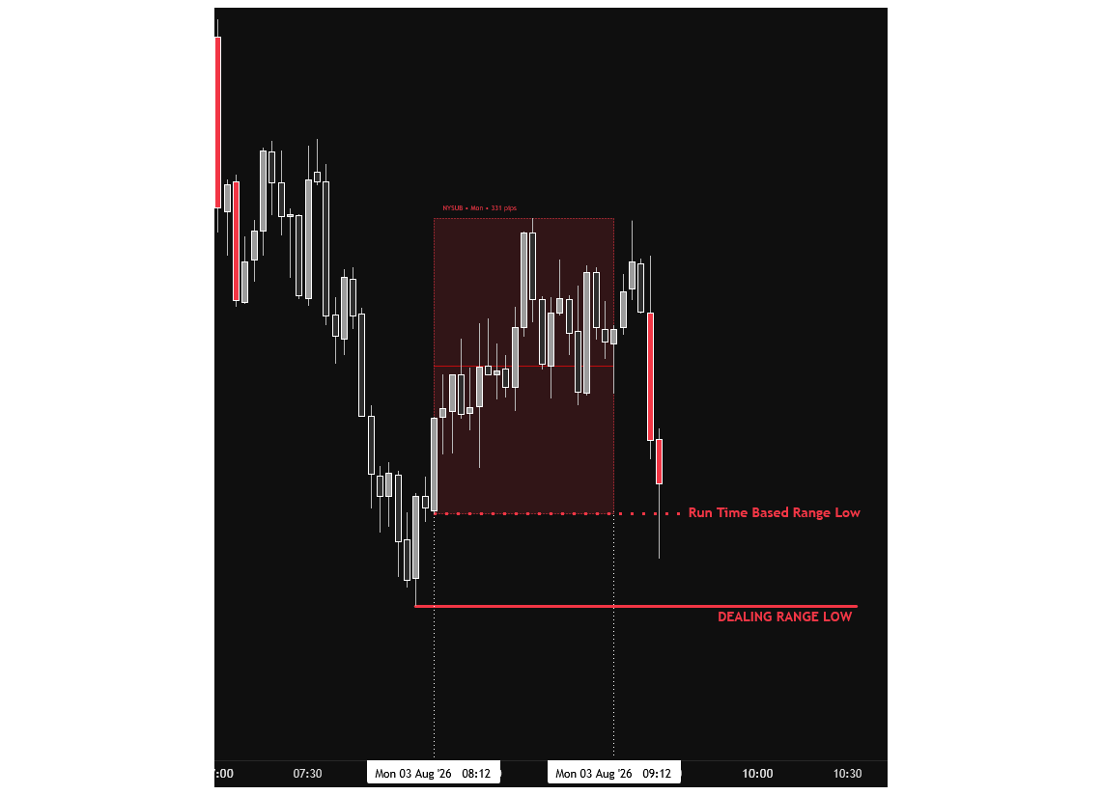
STEP 2: THE BIAS
LIVE

Slide 161
STEP 2: THE BIAS
We take out the high, and automatically my bias is bearish.
We take out the low, and automatically my bias is bullish.
So here, the low goes… which means I'm a buyer.

Slide 162
STEP 2: THE BIAS
The reason behind it is pretty simple:

Slide 163
STEP 2: THE BIAS
Remember what we said is sitting below that low?

Slide 164
STEP 2: THE BIAS
A stack of sell orders, from people selling the breakdown and people getting stopped out.

Slide 165
STEP 2: THE BIAS
Now, if you wanted to buy a big position, where would you go?

Slide 166
STEP 2: THE BIAS
You'd go to where the sellers are, because you can't buy anything unless somebody is selling it to you.

Slide 167
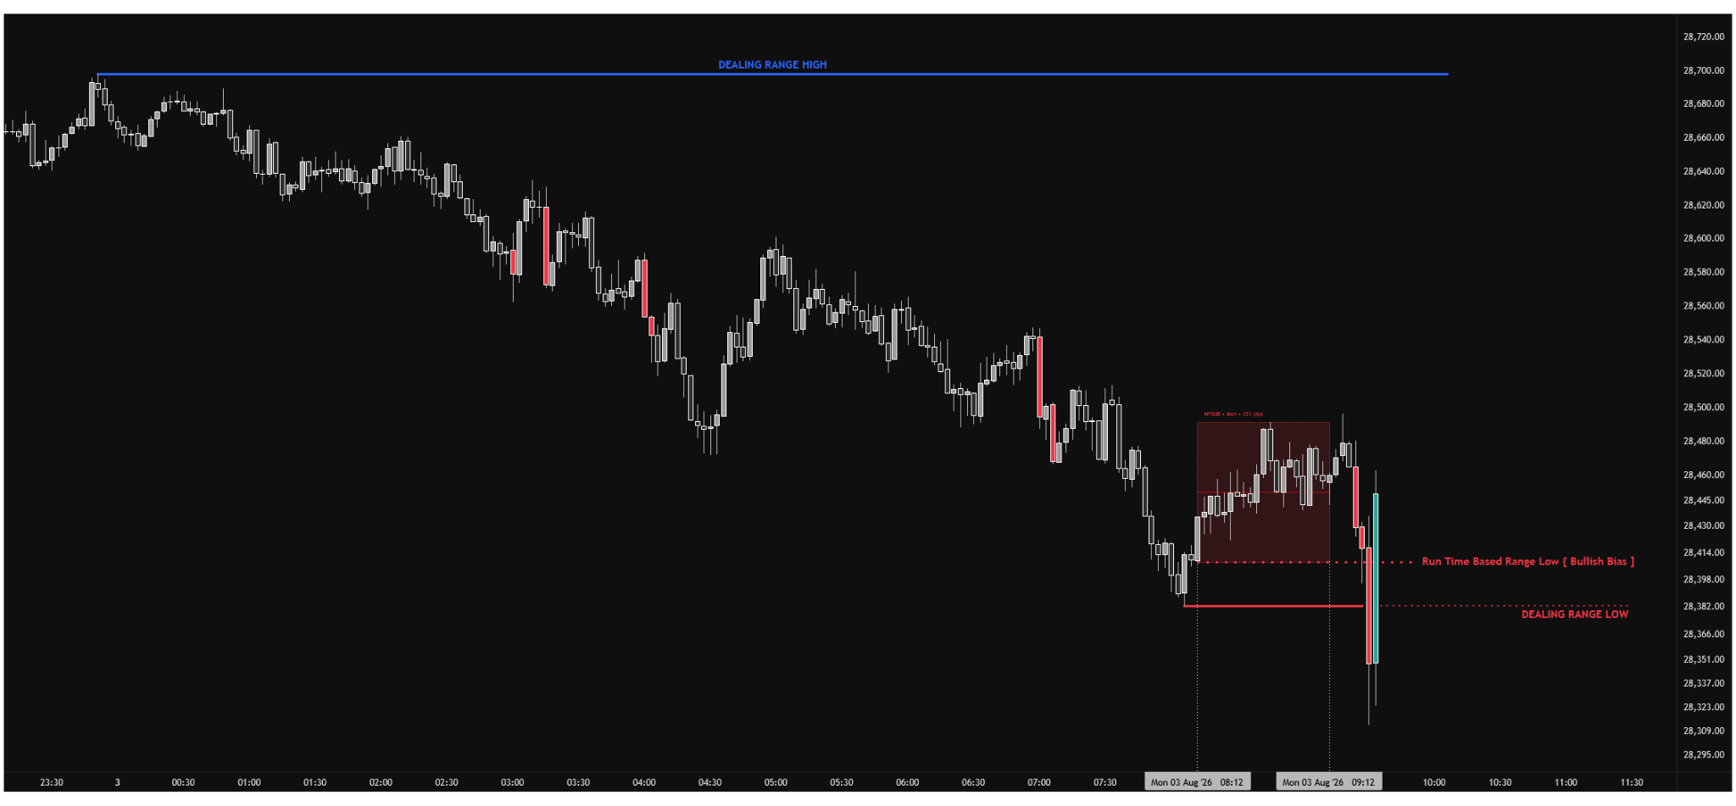
STEP 2: THE BIAS
LIVE

Slide 168
STEP 2: THE BIAS
So price dips below the low, all those sell orders go off at once, somebody buys the lot…
And now they've got what they came for, so price goes up.

Slide 169
STEP 2: THE BIAS
That's it.

Slide 170
STEP 2: THE BIAS
That's the whole thing.

Slide 171
STEP 2: THE BIAS
The dip wasn't the move… the dip was somebody getting filled.

Slide 172
STEP 2: THE BIAS
Now think about how many of your losing trades that just explained.

Slide 173
STEP 2: THE BIAS
You sold the low & it went straight back up

Slide 174
STEP 2: THE BIAS
You bought the high and it went straight back down.

Slide 175
STEP 2: THE BIAS
You weren't unlucky, you were just on the wrong side of it…

Slide 176
STEP 2: THE BIAS
And 9 times out of 10, you become the liquidity.

Slide 177
STEP 2: THE BIAS
2- Then the dealing range extreme has to go too.

Slide 178
STEP 2: THE BIAS
Now, the inner TBR box on its own isn't enough.

Slide 179
STEP 2: THE BIAS
Remember the outer box, the one we drew first? The Dealing range?

Slide 180
STEP 2: THE BIAS
That has to get taken as well.

Slide 181
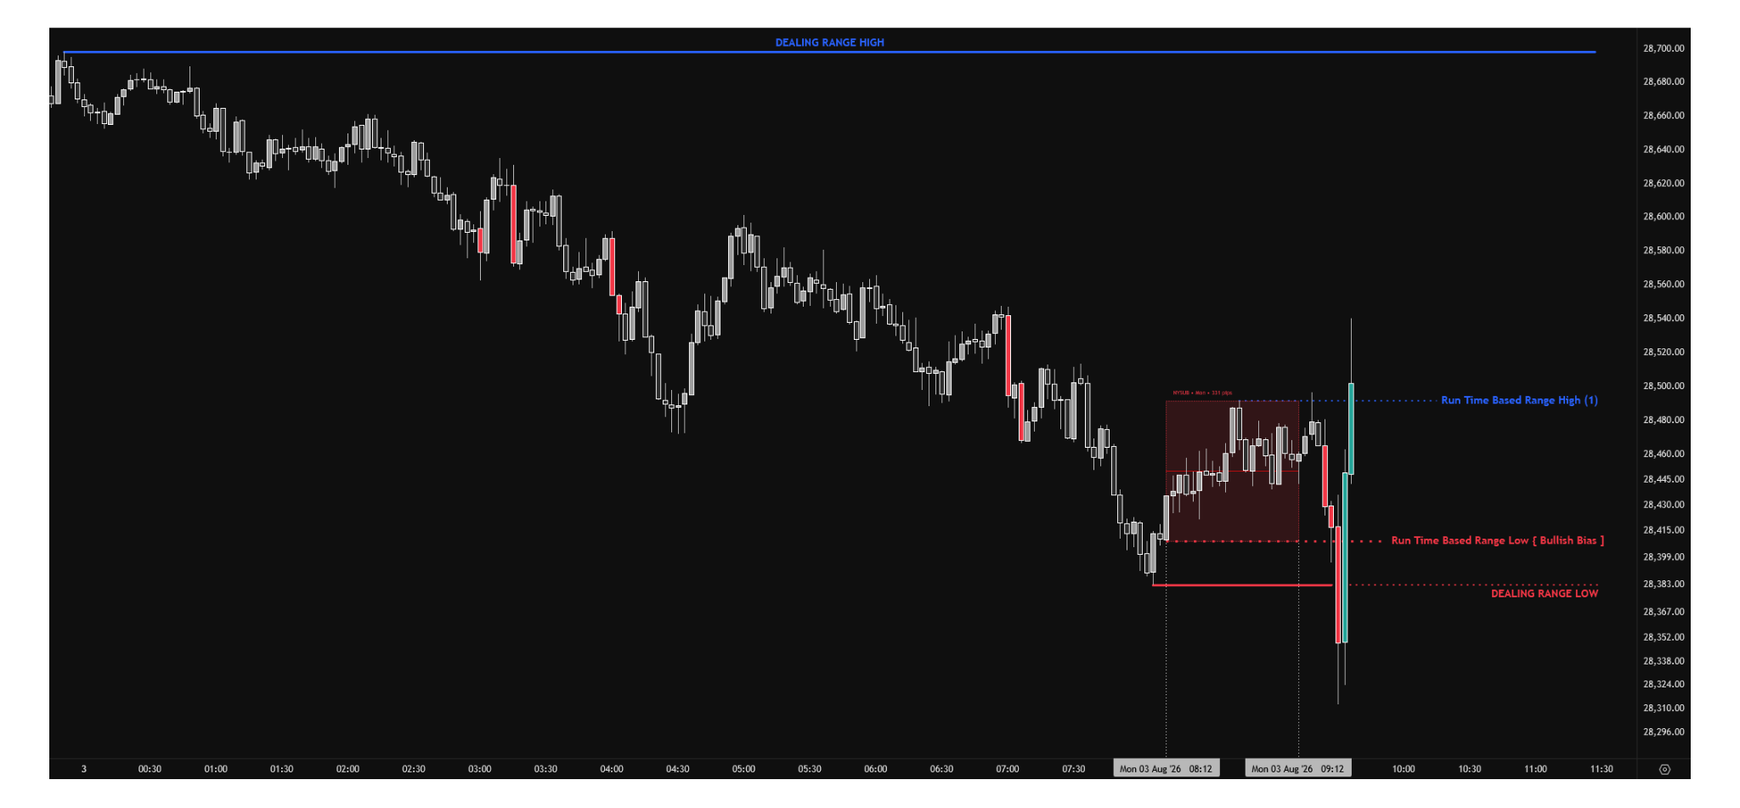
STEP 2: THE BIAS
LIVE

Slide 182
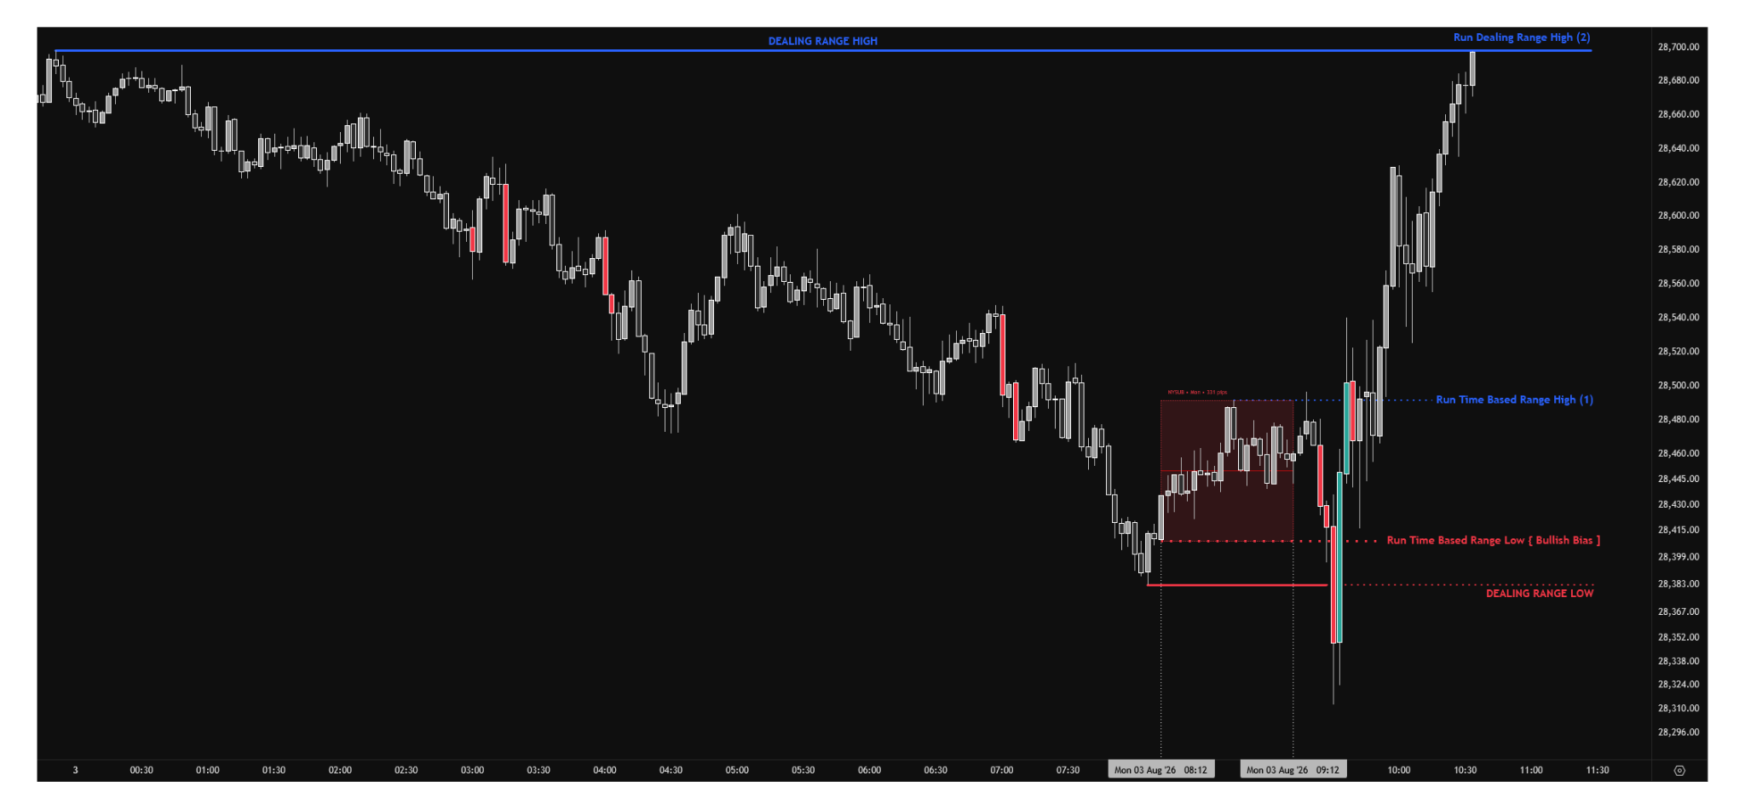
STEP 2: THE BIAS

Slide 183
STEP 2: THE BIAS
There's the high of my time based range going… that's the inner box.
Now you don't just sell blindly there.
You wait for the market to run above the extreme of the dealing range as well, the outer box.
Once it runs that high, then you can trust selling setups.

Slide 184
STEP 2: THE BIAS
1 levels swept…

Slide 185
STEP 2: THE BIAS
I call that a break…

Slide 186
STEP 2: THE BIAS
And once one has gone, you know exactly where you're headed.

Slide 187
STEP 2: THE BIAS
The opposing end.

Slide 188
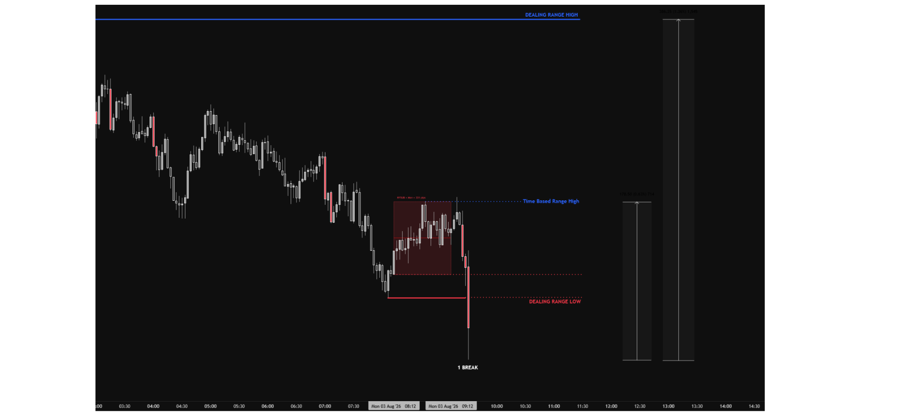
STEP 2: THE BIAS
LIVE

Slide 189
STEP 2: THE BIAS
Sweep one side, trade to the other side.
That's the trade.

Slide 190
STEP 2: THE BIAS
And now this is where I'm going to do something nobody else in this industry does.

Slide 191
STEP 2: THE BIAS
Because every guru online tells you their system works, and then shows you nothing…

Slide 192
STEP 2: THE BIAS
You just have to take their word for it.

Slide 193
STEP 2: THE BIAS
I'm not going to do that, I’ll show you verified 3rd party data so you can see for yourself.

Slide 194
STEP 2: THE BIAS
SHOW DATA:
https://www.youtube.com/watch?v=EkdQowvRwRU

Slide 195
STEP 2: THE BIAS
So think about what just changed.

Slide 196
STEP 2: THE BIAS
Instead of “trying to fix your psychology”...

Slide 197
STEP 2: THE BIAS
I took away the guesswork for you.

Slide 198
STEP 2: THE BIAS
You've got your 2 boxes, you've got your direction, and you've got your target.

Slide 199
STEP 2: THE BIAS
You just look at it and can predict where the market’s headed.

Slide 200
STEP 2: THE BIAS
BUT… there's one thing missing… a price.

Slide 201
STEP 2: THE BIAS
Because knowing the market’s going to go up or down isn’t enough…

Slide 202
STEP 2: THE BIAS
You still have to actually get in somewhere, right?

Slide 203
STEP 2: THE BIAS
And that’s exactly what we’ll be covering now, in step 3:

Slide 204
STEP 3:
3
THE ENTRY

Slide 205
STEP 3: THE ENTRY
So here's where we are.

Slide 206
STEP 3: THE ENTRY
So here's where we are.
My range low went.

Slide 207
STEP 3: THE ENTRY
So here's where we are.
My range low went.
The dealing range low went.

Slide 208
STEP 3: THE ENTRY
So here's where we are.
My range low went.
The dealing range low went.
The market wants to go up.

Slide 209
STEP 3: THE ENTRY
So here's where we are.
My range low went.
The dealing range low went.
The market wants to go up.
Here's the problem.

Slide 210
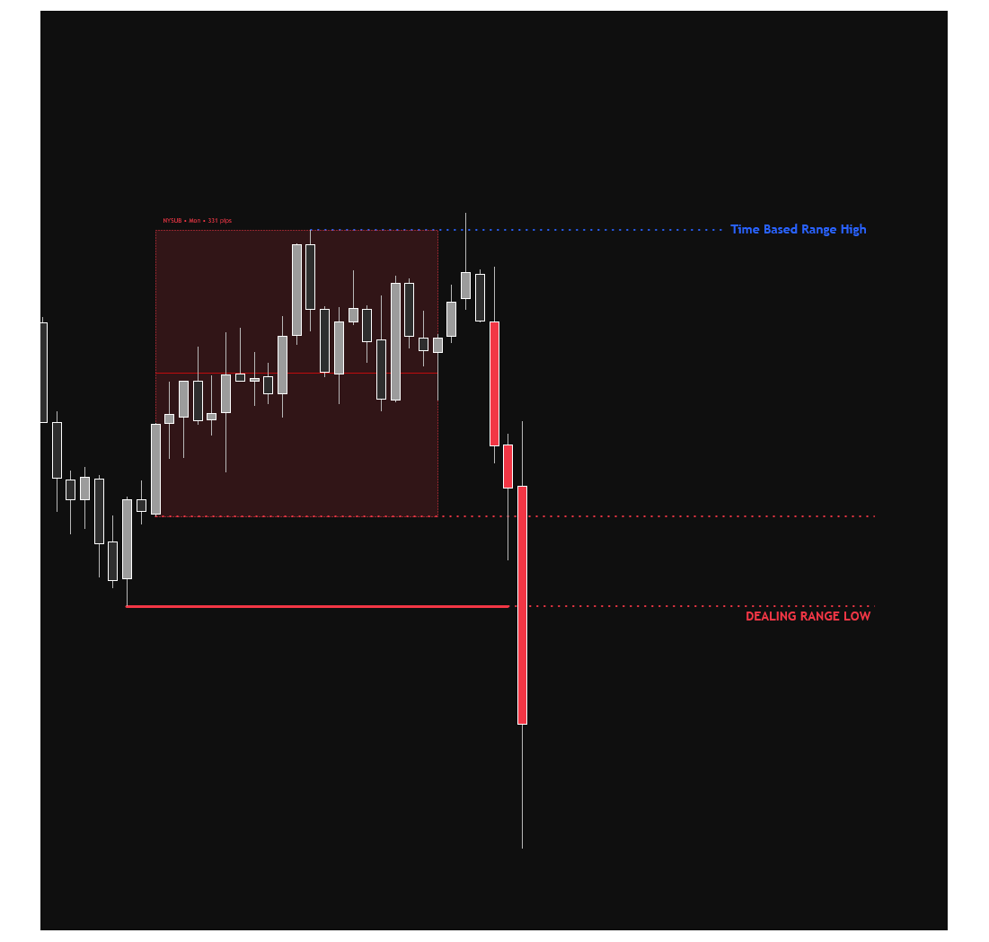
STEP 3: THE ENTRY
LIVE

Slide 211
STEP 3: THE ENTRY
Right now, on my screen, it is still going down.
I know it's going up… And it's falling in front of me.
If I buy here I get stopped out, and then it goes up without me.

Slide 212
STEP 3: THE ENTRY
So step 3 is one job…

Slide 213
STEP 3: THE ENTRY
Finding the moment it actually stops going down and starts going up - vice versa.

Slide 214
STEP 3: THE ENTRY
The reversal.

Slide 215
STEP 3: THE ENTRY
For that we just need to answer 2 questions:

Slide 216
STEP 3: THE ENTRY
For that we just need to answer 2 questions:
1-
Has it turned yet?

Slide 217
STEP 3: THE ENTRY
For that we just need to answer 2 questions:
1-
Has it turned yet?
2-
Where exactly do I buy?

Slide 218
STEP 3: THE ENTRY
To know when the market reverses, you first have to know what it looks like while it's still going.

Slide 219
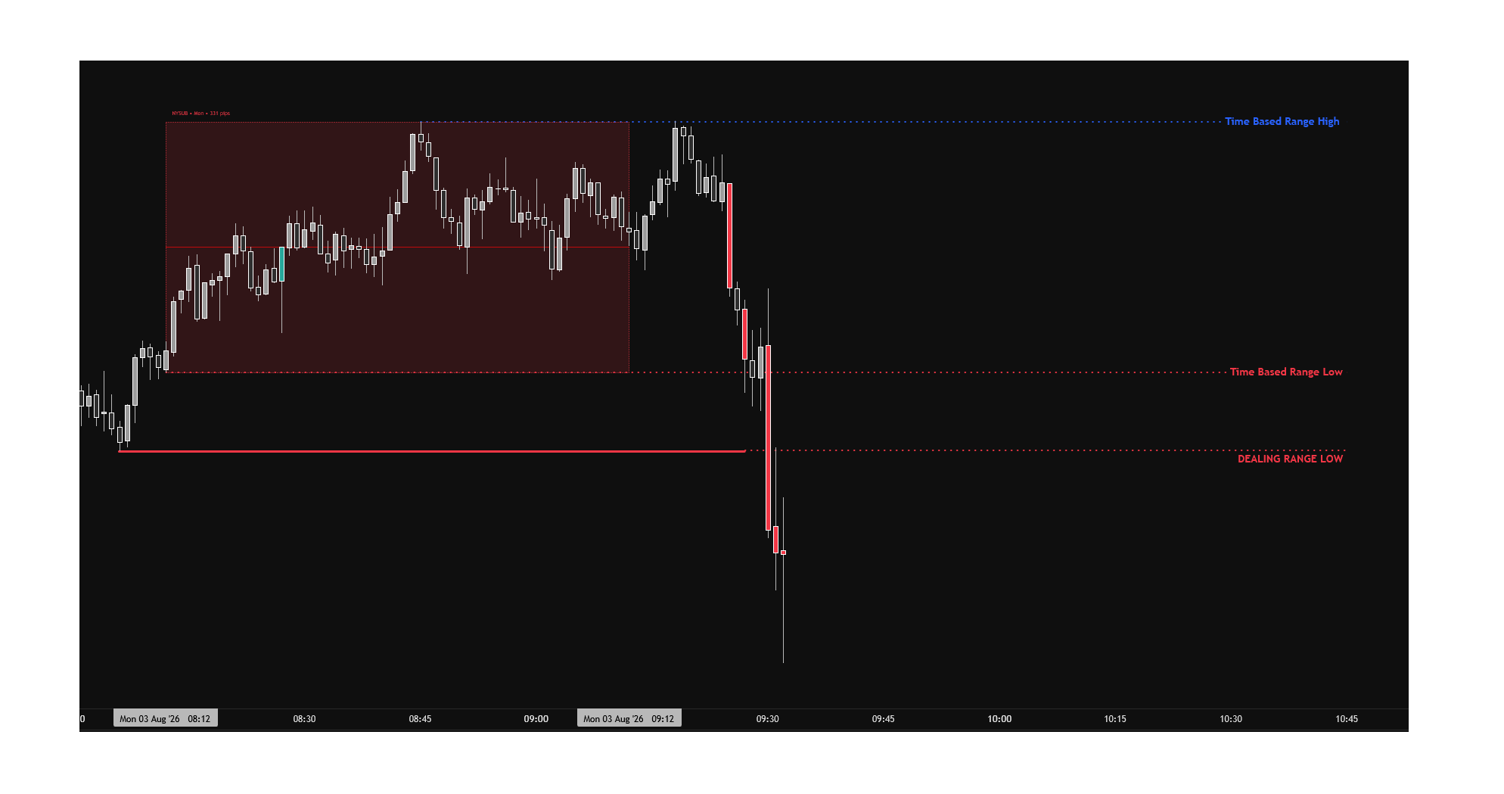
STEP 3: THE ENTRY
LIVE

Slide 220
STEP 3: THE ENTRY
Down close candle. Then another one lower. Then another one lower.
While a market's falling, every candle keeps closing below the last.
That's what falling is.

Slide 221
STEP 3: THE ENTRY
So the turn is when that stops.

Slide 222
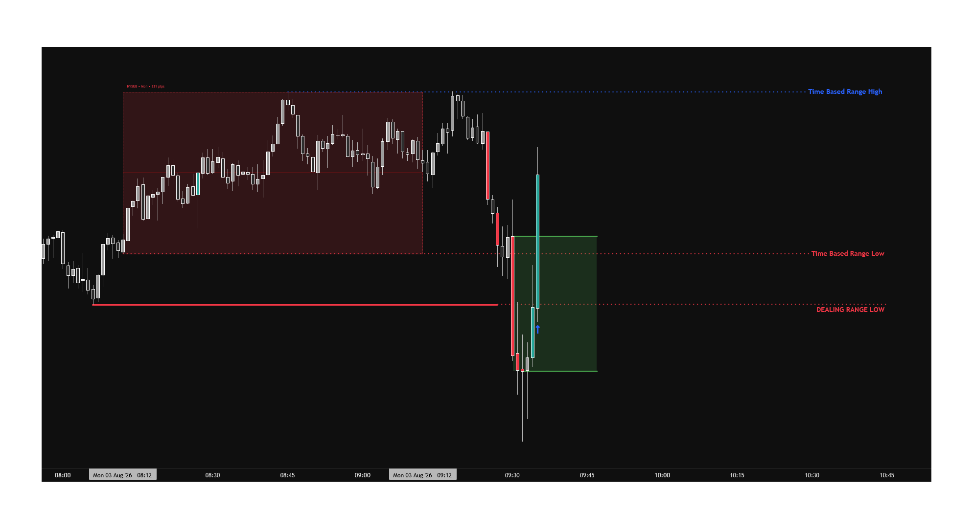
STEP 3: THE ENTRY
LIVE

Slide 223
STEP 3: THE ENTRY
3 down close candles… there, there, there.
And then this one closes above all 3 of them.
1 candle just undid three…

Slide 224
STEP 3: THE ENTRY
The thing that was happening has stopped happening.
I call this my 3 candle rotation...
That's delivery being shifted.

Slide 225
STEP 3: THE ENTRY
Now I want a second opinion, from a bigger timeframe…

Slide 226
STEP 3: THE ENTRY
A 1 minute chart can show you whats not there

Slide 227
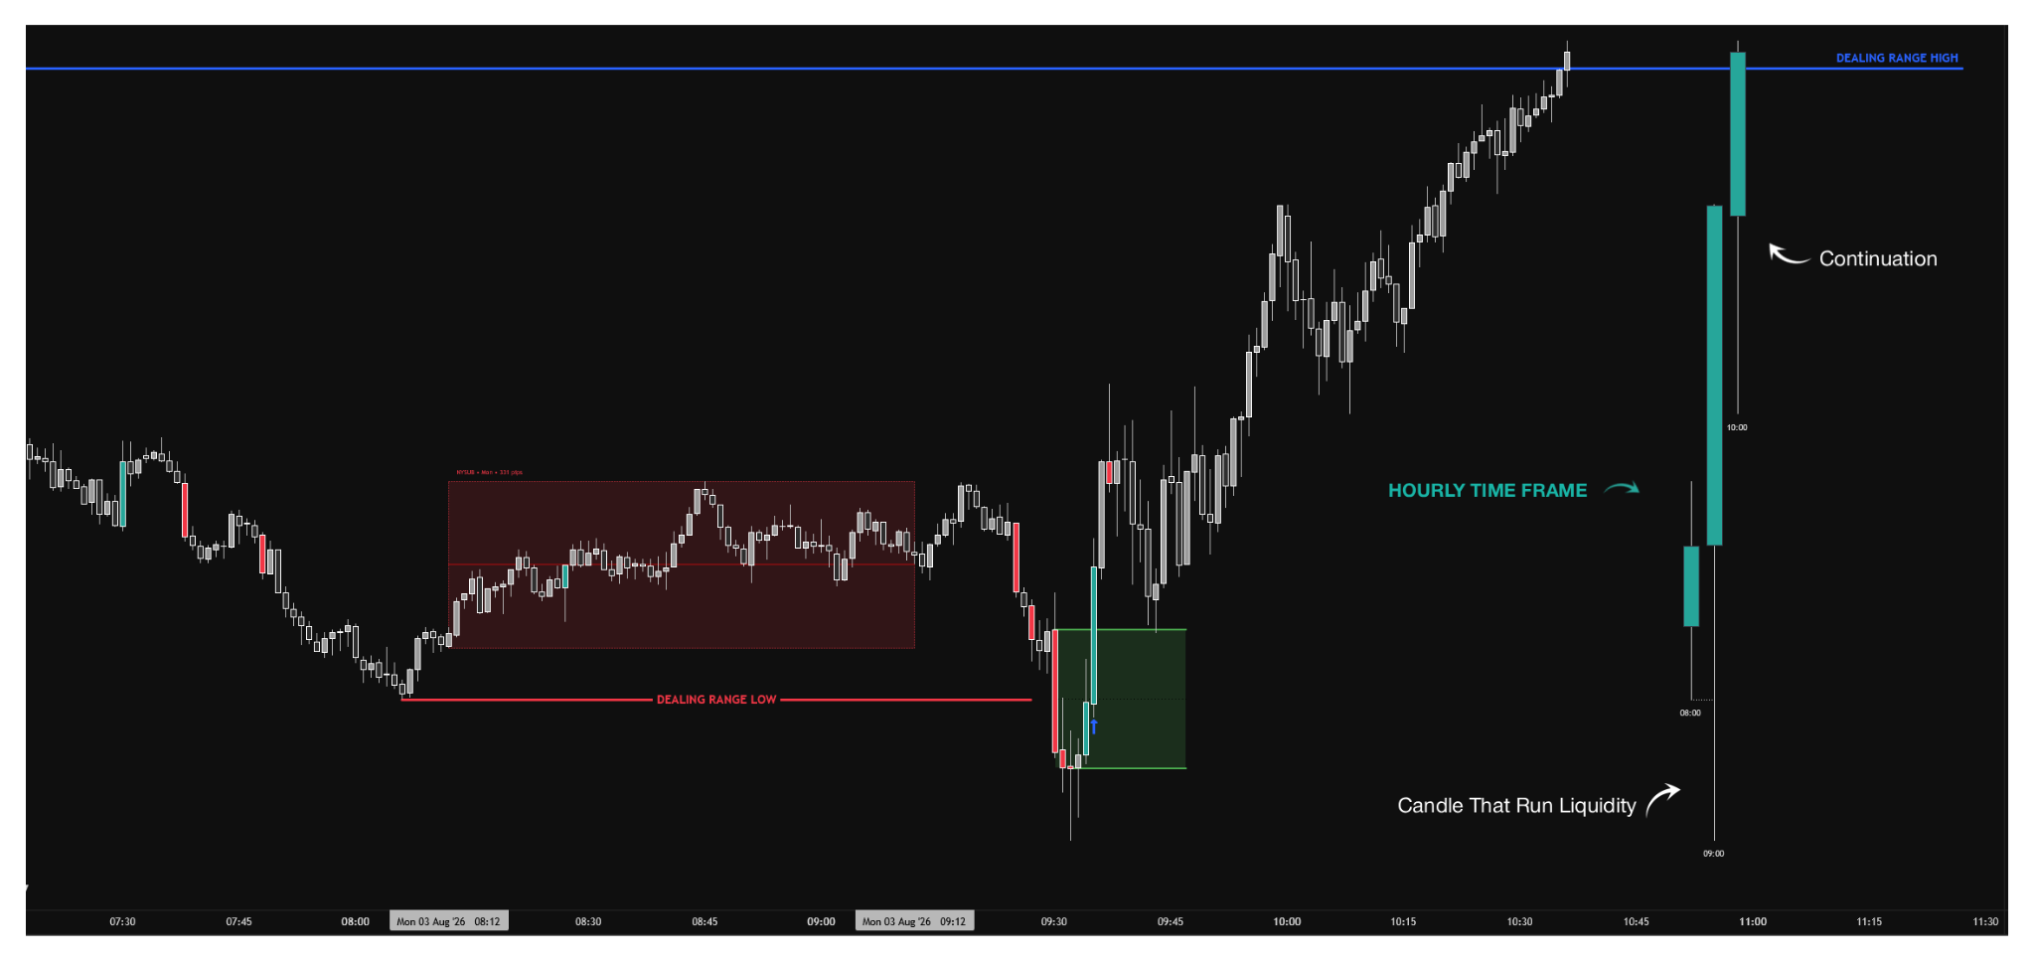
STEP 3: THE ENTRY
LIVE

Slide 228
STEP 3: THE ENTRY
Any 3 hourly candles in a row.
The middle one is the one that dips down and takes the liquidity.
Then the third closes back above the middle.
That's a swing low... The hour agrees.

Slide 229
STEP 3: THE ENTRY
So if the 9am candle takes the level and the 10am closes back inside… what should the 11am do?
It should go up… And that's exactly what it does.

Slide 230
STEP 3: THE ENTRY
That's the 3 candle swing structure... It's confirmation for your direction.

Slide 231
STEP 3: THE ENTRY
It is not where you buy…

Slide 232
STEP 3: THE ENTRY
It's what tells you buying is worth doing.

Slide 233
STEP 3: THE ENTRY
If you treat your hourly candles as your daily candles, a whole new world opens up.

Slide 234
STEP 3: THE ENTRY
So now that you know the market is reversing, we get to the next step:

Slide 235
STEP 3: THE ENTRY
2- Where exactly do I buy?

Slide 236
STEP 3: THE ENTRY
Knowing it's turned still isn't a price… I need a spot to enter my trade.

Slide 237
STEP 3: THE ENTRY
I've got 2, and I want them together.

Slide 238
STEP 3: THE ENTRY
The first is the order block made in liquidity.

Slide 239
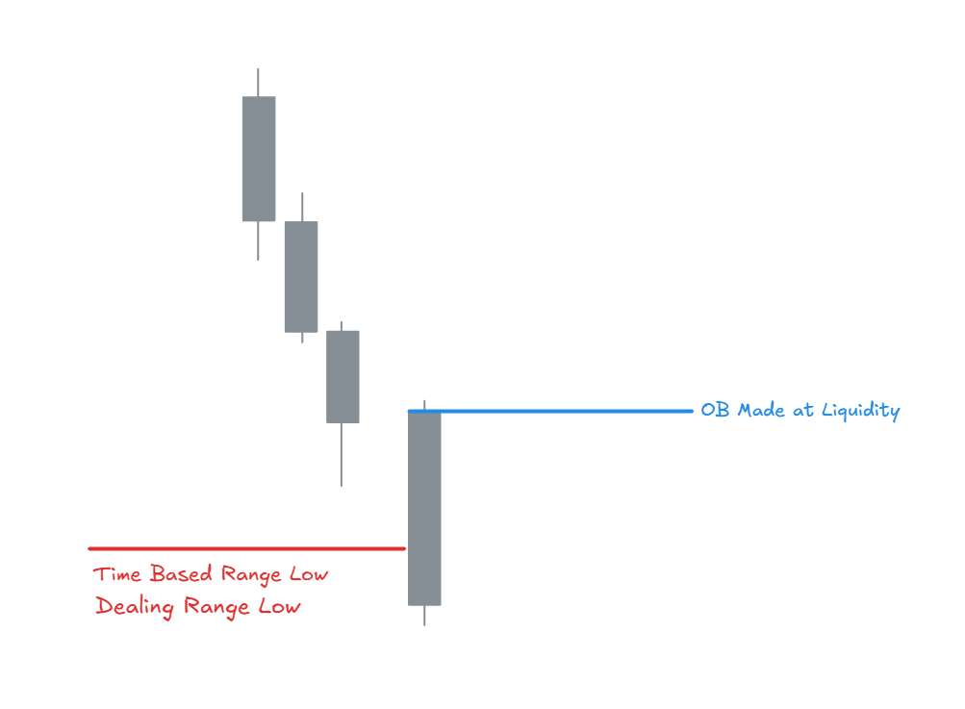
STEP 3: THE ENTRY
LIVE

Slide 240
STEP 3: THE ENTRY
Not that one. Not that one. Not that one. This one.
Why this one? Because this is the candle that traded into the liquidity below the low…
And then we closed back above it.

Slide 241
STEP 3: THE ENTRY
That's the candle that took everyone's stops…
The one the algorithm used to do the job.
So its body is my level.
And here's what people get wrong:
I don't buy when it closes. I buy when price comes back to it.

Slide 242
STEP 3: THE ENTRY
Every other candle on that chart is just a candle... That one did something.

Slide 243
STEP 3: THE ENTRY
Now, the second entry is the inverse gap.

Slide 244
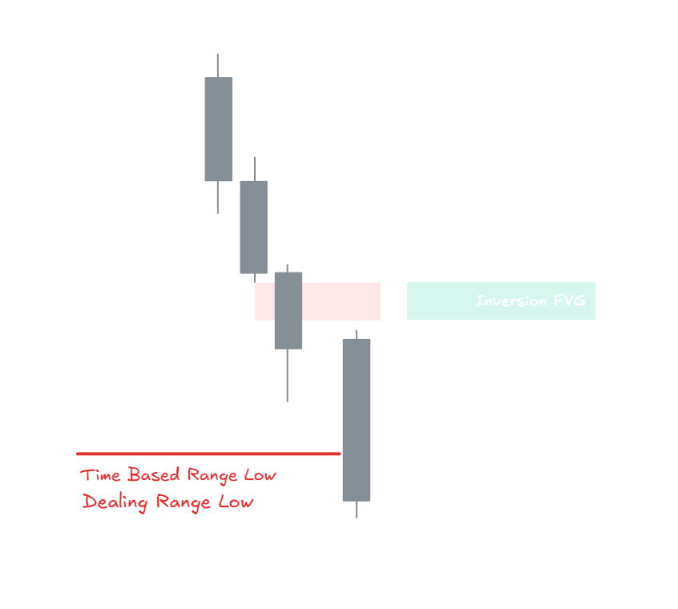
STEP 3: THE ENTRY
LIVE

Slide 245
STEP 3: THE ENTRY
When price moves fast it skips levels... It leaves a hole…
That's a gap.
A market that genuinely wants to keep falling will come back into that hole and carry on down.
Watch…
It comes back into it… And it doesn't carry on, it stops.
It tried to go one way and it couldn't… That failure is the signal.

Slide 246
STEP 3: THE ENTRY
And anything that forms in a liquidity pool, or at one, is very high probability.

Slide 247
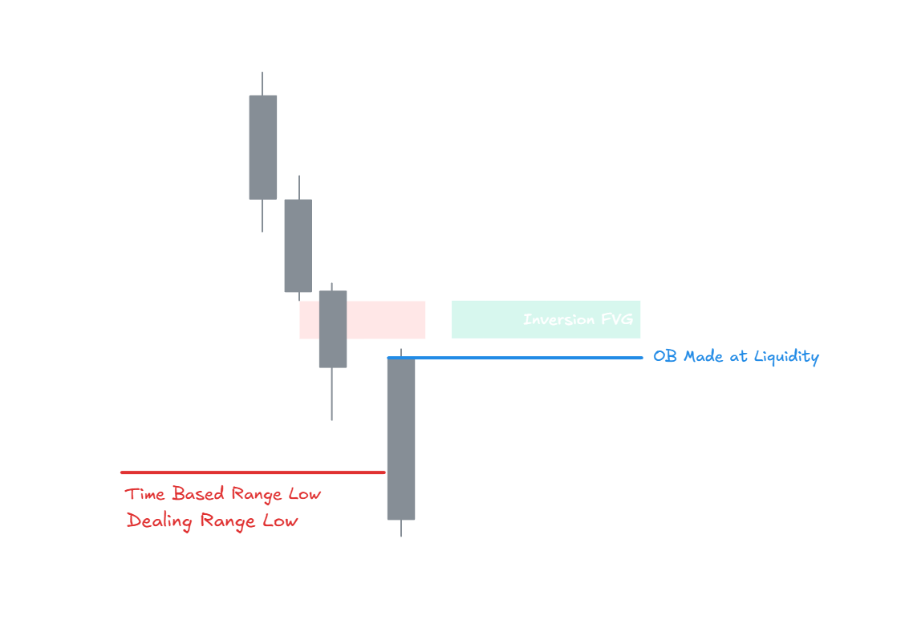
STEP 3: THE ENTRY
LIVE

Slide 248
STEP 3: THE ENTRY
Order block made in liquidity
Inverse gap
Same place.
2 entry functions coming together…
That's where I'm buying.

Slide 249
STEP 3: THE ENTRY
So that's your entry.

Slide 250
STEP 3: THE ENTRY
Did that make sense?
Put a yes in the chat.

Slide 251
STEP 3: THE ENTRY
Now, I want to be honest with you about something, because it'll save you a lot of time.

Slide 252
STEP 3: THE ENTRY
The entry is the part everyone obsesses over.

Slide 253
STEP 3: THE ENTRY
It's what most people showed up for...

Slide 254
STEP 3: THE ENTRY
It's what nearly every trading video on YouTube is about…

Slide 255
STEP 3: THE ENTRY
But for us it's actually the least important thing I've shown you today.

Slide 256
STEP 3: THE ENTRY
Because once you've eliminated one direction…

Slide 257
STEP 3: THE ENTRY
Once you know the market will go up or down…

Slide 258
STEP 3: THE ENTRY
Entries get easy, as you just saw.

Slide 259
STEP 3: THE ENTRY
You'll find one… There's always one.

Slide 260
STEP 3: THE ENTRY
Does that make sense?
Give me a yes in the chat.

Slide 261
STEP 3: THE ENTRY
So look at where you are now.

Slide 262
STEP 3: THE ENTRY
So look at where you are now.
You've got your 2 boxes.

Slide 263
STEP 3: THE ENTRY
So look at where you are now.
You've got your 2 boxes.
You've got your direction.

Slide 264
STEP 3: THE ENTRY
So look at where you are now.
You've got your 2 boxes.
You've got your direction.
You've got your target.

Slide 265
STEP 3: THE ENTRY
So look at where you are now.
You've got your 2 boxes.
You've got your direction.
You've got your target.
And now you've got a price, and you're in.

Slide 266
STEP 3: THE ENTRY
Which means for the first time today, you've got money on the line.

Slide 267
STEP 3: THE ENTRY
And this is where it actually gets hard.

Slide 268
STEP 3: THE ENTRY
Because from this second onwards you're not analysing anything…

Slide 269
STEP 3: THE ENTRY
You're holding.

Slide 270
STEP 3: THE ENTRY
Price is moving, and your account is moving with it.

Slide 271
STEP 3: THE ENTRY
So step 4 is about exiting your trades properly - so you don’t lose your money for no reason.

Slide 272
STEP 4:
4
THE EXIT

Slide 273
STEP 4: THE EXIT
So now you're in your trade.

Slide 274
STEP 4: THE EXIT
And this step is shorter than you think, because you already know your target. You marked it back in step 2, it's the opposing end of the range.

Slide 275
STEP 4: THE EXIT
So this step is only about one thing: what you do on the way there.

Slide 276
STEP 4: THE EXIT
And I'll show you why that matters with the worst day I've ever had.

Slide 277
STEP 4: THE EXIT
LIVE
[The -$8,580 day. P&L first. Sit on it. Then the chart.]

Slide 278
STEP 4: THE EXIT
Explain how you lost $8,580 and why it was your mistakes, not the system

Slide 279
STEP 4: THE EXIT
And I still finished that month green, because one bad day inside a repeatable process is just a bad day.

Slide 280
STEP 4: THE EXIT
But that's the exact reason this step exists...
So here's what I do now, and it's 3 things.

Slide 281
STEP 4: THE EXIT
1-
Stop goes below the low that just got swept

Slide 282
STEP 4: THE EXIT
1-
Stop goes below the low that just got swept
2-
Then the market grades itself — 25, 50, 75

Slide 283
STEP 4: THE EXIT
1-
Stop goes below the low that just got swept
2-
Then the market grades itself — 25, 50, 75
3-
Take the money and get out

Slide 284
STEP 4: THE EXIT
1-
Stop goes below the low that just got swept
2-
Then the market grades itself — 25, 50, 75
3-
Take the money and get out
1-
Your stop goes below the low that just got swept.

Slide 285
STEP 4: THE EXIT
Below the low if you're buying, above the high if you're selling.

Slide 286
STEP 4: THE EXIT
Because if price goes back through the level it just cleared, the reason you're in has gone.

Slide 287
STEP 4: THE EXIT
2- Then the market grades itself on the way to your target.

Slide 288
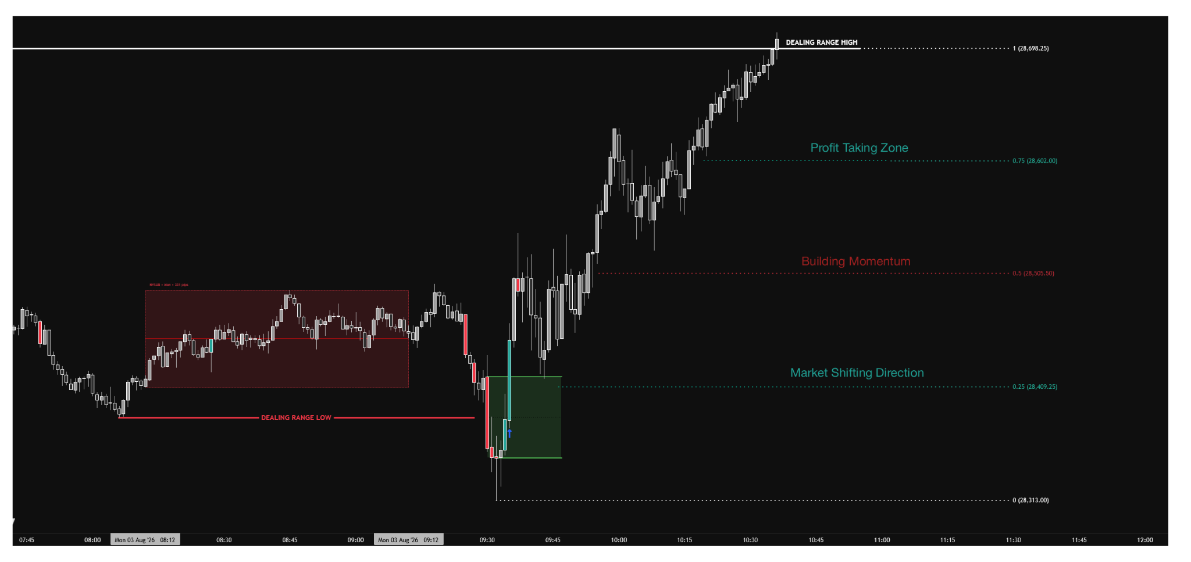
STEP 4: THE EXIT
LIVE

Slide 289
STEP 4: THE EXIT
Past 25, sentiment's beginning to shift and buyers are stepping in. That's my confirmation.
Past 50, the market has no need to come back to 25. That's where I move to break even.
50 to 75 is where I'm taking money off.
And once it closes at 75, that's exactly where it should rally into the opposing end.

Slide 290
STEP 4: THE EXIT
So notice what's happening there…

Slide 291
STEP 4: THE EXIT
I'm not deciding anything on the way to my target either…

Slide 292
STEP 4: THE EXIT
The market's grading itself and I'm just reading the score.

Slide 293
STEP 4: THE EXIT
3- Take the money and get out.

Slide 294
STEP 4: THE EXIT
And honestly, most days I'm not waiting for all of that.

Slide 295
STEP 4: THE EXIT
The easiest target is the opposing end, because I want to make my money and get out.

Slide 296
STEP 4: THE EXIT
I don't want to be sat inside the market for too long.

Slide 297
STEP 4: THE EXIT
Normally it takes 10 to 15 minutes to hit take profit from the 9:30 open.

Slide 298
STEP 4: THE EXIT
If you're 30 minutes in and price is still sat at your entry, something's wrong.

Slide 299
STEP 4: THE EXIT
Because no one ever, and I mean ever, goes broke taking profit…

Slide 300
STEP 4: THE EXIT
You go broke taking losses.

Slide 301
STEP 4: THE EXIT
One last thing, because this is what real trading actually looks like.

Slide 302
STEP 4: THE EXIT
You might buy that return to the order block and get stopped out anyway… It happens to me.

Slide 303
STEP 4: THE EXIT
So take 2 trades in the same direction.

Slide 304
STEP 4: THE EXIT
If they're both wrong, then you're just wrong on the day, and you come back tomorrow.

Slide 305
STEP 4: THE EXIT
It's a cost of doing business.

Slide 306
STEP 4: THE EXIT
So that's the whole system.

Slide 307
STEP 4: THE EXIT
And I want to say something before we go any further, because I know what some of you are thinking right now.

Slide 308
STEP 4: THE EXIT
That felt like a lot.

Slide 309
STEP 4: THE EXIT
Boxes, sweeps, rotations, order blocks, levels… and you're sat there wondering how you're supposed to hold all of that in your head at 9:30 in the morning.

Slide 310
STEP 4: THE EXIT
So let me take that worry off you right now.

Slide 311
STEP 4: THE EXIT
You're not going to be doing 4 things…
You're going to be doing 1 thing.

Slide 312
STEP 4: THE EXIT
Because in real time, all 4 of those steps happen inside about 12 minutes…

Slide 313
STEP 4: THE EXIT
And they happen in the same order, every single day.

Slide 314
STEP 4: THE EXIT
It only feels like a lot because I've spent the last hour pulling it apart in slow motion.

Slide 315
STEP 4: THE EXIT
Does that make sense?
Give me a yes in the chat.

Slide 316
STEP 4: THE EXIT
So here's what we're doing now.
I'm going to put up a new trade, and I'm going to run the whole thing start to finish at normal speed.

Slide 317
STEP 4: THE EXIT
So here's what we're doing now.

Slide 318
STEP 4: THE EXIT
Range Bias Entry Exit

Slide 319
STEP 4: THE EXIT
So you can see what it actually looks like when it's not being taught to you…
When it's just being traded.

Slide 320
STEP 4: THE EXIT
And then I'll show you 3 more trades I took that same week, so you can watch the same thing happen over and over and over and over again.

Slide 321
STEP 5:
5
FULL TRADE EXAMPLES

Slide 322
So that's the whole model…

Slide 323
My time based ranges.

Slide 324
And literally dozens of my students have successfully replicated it.

Slide 325
TESTIMONIAL DUMP

Slide 326
So far on this free live workshop we've covered:

Slide 327
So far on this free live workshop we've covered:
1.
The 2 exact time based ranges I trade, down to the minute, so you can go and mark them on your chart tomorrow morning.

Slide 328
So far on this free live workshop we've covered:
1.
The 2 exact time based ranges I trade, down to the minute, so you can go and mark them on your chart tomorrow morning.
2.
How to get your direction from the double break, so you know whether you're a buyer or a seller before the move happens instead of after it.

Slide 329
So far on this free live workshop we've covered:
1.
The 2 exact time based ranges I trade, down to the minute, so you can go and mark them on your chart tomorrow morning.
2.
How to get your direction from the double break, so you know whether you're a buyer or a seller before the move happens instead of after it.
3.
The exact entry I take most days, right down to which candle on your chart it is.

Slide 330
So far on this free live workshop we've covered:
1.
The 2 exact time based ranges I trade, down to the minute, so you can go and mark them on your chart tomorrow morning.
2.
How to get your direction from the double break, so you know whether you're a buyer or a seller before the move happens instead of after it.
3.
The exact entry I take most days, right down to which candle on your chart it is.
4.
Where your stop goes, when to move it, and how to grade the swing at 25, 50 and 75 so the trade manages itself instead of you managing it.

Slide 331
So far on this free live workshop we've covered:
1.
The 2 exact time based ranges I trade, down to the minute, so you can go and mark them on your chart tomorrow morning.
2.
How to get your direction from the double break, so you know whether you're a buyer or a seller before the move happens instead of after it.
3.
The exact entry I take most days, right down to which candle on your chart it is.
4.
Where your stop goes, when to move it, and how to grade the swing at 25, 50 and 75 so the trade manages itself instead of you managing it.
5.
Full trades from start to finish, on 5 different days, with third party data behind them.

Slide 332
Knowing what you know now:

Slide 333
Do you see how this is different to everything else you've tried?

Slide 334
Can you see yourself sitting down at 9:29 tomorrow and actually running this?

Slide 335
Do you see how this takes the decision out of your hands, so there's nothing left for you to be disciplined about?

Slide 336
Even if you use just a tiny fraction of what I showed you, would you say our time was well spent?

Slide 337
Would you like to spend even more time together, going even deeper on how to trade these ranges properly?

Slide 338
Drop a "Yes" in the chat.

Slide 339
Now, here's the thing...

Slide 340
Even if we had 4 hours together instead of just 60 minutes, it'd still be tough to pack everything I know into one training.

Slide 341
Because what I gave you today, as valuable as you've just told me it was, is genuinely the tip of the iceberg.

Slide 342
For example, I trade more than 2 time based ranges.

Slide 343
Those 2 are just the ones I can give away.

Slide 344
The 2 I gave you work, as you just saw… But there are a lot of people that are now using it…

Slide 345
So a few thousand more people trading them changes nothing.

Slide 346
The other ones we use are private to me and my mentees, simply to keep them secure and predictable.

Slide 347
They literally sign an NDA for it… we want to keep them protected.

Slide 348
Which means what I showed you today is the version I can give to anyone.

Slide 349
And if you liked that, you'll love what I've got next.

Slide 350
So I basically had 2 choices while creating this live class for you...

Slide 351
The first option is:

Slide 352
I share what I've covered today, we part ways, and you try to figure out the rest on your own.

Slide 353
And don’t get me wrong… you could definitely go and make some profits with it…

Slide 354
I’ve gotten so many messages from people making profits from my free course…

Slide 355
And this was much more in depth.

Slide 356
So it’s a nice option.

Slide 357
BUT…

Slide 358
My second option was:

Slide 359
I could take a more active role and responsibility, and ACTUALLY give you everything you need to help you:

Slide 360
I could take a more active role and responsibility, and ACTUALLY give you everything you need to help you:
1-
Get the rest of my secure private ranges… the parts of this I genuinely can't put out publicly…

Slide 361
I could take a more active role and responsibility, and ACTUALLY give you everything you need to help you:
1-
Get the rest of my secure private ranges… the parts of this I genuinely can't put out publicly…
2-
Execute it consistently, with me going through your actual trades with you every week…

Slide 362
I could take a more active role and responsibility, and ACTUALLY give you everything you need to help you:
1-
Get the rest of my secure private ranges… the parts of this I genuinely can't put out publicly…
2-
Execute it consistently, with me going through your actual trades with you every week…
3-
Watch me take these trades live, 3 times a week… so you're seeing it happen in real time instead of hearing about it after…

Slide 363
I could take a more active role and responsibility, and ACTUALLY give you everything you need to help you:
1-
Get the rest of my secure private ranges… the parts of this I genuinely can't put out publicly…
2-
Execute it consistently, with me going through your actual trades with you every week…
3-
Watch me take these trades live, 3 times a week… so you're seeing it happen in real time instead of hearing about it after…
4-
Learn the exact prop firm rules and risk settings that get you approved and keep you funded…

Slide 364
I could take a more active role and responsibility, and ACTUALLY give you everything you need to help you:
1-
Get the rest of my secure private ranges… the parts of this I genuinely can't put out publicly…
2-
Execute it consistently, with me going through your actual trades with you every week…
3-
Watch me take these trades live, 3 times a week… so you're seeing it happen in real time instead of hearing about it after…
4-
Learn the exact prop firm rules and risk settings that get you approved and keep you funded…
5-
Sit down with me one on one every 2 weeks and go through your own charts…

Slide 365
Which option makes more sense to you?

Slide 366
1 or 2? Type it in the chat.

Slide 367
Do you mind if I take a couple minutes to show you something I built that does exactly that?

Slide 368
Introducing -
The Time Based Ranges Academy.

Slide 369
The Time Based Ranges Academy is the 1on1 mentorship program I built to walk you through this entire process…

Slide 370
And help you become a consistently profitable, funded trader.

Slide 371
I actually guarantee that, so there's zero risk on your end.

Slide 372
We'll get to that in a second.

Slide 373
But before that, let me explain exactly how the whole thing works.

Slide 374
And I want to be really clear about what this is and what it isn't.

Slide 375
This is NOT a course.

Slide 376
This isn't some Discord where you get dropped in and left to watch videos on your own.

Slide 377
This is hands-on mentorship.

Slide 378
Me personally taking you through all of it, and making sure you can execute the TBR consistently and profitably.

Slide 379
So how does the TBR Academy actually work?

Slide 380
It's a 12-week intensive bootcamp…

Slide 381
1)
1on1 Onboarding call, just you and me

Slide 382
Before you touch anything, we get on a call together.

Slide 383
I want to see where you're actually at…

Slide 384
What you're trading now, what account you're on, how much time you've got in the morning, and what's been going wrong.

Slide 385
From there I’ll identify and help you “unlearn” the stuff that’s been holding you back…

Slide 386
And map it out the plan for the next 12 weeks.

Slide 387
You come off that call knowing exactly what you're doing tomorrow morning.

Slide 388
1)
1on1 Onboarding call, just you and me
Notes:
STACK

Slide 389
2)
Full Time Based Ranges Course

Slide 390
Including the ranges I can't put online.

Slide 391
The second you're in, you get all of it.

Slide 392
Every time based range I trade, not just the 2 I gave you today.

Slide 393
That's the NDA I mentioned, you sign it, and then you're sat at the same windows I'm sat at every morning.

Slide 394
You also get the full A-Z model course.

Slide 395
Foundations and framework, reading context and bias, liquidity and market structure, and putting it all together.

Slide 396
Plus Revealing Of The Veil, which is the deeper framework side of it, and the workbooks that go with every module.

Slide 397
So there's nothing I'm holding back from you.

Slide 398
You get what I use.

Slide 399
1)
1on1 Onboarding call, just you and me
2)
Full Time Based Ranges Course
Notes:
STACK

Slide 400
3)
3 live trading sessions with me, every single week.

Slide 401
3 mornings a week, I'm live, on my own account, in front of you.

Slide 402
You're watching me mark the range, wait for the break, and take the entry while it's actually happening.

Slide 403
This is super valuable…

Slide 404
You can't learn to time something from a video.

Slide 405
You learn it by watching somebody do it live, over and over.

Slide 406
3 times a week, for 12 weeks, that's 36 mornings of watching this get traded in real time.

Slide 407
1)
1on1 Onboarding call, just you and me
2)
Full Time Based Ranges Course
3)
3 live trading sessions with me, every single week.
Notes:
STACK

Slide 408
4)
Weekly group coaching calls.

Slide 409
This is where we go through everything that happened that week.

Slide 410
The trades you took, the trades you missed, the ones you weren't sure about.

Slide 411
You bring your charts, we put them up, and we go through them properly.

Slide 412
And you're not just learning from your own week.

Slide 413
You're in a room with people running the exact same model…

Slide 414
So you're seeing the same mistakes and the same wins from multiple different angles instead of 1.

Slide 415
1)
1on1 Onboarding call, just you and me
2)
Full Time Based Ranges Course
3)
3 live trading sessions with me, every single week.
4)
Weekly group coaching calls.
Notes:
STACK

Slide 416
5)
The private community, my weekly blueprint, and my market commentaries.

Slide 417
The community isn't a dead Discord full of people posting rocket emojis.

Slide 418
It's traders running this model right now, every morning, together.

Slide 419
Every week I post my blueprint for the week ahead, so you know what I'm watching before the week starts.

Slide 420
And my market commentaries throughout, so when something unusual happens you're not sat there guessing what it meant.

Slide 421
1)
1on1 Onboarding call, just you and me
2)
Full Time Based Ranges Course
3)
3 live trading sessions with me, every single week.
4)
Weekly group coaching calls.
5)
The private community, my weekly blueprint, and my market commentaries.
Notes:
STACK

Slide 422
Now, everything I've just walked you through…

Slide 423
Now, everything I've just walked you through…
The full model with every range I trade.

Slide 424
Now, everything I've just walked you through…
The full model with every range I trade.
The 3 live sessions a week.

Slide 425
Now, everything I've just walked you through…
The full model with every range I trade.
The 3 live sessions a week.
The weekly coaching.

Slide 426
Now, everything I've just walked you through…
The full model with every range I trade.
The 3 live sessions a week.
The weekly coaching.
The community.

Slide 427
Now, everything I've just walked you through…
The full model with every range I trade.
The 3 live sessions a week.
The weekly coaching.
The community.
That is already an enormous amount of support.

Slide 428
And most of the students I showed you at the start of today?

Slide 429
They had exactly that, and nothing else, and they still got those results.

Slide 430
But since you're here with me LIVE right now…

Slide 431
I decided to add 4 bonuses on top of it.

Slide 432
And I'm doing it this way on purpose, because every one of these solves a specific problem I already know you're going to run into.

Slide 433
BONUS 1:
The Scaling Phase - 3 extra months with me FOR FREE.

Slide 434
Now, don’t get me wrong… 12 weeks is enough to make you good at this.

Slide 435
I've seen it happen over and over.

Slide 436
But week 12 is also exactly where some traders start doing well and immediately get in their own way.

Slide 437
You've got a couple of green weeks, you start sizing up, and that's the point where you either go full time or keep struggling with inconsistency.

Slide 438
So if you're in today, you don't stop at week 12.

Slide 439
You get another 3 months with me on the other side of it, while you're actually scaling.

Slide 440
Weekly group coaching, the live sessions, the community, all of it continues.

Slide 441
1)
1on1 Onboarding call, just you and me
2)
Full Time Based Ranges Course
3)
3 live trading sessions with me, every single week.
4)
Weekly group coaching calls.
5)
The private community, my weekly blueprint, and my market commentaries.
BONUS 1:
The Scaling Phase - 3 extra months with me FOR FREE.
Notes:
STACK

Slide 442
BONUS 2:
I'll pay for your first prop firm challenge myself.

Slide 443
Almost everybody comes to me wanting a funded account…

Slide 444
And almost everybody has the same story.

Slide 445
They paid for a challenge before they were ready, they failed it on day 4, and they paid again.

Slide 446
And again.

Slide 447
A few hundred dollars a go, and every failed one makes you a bit more scared of the next.

Slide 448
So we do it differently.

Slide 449
You don't touch a challenge until I say you're ready for one.

Slide 450
And when I do say it, I pay for it.

Slide 451
Out of my own pocket.

Slide 452
Because if I'm telling you you're ready, I should be the one taking the risk on that, not you.

Slide 453
1)
1on1 Onboarding call, just you and me
2)
Full Time Based Ranges Course
3)
3 live trading sessions with me, every single week.
4)
Weekly group coaching calls.
5)
The private community, my weekly blueprint, and my market commentaries.
BONUS 1:
The Scaling Phase - 3 extra months with me FOR FREE.
BONUS 2:
I'll pay for your first prop firm challenge myself.
Notes:
STACK

Slide 454
BONUS 3:
Unlimited 1on1 DM access to me.

Slide 455
For the whole program.

Slide 456
You know the feeling of taking a trade and then sitting there afterwards not sure whether you actually did it right?

Slide 457
Green or red, it doesn't matter, you genuinely can't tell if you followed the model or got away with it.

Slide 458
That's the thing that keeps people stuck for years, because you can't fix something you can't see.

Slide 459
So you send it to me.

Slide 460
The chart, what you did, why you did it.

Slide 461
And I'll tell you what actually happened, which is usually not what you thought happened.

Slide 462
And I mean me.

Slide 463
And I mean me.
Not a chatbot, not a coach I hired.

Slide 464
And I mean me.
Not a chatbot, not a coach I hired.
Me.

Slide 465
1)
1on1 Onboarding call, just you and me
2)
Full Time Based Ranges Course
3)
3 live trading sessions with me, every single week.
4)
Weekly group coaching calls.
5)
The private community, my weekly blueprint, and my market commentaries.
BONUS 1:
The Scaling Phase - 3 extra months with me FOR FREE.
BONUS 2:
I'll pay for your first prop firm challenge myself.
BONUS 3:
Unlimited 1on1 DM access to me.
Notes:
STACK

Slide 466
And now the one I've saved for last.

Slide 467
Because this is the one that makes the biggest difference by a mile.

Slide 468
BONUS 4:
Bi weekly 1on1 calls with me

Slide 469
Everyone in this industry loves the words "1 on 1".

Slide 470
And then it turns out to be a call with 200 people on it where you might get to ask one question if you're quick enough.

Slide 471
That's not what this is.

Slide 472
For the first 3 months, every 2 weeks you and I get on a call.

Slide 473
We go through your last 2 weeks properly.

Slide 474
What you took, what you skipped, where your sizing is, what's actually stopping you from moving forward.

Slide 475
And then you leave that call knowing exactly what you're working on for the next 2 weeks.

Slide 476
On top of the live sessions.

Slide 477
On top of the weekly coaching.

Slide 478
On top of being able to message me whenever you want.

Slide 479
I built it this way because I wanted it to be genuinely unreasonable for you not to make it.

Slide 480
1)
1on1 Onboarding call, just you and me
2)
Full Time Based Ranges Course
3)
3 live trading sessions with me, every single week.
4)
Weekly group coaching calls.
5)
The private community, my weekly blueprint, and my market commentaries.
BONUS 1:
The Scaling Phase - 3 extra months with me FOR FREE.
BONUS 2:
I'll pay for your first prop firm challenge myself.
BONUS 3:
Unlimited 1on1 DM access to me.
BONUS 4:
Bi weekly 1on1 calls with me
Notes:
STACK

Slide 481
Now, here's the part I said we'd come back to… the guarantee.

Slide 482
If you go through the 6 months with me and you're still not consistently profitable, and you still haven't passed a prop firm challenge…

Slide 483
I keep working with you.

Slide 484
I keep working with you.
Personally.

Slide 485
I keep working with you.
Personally.
For free.

Slide 486
I keep working with you.
Personally.
For free.
Until you're funded.

Slide 487
And I want to tell you why I can offer that, because a guarantee this strong usually makes people suspicious, and it should.

Slide 488
It's because I'm not letting 200 people in.

Slide 489
It's because I'm not letting 200 people in.
I'm on the live sessions.

Slide 490
It's because I'm not letting 200 people in.
I'm on the live sessions.
I'm on your 1on1 calls.

Slide 491
It's because I'm not letting 200 people in.
I'm on the live sessions.
I'm on your 1on1 calls.
I'm the one answering your DMs.

Slide 492
There is a hard limit on how many people I can do that for…

Slide 493
And because there is, I can afford to add that guarantee and all the bonuses for free.

Slide 494
Which brings me to the last thing I need to be straight with you about.

Slide 495
There are hundreds of you here right now.

Slide 496
And everything I just added on top…

Slide 497
And everything I just added on top…
The 3 extra months.

Slide 498
And everything I just added on top…
The 3 extra months.
Me paying for your challenge.

Slide 499
And everything I just added on top…
The 3 extra months.
Me paying for your challenge.
The unlimited DM access.

Slide 500
And everything I just added on top…
The 3 extra months.
Me paying for your challenge.
The unlimited DM access.
The 1on1 calls.

Slide 501
Those 4 bonuses only apply to the first 10 people who join.

Slide 502
And the reason is simple.

Slide 503
Those bonuses are all me.

Slide 504
My time, personally, every week.

Slide 505
I can give that to 10 people properly.

Slide 506
I cannot give it to 50, and I'm not going to pretend otherwise and do a bad job of it.

Slide 507
So once those 10 spots go, and they will go, the bonuses come off.

Slide 508
The core program still exists.

Slide 509
You'd still get the model, the ranges, the live sessions, the coaching, the community.

Slide 510
But the level of personal access I'm offering today together with the guarantee won’t be on the table anymore.

Slide 511
So here's what I want you to do right now.

Slide 512
In the chat you'll see a link to the TBR Academy application.

Slide 513
Click it, it takes about 2 minutes.

Slide 514
It's just a few questions about where you are right now and what you're trying to get to, so we've got some context before we speak.

Slide 515
The last step is booking a call with me or one of my team.

Slide 516
And to be clear, this isn't a high-pressure sales call.

Slide 517
I'm working with you personally, so I have to be selective about who comes in.

Slide 518
We'll look at your situation and work out whether this is actually right for you.

Slide 519
If it is, we'll get you started immediately.

Slide 520
If it isn't, we'll tell you that too, and there's no hard feelings.

Slide 521
So go ahead, the link is right there in the chat.

Slide 522
Now while you're doing that, let me answer the questions I get asked the most…

Slide 523
Now while you're doing that, let me answer the questions I get asked the most…
Q1 -
"I've got a full-time job. Can I actually do this?"

Slide 524
Now while you're doing that, let me answer the questions I get asked the most…
Q1 -
"I've got a full-time job. Can I actually do this?"
Q2 -
"How long before I'm actually seeing results?"

Slide 525
Now while you're doing that, let me answer the questions I get asked the most…
Q1 -
"I've got a full-time job. Can I actually do this?"
Q2 -
"How long before I'm actually seeing results?"
Q3 -
"I've tried mentorships before and none of them worked. Why would this be different?"

Slide 526
Now while you're doing that, let me answer the questions I get asked the most…
Q1 -
"I've got a full-time job. Can I actually do this?"
Q2 -
"How long before I'm actually seeing results?"
Q3 -
"I've tried mentorships before and none of them worked. Why would this be different?"
Q4 -
"Do I need a big account to start?"

Slide 527
Now while you're doing that, let me answer the questions I get asked the most…
Q1 -
"I've got a full-time job. Can I actually do this?"
Q2 -
"How long before I'm actually seeing results?"
Q3 -
"I've tried mentorships before and none of them worked. Why would this be different?"
Q4 -
"Do I need a big account to start?"
Q5 -
"Is this really 1on1? How does it actually work?"

Slide 528
1)
1on1 Onboarding call, just you and me
2)
Full Time Based Ranges Course
3)
3 live trading sessions with me, every single week.
4)
Weekly group coaching calls.
5)
The private community, my weekly blueprint, and my market commentaries.
BONUS 1:
The Scaling Phase - 3 extra months with me FOR FREE.
BONUS 2:
I'll pay for your first prop firm challenge myself.
BONUS 3:
Unlimited 1on1 DM access to me.
BONUS 4:
Bi weekly 1on1 calls with me
Notes:
STACK

