Slide 1
Demand Analysis of All the Programs at UofA

Slide 2
Demand Calculation
The Data collection process consists of the following steps:
For each Specific program, there is a specific six digits CIP code. These codes can be found in National Center for Education Statistics. For example, the CIP code for the Chemistry is: 40.0501.
From these codes, we will have the program knowledge and it’s demand categories. From these information, we searched in O*NET for the demand data for that program.

Slide 3
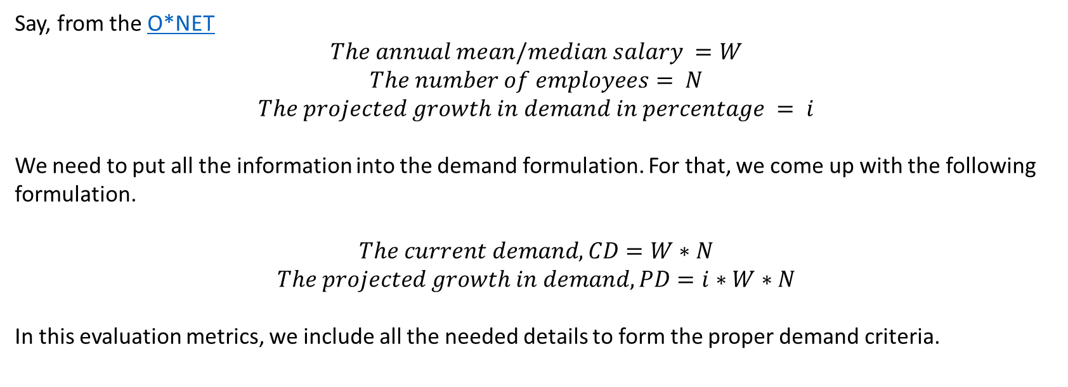
Demand Calculation (cont’d)
Say, from the O*NET
$$The annual mean/median salary =W$$
$$The number of employees= N$$
$$The projected growth in demand in percentage = i$$
We need to put all the information into the demand formulation. For that, we come up with the following formulation.
$$The current demand, CD=W∗N$$
$$The projected growth in demand, PD=i∗W∗N$$
In this evaluation metrics, we include all the needed details to form the proper demand criteria.

Slide 4
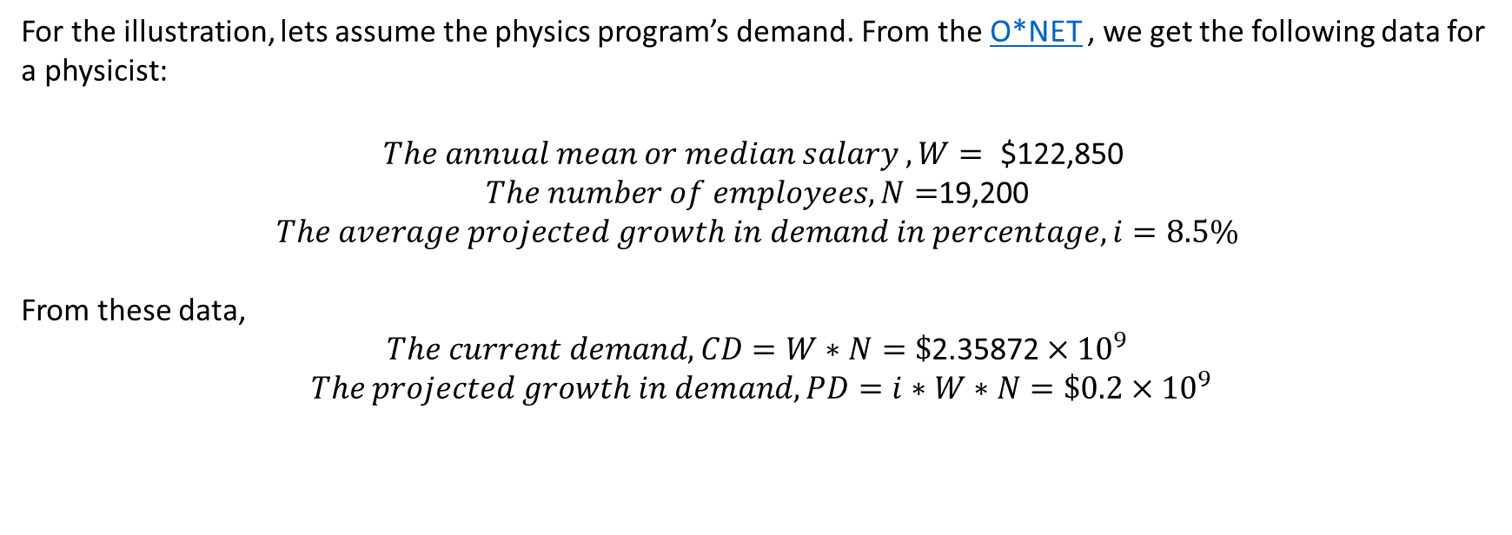
Example: 01
For the illustration, lets assume the physics program’s demand. From the O*NET , we get the following data for a physicist:
$$The annual mean or median salary ,W=\text{ \$122,850 }$$
$The number of employees, N=$19,200
$$The average projected growth in demand in percentage, i=8.5\%$$
From these data,
$$The current demand, CD=W∗N=\text{\$}\text{2.3}\text{5872}×{10}^{9}$$
$The projected growth in demand, PD=i∗W∗N=\$0.2×{10}^{9}$

Slide 5
Weighted Average Demand
For some programs, there may be more than one categories of profession. For example, a computer science program graduate may choose software engineering or hardware engineering or may be computer network architects etc. as a profession. For a specific program, we can find these categories from National Center for Education Statistics for a specific program. For these programs, we calculate the weighted average demand from the O*NET .

Slide 6
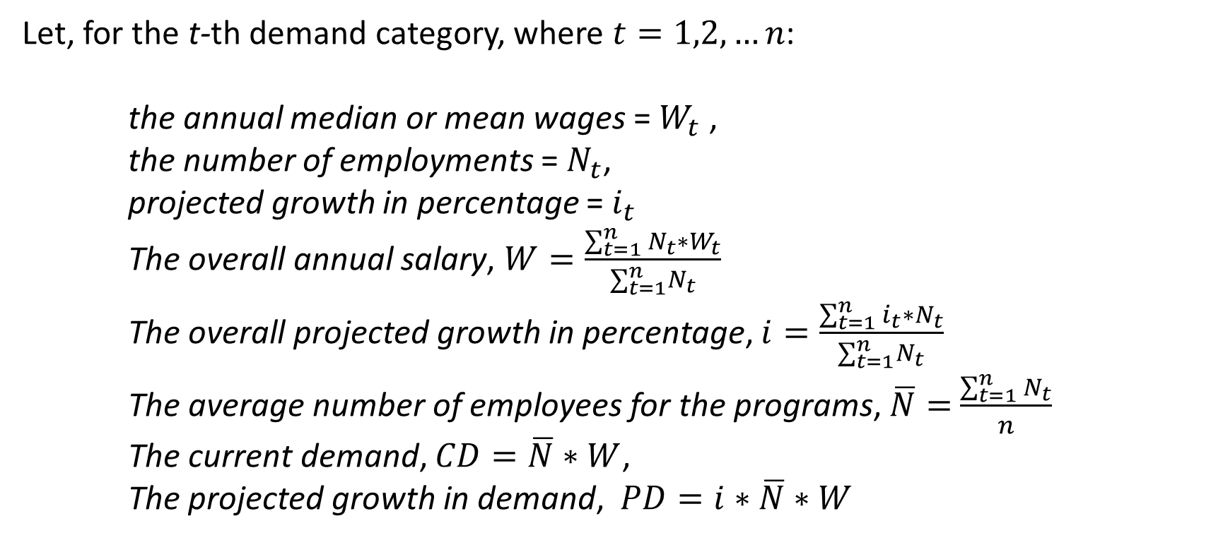
Weighted Average Demand (cont’d)
Let, for the t-th demand category, where $t=1,2,…n$:
the annual median or mean wages = $W_{t}$,
the number of employments = $N_{t}$,
projected growth in percentage = $i_{t}$
The overall annual salary, $W=\frac{\sum_{t=1}^{n}{N_{t}∗W_{t}}}{∑_{t=1}^{n}N_{t}}$
The overall projected growth in percentage, $i=\frac{\sum_{t=1}^{n}{i_{t}∗N_{t}}}{∑_{t=1}^{n}N_{t}}$
The average number of employees for the programs, $\overline{N}=$ $\frac{\sum_{t=1}^{n}{N_{t}}}{n}$
The current demand, $CD=\overline{N}∗W$,
The projected growth in demand, $PD=i∗\overline{N}∗W$

Slide 7
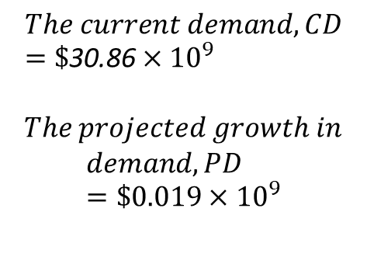
Example: 02
For example, we are considering the Computer science program for the weighted average demand calculation. From the National Center for Education Statistics and O*NET we get the following categories of demand:
Category | Salary | Number of Employees | Percentage of Growth
Computer Hardware Engineers | 117220 | 64400 | 0.05
Software Developers | 107510 | 421300 | 0.085
Computer Programmers | 86550 | 250300 | -0.02
Computer Network Architects | 112690 | 159300 | 0.05
Network and Computer Systems Administrators | 83510 | 383900 | 0.05
Computer and Information Systems Managers | 146360 | 414400 | 0.11
$$The current demand, CD=\text{\$}\text{30.86}×{10}^{9}$$
$The projected growth in$
$$demand, PD=\$0.019×{10}^{9}$$

