Slide 1

An Emulation Framework for Electric Vehicle Charging Using IEC-61499 Function Blocks
Project 72
Supervisor: Dr Partha Roop
Researchers: Sanath Vettivel & Heimana Palmer

Slide 2
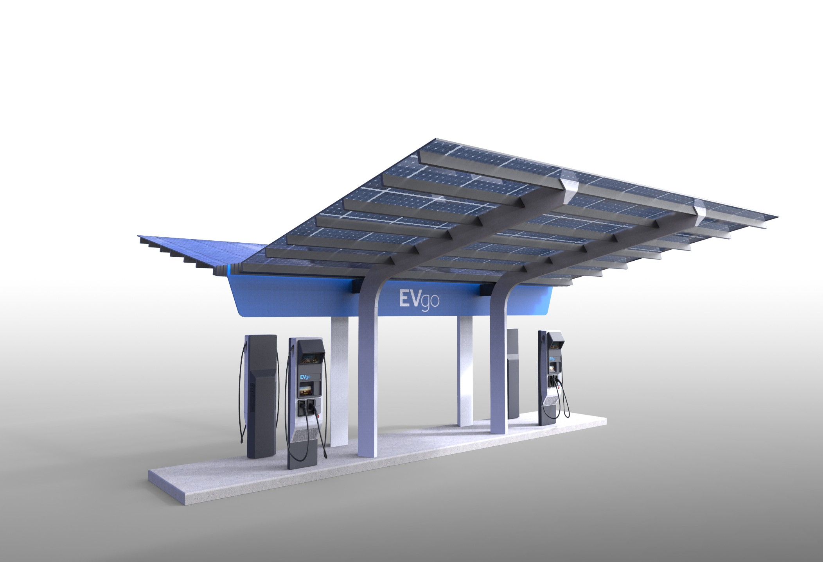
Background
Electric vehicles are becoming more popular.
Electric vehicles need to be charged.
How can we minimise the cost of charging them?
https://www.autoevolution.com/news/america-s-first-high-power-ev-charging-station-has-begun-its-construction-phase-114012.html

Slide 3
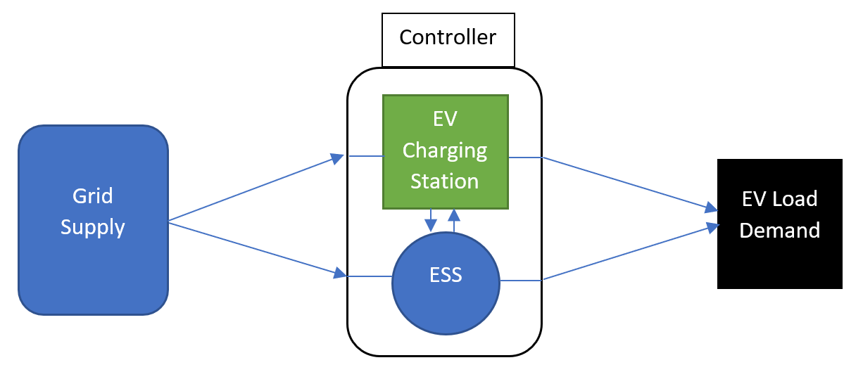
Representation of EV Charging Station

Slide 4
Related Work

Slide 5
Related Work
Time of Utilization Pricing Management to minimise the cost of charging
Current research uses algorithmic approach -> Bollinger Bands
Problem of uncoordinated electric vehicle charging demand due to less involvement of customers
Solved with Energy Storage System
Energy storage system key in minimising undesired effects of the load on grid
Large number of uncoordinated demand could have unfavourable effects on grid performance and efficiency

Slide 6
Related Work
Research model end-users demands to be exactly met by energy supply of the grid
Recognise that compromising charging time to minimise cost is not an option
Installation / running costs of energy storage system unit
Economic Analysis needed

Slide 7
MATLAB Algorithm
Load EV Data
Generate EV
Energy Demand Per Minute
Decide ESS Mode of Operation
Print Data
Repeat process for each day
Sum Energy Demand For Each Minute

Slide 8

Research Intent
We wanted to minimise the cost electric vehicle charging.
We are going to achieve this using an accurate simulation environment built with industry standard IEC-61499 function blocks.
Different research algorithms will be used to try minimise the cost.
Notes:
An accurate simulation environment built with industry standard IEC-61499 Function Blocks what we can use to research different algorithms for minimising the cost of EV charging.

Slide 9
Methodology

Slide 10
Methodology Overview
Model the Power Demand of Electric Vehicle Users
Energy storage system modes of operation
Implement MATLAB Algorithm into Industry Standard IEC-61499 Function Block Environment
‘Swap-in’ other Researched Algorithms to test which minimises charging cost

Slide 11



i. Modelling the Energy Demand - Example
BMW i3
5 Fast Charging Ports
Nissan leaf
38.77 kWh
35.89 kWh
39.1 kWh
Kia Soul
15 Normal Charging Ports
5.44 kWh
6.3 kWh
5.1 kWh
5.1 kWh
Assumption: SoC of all cars are under 80%.
E_{req} = 38.77 + 35.89 + 39.1 +5.44 + 6.3 + 5.1 + 5.1 = 135.7 kWh
Note: Project models a Public Singaporean Charging Station with 5 Fast Charging Ports (Higher Voltage) and 15 Normal Charging Ports

Slide 12
ii. Energy storage system - Modes of Operation
Low Demand &&(high or medium price)
High Demand
On-peak
Off-peak
Low Demand && low price
Off-peak charging
Low Demand &&(high or medium price)
High Demand
Low Demand && low price

Slide 13
ii. Energy storage system – Modes of Operation
On-peak | Off-peak | Off-peak Charging
Priorities use of energy storage system. Grid can supply if need be. | Priorities use of Grid (For Set Amount). Energy storage system can supply rest if need be. | The Grid charges both electric vehicles and the energy storage system.

Slide 14
iii. Industry Standard IEC-61499 Function Blocks
Provides coordination between multiple programmable logic controllers.
Object-Oriented Programming
Function Blocks (FBs)
Advantages:
Compatible with Multiple Devices (e.g. Microcontrollers, PLC and Sensor)
Could Interpret the data from multiple software tools
Interoperable and Event-Driven Execution

Slide 15
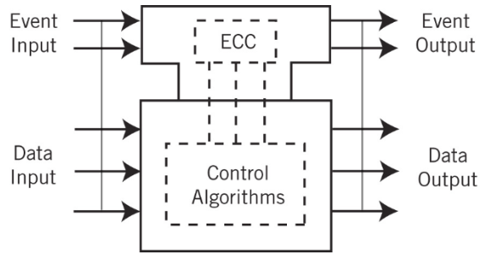
IEC-61499 Basic Function Block (BFB) Interface
https://www.controldesign.com/articles/2007/202/

Slide 16
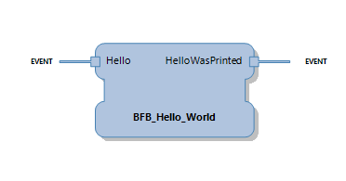
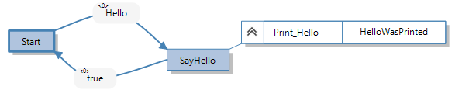
Basic Function BLOCK SIMPLE Example
printf( " Hello World " );

Slide 17
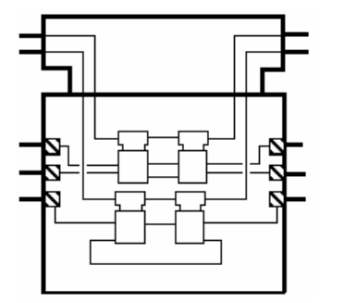
IEC-61499 Composite Function Block (CFB)
Event Input
Event Output
Data Input
Data Output
https://www.holobloc.com/papers/iec61499/overview.htm

Slide 18
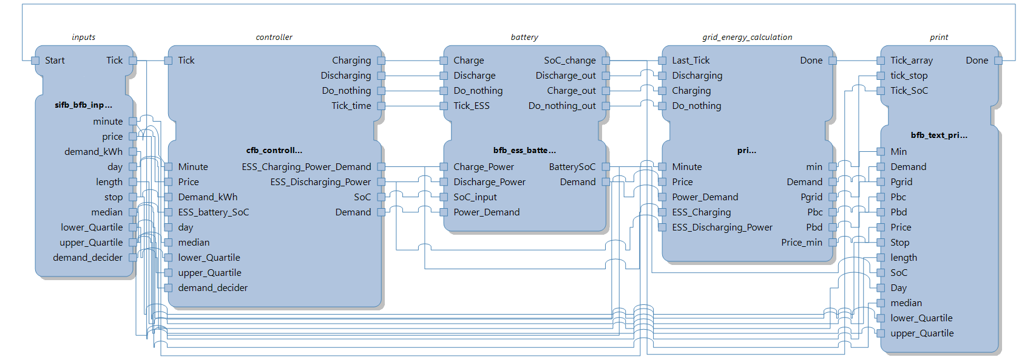
Project Working Environment

Slide 19

Simplified Overview of Function Block Environment
Input Load Power Demand and Price
ESS State of Charge Calculations
ESS Controller
Grid Energy Calculation
Print Results

Slide 20
Algorithms (i) Bollinger Bands (ii) Box and Whisker (iIi) Artificial Neural Network

Slide 21
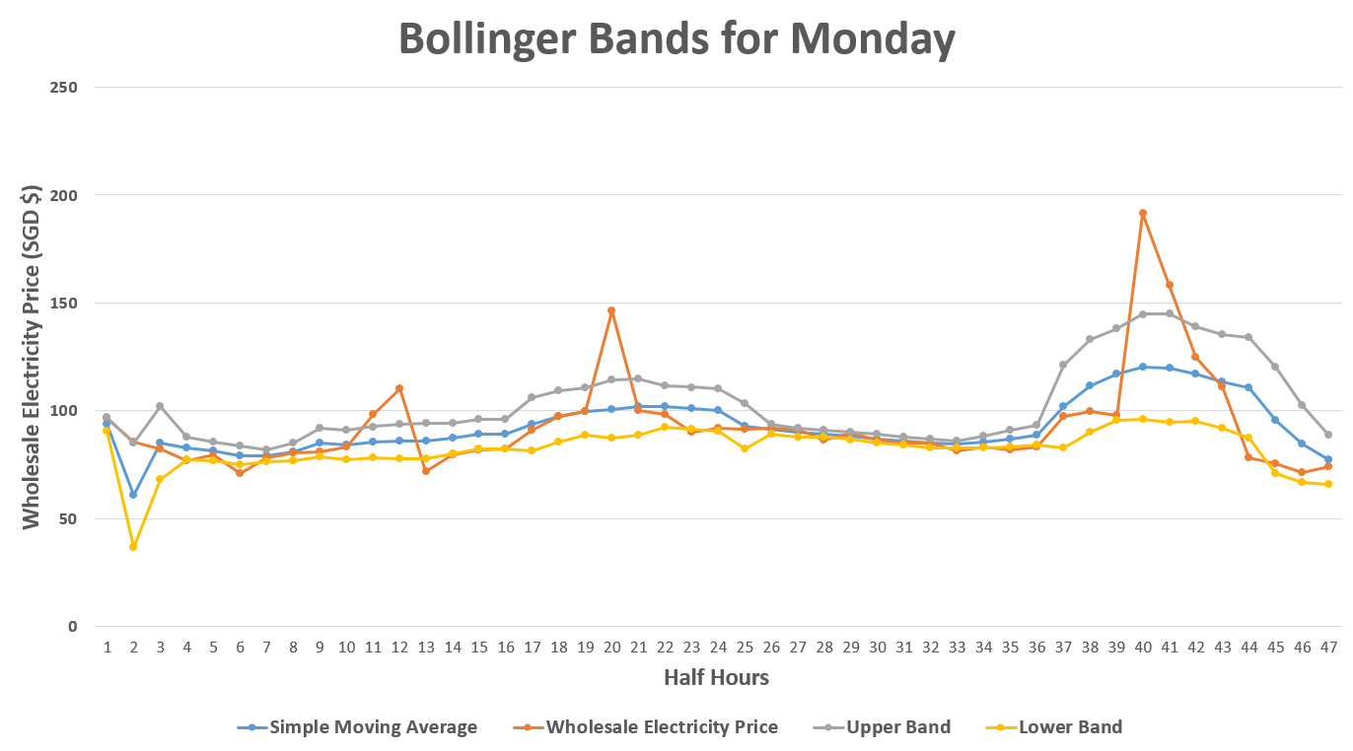
Algorithm One : Bollinger Bands

Slide 22
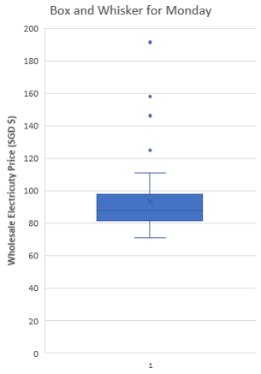
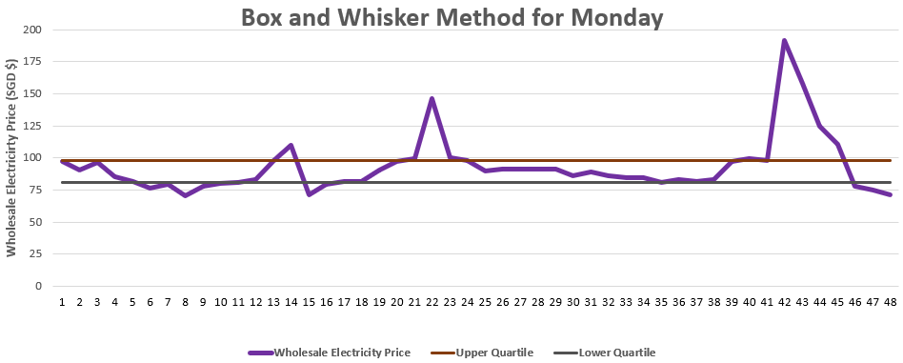
Algorithm two : Box and Whisker
Input Load Power Demand and Price
ESS Controller
ESS State of Charge Calculations
Print Results
Grid Energy Calculation

Slide 23
Algorithm three : Artificial Neural Network
Predicts likely mode of operation from five inputs
Neural Network has three layers
Trained using Reinforcement Learning
Works for data (electricity price and energy demand) it was not trained for too
Input Load Power Demand and Price
ESS Controller
ESS State of Charge Calculations
Print Results
Grid Energy Calculation

Slide 24
Results

Slide 25
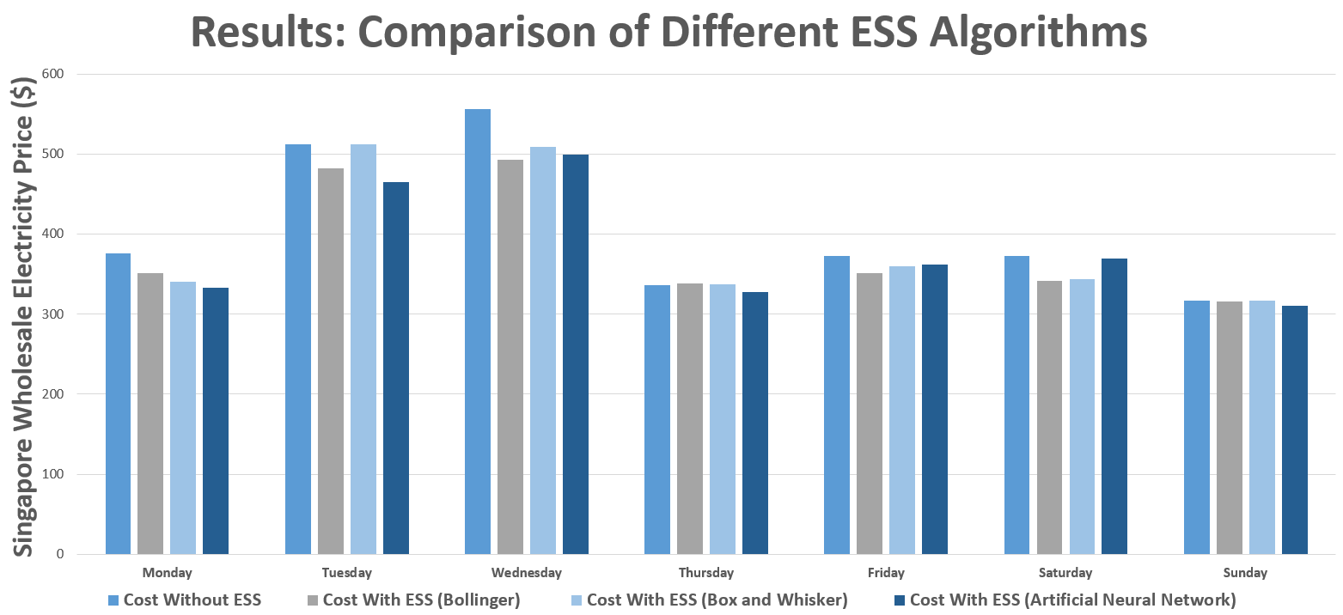
Comparison of Algorithms

Slide 26
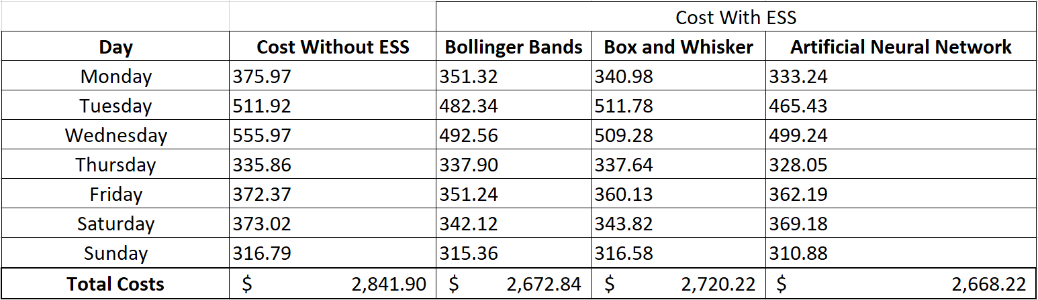
Comparison of Algorithms

Slide 27
Conclusions
Built a simulation environment with industry standard IEC-61499 Function Blocks
Research different algorithms for minimising the cost of electric vehicle charging.
Testing of algorithms proved the Artificial Neural Network to be best for real time.
Future work could involve our system being able to load Electricity price from online.
Future work to estimate the ‘break-even’ time after initial capital costs for installation.
Improve on each individual algorithm.

Slide 28
Acknowledgements
Dr Partha Roop
Dr Abhisek Ukil
Mr Hammond Pearce
Mr Kalpesh Chaudhari
Mr Keyan Monadjem

Slide 29
Appendix

Slide 30
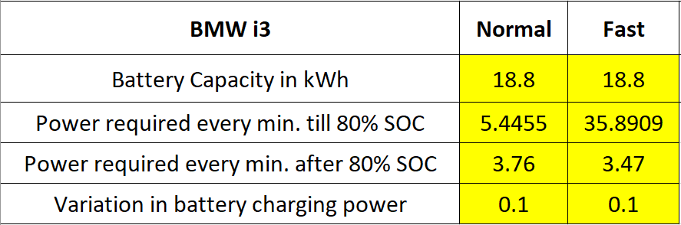
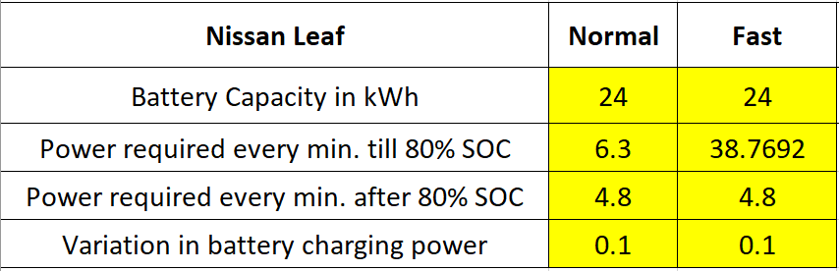
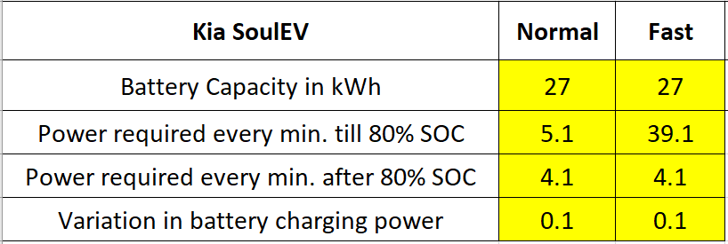
Modelling the Energy Demand
5 Fast Charging station
15 Normal Charging Station

Slide 31
Modelling the Energy Demand
$${SOC}_{i}\left(t\right)=\left(1−\frac{D_{k}}{D_{\max{k}}}\right)$$
$${SOC}_{f}\left(t\right)=80−100\%$$
$${SOC}_{b}\left(t\right)= {SOC}_{b}\left(t−1\right)+ \frac{P_{bc}(t)}{P1Cb ×60}−\frac{P_{bd}(t)}{P1Cb ×60}$$
D_{k}: Distance car has travelled (Random Normal Distribution)
D_{max}: Maximum distance the type of car can travel
SOC_{i} : Initial State of Charge of Car Battery
SOC_{f} : Initial State of Charge of Car Battery (Random Normal Distribution)
SOC_{b} : State of Charge of Energy Storage System at any minute
P_{bc} : Charging Power of the Energy Storage System
P_{bd} : Discharging Power of the Energy Storage System
P1Cb :Power Required by Energy Storage System to charge 100% in 1 hour (i.e. 1C rate)

Slide 32
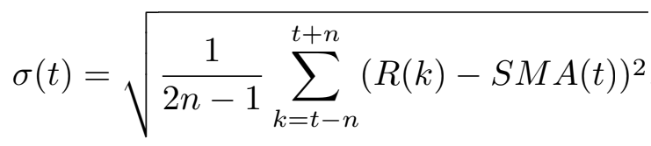
Bollinger Bands
Bollinger Bands approach based on related works
Uses Wholesale Electricity Price:
Simple Moving Average
Upper Band -> Based on Half of Standard Deviation
Lower Band -> Based on Half of Standard Deviation
R(k): Electricity Price
n : Number of steps used in Simple Moving Average
SMA : Simple Moving Average

Slide 33
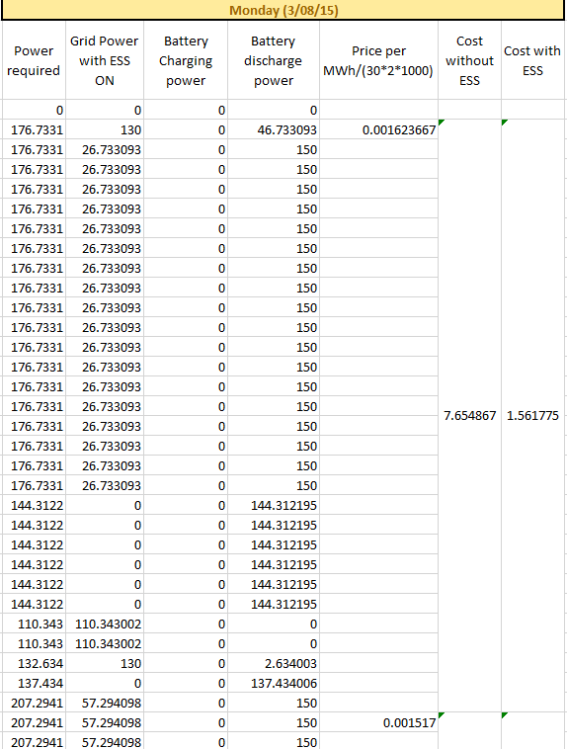
Calculating the Cost

Slide 34
Artificial Neural Network
Inputs:
Wholesale Electricity Price (Present minute and Future minute)
Energy Demanded by electric vehicles at charging station (Present minute and Previous minute
State of Charge of Energy Storage System (SoC)
Predicts likely mode of operation:
On-Peak, Off-Peak, Off-Peak Charging
Neural Network has three layers
Trained using Reinforcement Learning
Works for data (electricity price and energy demand) it was not trained for too

Slide 35
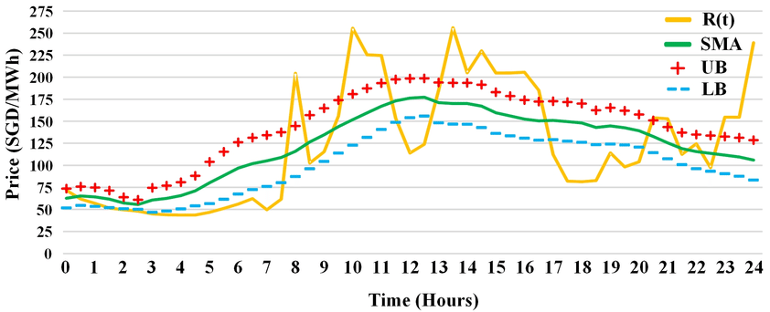
Disadvantage of Bollinger bands
https://www.researchgate.net/figure/Wholesale-Electricity-price-for-a-typical-day-and-price-band-allocation_fig2_308804006

Slide 36
Advantages of IEC-61499
Reusability
Component reuse
Portable
Ability of a system to run under different computing environments (moved from one system to another)
Interoperable:
Ability of two or more systems to cooperate at runtime.
Event-triggered:
In event-triggered control, all communication and processing activities, are initiated whenever a significant event other than the regular event of a clock tick occurs.

Slide 37
ESS Details
Capacity: 620 kWh
Discharge: 200 kWh
Charge: 150 kWh
Why was this chosen?
Battery capacity for four hours (150 kWh for 4 hours) .
150 kW chosen due to handle peaks (related work).

