Slide 1
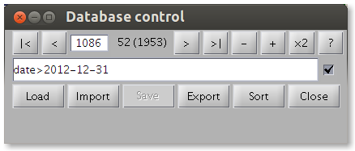
Current number
Number of records
First
Last
New
Help
Previous
Selection size
Next
Delete
Duplicate
Selection on/off
Selection criteria

