Slide 1
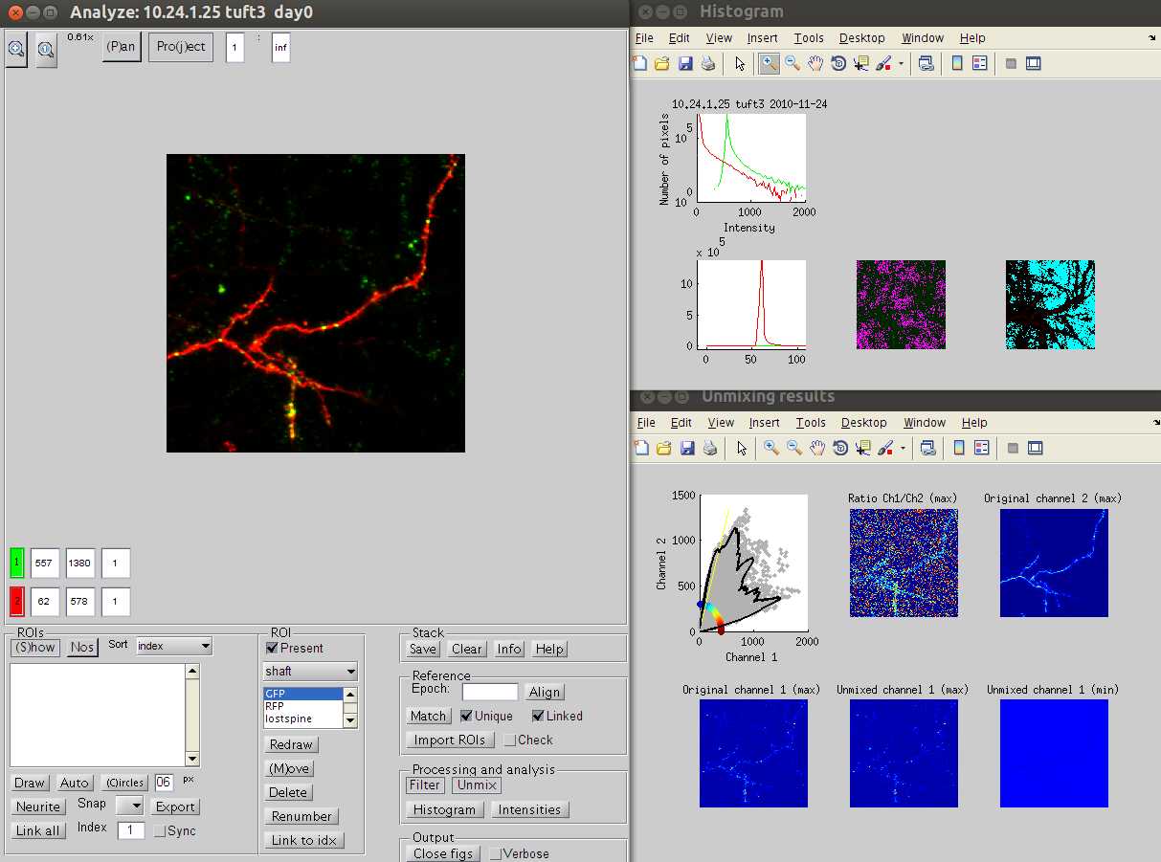
tp_unmixchannels
The goal of the procedure is to remove the fluorescence of the red fluorescent protein from the green channel. In our case, channel 1 is green, channel 2 is red.
The key idea is that the this red fluorescence is present in the green channel in a constant -but unknown- ratio. The pixels without any true green fluorescence would only have the 'leaky' red fraction. These pixels would have the maximum Channel 2/Channel 1 ratio and this ratio would be the fraction of Channel 2 that would always be present in Channel 1.
This simple idea does not work directly because of noise. Most of tp_unmixchannels reducing the effect of noise on this estimate.
First, it is important to not apply any median filtering on the raw stack before starting this procedure.
Line 62: saturated pixels are removed from the analysis by making the NaN (not a number)
Line 64: stack is blurred with a gaussian filter as a first step to reduce the impact of noise
Line 75: edges are removed, to stay away from filtering artefact introduced by blurring
Line 98: true black level is found by assuming it is the mode. For this it is important that the fluorescence is relatively sparse. This works well in a stack, not so well in a z-projected image, and not at all well in an z-averaged image. Also it is important that any possible dark-noise reduction or imaging offset is not too aggressive and that the mode is not 0. Check this in the image histogram. A mode of zero mostly like means that the real dark level was below zero, and can thus no longer be estimated.
Line 106: Modes are removed, and negative pixels are set to NaN and thus taken out of the analysis.
Line 144: Values with a very low channel 2 intensity will probably give a very noise estimate of the channel 2/channel 1 ratio. After removal after the very high valued outliers, only values more than 2 standard deviations above the mean of channel 2 intensity are considered.
Line 182: Of all the ratios, a sliding average in polar coordinates is taken, and the peak with the highest Ch2/Ch1 ratio is considered as the true fraction of Ch2 that is always present in Ch1.
The remainder of the function produces some plots to check the validity of the functions. Especially of interest, are the images of the maximum and minimum z-projection of channel 1 after removal. If too little is removed of the dendritic red signal, the dendrites are still very visible in the maximum projection. If too much is removed, the dendrites will become very visible in the minimum projection.
Green channel mode
Red channel mode zoomed in
First peak ratio Ch2/Ch1
Minimum projection to show no too much is removed

