Slide 1
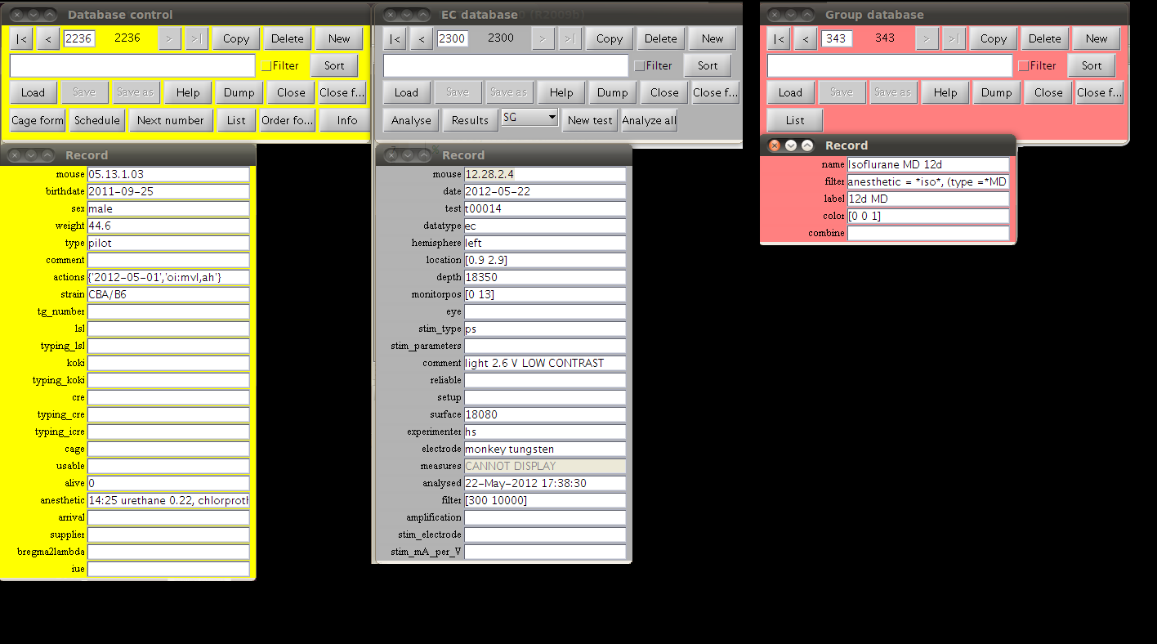
mouse = 05.13.1.03
birthdate = 2011-09-25
sex = male
weight = 44.6
type = control
tg_number = 10
Mouse=05.13.1.03
Date=2012-05-22
Test=t00014
Stim_type=ps
Amplification=10000
measures=[....]
Mouse=05.13.1.03
Date=2012-05-22
Test=t00015
Stim_type=ps
Amplification=10000
measures=[....]

Slide 2
Mouse = 05.13.1.03
Birthdate = 2011-09-25
Sex = male
Weight = 44.6
Type = control
Tg_number = 10
Mouse=05.13.1.03
Date=2012-05-22
Test=t00014
Stim_type=ps
Amplification=10000
measures=[....]
Mouse=05.13.1.03
Date=2012-05-22
Test=t00015
Stim_type=ps
Amplification=10000
measures=[....]
All Tests for Mouse = 05.13.1.03
All Tests for Mouse with Birthdate = 2011-09-25
All Tests for Date = 2012-05-22

Slide 3
Mouse = 05.13.1.03
Birthdate = 2011-09-25
Sex = male
Weight = 44.6
Mouse_type = control
Tg_number = 10
Created = 2012-06-04,21:03
Mouse=05.13.1.03
Date=2012-05-22
Test=t00014
Stim_type=ps
Amplification=10000
Measures=[....]
Created = 2012-06-04,19:04
Mouse=05.13.1.03
Date=2012-05-22
Test=t00015
Stim_type=ps
Amplification=10000
Measures=[....]
Created = 2012-06-04,19:07
Group=MD_Male
Filter = (Mouse with Mouse_type = MD and Sex = male)
Label = 12d Male MD
Combine = Isoflurane
Color = [1 0 0]
Created = 2012-06-04,20:01
Tests for Mouse = 05.13.1.03
Tests for Mouse with Birthdate = 2011-09-25
Tests for Birthdate = 2011-09-25 % coupling via unique key field of Birthdate record
Tests for Date = 2012-05-22
Tests for Mouse with Mouse_type = MD and Sex = male
Tests for (Filter for Group = MD_Male)
Tests for Filter for Group = MD_Male % equivalent to line above
Sort Tests for Mouse = 05.13.1.03 by
First Test for Date = 2012-05-22 % by Created field

