Slide 1
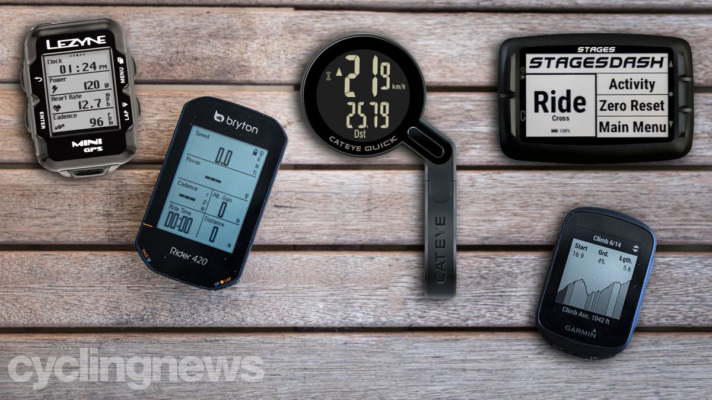
Grand-Tours-Analysis Data Scraping Process
Work by Deniz!
tdf_results
ProCyclingStats
giro_results
website that keeps cycling stats
vuelta_results
For a given athlete, use the date of a tour day from the results tables to find
The segment information (distance, segment names)
The corresponding(?) stats of the athlete (distance, time, elevation)
Both of these tables are indexed by a unique activity_id and athlete_id pair
Using the name of an athlete competing in the tours, search those with Pro tag along with their unique Strava athlete_id
Selenium + Beautiful soup
segments_data
Strava
strava_names
+
TDF & Giro only so far
582 riders
stats_data
sports social media site/app
Select only race-days and distances within 20% of official values to remove extra data.
strava_table

Slide 2
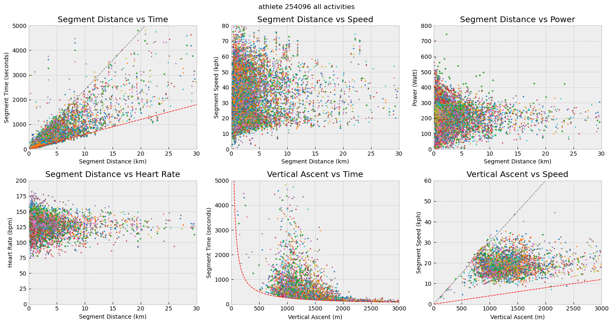
Plot of segments column from training.db for a particular athlete_id
Example of someone who uploads a lot

Slide 3
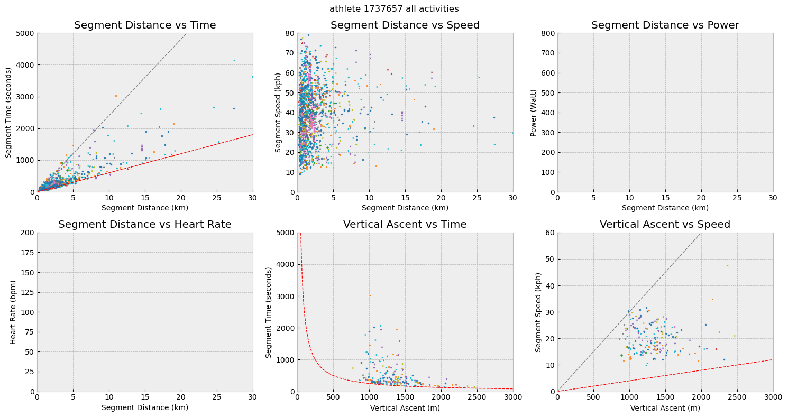

Slide 4
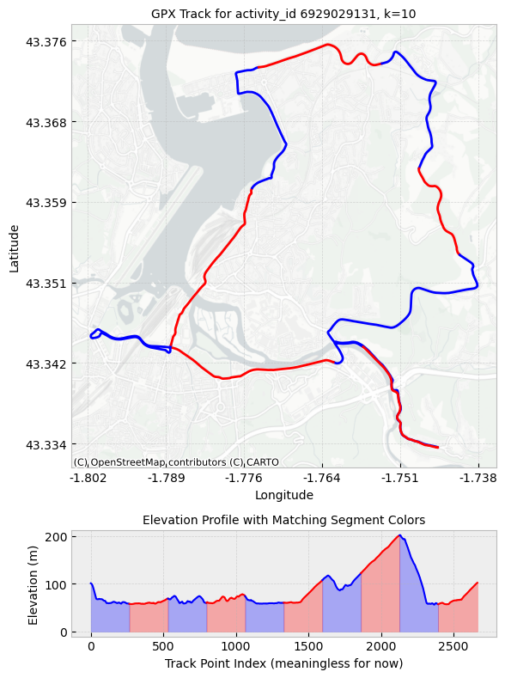
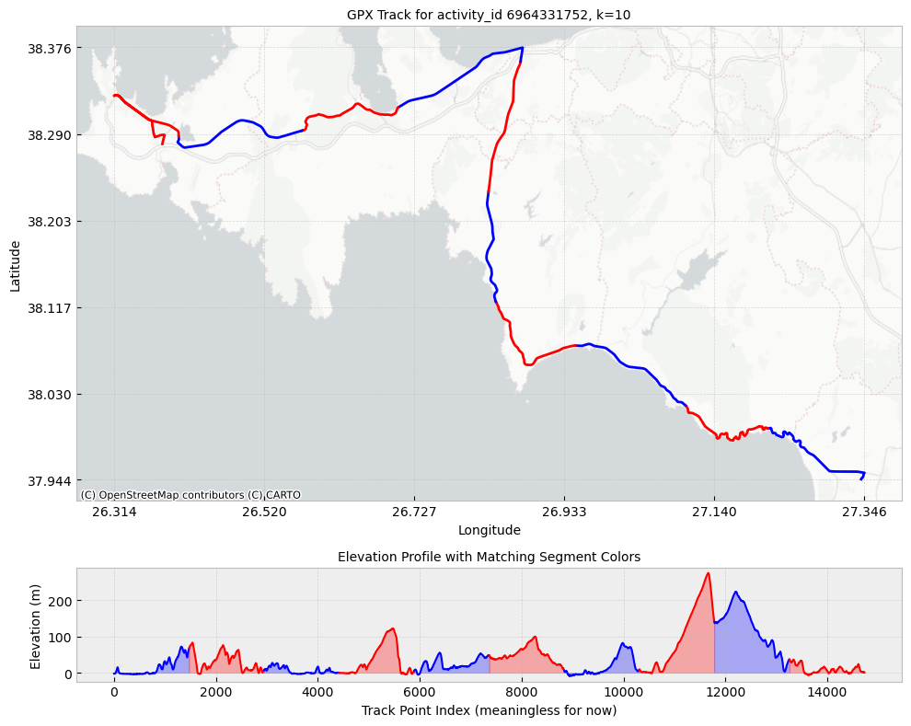
For a given activity_id we can download the gpx data and plot the track using geopandas

