Slide 1


Wandering Eye: Prowling the web for wildlife IDs San Diego Zoo Hackathon September 22-24, 2017 Team Okapi: Mike Gahan, Katie Heineman, Tricia Leskiw & Vachan Vadmal

Slide 2
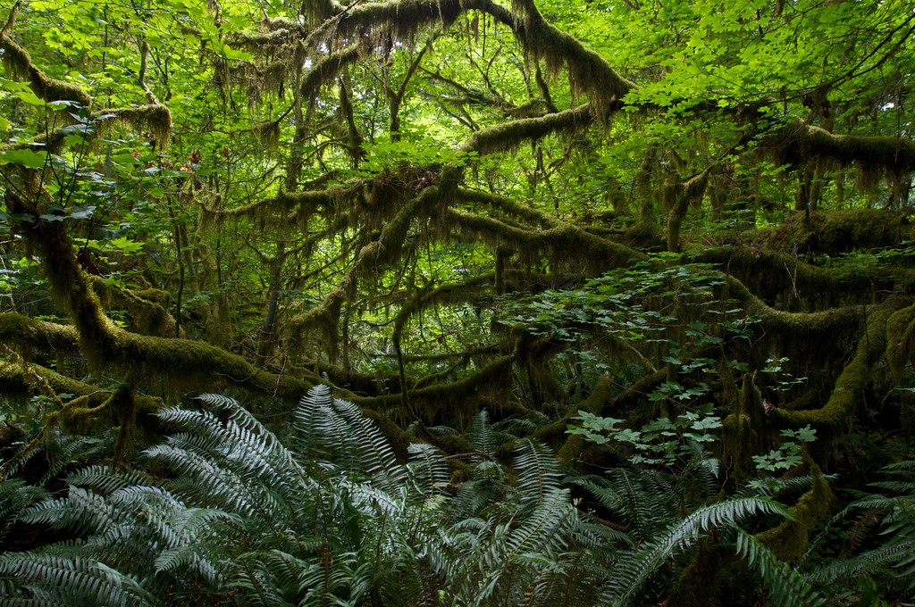
Welcome to “Wandering Eye” Universal Image Recognition Service Layer
This service layer is a web service designed to allow the conservation community to accurately and quickly document species by evaluating which service (or combination of services) best fits the need of the conservation application.
“Wandering Eye” allows conservationists to easily plug in a range of various image recognition services, in order to quickly optimize results and image recognition training.

Slide 3
Problem
Species image recognition (think photos from camera traps) is crucial to estimating rare animal populations
Numerous computer vision products exist, but no one solution is optimized for all problems
The Spatial Monitoring and Reporting Tool (SMART) Partnership and requires a tool for accessing multiple web services image recognition for data monitoring, law enforcement and knowledge acquisition
“Accurate and timely species identification is essential to recording ecological data and understanding species abundance and distribution.”*
*From the 2017 San Diego Hackathon problem statement #3 description

Slide 4
Solution
Introducing Wandering Eye
FUNCTION: universal image recognition service layer (a web service)
AUDIENCE: designed for the conservation community
GOAL: to accurately and quickly document species by evaluating which service (or combination of services) best fits the need of the conservation application.
“Wandering Eye” allows conservationists to easily plug in a range of various image recognition services, in order to quickly optimize results and image recognition training.
Notes:
http://zoohackathon.com/problemstatements/sandiego

Slide 5
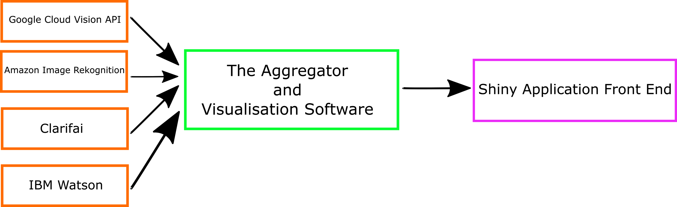
Diagram of Solution Process
In a nutshell, this universal image recognition service layer:
brings together multiple image recognition services
understands what each services does
aggregates & compare the results of each service to provided automated species identifications

Slide 6
Our Problem-solving approach
Team “Okapi” used provided Sample photos and:
Ran through Amazon Rekognition and Google Cloud Vision APIs and exported image recognition results into .csv files
Created Shiny web application using R language for basic photo upload site
Manually classified each photo into a master “training data set” which included species name, day or night photo, color or B&W, number of animals, etc.
Ran through ClarifAI and IBM Watson APIs and exported image recognition results into .csv file
Enhanced Shiny with text mining similarity tool Cosine to, created Wix website and presentation slides and started on Devpost submission!

Slide 7
Web app development strategy
https://katieheineman-shiny-apps.shinyapps.io/WanderingEye/

Slide 8
Demo Recap
RESOURCES NEEDED for the implementation of the product:
API keys, money to cover server hours used, photos, and Internet connection, hosting (if standalone app planned)
WAYS in which it can be implemented: conservationists, rangers, citizen scientists can upload photos or batch of photos; best to have existing conservation application technically interface to the Wandering Eye “pipeline”
IMPACT: allows rapid identification of species; allows for efficient species identification used for data monitoring and population tracking, poaching and animal related law enforcement, and knowledge acquisition
WEBSITE: visual front used to also access Wandering Eye:
https://tleskiw.wixsite.com/sdhackathon2017

Slide 9
Observations
Wandering Eye
Composite score is correct 65% of the time
For common name, Wandering Eye identifies animal correctly 33% of the time
More likely to identify animal correctly if entire animal (not just partial animal) was shown in photo
Amazon Rekognition
Best at getting species-specific common name
ClarifAI
Best at generating family-specific common name

Slide 10
Future Opportunities
Enhance Wandering Eye by:
Adding more APIs like iNaturalist, Microsoft Computer Vision, Extract Compare, Wild-ID and Camelot
Creating a larger animal-related dictionary of terms to help better exclude irrelevant output words
Conduct user interface research to learn which end user features are most valued
Data Visualization features
Notes:
http://zoohackathon.com/problemstatements/sandiego

Slide 11
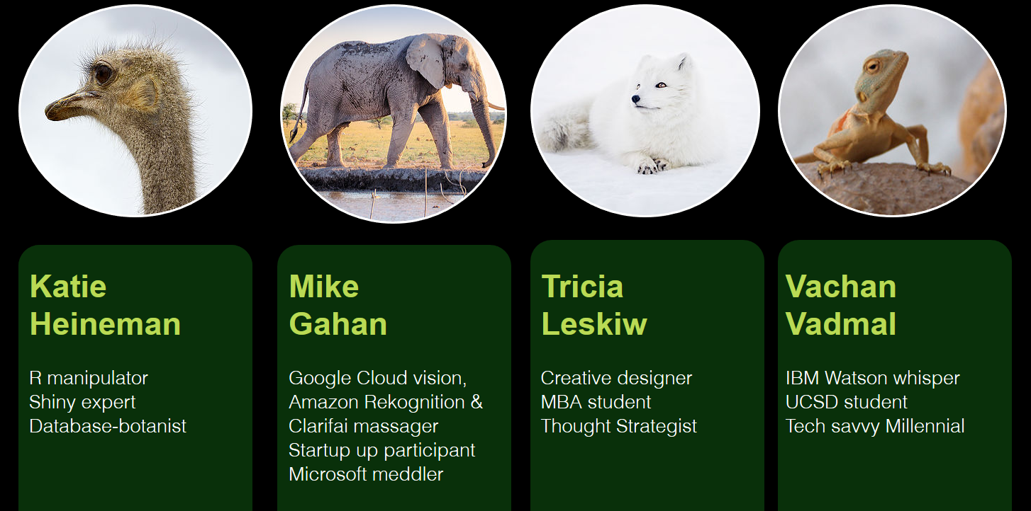
Team “Okapi” & Roles

Slide 12
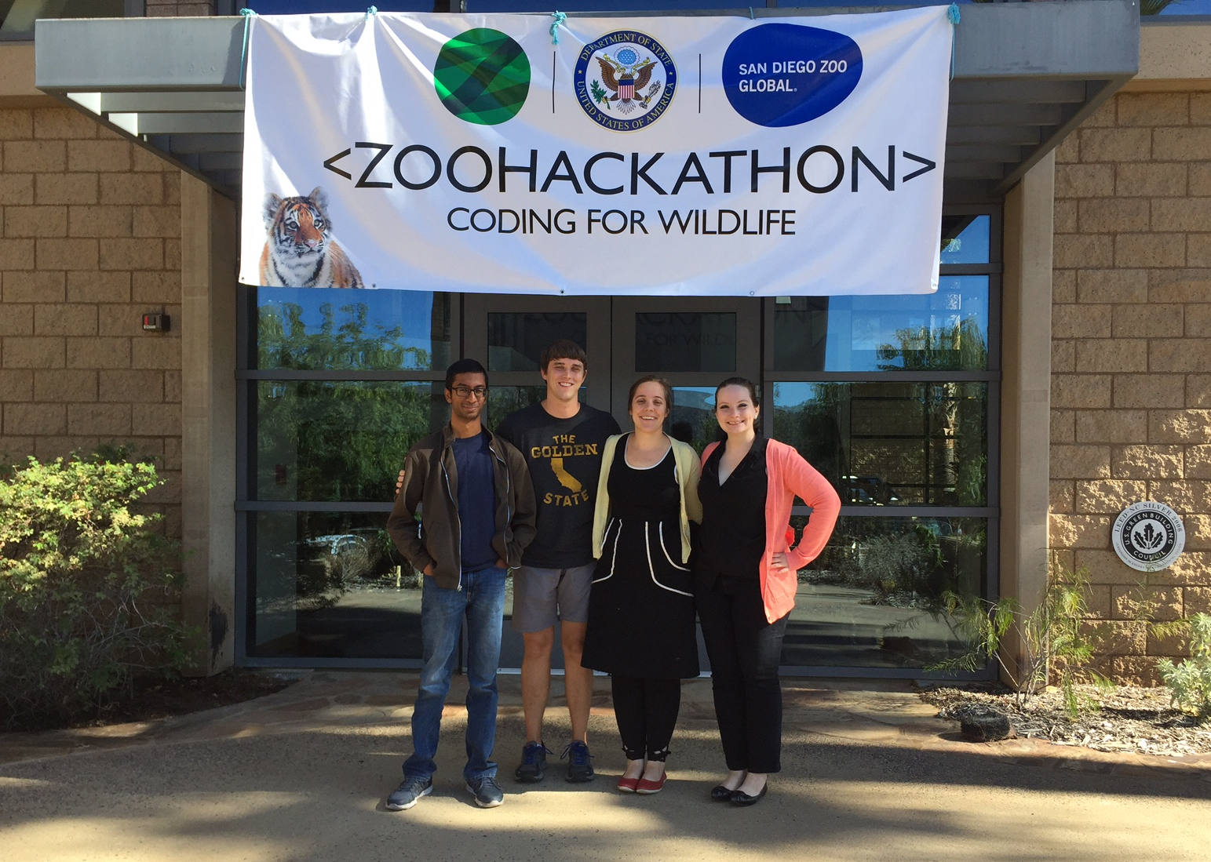
Q+A
Thank You!

