Slide 1
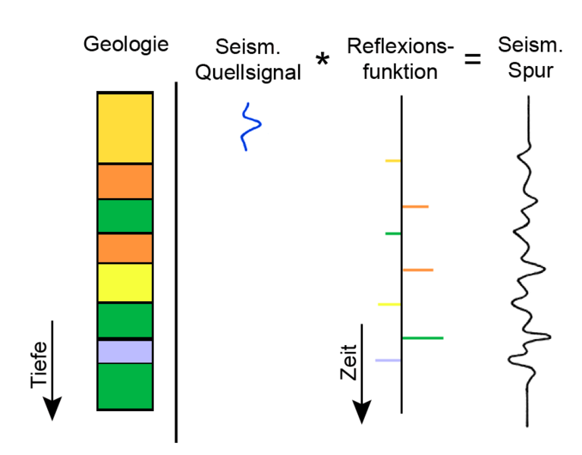
Linear Systems
Linear systems: basic concepts
Other transforms
  Laplace transform
  z-transform
Applications:
  Instrument response - correction
  Convolutional model for seismograms
  Stochastic ground motion
Scope: Understand that many problems in geophysics can be reduced to a linear system (filtering, tomography, inverse problems).
Computational Geophysics and Data Analysis

Slide 2
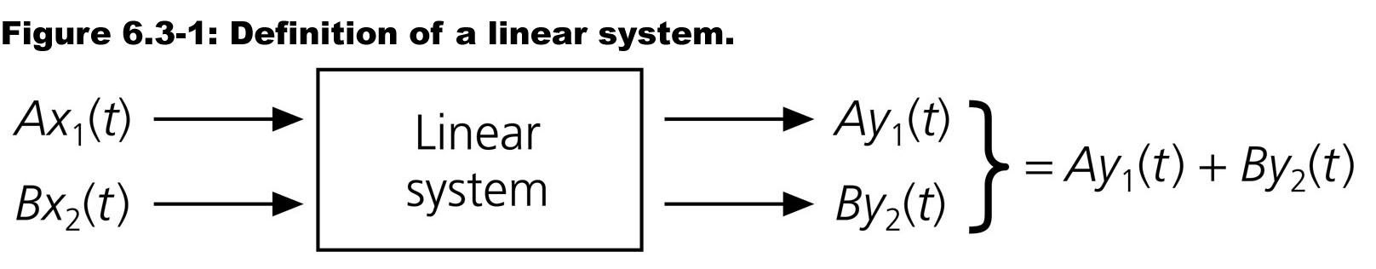
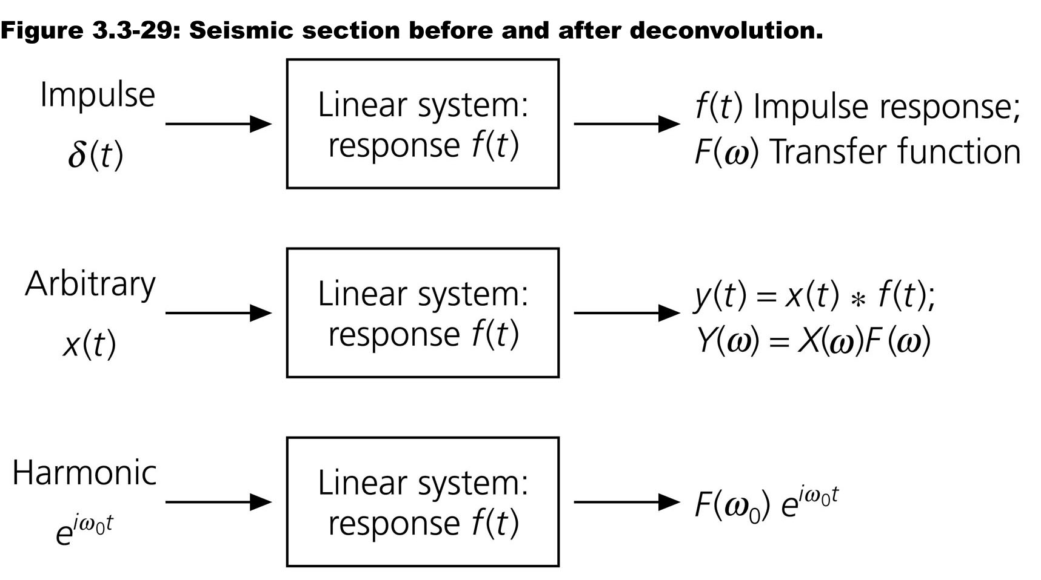
Linear Systems
Computational Geophysics and Data Analysis

Slide 3
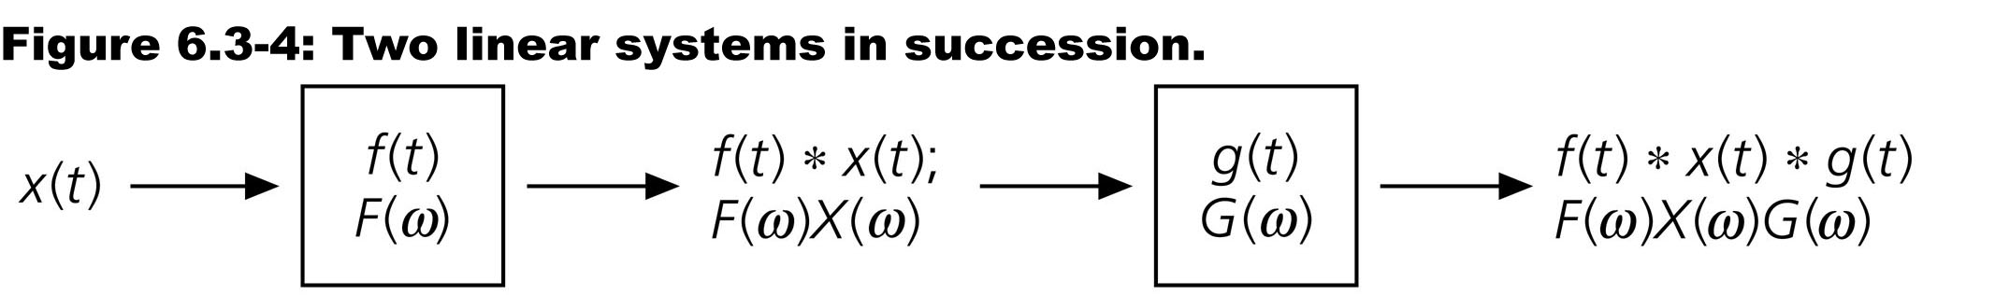
Convolution theorem
The output of a linear system is the convolution of the input and the impulse response (Green‘s function)
Computational Geophysics and Data Analysis

Slide 4
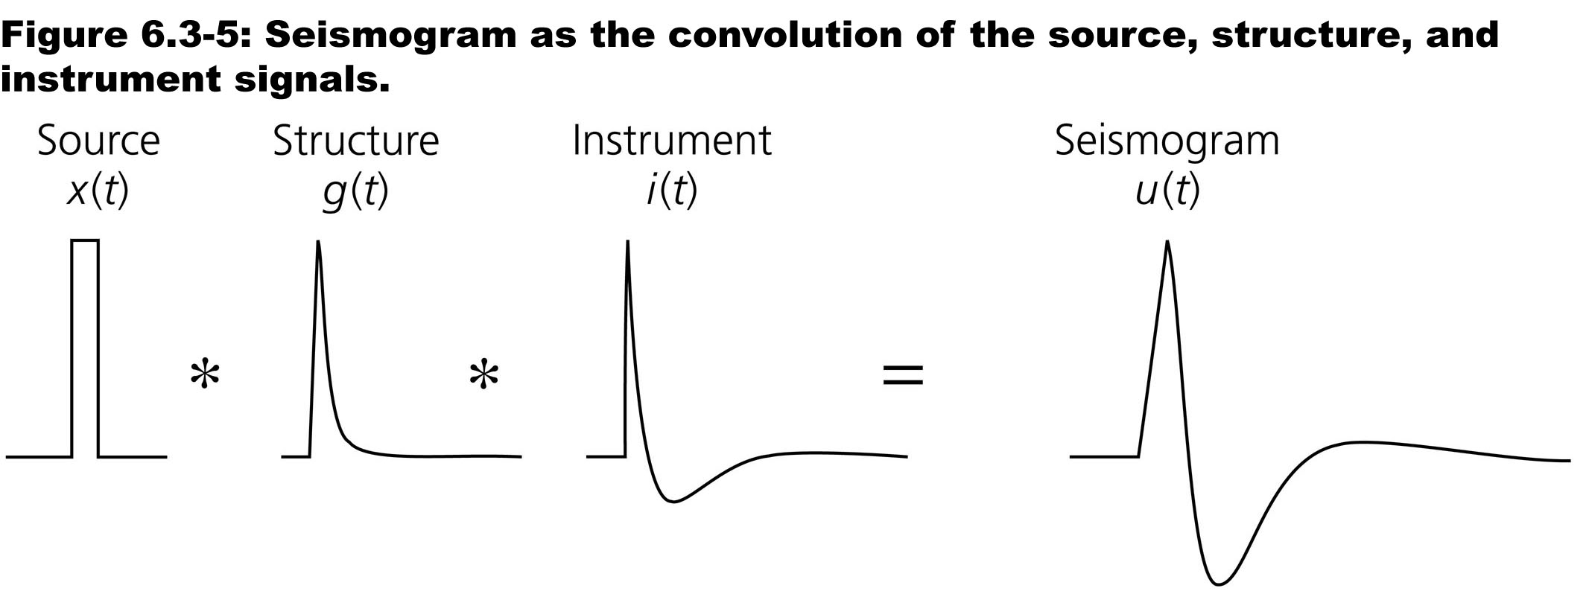
Example: Seismograms
-> stochastic ground motion
Computational Geophysics and Data Analysis

Slide 5
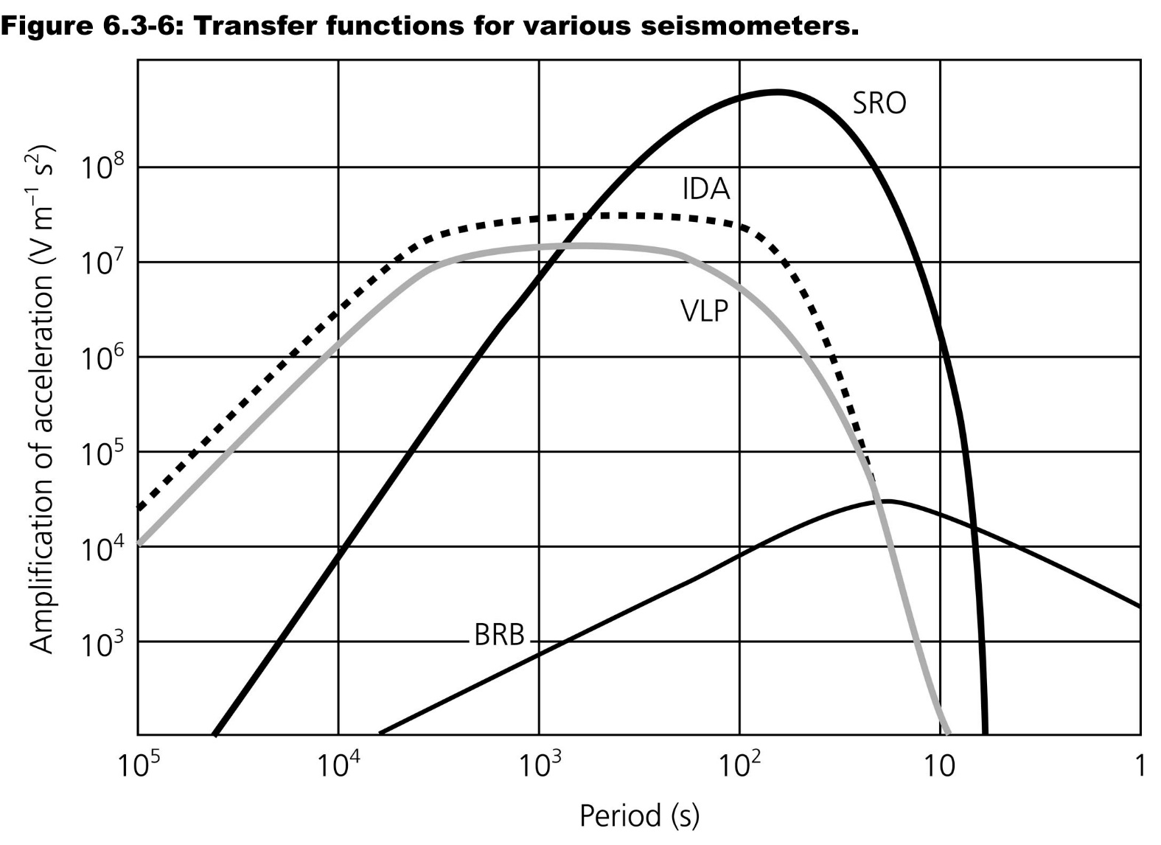
Example: Seismometer
Computational Geophysics and Data Analysis

Slide 6
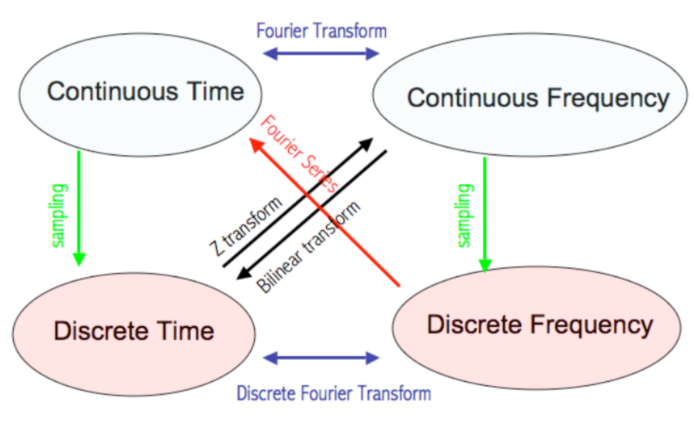
Various spaces and transforms
Computational Geophysics and Data Analysis

Slide 7
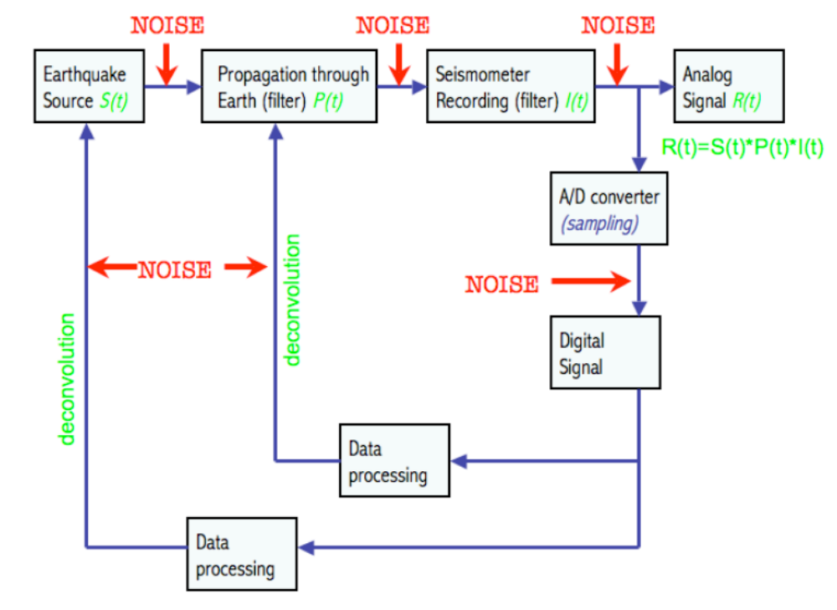
Earth system as filter
Computational Geophysics and Data Analysis

Slide 8
Other transforms
Computational Geophysics and Data Analysis

Slide 9
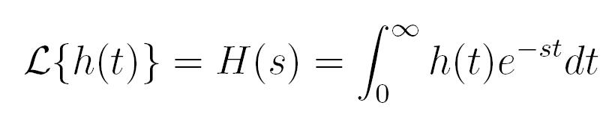
Laplace transform
Goal: we are seeking an opportunity to formally analyze linear dynamic (time-dependent) systems. Key advantage: differentiation and integration become multiplication and division (compare with log operation changing multiplication to addition).
Computational Geophysics and Data Analysis

Slide 10
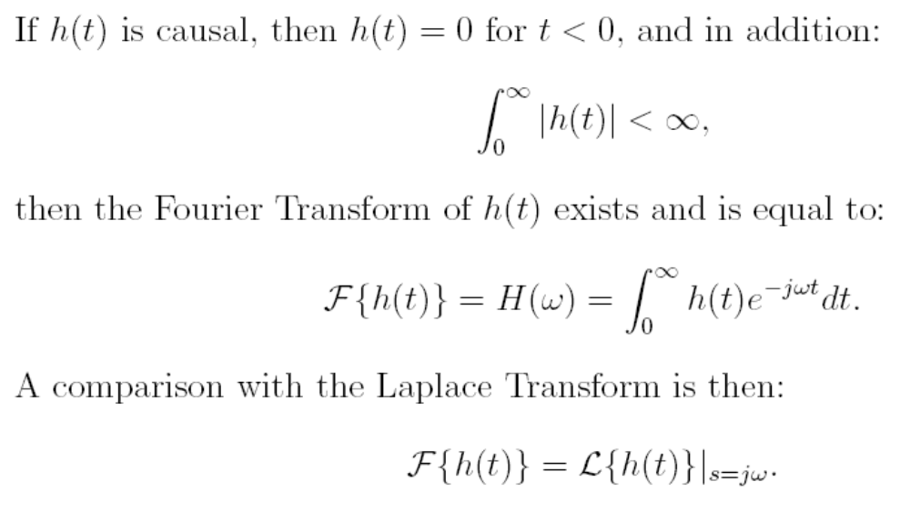
Fourier vs. Laplace
Computational Geophysics and Data Analysis

Slide 11
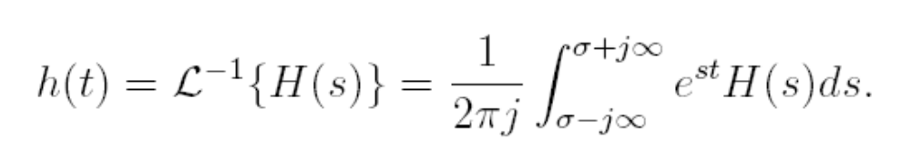
Inverse transform
The Laplace transform can be interpreted as a generalization of the Fourier transform from the real line (frequency axis) to the entire complex plane. The inverse transform is the Brimwich integral
Computational Geophysics and Data Analysis

Slide 12
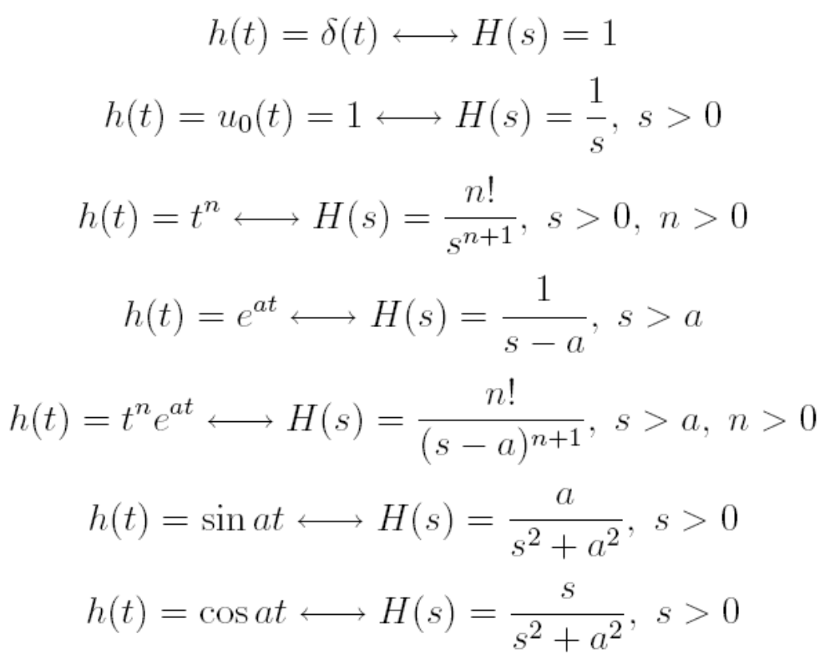
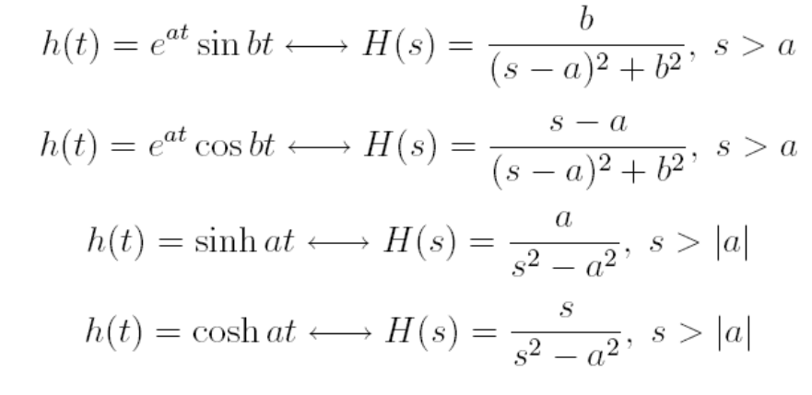
Some transforms
Computational Geophysics and Data Analysis

Slide 13
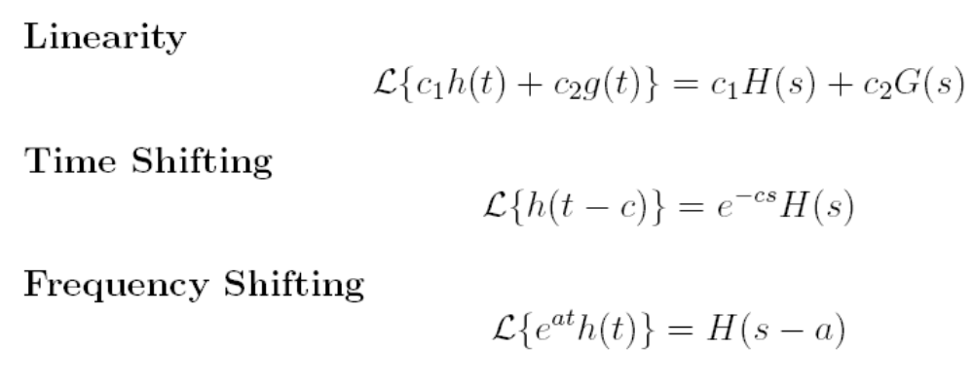
… and characteristics
Computational Geophysics and Data Analysis

Slide 14
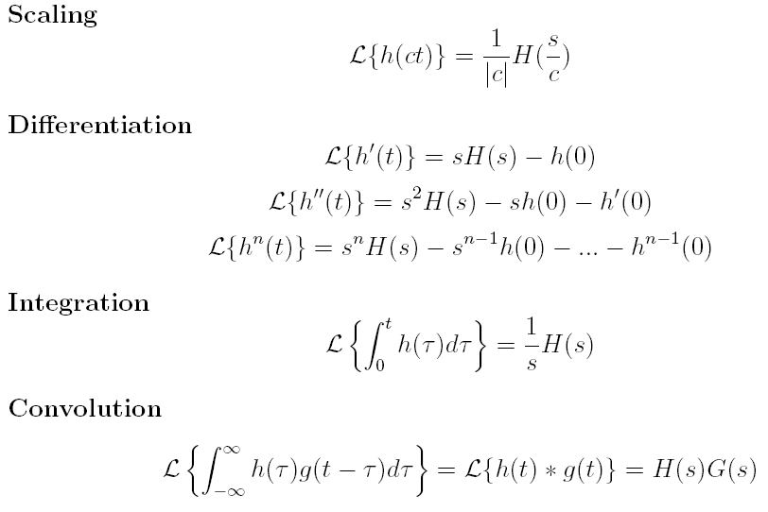
… cont‘d
Computational Geophysics and Data Analysis

Slide 15
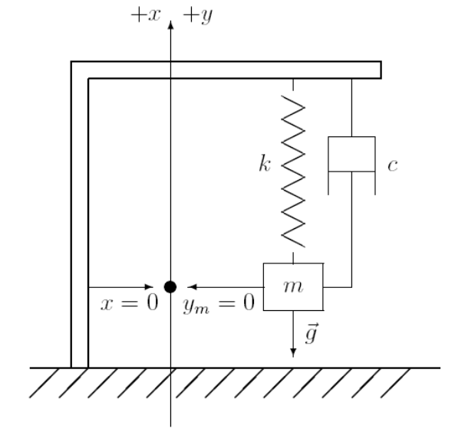
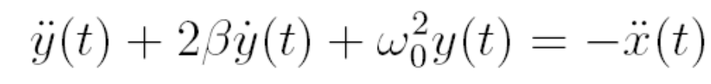
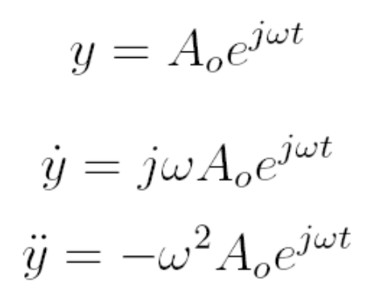
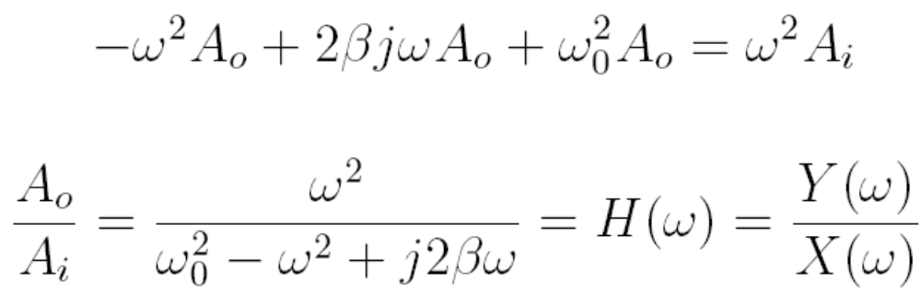
Application to seismometer
Remember the seismometer equation
Computational Geophysics and Data Analysis

Slide 16
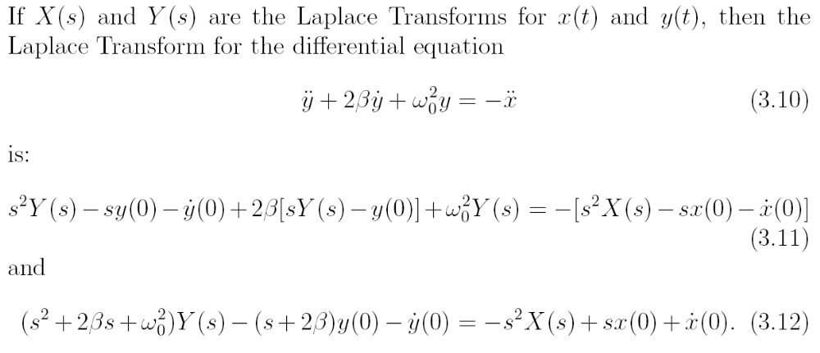
… using Laplace
Computational Geophysics and Data Analysis

Slide 17
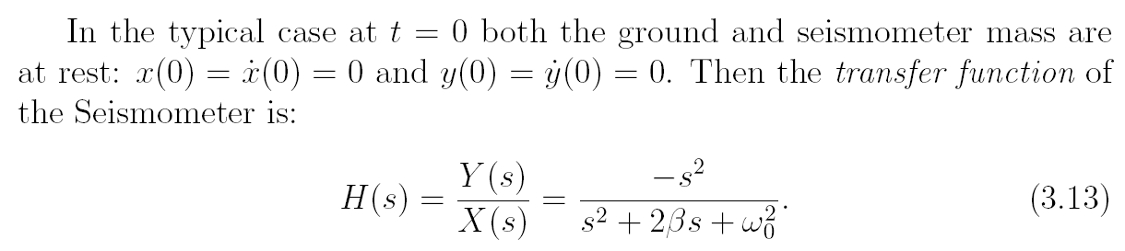
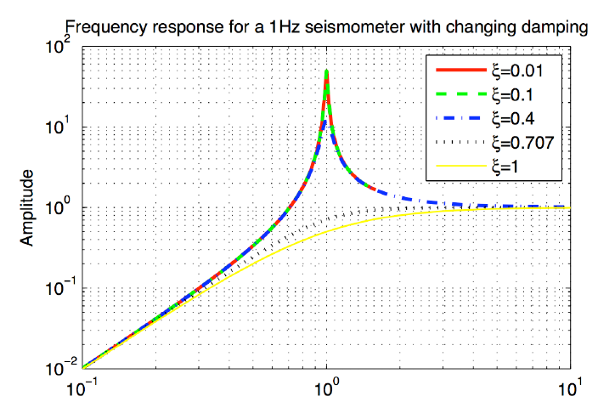
Transfer function
Computational Geophysics and Data Analysis

Slide 18
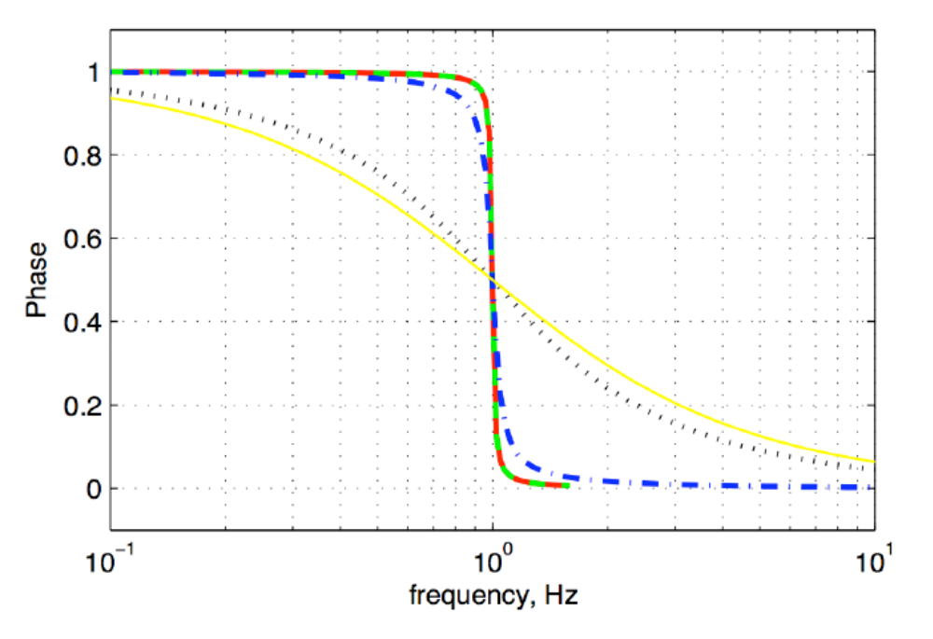
… phase response …
Computational Geophysics and Data Analysis

Slide 19
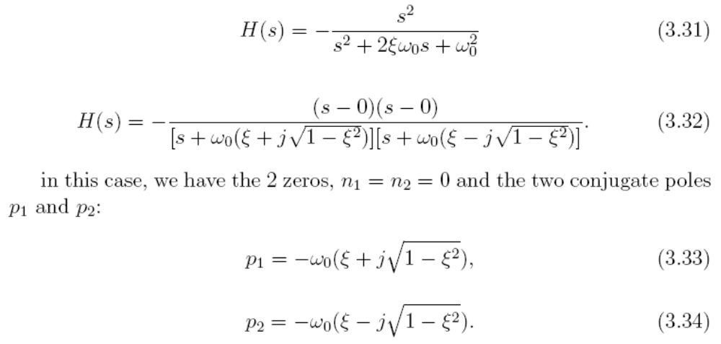
Poles and zeroes
If a transfer function can be represented as ratio of two polynomials, then we can alternatively describe the transfer function in terms of its poles and zeros. The zeros are simply the zeros of the numerator polynomial, and the poles correspond to the zeros of the denominator polynomial
Computational Geophysics and Data Analysis

Slide 20
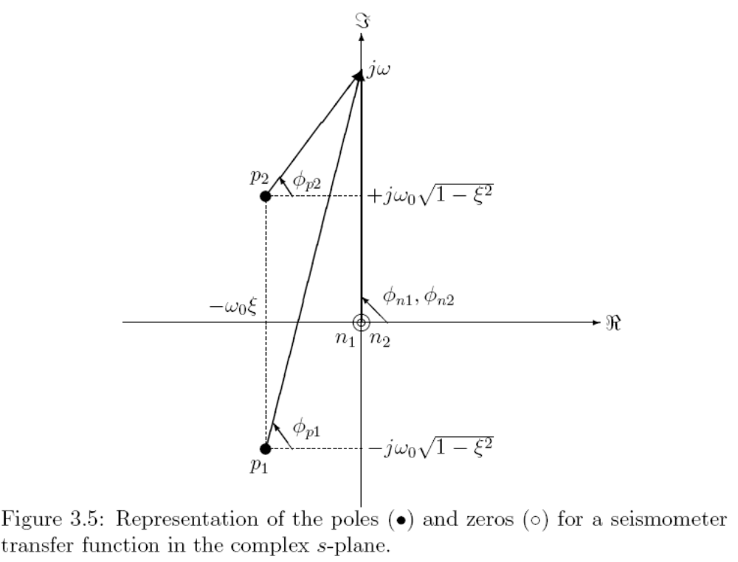
… graphically …
Computational Geophysics and Data Analysis

Slide 21
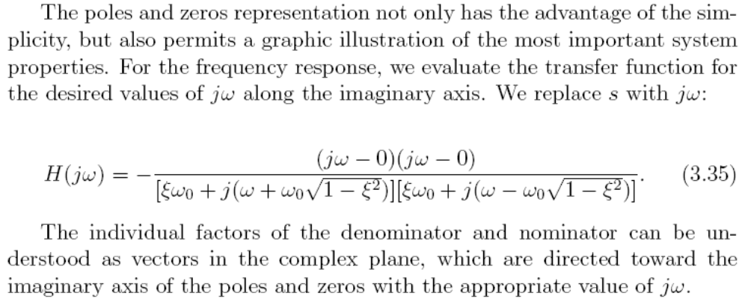
Frequency response
Computational Geophysics and Data Analysis

Slide 22
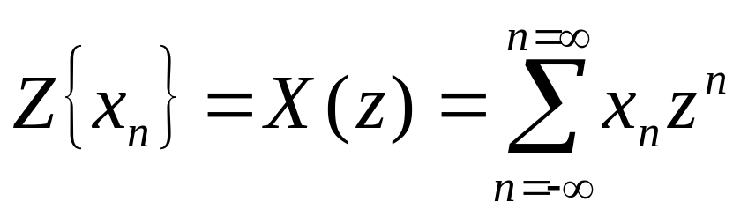
The z-transform
The z-transform is yet another way of transforming a disretized signal into an analytical (differentiable) form, furthermore
      Some mathematical procedures can be more easily carried out on discrete signals
      Digital filters can be easily designed and classified
      The z-transform is to discrete signals what the Laplace transform is to continuous time domain signals
  Definition:
In mathematical terms this is a Laurent serie around z=0, z is a complex number.
(this part follows Gubbins, p. 17+)
Computational Geophysics and Data Analysis

Slide 23
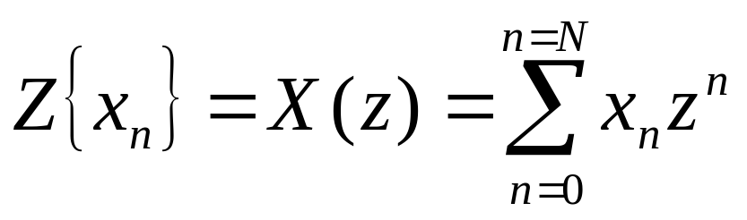
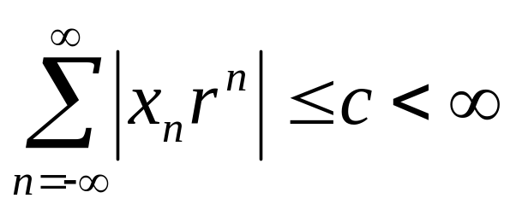
The z-transform
for finite n we get
Z-transformed signals do not necessarily converge for all z. One can identify a region in which the function is regular. Convergence is obtained with r=|z| for
Computational Geophysics and Data Analysis

Slide 24
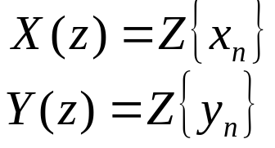
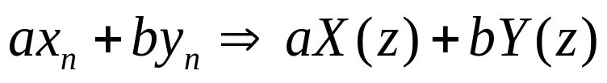
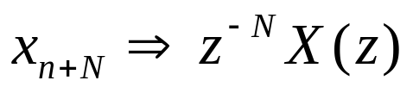
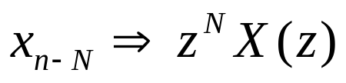
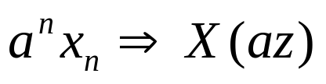
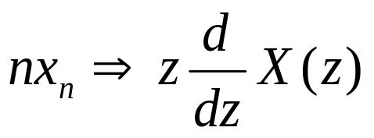
The z-transform: theorems
let us assume we have two transformed time series
Linearity:
Advance:
Delay:
Multiplication:
Multiplication n:
Computational Geophysics and Data Analysis

Slide 25
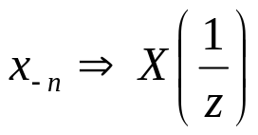
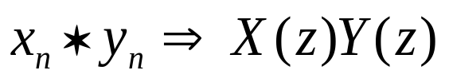
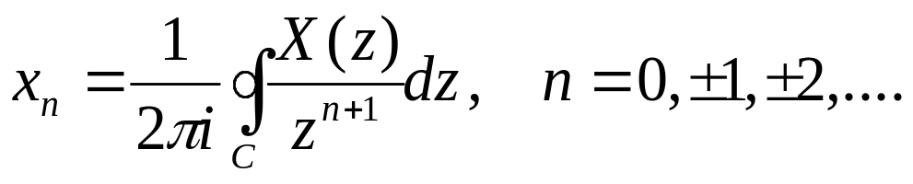
The z-transform: theorems
… continued
Time reversal:
Convolution:
… haven‘t we seen this before? What about the inversion, i.e., we know X(z) and we want to get x_{n}
Inversion
Computational Geophysics and Data Analysis

Slide 26

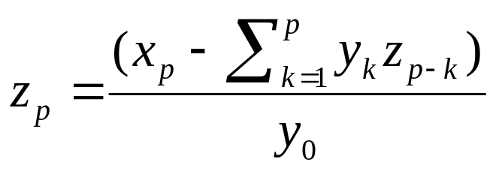
The z-transform: deconvolution
Convolution:
If multiplication is a convolution, division by a z-transform is the deconvolution:
Under what conditions does devonvolution work? (Gubbins, p. 19)
-> the deconvolution problem can be solved recursively
… provided that y₀ is not 0!
Computational Geophysics and Data Analysis

Slide 27
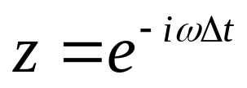
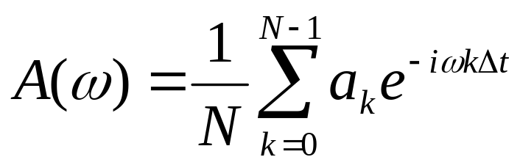
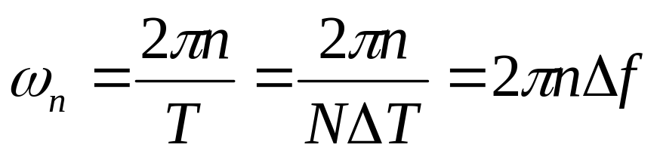
From the z-transform to the discrete Fourier transform
Let us make a particular choice for the complex variable z
We thus can define a particular z transform as
this simply is a complex Fourier serie. Let us define (Δf being the sampling frequency)
Computational Geophysics and Data Analysis

Slide 28
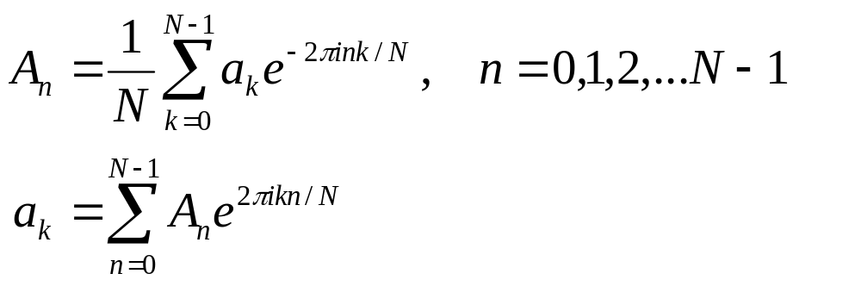
From the z-transform to the discrete Fourier transform
This leads us to:
… which is nothing but the discrete Fourier transform. Thus the FT can be considered a special case of the more general z-transform!
Where do these points lie on the z-plane?
Computational Geophysics and Data Analysis

Slide 29
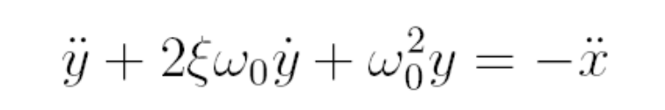
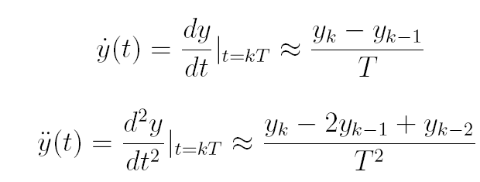
Discrete representation of a seismometer
… using the z-transform on the seismometer equation
… why are we suddenly using difference equations?
Computational Geophysics and Data Analysis

Slide 30
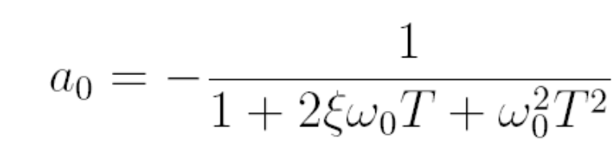
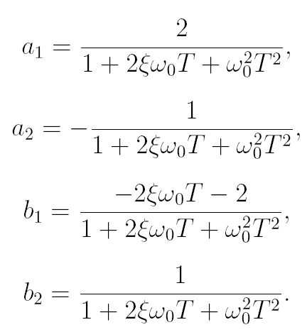
… to obtain …
Computational Geophysics and Data Analysis

Slide 31
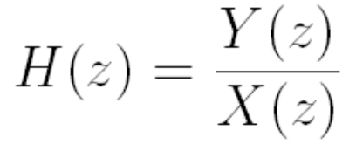
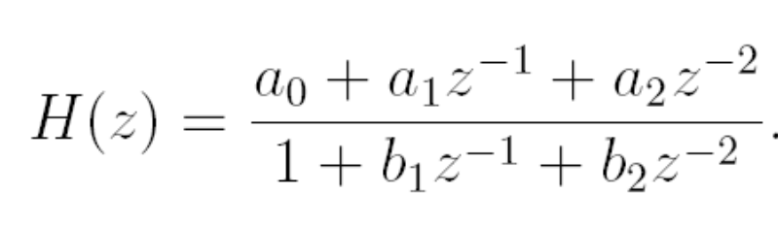
… and the transfer function
… is that a unique representation … ?
Computational Geophysics and Data Analysis

Slide 32
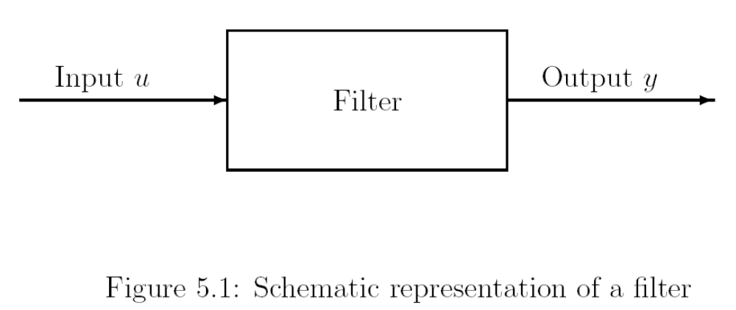
Filters revisited … using transforms …
Computational Geophysics and Data Analysis

Slide 33


RC Filter as a simple analogue
Computational Geophysics and Data Analysis

Slide 34


Applying the Laplace transform
Computational Geophysics and Data Analysis

Slide 35


Impulse response
… is the inverse transform of the transfer function
Computational Geophysics and Data Analysis

Slide 36

… time domain …
Computational Geophysics and Data Analysis

Slide 37





… what about the discrete system?
Time domain
Z-domain
Computational Geophysics and Data Analysis

Slide 38
Further classifications and terms
MA moving average
FIR finite-duration impulse response filters
-> MA = FIR
Non-recursive filters - Recursive filters
AR autoregressive filters
IIR infininite duration response filters
Computational Geophysics and Data Analysis

Slide 39


Deconvolution – Inverse filters
Deconvolution is the reverse of convolution, the most important applications in seismic data processing is removing or altering the instrument response of a seismometer. Suppose we want to deconvolve sequence a out of sequence c to obtain sequence b, in the frequency domain:
Major problems when A(ω) is zero or even close to zero in the presence of noise!
One possible fix is the waterlevel method, basically adding white noise,
Computational Geophysics and Data Analysis

Slide 40

Using z-tranforms
Computational Geophysics and Data Analysis

Slide 41



Deconvolution using the z-transform
One way is the construction of an inverse filter through division by the z-transform (or multiplication by 1/A(z)). We can then extract the corresponding time-representation and perform the deconvolution by convolution …
First we factorize A(z)
And expand the inverse by the method of partial fractions
Each term is expanded as a power series
Computational Geophysics and Data Analysis

Slide 42

Deconvolution using the z-transform
Some practical aspects:
Instrument response is corrected for using the poles and zeros of the inverse filters
Using z=exp(iωΔt) leads to causal minimum phase filters.
Computational Geophysics and Data Analysis

Slide 43

A-D conversion
Computational Geophysics and Data Analysis

Slide 44

Response functions to correct …
Computational Geophysics and Data Analysis

Slide 45

FIR filters
More on instrument response correction in the practicals
Computational Geophysics and Data Analysis

Slide 46
Other linear systems
Computational Geophysics and Data Analysis

Slide 47

Convolutional model: seismograms
Computational Geophysics and Data Analysis

Slide 48


The seismic impulse response
Computational Geophysics and Data Analysis

Slide 49

The filtered response
Computational Geophysics and Data Analysis

Slide 50

1D convolutional model of a seismic trace
The seismogram of a layered medium can also be calculated using a convolutional model ...
u(t) = s(t) * r(t) + n(t)
u(t) seismogram
s(t) source wavelet
r(t) reflectivity
Computational Geophysics and Data Analysis

Slide 51
Deconvolution
Deconvolution is the inverse operation to convolution.
When is deconvolution useful?
Computational Geophysics and Data Analysis

Slide 52


Stochastic ground motion modelling
Y strong ground motion
E source
P path
G site
I instrument or type of motion
f frequency
M₀ seismic moment
From Boore (2003)
Computational Geophysics and Data Analysis

Slide 53


Examples
Computational Geophysics and Data Analysis

Slide 54
Summary
Many problems in geophysics can be described as a linear system
The Laplace transform helps to describe and understand continuous systems (pde‘s)
The z-transform helps us to describe and understand the discrete equivalent systems
Deconvolution is tricky and usually done by convolving with an appropriate „inverse filter“ (e.g., instrument response correction“)
Computational Geophysics and Data Analysis

