Slide 1
Filtering Geophysical Data: Be careful!
Filtering: basic concepts
Seismogram examples, high-low-bandpass filters
The crux with causality
Scope: Understand the effects of filtering on time series (seismograms).
Computational Geophysics and Data Analysis

Slide 2
Why filtering
Get rid of unwanted frequencies
Highlight signals of certain frequencies
Identify harmonic signals in the data
Correcting for phase or amplitude characteristics of instruments
Prepare for down-sampling
Avoid aliasing effects
Computational Geophysics and Data Analysis

Slide 3
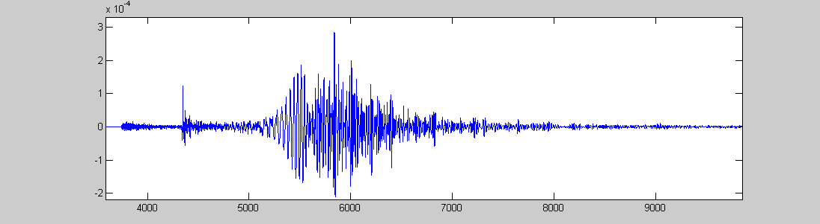
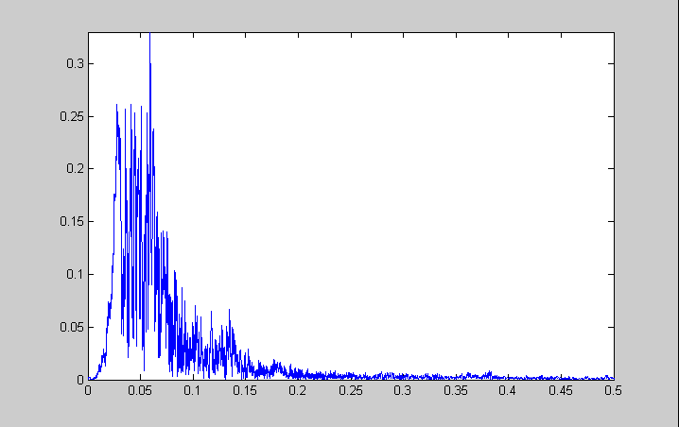
A seismogram
Amplitude
Time (s)
Spectral amplitude
Frequency (Hz)
Computational Geophysics and Data Analysis

Slide 4
Digital Filtering
Often a recorded signal contains a lot of information that we are not interested in (noise). To get rid of this noise we can apply a filter in the frequency domain.
The most important filters are:
High pass: cuts out low frequencies
Low pass: cuts out high frequencies
Band pass: cuts out both high and low frequencies and leaves a band of frequencies
Band reject: cuts out certain frequency band and leaves all other frequencies
Computational Geophysics and Data Analysis

Slide 5
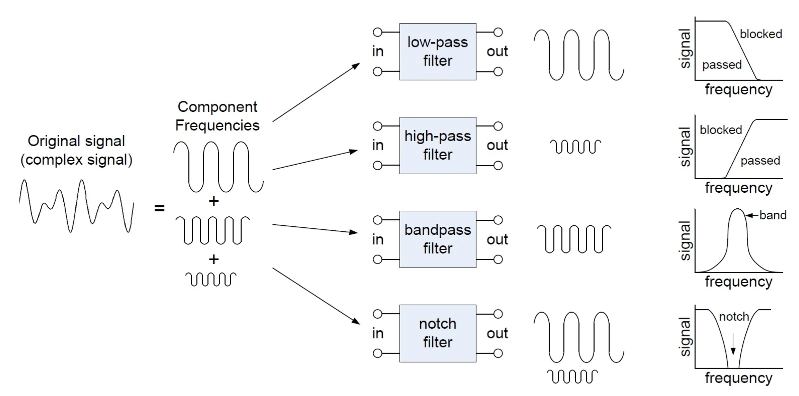

4 basic filters
Computational Geophysics and Data Analysis

Slide 6
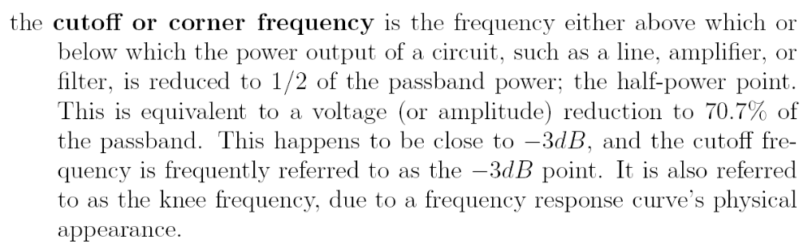
Cutoff frequency
Computational Geophysics and Data Analysis

Slide 7
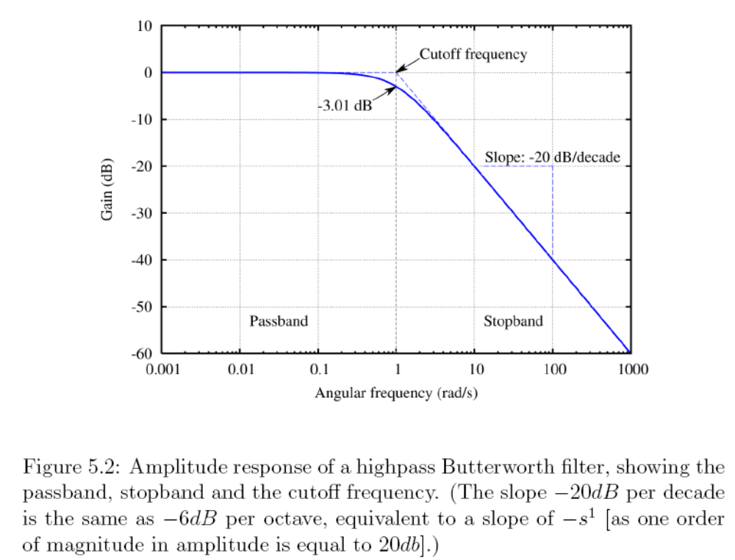
Cut-off and slopes in spectra
Computational Geophysics and Data Analysis

Slide 8
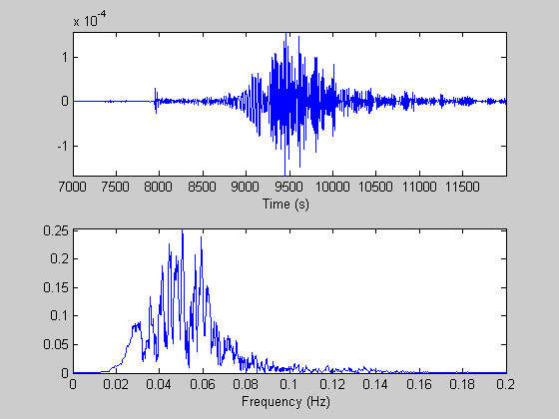
Digital Filtering
Computational Geophysics and Data Analysis

Slide 9
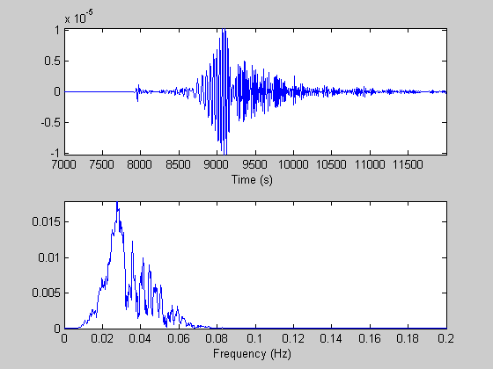
Low-pass filtering
Computational Geophysics and Data Analysis

Slide 10
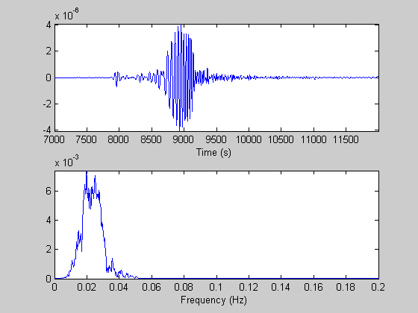
Lowpass filtering
Computational Geophysics and Data Analysis

Slide 11
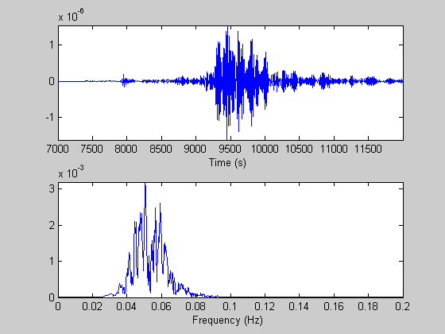
High-pass filter
Computational Geophysics and Data Analysis

Slide 12
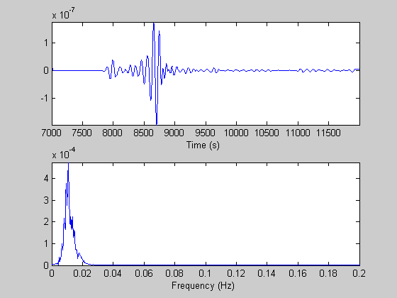
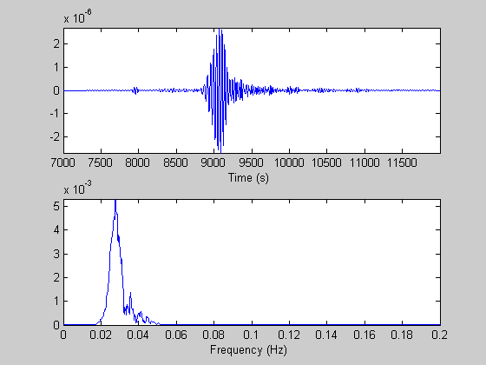
Band-pass filter
Computational Geophysics and Data Analysis

Slide 13
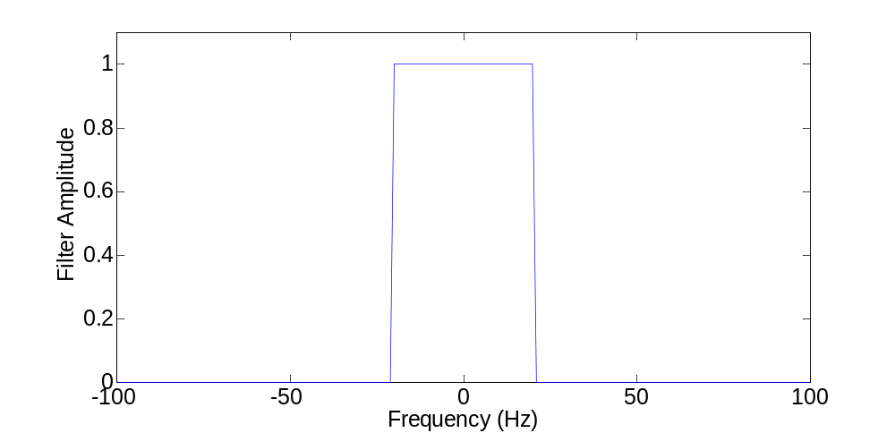
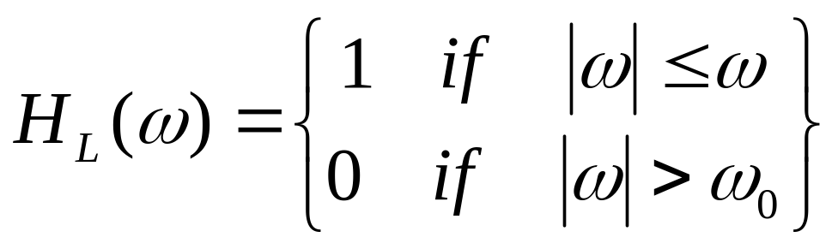
The simplemost filter
The simplemost filter gets rid of all frequencies above a certain cut-off frequency (low-pass), „box-car“
Computational Geophysics and Data Analysis

Slide 14
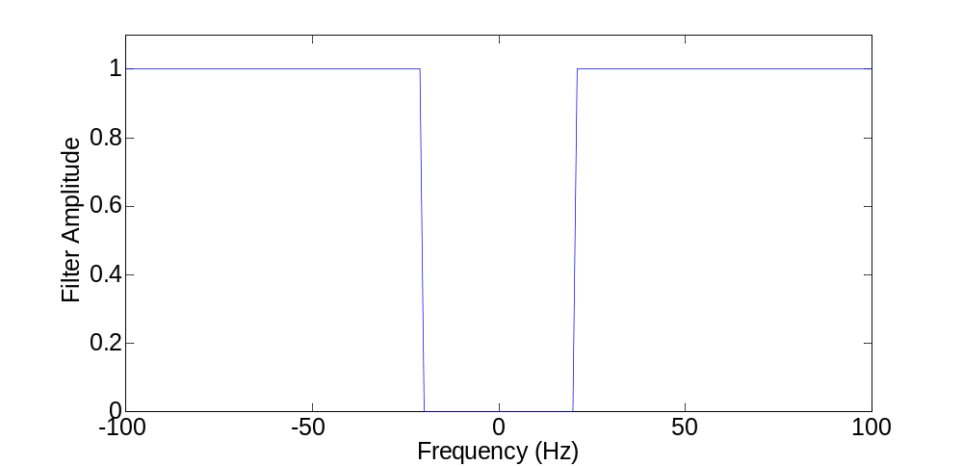
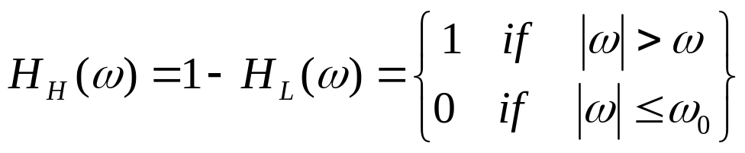
The simplemost filter
… and its brother … (high-pass)
Computational Geophysics and Data Analysis

Slide 15
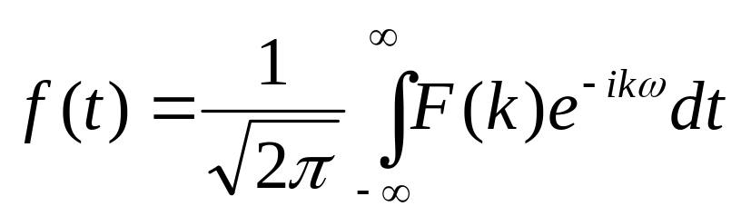
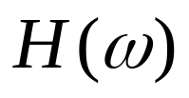
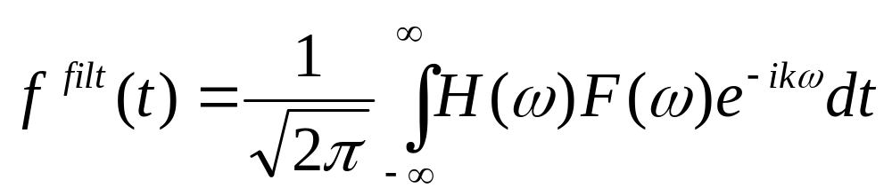
… let‘s look at the consequencse
… but what does H(ω) look like in the time domain … remember the convolution theorem?
Computational Geophysics and Data Analysis

Slide 16
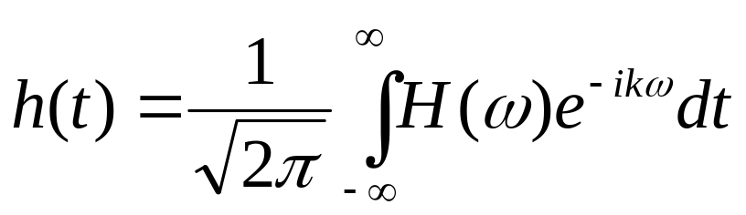
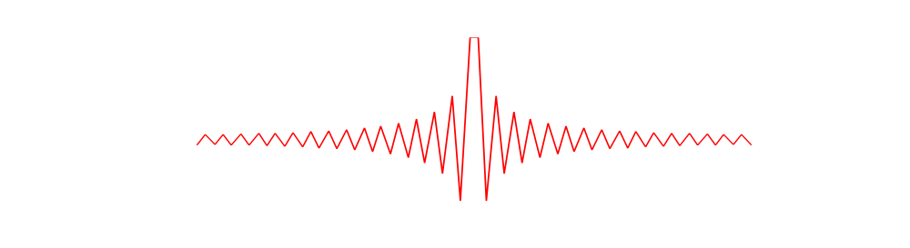
… surprise …
Computational Geophysics and Data Analysis

Slide 17
Zero phase and causal filters
Zero phase filters can be realised by
Convolve first with a chosen filter
Time reverse the original filter and convolve again
First operation multiplies by F(ω), the 2nd operation is a multiplication by F*(ω)
The net multiplication is thus | F(w)|²
These are also called two-pass filters
Computational Geophysics and Data Analysis

Slide 18
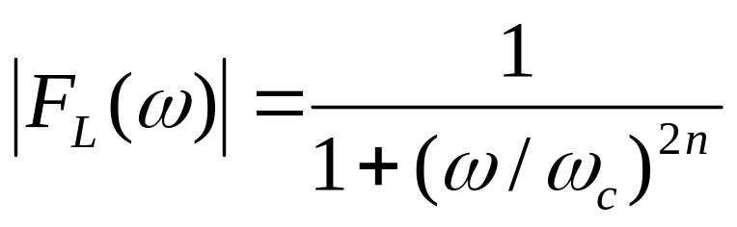
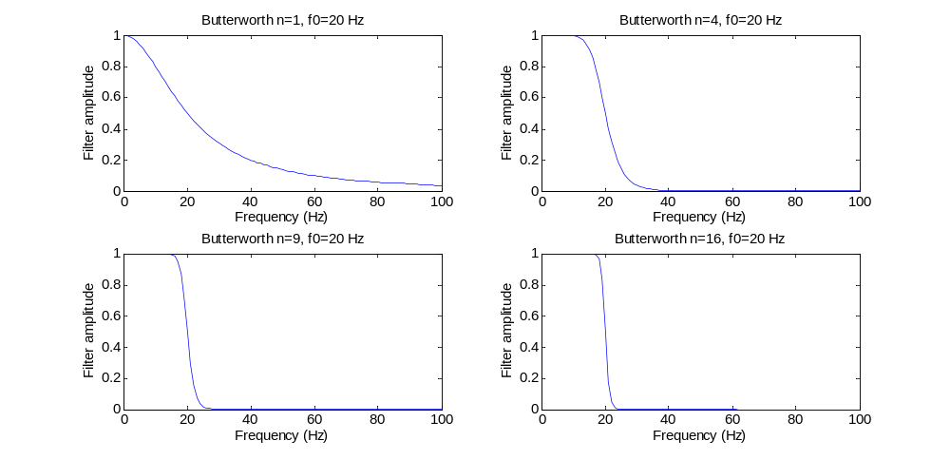
The Butterworth Filter (Low-pass, 0-phase)
Computational Geophysics and Data Analysis

Slide 19
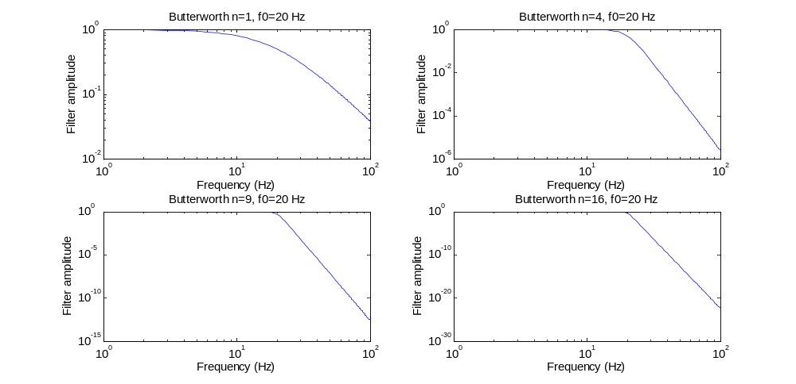
In log-log scale …
Computational Geophysics and Data Analysis

Slide 20
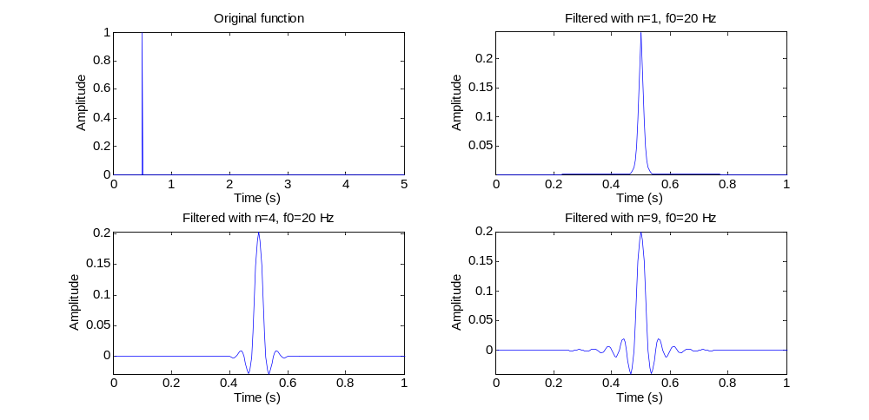
… effect on a spike …
Computational Geophysics and Data Analysis

Slide 21
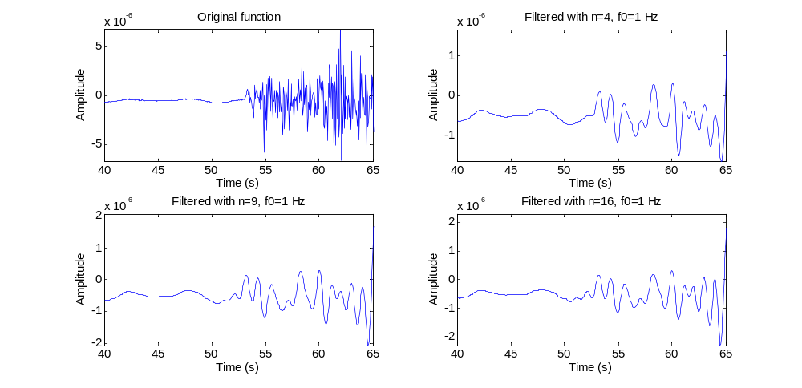
… on a seismogram …
… varying the order …
Computational Geophysics and Data Analysis

Slide 22
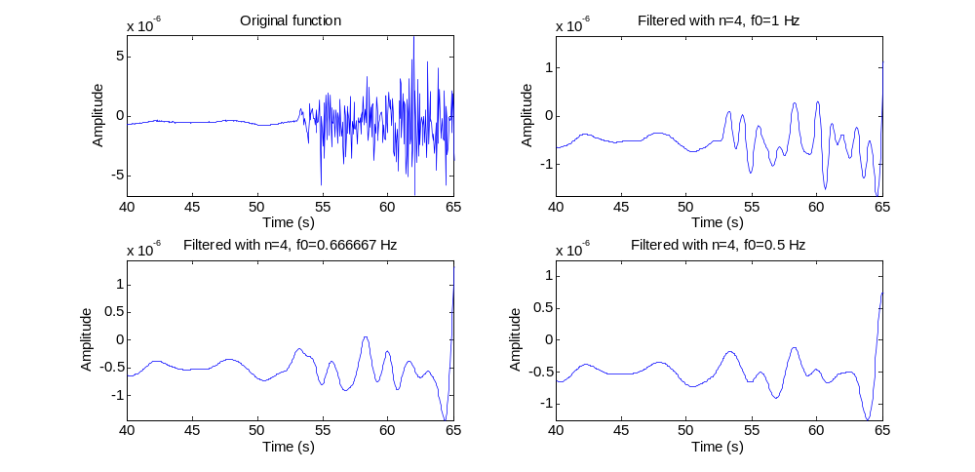
… on a seismogram …
… varying the cut-off frequency…
Computational Geophysics and Data Analysis

Slide 23
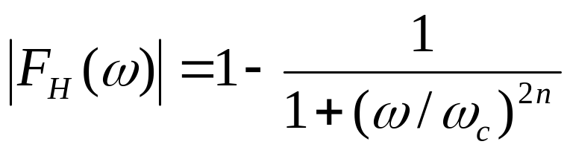
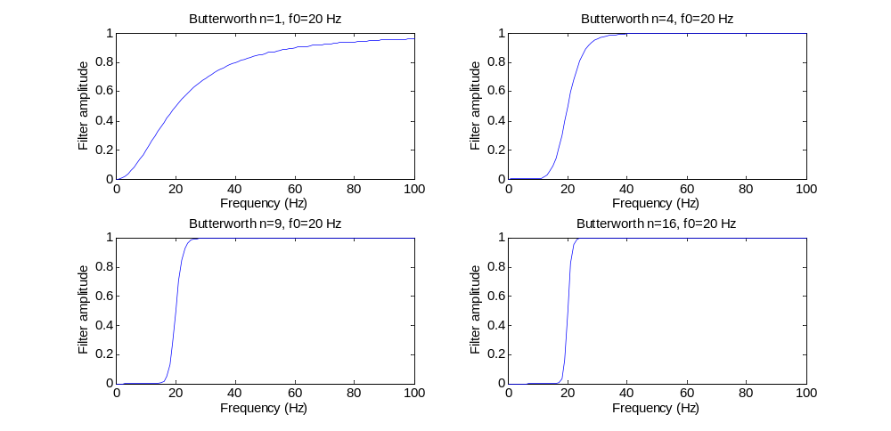
The Butterworth Filter (High-Pass)
Computational Geophysics and Data Analysis

Slide 24
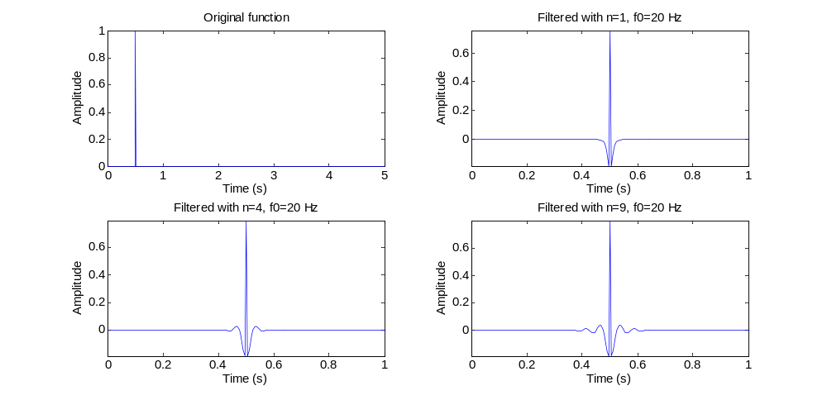
… effect on a spike …
Computational Geophysics and Data Analysis

Slide 25
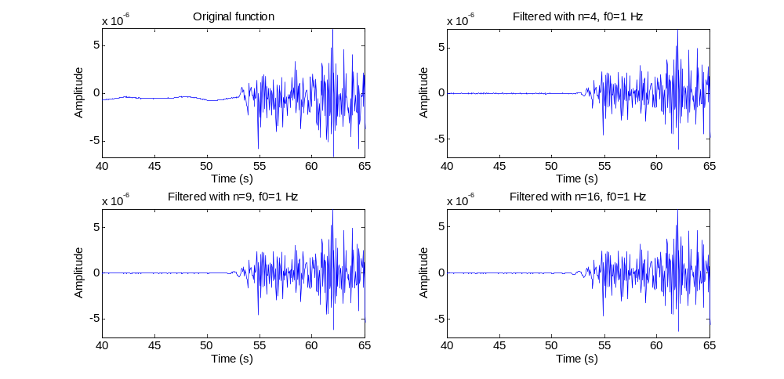
… on a seismogram …
… varying the order …
Computational Geophysics and Data Analysis

Slide 26
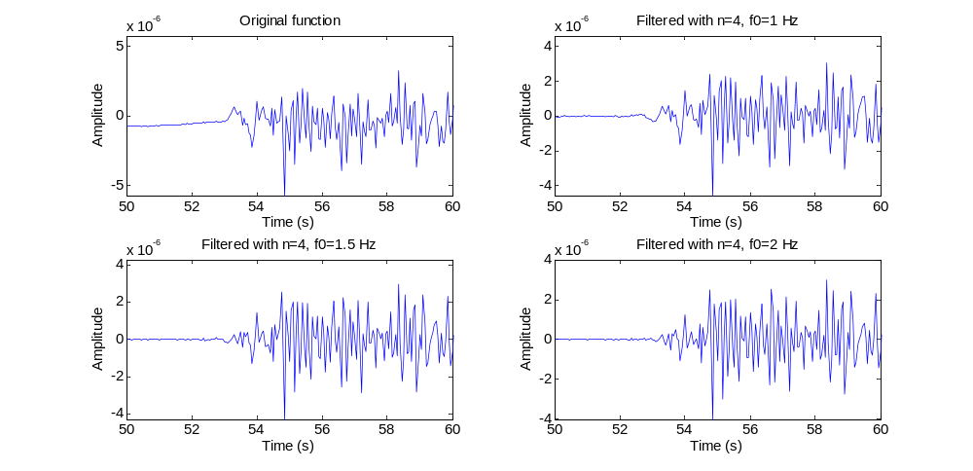
… on a seismogram …
… varying the cut-off frequency…
Computational Geophysics and Data Analysis

Slide 27
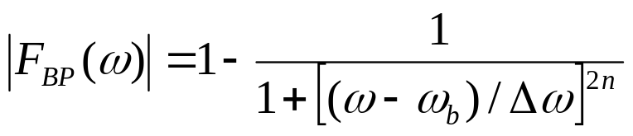
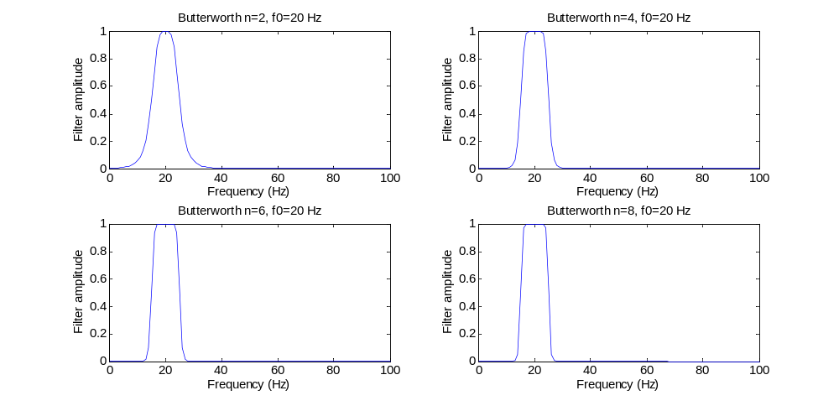

The Butterworth Filter (Band-Pass)
Computational Geophysics and Data Analysis

Slide 28
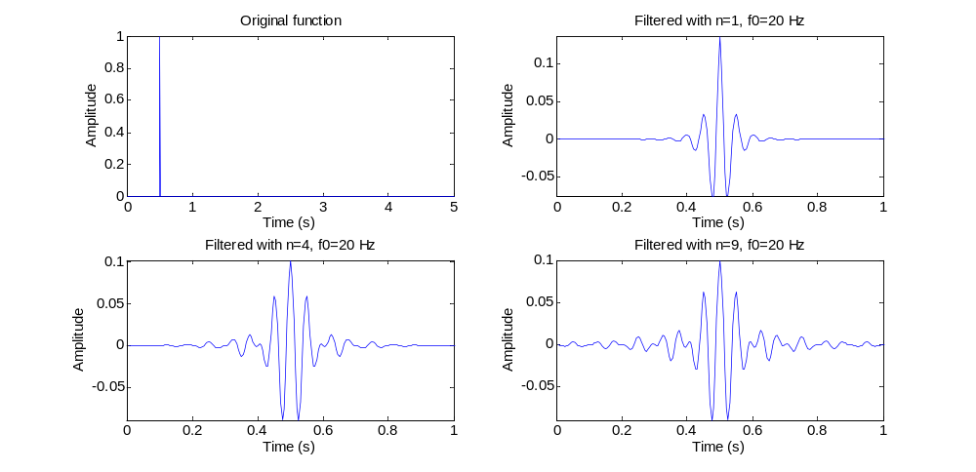
… effect on a spike …
Computational Geophysics and Data Analysis

Slide 29
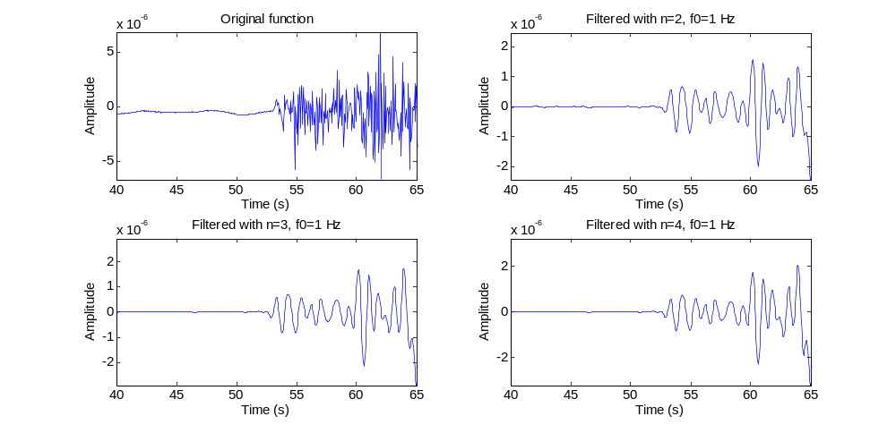
… on a seismogram …
… varying the order …
Computational Geophysics and Data Analysis

Slide 30
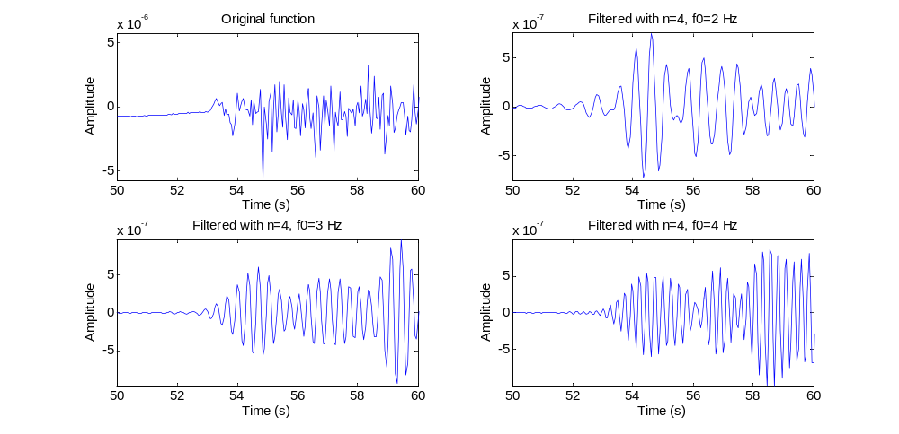
… on a seismogram …
… varying the cut-off frequency…
Computational Geophysics and Data Analysis

Slide 31
Zero phase and causal filters
When the phase of a filter is set to zero (and simply the amplitude spectrum is inverted) we obtain a zero-phase filter. It means a peak will not be shifted.
Such a filter is acausal. Why?
Computational Geophysics and Data Analysis

Slide 32
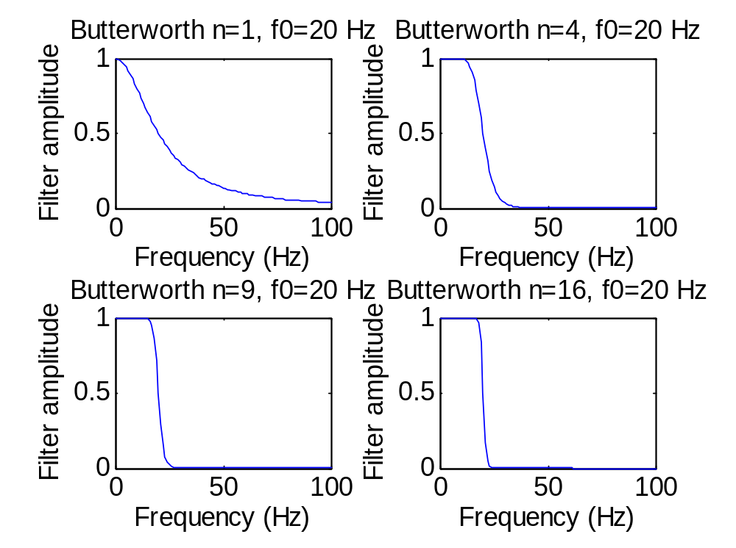
Butterworth Low-pass (20 Hz) on spike
Computational Geophysics and Data Analysis

Slide 33
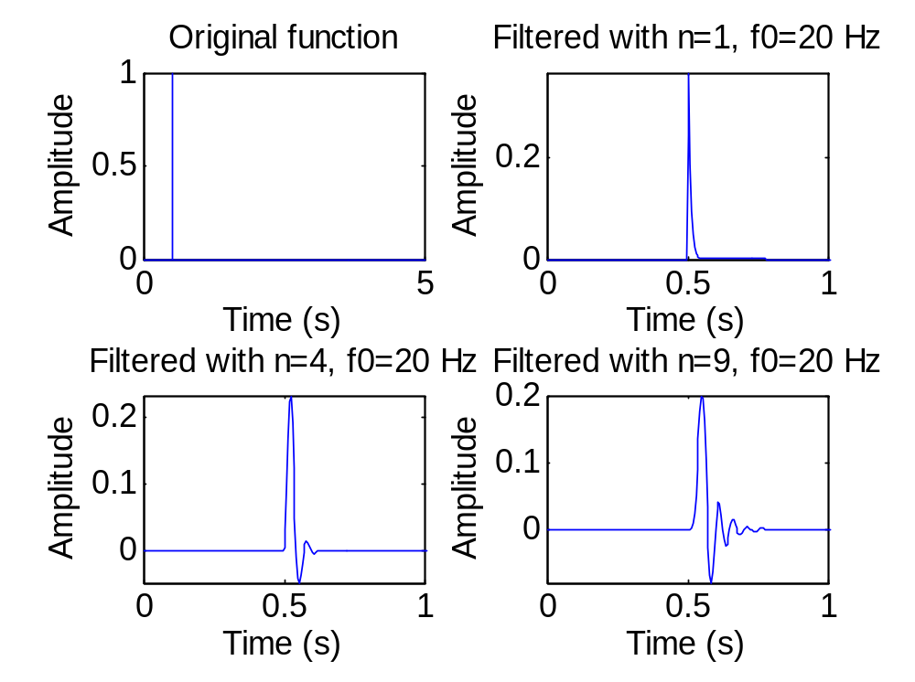
(causal) Butterworth Low-pass (20 Hz) on spike
Computational Geophysics and Data Analysis

Slide 34
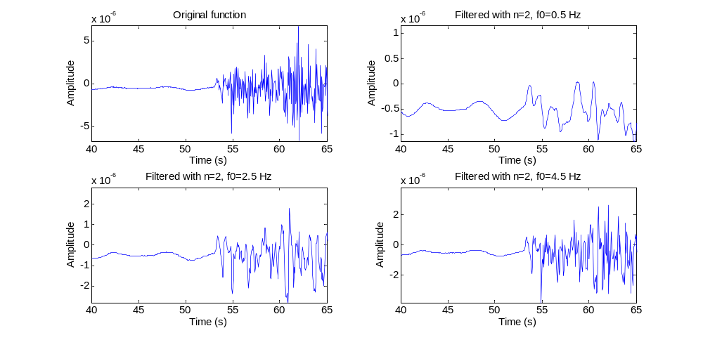
Butterworth Low-pass (20 Hz) on data
Computational Geophysics and Data Analysis

Slide 35
Summary
Filtering is not necessarily straight forward, even the fundamental operations (LP, HP, BP, etc) require some thinking before application to data.
The form of the filter decides upon the changes to the waveforms of the time series you are filtering
For seismological applications filtering might drastically influence observables such as travel times or amplitudes
„Windowing“ the signals in the right way is fundamental to obtain the desired filtered sequence
Computational Geophysics and Data Analysis

