Slide 1
… by the end of the day …
Maths background of Fourier transform and sampling (repetition!?)
How does one do the Fourier transform on a computer (in Python)
What do the outputs mean, why are they complex
What is a spectrum (really)
Appreciate that a spectrum is an „estimation“
Understand what can be done to improve the estimation of a spectrum
Understand the difference between an amplitude (power) spectrum and power spectral density
Know how to write a python code to estimate a spectrum
Experience an example of spectral estimation in seismology (free oscillations, exciting!)
Computational Geophysics and Data Analysis

Slide 2
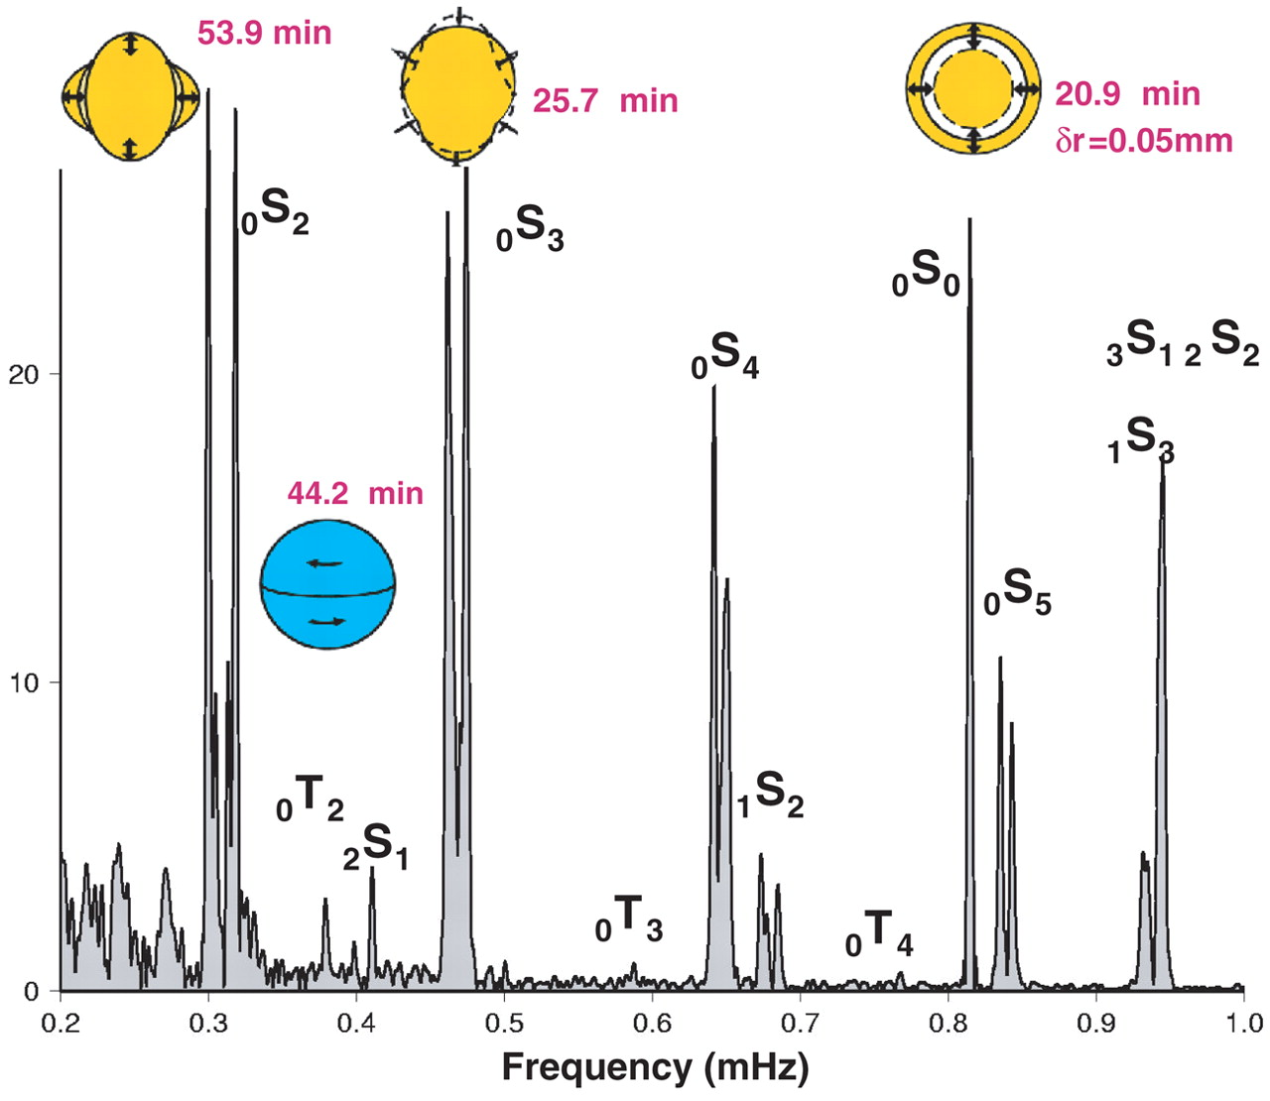
Spectral analysis: Foundations
Orthogonal functions
Fourier Series
Discrete Fourier Series
Fourier Transform: properties
Convolution
DFT and FFT
Scope: Understanding where the Fourier Transform comes from. Moving from the continuous to the discrete world. (Almost) everything we need to understand for filtering.
Computational Geophysics and Data Analysis

Slide 3
Fourier Series
continuous vs. discrete
Computational Geophysics and Data Analysis

Slide 4
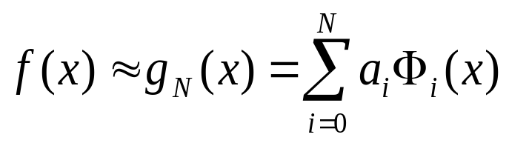
Fourier Series: one way to derive them
The Problem
we are trying to approximate a function f(x) by another function g_{n}(x) which consists of a sum over N orthogonal functions Φ(x) weighted by some coefficients a_{n}.
Computational Geophysics and Data Analysis

Slide 5
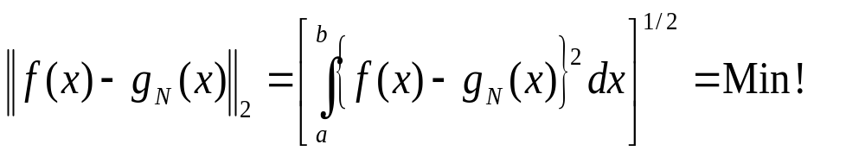
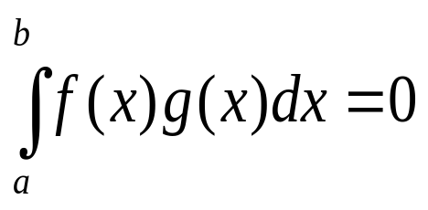
The Problem
... and we are looking for optimal functions in a least squares (l₂) sense ...
... a good choice for the basis functions Φ(x) are orthogonal functions.
What are orthogonal functions? Two functions f and g are said to be orthogonal in the interval [a,b] if
How is this related to the more conceivable concept of orthogonal vectors? Let us look at the original definition of integrals:
Computational Geophysics and Data Analysis

Slide 6
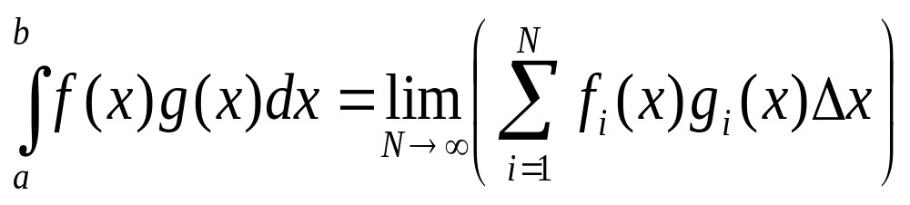
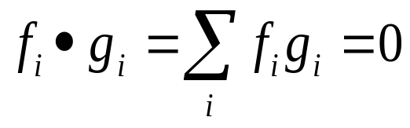
Orthogonal Functions
... where x₀=a and x_{N}=b, and x_{i}-x_{i-1}=Δx ...
If we interpret f(x_{i}) and g(x_{i}) as the ith components of an N component vector, then this sum corresponds directly to a scalar product of vectors. The vanishing of the scalar product is the condition for orthogonality of vectors (or functions).
f_{i}
g_{i}
Computational Geophysics and Data Analysis

Slide 7

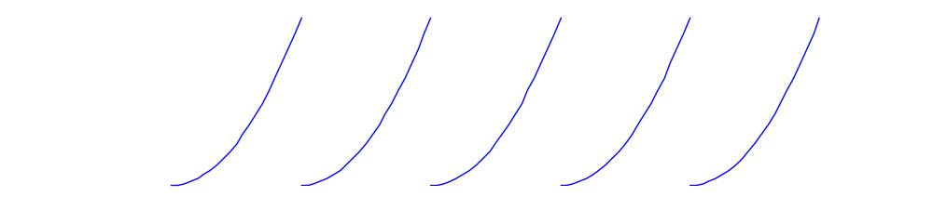
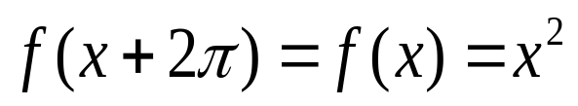
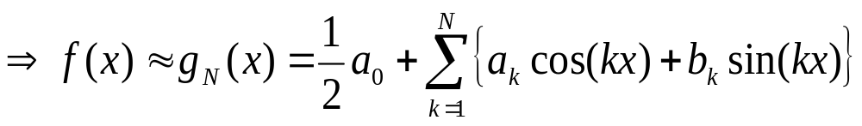
Periodic functions
Let us assume we have a piecewise continuous function of the form
... we want to approximate this function with a linear combination of 2π periodic functions:
Computational Geophysics and Data Analysis

Slide 8
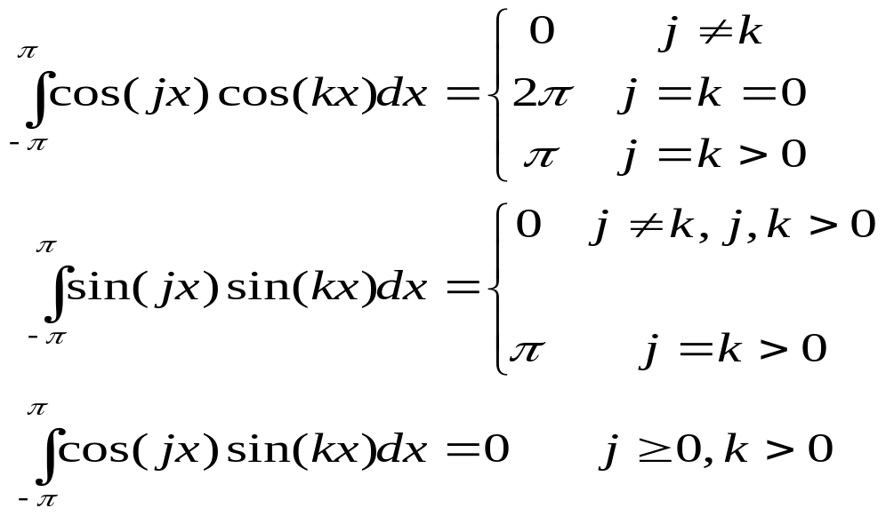
Orthogonality
... are these functions orthogonal ?
... YES, and these relations are valid for any interval of length 2π.
Now we know that this is an orthogonal basis, but how can we obtain the
coefficients for the basis functions?
from minimising f(x)-g(x)
Computational Geophysics and Data Analysis

Slide 9
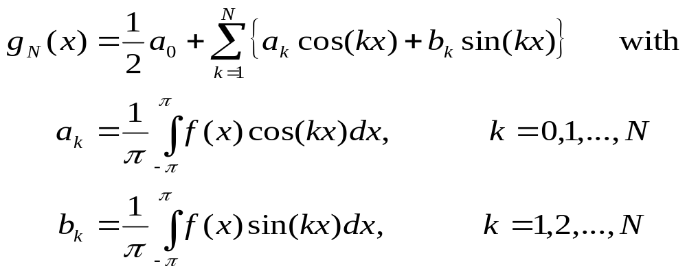
Fourier coefficients
optimal functions g(x) are given if
... with the definition of g(x) we get ...
leading to
Computational Geophysics and Data Analysis

Slide 10
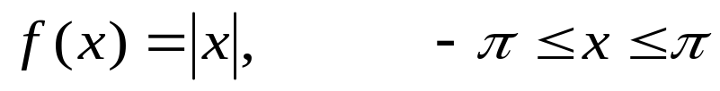
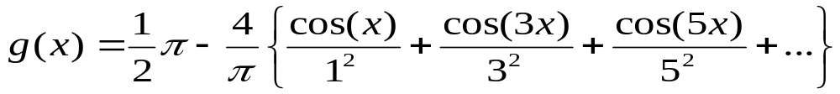
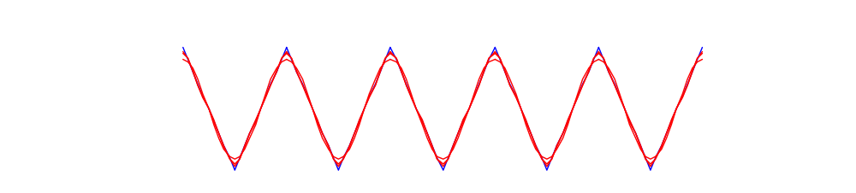
Fourier approximation of |x|
... Example ...
leads to the Fourier Serie
.. and for n<4 g(x) looks like
Computational Geophysics and Data Analysis

Slide 11

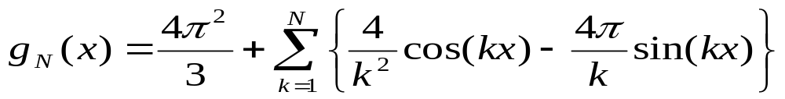
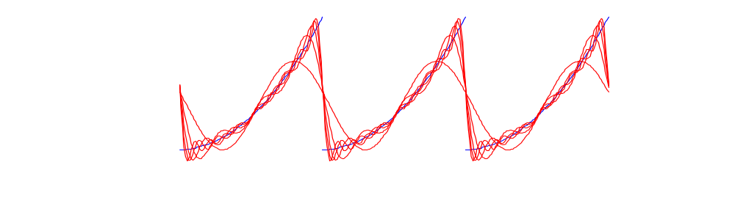
Fourier approximation of x²
... another Example ...
leads to the Fourier Serie
.. and for N<11, g(x) looks like
Computational Geophysics and Data Analysis

Slide 12
Jupyter Notebook
Fourier Series
Computational Geophysics and Data Analysis

Slide 13
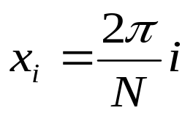
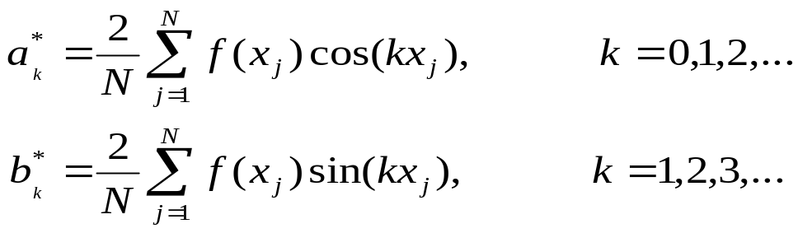
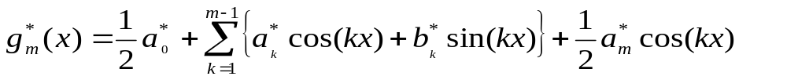
Fourier - discrete functions
... what happens if we know our function f(x) only at the points
it turns out that in this particular case the coefficients are given by
.. the so-defined Fourier polynomial is the unique interpolating function to the function f(x_{j}) with N=2m
Computational Geophysics and Data Analysis

Slide 14

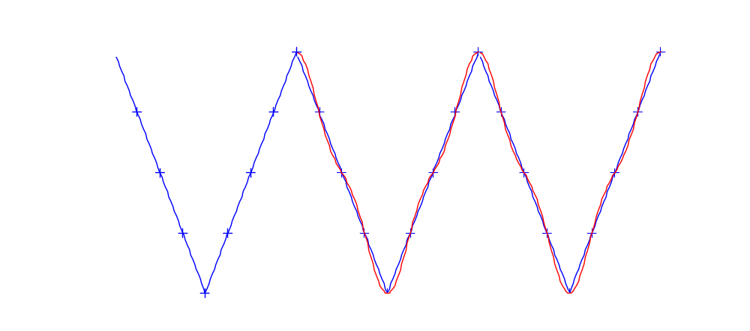
Fourier - collocation points
... with the important property that ...
... in our previous examples ...
f(x)=|x| => f(x) - blue ; g(x) - red; x_{i} - ‘+’
Computational Geophysics and Data Analysis

Slide 15
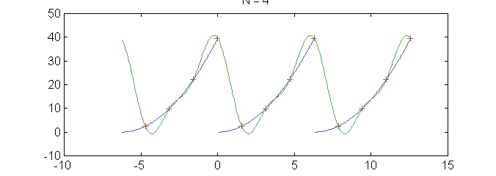
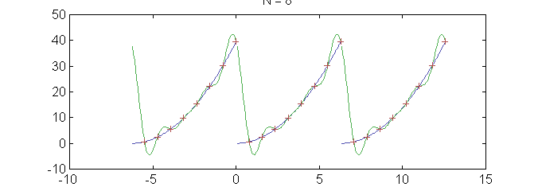
Fourier series - convergence
f(x)=x² => f(x) - blue ; g(x) - red; x_{i} - ‘+’
Computational Geophysics and Data Analysis

Slide 16
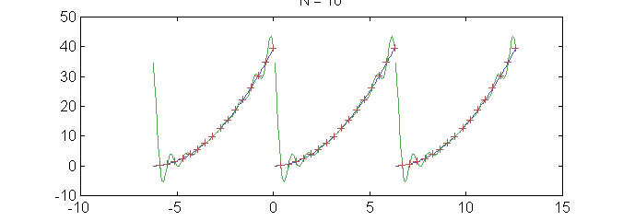
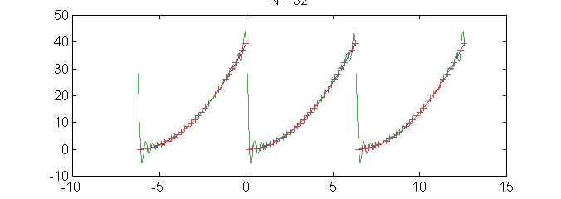
Fourier series - convergence
f(x)=x² => f(x) - blue ; g(x) - red; x_{i} - ‘+’
Computational Geophysics and Data Analysis

Slide 17
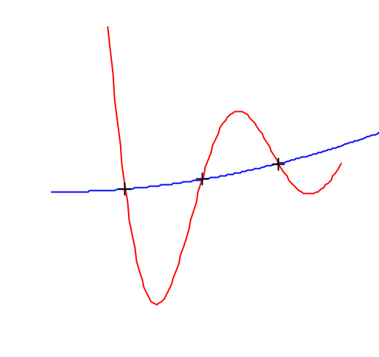
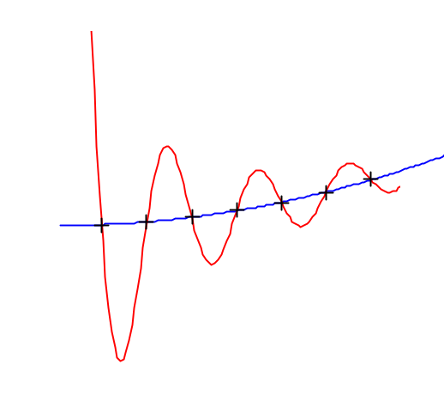
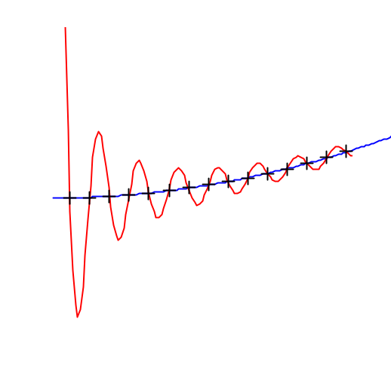
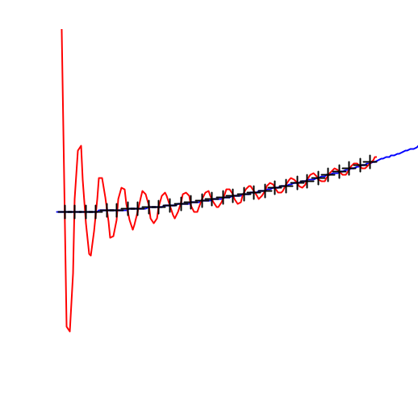
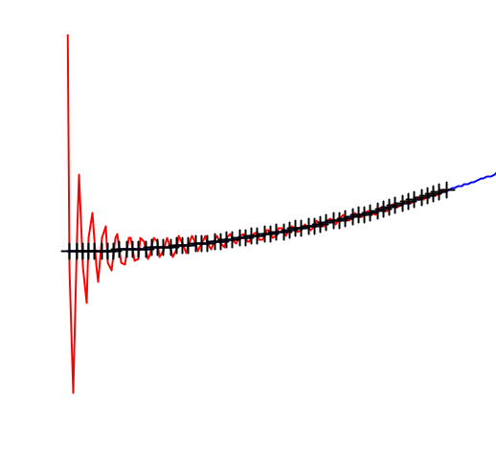
Gibb’s phenomenon
f(x)=x² => f(x) - blue ; g(x) - red; x_{i} - ‘+’
The overshoot for equi-spaced Fourier interpolations is ≈14% of the step height.
Computational Geophysics and Data Analysis

Slide 18
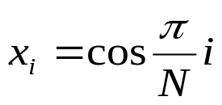
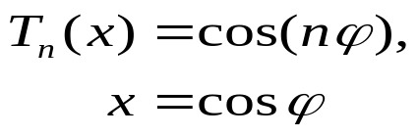

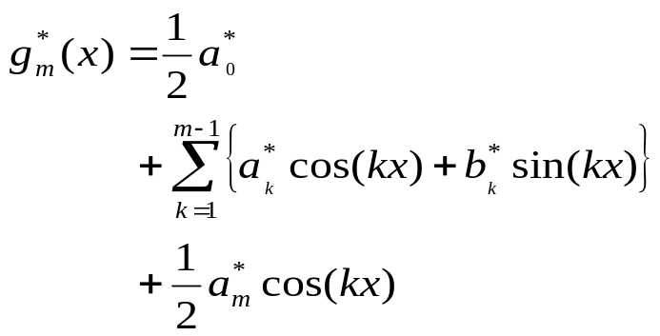
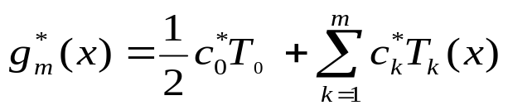
Fourier vs. Chebyshev
Fourier
Chebyshev
collocation points
periodic functions
domain
limited area [-1,1]
basis functions
interpolating function
Computational Geophysics and Data Analysis

Slide 19
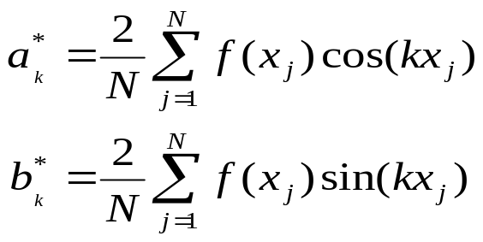
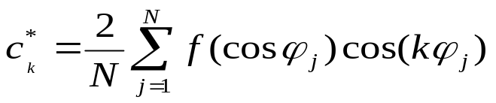
Fourier vs. Chebyshev (cont’d)
Fourier
Chebyshev
coefficients
Gibb’s phenomenon for discontinuous functions
Efficient calculation via FFT
infinite domain through periodicity
limited area calculations
grid densification at boundaries
coefficients via FFT
excellent convergence at boundaries
Gibb’s phenomenon
some properties
Computational Geophysics and Data Analysis

Slide 20
Jupyter Notebook
Fourier Fundamentals
Exercise 1 and 2
Computational Geophysics and Data Analysis

Slide 21
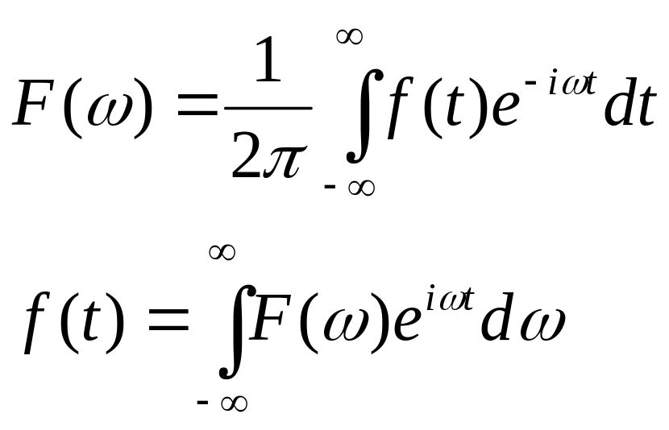
The Fourier Transform Pair
Forward transform
Inverse transform
Note the conventions concerning the sign of the exponents and the factor.
Computational Geophysics and Data Analysis

Slide 22
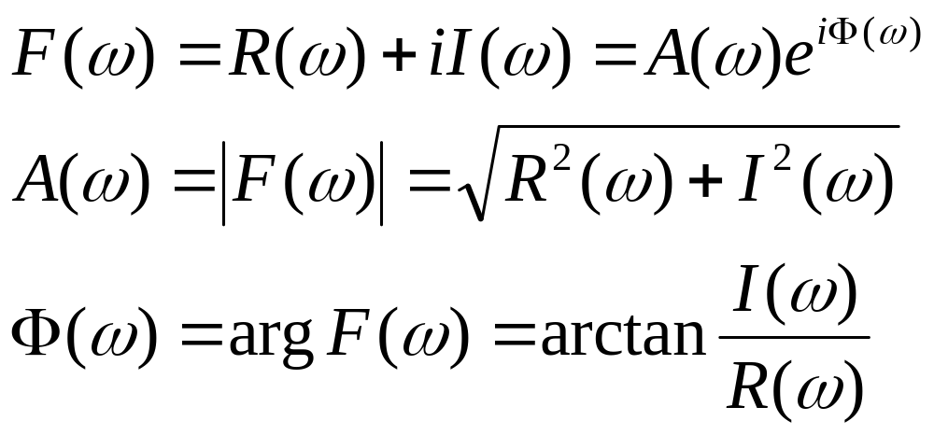
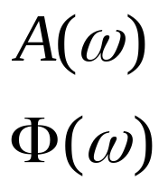
The Fourier Transform Pair
Amplitude spectrum
Phase spectrum
In most application it is the amplitude (or the power) spectrum that is of interest.
Computational Geophysics and Data Analysis

Slide 23
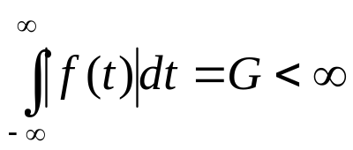
The Fourier Transform: when does it work?
Conditions that the integral transforms work:
f(t) has a finite number of jumps and the limits exist from both sides
f(t) is integrable, i.e.
Properties of the Fourier transform for special functions:
Function f(t) | Fouriertransform F(ω)
even | even
odd | odd
real | hermitian
imaginary | antihermitian
hermitian | real
Computational Geophysics and Data Analysis

Slide 24
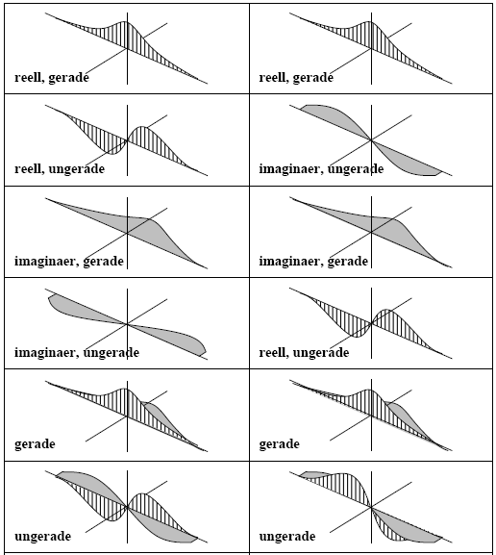
… graphically …
Computational Geophysics and Data Analysis

Slide 25




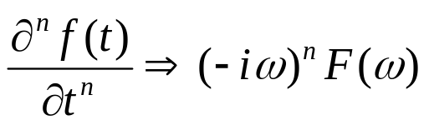
Some properties of the Fourier Transform
Defining as the FT:
Linearity
Symmetry
Time shifting
Time differentiation
Computational Geophysics and Data Analysis

Slide 26
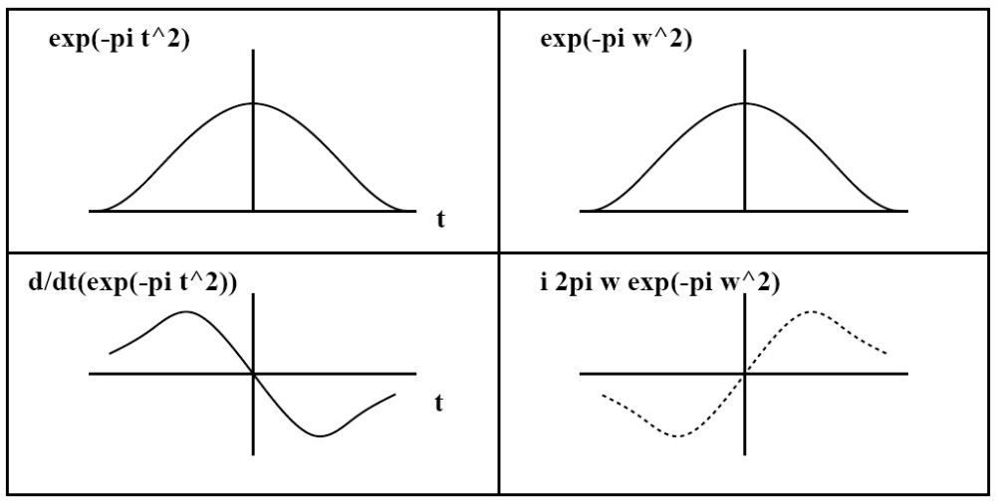
Differentiation theorem
Time differentiation
Computational Geophysics and Data Analysis

Slide 27
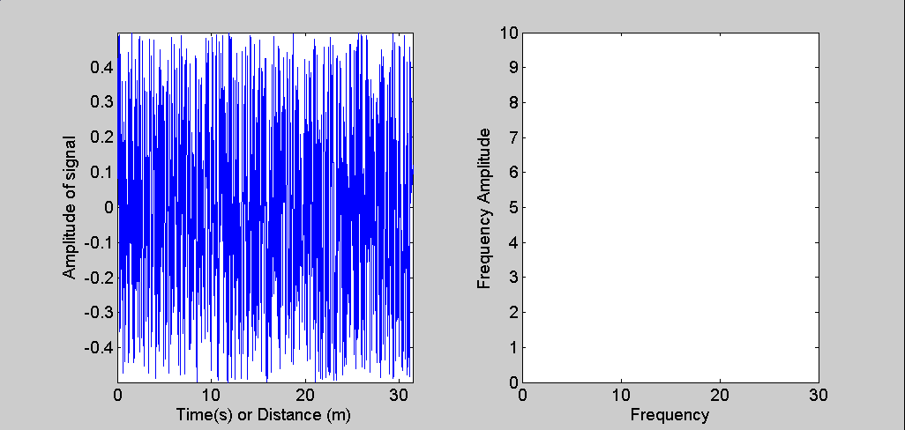
Fourier Spectra: Main Cases random signals
Random signals may contain all frequencies. A spectrum with constant contribution of all frequencies is called a white spectrum
Computational Geophysics and Data Analysis

Slide 28
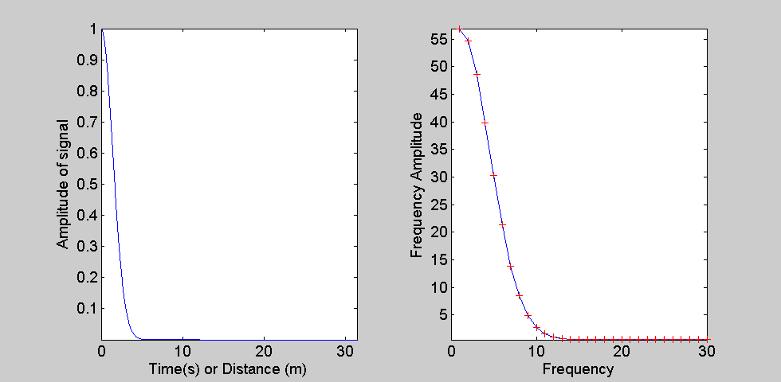
Fourier Spectra: Main Cases
Gaussian signals
The spectrum of a Gaussian function will itself be a Gaussian function. How does the spectrum change, if I make the Gaussian narrower and narrower?
Computational Geophysics and Data Analysis

Slide 29
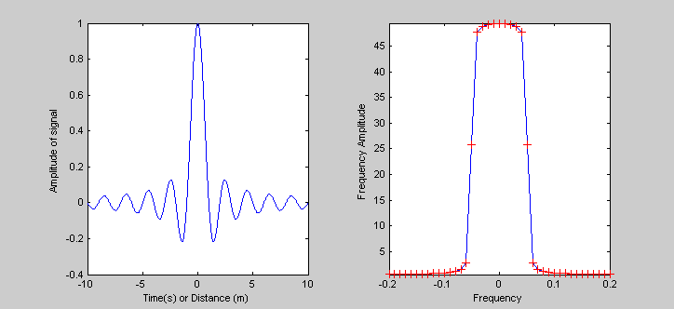
Fourier Spectra: Main Cases
Transient waveform
A transient wave form is a wave form limited in time (or space) in comparison with a harmonic wave form that is infinite
Computational Geophysics and Data Analysis

Slide 30
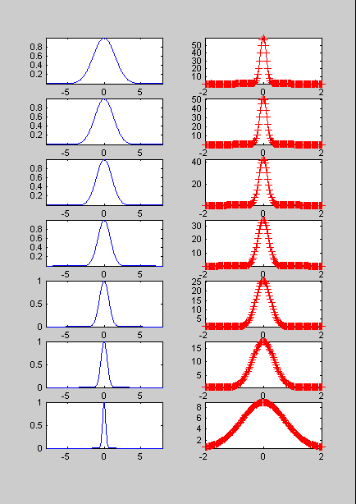
Puls-width and Frequency Bandwidth
time (space)
spectrum
Widening frequency band
Narrowing physical signal
Computational Geophysics and Data Analysis

Slide 31
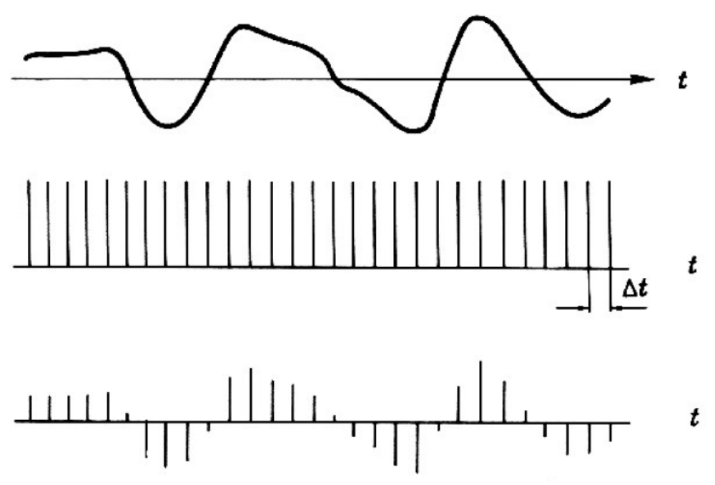
The digital world
Computational Geophysics and Data Analysis

Slide 32
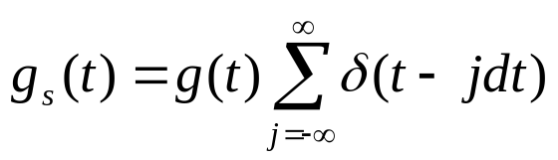
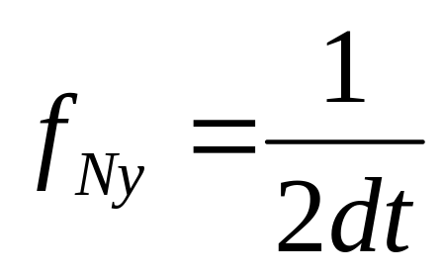
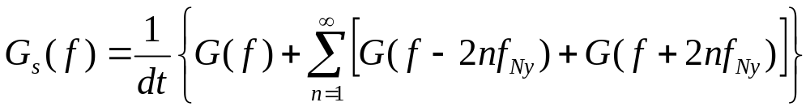
The digital world
g_{s} is the digitized version of g and the sum is called the comb function.
Defining the Nyquist frequency f_{Ny} as
after a few operations the spectrum can be written as
… with very important consequences …
Computational Geophysics and Data Analysis

Slide 33

The sampling theorem
The implications are that for the calculation of the spectrum at frequency f there are also contributions of frequencies f±2nf_{Ny}, n=1,2,3,…
That means dt has to be chosen such that f_{N} is the largest frequency contained in the signal.
Computational Geophysics and Data Analysis

Slide 34

The Fast Fourier Transform FFT
... spectral analysis became interesting for computing with the introduction of the Fast Fourier Transform (FFT). What’s so fast about it ?
The FFT originates from a paper by Cooley and Tukey (1965, Math.
Comp. vol 19 297-301) which revolutionised all fields where Fourier
transforms where essential to progress.
The discrete Fourier Transform can be written as
Computational Geophysics and Data Analysis

Slide 35


The Fast Fourier Transform FFT
... this can be written as matrix-vector products ...
for example the inverse transform yields ...
.. where ...
Computational Geophysics and Data Analysis

Slide 36
FFT
... the FAST bit is recognising that the full matrix - vector multiplication
can be written as a few sparse matrix - vector multiplications
(for details see for example Bracewell, the Fourier Transform and its
applications, MacGraw-Hill) with the effect that:
Number of multiplications
full matrix FFT
N² 2Nlog₂N
this has enormous implications for large scale problems.
Note: the factorisation becomes particularly simple and effective
when N is a highly composite number (power of 2).
Computational Geophysics and Data Analysis

Slide 37
FFT
Number of multiplications
Problem full matrix FFT Ratio full/FFT
1D (nx=512) 2.6x10⁵ 9.2x10³ 28.4
1D (nx=2096) 94.98
1D (nx=8384) 312.6
.. the right column can be regarded as the speedup of an algorithm
when the FFT is used instead of the full system.
Computational Geophysics and Data Analysis

Slide 38
Jupyter Notebook
Fourier Fundamentals
Exercise 3
Computational Geophysics and Data Analysis

Slide 39
Jupyter Notebook
Amplitude Spectrum
Computational Geophysics and Data Analysis

Slide 40
Summary
The Fourier Transform can be derived from the problem of approximating an arbitrary function.
A regular set of points allows exact interpolation (or derivation) of arbitrary functions
There are other basis functions (e.g., Chebyshev polynomials) with similar properties
The discretization of signals has tremendous impact on the estimation of spectra: aliasing effect
The FFT is at the heart of spectral analysis
Computational Geophysics and Data Analysis

Slide 41

Fourier Transform: Applications in seismology
Estimation of spectra
  windowing
  resampling
Seismograms – frequency content
Spectral estimation
Eigenmodes of the Earth
„Seismo-weather“ with FFTs
Scope: Understand how to estimate the spectrum from time series and interpret both phase and amplitude part. Learn other applications of the FFT in seismology
Computational Geophysics and Data Analysis

Slide 42

Phase and amplitude spectrum
The spectrum consists of two real-valued functions of angular frequency, the amplitude spectrum mod (F(ω)) and the phase spectrum φ(ω)
In many cases the amplitude spectrum is the most important part to be considered. However there are cases where the phase spectrum plays an important role (-> resonance, seismometer)
Computational Geophysics and Data Analysis

Slide 43


The spectrum
Amplitude spectrum
Phase spectrum
Fourier space
Physical space
Computational Geophysics and Data Analysis

Slide 44
The Fast Fourier Transform (FFT)
Most processing tools (e.g. octave, Matlab, Mathematica, Fortran, etc) have intrinsic functions for FFTs
>> help fft
FFT Discrete Fourier transform.
FFT(X) is the discrete Fourier transform (DFT) of vector X. For
matrices, the FFT operation is applied to each column. For N-D
arrays, the FFT operation operates on the first non-singleton
dimension.
FFT(X,N) is the N-point FFT, padded with zeros if X has less
than N points and truncated if it has more.
FFT(X,[],DIM) or FFT(X,N,DIM) applies the FFT operation across the
dimension DIM.
For length N input vector x, the DFT is a length N vector X,
with elements
N
X(k) = sum x(n)*exp(-j*2*pi*(k-1)*(n-1)/N), 1 <= k <= N.
n=1
The inverse DFT (computed by IFFT) is given by
N
x(n) = (1/N) sum X(k)*exp( j*2*pi*(k-1)*(n-1)/N), 1 <= n <= N.
k=1
See also IFFT, FFT2, IFFT2, FFTSHIFT.
Matlab FFT
Computational Geophysics and Data Analysis

Slide 45

Detrending - Example
Source: swharden.com
Computational Geophysics and Data Analysis

Slide 46

Detrending - Example
Computational Geophysics and Data Analysis

Slide 47

zero - padding
zero padding in the time domain corresponds to ideal interpolation
in the frequency domain
Computational Geophysics and Data Analysis

Slide 48

Some examples
Computational Geophysics and Data Analysis

Slide 49

Computational Geophysics and Data Analysis

Slide 50

Spectral leakage
Computational Geophysics and Data Analysis

Slide 51


Windowing/Tapering
Computational Geophysics and Data Analysis

Slide 52
Simple rules
Add as many zeros as possible!
Select a fine enough sampling interval, stay away from Nyquist! (no problem with periodicity …)
Use Window functions (tapers) … more on that later
Computational Geophysics and Data Analysis

Slide 53
Programming Exercise
Jupyter Notebook
Programming Exercise
From scratch:
Import necessary libraries
Define with approriate length time series with two sinusoids of different frequencies
Plot the function
Calculate and plot its amplitude spectrum
Apply zero padding (add many zeros to time series)
Compare amplitude spectrum before and after
Computational Geophysics and Data Analysis

