Slide 1
Other transforms (z-, Laplace-)
... required to understand instrument correction procedures and filtering theory ...
... or where do the „poles and zeros“ come from?
Computational Geophysics and Data Analysis

Slide 2
Question
What is the best way of describing the frequency response (transfer function, filter) of a linear system (e.g., a seismometer)
Computational Geophysics and Data Analysis

Slide 3
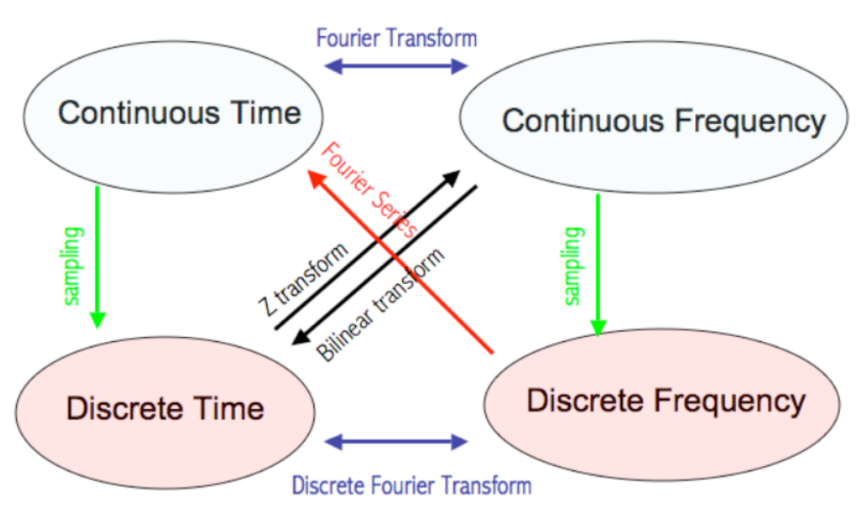
Various spaces and transforms
Computational Geophysics and Data Analysis

Slide 4
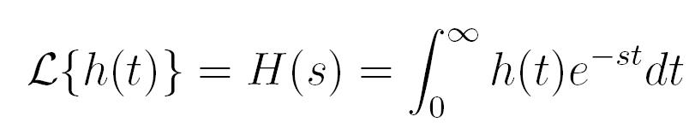
Laplace transform
Goal: we are seeking an opportunity to formally analyze linear dynamic (time-dependent) systems. Key advantage: differentiation and integration become multiplication and division (compare with log operation changing multiplication to addition).
Computational Geophysics and Data Analysis

Slide 5
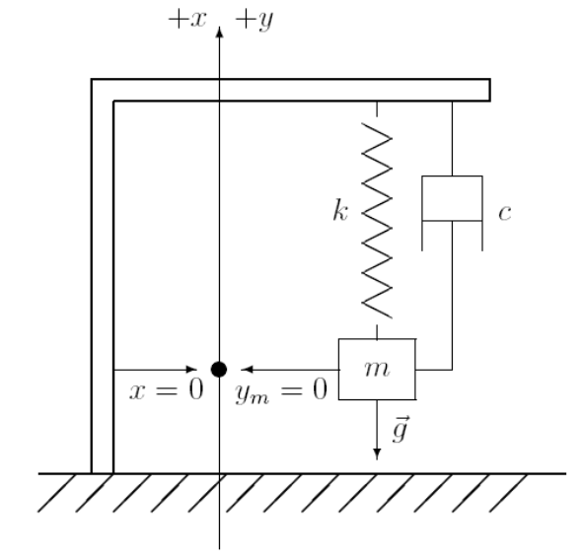
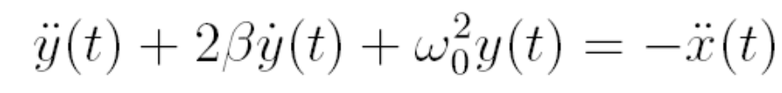
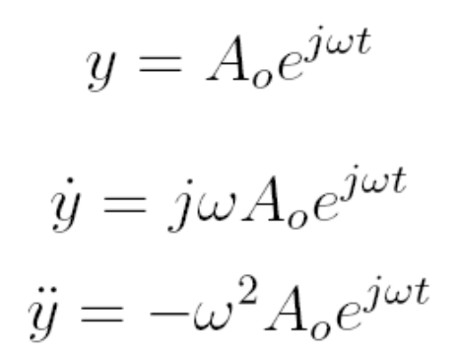
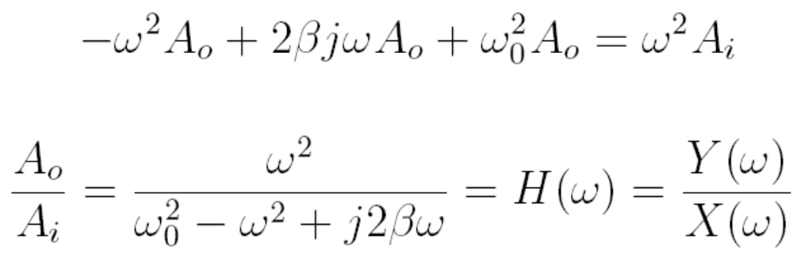
Application to seismometer
Remember the seismometer equation
Computational Geophysics and Data Analysis

Slide 6
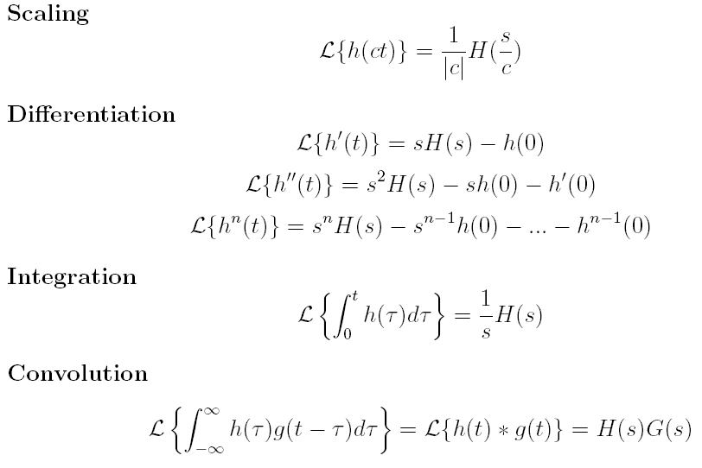
Some properties of the Laplace transformation
Computational Geophysics and Data Analysis

Slide 7
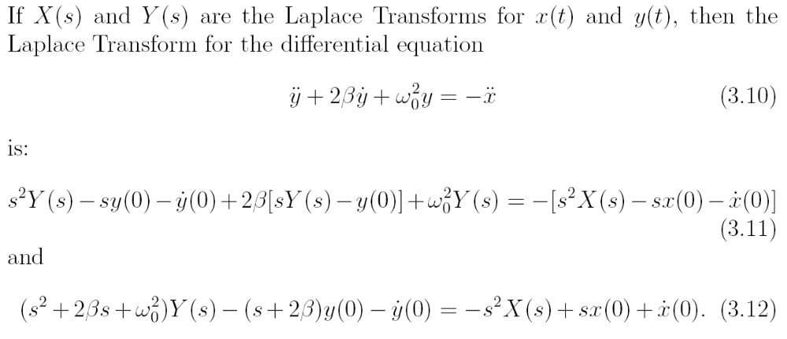
… using Laplace
Computational Geophysics and Data Analysis

Slide 8
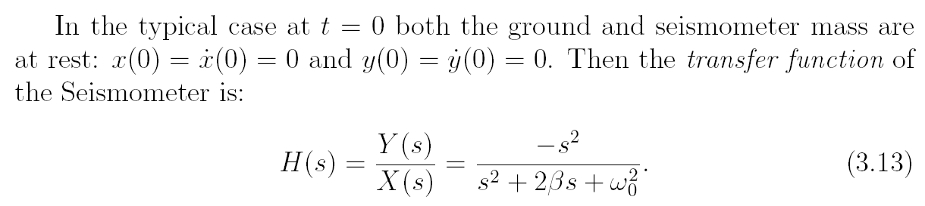
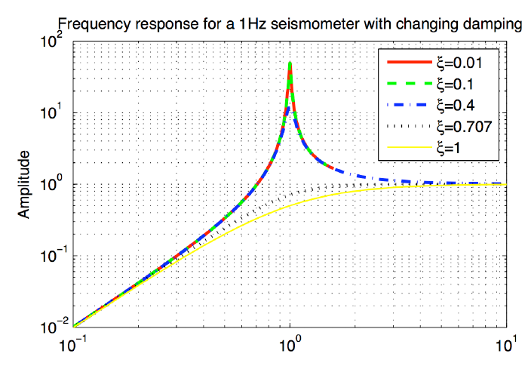
Transfer function
Computational Geophysics and Data Analysis

Slide 9
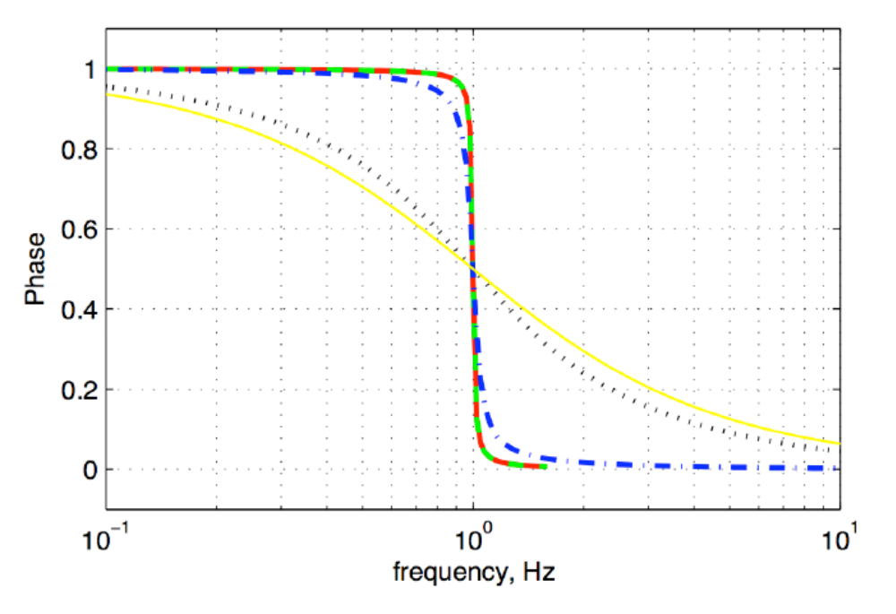
… phase response …
Computational Geophysics and Data Analysis

Slide 10
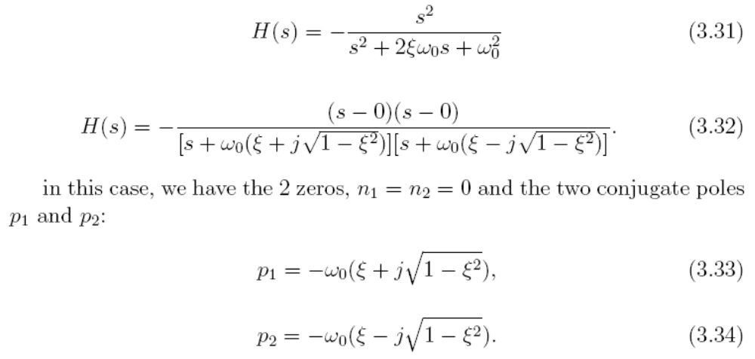
Poles and zeroes
If a transfer function can be represented as ratio of two polynomials, then we can alternatively describe the transfer function in terms of its poles and zeros. The zeros are simply the zeros of the numerator polynomial, and the poles correspond to the zeros of the denominator polynomial
Computational Geophysics and Data Analysis

Slide 11
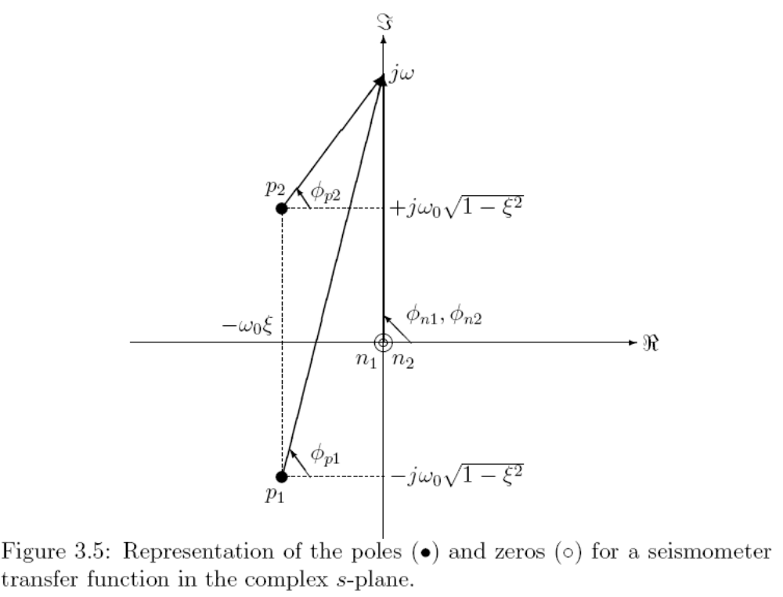
… graphically …
Computational Geophysics and Data Analysis

Slide 12
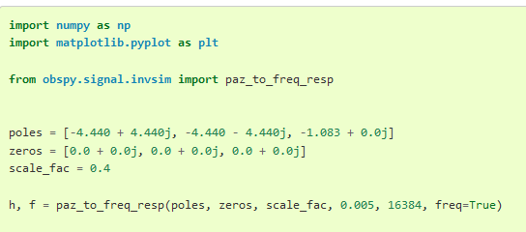
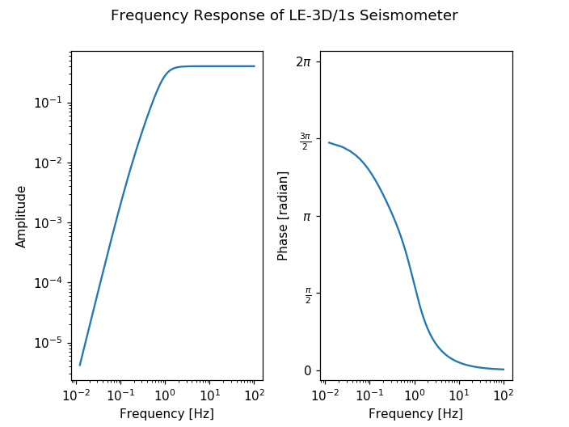
Poles and zeros
Seismogram metadata contain information on the seismometer transfer function (instrument response)
This response describes how each frequency is modified by the seismometer
It needs to be corrected for to obtain true ground motion (instrument correction)
This instrument response function is described by poles and zeros simply because it‘s the most compact way of desribing that function mathematically
Poles and zeros originate from the solution of the transfer function using Laplace transforms
Computational Geophysics and Data Analysis

Slide 13
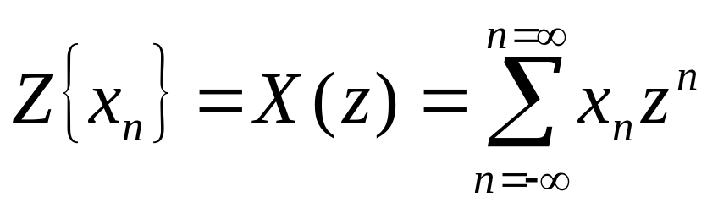
The z-transform
The z-transform is yet another way of transforming a disretized signal into an analytical (differentiable) form, furthermore
      Some mathematical procedures can be more easily carried out on discrete signals
      Digital filters can be easily designed and classified
      The z-transform is to discrete signals what the Laplace transform is to continuous time domain signals
  Definition:
In mathematical terms this is a Laurent serie around z=0, z is a complex number.
(this part follows Gubbins, p. 17+)
Computational Geophysics and Data Analysis

Slide 14
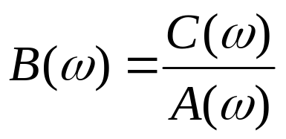
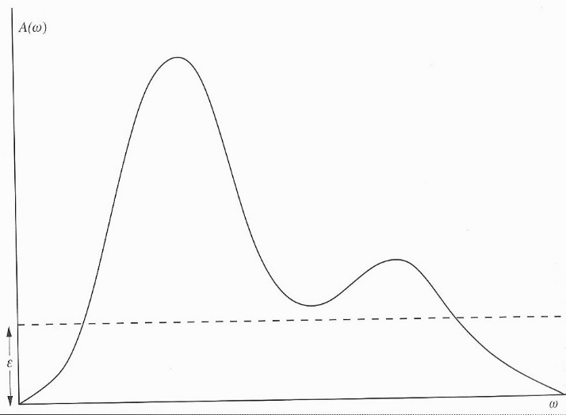
Deconvolution – Inverse filters
Deconvolution is the reverse of convolution, the most important applications in seismic data processing is removing or altering the instrument response of a seismometer. Suppose we want to deconvolve sequence a out of sequence c to obtain sequence b, in the frequency domain:
Major problems when A(ω) is zero or even close to zero in the presence of noise!
One possible fix is the waterlevel method, basically adding white noise,
Computational Geophysics and Data Analysis

Slide 15
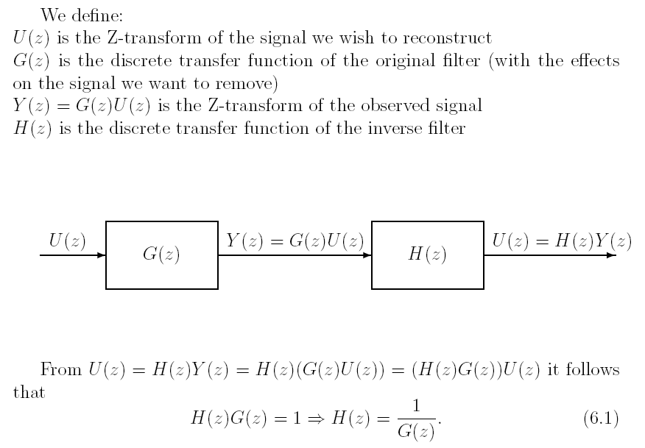
Using z-transforms
Computational Geophysics and Data Analysis

Slide 16
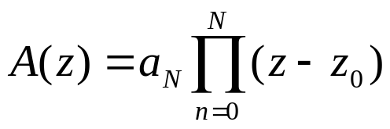
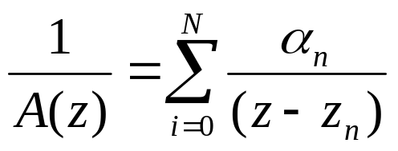
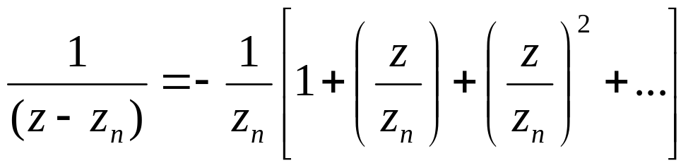
Deconvolution using the z-transform
One way is the construction of an inverse filter through division by the z-transform (or multiplication by 1/A(z)). We can then extract the corresponding time-representation and perform the deconvolution by convolution …
First we factorize A(z)
And expand the inverse by the method of partial fractions
Each term is expanded as a power series
Computational Geophysics and Data Analysis

Slide 17
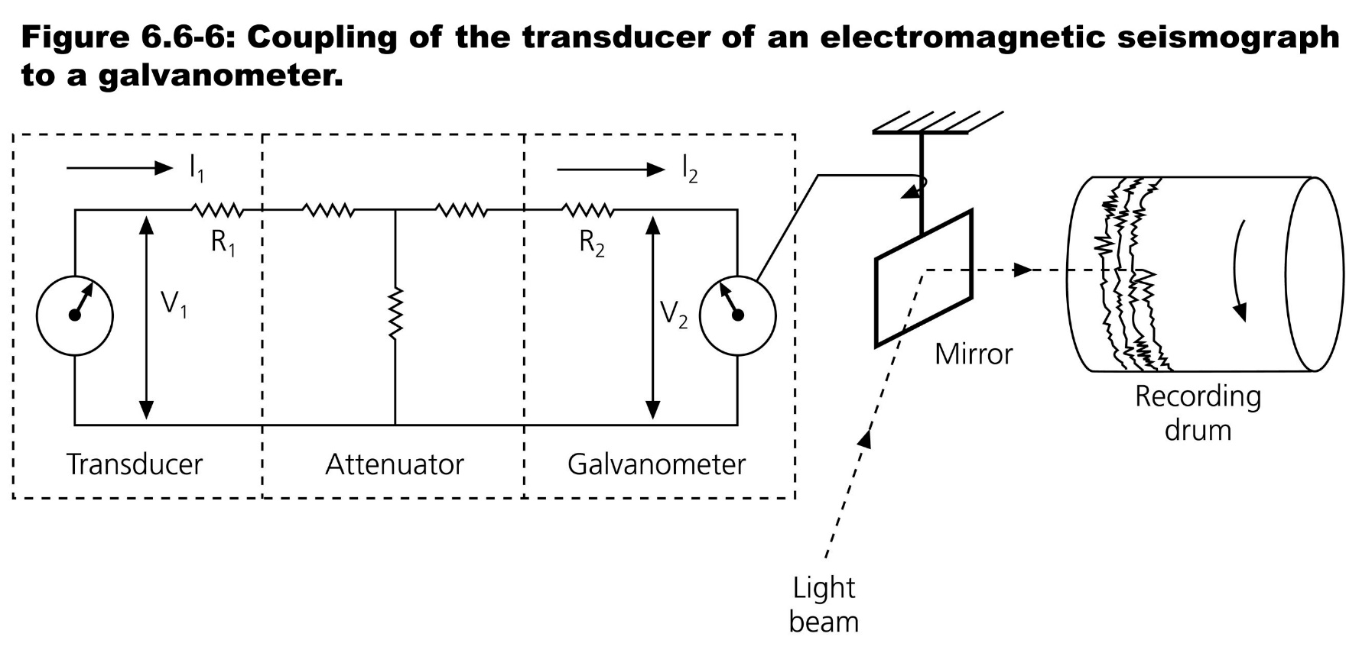
Deconvolution using the z-transform
Some practical aspects:
Instrument response is corrected for using the poles and zeros of the inverse filters
Using z=exp(iωΔt) leads to causal minimum phase filters.
Computational Geophysics and Data Analysis

Slide 18
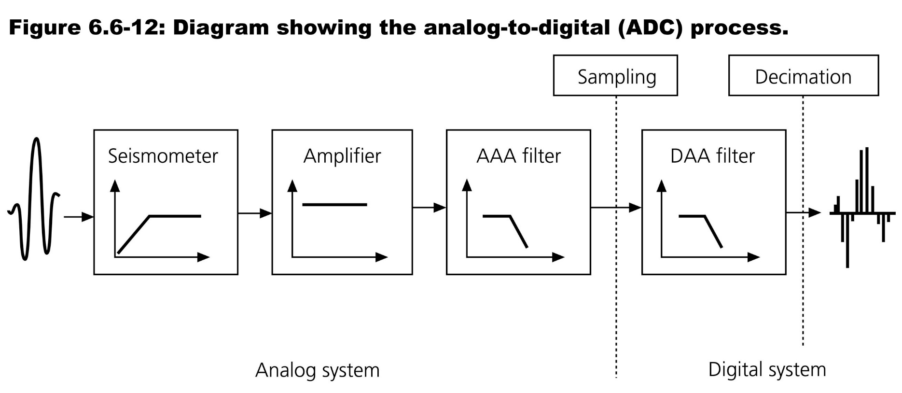
A-D conversion
AAA Analog Anti-Alias
DAA Ditigal Anti-Alias
Computational Geophysics and Data Analysis

Slide 19
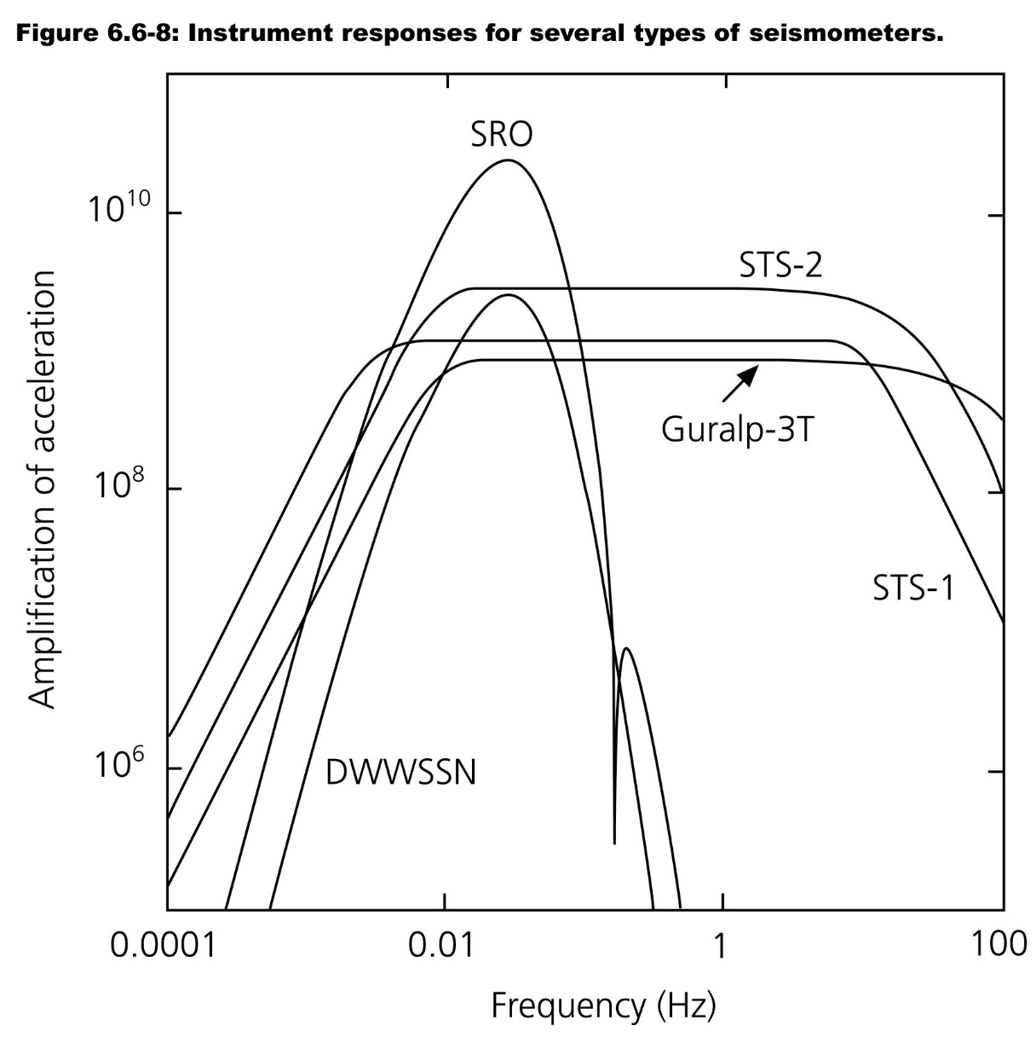
Response functions to correct …
Computational Geophysics and Data Analysis

Slide 20
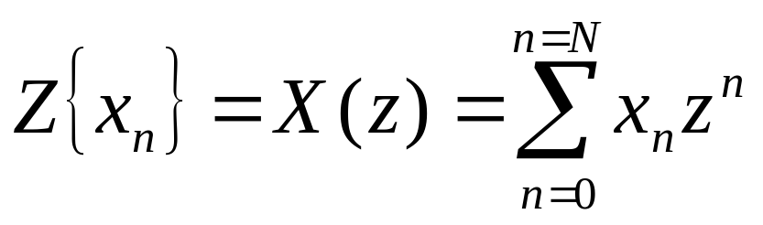
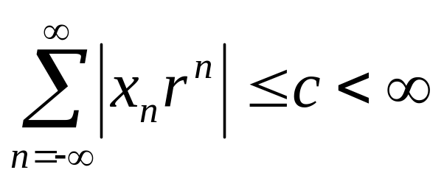
The z-transform
for finite n we get
Z-transformed signals do not necessarily converge for all z. One can identify a region in which the function is regular. Convergence is obtained with r=|z| for
Computational Geophysics and Data Analysis

Slide 21
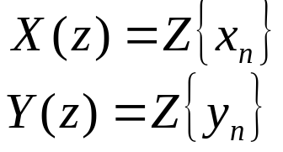
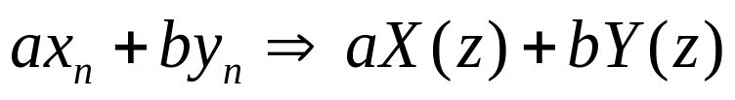
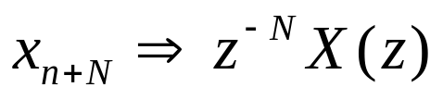
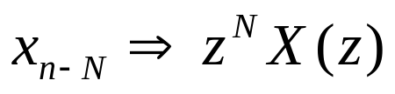
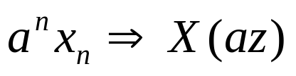
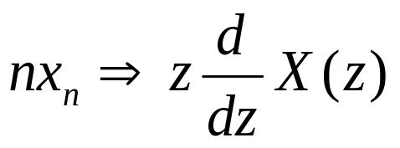
The z-transform: theorems
let us assume we have two transformed time series
Linearity:
Advance:
Delay:
Multiplication:
Multiplication n:
Computational Geophysics and Data Analysis

Slide 22
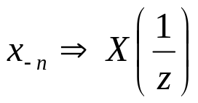
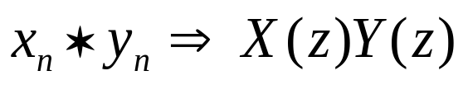
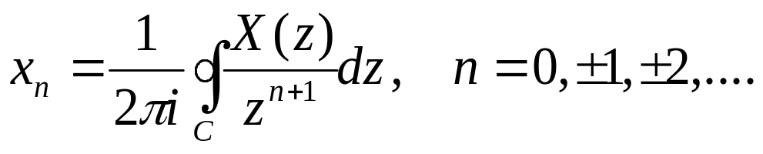
The z-transform: theorems
… continued
Time reversal:
Convolution:
… haven‘t we seen this before? What about the inversion, i.e., we know X(z) and we want to get x_{n}
Inversion
Computational Geophysics and Data Analysis

Slide 23

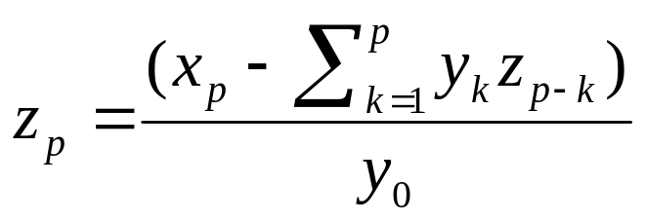
The z-transform: deconvolution
Convolution:
If multiplication is a convolution, division by a z-transform is the deconvolution:
Under what conditions does devonvolution work? (Gubbins, p. 19)
-> the deconvolution problem can be solved recursively
… provided that y₀ is not 0!
Computational Geophysics and Data Analysis

Slide 24
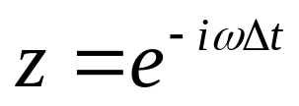
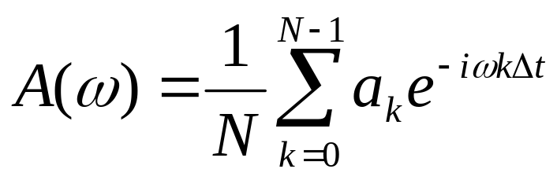
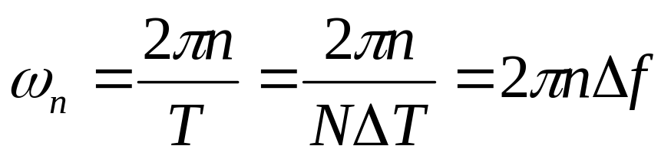
From the z-transform to the discrete Fourier transform
Let us make a particular choice for the complex variable z
We thus can define a particular z transform as
this simply is a complex Fourier serie. Let us define (Δf being the sampling frequency)
Computational Geophysics and Data Analysis

Slide 25
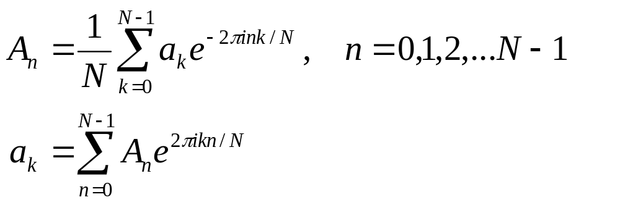
From the z-transform to the discrete Fourier transform
This leads us to:
… which is nothing but the discrete Fourier transform. Thus the FT can be considered a special case of the more general z-transform!
Where do these points lie on the z-plane?
Computational Geophysics and Data Analysis

Slide 26
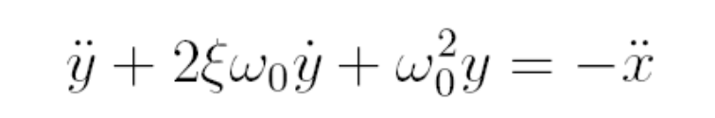
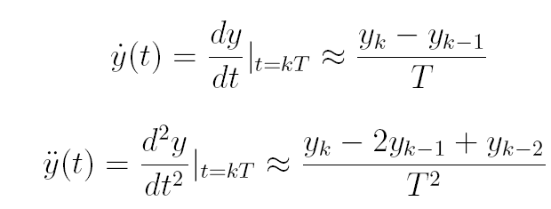
Discrete representation of a seismometer
… using the z-transform on the seismometer equation
… why are we suddenly using difference equations?
Computational Geophysics and Data Analysis

Slide 27
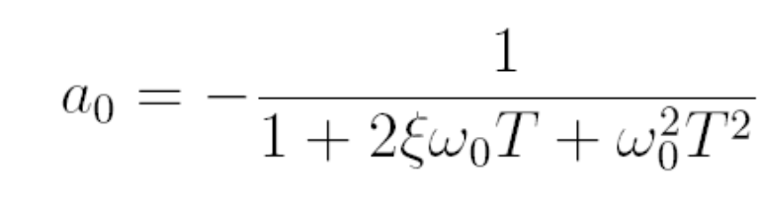
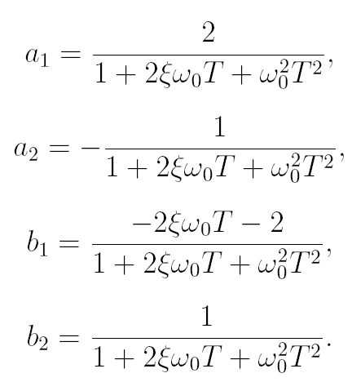
… to obtain …
Computational Geophysics and Data Analysis

Slide 28
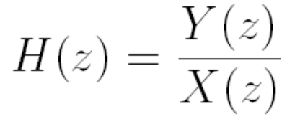
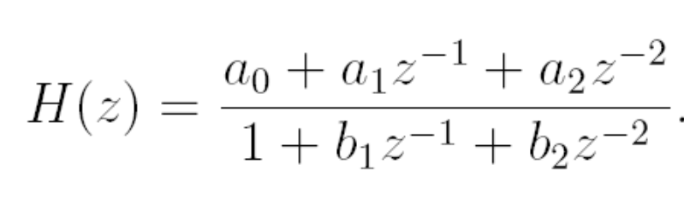
… and the transfer function
… is that a unique representation … ?
Computational Geophysics and Data Analysis

Slide 29
Further classifications and terms
MA moving average
FIR finite-duration impulse response filters
-> MA = FIR
Non-recursive filters - Recursive filters
AR autoregressive filters
IIR infininite duration response filters
Computational Geophysics and Data Analysis

Slide 30
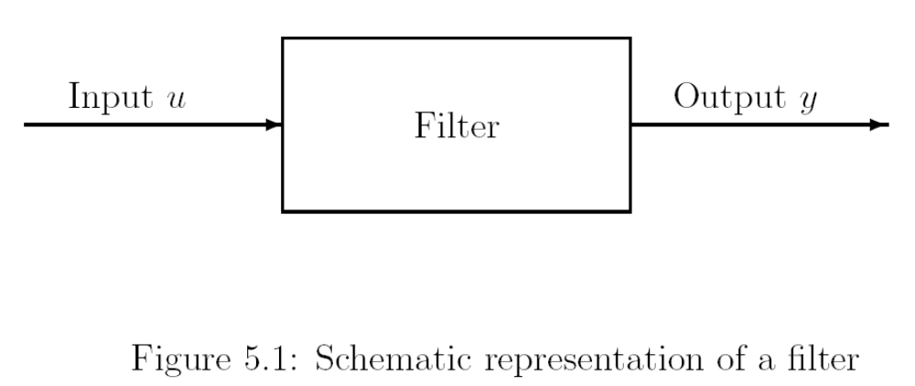
Filters revisited … using transforms …
Computational Geophysics and Data Analysis

Slide 31
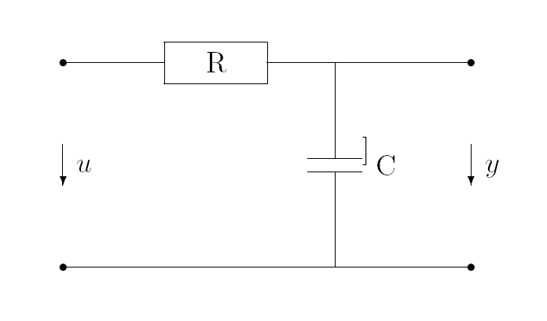
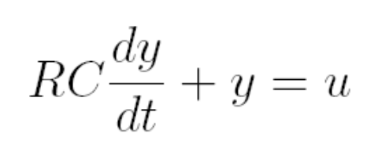
RC Filter as a simple analogue
Computational Geophysics and Data Analysis

Slide 32


Applying the Laplace transform
Computational Geophysics and Data Analysis

Slide 33


Impulse response
… is the inverse transform of the transfer function
Computational Geophysics and Data Analysis

Slide 34

… time domain …
Computational Geophysics and Data Analysis

Slide 35





… what about the discrete system?
Time domain
Z-domain
Computational Geophysics and Data Analysis

Slide 36

FIR filters
More on instrument response correction in the practicals
Computational Geophysics and Data Analysis

Slide 37

Inverse transform
The Laplace transform can be interpreted as a generalization of the Fourier transform from the real line (frequency axis) to the entire complex plane. The inverse transform is the Brimwich integral
Computational Geophysics and Data Analysis

Slide 38


Some transforms
Computational Geophysics and Data Analysis

Slide 39

… and characteristics
Computational Geophysics and Data Analysis

Slide 40
… cont‘d
Computational Geophysics and Data Analysis

Slide 41

Fourier vs. Laplace
Computational Geophysics and Data Analysis

Slide 42

Frequency response
Computational Geophysics and Data Analysis

