Slide 1
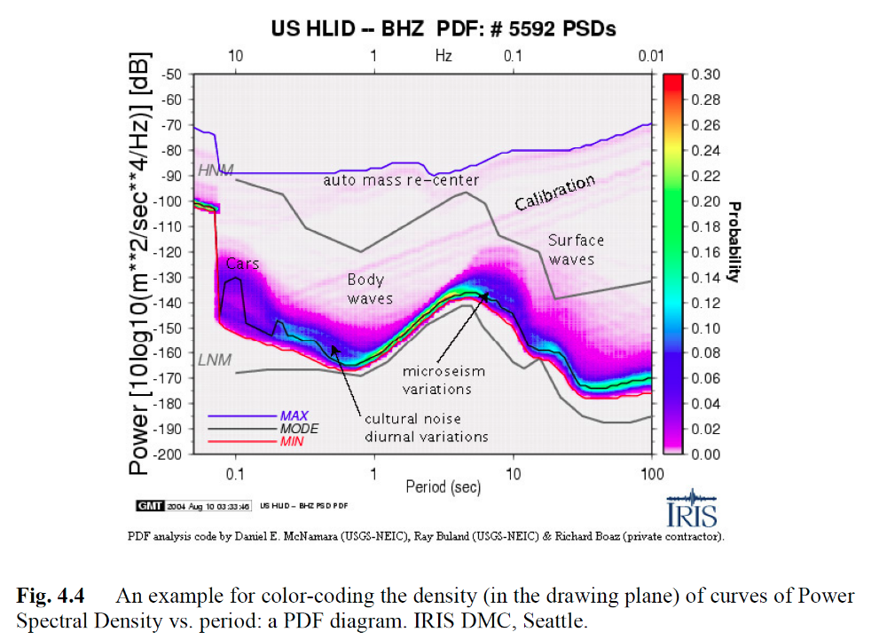
Power Spectral Density
Fundamental tool to characterize „noise“ (stationary signals)
Not physical power, but proportional to it
Not reversible (like the FFT)
Often applied (or displayed) for acceleration data [m/s²]
Motivation:
  Signals of different sampling intervals should have quantitatively the same power (or energy) spectrum
Computational Geophysics and Data Analysis

Slide 2
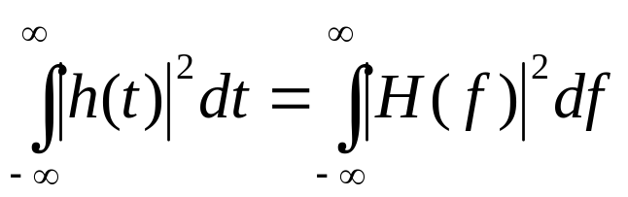
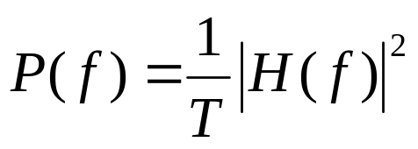
Energy and Power Spectra
The theorem by Parseval states the preservation of energy
Interpretation: The sum of the squared amplitude is the total energy of the system, thus |h(t)|² in the integral is the power and consequently |H(f)|² is the power spectral density (PSD) if it is normalized by the signal duration T (i.e., both sides are divided by T):
... this is the continuous world ...
Computational Geophysics and Data Analysis

Slide 3
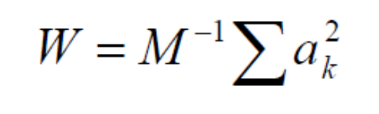
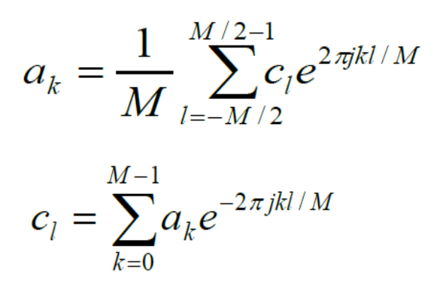
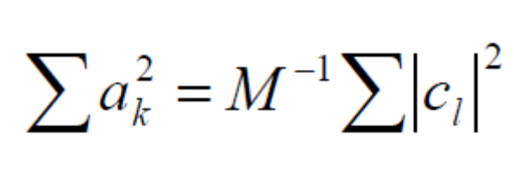
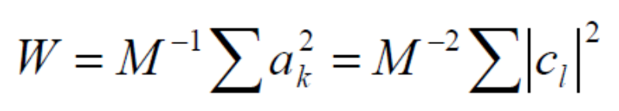
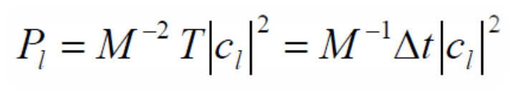
Energy and Power Spectra
... discrete world ...
DFT
Power of signal (average square)
Equivalence (DFT)
Thus ...
Each coefficient c_{l} stands for spectral contribution in 1/T bin
[ Amplitude²/Hz]
Discrete equivalent of PSD function (independent of sampling)[
Computational Geophysics and Data Analysis

Slide 4
Low Noise Model ... but ...
Amplitude units:
Acceleration m/s²
Computational Geophysics and Data Analysis

Slide 5
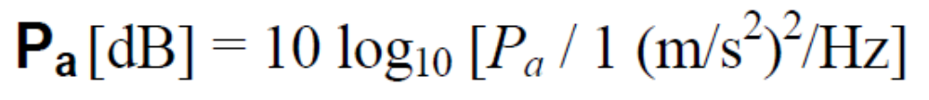
PSDs in db
Definition of db
Expressed as the ration of two amplitudes, or the ration with respect to some reference amplitude, we
Define this reference amplitude to be the unit of our PSD, e.g., 1 [(m/s²)²/Hz], thus
Value from original PSD
Computational Geophysics and Data Analysis

