Slide 1
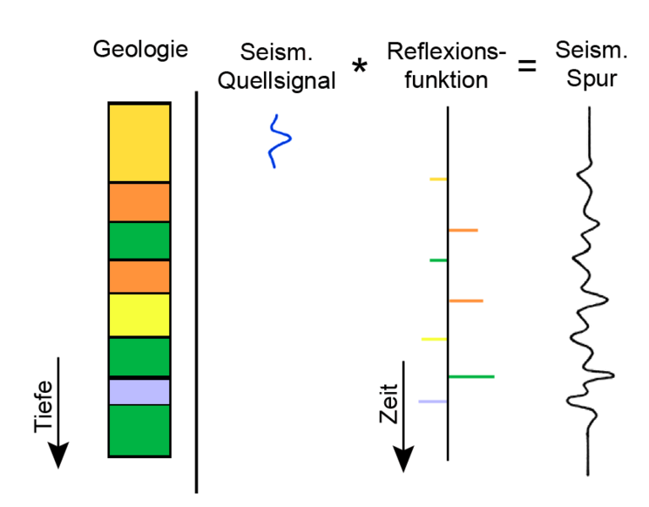
Linear Systems
Linear systems: basic concepts
Convolution/Deconvolution
Applications:
  Instrument response - correction
  Convolutional model for seismograms
  Stochastic ground motion
Scope: Understand that many problems in geophysics can be reduced to a linear system (filtering, tomography, inverse problems).
Computational Geophysics and Data Analysis

Slide 2
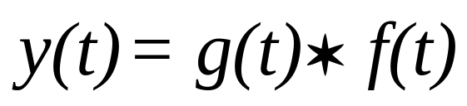
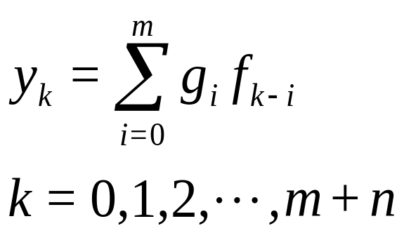
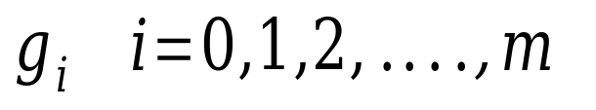
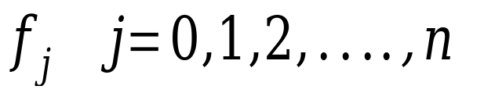
Discrete Convolution
This equation is explicitly coded in the Jupyter notebook example
Computational Geophysics and Data Analysis

Slide 3
Convolution
Impuls-Response
>> x
x =
0 0 1 0
>> y
y =
1 2 3
>> conv(x,y)
ans =
0 0 1 2 3 0
System Input
System Output

Slide 4
Convolution - Illustration
x
„Faltung“
y
y
x*y
0 1 0 0
0
1 2 3
0 1 0 0
0
1 2 3
0 1 0 0
1
1 2 3
0 1 0 0
2
1 2 3
0 1 0 0
3
1 2 3
0 1 0 0
0
1 2 3

Slide 5
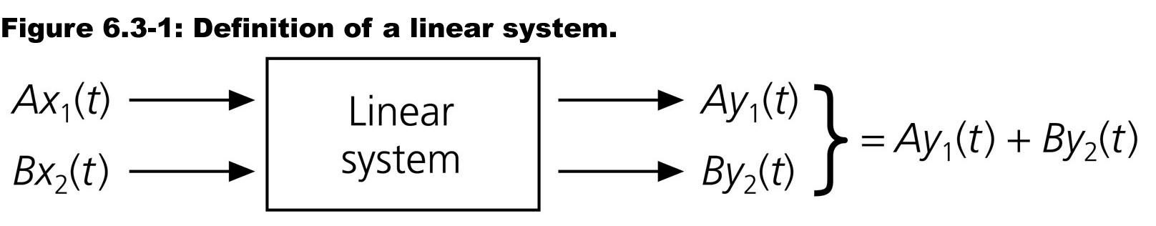
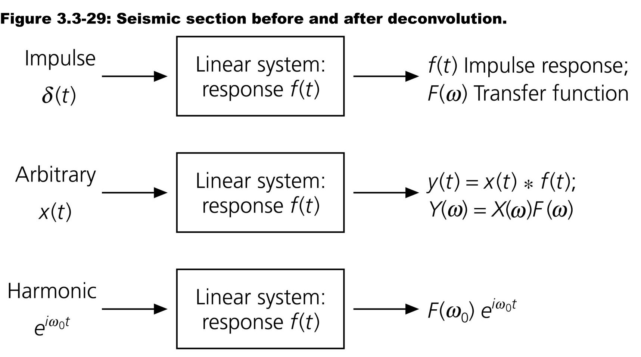
Linear Systems
Computational Geophysics and Data Analysis

Slide 6
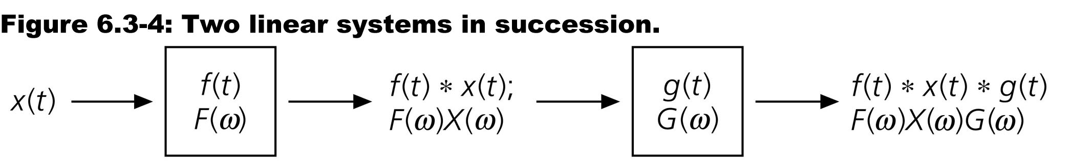
Convolution theorem
The output of a linear system is the convolution of the input and the impulse response (Green‘s function)
Computational Geophysics and Data Analysis

Slide 7
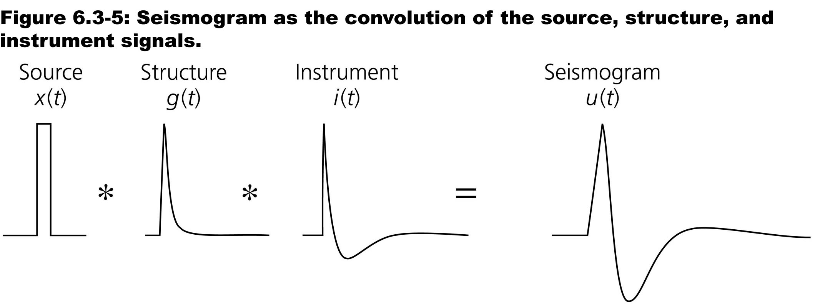
Example: Seismograms
-> stochastic ground motion
Computational Geophysics and Data Analysis

Slide 8
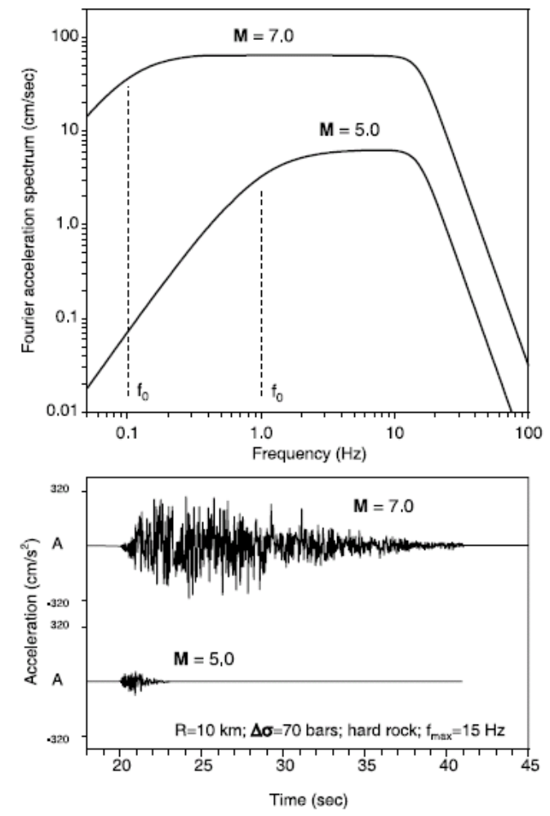
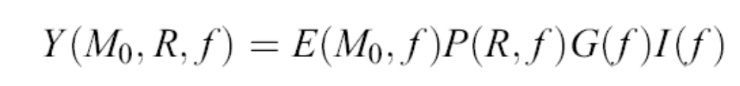
Stochastic ground motion modelling
Y strong ground motion
E source
P path
G site
I instrument or type of motion
f frequency
M₀ seismic moment
From Boore (2003)
Computational Geophysics and Data Analysis

Slide 9
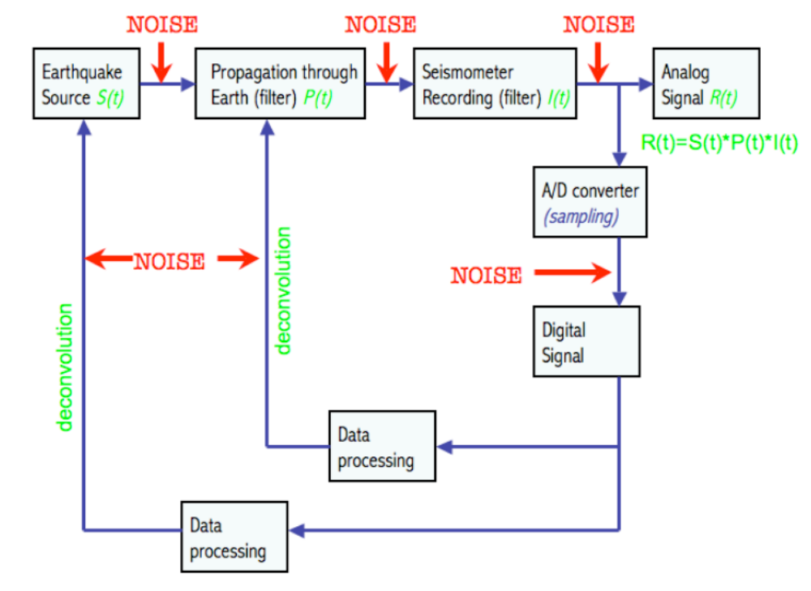
Earth system as filter
Computational Geophysics and Data Analysis

Slide 10
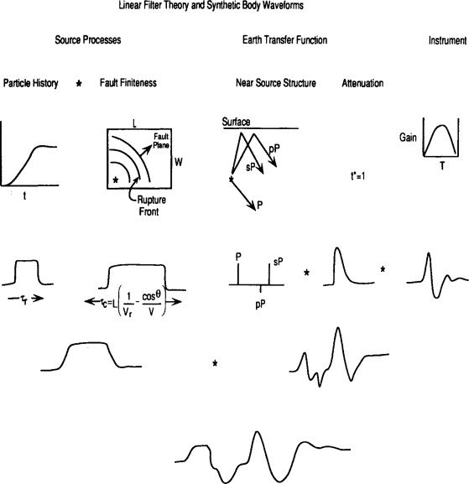
Earth as a Filter
Computational Geophysics and Data Analysis

Slide 11
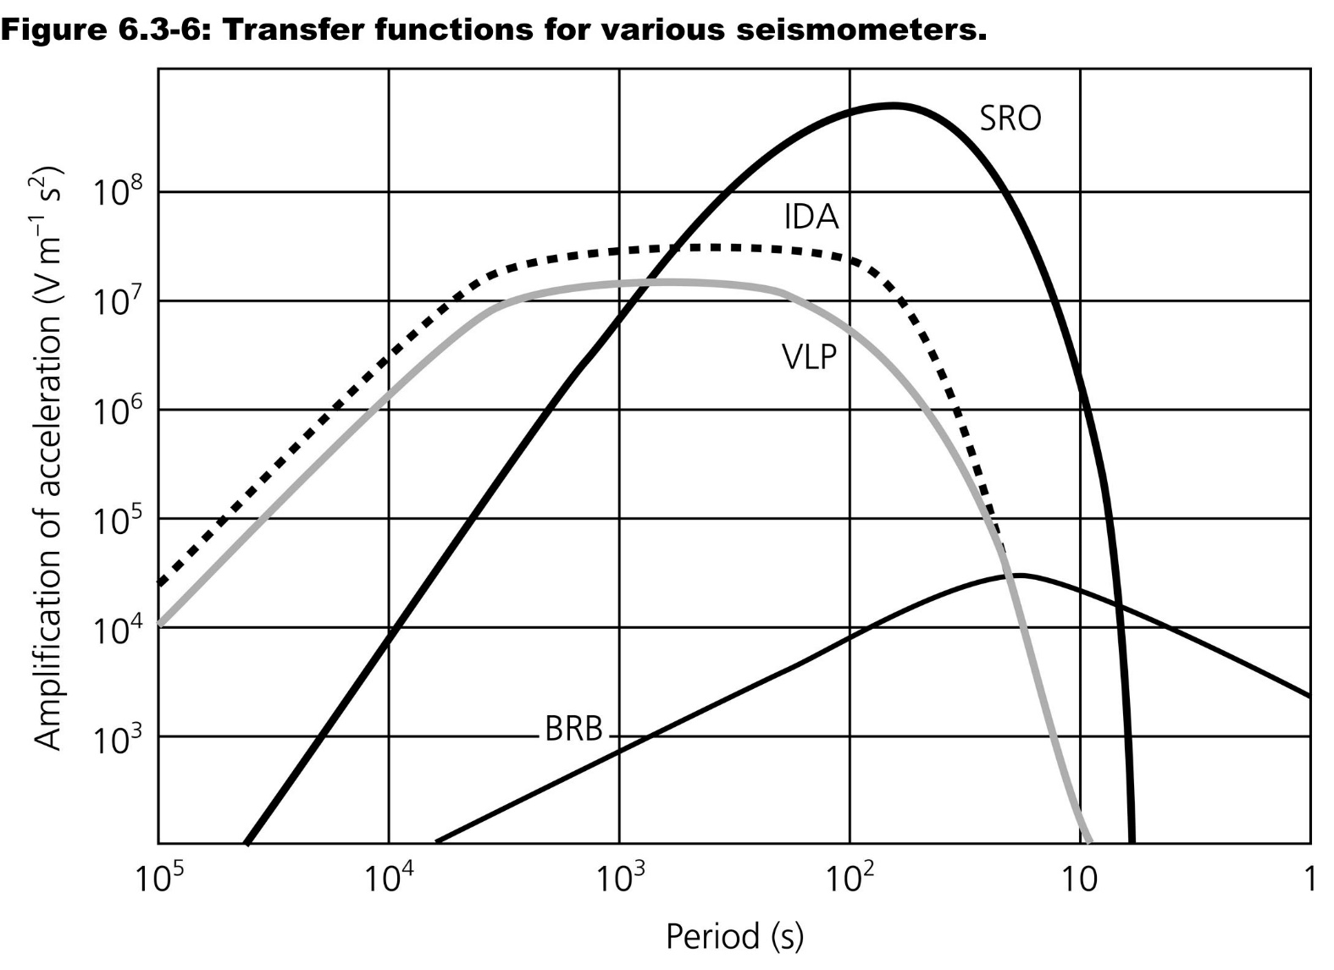
Example: Seismometer
Computational Geophysics and Data Analysis

Slide 12
Other sesimological linear systems
Computational Geophysics and Data Analysis

Slide 13
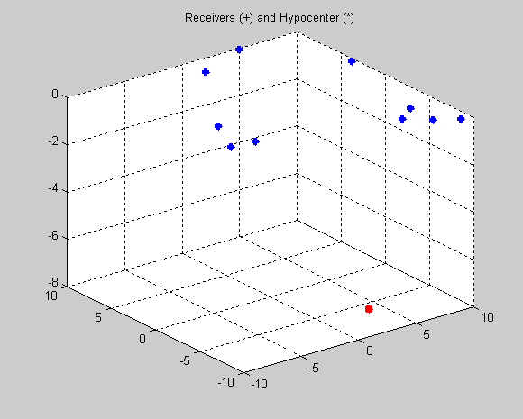
Convolutional model: seismograms
Computational Geophysics and Data Analysis

Slide 14
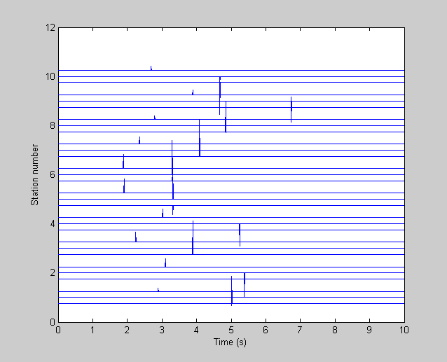
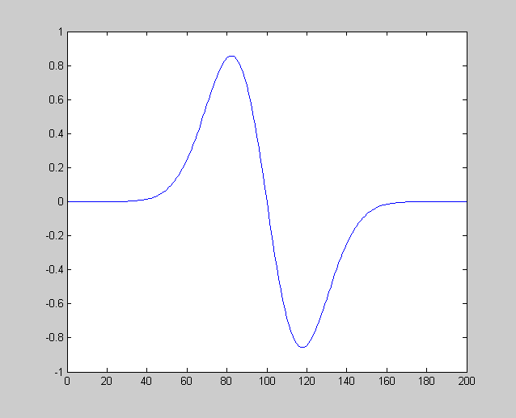
The seismic impulse response
Computational Geophysics and Data Analysis

Slide 15
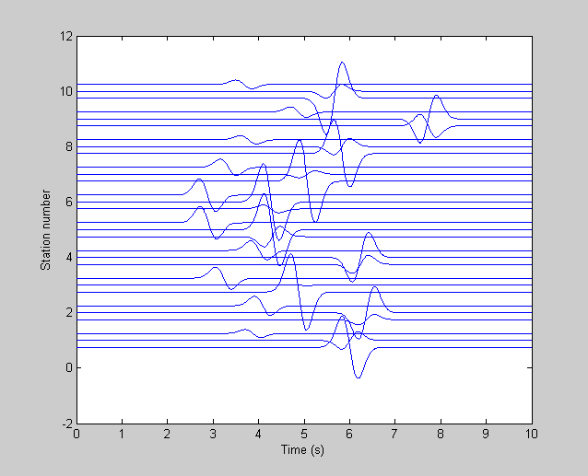
The filtered response
Computational Geophysics and Data Analysis

Slide 16
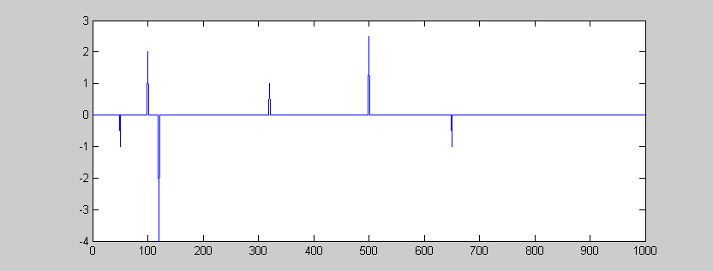
1D convolutional model of a seismic trace
The seismogram of a layered medium can also be calculated using a convolutional model ...
u(t) = s(t) * r(t) + n(t)
u(t) seismogram
s(t) source wavelet
r(t) reflectivity
Computational Geophysics and Data Analysis

Slide 17
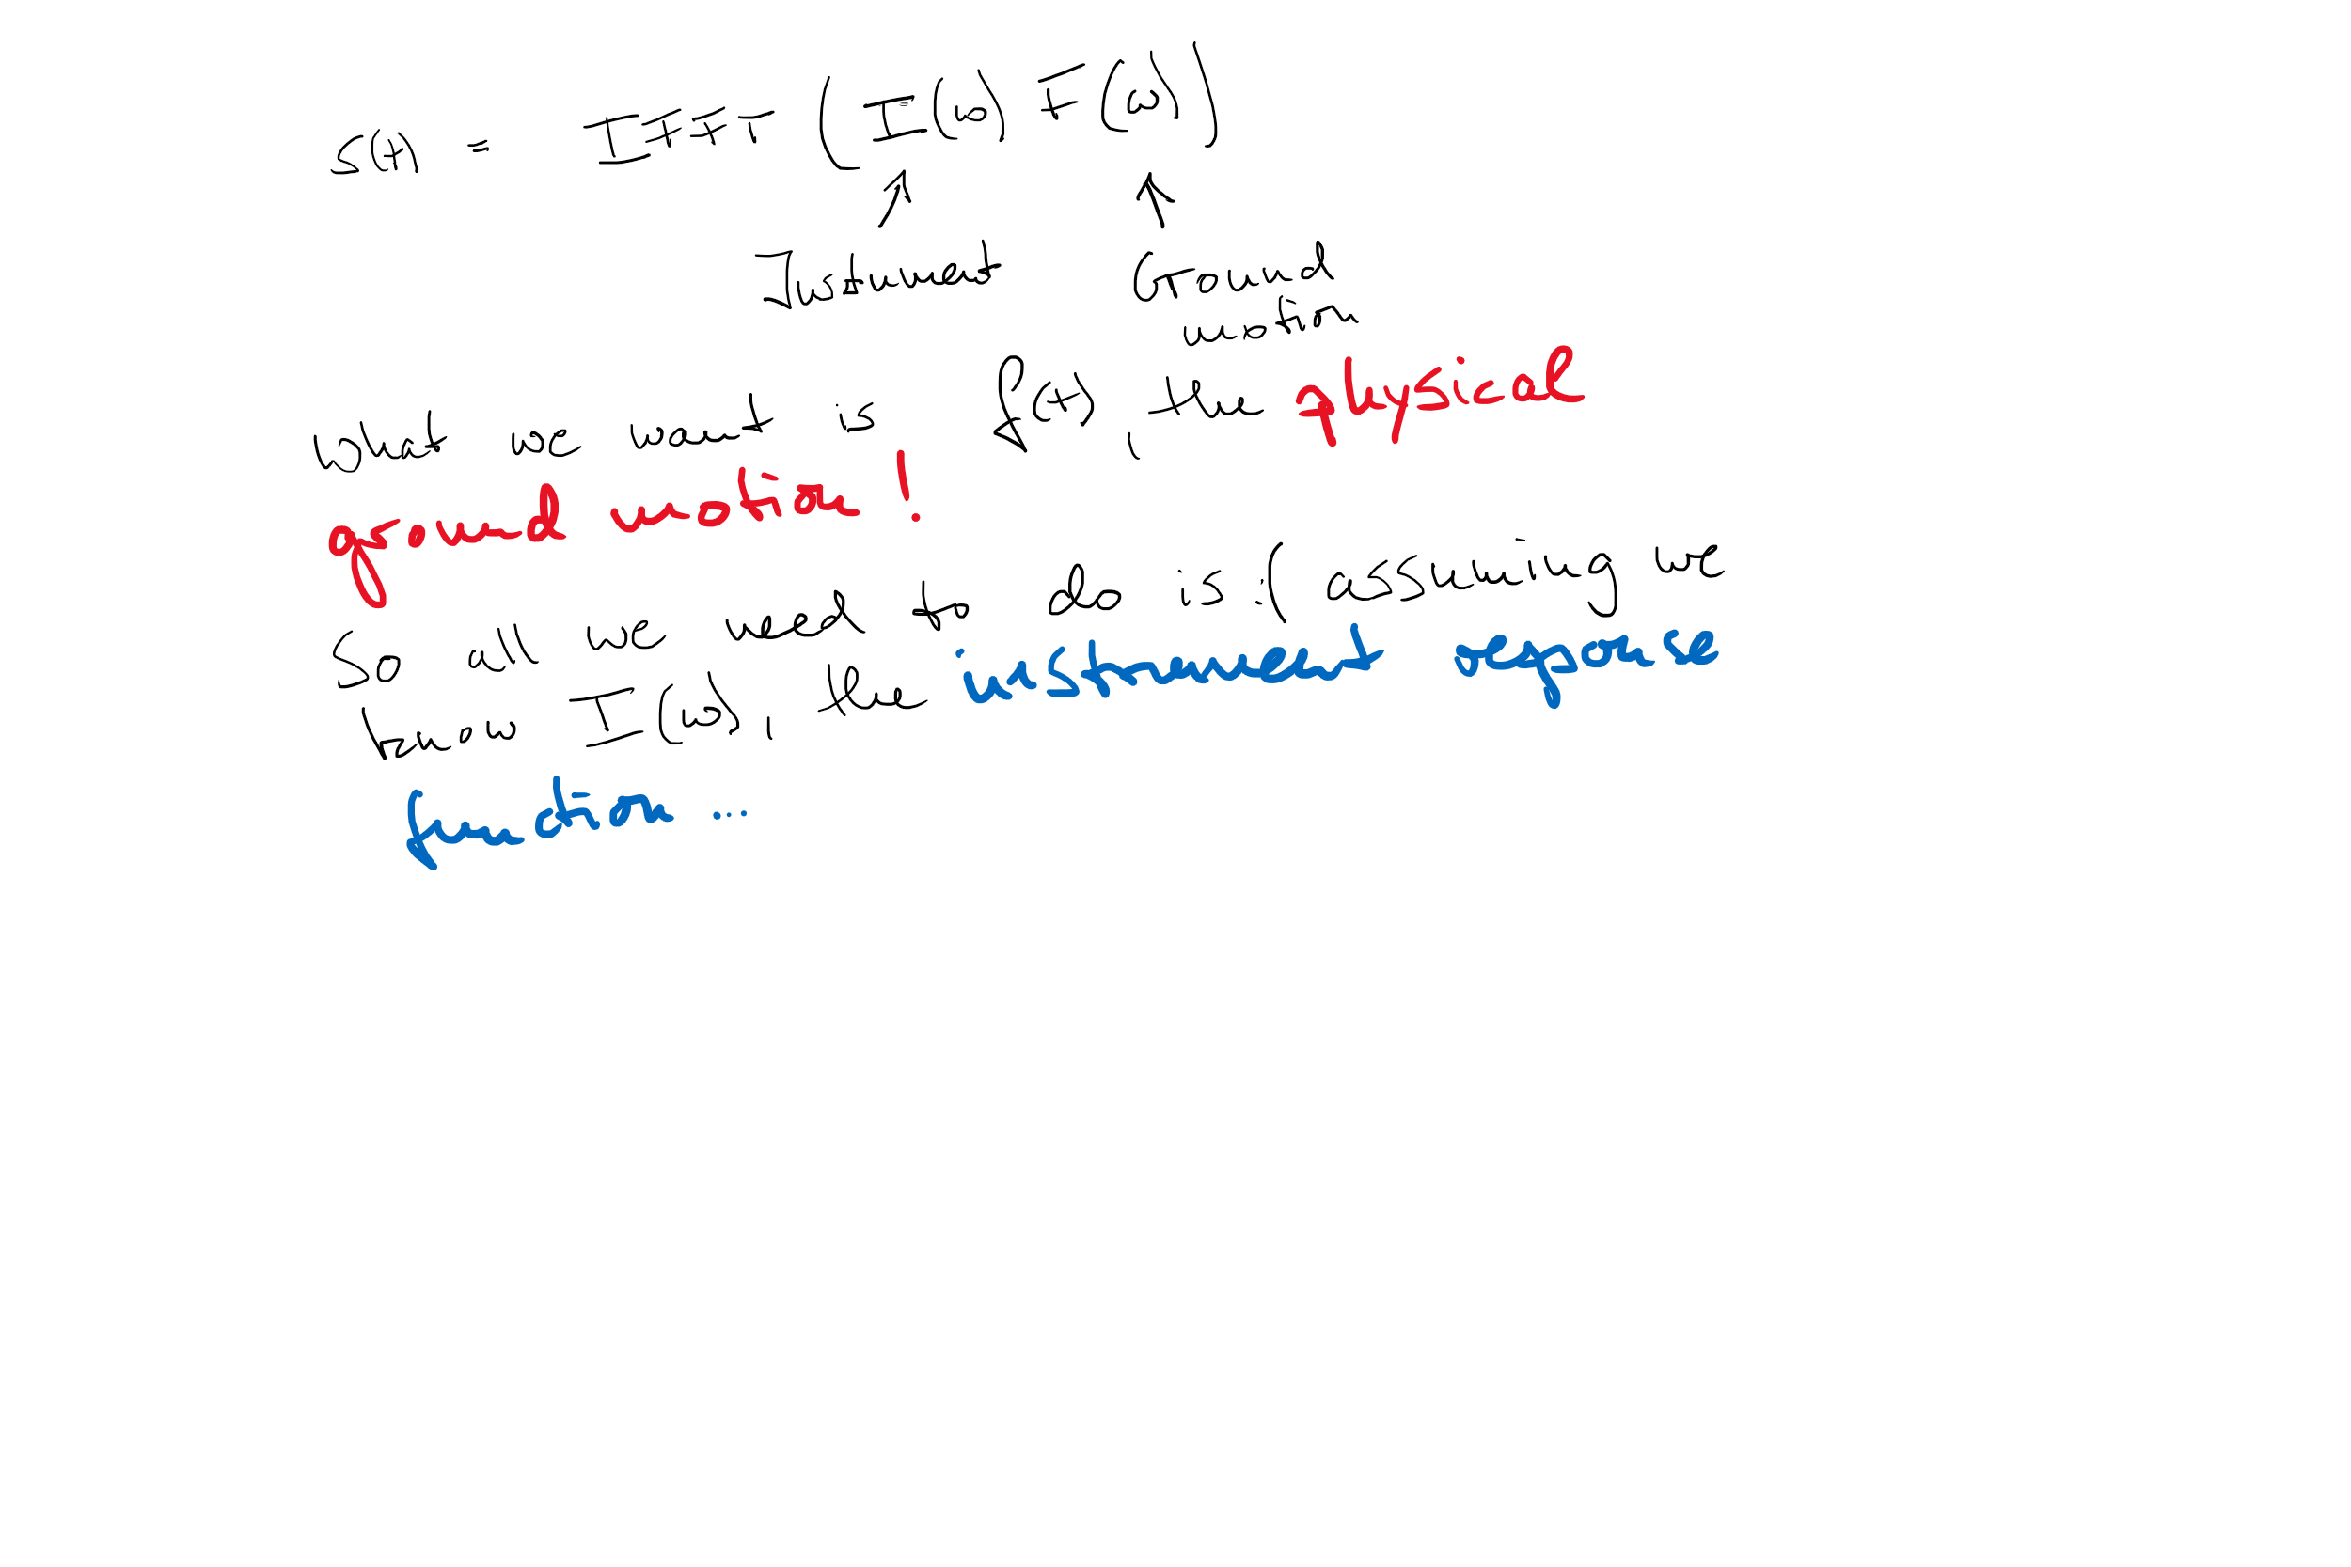
Deconvolution
When convolution is a spectral multiplication ....
Computational Geophysics and Data Analysis

Slide 18
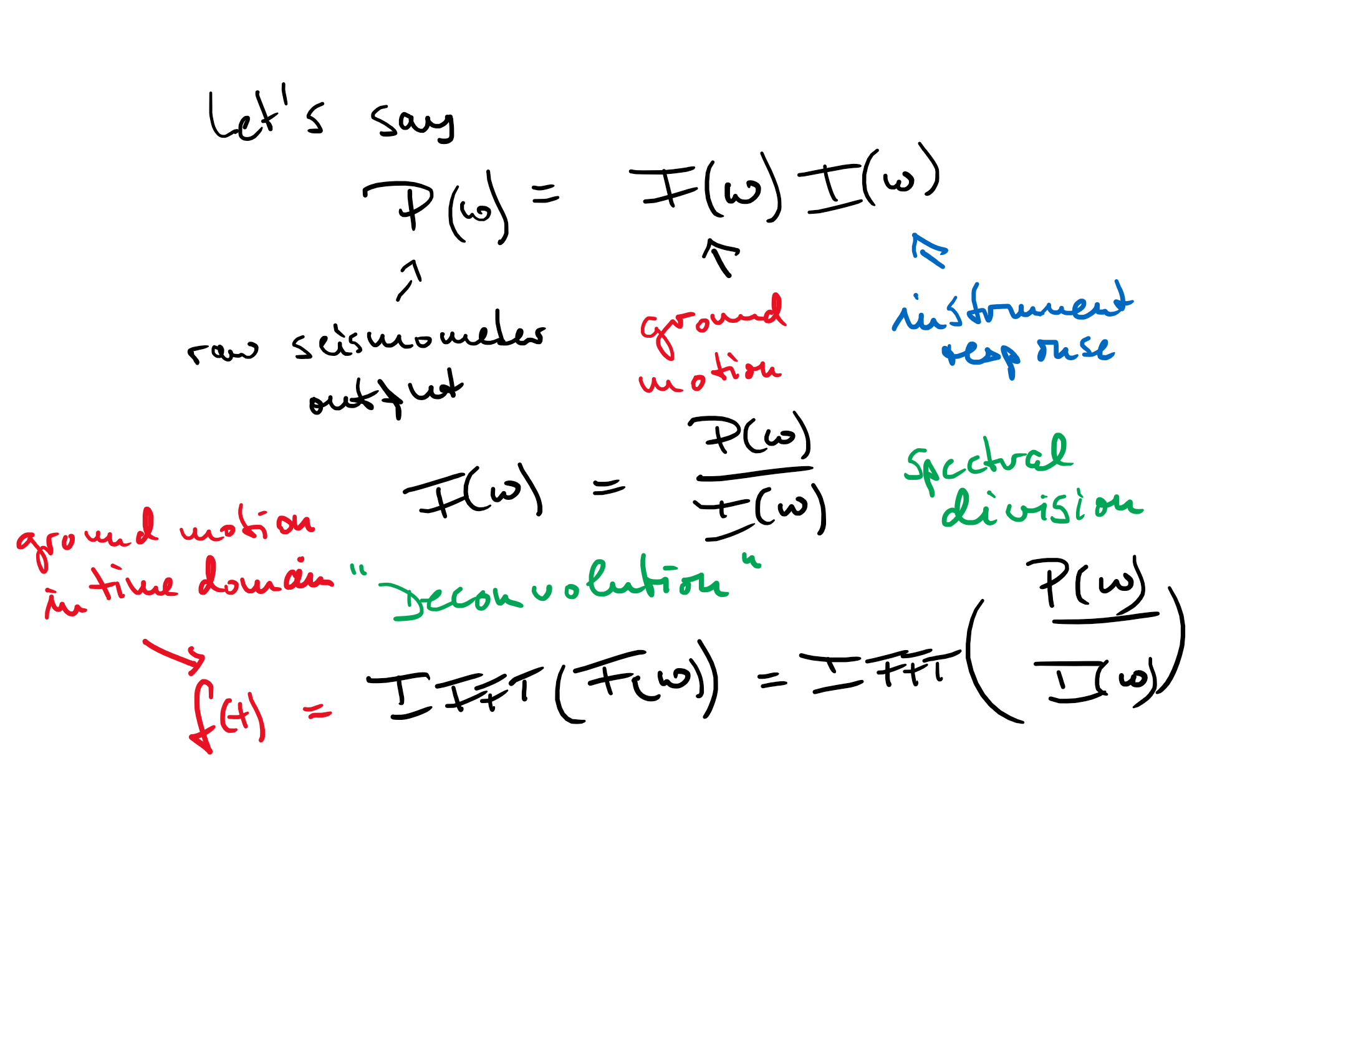
Deconvolution
... deconvolution is a spectral division ...
Computational Geophysics and Data Analysis

Slide 19
Deconvolution
Deconvolution is the inverse operation to convolution.
When is deconvolution useful?
Computational Geophysics and Data Analysis

Slide 20
Instrument Correction (in words)
The seismometer equation (pdf) characterizes the motion of a seismometer mass for a given physical ground motion input (exactly)
The question of how this mass reacts at each frequency leads to the „transfer function“ or „response function“ defined in the frequency domain
To characterize this function with as little information as possible we need other transforms (Laplace-, Z-)
As it is easy to transform an observed seismogram into the spectral domain, the true ground motion can be obtained by deconvolution
In practice, problems may arrise!
Computational Geophysics and Data Analysis

Slide 21
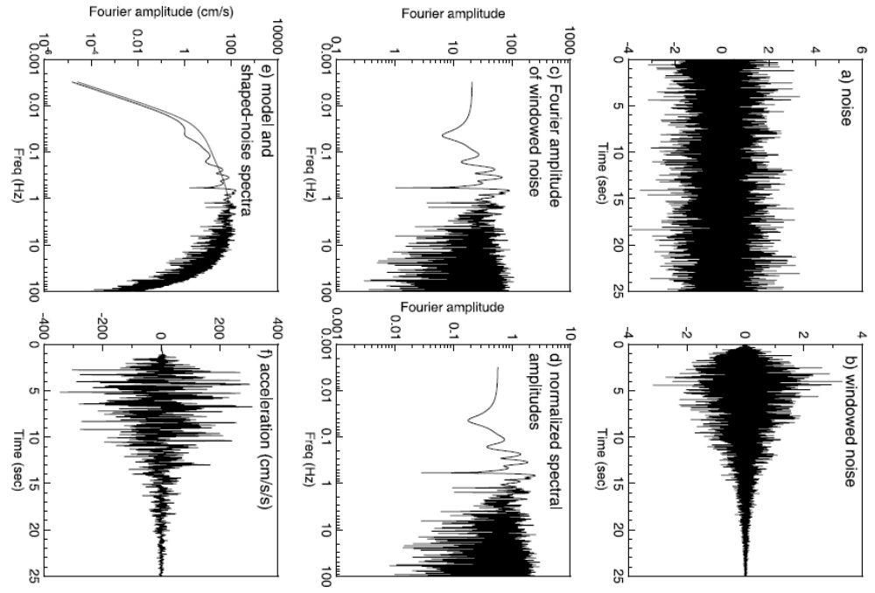
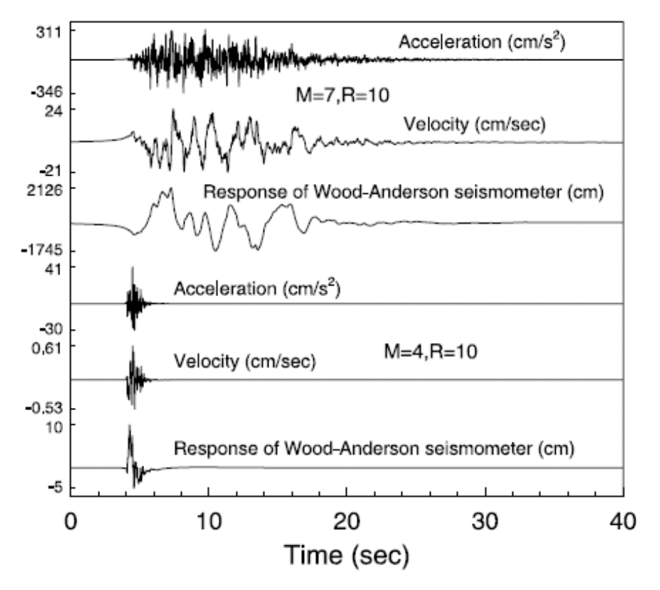
Examples
Computational Geophysics and Data Analysis

Slide 22
Summary
Many problems in geophysics can be described as a linear system
Deconvolution is tricky and usually done by convolving with an appropriate „inverse filter“ (e.g., instrument response correction“)
To avoid dividing by small numbers a „waterlevel“ term is introduced
Computational Geophysics and Data Analysis

