Slide 1
Other transforms (z-, Laplace-)
... required to understand instrument correction procedures and filtering theory ...
... or where do the „poles and zeros“ come from?
Computational Geophysics and Data Analysis

Slide 2
Question
What is the best way of describing the frequency response (transfer function, filter) of a linear system (e.g., a seismometer)
Computational Geophysics and Data Analysis

Slide 3
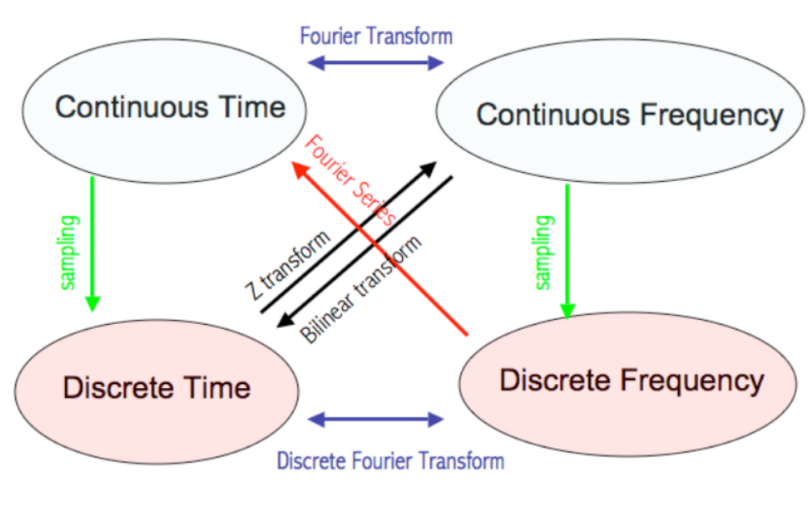
Various spaces and transforms
Computational Geophysics and Data Analysis

Slide 4
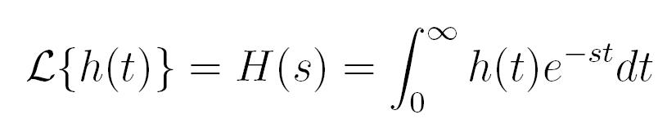
Laplace transform
Goal: we are seeking an opportunity to formally analyze linear dynamic (time-dependent) systems. Key advantage: differentiation and integration become multiplication and division (compare with log operation changing multiplication to addition).
Computational Geophysics and Data Analysis

Slide 5
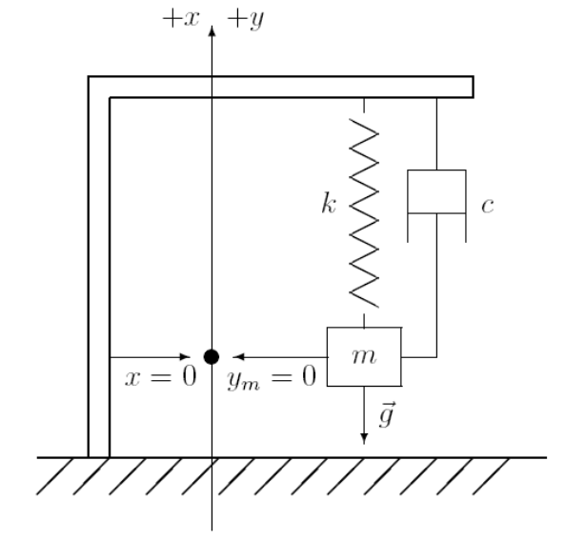
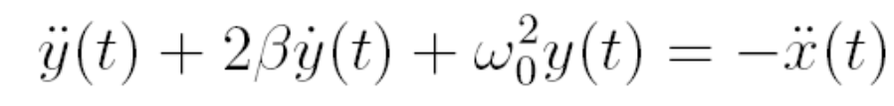
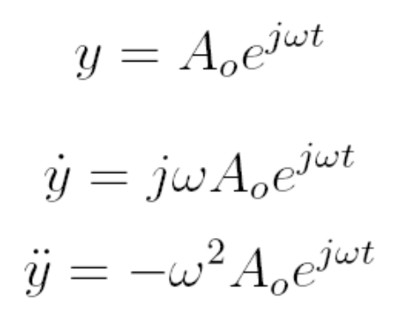
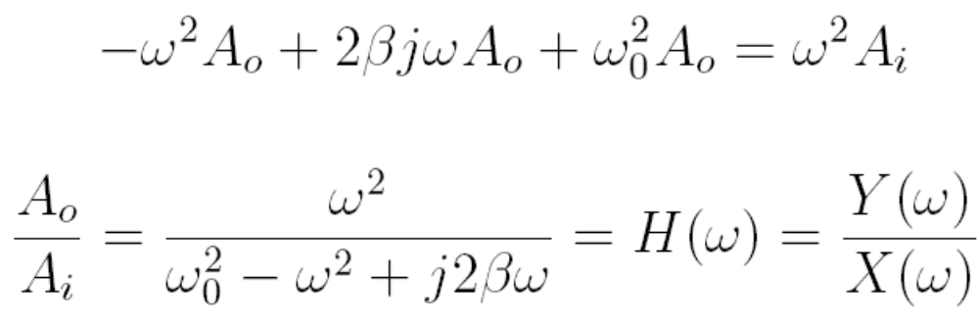
Application to seismometer
Remember the seismometer equation
Computational Geophysics and Data Analysis

Slide 6
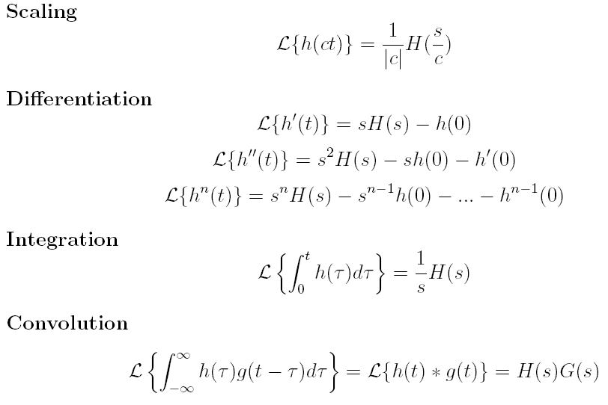
Some properties of the Laplace transformation
Computational Geophysics and Data Analysis

Slide 7
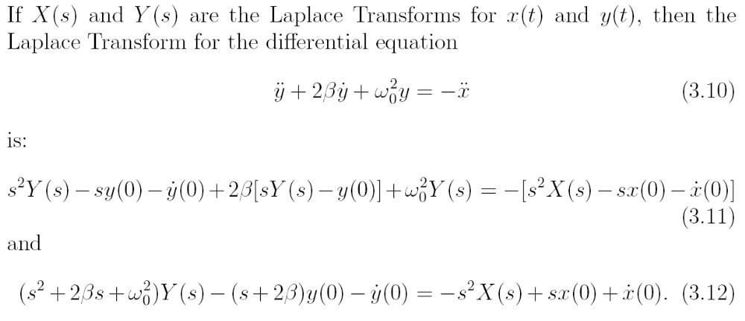
… using Laplace
Computational Geophysics and Data Analysis

Slide 8
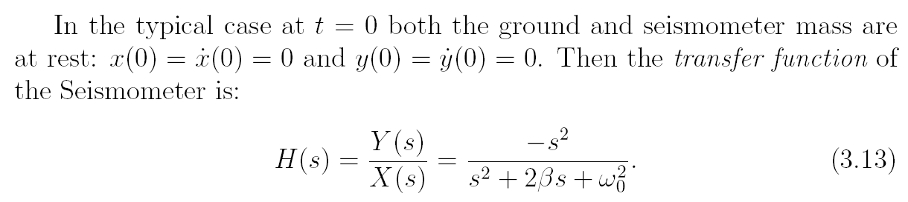
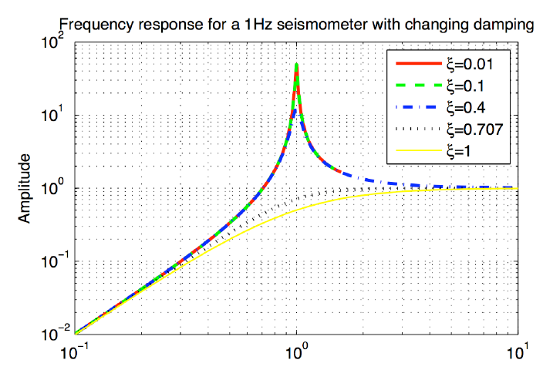
Transfer function
Computational Geophysics and Data Analysis

Slide 9
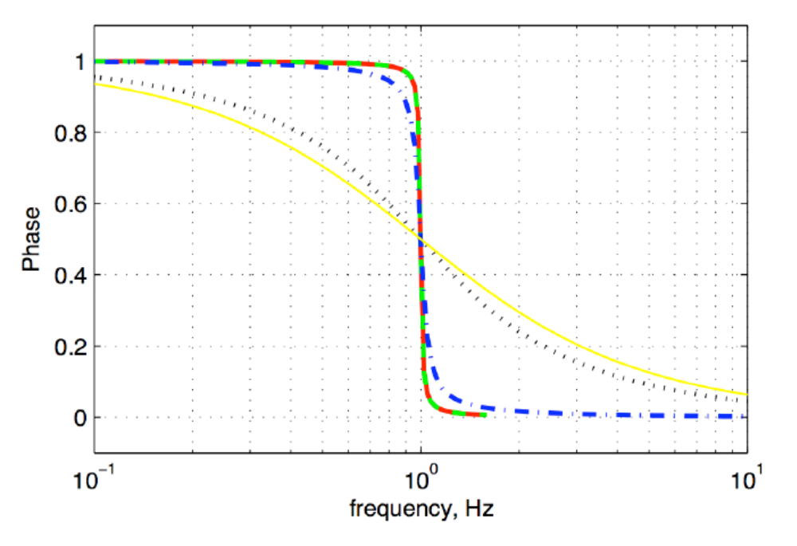
… phase response …
Computational Geophysics and Data Analysis

Slide 10
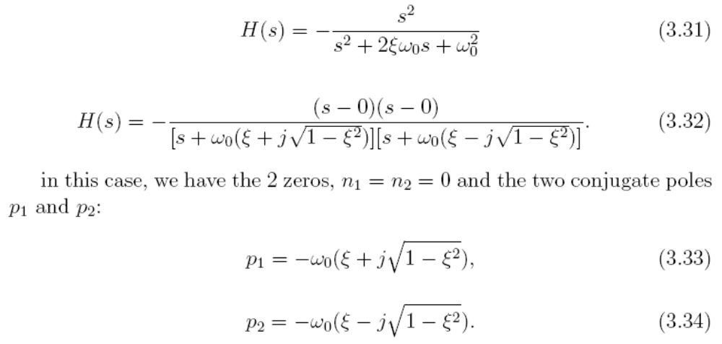
Poles and zeroes
If a transfer function can be represented as ratio of two polynomials, then we can alternatively describe the transfer function in terms of its poles and zeros. The zeros are simply the zeros of the numerator polynomial, and the poles correspond to the zeros of the denominator polynomial
Computational Geophysics and Data Analysis

Slide 11
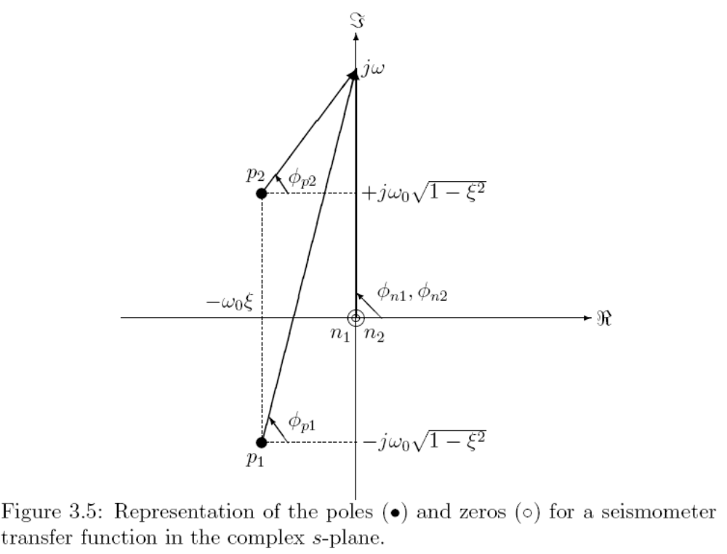
… graphically …
Computational Geophysics and Data Analysis

Slide 12
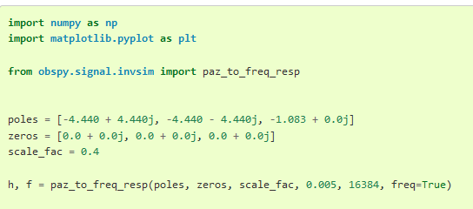
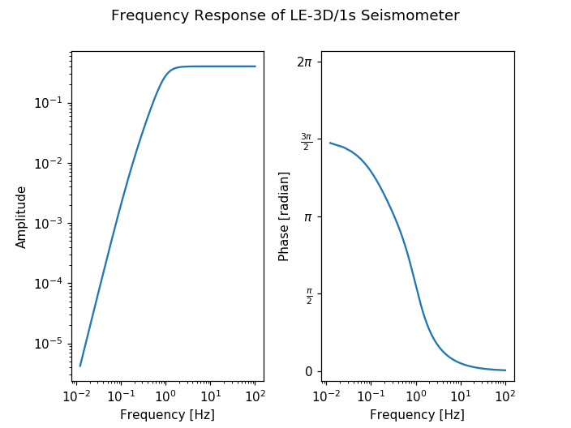
Poles and zeros
Seismogram metadata contain information on the seismometer transfer function (instrument response)
This response describes how each frequency is modified by the seismometer
It needs to be corrected for to obtain true ground motion (instrument correction)
This instrument response function is described by poles and zeros simply because it‘s the most compact way of desribing that function mathematically
Poles and zeros originate from the solution of the transfer function using Laplace transforms
Computational Geophysics and Data Analysis

Slide 13
This is the end
Computational Geophysics and Data Analysis

