Slide 1
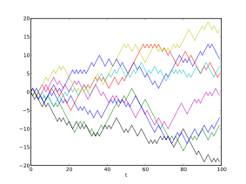

Bayesian analysis: a brief introduction
Robert West
University College London
@robertjwest
Image from Wikipedia

Slide 2
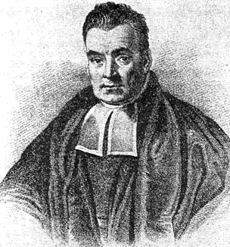
Thomas Bayes (1701 – 1761)
An English statistician, philosopher and Presbyterian minister who formulated Bayes' theorem. Bayes never published what would eventually become his most famous accomplishment; his notes were edited and published after his death by Richard Price. (Wikipedia)

Slide 3
Some key advantages of Bayesian analysis
It provides a rational way of revising beliefs with each new piece of data
It tests the experimental hypothesis directly, rather than the null hypothesis
It can be undertaken at any point in a data-gathering exercise without incurring a penalty for ‘data peeking’ and so makes much more efficient use of resources
It prevents the common mistake of confusing ‘lack of clear evidence for an effect’ with ‘no effect’

Slide 4
What is probability?
Interpretation of probability | Description | Example: Probability of rolling a 6 from a die roll
Frequentist | Long-run proportion | The long-run proportion of times a 6 will occur
Bayesian | Justified strength of belief | A justified strength of belief that a 6 will occur on a given roll
The Bayesian approach applies to all situations where there is uncertainty, not just ones where there is presumed to be an indefinite sequence of similar situations

Slide 5
Bayes-Price Rule
A rule for updating strength of belief in a hypothesis (H1), relative to another hypothesis (H0), in the light of evidence
Example
H1: Varenicline is more effective than nicotine transdermal patch at helping smokers to stop
H0: There is no difference between varenicline and nicotine transdermal patch
Evidence: Findings from an RCT comparing the two types of treatment

Slide 6
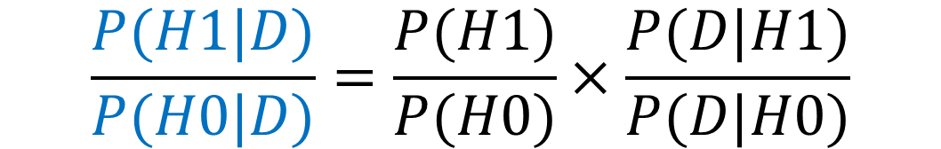
Bayes-Price Rule
$$\frac{P(H1|D)}{P(H0|D)}=\frac{P(H1)}{P(H0)}×\frac{P(D|H1)}{P(D|H0)}$$
P(H1|D) is the probability that H1 is true given data, D
P(H0|D) is the probability that H0 is true given data, D
P(D|H1) is the probability of observing D given H1
P(D|H0) is the probability of observing D given H0
P(H1)/P(H0) are the prior odds of H1 versus H0

Slide 7
Bayes-Price Rule
$$\frac{P(H1|D)}{P(H0|D)}=\frac{P(H1)}{P(H0)}×\frac{P(D|H1)}{P(D|H0)}$$
Posterior odds
Prior odds
Likelihood ratio
Aka ‘Bayes Factor’

Slide 8
Mrs Jones
Mrs Jones is pregnant. She is in a ‘high-risk’ group for the fetus having ‘sick baby syndrome (SBS)’ with prevalence of 1 in 100
There is a test for SBS which is 90% sensitive (picks up SBS 90% of the time if it present), and 90% specific (correctly indicates when SBS is not present 90% of the time)
Mrs Jones takes the test and it is positive (the ‘bad’ result)
What is the probability that the baby has SBS?

Slide 9
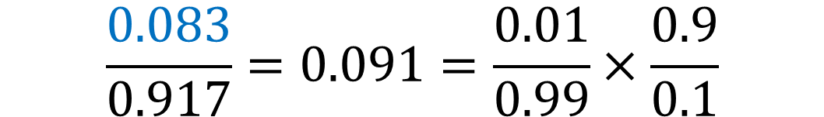
The answer is 8.3%
$$\frac{0.083}{0.917}=0.091=\frac{0.01}{0.99}×\frac{0.9}{0.1}$$
The reason it is so low is that the prior odds were only 1:99
‘Priors’ matter

Slide 10
Mrs Jones again
We now repeat the test using the probability of 0.08 to create the new prior odds
The result is once again positive (the ‘bad’ one)
What is the probability now that the baby has SBS?

Slide 11
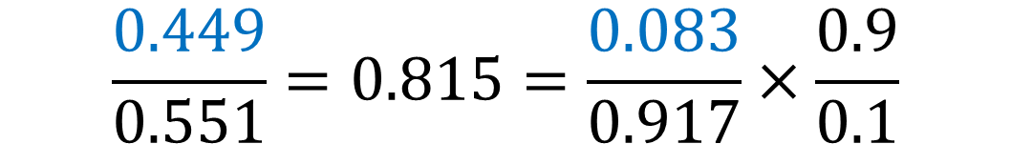
The answer is 44.9%
$$\frac{0.449}{0.551}=0.815=\frac{0.083}{0.917}×\frac{0.9}{0.1}$$
It is still less than 50% but it is climbing rapidly

Slide 12
Mrs Jones a third time
We now repeat the test using the probability of 0.45 to create the new prior odds
The result is once again positive (the ‘bad’ one)
What is the probability now that the baby has SBS?

Slide 13
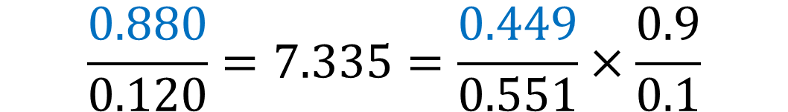
The answer is 88%
$$\frac{0.880}{0.120}=7.335=\frac{0.449}{0.551}×\frac{0.9}{0.1}$$
Now the probability is high, after 3 positive results
‘Priors’ can rapidly become less important as new data is accumulated

Slide 14
So what does a Bayesian analysis tell us?
As we collect more data it allows us to update our justified strength of belief in a hypothesis relative to another hypothesis
The more discriminating the data we collect, the greater its impact on our belief

Slide 15
Effect size estimation versus hypothesis testing
Bayesian analysis goes beyond working out Bayes Factors and Posterior Odds, to estimation of effect sizes with ‘credibility intervals’
Effect size estimation with credibility intervals is the Bayesian equivalent to ‘confidence intervals’ in frequentist statistics
As data are gathered Bayesian analysis cumulatively adjusts the effect size and its probability distribution: this can be more useful in many circumstances than comparative hypothesis testing because it provides a direct estimation of what one is trying to assess: how big is the effect?

Slide 16
Some key advantages of Bayesian analysis
It provides a rational way of revising beliefs with each new piece of data
It tests the experimental hypothesis directly, rather than the null hypothesis
It can be undertaken at any point in a data-gathering exercise without incurring a penalty for ‘data peeking’ and so makes much more efficient use of resources
It prevents the common mistake of confusing ‘lack of clear evidence for an effect’ with ‘no effect’

Slide 17
What has Bayesian analysis been used for?
Decrypting cyphers
Calculating insurance premiums
Face recognition
Identifying email SPAM
Courtroom decisions
Locating lost valuables (e.g. an A-bomb dropped in the ocean)

Slide 18
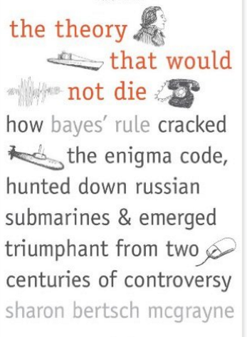
Further reading
A re-analysis of RCTs in Addiction: Beard E et al (2016) Using Bayes factors for testing hypotheses about intervention effectiveness in addictions research. Addiction, doi:10.1111/add.13501.
An example RCT: Brown J et al (2016) An Online Documentary Film to Motivate Quit Attempts Among Smokers in the General Population (4Weeks2Freedom): A Randomized Controlled Trial. Nicotine Tob Res. 2016 May;18(5):1093-100. doi: 10.1093/ntr/ntv161.
Zoltan Dienes’ Bayes Calculator: http://www.lifesci.sussex.ac.uk/home/Zoltan_Dienes/inference/Bayes.htm

