Slide 1
Bayesian data analysis: getting started
Matti Heino
www.mattiheino.com

Slide 2
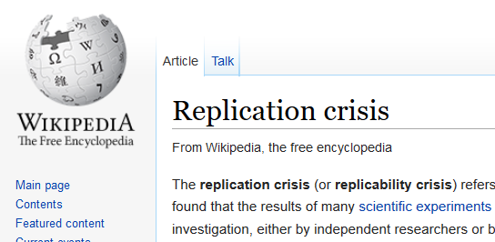

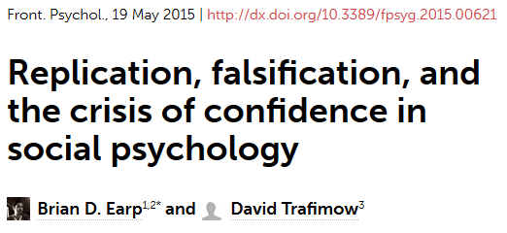

Slide 3
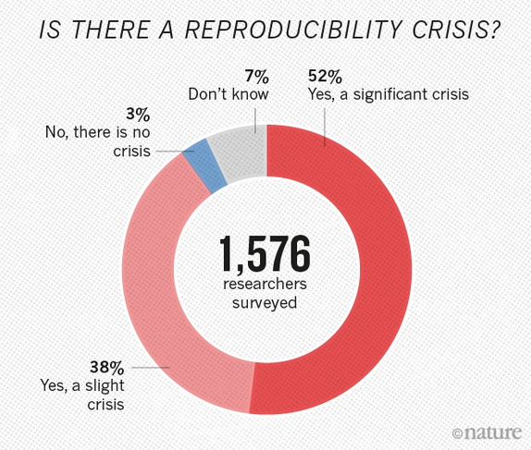
Link to source (Nature)

Slide 4
The good news...
The bad news...
Bayes may help! (if applied transparently and mindfully *)
BFs can be hacked, just as p-values currently are
Selective reporting will still undermine reliability of results **
Average power in good health psych journals only ~0.60 ***
* See e.g. link or link
** see link
*** see link

Slide 5
… but subjectivity is salient (think UFOs vs. Higgs boson)
BFs can be hacked, just as p-values currently are
Selective reporting will still undermine reliability of results **
Average power in good health psych journals only ~0.60 ***
* See e.g. link or link
** see link
*** see link

Slide 6
… but (maybe) we know to ask for more info
… but subjectivity is salient (think UFOs vs. Higgs boson)
BFs can be hacked, just as p-values currently are
Selective reporting will still undermine reliability of results **
Average power in good health psych journals only ~0.60 ***
* See e.g. link or link
** see link
*** see link

Slide 7
… but lack of evidence from small samples becomes clear
… but (maybe) we know to ask for more info
… but subjectivity is salient (think UFOs vs. Higgs boson)
BFs can be hacked, just as p-values currently are
Selective reporting will still undermine reliability of results **
Average power in good health psych journals only ~0.60 ***
* See e.g. link or link
** see link
*** see link

Slide 8


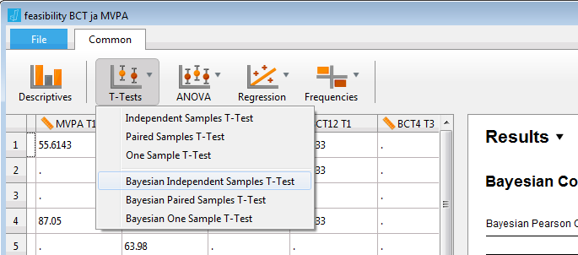
Tools of the trade
“The JASP Project aims to produce software for both Bayesian and Frequentist statistical analyses, that is easy to use and familiar to users of SPSS.”

Slide 9
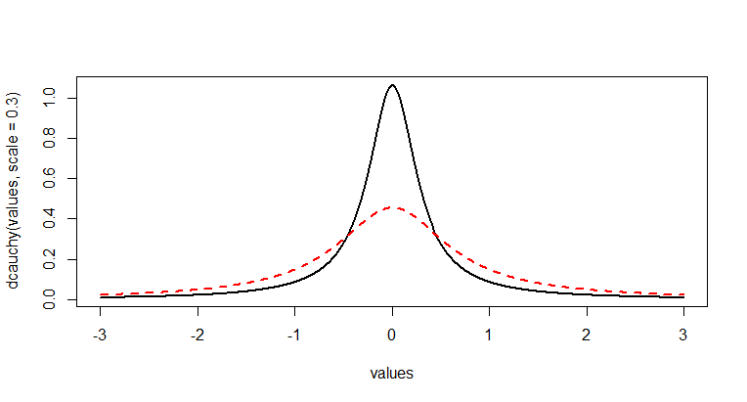
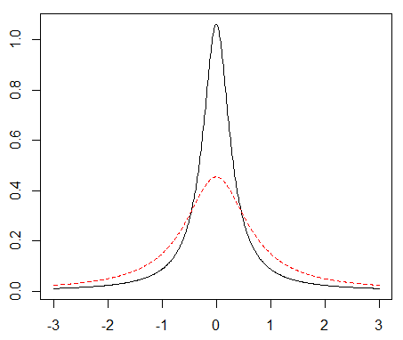
Tools of the trade
Need to determine “cauchy prior width” around zero
Default is .707 – not acceptable to many of our contexts!
Richard et al. (2003): average (Cohen’s) d in health psychology ~0.3
If you think half of your effects are between d = -0.3 and d = 0.3, you set width to 0.3

Slide 10
Example: BCT usage among girls and boys
“We did not detect a difference between boys and girls, t(439) = -0.773, p = 0.440”
“The results indicated moderate support for the null hypothesis of no difference between boys and girls (BF01 = 6.579)”
What’s under the hood?

Slide 11
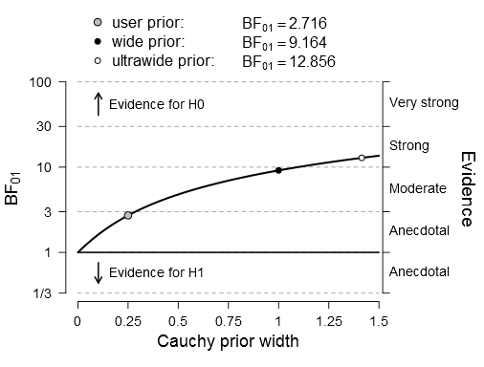
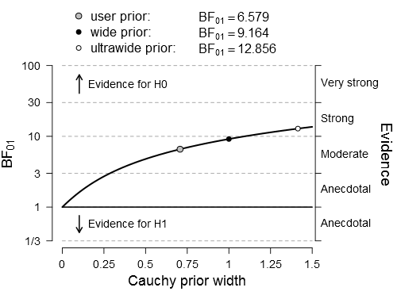
Prior width 0.707

Slide 12
Prior width 0.30

Slide 13

Prior width 0.30
You get these graphs from JASP with 2 clicks!

Slide 14
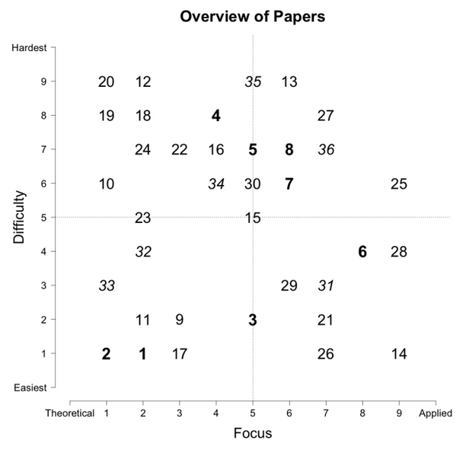
Resources
Etz et al. 2016:
“How to become a Bayesian in eight easy steps: An annotated reading list” [link]

Slide 15
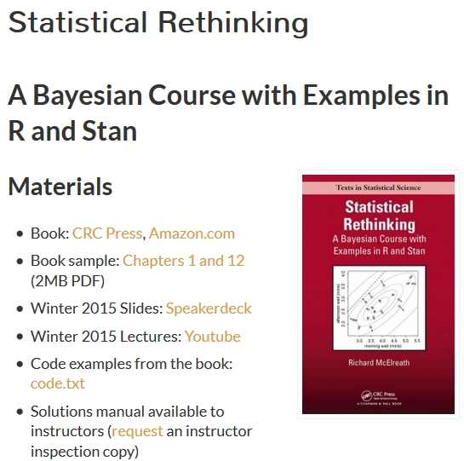
Resources
(A coding approach, no math needed!)
http://xcelab.net/rm/statistical-rethinking/

Slide 16


Thank you! Take home:
Transparency counteracts hacking
Subjective elements (e.g. priors) can and need to be justified
→ Lack of reporting space no issue nowadays
Pre-registration, data sharing, supplementary materials…
➡ e.g. store them at OSF: osf.io
www.mattiheino.com
@heinonmatti

Slide 17
Additional slides

Slide 18
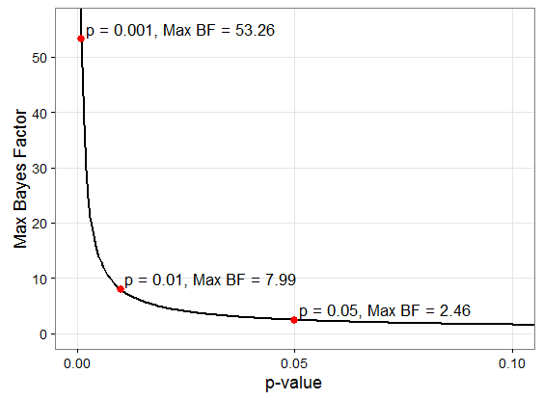
Maximum Bayes Factor for a given p-value
More info: https://alexanderetz.com/2016/06/19/understanding-bayes-how-to-cheat-to-get-the-maximum-bayes-factor-for-a-given-p-value/
Notes:
Alexander Etz ‏@AlxEtz Jun 13
@Research_Tim @lakens I'll make a quick blog about it this week. One answer: for p<~.4, its 1/[-e*p*ln(p)]
Alexander Etz ‏@AlxEtz Jun 13
@Research_Tim @lakens try this r code 1/(-exp(1)*.05*log(.05))

Slide 19
Maximum Bayes Factor for a given p-value
More info: https://alexanderetz.com/2016/06/19/understanding-bayes-how-to-cheat-to-get-the-maximum-bayes-factor-for-a-given-p-value/
Notes:
Alexander Etz ‏@AlxEtz Jun 13
@Research_Tim @lakens I'll make a quick blog about it this week. One answer: for p<~.4, its 1/[-e*p*ln(p)]
Alexander Etz ‏@AlxEtz Jun 13
@Research_Tim @lakens try this r code 1/(-exp(1)*.05*log(.05))

Slide 20
Maximum Bayes Factor for a given p-value
1 in 9 chance you’re wrong if start with 50% probability
(1/1 * 8/1 = 8/1)
1 in 3 if you start with 25% probability!
(1/4 * 8/1 = 2/1)
BF ≈ 8
More info: https://alexanderetz.com/2016/06/19/understanding-bayes-how-to-cheat-to-get-the-maximum-bayes-factor-for-a-given-p-value/
Notes:
Alexander Etz ‏@AlxEtz Jun 13
@Research_Tim @lakens I'll make a quick blog about it this week. One answer: for p<~.4, its 1/[-e*p*ln(p)]
Alexander Etz ‏@AlxEtz Jun 13
@Research_Tim @lakens try this r code 1/(-exp(1)*.05*log(.05))

Slide 21
Maximum Bayes Factor for a given p-value
1 in 9 chance you’re wrong if start with 50% probability
(1/1 * 8/1 = 8/1)
1 in 3 if you start with 20% probability!
(1/4 * 8/1 = 2/1)
To consider:
How much money, how many years of work is this worth?
BF ≈ 8
More info: https://alexanderetz.com/2016/06/19/understanding-bayes-how-to-cheat-to-get-the-maximum-bayes-factor-for-a-given-p-value/
Notes:
Alexander Etz ‏@AlxEtz Jun 13
@Research_Tim @lakens I'll make a quick blog about it this week. One answer: for p<~.4, its 1/[-e*p*ln(p)]
Alexander Etz ‏@AlxEtz Jun 13
@Research_Tim @lakens try this r code 1/(-exp(1)*.05*log(.05))

Slide 22
A note on p/BF-hacking
Simmons, Nelson & Simonsohn (2012): A 21 word solution:
“We report how we determined our sample size, all data exclusions (if any), all manipulations and all measures in the study.”

Slide 23
A note on p/BF-hacking
Some p-hacking methods apply to Bayes, e.g.
Selective dropping of outliers
Reporting exploratory results as confirmatory
Outcome switching
Some don’t
E.g. arbitrary stopping rules

Slide 24
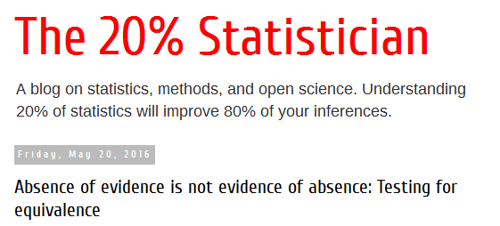

Equivalence testing (support for H0) in frequentism
http://daniellakens.blogspot.de/2016/05/absence-of-evidence-is-not-evidence-of.html

Slide 25

A new kind of selective reporting?
Researcher wants to show an effect
Reports a p-value
Researcher wants to show evidence of no effect
Reports a BF (with a wide prior scale)
Reviewers: you may want to see a BF for every p
If you see arbitrary reporting, unreported statistics may be lurking in the shadows, unseen...
Notes:
Keskustelu täällä: https://www.facebook.com/groups/853552931365745/permalink/1010518825669154/

Slide 26
“But I don’t know which prior to use!”

Slide 27
Does one ever have zero prior knowledge?
Richard et al. (2003) meta-meta-analysis
25 000 studies, 322 meta-analyses, including health and motivation
 | No. of studies | Mean r | ~d*
Health psychology | 2 340 | 0.17 | 0.3
* http://www.psychometrica.de/effect_size.html#interpretation

Slide 28
Power and evidence

Slide 29
Power and evidence
We set alpha at p=0.05 because orthodoxy: then “worthy of another look”
Never “finding is real”
Not the probability hypothesis is false
We set power at 80% because orthodoxy: “type 2 errors four times more acceptable than type 1 errors”
Notes:
40+ years ago Fisher thought finding then “worthy of another look”

Slide 30
Power and evidence
We set BF at 3 / 10 / 100 because…?!
In Bayes, evidence is relative
If H1 is a 1000 times more likely than H2, a third hypothesis might be more likely than either!
In Frequentism, no evidence
Only long-run error rates, conditional on p being computed correctly!*
* Greenland et al. Statistical tests, P values, confidence intervals, and power: a guide to misinterpretations [link]

Slide 31



http://xcelab.net/rm/statistical-rethinking/

Slide 32
The pessimistic view…
“In fact, I think that kind of interpretation is almost supported by the availability of qualitative interpretation guidelines for Bayes factors: The notion that Bayes factors can be directly interpreted themselves - rather than converted first to posterior odds - seems to me to reinforce the idea that they're the endpoint of an analysis: that the Bayes factor directly tells us about how certain we can be that a particular hypothesis is correct. I know that Jeff Rouder has explicitly argued against this interpretation - instead saying that researchers should report Bayes factors and let researchers select and update their own priors (perhaps aided by suggestions from the researchers), and in an ideal world, that's exactly how things would work, but I don't think that this is realistic for everyday readers and researchers with limited statistical expertise.”
http://thepathologicalscience.blogspot.fi/2016/06/my-talk-at-m3-conference-on-bayes.html?m=1

Slide 33
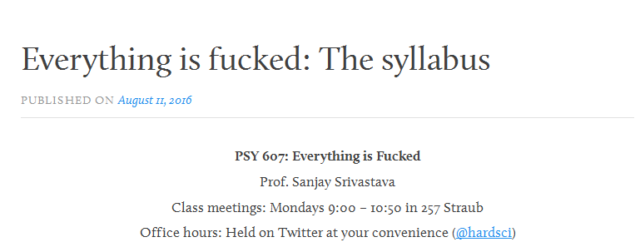
Bonus: a great reading list!
Link

Slide 34
Now it’s really over!
Questions?
Comments?
Ideas?
@heinonmatti
www.mattiheino.com

