Slide 1


USTHB university Algiers, Algeria
Electronics and Computer engineering Faculty (FEI)
Signal Processing Laboratory
Topic Identification of Noisy Arabic Texts Using Graph Approaches
Key Words :
Mr K. ABAINIA Dr S. OUAMOUR Prof H. SAYOUD
TIR’15 (1-4 Sept. 2015)

Slide 2
USTHB university - Algeria
Talk Outline
1
Background
2
Corpus
3
Preprocessing
4
Topic Identification based Graph Approaches
5
Experimental results
6
Summary
Background
Corpus
Preprocessing
Topic Identification
Experiments
Summary
Topic Identification of Noisy Arabic Texts Using Graph Approaches
TIR’15 September 1-4, 2015

Slide 3
USTHB university - Algeria
What is Topic Identification ?
Topic Identification is the task of automatically recognizing the subject or the theme in which the text is written.
Automatic text categorization by attributing one or more labels from a predefined set of topics.
Background
Corpus
Preprocessing
Topic Identification
Experiments
Summary
Topic Identification of Noisy Arabic Texts Using Graph Approaches
TIR’15 September 1-4, 2015

Slide 4
USTHB university - Algeria
Applications of Topic Categorization
Newswires: news are organized and archived by subject categories (e.g. Politics, Economy, Sports, etc.);
Academic articles: papers are classified by domains and sub-areas;
Emails routing: directing received emails to a specific mailbox depending on the topic;
Civil security: predicting manifestations and/or terrorists’ plots by automatically analyzing on-line conversations;
Background
Corpus
Preprocessing
Topic Identification
Experiments
Summary
Topic Identification of Noisy Arabic Texts Using Graph Approaches
TIR’15 September 1-4, 2015

Slide 5
USTHB university - Algeria
Motivation
Many Topic Identification researches have been evaluated on long and well written texts (e.g. Scientific papers and Newspaper articles).
Many researches have been undergone on European languages and Asian languages, except the Arabic language (few works).
Arabic language is the more difficult one having a complex morphology and a large vocabulary.
Background
Corpus
Preprocessing
Topic Identification
Experiments
Summary
Topic Identification of Noisy Arabic Texts Using Graph Approaches
TIR’15 September 1-4, 2015

Slide 6
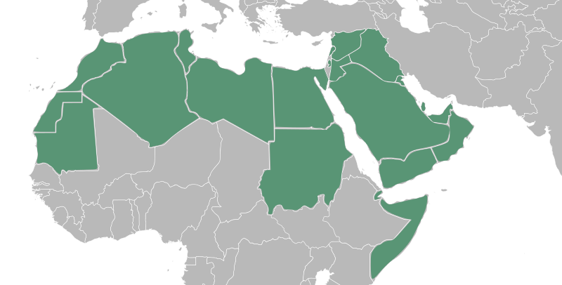
USTHB university - Algeria
Statistics (1)
Arabic was the 5th most widely-spoken language, and is the tongue language of 422 million people in 22 countries.
https://www.cia.gov/library/publications/the-world-factbook/
Background
Corpus
Preprocessing
Topic Identification
Experiments
Summary
Topic Identification of Noisy Arabic Texts Using Graph Approaches
TIR’15 September 1-4, 2015

Slide 7

USTHB university - Algeria
Statistics (2)
As the religious language of the Quran (7th century), it was rapidly expanded during the rise of Islam in the 8th century
PEW Research Center
Background
Corpus
Preprocessing
Topic Identification
Experiments
Summary
Topic Identification of Noisy Arabic Texts Using Graph Approaches
TIR’15 September 1-4, 2015

Slide 8
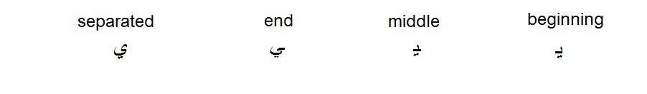

USTHB university - Algeria
Arabic language characteristics
Alphabet set consists of 28 main letters with other forms taken by some characters (e.g. Alif “ألف”, Yaa “ياء” and Taa “تاء”).
There is no capitalization in Arabic (i.e. capital and small letters)
Letter can have different shapes depending on its location in the word.
Word meaning is often determined by diacritics (or vowels).
Letter repetition twice is replaced by Shadda character “ّ”
Some conjunctions like “و” (AND) are welded to the following word, which makes the preprocessing quite difficult.
Background
Corpus
Preprocessing
Topic Identification
Experiments
Summary
Topic Identification of Noisy Arabic Texts Using Graph Approaches
TIR’15 September 1-4, 2015

Slide 9
USTHB university - Algeria
Talk Outline
1
Background
2
Corpus
3
Preprocessing
4
Topic Identification based Graph Approaches
5
Experimental results
6
Summary
Background
Corpus
Preprocessing
Topic Identification
Experiments
Summary
Topic Identification of Noisy Arabic Texts Using Graph Approaches
TIR’15 September 1-4, 2015

Slide 10

USTHB university - Algeria
ANTSIX Corpus
Economy
Health
50 texts
50 texts
ANTSIX
300 texts
Informatics
Religion
50 texts
50 texts
Hunting
Sports
50 texts
50 texts
Text length ranges between 32 and 318 words
Background
Corpus
Preprocessing
Topic Identification
Experiments
Summary
Topic Identification of Noisy Arabic Texts Using Graph Approaches
TIR’15 September 1-4, 2015

Slide 11
USTHB university - Algeria
Difficulty
Main difficulty = Noisy texts (discussion forum texts)
Citations in other languages
URLs
Typing errors
Tags (e.g. hash tags, user tags...)
Insignificant characters (e.g. emoticons)
Abbreviations
Letters mistakenness (e.g. the letter “ظ” and the letter “ض”)
Background
Corpus
Preprocessing
Topic Identification
Experiments
Summary
Topic Identification of Noisy Arabic Texts Using Graph Approaches
TIR’15 September 1-4, 2015

Slide 12
USTHB university - Algeria
Talk Outline
1
Background
2
Corpus
3
Preprocessing
4
Topic Identification based Graph Approaches
5
Experimental results
6
Summary
Background
Corpus
Preprocessing
Topic Identification
Experiments
Summary
Topic Identification of Noisy Arabic Texts Using Graph Approaches
TIR’15 September 1-4, 2015

Slide 13
USTHB university - Algeria
Text preprocessing (step 1)
Read the text as UTF-8 text.
Strip some characters:
insignificant characters.
French and English characters.
Arabic diacritics.
Separate contracted words (i.e. Replace “/” and “-” with white spaces).
Strip multiple word delimiters (i.e. white space, “\n” and “\r”).
Normalize some letters:
Replace Alif with different forms (“أ”, “إ” and “آ”) by Alif bare (“ا”).
Replace Alif MaqSura (“ى”) by Yaa (“ي”).
Background
Corpus
Preprocessing
Topic Identification
Experiments
Summary
Topic Identification of Noisy Arabic Texts Using Graph Approaches
TIR’15 September 1-4, 2015

Slide 14
USTHB university - Algeria
Text preprocessing (step 2)
Extract a list of words.
Remove stop words (600 stop words).
Stem the rest of words (remove prefixes and suffixes).
'اقتصادها‘ 'اقتصادي'
'الاقتصاد'
اقتصاد
'الاقتصادي'
Background
Corpus
Preprocessing
Topic Identification
Experiments
Summary
Topic Identification of Noisy Arabic Texts Using Graph Approaches
TIR’15 September 1-4, 2015

Slide 15
USTHB university - Algeria
Talk Outline
1
Background
2
Corpus
3
Preprocessing
4
Topic Identification based Graph Approaches
5
Experimental results
6
Summary
Background
Corpus
Preprocessing
Topic Identification
Experiments
Summary
Topic Identification of Noisy Arabic Texts Using Graph Approaches
TIR’15 September 1-4, 2015

Slide 16
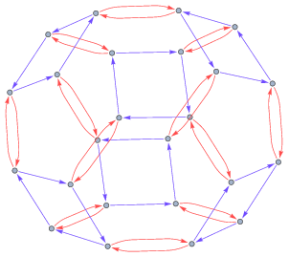





USTHB university - Algeria
Approaches of topic identification
LIGA
TIGA1
TIGA2
Three graph approaches
Nodes represent the word weights and edges represent word successions
The graph is represented by the following quintuple
are respectively a set of nodes and a set of edges.
Function used to assign vertices to the graph.
Function to assign weights to vertices.
Function to assign weights to edges.
Resultant graphs can be easily interpreted by human (visual analytics)
Background
Corpus
Preprocessing
Topic Identification
Experiments
Summary
Topic Identification of Noisy Arabic Texts Using Graph Approaches
TIR’15 September 1-4, 2015

Slide 17

USTHB university - Algeria
LIGA approach (training)
Training doc
A list of words W
=
+ 1
if
W
( ) =
^
= 1
otherwise
=
+ 1
if
W
edge is created
^
= 1
otherwise
Background
Corpus
Preprocessing
Topic Identification
Experiments
Summary
Topic Identification of Noisy Arabic Texts Using Graph Approaches
TIR’15 September 1-4, 2015

Slide 18
USTHB university - Algeria
Training example
“Allah does not change a people´s lot unless they change what is in their hearts”
[Allah] [does] [not] [change] [a] [people] [s] [lot] [unless] [they] [change] [what] [is] [in] [their] [hearts]
Allah
1
does
1
not
a
1
people
1
s
1
1
1
1
1
1
1
1
1
change
1
lot
hearts
2
1
1
1
1
what
1
is
1
in
1
their
1
1
1
1
Background
Corpus
Preprocessing
Topic Identification
Experiments
Summary
Topic Identification of Noisy Arabic Texts Using Graph Approaches
TIR’15 September 1-4, 2015

Slide 19




USTHB university - Algeria
LIGA approach (classification)
Unlabeled text
path of words (consecutive words)
Similarity = path matching function
= 0
Background
Corpus
Preprocessing
Topic Identification
Experiments
Summary
Topic Identification of Noisy Arabic Texts Using Graph Approaches
TIR’15 September 1-4, 2015

Slide 20


USTHB university - Algeria
TIGA1
TIGA1 Biasing the LIGA node weights using TF-IDF method.
Background
Corpus
Preprocessing
Topic Identification
Experiments
Summary
Topic Identification of Noisy Arabic Texts Using Graph Approaches
TIR’15 September 1-4, 2015

Slide 21


USTHB university - Algeria
TIGA2
TIGA2 Biasing the TIGA1 edge weights using TF-IDF method.
Background
Corpus
Preprocessing
Topic Identification
Experiments
Summary
Topic Identification of Noisy Arabic Texts Using Graph Approaches
TIR’15 September 1-4, 2015

Slide 22
USTHB university - Algeria
Talk Outline
1
Background
2
Preprocessing
3
Corpus
4
Topic Identification based Graph Approaches
5
Experimental results
6
Summary
Background
Corpus
Preprocessing
Topic Identification
Experiments
Summary
Topic Identification of Noisy Arabic Texts Using Graph Approaches
TIR’15 September 1-4, 2015

Slide 23
USTHB university - Algeria
Experiment setup
ANTSIX corpus:
60% was used in the training.
40% was reserved for the test.
Three path matching functions are used:
PM1: uses only node weights.
PM2: uses only edge weights.
PM3: uses node and edge weights both.
Background
Corpus
Preprocessing
Topic Identification
Experiments
Summary
Topic Identification of Noisy Arabic Texts Using Graph Approaches
TIR’15 September 1-4, 2015

Slide 24
USTHB university - Algeria
Results (accuracies)
LIGA is worse than TIGA1 and TIGA2.
TIGA2 is more accurate than the two others (achieved the best accuracy).
PM2 produced worse performances comparing to PM1 and PM3.
LIGA and TIGA1 can be optimized by using PM1 instead of the original PM3.
Background
Corpus
Preprocessing
Topic Identification
Experiments
Summary
Topic Identification of Noisy Arabic Texts Using Graph Approaches
TIR’15 September 1-4, 2015

Slide 25
USTHB university - Algeria
Talk Outline
1
Background
2
Preprocessing
3
Corpus
4
Topic Identification based Graph Approaches
5
Experimental results
6
Summary
Background
Corpus
Preprocessing
Topic Identification
Experiments
Summary
Topic Identification of Noisy Arabic Texts Using Graph Approaches
TIR’15 September 1-4, 2015

Slide 26
USTHB university - Algeria
Conclusion
Several experiments of topic identification were conducted on noisy Arabic forum texts.
ANTSIX corpus
300 noisy Arabic texts
6 different topics
Characters removing and normalizing
Stop words removing(600 stop words)
Words stemming
Contributions
Preprocessing
Three approaches
LIGA
Two improvements (i.e. TIGA1 and TIGA2)
TIGA1 and TIGA2 outperformed LIGA
TIGA2 is the more accurate
Original PM (PM3) can be optimized as PM1
PM2 is not suitable in noisy Arabic texts
Comparison between 3 PM functions
Background
Corpus
Preprocessing
Topic Identification
Experiments
Summary
Topic Identification of Noisy Arabic Texts Using Graph Approaches
TIR’15 September 1-4, 2015

Slide 27
USTHB university - Algeria
Perspective
Evaluate TIGA1 and TIGA2 on a large corpus
Benchmark the proposed approaches
Compare the two algorithms with other well known tools
Test other techniques of weighting instead TF-IDF
Background
Corpus
Preprocessing
Topic Identification
Experiments
Summary
Topic Identification of Noisy Arabic Texts Using Graph Approaches
TIR’15 September 1-4, 2015

Slide 28

Thank you
Kheireddine Abainia
abainia@hotmail.fr
Siham Ouamour
siham.ouamour@uni.de
Halim Sayoud
halim.sayoud@uni.de

