Slide 1

Inductive building of search results ranking models to enhance the relevance of text information retrieval
Vyacheslav ZOSIMOV, Cand. Sci¹
Volodymyr STEPASHKO, Dr. Sci²
Oleksandra BULGAKOVA, Cand. Sci¹
¹Mykolaiv National University
²International Research and Training Centre for Information Technologies and Systems of the National Academy of Sciences of Ukraine

Slide 2
Description of the developed technology
For solving the problem of improving the efficiency of relevant information search on the Internet it is necessary to develop a system that provides:
1. High search precision rates, it means the lack of search spam and artificially promoted sites among search results.
2. Search completeness rates not worse than by current search engines.
3. High performance of search results analysis.
4. Wide capacity of software customization by user.
Proposed technology consists of the three main phases:
Phase 1. Information collecting.
Phase 2. Sifting the commercial information.
Phase 3. Results ranking.
DEXA - TIR - 2015

Slide 3
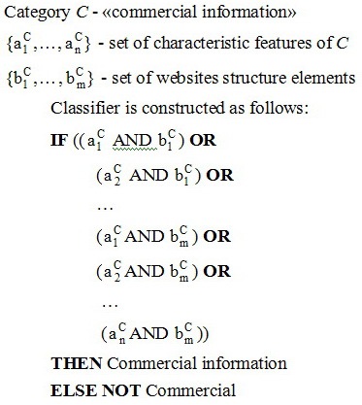
Sifting the commercial information
Main groups of commercial sites:
1. Online stores.
2. Sites that offer access to the information for a fee or watching ads
3. Websites of companies.
4. Message boards.
DNF classifier:
Structural elements of the websites:
meta tags, the path to Java-script and image of design;
titles, meta description, keywords;
shopping cart;
text on the home page;
navigation elements.
Features of the commercial sites:
Presence among the navigation elements the following items: "Services", "Company", "Price List", "Dealer", "Activity of the company", "Employment", "order service", "Jobs“, "Price", "Our customers”;
Usage of the specialized CMS for creating online stores.
DEXA - TIR - 2015

Slide 4
Experimental results on more effective search
of the scientific and technical information
Information is searched by keywords at first using search engine google and then using the proposed technology.
The purpose of the experiment: comparative effectiveness of information search by search engine google and the proposed technology.
Query: "Information Security"
google.com.ua
Developed technology
Query: «Programming 1С»
google.com.ua
Developed technology
DEXA - TIR - 2015

Slide 5
ON THE GIA GMDH AS A RESEARCH TOOL
The scientific school of Inductive Modelling was originated by Prof. Aleksey Ivakhnenko. The very first article on his Group Method of Data Handling was published by him in 1968.
GMDH as a self-organizing data mining tool is based on the main principles:
automatic generation of inductively complicated variants
non-final decisions and successive selection of models of optimum complexity
using so called external criteria of cross-validation type based on the division of a dataset into at least two parts.
The classical multilayered iterative algorithm MIA GMDH [4] is based on the nature inspired idea of mass biological selection with pairwise account of features. Currently it is considered as a polynomial neural network (PNN) notable by self-organization of both its architecture and parameters.
GMDH has advantages of automatic formation of the network structure, simplicity and speed of parameters estimation as well as the possibility to "fold" the adjusted network into an explicit mathematical model.
The generalized iterative algorithm GIA GMDH has constructed enclosing typical known and new architectures of the iterative procedures of both multilayered and relaxational type with combinatorial optimizing the partial descriptions (quadratic transfer functions).

Slide 6
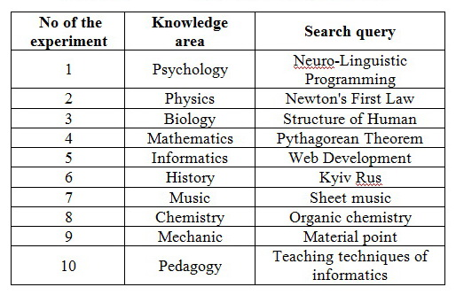
Building ranking models for specific fields
In the process of ranking models construction, 64 lecturers from various departments of Mykolaiv National University (Ukraine) have participated. All participants were divided into 10 groups of 6 to 8 people. Each group analyzed one search query in their field of knowledge. Each expert sorts by relevance first 50 sites with scientific-and-engineering information obtained from the Yandex search engine results page (SERP) after sifting the commercial spam information.
The complete lists of knowledge areas and search queries participated in modeling experiments
DEXA - TIR - 2015

Slide 7
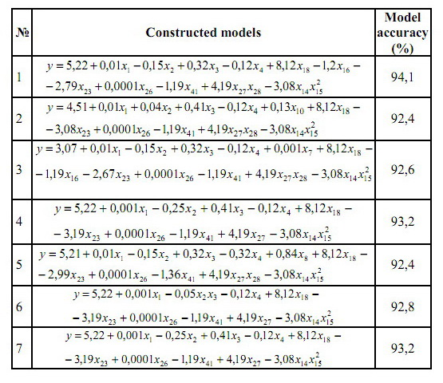
Building ranking models for specific fields
Results of the experiment for ranking models building
Ranking models was built using GIA GMDH based on 42 features which are typically used in search engines ranking.
The accuracy of models varies from 92,4% to 95,8%.
After that new queries in the same fields can be handled without experts with high accuracy.
This means that the most relevant target sources will already be placed at the top of the modified search delivery.
DEXA - TIR - 2015

Slide 8
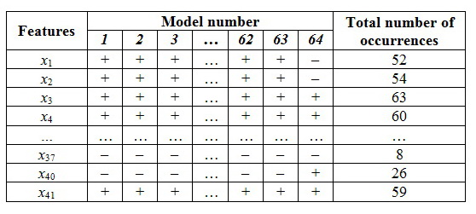
Building the universal ranking model
The frequency of feature’s occurrence in ranking models built during the experiments
To sift uninformative features, the threshold of their occurrence frequency in the formulae was determined at an acceptable level 50. Features with the frequency 50 to 64 were selected as informative and the rest were excluded.
DEXA - TIR - 2015

Slide 9
Building the universal ranking model
A new ranking model was built using GIA GMDH based on the extracted informative features from Table III used as input arguments. The following model has built:
Accuracy of the model is 88.6%, slightly lower as compared to any of the built models based on the learning sample.
DEXA - TIR - 2015

Slide 10
Yandex ranking model rebuilt using GIA GMDH
The most influencing in the Yandex ranking model are the following 16 factors:
х3 – the ratio of the total words number on the site to the keywords number on the site;
х4 – the ratio of the total words number on the page to the keywords number on the page;
х6 – topic’s popularity;
х7 – requests number of the particular keyword for a certain period of time;
х12 – website age;
х14 – frequency of updating site information;
х22 – keywords font size;
х27 – keywords presence in title;
х28 – keywords presence in meta-tags;
х35 – match website keywords to the search engine page directory in which site is;
х41– number of external links, containing keywords in its title;
х42 – Yandex citation index;
This data are automatically collected from several sources: Yandex database, html-code analysis and independent services for the sites content analysis .
Comment: The most influenced in the Yandex ranking has the external factors (x₄, x₆, x₇, x₁₂, x ₁₄, x₄₁, h₄₂) as compared to internal ones.
DEXA - TIR - 2015

Slide 11
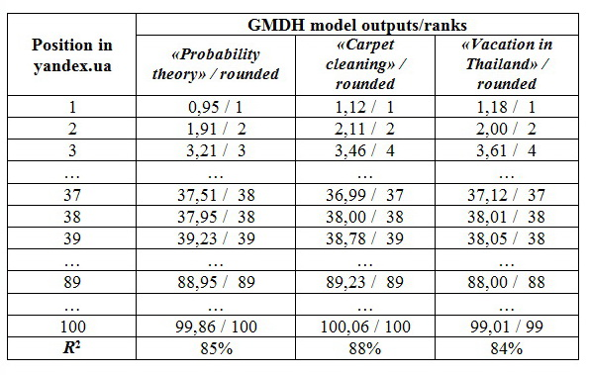
Testing the constructed Yandex ranking model
The results show that the GMDH approximation of unknown true Yandex ranking rules
gives quite good fit to original for simulation in several very diverse areas.
DEXA - TIR - 2015

Slide 12
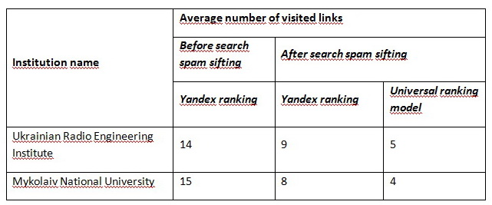
Comparison the performance results of the search engine Yandex and built universal ranking model
In these results, all user queries during two months were taken into account. So we can make an important practical conclusion: the most reputable search engines, attaching more importance to external ranking features, complicate the possibility of artificial enhancing a site popularity but it decreases the relevance of search results for a user.
DEXA - TIR - 2015

Slide 13
Google ranking model built using GIA GMDH
The most influencing in the Google ranking model are the following 16 factors:
х3 – the ratio of the total words number on the site to the keywords number on the site;
х4 – the ratio of the total words number on the page to the keywords number on the page;
х5 – Google PR;
х6 – subject popularity;
х7 – requests number of the particular keyword for a certain period of time;
х12 – website age;
х15 – recently updated pages;
х16 – number of pictures on website;
х22 – keywords font size;
х27 – keywords presence in title;
х28 – keywords presence in meta-tags;
х35 – match website keywords to the search engine page directory in which site is;
х37 – total number of links;
х38 – number of internal links;
х39 – number of external links;
х40 – website depth;
х41– number of external links, containing keywords in its title;
Comment: The most influenced in the Google ranking are the external factors (x₅, x₆, x₇, x₁₂, x ₃₅, x₃₉, h₄₁) as compared to internal ones.
DEXA - TIR - 2015

Slide 14
Verification of Web resources ranking results
Results of sites ranking using
model built with GIA GMDH
Web resources ranking results
Place in google.com.ua | Values by GMDH | Rounded results
1 | 1,23 | 1
2 | 1,89 | 2
3 | 4,01 | 4
4 | 4,21 | 4
… | … | …
21 | 21,23 | 21
22 | 22,49 | 23
… | … | …
57 | 57,22 | 57
58 | 58,15 | 58
… | … | …
99 | 98,95 | 99
100 | 99,56 | 100
Place in google.com.ua | Values by GMDH
 | «omelet recipe» / rounded result | «buy notebook Kiev» / rounded result | «expert systems» / rounded result
1 | 0,83 / 1 | 1,02 / 1 | 0,78 / 1
2 | 1,91 / 2 | 2,11 / 2 | 2,02 / 2
… | … | … | …
37 | 37,91 / 38 | 36,99 / 37 | 36,89 / 37
38 | 37,95 / 38 | 38,00 / 38 | 38,01 / 38
… | … | … | …
77 | 77,02 / 77 | 76,01 / 76 | 78,00 / 78
78 | 78,11 / 78 | 77,72 / 78 | 78,32 / 78
… | … | … | …
100 | 99,86 / 100 | 100,56 / 101 | 100,01 / 100
R² | 87% | 95% | 93%
We have verified the correctness of the constructed model (3) for other completely different search queries: «omelet recipe» «buy notebook Kiev» «expert systems».
Table 4 shows the successful results of comparing web resources ranking by Google and the model built using GIA GMDH
DEXA - TIR - 2015

Slide 15
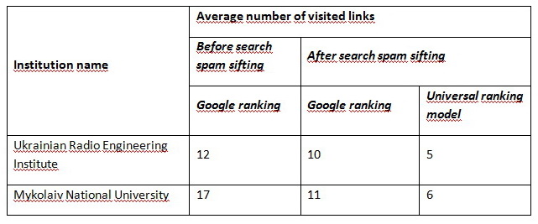
Comparison the performance results of the search engine Google and built universal ranking model
DEXA - TIR - 2015

Slide 16
Discussion
The aim of the paper was to demonstrate the possibility to build automated procedures to significantly improve the target informativity of returns of a present search engine. The developed technique uses the search results of Google or Yahoo as input data. The sifting of irrelevant commercial information is based on data obtained from public API and search results parse. The collected data are analyzed for the availability of pre-defined attributes of commercial sites to remove them from the delivery set.
To enhance the effectiveness of the proposed technique, the sites remaining after sifting are additionally ranked according to the model built using the generalized iterative algorithm GMDH. A procedure of experiments for constructing such a model is described in this article. This enables a comfortable opportunity for a user to find the needed target information on sites placed in the first few positions of the search delivery modified using the proposed technique. Besides that, the results are presented concerning the developed system application in two state institutions of Ukraine to demonstrate the technique efficiency.
An additional task is also solved in this paper on assessing the effectiveness of inductive GMDH algorithms for construction of search results ranking models. For this purpose, the experiments were carried out aimed to "discover" the unknown accurate ranking model for search results of Yandex and Google. Ranking models of the search engines are hidden for users, so the definition of site relevance evaluation parameters of these engines is of great scientific and applied interest. The simulation results showed that the GMDH algorithm successfully builds polynomial models approximating the unknown ranking rules of the popular search engines with great accuracy.
DEXA - TIR - 2015

Slide 17
Conclusion
Inductive approach to building ranking models from a user's learning sets can significantly improve the quality of search compared to the ranking models of modern search engines in case of both the presence of search spam in SERP and without it.
Such kind of model for removing commercial information can be configured to churn any other category of information on pre-selected criteria including the sifting any information other than commercial.
The use of the generalized iterative algorithm GMDH makes it possible to build highly efficient ranking models to enhance relevance of search results by any search engine. This shows good prospects for further research in this direction.
Attaching more importance to external ranking features, main search engines complicate the possibility of artificial cheat of site popularity but it decreases the relevance level of search results.
DEXA - TIR - 2015

