Slide 1
Hidden Markov Models
The Likelihood Problem
And
The Learning Problem

Slide 2
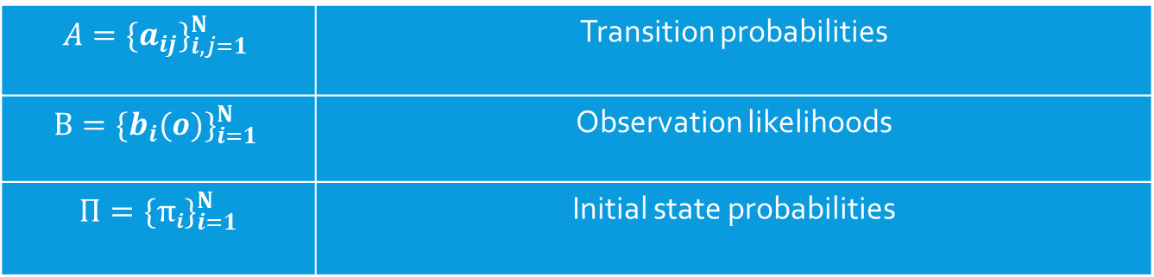

Hidden Markov Models: Recap
A Hidden Markov Model is a finite state machine with hidden states.
We can refer to it as a 3-tuple of parameters λ$=(A,B,Π)$ where
$$A={\{a_{ij}\}}_{i,j=1}^{N}$$ | Transition probabilities
$$B={\{b_{i}(o)\}}_{i=1}^{N}$$ | Observation likelihoods
$$Π={\{πi\}}_{i=1}^{N}$$ | Initial state probabilities

Slide 3
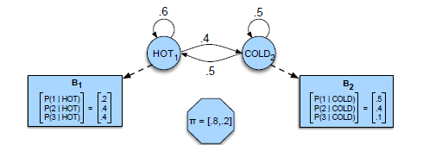

Transition Probabilities
$A={\{aij\}}_{i,j=1}^{N}$
These are each of the weighted edges between the nodes (states).
Each value represents the probability that the state i will transition to the state j.
P(COLD|COLD) = 0.5, P(HOT|COLD) = 0.5,
P(HOT|HOT) = 0.6, P(COLD|HOT) = 0.4

Slide 4

Transition Probability Matrix
$A={\{aij\}}_{i,j=1}^{N}$
This is a transition probability matrix, or stochastic matrix.
$$\left(\begin{matrix}a_{11} & ⋯ & a_{n1} \\ ⋮ & ⋱ & ⋮ \\ a_{1n} & ⋯ & a_{nn}\end{matrix}\right)$$
The first column is every transition from state 1, the n-th column is every transition from state n.

Slide 5

Transition Probability Matrix
$A={\{aij\}}_{i,j=1}^{N}$
The first column is every transition from state 1, the n-th column is every transition from state n.
$$\left(\begin{matrix}a_{11} & ⋯ & a_{n1} \\ ⋮ & ⋱ & ⋮ \\ a_{1n} & ⋯ & a_{nn}\end{matrix}\right)$$
What is the sum of each column? i.e. $\sum_{i=1}^{n}{a_{1i}}=$ $a_{11}+a_{12}+…a_{1n}= ?$

Slide 6

Transition Probability Matrix
$A={\{aij\}}_{i,j=1}^{N}$
The first column is every transition from state 1, the n-th column is every transition from state n.
$$\left(\begin{matrix}a_{11} & ⋯ & a_{n1} \\ ⋮ & ⋱ & ⋮ \\ a_{1n} & ⋯ & a_{nn}\end{matrix}\right)$$
What is the sum of each column? i.e. $\sum_{i=1}^{n}{a_{1i}}=$ $a_{11}+a_{12}+…a_{1n}=1$

Slide 7

Transition Probability Matrix
$A={\{aij\}}_{i,j=1}^{N}$
The first column is every transition from state 1, the n-th column is every transition from state n.
$$\left(\begin{matrix}a_{11} & ⋯ & a_{n1} \\ ⋮ & ⋱ & ⋮ \\ a_{1n} & ⋯ & a_{nn}\end{matrix}\right)$$
What does each element along the diagonal represent? (so each $a_{11},a_{22},…{,a}_{nn}$)

Slide 8

Transition Probability Matrix
$A={\{aij\}}_{i,j=1}^{N}$
The first column is every transition from state 1, the n-th column is every transition from state n.
$$\left(\begin{matrix}a_{11} & ⋯ & a_{n1} \\ ⋮ & ⋱ & ⋮ \\ a_{1n} & ⋯ & a_{nn}\end{matrix}\right)$$
What does each element along the diagonal represent? (so each $a_{11},a_{22},…{,a}_{nn}$)
Each probability that a given state will transition to itself.

Slide 9
Regular vs. Hidden markov models
What is the difference?
Markov Models are a set of states with weighted transitions between states representing probabilities.
Hidden Markov Models are exactly that but some of these states are hidden or not directly observable.
Ex: If each pair below is a set of states in a HMM, which is the set of hidden states?
The weather, how many overshirts someone is wearing
Words in a sentence, POS-tags
Letters in a word, images of letters (OCR)

Slide 10
Regular vs. Hidden markov models
What is the difference?
Markov Models are a set of states with weighted transitions between states representing probabilities.
Hidden Markov Models are exactly that but some of these states are hidden or not directly observable.
Ex: If each pair below is a set of states in a HMM, which is the set of hidden states?
The weather, how many overshirts someone is wearing
Words in a sentence, POS-tags
Letters in a word, images of letters (OCR)

Slide 11
Regular vs. Hidden markov models
What is the difference?
Markov Models are a set of states with weighted transitions between states representing probabilities.
Hidden Markov Models are exactly that but some of these states are hidden or not directly observable.
Ex: If each pair below is a set of states in a HMM, which is the set of hidden states?
The weather, how many overshirts someone is wearing
Words in a sentence, POS-tags
Letters in a word, images of letters (OCR)

Slide 12
Regular vs. Hidden markov models
What is the difference?
Markov Models are a set of states with weighted transitions between states representing probabilities.
Hidden Markov Models are exactly that but some of these states are hidden or not directly observable.
Ex: If each pair below is a set of states in a HMM, which is the set of hidden states?
The weather, how many overshirts someone is wearing
Words in a sentence, POS-tags
Letters in a word, images of letters (OCR)

Slide 13
Three Fundamental Problems
Likelihood (sometimes called Evaluation):
Given a Hidden Markov Model λ = (A, B, Π) and an observation sequence O = o₁o₂...o_{T}, what is the probability that this sequence will occur? Namely, what is P(O|λ)?
Decoding:
Given an HMM λ and an observation sequence O = o₁o₂...o_{T}, what is the most probable sequence of states? Namely, what is the most probable Q?
Learning:
Given an observation sequence O = o₁o₂...o_{T} and the set of possible states in the HMM, learn the HMM parameters A and B.

Slide 14
A few Applications of Hmms
OCR (Optical Character Recognition)
POS Tagging (Part of Speech Tagging)
Speech Recognition
Emotion in Speech Recognition

Slide 15
The Likelihood Problem
What is the input?
An HMM: λ = (A, B, Π)
A sequence of observations: O = o₁o₂...o_{T}
What is the output?
A probability: P(O|λ)
We’re looking for the probability of this state occurring in the given HMM.

Slide 16
The Decoding Problem
What is the input?
An HMM: λ = (A, B, Π)
A sequence of observations: O = o₁o₂...o_{T}
What is the output?
A sequence: Q = q₁q₂...q_{T}
We’re looking for the most likely sequence to occur given the HMM and the observation sequence.

Slide 17
The Learning Problem
What is the input?
A sequence of observations: O = o₁o₂...o_{T}
The set of possible states in the HMM
What is the output?
The parameters A and B
We’re looking for the set of states and observations.

