Slide 1
Strategic Digital Transformation
A Path to Organizational Excellence

Slide 2
Executive Summary
Digital transformation is no longer optional
Companies must adapt to changing market dynamics
This presentation outlines key strategic priorities

Slide 3
Market Analysis
75% of companies report accelerated digital adoption
Cloud computing market growth: 18% YoY
AI integration projected to add $15.7T to global GDP by 2030

Slide 4
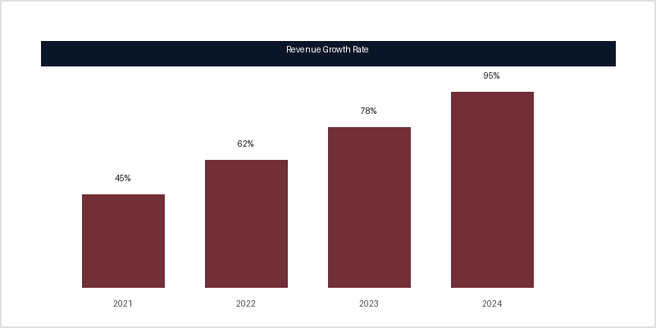
Revenue Growth Performance
Strong year-over-year growth
45% increase in 2021
95% projected by 2024
Outperformed industry average

Slide 5
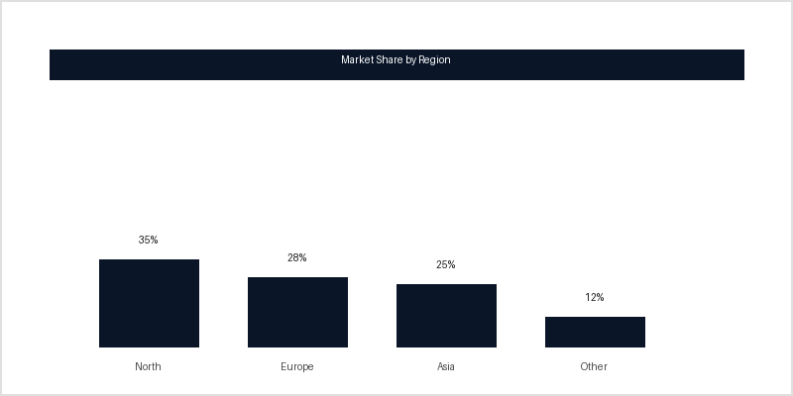
Market Share Distribution
Source: Internal Market Analysis Report 2024

Slide 6

Key Success Indicators
Customer Satisfaction
Net Promoter Score > 50
Customer Retention > 90%
Response Time < 24hrs

Slide 7
Implementation Roadmap
Phase 1: Foundation (Q1-Q2)
• Infrastructure modernization
• Team capability building
Phase 2: Acceleration (Q3-Q4)
• Core system integration
• Pilot program launch

Slide 8
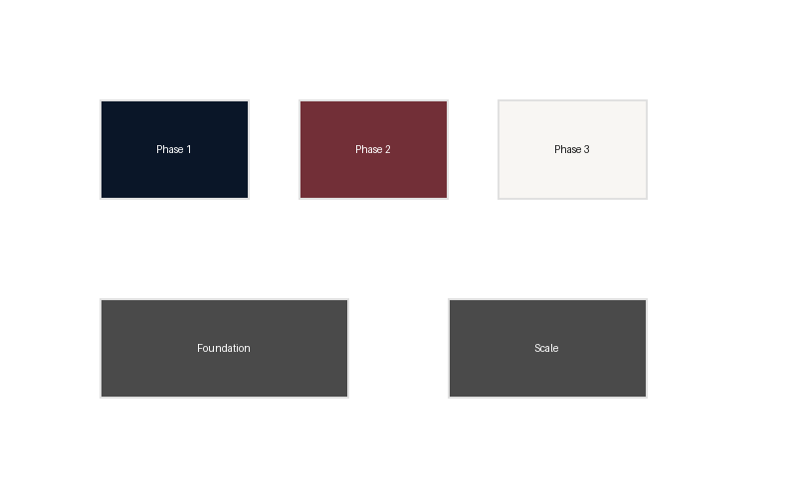
Strategic Roadmap Visualization
Four-phase approach to digital transformation

Slide 9
Success Metrics
Customer satisfaction: +15%
Cost reduction: 20%
Time-to-market: 30% faster
Revenue growth: 12% YoY

Slide 10
Conclusion
Strategic digital transformation drives sustainable growth
Leadership commitment is critical for success
Continuous adaptation to market changes is essential

