Slide 1
JAVA SE FUNDAMENDALS - 1
- Theeba, Trainer

Slide 2

What is Java
High-level programming language
initiated by James Gosling, Mike Sheridan and Patrick Naughton from Sun Microsystems in 1991.
Embedded devices like set-top boxes and handheld devices.
Object-oriented programming language
"Write Once, Run Anywhere"

Slide 3

Java Features
Simple
High-level programming language
Object-oriented programming language
Architectural Neutral
"Write Once, Run Anywhere“
Multithreaded
Distributed
Secure

Slide 4
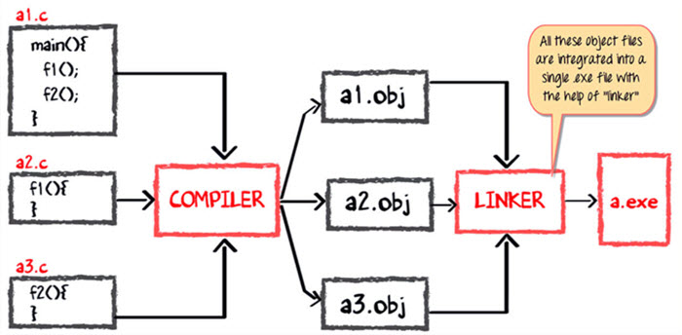
Compiling & Linking phase of C code

Slide 5
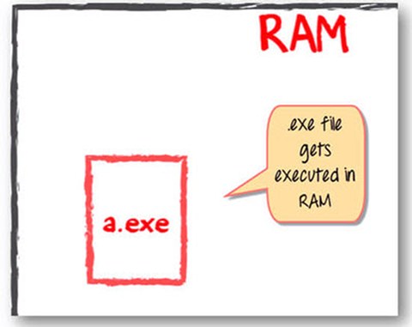
Executing of C program

Slide 6
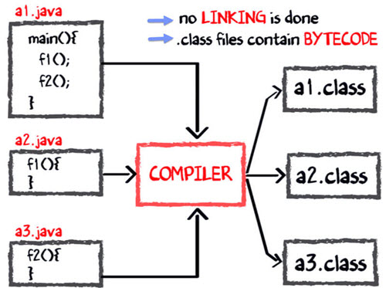
Compilation of java program

Slide 7
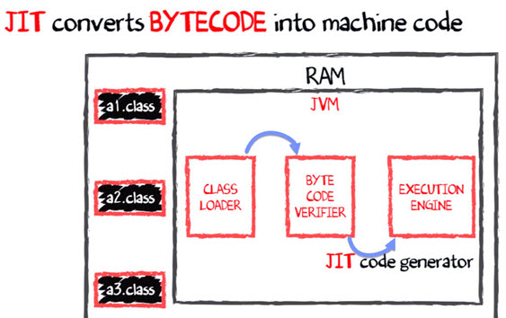
Executing a java program

Slide 8
Java is bit slow
Dynamic Linking
Run-time Interpreter

Slide 9
Why Java ????

Slide 10

Easy To Learn

Slide 11
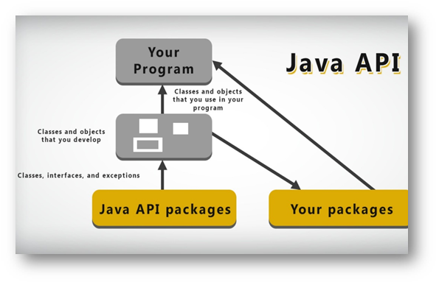
Rich API

Slide 12
JAVA Program Execution

Slide 13
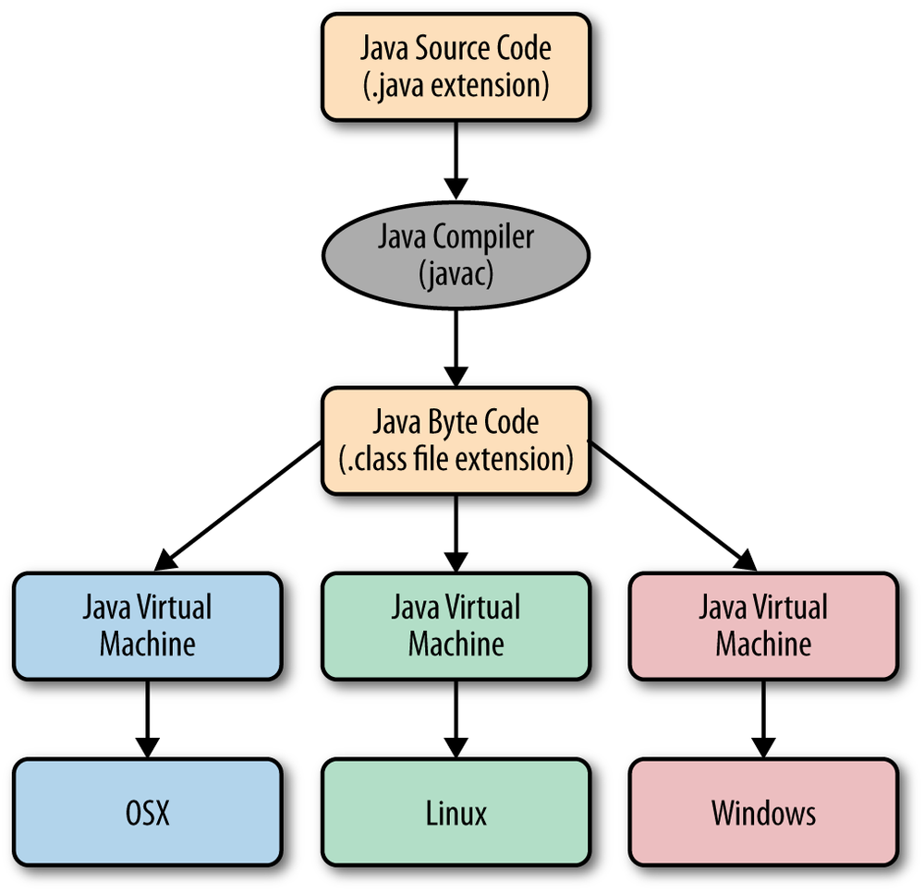
Java Execution fig1.

Slide 14
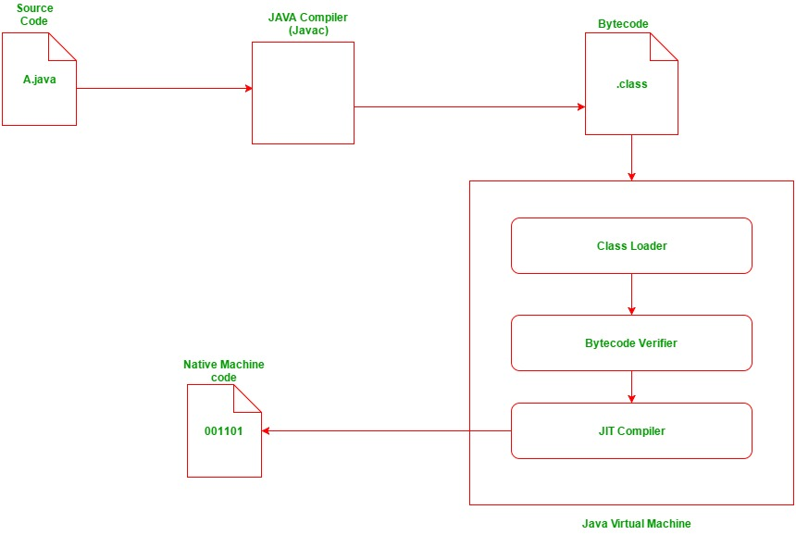
Java execution fig2.

Slide 15
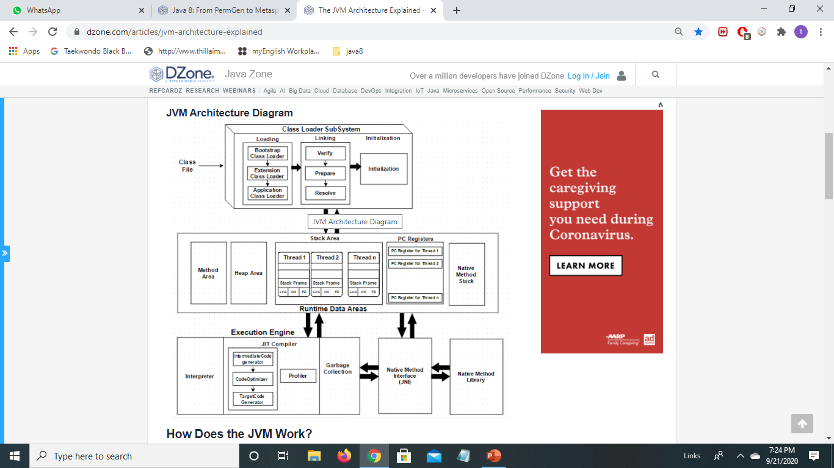
JVM architecture- Detailed View

Slide 16
(i) Class loader
Class Loading and Initializing
Loading class files from file system, network or any other source.
Generates binary data in method area.
3 default class loader used in Java
  Bootstrap
  Extension
  System or Application class loader.

Slide 17
Class Loader | Bootstrap classloader | Extension classloader | Application classloader
Implemented by | native language (mostly C) | sun.misc.Launcher$ExtClassLoader class | sun.misc.Launcher$AppClassLoader class
Loads class file from | JRE/lib/rt.jar | JRE/lib/ext | CLASSPATH environment variable
Parent class | No Parent | Bootstrap classloader | Extension classloader

Slide 18
3 principles on functionality- class loader
Delegation hierarchy model
    when class is not already loaded, the child classloader asks its parent to load the class until bootstrap class loader is checked.
Find Class
Class is loaded by bootstrap class loader
From JRE/lib/rt.jar
Bootstrap Classloader
Load class
Load class
Find Class
Class is loaded by Extension class loader
From JRE/lib/ext
Extension Classloader
Load class
Load class
Request to load a class
Application Classloader
CLASSPATH
If Not Found, NoClassDefFoundError

Slide 19
3 principles on functionality- class loader
Visibility
    child classloader can see all classes loaded by parent classloader. Reverse not true
Uniqueness
    any class is loaded only once.

Slide 20
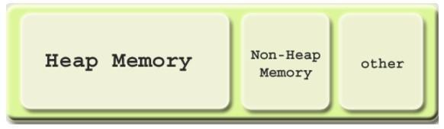
Java (JVM) Memory Structure
JVM memory is divided into : Heap Memory, Non-Heap (Special Heap) Memory, and Other.

Slide 21
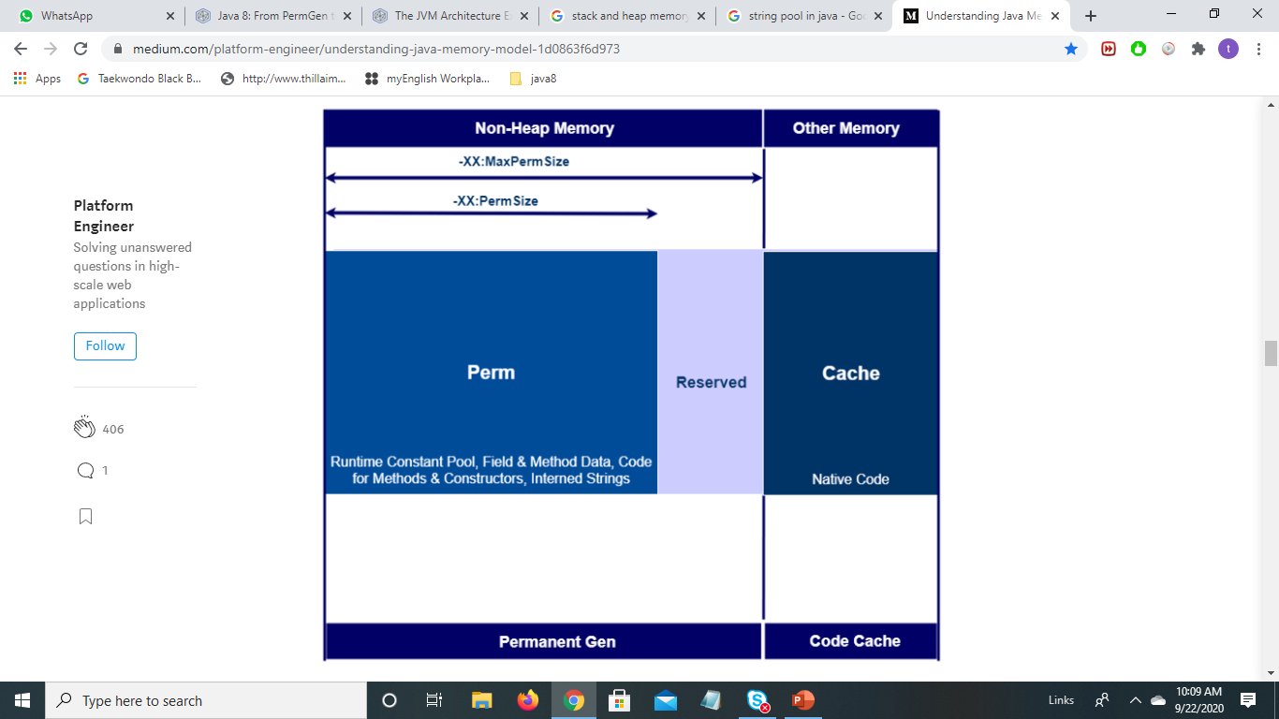
Before Java8 - (JVM) Memory- Non Heap & Other

Slide 22
Limitation of PermGen Space
limited memory size
  generating the famous OutOfMemoryError : PermGen
  class loaders weren't garbage collected properly
    generated a memory leak.

Slide 23
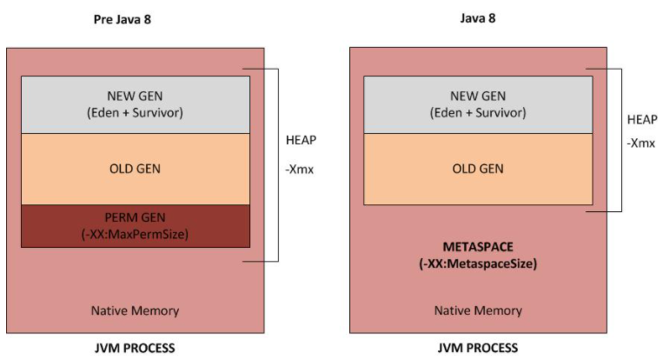
Metaspace- Java8 Improvement

Slide 24
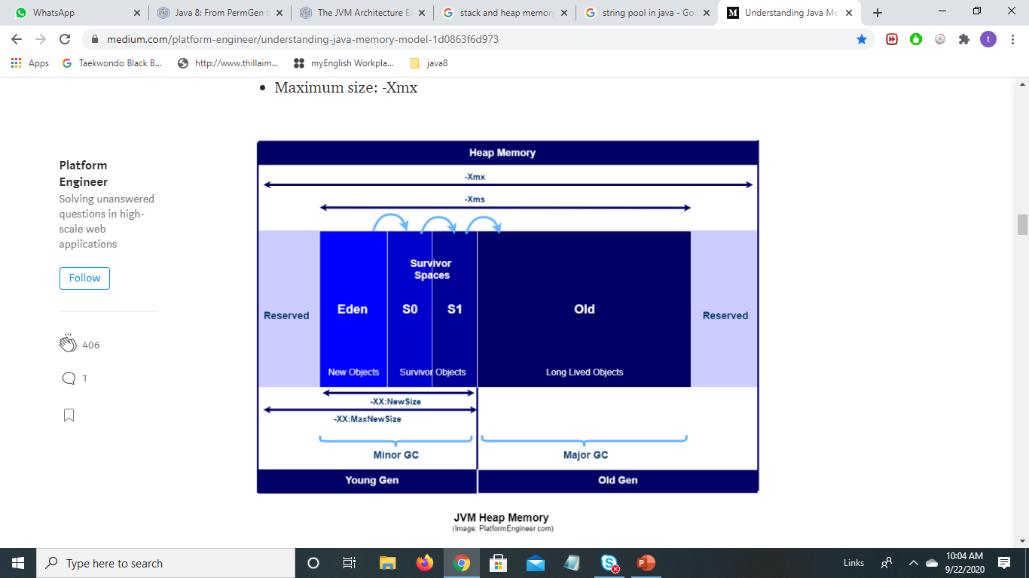
Java (JVM) Memory - Heap
Heap memory:-
    By default, maximum heap size is set to 64MB.

Slide 25
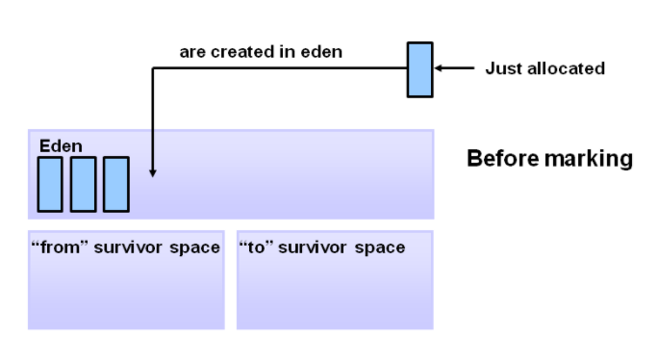
Generational GC
Object Creation

Slide 26
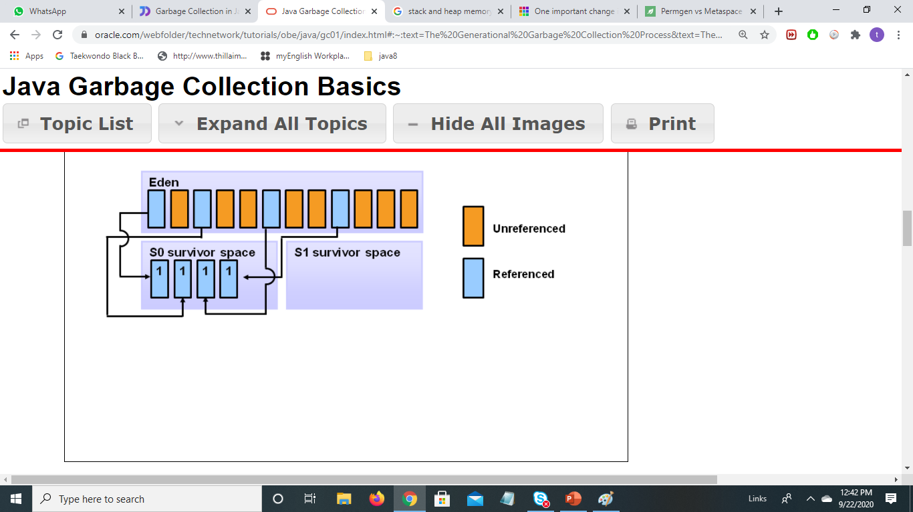
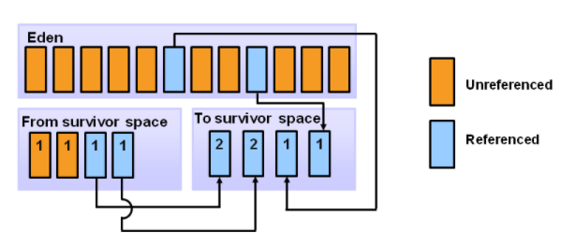
Generational GC
Minor GC Cycle-1
Minor GC Cycle-2

Slide 27
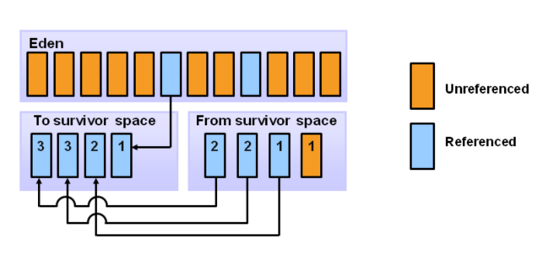
Generational GC
Minor GC Cycle-3

Slide 28
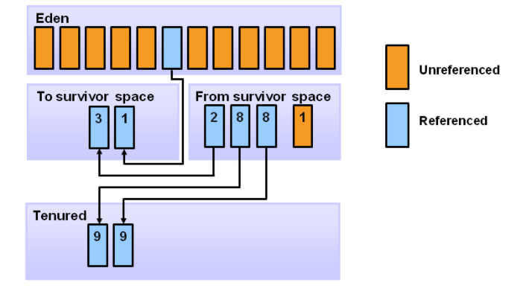
Generational GC
Considering Threshold= 8 in this example,
Minor GC Cycle-9

Slide 29
List of Primitive Datatypes

Slide 30
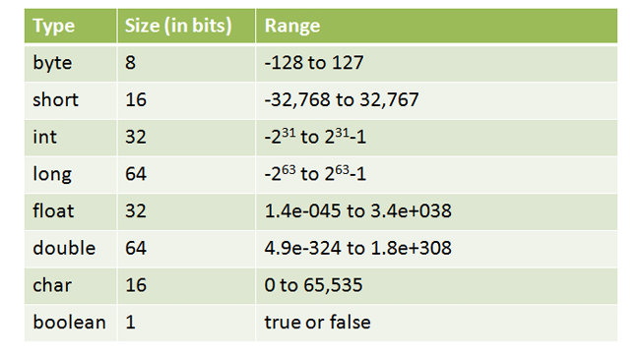
Primitive type- Size & Range

Slide 31
Consider
byte b1 = 10; short s1 = 15;
int num1 = 150; long num2 = 20L; char c1 =‘A’;
b1 = c1;
// Error -→ b1 = (byte) c1;
Integral Type:-
Valid or Not ??
c1 = b1;
// Error -→ c1 = (char) b1;
s1 = c1
// Error -→ s1 = (short) c1;
c1 = s1
// Error -→ c1 = (char) s1;
num1 = c1
//Okay
c1 = num1
// Error -→ c1 = (char) num1;
c1 = 64906;
// Okay. 64906 is in range 0 to 65535
c1 = 70000;
// Error 70000 is out of range -→ c1 = (char) 70000;
// Okay But will lose original
value

Slide 32
With Underscore-Valid or Not ??
int y1 = _2021 ;
// Error. Underscore in beginning.
int y2 = 2021_ ;
// Error. Underscore in end.
int y3 = 20_21;
// Valid
int y4 = 0_X471;
// Error. Underscore inside prefix 0X.
int y5 = 0_631 ;
// Valid.
int y6 = 0x_A421;
// Valid.
double d1 = 2021_ . 09_26;
// Error. Underscore before decimal.
double d2 = 2021. _ 26_09;
// Error. Underscore after decimal.

Slide 33
JAVA MEMORY MODEL
CODE
STACK MEMORY
HEAP MEMORY
b
240056
int num1 =10;
int num2 = 20;
240056
Integer
Primitive
Type Data
10
say
100500
num2
20
“Hello”
String say= new String(“Hello”);
Reference
Type Data
num1
10
100500
String
Integer b = new Integer(10);

Slide 34
Primitive Vs Reference type
 | Primitive Type | Reference Type
No. of Types | 8 Boolean and numerical types: byte, short, int, long, float, double, char and Boolean | Unlimited no. of reference types- done by user
Memory location | stores actual data | holds reference to data
When Variable assigned to another variable | a copy of value is made | A copy of reference is made
When variable passed as an argument to a method | Only copy of value passed. Hence called method has no access to original value. Changes done by called method affects only the copied value. | Copy of reference being passed. Hence called method changes the value( content of object)

Slide 35
Operators
Unary Operator ( ++, --, -, +)
  Syntax :-
  Operand Operator (or)
  Operator Operand

Slide 36
Unary Operator
  Increment( ++ ) / Decrement (--)
  i++ / i-- ( post increment/ Decrement)
  ++ i / --i ( pre increment / Decrement)
Unary plus / Unary minus
    Rule 1 : When operand is of byte, short or char, unary plus/ unary minus promotes it to integer.

Slide 37
What is the value of i and j ??
int i = 100 ;
int j = 50;
j = i++ + 15;
j = 100 + 15; // in memory, i=101
j = 115 // i=101, j=115
int i = 100;
int j = 50;
K = i -- + --j;
K = 100 + 49 // in memory, i = 99; j=49
K = 149
byte b1 = 10;
byte b2 = +5;
b1 = b2;
// Valid. Byte to Byte Assignment
b1 = +b2;
// usage of + with b2 promoted it from byte to int
→ b1 = (byte) +b2; // Valid

Slide 38
Binary Operator ( =, +,-, *, /, %, +=, -=,
*=, /=, )
Syntax :-
Operand1 Operator Operand2 (Infix expression)

Slide 39
Rules for Arithmetic ( +, -, *,/)
 | Operand | Other Operand Converted to | Whole Expression
RULE 1 | double | double | double
RULE 2 | float | float | float
RULE 3 | long | long | Long
IF NONE OF ABOVE RULES APPLIES | int | int | int

Slide 40
Consider
byte b1 = 2, b2 =3;
int i = 10;
float f1 = 2.5f;
double d1 = 20.0;
f1 = i + f1;
// okay
f1 = i * d1;
// error
→ f1 = (float) (i * d1); // valid
f1 = 0.0f/-0.0f
// returns NAN
f1 = 0 % 7
// returns zero

Slide 41
String concatenation operator (+)
Consider
Boolean b1 = true;
int days = 365;
str1 = b1 + ” friends”;
// returns “truefriends”
str1 = b1 +days + ” friends”;
// error : Cannot convert Boolean with numerics
Str1 = 20 + 30 + “ friends”;
// “2030 friends” ? (or) “ 50 friends” ??
// It returns “50 friends”
str1 = 20 + (30 + “ friends”);
str1 = 20 + “” + 30 + “friends”;
str1 = “”+ 20 + 30 + “ friends”;
// All cases returns 2030 friends

Slide 42
String Constant pool
Heap memory
Stack memory
Code
“Krosumlabs”
String
Constant pool
int rollNo =1101;
String urlName = “Krosumlabs”;
String companyName = “Krosumlabs”;
String Name = new String(“Krosumlabs”);
Name
companyName
urlName
rollNo | 1101
“Krosumlabs”

