Slide 1

ITP4522 Group Project
SE1D
Tang Chun Hei(200022972)
Tsang Fu Yuen(200246734)

Slide 2
Introduction
We are required to develop a new system for Eastern Delivery Express (EDE) Limited which is a company provides delivery services from Hong Kong to local or other three countries, they are Australia, Shanghai China, and Japan. In the coming two years the Company would like to expand the existing services to Toronto, New York, and London.

Slide 3
Initial Finding
Reports
Accounts
The PCs
Registration
Payment
Shipment Collection
Shipping Expenses
Tracking
Shipment Records
Customer Service

Slide 4
System Request
New Server
Back-end system (server for staff)
Application server (all user)
User friendly interface
Website
Place orders & answer queries
Track shipment
Delivery details

Slide 5
Feasibility Analysis

Slide 6
Technical Feasibility
A simple system
Rent existing server

Slide 7
Organizational Feasibility
Accounting staff | Compare the signature by AI and send back a report
Managing Director | Auto-generate different type of chart with one click Allow accessing the background with administration
Customer Service staff | Collect the question of the customer for analysis Allow tracing the shipment status
Operation Centre staff | Allow tracing the shipment status Automatically pre-alert overseas colleagues Allow to search the shipment and prepare the report
IT department | Allow changing the setting of the system Allow improving the existing problems
Express Centre staff | Auto send an error message to alert the customer of missing information

Slide 8
Economic Feasibility
Development Costs | Operational Costs
Development team salaries the people who built the system Hardware and software license of software computer installation Data conversion costs data will store in a specific format | Salaries for operations staff IT department staff maintains the system periodically or debug for the system maintain the website security Software and Hardware upgrades to make sure the computer compatible with the system User training need extra resources to teach the staff how to use the system

Slide 9
Tangible Benefits | Intangible Benefits
Increased sales website can reach more customer Reductions in staff some process can be handled by the system, such as customer service | Increased market share website can increase market competitiveness Increased brand recognition a well-constructed system can increase the satisfaction of the customer Improved customer service website is convenient and with a good user interface to enhance customer impression Better partnership relations system can sort or transfer data clearly that can attract other companies to create a partnership with us

Slide 10
Current Problem and Solution
Current Problem | Solution
It is time consuming for Express Centre Clerk to check customer’s document and then input the information . | An online form can let customer to fill in the bill information when they apply for the delivery service. This can reduce the time consuming for checking whether the documents has filled the requirement information.
Customer must have an account before booking the pickup service | Provide a online system for customer to register account. Without account it is hard to manage the order

Slide 11
It is very high workload and time consuming for operation center staff to prepare for the shipment report and Pre-Alerting reminder to overseas Operation Centre colleagues. | System can help operation staffs to manage the shipment report and also can pre-alerting reminder to the oversea operation center colleagues automatically.
Account Department takes a long time to follow with the customer documents, including the receipts , payment and invoice | Account department can track the payment status by the orderID. They can sort the payment by paid or haven’t pay

Slide 12
The Customer Service staff thinks they don’t have sufficient information to answer customer queries that is relate to the shipment | CS staff can get the shipment record from the server and then display to the customer
The computer systems in different offices and centers are independent systems and they are not integrated with each other. Data is transfer by email. | A new server should be purchased for the installation of the database server and application server. To increase system security, all the staff should have their accounts to manage and log their records and tasks.
The Managing Director prefers to have more reports for analysis and management control | Managing Director can ask AI to parse the reports from the database server

Slide 13
Functional Requirement
New Server
Artificial Intelligence
Create Website
Payment Method
Pre-alerting system
Track the Shipment
Monthly Shipment Record

Slide 14
New Server
Connect the data together
Application server can record the application of the user
Database server that can receive the application data from the application server
Staff can login to the database server to request the data
Back-up server to store the data to prevent server down situation.

Slide 15
Artificial Intelligence
Help managers to analyze the transaction and manage
Analyze the transaction of different area or country
Managing director account can get the data from the AI
Calculate different statistic of the transaction
Express information will automatically receive to the Accounting clerks account
Accounting clerks can stop the received function and send back the data to the database

Slide 16
Register on Website
Basic Account
Company Account

Slide 17
Payment Method
Credit Card
Account Balance
Cash
Cheque

Slide 18
Pre-Alerting System
Remind both sender and receiver about the pick-up date and the delivery date
A day before the pick-up or delivery date
The system will send the delivery message to the registered account

Slide 19
Track the Shipment
Track their shipment by login into their account on the website
Input OrderID of the order
Database server will return the details of the order

Slide 20
Monthly Shipment Record
Check their monthly record by login into their account
A shipment record button on the website
User can sort the shipment record by the date, amount, area, invoiceID.

Slide 21
Non-Functional Requirement
Usability
Operational
Data Storing
Security
Compatibility
Performances
Reliability

Slide 22
Usability
Filter and sorting function
Follow the instruction video to learn how to use the software commands
Click the tips button to get more instruction

Slide 23
Logging
Protect company interests
Different types of accounts
User interface will be different
A log to keep the recent logging records

Slide 24
Performances
Stable response time
Quick and reliable system
Transfer data to different offices in few seconds
Provide fast and convenient service to the customer.

Slide 25
Reliability
Providing maintenance service
Backup server should be provided to be more reliable.

Slide 26
Current and Proposed System
Current system | Proposed system
Staff Managing Director want more reports High pressure for AC dept consolidate and keep the record Express Centre clerk has to input the Bills to electronic spreadsheets Shipping clerk has to manually printing shipment reports for chief operations manager Customer service staff thinks they are not capable to answer customer inquiries which is mainly about the shipment status. | Staff managing director can request more reports from the server with AI helping Accounting department can consolidate the data to the database server with AI helping Shipping clerks can inform receiver automatically Shipping clerks can manage the report with AI helping Customer service can answer customer inquiries with AI helping

Slide 27
Current system | Proposed system
Server System independent in different offices can centers | Server A database server for the not inter-connected PCs to share their data to the server, and different operation center staffs can request it from the server. An application server for the customer and staff to apply their requirement Backup system to prevent data loss
Customer Customer has to call 24-hour customer service hotline to register account. Customer has to call 24-hour customer service hotline to track their shipments Customer can’t use cheque to pay if he or she doesn’t has an account Customer’s bill or invoice require some time to send to EDE Customer can not book a pickup order if he or she doesn’t has an account. | Customer Customer can register an account with the website Customer can book a pickup arrangement of shipping collection with their account Customer can calculate the shipping expenses on the website Customer can track the shipment by providing their shipmentID on the website Customer’s bill or invoice can send to the server immediately

Slide 28
Expected Outcome of Proposed System
Reducing staff workload
Better service for customer
New server to connect data together
Enhance company reputation

Slide 29
Use Case Diagram

Slide 30
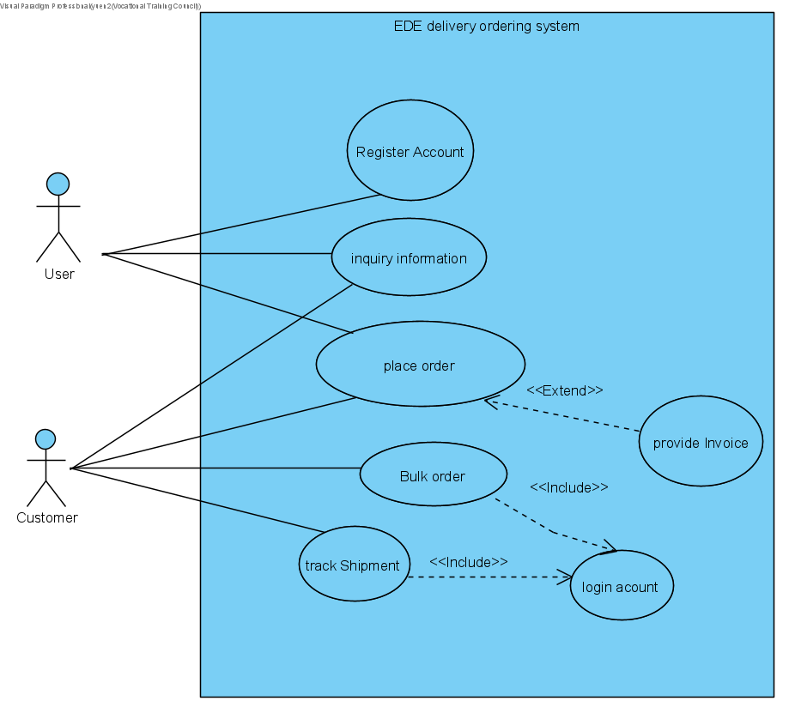

Slide 31
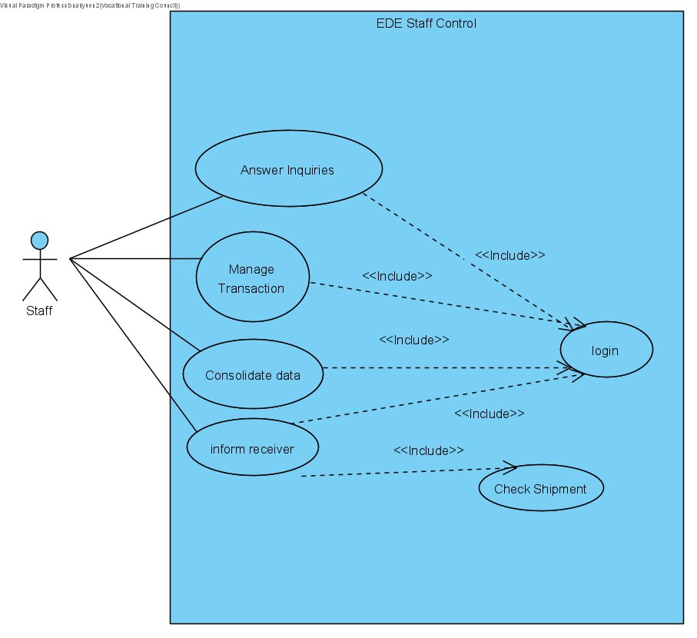

Slide 32
ER Diagram/ Class Diagram

Slide 33
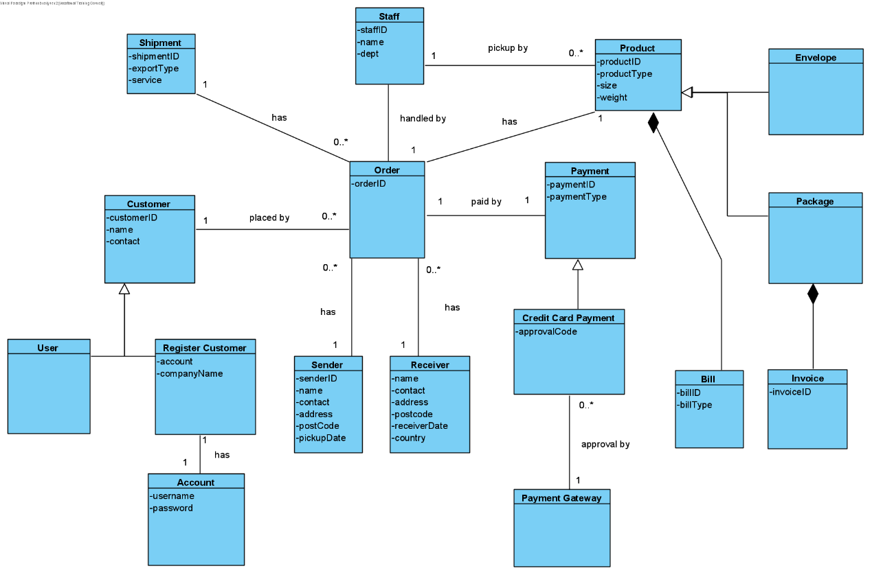

Slide 34
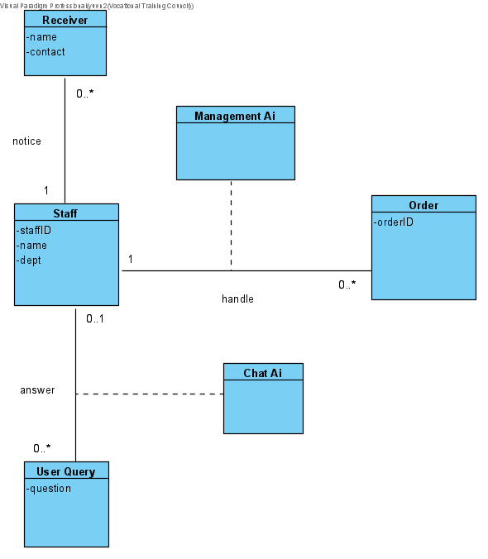

Slide 35
User Interface Design

Slide 36
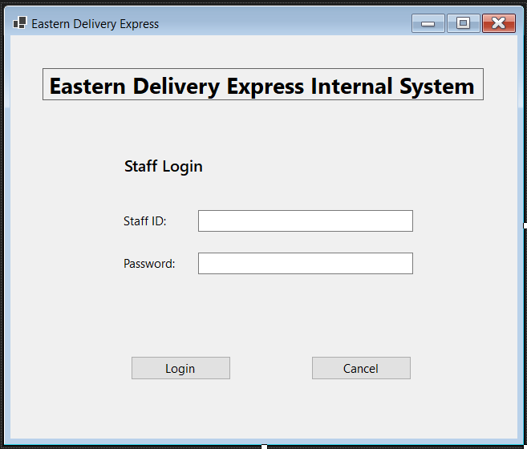
Staff Login UI

Slide 37
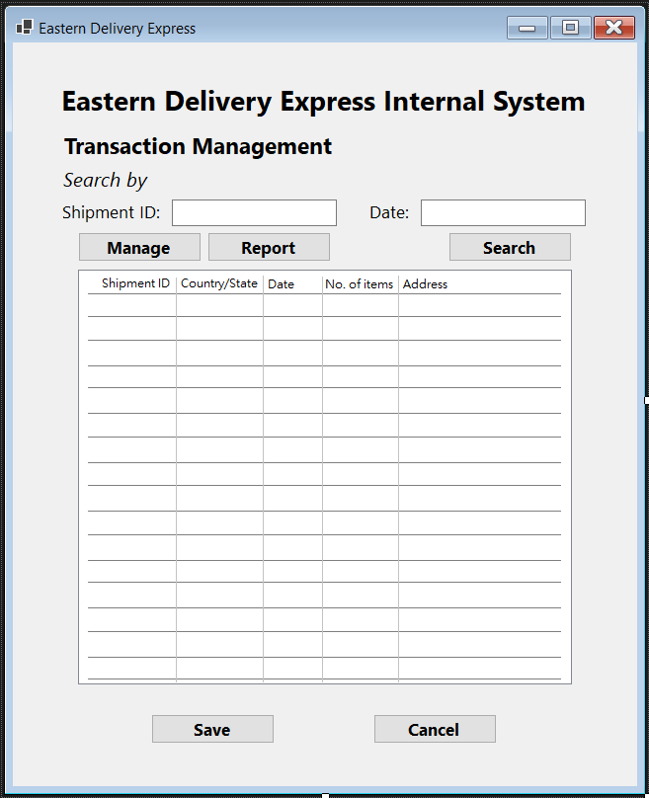
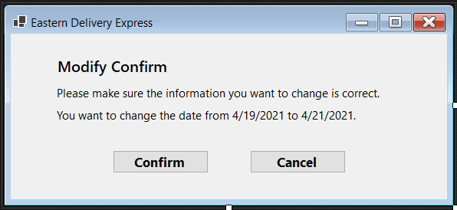
Staff Management UI

Slide 38
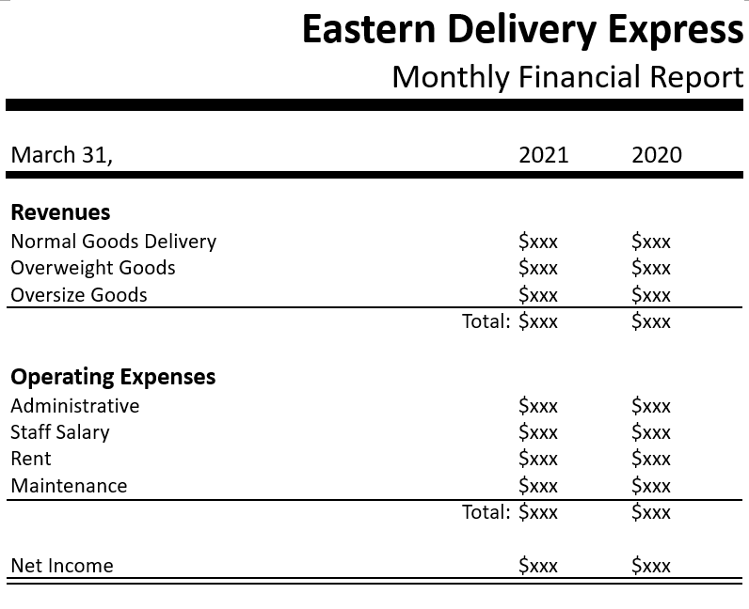
Monthly Report

Slide 39
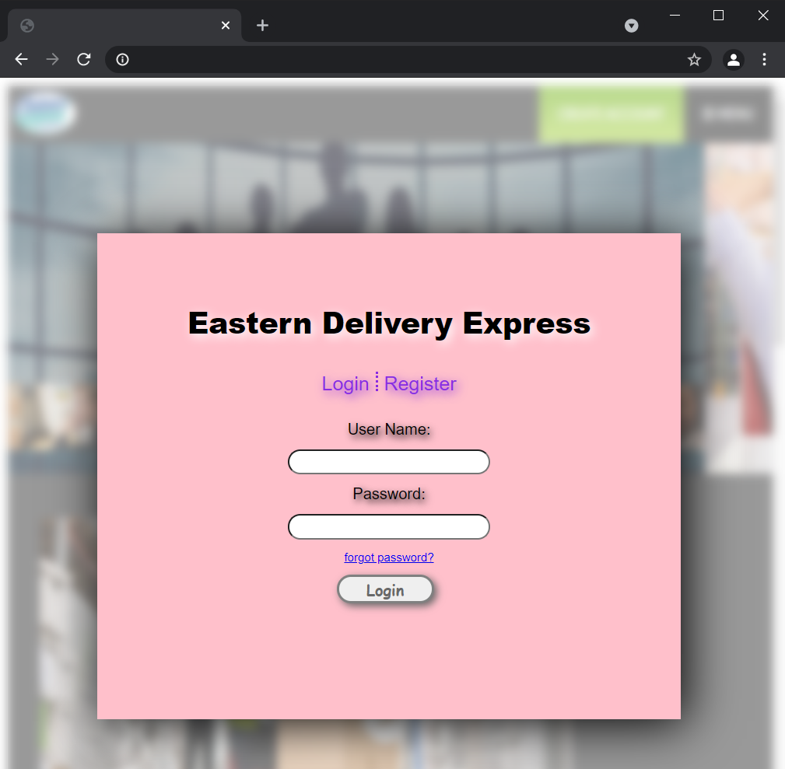
Web Login UI

Slide 40
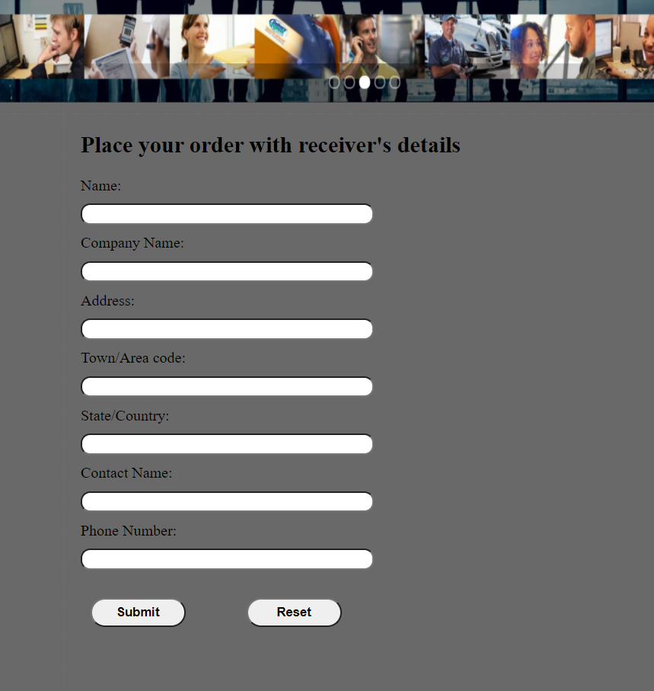
Web Order UI

Slide 41
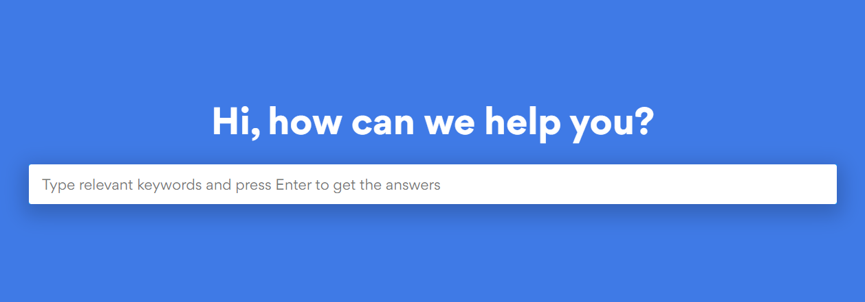
Web AI Customer Service UI

Slide 42
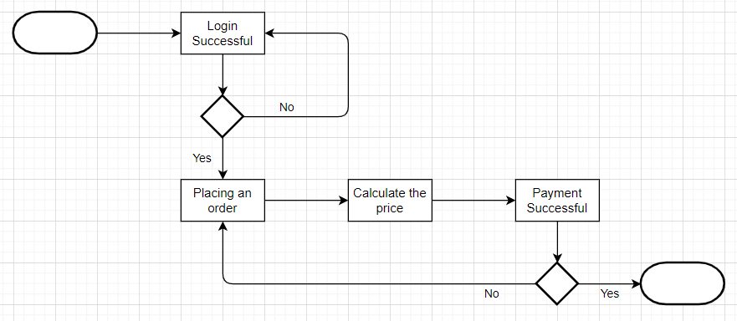
Workflow Diagram

Slide 43
Test Plan
 | Web interface | System Management | System interface
Unit tests | Black-box tests | Black-box tests | White-box tests
Integration tests | User interface Use scenario test | User interface tests Use scenario test | System interface tests
System tests | Requirement tests Security tests Performance tests Usability test | Requirements tests Security tests | Requirements tests Security tests Performance tests
Acceptance tests | Alpha test Beta test | Beta test | Alpha test Beta test

Slide 44
Sample Test Cases

Slide 45
Web Login
Test Case | Pre-condition | Test Steps | Test Result
Verify login information with correct username and password | User have an account | 1. Navigate to the login page 2. Enter username 3. Enter password 4. Click the login button | 1. user navigate to the login page 2. user can input their username 3. user can enter their password 4. user login success and navigate to home page
Verify login information with incorrect username | User have an account | 1. Navigate to the login page 2. Enter username 3. Enter password 4. Click the login button | 1. user navigate to the login page 2. user can input their username 3. user can enter their password 4. error message to alert user wrong username
Verify login information with correct username and incorrect password | User have an account | 1. Navigate to the login page 2. Enter username 3. Enter password 4. Click the login button | 1. user navigate to the login page 2. user can input their username 3. user can enter their password 4. error message to alert user wrong password

Slide 46
Accounting Clerk
Test Case | Pre-condition | Test Steps | Test Result
Accounting clerk transfer consolidated data to database server | Login AC account | 1. Click the interface that is upload data to database server 2. click the upload button and wait for it process | Navigate to the upload interface success Pop out data upload success and return the data location code
Accounting clerk transfer consolidated data to database server | Login AC account | 1. Click the interface that is upload data to database server 2. click the upload button and wait for it process | Navigate to the upload interface success Pop out data upload fail

Slide 47
Managing Director
Test Case | Pre-condition | Test Steps | Test Result
Managing director request more report | Login managing director account | 1. Click the report interface 2. activate AI to get report | Navigate to the report interface success AI keeps sending the report from database to the director
Managing director request more report | Login managing director account | 1. Click the report interface 2. activate AI to get report | Navigate to the report interface success AI can not recognize the report in database and pop out error message

Slide 48
Migration Plan
We focus on time, cost, and risk
Conversion strategy
Parallel conversion
Conversion location
Phased conversion
Conversion module
Modular conversion

Slide 49
Parallel Conversion
Run both system simultaneously
Reduce risk
Staff can take time to learn new system features

Slide 50
Phased Conversion
Phase by phase
Reduce help desk personnel workload

Slide 51
Modular Conversion
Reduce the risk
Test the module before use one by one

Slide 52
System Support Arrangement
Training session ➔ teach the staffs how to use the new function
Instruction videos ➔ check the function usage

Slide 53
Maintenance
Collect user opinion
Committee discussion ➔ figure out better performance
Analysis new requirement
Develop new requirement

Slide 54
Conclusion
Information Technology has become a huge part of our daily life, and convenience has become a kind of lifestyle. Apart from our daily life, it also affected the operations of many industries. Many companies nowadays will computerize the daily workflow, data processing, report generation, etc. in order to handle things faster. Therefore, it is important for the company to develop a great system otherwise it will become a loss for the company.

