Slide 1
Deep metric learning
conceitos, aplicações e algumas contribuições Heitor S. Ramos heitor@dcc.ufmg.br

Slide 2
Artificial Intelligence
Artificial intelligence (sometimes referred to by the acronym AI) is the science that studies the modeling of human-like intelligence exhibited by machines or software.

Slide 3
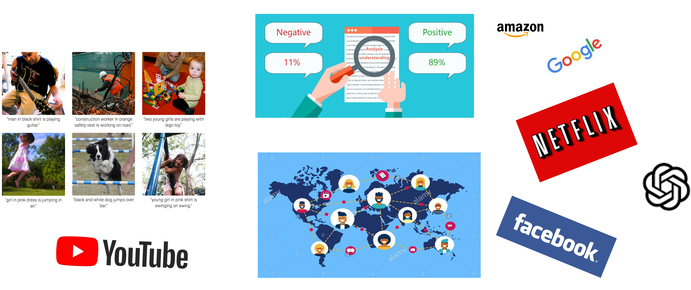
Artificial Intelligence

Slide 4
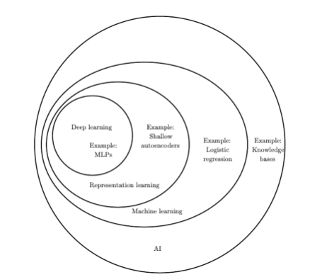
Artificial Intelligence (Deep Learning Book)
Artificial Intelligence

