Slide 1

Gesture Prediction Using ToF : an end to end workflow with Matlab and STM32Cube.AI
Martin Joel Mouk Elele, Danilo Pau
System Research and Applications

Slide 2
Table of Content
Overview
Data exploration
Data preprocessing
Datastore creation
Building the Classification model
Training and Fine Tuning
Model Pruning and Quantization
Exporting and Benchmarking

Slide 3




Overview
The aim of this project is to showcase the end-to-end workflow from data acquisition, design, optimization and deployability of a tiny neural model on a microcontroller.
The workflow comprises the use of Matlab and STM32Cube.AI Developer Cloud
The dataset is composed by ToF data, which will be processed by the workflow.
The ToF dataset is extracted using the VL53L8CX ToF sensor provided by STMicroelectronics
Dataset_Link:

Slide 4
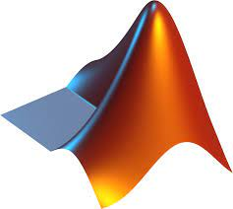



PHASE 1
PHASE 2
PHASE 3
PHASE 4
DATA PREPROCESSING
OPTIMIZATION
DEPLOY ON STM32
MODELING
D1 Data acquisition (ToF data from VL53L8X sensor)
M1 Creating a tensor data container to access the data correctly during training
O1 Evaluating the most accurate model on the test data
MCU1 Import the quantized model (ONNX) into the STM32Cube.ai Developer Cloud
D2 Extracting the frames from the mat file
M2 Defining a neural network (2D CNN) to predict the class of belonging of each data input
O2 Performing hyper parameter tuning and train validation and testing, for optimal accuracy and confidence
MCU2 Optimizing the model (balance between required RAM size and inference time)
M3 Check deployability with STM32Cube.ai Developer Cloud
D3 Standardizing, thresholding and cleaning all the frames
O3 Pruning the model to remove redundant weights
MCU3 Benchmarking on STM32 and measuring the inference time.
D4 Augmenting the data (applying transforms) to enhance the model’s generalization abilities
M4 Tracking the training progress and the best model during evaluation
O4 Model 8-bit post training quantization (PTQ) for low cost deployment on STM32
MCU4 Looping between PHASE 2, 3, 4 as required
Notes:
‹#›

Slide 5
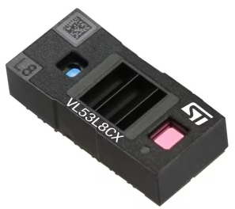




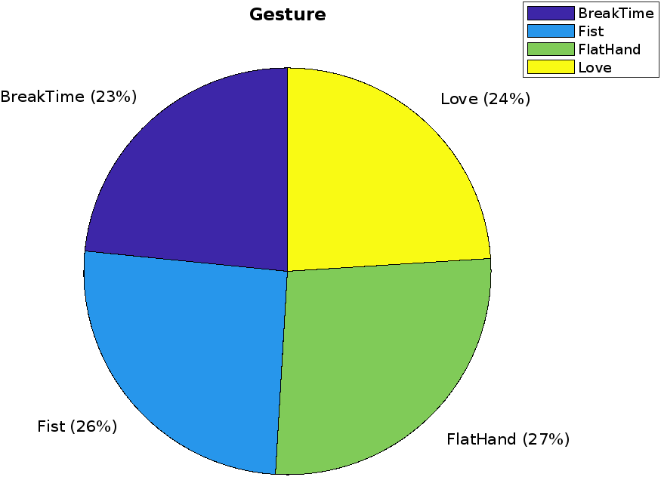
Data exploration
Dataset is an almost balanced one, containing 5310 samples (ToF frames) extracted from a VL53L8CX ToF sensor, which is based on STMicroelectronics FlightSense Technology.
Dataset gestures
BreakTime Fist
The recorded candidates performed four distinct gestures
Thus, the dataset is made of static gesture frames, [8 x 8] in size.
FlatHand Love
The depth frames contain values corresponding to increase in distance from the depth sensor, thus farther objects have greater values.
Class distribution in the dataset

Slide 6

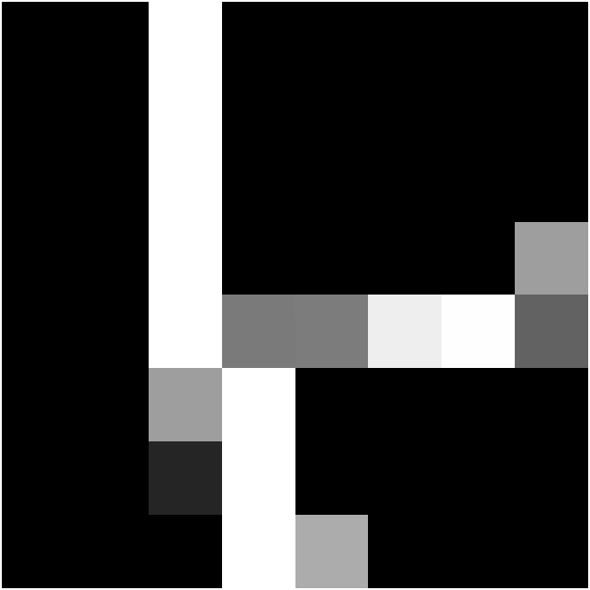
Data Preprocessing
Original frame
Considering the raw and zonal data obtained from the VL53L8CX (8x8 frame setting)
The raw data represents the unprocessed frame, which needs calibration (in range) and cleaning
The zonal frame is a preprocessed frame with an initial filtering (zonal) during collection.
Saturated frame
Processed frame
Standardizing the frames to [-1, 1] range. to reduce the computational cost when training the model on the frames.
This also helps for better visualization of the data frames, since the saturation created from high values has been removed.
Augmentations on both frame types (left flip, top flip, center crop, top crop, bottom crop , left crop, right crop, left translation, right translation, rotations [90, 180, 270]
Gesture: BreakTime

Slide 7
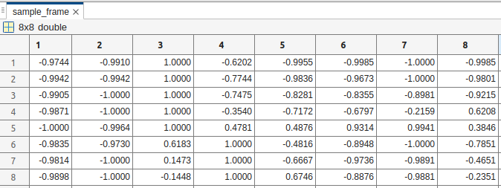
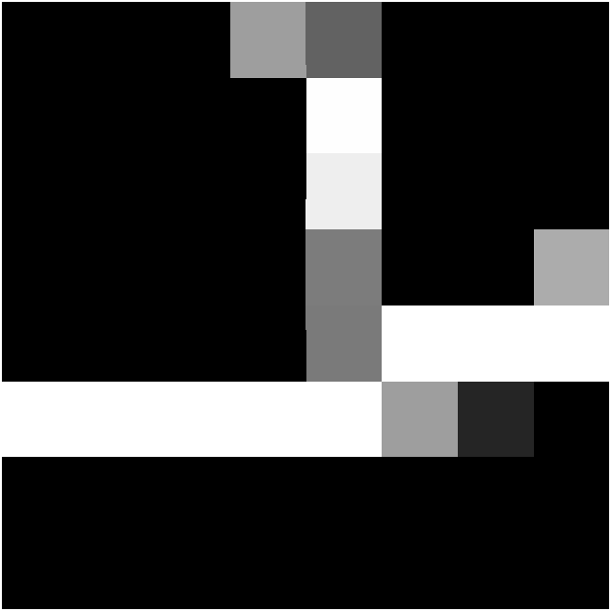
Datastore Creation
Composed of 8x8x2 frames
The Dataset is augmented from 5310 frames to 69030 frames (for each frame type)by applying 12 augmentations on each frame as described earlier.
Each cleaned (raw) frame and its corresponding zonal frame are concatenated, with a corresponding label associated to each (concatenated) frame, which will be used to compare the classification results from the model.
Example of preprocessed depth map channel
Sample augmentation on zonal frame
The frames are stored in a data table alongside their corresponding label.
Dataset split: 75% train, 15% validation and 15% test
Rotation 90

Slide 8
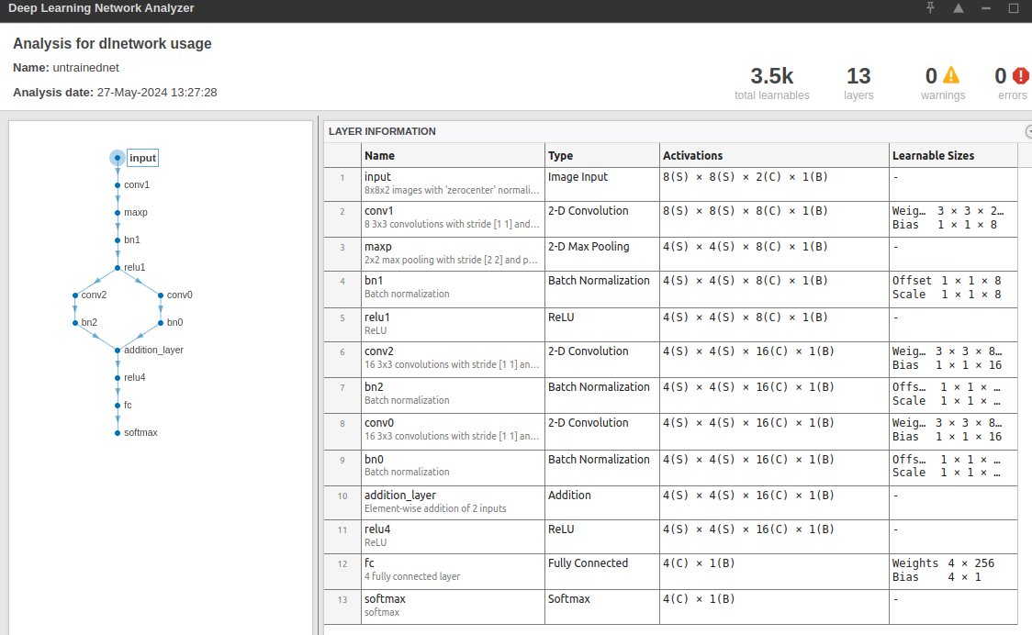

Building the Classification model
The model is built in MATLAB 2024 (online)
The model has a residual network architecture (ResNet). In this case, we fight low gradients by adding the results from two parallel convolution layers.
[8 8 2] input shape with about 3.5K learnable parameters,13 layers and a probability output (softmax) to predict the class of belonging of the input image (4).
8x8x2 input image
Addition layer for prediction enhancing

Slide 9
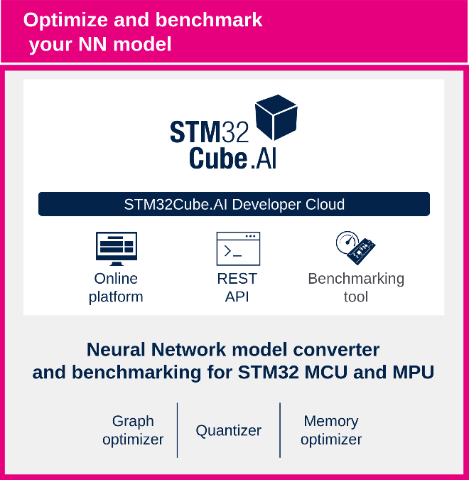
Deployability of Model
Exporting untrained model
Exporting the designed model as onnx to allow interoperability of the model between MATLAB and the STM32Cube.AI Developer Cloud platform
Verifying interpretability
Checking the architecture of the model; layers, activation functions, connections, and other properties of the model to ensure it aligns with the expectations.
Anticipating model compatibility on STM32Cube.AI Developer Cloud https://stm32ai-cs.st.com/home
Ensuring that the exported model, once trained, will be compatible with the tools and infrastructure provided by STM32Cube.AI Developer Cloud.
Considering factors such as supported model formats, memory and computational constraints of the target board (STM32L4R9I-DISCO), and specific optimizations or conversions required for deployment on the platform.

Slide 10
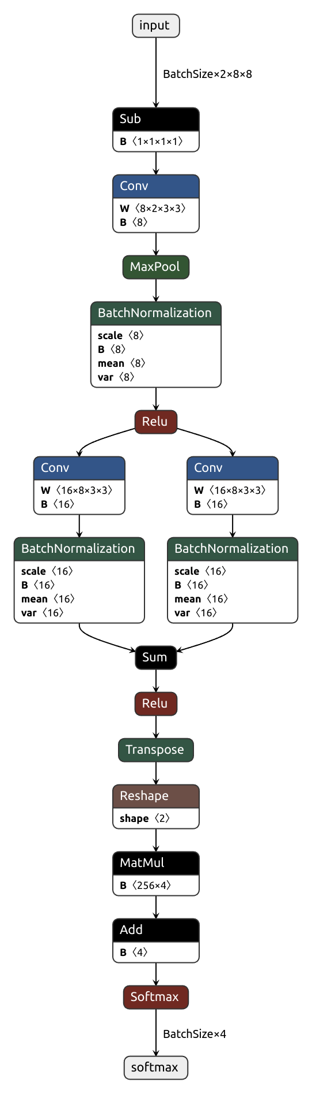
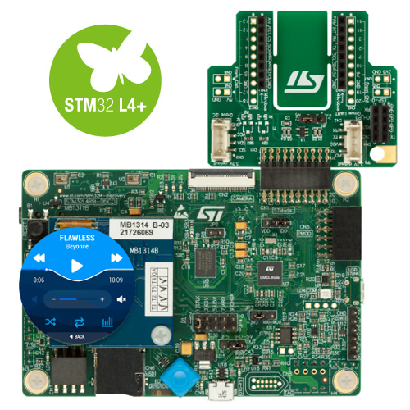
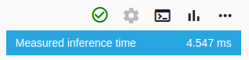
Deployability Analysis of Untrained Model
Untrained model
MACC 48552
FLASH
Weights 13.67 KiB
Library 17 KiB
RAM
Activations 2.5 Ki B
Library 3 Ki B
Execution time
[board name, STM32L4R9I-DISCO]
4.547 ms
Board inference time
Model representation in STM32 Cloud

Slide 11
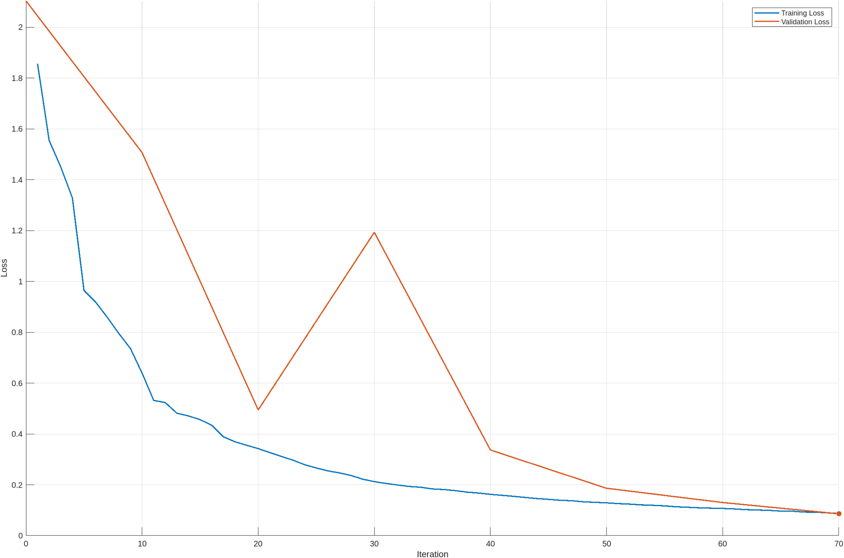
Training Process
Validation loss monitoring
Network weights updated using the limited memory LBFGS algorithm and trained over 70 iterations
The L-BFGS algorithm is suitable for small networks and data sets that you can process in a single batch, thus requires less computational resources (less memory)
High convergence within the first 50 iterations

Slide 12
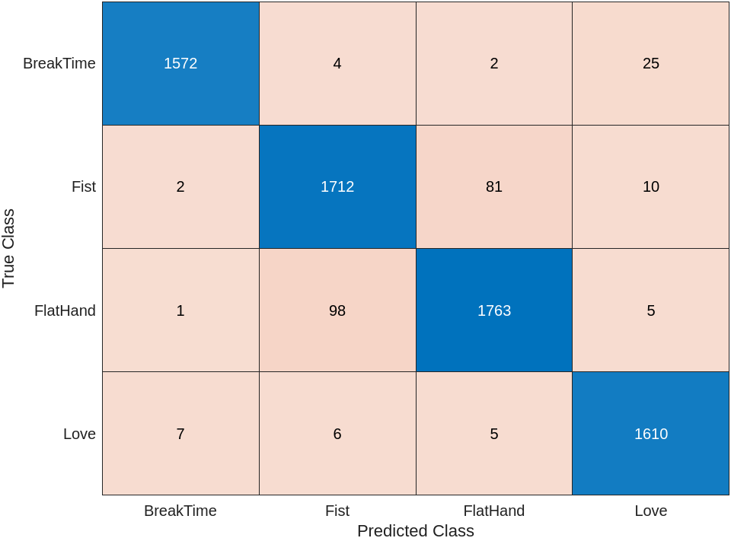
Test results
As expected, with the advantage the residual connection added to model enables it to perform quite well, with a test set accuracy of about 96.43%.
The confusion matrix on the test set predictions is also visualized, in order to determine which classes were more problematic during training.
Least accurately predicted class
Notes:
96.4363

Slide 13
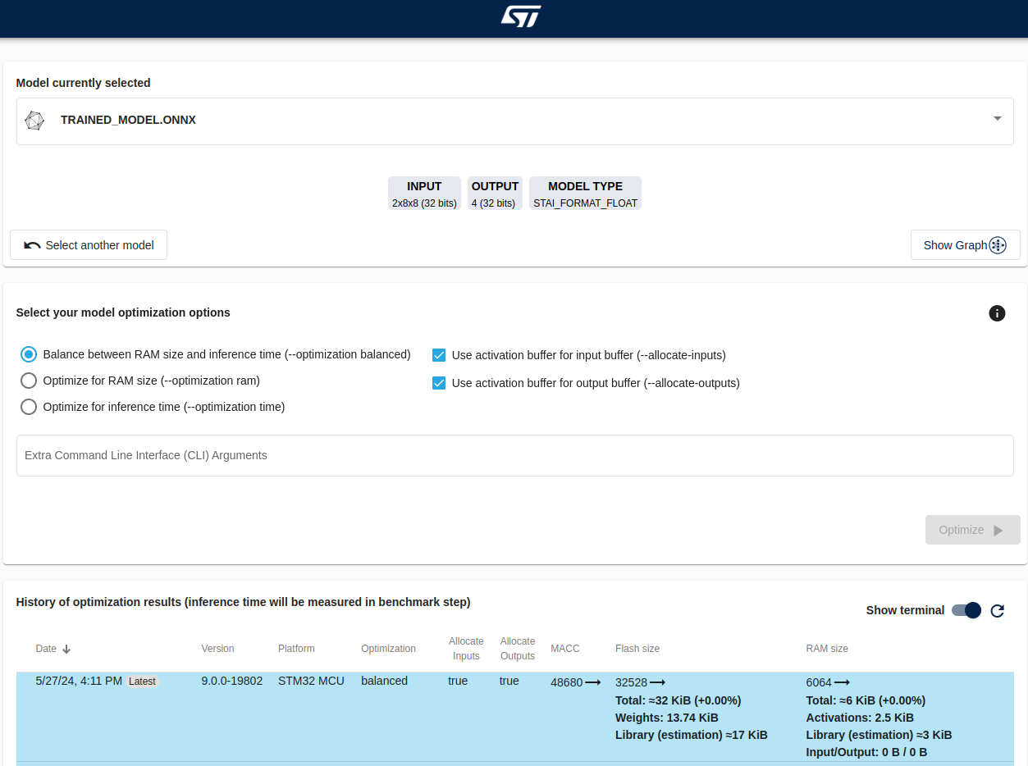
Deployability Analysis of Trained Model
Trained model
MACC 48680
FLASH
Weights 13.74 KiB
Library 17 KiB
RAM
Activations 2.5 KiB
Library 3 Ki B
Execution time [board name, STM32L4R9I-DISCO]
4.741 ms

Slide 14
Deployability Comparison
Both the untrained and trained models have a similar number of Multiply-Accumulate Operations (MACC), indicating no significant increase in computational complexity due to training.
Training the model has resulted in increased memory usage (FLASH).
The increase in model size and complexity has led to a slightly longer execution time for inference after training.
 | Parameters (K) | Accuracy (%) | MACC | FLASH (KiB) | RAM (KiB) | Execution Time [STM32L4R9I-DISCO] (ms)
Untrained Model | 3.5 | - | 48552 | Weights: 13.67 Library: 17 | Activations: 2.5 Library: 3 | 4.547
Trained Model | 3.5 | 96.43 | 48680 | Weights: 13.74 Library: 17 | Activations: 2.5 Library: 3 | 4.741

Slide 15

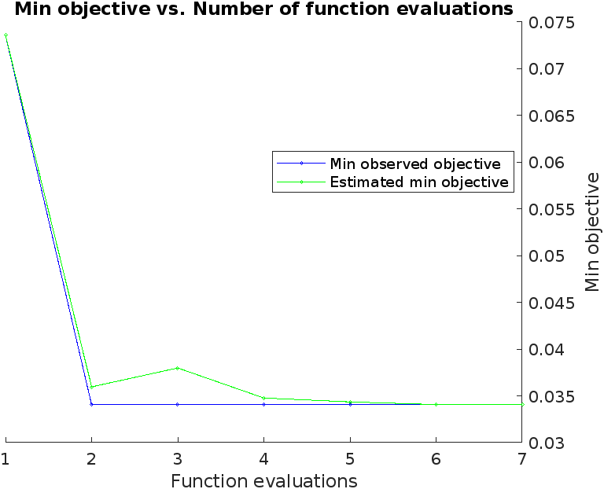
HyperParameter Tuning
Getting the model with the highest accuracy on the test set.
Iterating through several configurations with learnables equal to or less than the initial trained model (Bayesian optimization).
Each model is trained over 100 to 120 iterations, number which varies as a hyper parameter too.
The best model obtained from this process is a 3.1K learnables model, with a test accuracy of 96.59%
Best HP configuration
Best model

Slide 16
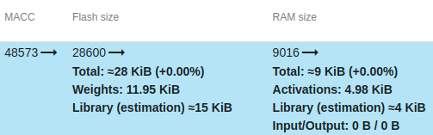
Deployability Analysis of Optimized model
Optimized model
MACC 48573
FLASH
Weights 11.95 KiB
Library 15 KiB
RAM
Activations 4.95 KiB
Library 4 Ki B
Execution time [board name, STM32L4R9I-DISCO]
5.882 ms
Fewer accumulated multiplications

Slide 17
Deployability Comparison
The optimization process aims to reduce the model size while maintaining or improving accuracy.
The resulting optimized model demonstrates reduced MACC, FLASH and an increase in execution time compared to both the untrained and trained models, due to a change in the parameters.
 | Parameters (K) | Accuracy (%) | MACC | FLASH (KiB) | RAM (KiB) | Execution Time [STM32L4R9I-DISCO] (ms)
Untrained Model | 3.5 | - | 48552 | Weights: 13.67 Library: 17 | Activations: 2.5 Library: 3 | 4.547
Trained Model | 3.5 | 96.43 | 48680 | Weights: 13.74 Library: 17 | Activations: 2.5 Library: 3 | 4.741
HPO Optimized Model | 3.1 | 96.59 | 48573 | Weights: 11.95 Library: 15 | Activations: 4.95 Library: 4 | 5.882
Increase in inference time due to change in model parameters

Slide 18
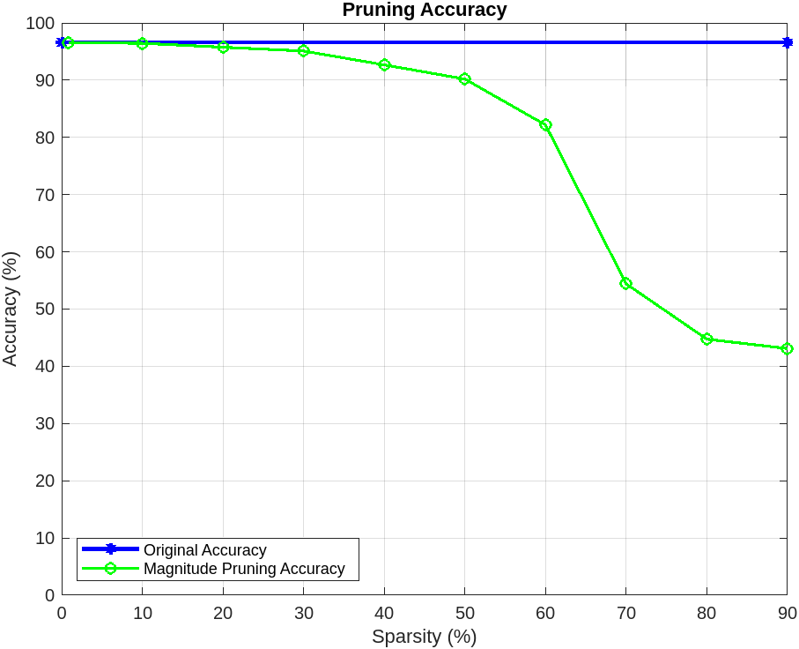
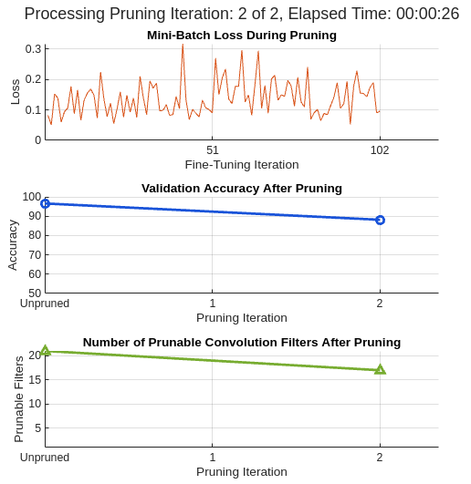
Pruning
Estimation from magnitude pruning plot
Masking some of the weights of the optimized model, in order to get an estimate of the percentage of weights to be pruned.
From the results obtained, the optimized model is pruned to a reduced model with a similar accuracy as the initial model, using Taylor’s probability score.
Initially, a plot of the model accuracy vs model sparsity is plotted so as to get the best sparsity (minimum accuracy loss)
From visualization, pruning about 20% of the filters doesn’t reduce the model’s accuracy by much
The pruned model is trained and evaluated over few epochs, with accuracy checked on the test set.
Slight accuracy change
pruning of the filters

Slide 19
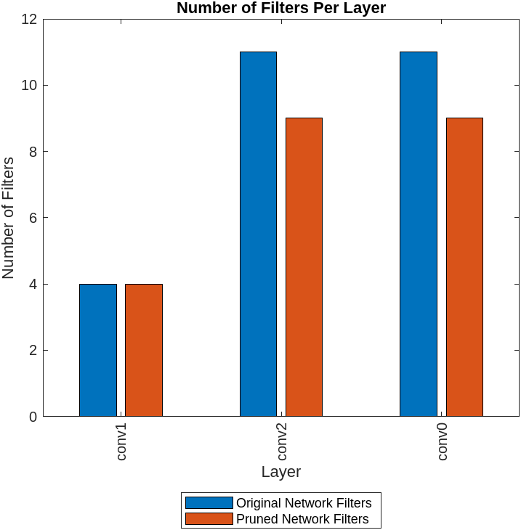
Comparing the Original Optimized model and the Pruned model
 | Neural Network Non-zero Learnables (K) | Approx. Neural Network Memory (KiB) | Accuracy
HPO optimized Neural Network | 3.1 | 11.914 | 96.59
Pruned Neural Network | 2.5 | 9.905 | 96.42
Percentage Change | -17.5 | -17.7 | -0.179

Slide 20
Deployability Analysis of Pruned model
Pruned model
MACC 26444
FLASH
Weights 9.84 KiB
Library 15 KiB
RAM
Activations 4.18 KiB
Library 4 Ki B
Execution time [board name, STM32L4R9I-DISCO]
4.999 ms
The number of filters per layer have been pruned to a maximum of about 9 filters per layer, which considerably reduce the number of multiplications.
The results of pruning are well visible with regards to the time of inference on the board.

Slide 21


You can personalize this
last page with a short link
(ex. www.st.com/shortlink)
You can find a complete list of st.com short links on this page:
http://seo.st.com/toolbox/shortcuts/
Find out more at www.st.com

