Slide 1

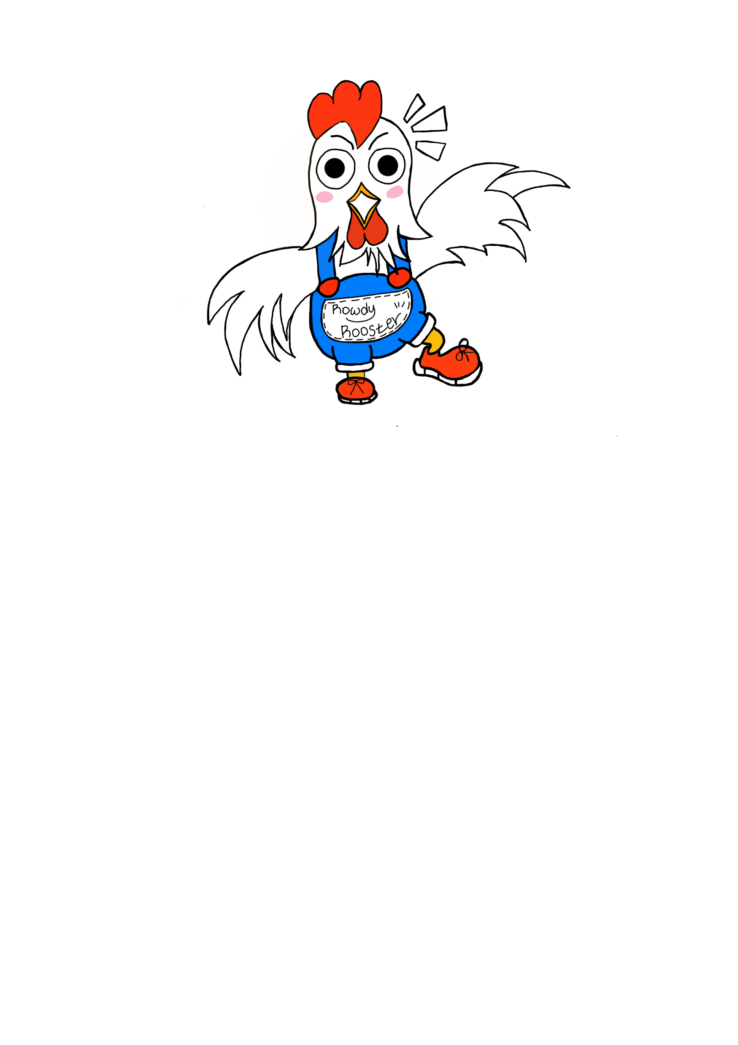
Make the world better place
Boya Li
David Moon
EunJeong Heo

Slide 2
Table of Content
01
Motivation
02
Question to Answer
03
Key Approaches
04
Machine Learning Models
05
ML Model Web application
06
Conclusion

Slide 3
QUIZ
X
Quiz
Q1. In all low-income countries across the world today, how many girls finish primary school?
A) 20%
B) 40%
C) 60 %
Q3. In the last 20 years, the proportion of the world population living in extreme poverty has . . .
A) Almost doubled
B. Remained more or less the same
C) Almost halved
Q5. There are 2 billion children in the world today, aged 0 to 15 years old.
How many children will there be in the year 2100, according to the United Nations
A) 4 billion
B. 3 billion
C) 2 billion
Q13. Global climate experts believe that, over the next 100 years, the average temperature will...
A) get warmer
B. remain the same
C) get colder
CONTENT
CONTENT
Notes:
In project 2, we created a web application based on the book ‘Factfulness’, discussed how much our worldview is skewed across certain fronts, and found some correlation between our data and USAID's foreign aid trend. Even though we learned the world is not as worst as we thought, there is still a lot of space where society can put effort to make a better world.

Slide 4

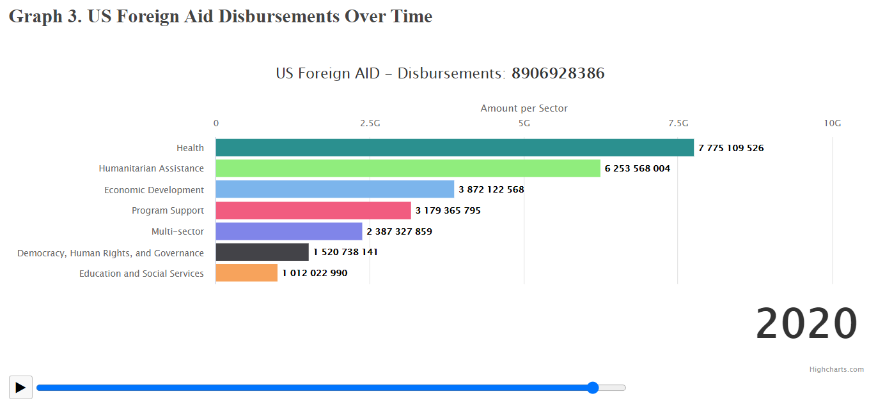

Motivation
: ‘Factfulness’ and AID
1
Why do we need Foreign Aid?
The most common type of foreign aid is official development assistance(ODA), which is assistance given to promote development and to combat poverty.
Notes:
Therefore, following the last part of Project 2, in our last project, we decided to dig deep into Foreign Aid sectors. Foreign Aid is the international transfer of capital, goods, or services from a country or international organization for the benefit of the recipient country or its population. The most common type of foreign aid is official development assistance (ODA), which is assistance given to promote development and to combat poverty.

Slide 5

Motivation
: ‘Factfulness’ and Foreign Aid
1
Is dividing in the ‘rich’ and ‘poor’ countries enough?
=
standing on top of a skyscraper
and looking down at a city
It’s hard to prioritize which country should be aided first for the efficiency
and pick up on progress if you divide the world into just two options!
Notes:
https://www.gatesnotes.com/books/factfulness
However, finding poor countries and support them is enough? When those are the only rich and poor two options, you’re more likely to think anyone who doesn’t have a certain quality of life is “poor.”
In this way, it’s hard to prioritize which country should be aided first for the efficiency and pick up on progress if you divide the world into just two options.
Hans Rosling from ‘Factfulness’ compares this instinct to standing on top of a skyscraper and looking down at a city. All of the other buildings will look short to you whether they’re ten stories or 50 stories high. It’s the same with income. Life is significantly better for those on level 2 than level 1, but it’s hard to see that from level 4 unless you know to look for it.

Slide 6

Question to Answer
: How to predict which countries should be prioritized to Foreign Aid?
2
How to predict which countries should be prioritized to Foreign Aid?

Slide 7
Key Approaches
Dataset Summary: 1) World Health Statistics 2) Socio-Economic Factors
3
Data Source: Kaggle
world_health_statistics.csv
US_health_disbursement.csv
aid_to_underdeveloped_countries.csv
Independent variables (X)
cancer, air_pollution_death, alchol_abuse, drinking_water, hand_wash, fuel_tech, UHC_data_access , tuberculosis, doctors, poisoning, unsafe_wash, tabacco, life_expectancy, population, etc.
Country, child_mortality, Exports, Imports, Health,
Income, Inflation, Life_expectancy, Totla_ fertility, gdp
Dependent Variables(Y)
US_disbursement_health_sector
Can we predict the amount of disbursement?
Can we cluster by its characteristics?
Notes:
https://www.gatesnotes.com/books/factfulness
However, finding poor countries and support them is enough? When those are the only rich and poor two options, you’re more likely to think anyone who doesn’t have a certain quality of life is “poor.”
In this way, it’s hard to prioritize which country should be aided first for the efficiency and pick up on progress if you divide the world into just two options.
Hans Rosling from ‘Factfulness’ compares this instinct to standing on top of a skyscraper and looking down at a city. All of the other buildings will look short to you whether they’re ten stories or 50 stories high. It’s the same with income. Life is significantly better for those on level 2 than level 1, but it’s hard to see that from level 4 unless you know to look for it.

Slide 8
Key Approaches
: Overall process
3
Data Load
Build ML models
Web application
Data clean up (Python)
&
Exploration
Multi-linear regression
K-means
Hierarchical Clustering
Hiroku
&
Tableau
START
Website

Slide 9
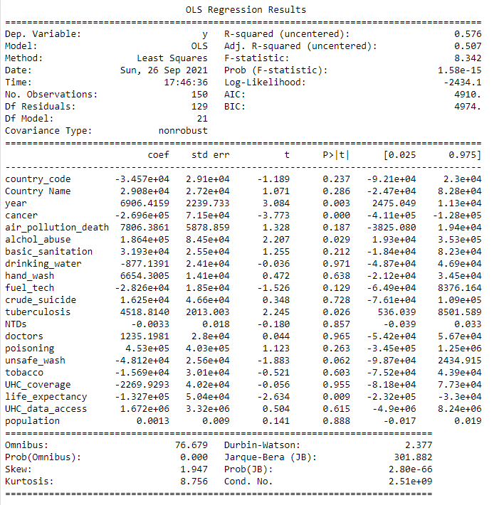


Machine Learning Models
1) multi-linear regression : Can we predict the amount of disbursement?
4
Hurdles
Creating a new dataset
Dealing with null values
Low correlations between X and Y
High p-value and low R-squared
Lesson learned: “too many external factors!”
Countries often provide foreign aid …
to enhance their own security
to achieve a country’s diplomatic goals
to promoting a country’s exports
Notes:
https://www.britannica.com/topic/foreign-aid
Countries often provide foreign aid to enhance their own security. Thus, economic assistance may be used to prevent friendly governments from falling under the influence of unfriendly ones or as payment for the right to establish or use military bases on foreign soil. Foreign aid also may be used to achieve a country’s diplomatic goals, enabling it to gain diplomatic recognition, to garner support for its positions in international organizations, or to increase its diplomats’ access to foreign officials. Other purposes of foreign aid include promoting a country’s exports (e.g., through programs that require the recipient country to use the aid to purchase the donor country’s agricultural products or manufactured goods) and spreading its language, culture, or religion. Countries also provide aid to relieve suffering caused by natural or man-made disasters such as famine, disease, and war, to promote economic development, to help establish or strengthen political institutions, and to address a variety of transnational problems including disease, terrorism and other crimes, and destruction of the environment. Because most foreign aid programs are designed to serve several of these purposes simultaneously, it is difficult to identify any one of them as most important.

Slide 10
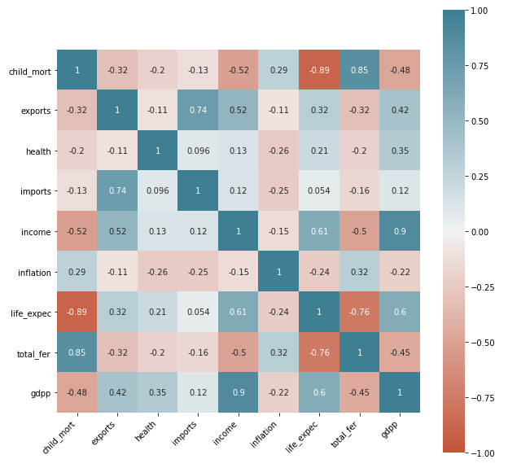
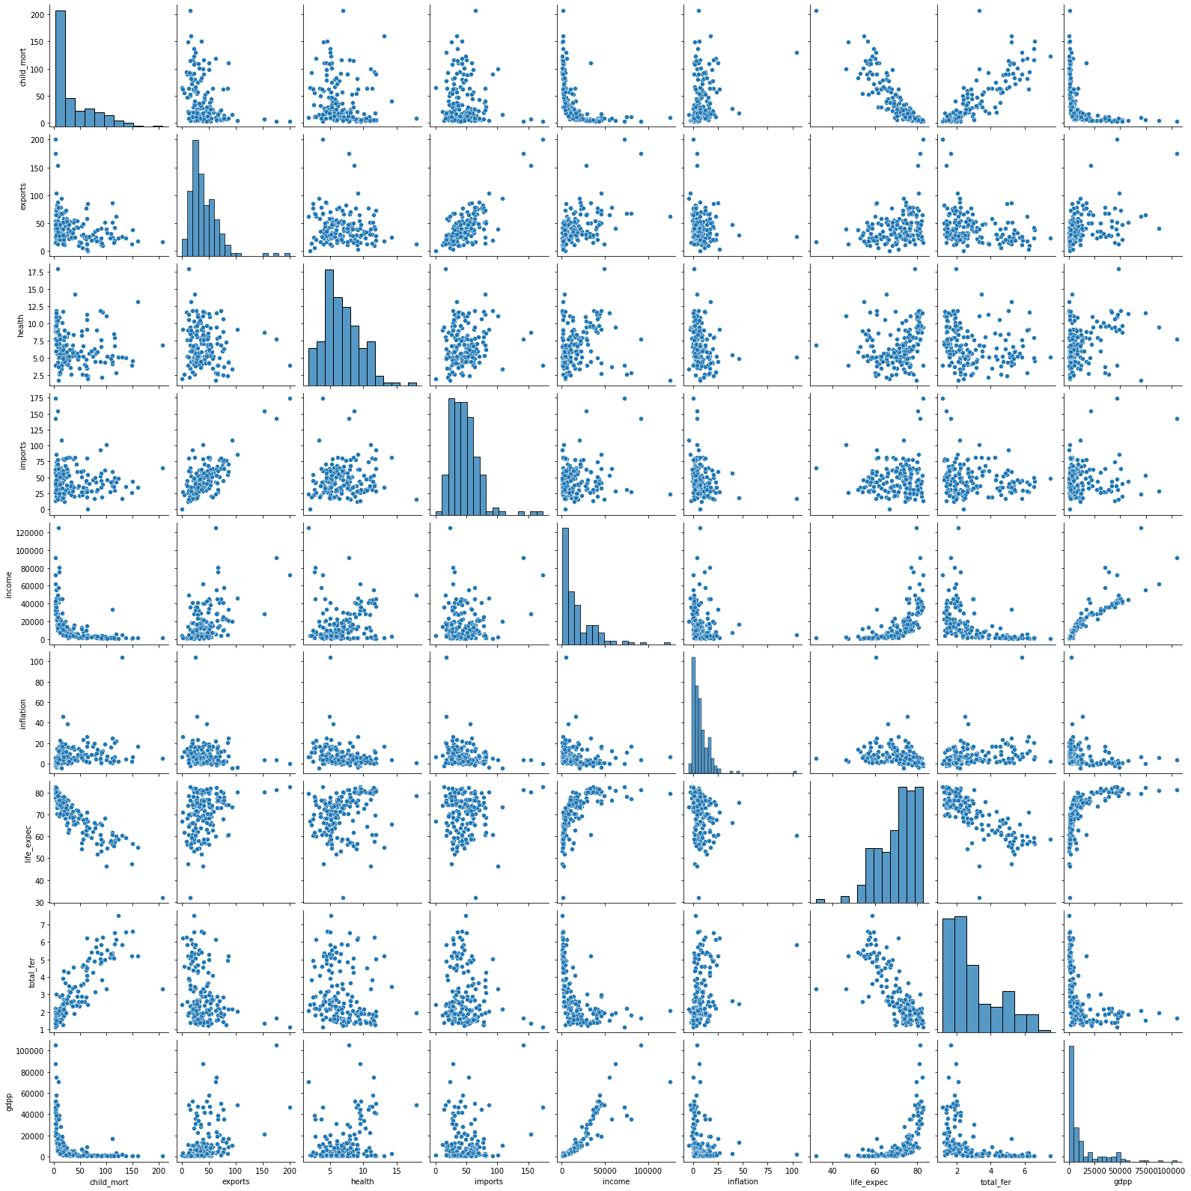
Machine Learning Models
2) Clustering
4
Data exploration_correlations
Notes:
'child_mortality’ & 'life_expentency’ : -0.89
'child_mortality’ & 'total_fertility’: 0.85
'exports’ & 'imports' 0.74
'life_expentency’ & 'total_fertility' : -0.76

Slide 11
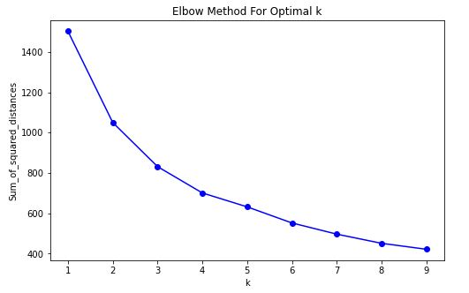
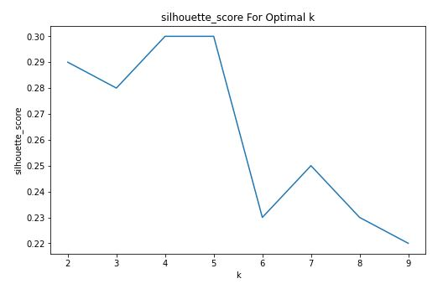
Machine Learning Models
2) Clustering_k-means
4
1) K-means Clustering_Find optimal K: ‘elbow method’ & ‘Silhouette score’
‘4’ is optimal k!
Notes:
As k increases, the sum of squared distance tends to zero.
Imagine we set k to its maximum value n (where n is number of samples) each sample will form its own cluster meaning sum of squared distances equals zero. Below is a plot of sum of squared distances for k in the range specified above. **If the plot looks like an arm, then the elbow on the arm is optimal k!

Slide 12
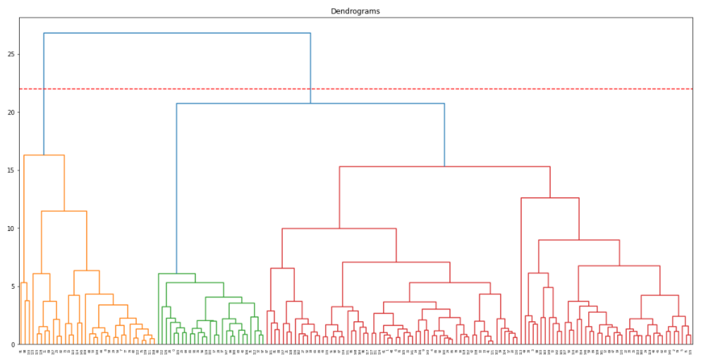
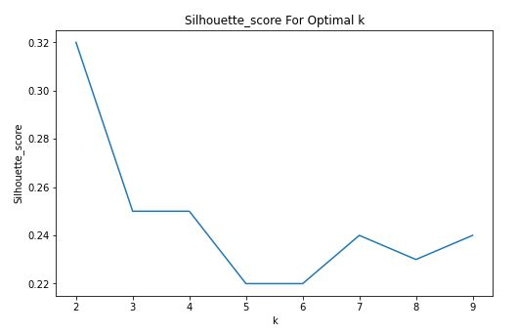
Machine Learning Models
2) Clustering_ Hierarchical
4
2) Hierarchical Clustering_Find optimal K: ‘Dendrograms’ & ‘Silhouette score’
‘2’ is optimal k!
Notes:
As k increases, the sum of squared distance tends to zero.
Imagine we set k to its maximum value n (where n is number of samples) each sample will form its own cluster meaning sum of squared distances equals zero. Below is a plot of sum of squared distances for k in the range specified above. **If the plot looks like an arm, then the elbow on the arm is optimal k!

Slide 13
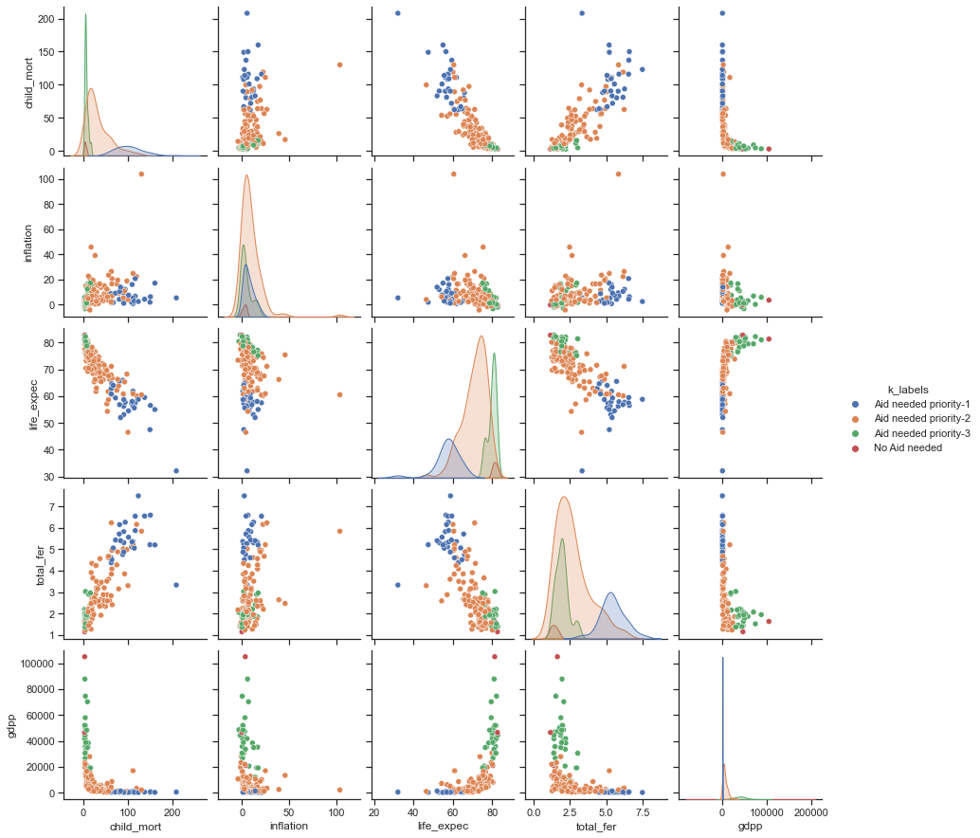
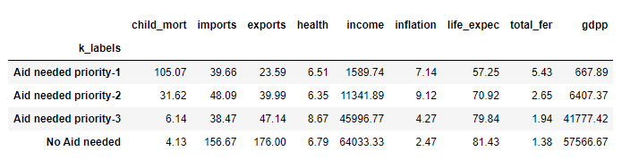
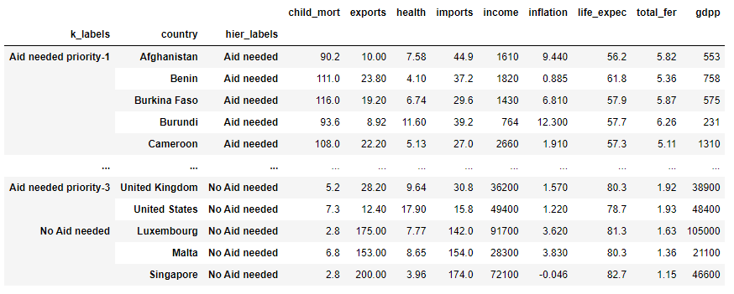
Machine Learning Models
2) Clustering_ final outcome
4
‘ Labeling the cluster’
Notes:
As k increases, the sum of squared distance tends to zero.
Imagine we set k to its maximum value n (where n is number of samples) each sample will form its own cluster meaning sum of squared distances equals zero. Below is a plot of sum of squared distances for k in the range specified above. **If the plot looks like an arm, then the elbow on the arm is optimal k!

Slide 14
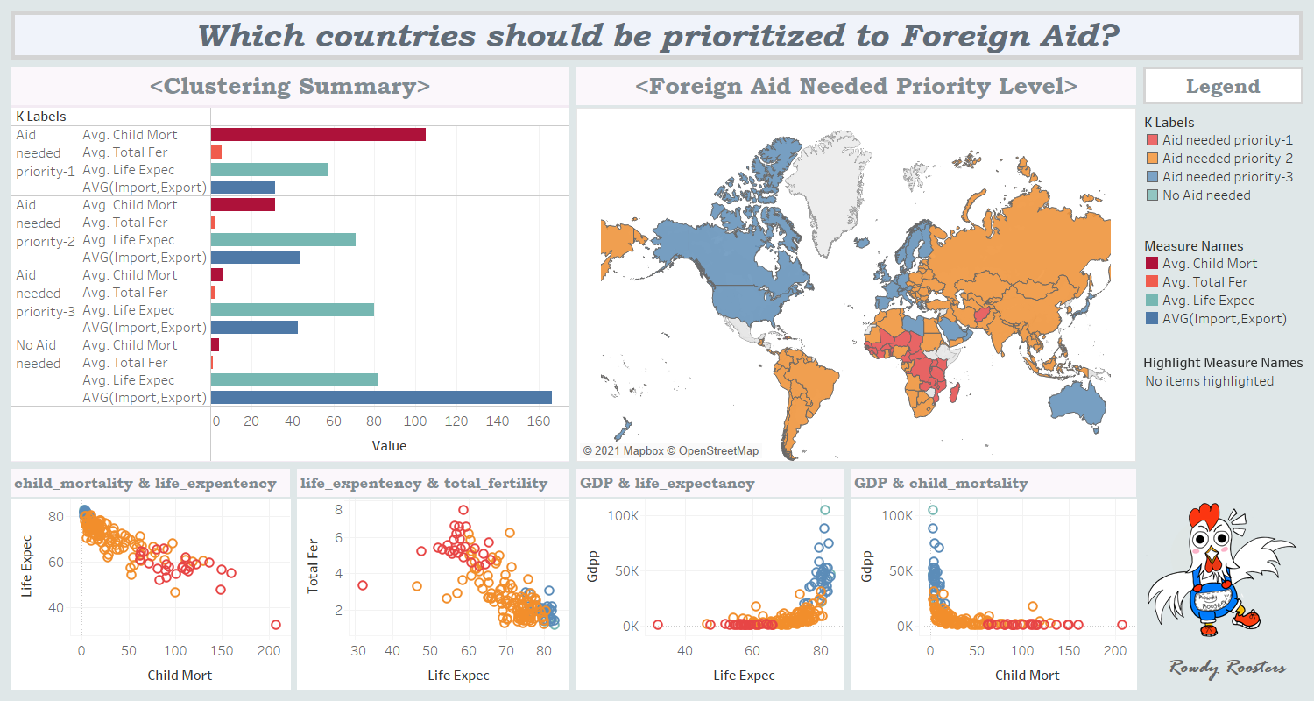
Notes:
https://www.gatesnotes.com/books/factfulness
However, finding poor countries and support them is enough? When those are the only rich and poor two options, you’re more likely to think anyone who doesn’t have a certain quality of life is “poor.”
In this way, it’s hard to prioritize which country should be aided first for the efficiency and pick up on progress if you divide the world into just two options.
Hans Rosling from ‘Factfulness’ compares this instinct to standing on top of a skyscraper and looking down at a city. All of the other buildings will look short to you whether they’re ten stories or 50 stories high. It’s the same with income. Life is significantly better for those on level 2 than level 1, but it’s hard to see that from level 4 unless you know to look for it.

Slide 15
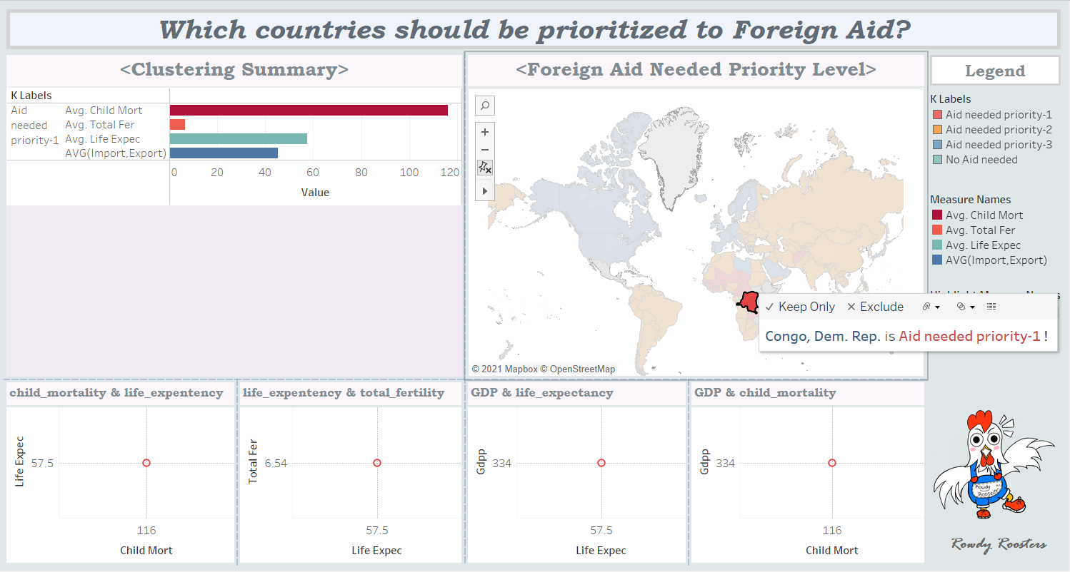
Notes:
https://www.gatesnotes.com/books/factfulness
However, finding poor countries and support them is enough? When those are the only rich and poor two options, you’re more likely to think anyone who doesn’t have a certain quality of life is “poor.”
In this way, it’s hard to prioritize which country should be aided first for the efficiency and pick up on progress if you divide the world into just two options.
Hans Rosling from ‘Factfulness’ compares this instinct to standing on top of a skyscraper and looking down at a city. All of the other buildings will look short to you whether they’re ten stories or 50 stories high. It’s the same with income. Life is significantly better for those on level 2 than level 1, but it’s hard to see that from level 4 unless you know to look for it.

Slide 16
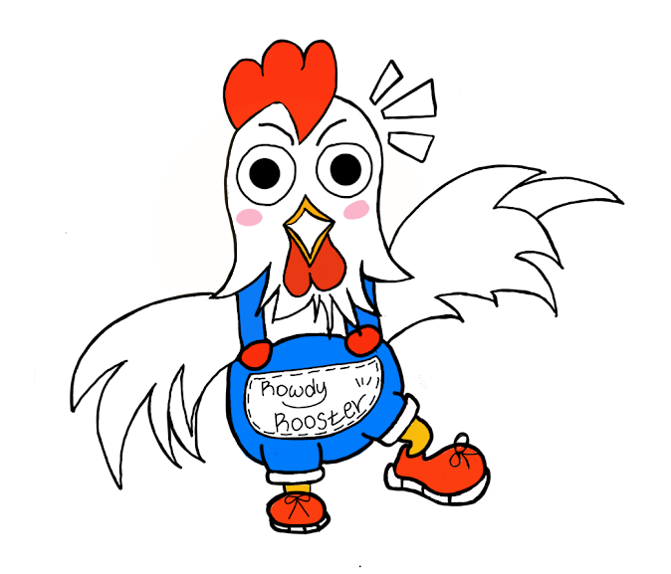
ML Model Web application
2) Clustering_ final outcome
5
Hey,
click me !
Notes:
As k increases, the sum of squared distance tends to zero.
Imagine we set k to its maximum value n (where n is number of samples) each sample will form its own cluster meaning sum of squared distances equals zero. Below is a plot of sum of squared distances for k in the range specified above. **If the plot looks like an arm, then the elbow on the arm is optimal k!

Slide 17




06
X
06. Conclusion
page
Recognize
Problem Solving
Take an Action
Recognize that the world isn’t as bad as I thought
Do your analysis
See the world
in multiple angles
Notes:
So, when getting your information online, it’s always best to read multiple sources, not just one. It’s the equivalent of traveling around the world. Only when we surf the globe can we learn to see it as it really is, so that we may form our opinions based on facts, not feelings.

Slide 18
Thank you!
Q&A?

