Slide 1

PM DataCare
Caring for your SAP PM master data
Requester walkthrough — create, fill, save, and submit a request
July 2026

Slide 2
Before you start
1
2
3
Open the portal
Check your role
What happens after
Use the site link shared by the Data Maintenance team in Edge or Chrome. Your Windows login signs you in automatically — no password.
The home page greets you with your role badge. As a Requester you can create requests, track them, comment, and attach files.
The Data Maintenance team executes your request manually in SAP (Fiori MDG) and marks it Completed. You are emailed at the key steps.
Tip: bookmark the site — the request you need is always two clicks away.

Slide 3
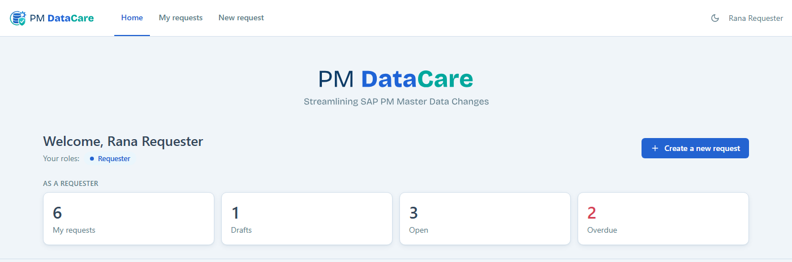
1
Your home page
3
1
2
1
New request — starts a new change request (same as the blue button)
3
My requests — everything you created — drafts, open, and finished
2
Create a new request — the quickest way to begin

Slide 4
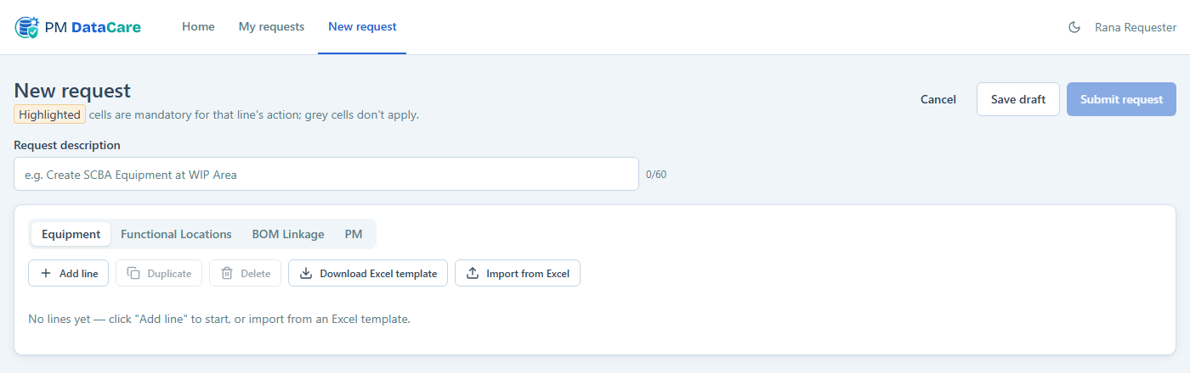
2
Start with a clear description
1
2
3
1
Request description — one line saying WHAT and WHY — e.g. "Create SCBA Equipment at WIP Area" or an MOC/work-order reference. Required before you can submit.
3
Object type tabs — pick where your changes belong: Equipment, Functional Locations, BOM Linkage, or PM. One request can use several tabs.
2
Character counter — keep it short — 60 characters max

Slide 5
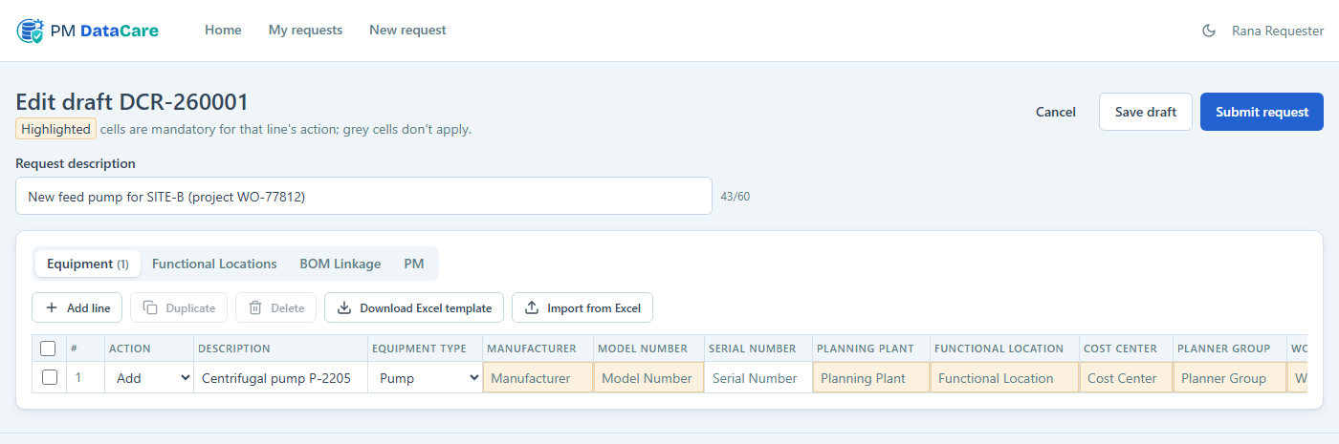
3
Add and fill your line items
1
2
3
1
Add line — one row per SAP object you want changed
3
Highlighted (amber) cells — mandatory for that action — fill them all. Grey cells don’t apply and stay locked.
2
Action — Add, Change, or Delete — it decides which cells matter

Slide 6
4
Working with many lines? Use Excel
3
1
2
1
Download Excel template — a ready-made sheet for the current tab — amber headers mark mandatory columns, dropdowns match the app
3
Duplicate / Delete — tick lines with the checkboxes, then copy or remove them in bulk
2
Import from Excel — brings your filled rows back in and validates every cell

Slide 7
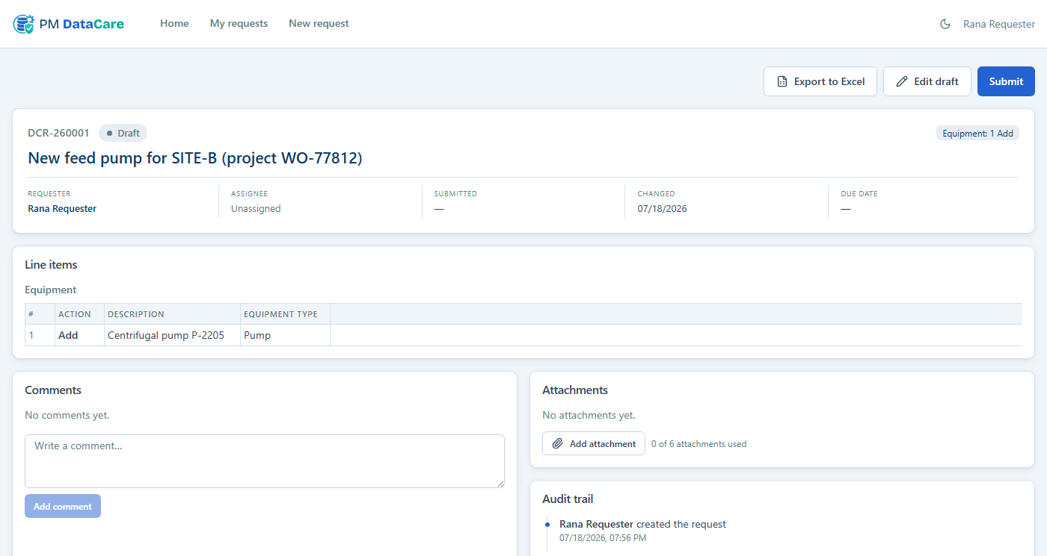
5
Not finished? Save it as a draft
2
3
1
1
Draft — private to you — nobody works on it yet, nothing is validated. Find it any time under My requests.
3
Submit — you can also submit straight from this page when it’s ready
2
Edit draft — reopens the editor exactly where you left off

Slide 8
6
Submit when everything is ready
1
The app checks your request first. If the description is missing or any amber cell is empty or invalid, a red box lists exactly what to fix and jumps to the right tab. Untouched empty lines are removed automatically — no need to tidy them. After a successful submit the request moves to Waiting to be started and the Data Maintenance team is notified by email.

Slide 9
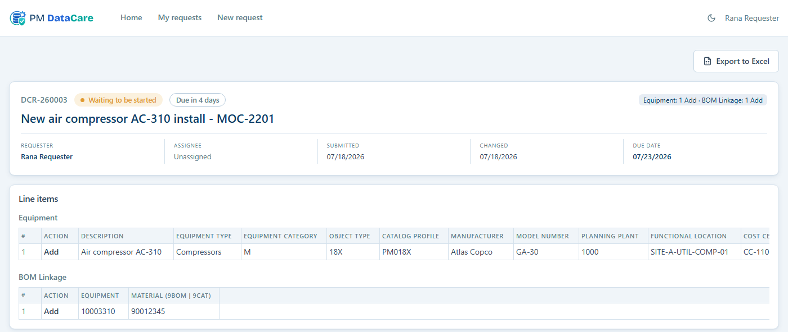
7
After you submit — track it here
1
2
3
1
Status — Waiting → In process → Completed (you get an email when it’s done or rejected)
3
Due date — computed from your line actions when you submit
2
Due countdown — the team’s SLA deadline for your request
4
Comments & attachments — talk to the team and add supporting files right on this page — any time

Slide 10
Good to know
Rejected?
Attachments
You’ll get the reason by email and on the request page. Click Reopen — it becomes your draft again; fix and resubmit.
PDF, images, emails, and Office files, up to 100 MB, max 6 per request. Picked files upload only when you press Upload — remove wrong picks freely before that.
Descriptions matter
Drafts are private
A clear one-line description with your MOC or work-order number is the fastest way to get your request understood and done.
Only you (and admins) can see your drafts. Everything else on the site is visible to the team.
Questions or problems? Abdullah F. Alharbi · abdullah.hejaili@aramco.com

