Slide 1
IFE系统设计

Slide 2
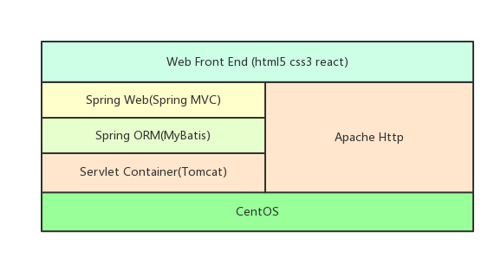
IFE架构
Notes:
后台主要是动态http服务和静态http服务配合

Slide 3
Web Service
Spring servlet
Default servlet
RESTful
MyBatis
Exception
Unit Test

Slide 4
servlet
Servlet（Server Applet），全称Java Servlet，未有中文译文。是用Java编写的服务器端程序。其主要功能在于交互式地浏览和修改数据，生成动态Web内容。狭义的Servlet是指Java语言实现的一个接口，广义的Servlet是指任何实现了这个Servlet接口的类，一般情况下，人们将Servlet理解为后者。
Servlet运行于支持Java的应用服务器中。从实现上讲，Servlet可以响应任何类型的请求，但绝大多数情况下Servlet只用来扩展基于HTTP协议的Web服务器。
最早支持Servlet标准的是JavaSoft的Java Web Server。此后，一些其它的基于Java的Web服务器开始支持标准的Servlet。

Slide 5
servlet
<servlet>
<servlet-name>HelloServlet</servlet-name>
<servlet-class>org.spring.servlet.HelloServlet</servlet-class>
<load-on-startup>1</load-on-startup>
</servlet>
<servlet-mapping>
<servlet-name>HelloServlet</servlet-name>
<url-pattern>/simple_servlet</url-pattern>
</servlet-mapping>
Notes:
简单的servlet 配置

Slide 6
url-pattern
1. 精确路径匹配。例子：比如servletA 的url-pattern为 /test，servletB的url-pattern为 /* ，这个时候，如果我访问的url为http://localhost/test ，这个时候容器就会先进行精确路径匹配，发现/test正好被servletA精确匹配，那么就去调用servletA，也不会去理会其他的 servlet了。 2. 最长路径匹配。例子：servletA的url-pattern为/test/*，而servletB的url-pattern为/test/a/*，此 时访问http://localhost/test/a时，容器会选择路径最长的servlet来匹配，也就是这里的servletB。 3. 扩展匹配，如果url最后一段包含扩展，容器将会根据扩展选择合适的servlet。例子：servletA的url-pattern：*.action 4. 如果前面三条规则都没有找到一个servlet，容器会根据url选择对应的请求资源。如果应用定义了一个default servlet，则容器会将请求丢给default servlet（什么是default servlet？后面会讲）。

Slide 7
DispatcherServlet
DispatcherServlet是前端控制器设计模式的实现，提供spring Web MVC的集中访问点，而且负责职责的分派，而且与Spring IoC容器无缝集成，从而可以获得Spring的所有好处。
DispatcherServlet主要用作职责调度工作，本身主要用于控制流程，主要职责如下：
1、文件上传解析，如果请求类型是multipart将通过MultipartResolver进行文件上传解析；
2、通过HandlerMapping，将请求映射到处理器（返回一个HandlerExecutionChain，它包括一个处理器、多个HandlerInterceptor拦截器）；
3、通过HandlerAdapter支持多种类型的处理器(HandlerExecutionChain中的处理器)；
4、通过ViewResolver解析逻辑视图名到具体视图实现；
5、本地化解析；
6、渲染具体的视图等；
7、如果执行过程中遇到异常将交给HandlerExceptionResolver来解析。

Slide 8
DispatcherServlet
<!-- 配置Spring MVC DispatcherServlet -->
<servlet>
<servlet-name>MVC</servlet-name>
<servlet-class>org.springframework.web.servlet.DispatcherServlet</servlet-class>
<!-- 初始化参数 -->
<init-param>
<!-- 加载SpringMVC的xml到 spring的上下文容器中 -->
<param-name>contextConfigLocation</param-name>
<param-value>
classpath:mvc-context.xml
</param-value>
</init-param>
</servlet>
<!-- 配置DispatcherServlet所需要拦截的 url -->
<servlet-mapping>
<servlet-name>MVC</servlet-name>
<url-pattern>/</url-pattern>
</servlet-mapping>

Slide 9
mvc-context
<?xml version="1.0" encoding="UTF-8"?>
<beans xmlns="http://www.springframework.org/schema/beans" xmlns:xsi=http://www.w3.org/2001/XMLSchema-instance>
<context:component-scan base-package="org.test.controller"></context:component-scan>
<!-- 配置SpringMVC的视图渲染器 -->
<bean class="org.springframework.web.servlet.view.InternalResourceViewResolver" p:prefix="/" p:suffix="">
</bean>
</beans:bean>

Slide 10
WebMvcConfigurationSupport
@Configuration
public class MyWebMvcConfigurationSupport extends WebMvcConfigurationSupport {
@Override
protected void extendMessageConverters(List<HttpMessageConverter<?>> converters) {
converters.add(new WiselyMessageConverter());
}
}
Notes:
protected final void addDefaultHttpMessageConverters(List<HttpMessageConverter<?>> messageConverters) {
StringHttpMessageConverter stringConverter = new StringHttpMessageConverter();
stringConverter.setWriteAcceptCharset(false);
messageConverters.add(new ByteArrayHttpMessageConverter());
messageConverters.add(stringConverter);
messageConverters.add(new ResourceHttpMessageConverter());
messageConverters.add(new SourceHttpMessageConverter<>());
messageConverters.add(new AllEncompassingFormHttpMessageConverter());
if (romePresent) {
messageConverters.add(new AtomFeedHttpMessageConverter());
messageConverters.add(new RssChannelHttpMessageConverter());
}
if (jackson2XmlPresent) {
ObjectMapper objectMapper = Jackson2ObjectMapperBuilder.xml().applicationContext(this.applicationContext).build();
messageConverters.add(new MappingJackson2XmlHttpMessageConverter(objectMapper));
}
else if (jaxb2Present) {
messageConverters.add(new Jaxb2RootElementHttpMessageConverter());
}
if (jackson2Present) {
ObjectMapper objectMapper = Jackson2ObjectMapperBuilder.json().applicationContext(this.applicationContext).build();
messageConverters.add(new MappingJackson2HttpMessageConverter(objectMapper));
}
else if (gsonPresent) {
messageConverters.add(new GsonHttpMessageConverter());
}
if (jackson2SmilePresent) {
ObjectMapper objectMapper = Jackson2ObjectMapperBuilder.smile().applicationContext(this.applicationContext).build();
messageConverters.add(new MappingJackson2SmileHttpMessageConverter(objectMapper));
}
if (jackson2CborPresent) {
ObjectMapper objectMapper = Jackson2ObjectMapperBuilder.cbor().applicationContext(this.applicationContext).build();
messageConverters.add(new MappingJackson2CborHttpMessageConverter(objectMapper));
}
}

Slide 11
web controller
@Controller
public class WebController {
@RequestMapping({ "/" })
public String root() {
return "index.html";
}
@RequestMapping({ "/restful_test" })
public String home() {
return "page/restful.jsp";
}
@RequestMapping(value = "login", method = RequestMethod.POST)
public ModelAndView login(String username, String password) {
if (this.checkParams(new String[] { username, password })) {
ModelAndView mav = new ModelAndView("page/succ.jsp");
mav.addObject("username", username);
mav.addObject("password", password);
return mav;
}
return new ModelAndView("home");
}

Slide 12
Default servlet
<servlet-mapping>
<servlet-name>default</servlet-name>
<url-pattern>*.js</url-pattern>
<url-pattern>*.jpg</url-pattern>
<url-pattern>*.html</url-pattern>
<url-pattern>*.css</url-pattern>
<url-pattern>*.png</url-pattern>
<url-pattern>*.mp4</url-pattern>
</servlet-mapping>
Notes:
<servlet>
<servlet-name>default</servlet-name>
<servlet-class>org.apache.catalina.servlets.DefaultServlet</servlet-class>
<init-param>
<param-name>debug</param-name>
<param-value>0</param-value>
</init-param>
<init-param>
<param-name>listings</param-name>
<param-value>false</param-value>
</init-param>
<load-on-startup>1</load-on-startup>
</servlet>

Slide 13
RESTful架构
REST全称是Representational State Transfer，中文意思是"表现层状态转化" ，省略了主语。"表现层"其实指的是"资源"（Resources）的"表现层"。
所谓"资源"，就是网络上的一个实体，或者说是网络上的一个具体信息。它可以是一段文本、一张图片、一首歌曲、一种服务，总之就是一个具体的实在。你可以用一个URI（统一资源定位符）指向它，每种资源对应一个特定的URI。要获取这个资源，访问它的URI就可以，因此URI就成了每一个资源的地址或独一无二的识别符。
所谓"上网"，就是与互联网上一系列的"资源"互动，调用它的URI。

Slide 14
状态转化
访问一个网站，就代表了客户端和服务器的一个互动过程。在这个过程中，势必涉及到数据和状态的变化。
互联网通信协议HTTP协议，是一个无状态协议。这意味着，所有的状态都保存在服务器端。因此，如果客户端想要操作服务器，必须通过某种手段，让服务器端发生"状态转化"（State Transfer）。而这种转化是建立在表现层之上的，所以就是"表现层状态转化"。
客户端用到的手段，只能是HTTP协议。具体来说，就是HTTP协议里面，四个表示操作方式的动词：GET、POST、PUT、DELETE。它们分别对应四种基本操作：GET用来获取资源，POST用来新建资源（也可以用于更新资源），PUT用来更新资源，DELETE用来删除资源。

Slide 15
test
curl -X POST -H "Content-Type: application/json" -d "{\"id\":2,\"name\":\"Mike\"}" http://localhost:8080/SpringMVC_01/service/object
curl http://localhost:8080/SpringMVC_01/ service /object/2
curl -X PUT -H "Content-Type: application/json" -d "{\"id\":2,\"name\":\"Mike\"}" http://localhost:8080/SpringMVC_01/ service /object
curl -X DELETE http://localhost:8080/SpringMVC_01/ service /object/2

Slide 16
service controller
@RequestMapping(value = "/object/{id}", method = RequestMethod.GET)
@ResponseBody
public JsonObject getObject(@PathVariable final int id) {
JsonObject object = objectMap.get(id);
return object;
}
@RequestMapping(value = "/object", method = RequestMethod.POST, consumes = "application/json")
@ResponseBody
public void postObject(@RequestBody JsonObject json) {
objectMap.put(json.getId(), json);
}

Slide 17
service controller
@RequestMapping(value = "/object", method = RequestMethod.PUT, consumes = "application/json")
@ResponseBody
public void putObject(JsonObject json) {
objectMap.put(json.getId(), json);
}
@RequestMapping(value = "/object/{id}", method = RequestMethod.DELETE)
@ResponseBody
public void deleteObject(@PathVariable final int id) {
objectMap.remove(id);
}

Slide 18
Exception Handling in Spring MVC
Controller Based Exception Handling
Global Exception Handling
HandlerExceptionResolver

Slide 19
Controller Based Exception Handling
@RequestMapping(value = "/throwException", method = RequestMethod.GET)
@ResponseBody
public void throwException() {
throw new RuntimeException();
}
@ExceptionHandler(Exception.class)
@ResponseBody
public Exception handleError(HttpServletRequest req, Exception exception) {
exception.printStackTrace();
return exception;
}

Slide 20
Mybatis
config
Mapper
Transitional

Slide 21
config
<!-- in-memory database and a datasource -->
<jdbc:embedded-database id="dataSource">
<jdbc:script location="classpath:database/jpetstore-hsqldb-schema.sql" />
</jdbc:embedded-database>
<!-- transaction manager, use DataSourceTransactionManager" for JDBC local
tx -->
<bean id="transactionManager"
class="org.springframework.jdbc.datasource.DataSourceTransactionManager">
<property name="dataSource" ref="dataSource" />
</bean>
<!-- enable component scanning and autowire (beware that this does not enable
mapper scanning!) -->
<context:component-scan base-package="org.spring.service" />
<!-- enable transaction demarcation with annotations -->
<tx:annotation-driven />
<!-- define the SqlSessionFactory -->
<bean id="sqlSessionFactory" class="org.mybatis.spring.SqlSessionFactoryBean">
<property name="dataSource" ref="dataSource" />
<property name="typeAliasesPackage" value="org.test.data" />
</bean>
<!-- scan for mappers and let them be autowired -->
<mybatis:scan base-package="org.spring.mapper" />
Notes:
<listener>
<listener-class>org.springframework.web.context.ContextLoaderListener</listener-class>
</listener>

Slide 22
mapper interface
public interface AccountMapper {
Account getAccountByUsername(String username);
void insertAccount(Account account);
void updateAccount(Account account);
void deleteAccount(String username);
}

Slide 23
mapper xml
<mapper namespace="org.test.mapper.AccountMapper">
<select id="getAccountByUsername" resultType="Account">
select * from account where account.username = #{username}
</select>
<update id="updateAccount" parameterType="Account">
update account set email = #{email}, where username = #{username}
</update>
<insert id="insertAccount" parameterType="Account">
insert into account (email, username) values (#{email}, #{username})
</insert>
<delete id="deleteAccount">
delete from account where account.username = #{username}
</delete>
</mapper>

Slide 24
Transitional
@Service
public class AccountService {
@Autowired
private AccountMapper accountMapper;
@Transactional(propagation = Propagation.SUPPORTS, isolation = Isolation.REPEATABLE_READ, readOnly = true)
public Account getAccount(String username) {
return accountMapper.getAccountByUsername(username);
}
@Transactional(propagation = Propagation.REQUIRED, isolation = Isolation.REPEATABLE_READ, rollbackFor=Exception.class)
public void insertAccount(Account account) {
accountMapper.insertAccount(account);
}
}
Notes:
<!-- 使用注解方式的事务 -->
<tx:annotation-driven transaction-manager="transactionManager" />
<bean id="transactionManager" class="org.springframework.jdbc.datasource.DataSourceTransactionManager">
<property name="dataSource" ref="dataSource" />
</bean>
<!-- 声明式事务管理 -->
<tx:advice id="txAdvice" transaction-manager="transactionManager">
<tx:attributes>
<tx:method name="delete*" propagation="REQUIRED" isolation="REPEATABLE_READ" read-only="false" />
<tx:method name="insert*" propagation="REQUIRED" isolation="REPEATABLE_READ" read-only="false" />
<tx:method name="save*" propagation="REQUIRED" isolation="REPEATABLE_READ" read-only="false" />
<tx:method name="update*" propagation="REQUIRED" isolation="REPEATABLE_READ" read-only="false" />
<tx:method name="find*" propagation="SUPPORTS" read-only="true" />
<tx:method name="get*" propagation="SUPPORTS" read-only="true" />
<tx:method name="select*" propagation="SUPPORTS" read-only="true" />
<tx:method name="remove*" propagation="REQUIRED" isolation="REPEATABLE_READ" read-only="false" />
<tx:method name="sync" propagation="REQUIRED" isolation="REPEATABLE_READ" read-only="false" />
</tx:attributes>
</tx:advice>
<aop:config>
<aop:pointcut id="baseServiceMethods" expression="execution(* com.fairlink.ifeservice.*.service.*.*(..))" />
<aop:advisor pointcut-ref="baseServiceMethods" advice-ref="txAdvice" />
</aop:config>
<aop:aspectj-autoproxy />

Slide 25
Isolation
READ_UNCOMMITTED :Allows to read changes that haven’t yet been committed
READ_COMMITTED:Allows reads from concurrent transactions that have been com- mitted.
REPEATABLE_READ:Multiple reads of the same field will yield the same results untill it is changed by itself
SERIALIZABLE: It is complete isolation.It involves full locking.It affets performace because of locking.

Slide 26
Propagation
REQUIRED behavior means that the same transaction will be used if there is an already opened transaction in the current bean method execution context.
REQUIRES_NEW behavior means that a new physical transaction will always be created by the container.
The NESTED behavior makes nested Spring transactions to use the same physical transaction but sets save points between nested invocations so inner transactions may also rollback independently of outer transactions.
The MANDATORY behavior states that an existing opened transaction must already exist. If not an exception will be thrown by the container.
The NEVER behavior states that an existing opened transaction must not already exist. If a transaction exists an exception will be thrown by the container.
The NOT_SUPPORTED behavior will execute outside of the scope of any transaction. If an opened transaction already exists it will be paused.
The SUPPORTS behavior will execute in the scope of a transaction if an opened transaction already exists. If there isn't an already opened transaction the method will execute anyway but in a non-transactional way.

Slide 27
junit
@ContextConfiguration(locations = { "classpath:root-context.xml" })
@RunWith(SpringJUnit4ClassRunner.class)
public class AccountServiceTest {
@Autowired
private AccountService accountService;
@Test
public void test (){
Account account = new Account();
account.setUsername("john");
account.setEmail("hejian@sina.com");
accountService.insertAccount(account);
Account account2 = accountService.getAccount("john");
Assert.assertEquals("email not equal", account.getEmail(), account2.getEmail());
}
}

Slide 28
jmockit
public class AccountResourceTest {
private MyBatisServiceController accountController;
@Injectable
private AccountService accountService;
@Before
public void setup() throws NoSuchFieldException, SecurityException, IllegalArgumentException, IllegalAccessException {
accountController = new MyBatisServiceController();
Map<String, Object> memMap = new HashMap<String, Object>() {
{ put("accountService", accountService); }
};
for (Entry<String, Object> e : memMap.entrySet()) {
Field f = MyBatisServiceController.class.getDeclaredField(e.getKey());
f.setAccessible(true);
f.set(accountController, e.getValue());
}
}
@Test
public void test(){
new Expectations() { {
accountService.getAccount(anyString);
Account account = new Account();
account.setEmail("hejian@sina.com");
result = account;
} };
Account account = accountController.getAccount("john");
Assert.assertEquals("email not equal", "hejian@sina.com", account.getEmail());
}}

Slide 29
web
Requirejs(模块化协议)
React(模块化语言)
webpack(构建工具)

Slide 30
非模块化
<body>
<div id="wrapper"></div>
<script src="jquery.js"></script>
<script src="underscore.js"></script>
<script src=“main.js"></script>
</body>

Slide 31
requirejs
<script type="text/javascript" src="lib/require.js"></script>
<script type="text/javascript">
requirejs.config({
baseUrl: 'lib',
paths: {
dist: '../dist'
}
});
// Start loading the main app file. Put all of
// your application logic in there.
requirejs(['dist/main']);
</script>
Notes:
划分协议

Slide 32
define
define(["jquery", "underscore"],
function($, _){
//some code
});
Notes:
划分协议

Slide 33
umd
(function (root, factory) {
if (typeof define === "function" && define.amd) {
define(["jquery", "underscore"], factory);
} else if (typeof exports === "object") {
module.exports = factory(require("jquery"), require("underscore"));
} else {
root.Requester = factory(root.$, root._);
}
}(this, function ($, _) {
// this is where I defined my module implementation
var Requester = { // ... };
return Requester;
}));

Slide 34
react
export default class ReactPage extends React.Component {
constructor(props) {
super(props)
}
componentDidMount() {
console.log('componentDidMount');
}
componentWillUnmount() {
console.log('componentWillUnmount');
}
render() {
return (
<div style={{padding: '10px' }}>
<h1>Hello, React Page</h1>
</div>
);
}
}
Notes:
划分页面模块

Slide 35
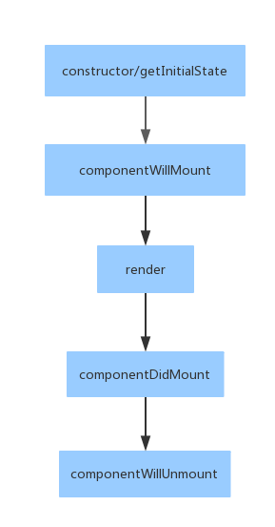
Lifecycle

Slide 36
webpack
优点：
丰富的插件（loader, plugin）
方便引用第三方库
缺点：
打包器而不是加载器
Notes:
按模块打包，html模板填充，生成文件hash code

Slide 37
webpack
var React = require('react');
var ReactDOM = require('react-dom');
var style = require('./app.css');
ReactDOM.render(
<div>
<h1 className={style.h1}>Hello World</h1>
<h2 className="h2">Hello Webpack</h2>
</div>,
document.getElementById('example')
);
Notes:
自动完成样式名编纂，限制使用范围
Demo06
exports.push([module.id, "._2TSEVtnYKGduKLH0Hv-lQ5 {\r\n color:red;\r\n}\r\n\r\n.h2 {\r\n color: blue;\r\n}\r\n\r\n._3UxLIxhTTx35y5l351KeC6 {\r\n font-family: myFirstFont;\r\n src: url(" + __webpack_require__(181) + "), url(" + __webpack_require__(182) + ");\r\n}\r\n", ""]); // exports exports.locals = { "h1": "_2TSEVtnYKGduKLH0Hv-lQ5", "serif": "_3UxLIxhTTx35y5l351KeC6" };

Slide 38
webpack
module.exports = {
entry: './main.jsx',
output: {
filename: 'bundle.js'
},
module: {
loaders:[
{ test: /\.js[x]?$/, exclude: /node_modules/, loader: 'babel-loader?presets[]=es2015&presets[]=react' },
{ test: /\.css$/, loader: 'style-loader!css-loader?modules' }
]
}
};
Notes:
完全打包到bundle中

Slide 39
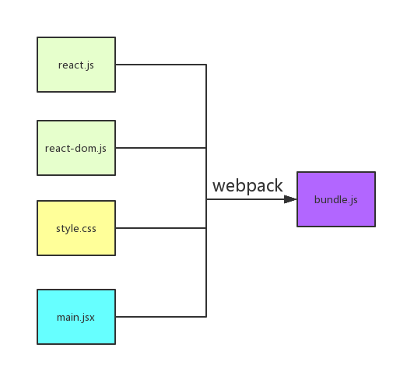
webpack

Slide 40
如何开发第三方页面
共享源码库（NPM）
保持输出代码都是UMD

Slide 41
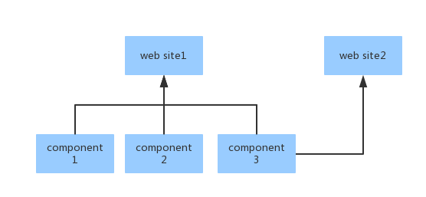
二进制共享方式

Slide 42
二进制共享方式
<body>
<div id="root"></div>
<script type="text/javascript" src="require.js"></script>
<script type="text/javascript">
requirejs.config({
paths: {
'react': 'http://localhost:8000/lib/react',
'react-dom': 'http://localhost:8000/lib/react-dom',
'react-addons-css-transition-group': 'http://localhost:8000/lib/react-addons-css-transition-group',
'react-transition': 'http://localhost:8000/lib/react-transition',
'header': 'http://localhost:8000/dist/header',
}
});
requirejs(['bundle']);
</script>
</body>

Slide 43
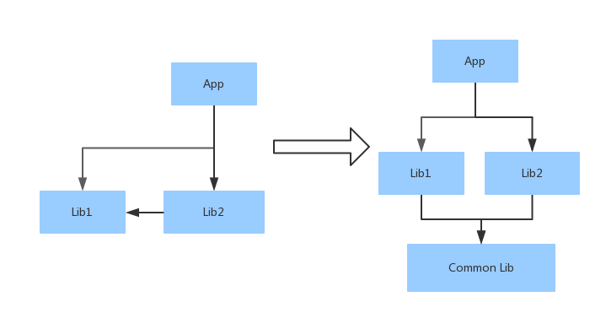
3rd party lib

Slide 44
生成公共库
import _ReactCSSTransitionGroup from 'react-addons-css-transition-group';
export { _ReactCSSTransitionGroup as ReactCSSTransitionGroup };
import _React from 'react';
export { _React as React };
import _ReactDOM from 'react-dom';
export { _ReactDOM as ReactDOM };

Slide 45
重新导出目标库
import {ReactDOM} from 'react-transition';
module.exports = ReactDOM;
import {React} from 'react-transition';
module.exports = React;
import {ReactCSSTransitionGroup} from 'react-transition';
module.exports = ReactCSSTransitionGroup;

Slide 46
external
'react': {
root: 'React',
commonjs2: 'react',
commonjs: 'react',
amd: 'react'
},
'react-dom': {
root: 'ReactDOM',
commonjs2: 'react-dom',
commonjs: 'react-dom',
amd: 'react-dom'
},
'react-addons-css-transition-group': {
root: 'ReactCSSTransitionGroup',
commonjs2: 'react-addons-css-transition-group',
commonjs: 'react-addons-css-transition-group',
amd: 'react-addons-css-transition-group'
},
'react-transition': {
root: 'ReactTransition',
commonjs2: 'react-transition',
commonjs: 'react-transition',
amd: 'react-transition'
},

Slide 47
使用前端路由
@RequestMapping(value = "/react_demo/**", method = RequestMethod.GET)
public String react() {
return "react_demo/index.html";
}

Slide 48
React-router
<Router history={withExampleBasename(browserHistory, browserHistory.getCurrentLocation().pathname)}>
<Route path="/" component={Home} />
<Route path="/react_page" component={ReactPage} />
<Route path="/form" component={Form} />
<Route path="/jmui" component={JMUI} />
<Route path="/animation" component={Animation} />
{routes}
<Route path="/music" component={Music} />
</Router>

Slide 49
单页应用
优点：
实现局部加载
在前端保持当前状态（如播放音乐）
缺点：

Slide 50
Q&A

