Slide 1

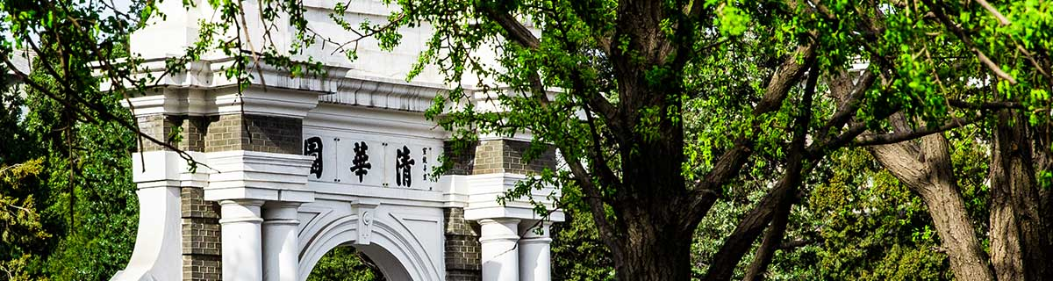
Brain activity during driving with distraction:
an immersive fMRI study
李亚京 2022-4-26
Frontiers in Human Neuroscience, 2013

Slide 2
Introduction
Identify the neural underpinnings of human driving behavior by visualizing the areas of the brain involved in driving under different levels of demand
Innovative experimental tools : driving simulator, functional magnetic resonance imaging (fMRI) system and virtual reality

Slide 3
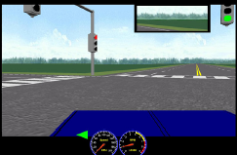
Methods
A driving simulator with a fully functional steering wheel and pedals
Functional magnetic resonance imaging (fMRI) system
Virtual reality

Slide 4
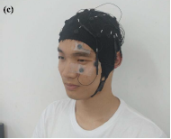
Methods
fMRI(功能性磁共振成像)
A new neuroimaging method which uses magnetic resonance imaging to measure the changes of hemodynamics caused by neuronal activity
Non-invasive, no radiation exposure
Brain function localization

Slide 5
Methods
Participants
Recruited through the university network via advertisement and emails
Right-handed with normal or corrected vision
16 participants (7 females and 9 males)
Between the ages of 20 and 30 years (Mean 25.8, SD 1.5)
Actively driving and with mean driving experience of 7.4 years (SD 2.5)
Notes:
通过两个实验来验证这 3 个假设。

Slide 6
Methods
Driving Tasks
Introduction through voice recording (e.g., “At the intersection, turn left”) approximately 5 s prior to the task
Following the traffic rules and to drive as close to the posted speed limit as possible
Straight driving served as the control condition (baseline)
interspersed between other specific tasks in pseudo-random order
Notes:
通过两个实验来验证这 3 个假设。

Slide 7
Methods
Driving tasks：
Each driving task was separated by at least 15 s of straight driving (baseline/controls)
Wearing fMRI-compatible headphones to hear the audio tasks, answered the questions by pressing corresponding buttons
Receiving motion training to operate the driving controls with minimal head motion
Notes:
通过两个实验来验证这 3 个假设。

Slide 8
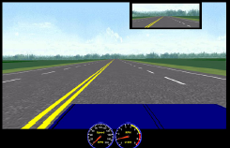
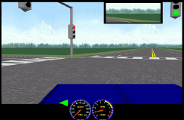
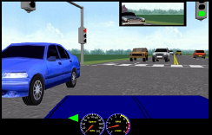
Methods
1.straight driving, six times
2.six simple right-hand turns and six left-hand turns with no traffic
3.six left turns with a stream
of oncoming traffic
Notes:
通过两个实验来验证这 3 个假设。

Slide 9
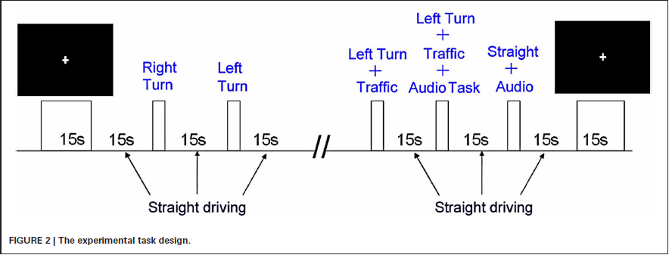
Methods

Slide 10
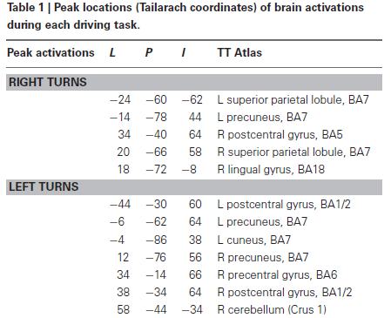
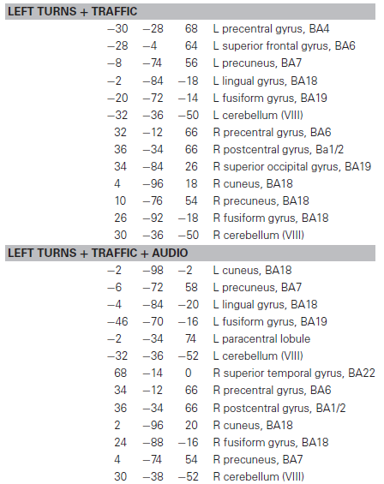
Data Analysis

Slide 11
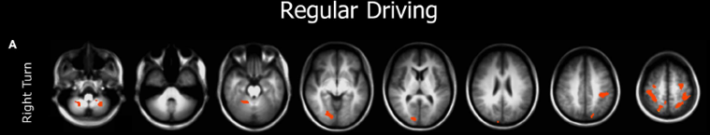
Results
Performing right turns is the simplest task, generated minimal activation relative to the control condition.

Slide 12
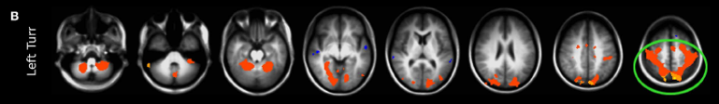
Results
Making left turns, without oncoming traffic, the participants showed activations in the posterior brain, including visual-parietal(视顶叶) and motor areas, suggesting that cognitive resources involving visuospatial
and motor coordination are required for making left turns.

Slide 13
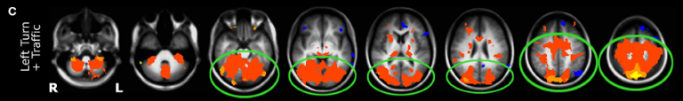
Results
Performing the more demanding left turns at busy intersections, produced larger activations in the posterior network, along with additional activation of the cingulate cortex(扣带皮层), an area important for cognitive-response selection and alertness.

Slide 14
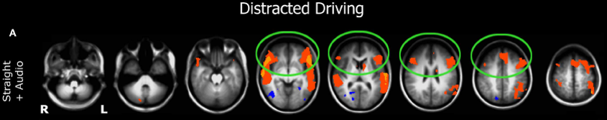
Results
A significant shift in activation from the posterior to the anterior brain was observed when driving became distracted. Auditory distraction during straight driving significantly activated not only auditory areas but also the prefrontal cortices (前额叶皮质), while decreased activation in posterior brain regions was evident.

Slide 15
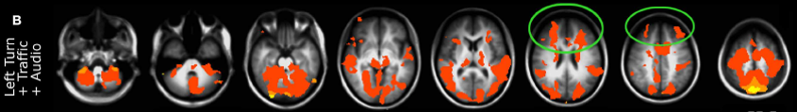
Results
When the more challenging maneuver (turning left at a busy intersection) was performed under cognitive distraction, the anterior network was additionally engaged, predominantly in the dorsolateral prefrontal cortex(背外侧前额叶皮质)/frontal pole(额叶极).

Slide 16
Discussion
Undistracted driving engaged the posterior brain system, while driving under cognitive distractions activated the anterior brain system.
The anterior, executive attention in multitasking and the posterior, visual response attention system. With cognitive distraction during driving, to support mental processing in the anterior brain, resources of the posterior brain important for visual alertness and visual attention were sacrificed.

Slide 17
Conclusion
Brain activations during driving rely on areas including the posterior visual-spatial attentional system vs. the anterior, frontal-lobe(前额叶) functions in multitasking and divided attention.
As the brain has limited cognitive resources, this fundamental constraint limits the capacity during driving to carrying out any other cognitive operations such as language comprehension.

Slide 18
Limitation
Using of young drivers, which may reduce the generalizability to older populations
Simulated driving ≠ Real car driving

Slide 19
Thank you

