Slide 1
e4 Overview
Eclipse Board Meeting, Miami, Dec 2009
Boris Bokowski
© 2009 IBM Corporation

Slide 2
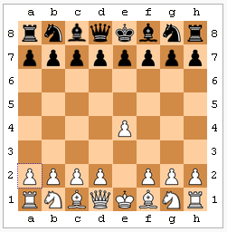
“Advancing the king's pawn up two squares is highly useful because it occupies a center square, attacks the center square d5, and allows the development of White's king's bishop and queen.” (Wikipedia)

Slide 3














The Challenge
Rational Software | Eclipse
Tension between Stability and Innovation
We need to innovate to remain a viable platform
© 2009 IBM Corporation

Slide 4
e4
“The mission of the e4 project is to build a next generation platform for pervasive, component-based applications and tools.”

Slide 5
e4 – Purpose
Rational Software | Eclipse
Place for innovation
Not a product
e4 technologies will be used as the basis of Eclipse 4.0
(and some will show up in 3.x)
Engage open source community
Build a better Eclipse
  Make it more flexible and easier to use
  Prepare for web technologies
IBM Confidential
© 2009 IBM Corporation

Slide 6
e4 – Work Areas
Building UI Components
  Using HTML/JavaScript, OpenSocial
  XWT: declarative SWT
  Easier to use API (20% covering 80% of the cases)
Assembling UI Components
  Based on EMF model (modeled workbench)
  Better control over result (filtering, sorting, etc)
  Skinnable UI (CSS, Renderer)
  Visual tool for assembling? (community contribution)
Other
  Flexible Resources (→ 3.6), JS Modularity

Slide 7
Backwards Compatibility
Existing plug-ins
Compatibility
Layer
"pure e4" plug-ins
e4

Slide 8
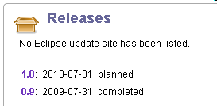
Releases

Slide 9
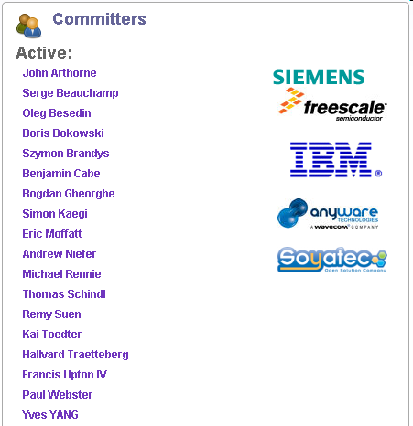
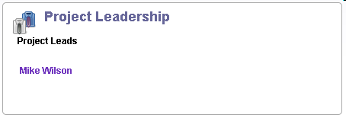
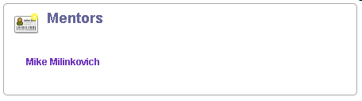
People
Independent

Slide 10
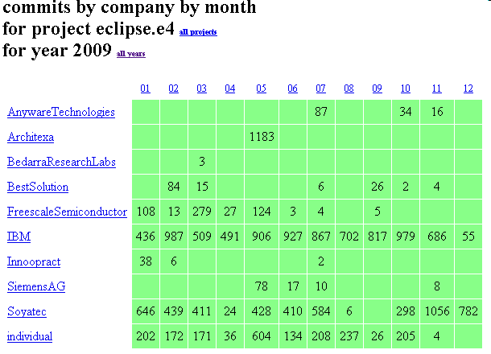
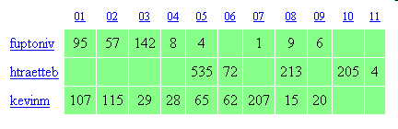

Slide 11
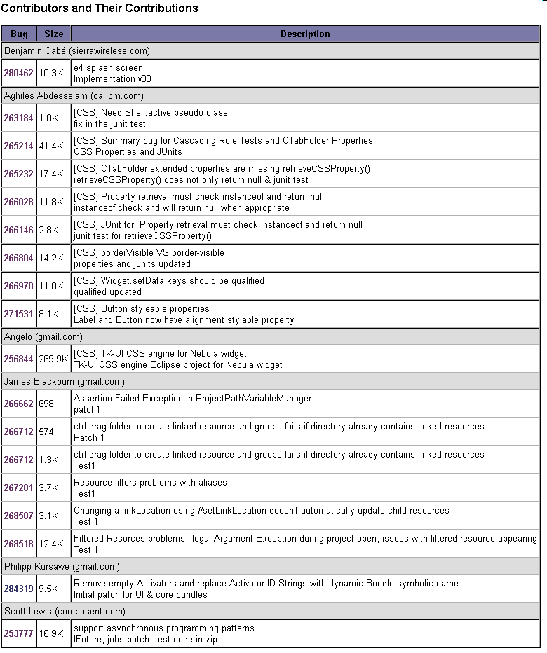
Contributions

Slide 12
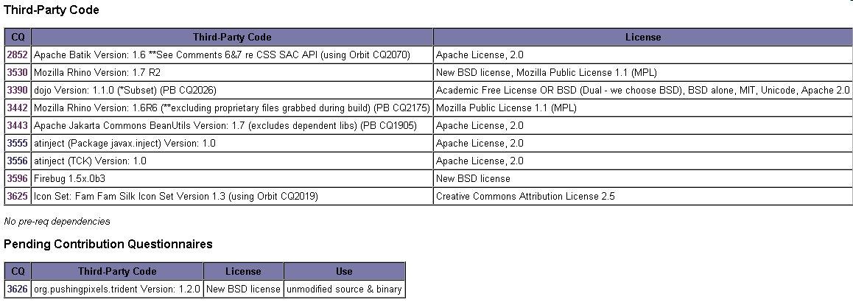
New Third-Party Dependencies

Slide 13
What’s next
Rational Software | Eclipse
“Eclipse SDK R4.0” to be delivered July 2010
Goals
  All SDK R3.6 plug-ins hosted and running
  Ready for wider consumption
But(!) this is the first release of a significantly new codebase
  It will not be on the Helios release train
    Early adopters in community will be moving
  Need significant real-world testing
    Help us make the compatibility bulletproof
Expect to be on 2011 release train
  Requirement: All other release train projects run
IBM Confidential
© 2009 IBM Corporation
Notes:
Allow each perspective to have fine control over the look and feel.JavaScript support in EclipseSupport web UI components as first class editors or views in the desktop EclipseExpand the e4 communityFine control over File | New menu based on perspectiveAllow more fine grained control over visual aspects of views and perspectivesSupport for nested projectsEnsure backwards compatibility of Eclipse 4.0Provide full skinning capabilities for the Eclipse Workbench

Slide 14
Further reading
Rational Software | Eclipse
“Eclipse has a future.”
  http://dev.eclipse.org/blogs/mcqjustmcq/2009/07/25/eclipse-has-a-future/
“White Paper: e4 Technical Overview”
  http://eclipse.org/e4/resources/e4-whitepaper.php
Websites:
  e4 Wiki -- http://wiki.eclipse.org/E4
  e4 Homepage -- http://eclipse.org/e4
IBM Confidential
© 2009 IBM Corporation

Slide 15
Comments? Questions?
Rational Software | Eclipse
IBM Confidential
© 2009 IBM Corporation

