Slide 1
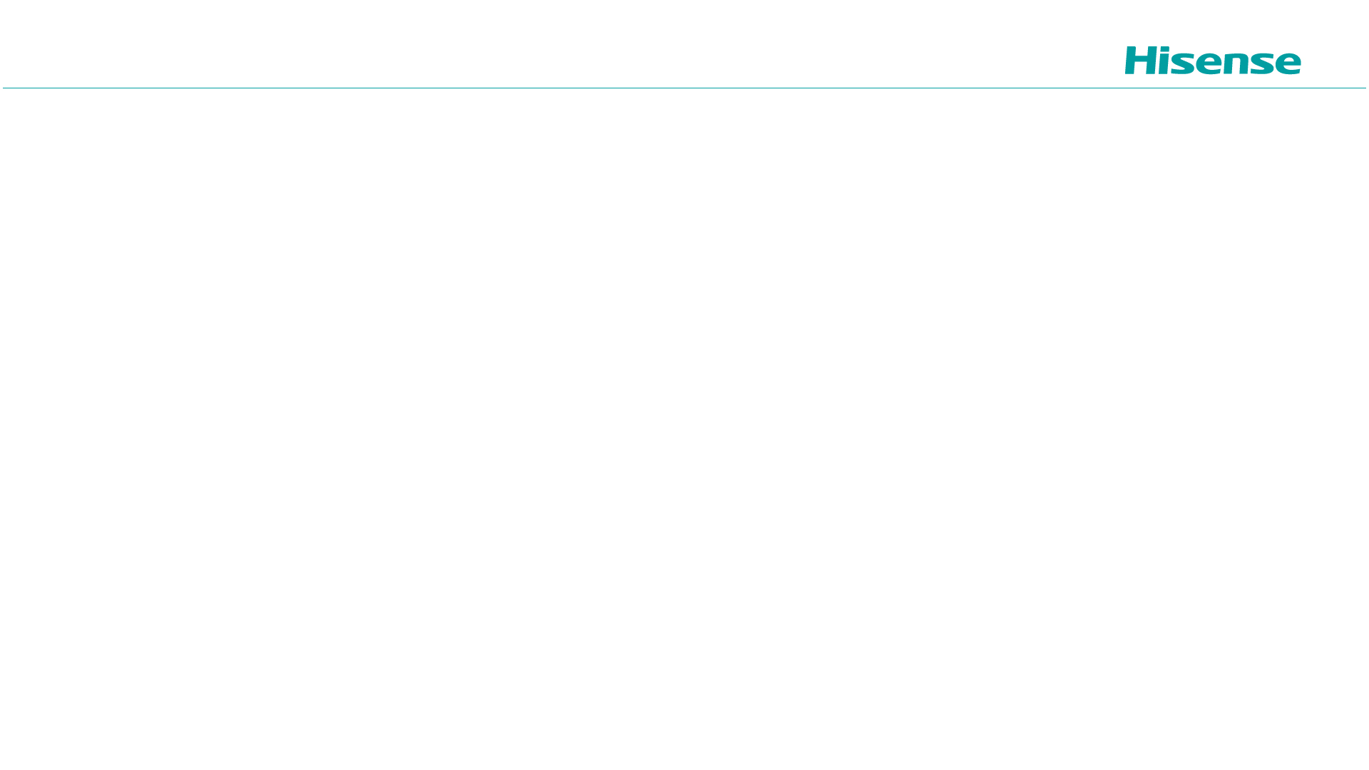
多媒体封装格式：WebM
魏勇邦
2026年11月7日 星期六

Slide 2
WebM
Google为了和H264相抗衡，专门针对html5所制定
开源免费
文件结构基于matroska(mkv)格式,是其子集
YouTube 80%的视频采用WebM

Slide 3
Naming
Container format name | WebM
Filename Extension | .webm
MIME-type | video/webm
Audio-only MIME-type | audio/webm
Video Codec Name | VP8 or VP9
AudioCodec Name | Vorbis or Opus

Slide 4
Guidelines
Demuxer and Muxer Guidelines
  DocType SHOULD be webm
  Video Codec SHOULD be VP8
    Codec ID SHOULD be V_VP8
    No “CodePrivate”Data
  Audio Code SHOULD be Vorbis or Opus.
    The Codec ID SHOULD be “A_VORBIS” or “A_OPUS”
  Initial release does not support subtitles
  DocReadTypeVersion：follow the Matroska Specification

Slide 5
Guidlines
Muxer Guidelines
  SHOULD contain the SeekHead
  SHOULD include a keyframe-only Cues, recommended the Cues be before any Clusters
  All absolute(Block+cluster) timecodes MUST be monotonically increasing
  TimecodeScale SHOULD be set to a default of 1000000ns
  Key frames SHOULD be at the beginning of clusters
  Audio blocks that contain the video key frame’s timecode SHOULD be in the same cluster as the video key frame block.
  Audio blocks that have same absolute timecode as video blocks SHOULD be before the video blocks
  MUST only support pixel for DisplayUnit

Slide 6
Guidelines
Demuxer Guiderlines
  The demuxer MUST only open webm DocType files
  Once the demuxer deems the header and metadata of the file to be valid for a WebM file and the player starts playing the file,the demuxer MUST do all it can to parse the file, so playback can occur as correctly as possible.
  Seeking will be disabled if the webm file does not have a key frame Cues element
    The project is considering support for seeking without a Cues element
  If the Cues elements is not at the beginning of the file, its retrieval should be deferred to allow playback to start as soon as possible.

Slide 7
WebVTT
http://dev.w3.org/html5/webvtt/
主要用于网页中的外挂字幕，在html中使用<track>标签声明。
  <video width="640" height="480" controls>
  <source src="video.mp4" type="video/mp4" />
  <source src="video.webm" type="video/webm" />
  <track src="subtitles.vtt" kind="subtitles" srclang="en" label="English" />
  </video>
Src- 源WebVTT文件
Srclang - 轨道的语言
Label - 用户可读的标签
Kind - 类型
如果没有指定类型，默认为字幕（subtitles）
如果类型是字幕（subtitles），需要指定srclang
不能有两个相同类型（king）的轨道有同一个标签（label）

Slide 8
WebVTT
Storing WebVTT data in a WebM Track
  The TrackType sub-elements value is 0x11 for webVTT subtitles and captions
  0x21 for WebVTT descriptions ,and METADATA
  The label attribute is stored as the Name sub-elemetns
  The srclang attribute is stored as the Language sub-element.
  CodecID is “D_WEBVTT/kind”,where the kind is one of SUBTITLES,CAPTIONS,DESCRIPTIONS,METADATA

Slide 9
WebVTT
Storing WebVTT cue in a WebM Block
  MUST be encoded as UTF-8
  The timestamp and its duration are synthesized from the start and end time specified on the timestamp of the WebVTT cue.

