Slide 1


Slide 2
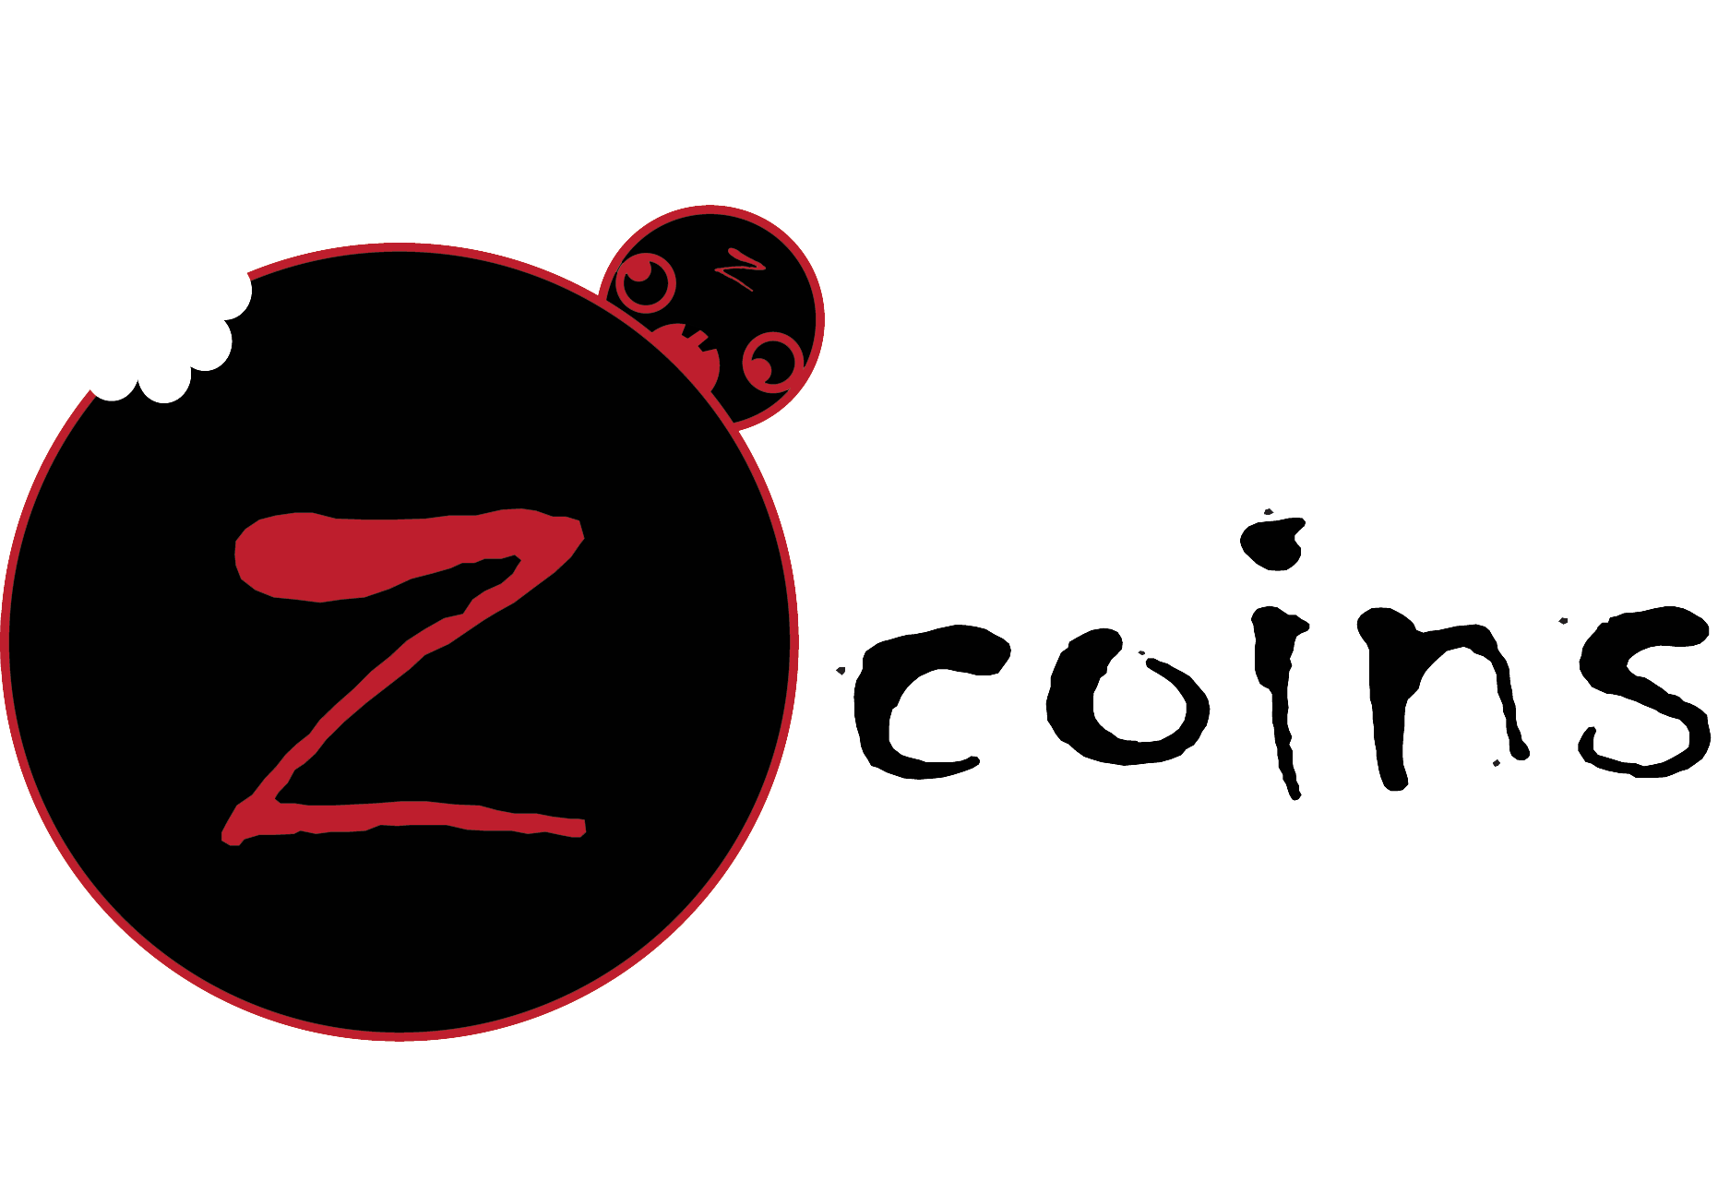

Jared Harkins
Teddy Lee
Angel Macias
Kai Yue

Slide 3
Earn Your Coins
Similar to Bitcoins.
But not really.
Notes:
Introduce how we thought of the idea
Cryptocurrency, but 1. not enough power 2. too much for one day 3. we still wanted to create a coin that would hold a different kind of value

Slide 4
Time to RUN
To earn your coins!

Slide 5
Or get Eaten
(Just Kidding, You’ll just get mugged… by zombies)

Slide 6
Demonstration

Slide 7
The End

