Slide 1

Currency Conspiracy
Market analysis of Bitcoin and Gold
&
The media narrative surrounding price fluctuations
The Federal Reserve and private banking cartels pushing false media narratives to manipulate markets…
A light analysis of Bitcoin & Gold

Slide 2
Bitcoin & Gold
Differences:
Gold
Supposed to be what the value of our current reserve currency (USD) is based on.
Historically long-standing of perceived value
Tangible
Bitcoin
Relatively new asset class (Digitized assets)
Intangible
Only basis of value is scarcity and human emotion
Similarities:
Fathered other currencies
Government & regulatory attention
World-wide adoption
Challenges the value-basis of other assets

Slide 3
a Brief (recent) History of gold
Around the beginning of 1980, there was a dramatic rise and fall in the price of Gold for roughly two reasons
Rise:
Geopolitical conflicts causing unrest
Inflation bubble (at a high of about 13%) which peaked around December of 1979
Fall:
Fed hiked interest rates
Media warned of dramatic price correction
Fed also bailed out Wallstreet businesses
( Sound familiar at all? )
Sources:
https://seekingalpha.com/article/194587-golds-dramatic-rise-and-fall-in-1980s-why-its-important
https://www.cbsnews.com/news/the-arguments-for-and-against-investing-in-gold/

Slide 4
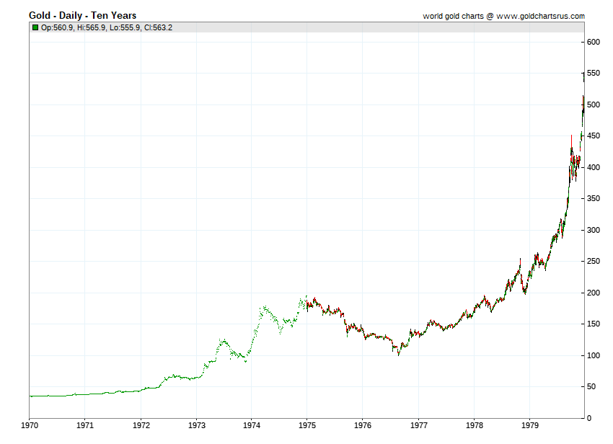
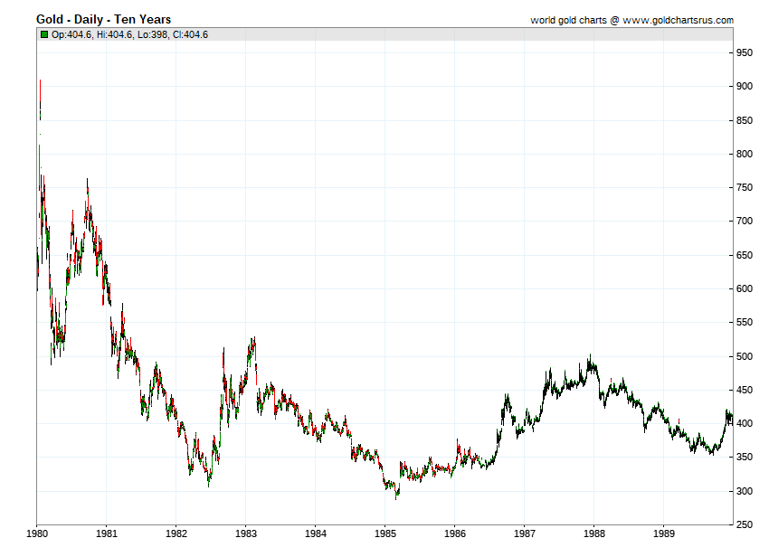
A Brief (recent) History of gold Continued
Price of gold 1970 - 1980
Price of gold 1980 - 1990

Slide 5
a Brief (recent) History of Bitcoin
Around the beginning of 2018, there was a dramatic rise and fall in the price of BTC and then again in 2020 for roughly 3 similar reasons
Rise:
Corona Virus (as opposed to war during the time-period of our gold analysis)
Geopolitical conflicts causing unrest
Inflation bubble
Fall:
Media smear-campaign
Regulation concerns (attention from the SEC)
Hacks and other security concerns
Sources:
https://en.bitcoinwiki.org/wiki/Bitcoin_history
https://changelly.com/blog/bitcoin-btc-price-history-in-2019/
https://www.sec.gov/news/press-release/2020-338

Slide 6

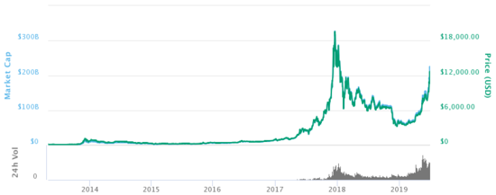
a Brief (recent) History of Bitcoin Continued

Slide 7
Comparing the price trend
<iframe width="800" height="836" src="https://app.powerbi.com/view?r=eyJrIjoiMTgyMTdmZjEtMzI3YS00MDA4LTg1ODEtZDc5YTM3MTYzNGQ0IiwidCI6IjY3NGQzZTZjLTQ1ZjctNDJlOS05MzhjLWZjZDAxZTNmZjU3YyJ9" frameborder="0" allowFullScreen="true"></iframe>

Slide 8
So why would “the powers that be” want to scare public funds out of promising asset classes and commodities? In other words: manipulate the market?

Slide 9
Example
The Rothschild Family and the Napoleonic Wars:
Not only did the Rothschilds serve as a primary source of funding for the war, when the key battle of Waterloo was fought and won, he spread the rumor that Napoleon had won instead
Why, you ask?
The panic lead the stock market to crash
And then Rothschild bought up nearly the entirety of the British economy for pennies on the pound
Upon hearing of the victory that the Rothschild-funded forces had over Napoleon, the stock market soared
Sources:
https://napoleonbonapartepodcast.com/2006/11/09/the-rothschild-family-and-the-napoleonic-wars/
https://www.grunge.com/363140/how-the-rothschild-family-really-got-so-rich/

Slide 10
In conclusion
“Whoever controls the money of a nation, controls that nation and is absolute master of all industry and commerce. When you realize that the entire system is very easily controlled, one way or another, by a few powerful men at the top, you will not have to be told how periods of inflation and depression originate.”
~President James A. Garfield, shortly before his death in 1881
-Just one of many figures that were assassinated by the shadow-banking system that runs our country and countless others before it
Source:
https://generalfraud.blogspot.com/2015/06/eight-presidents-who-opposed-central.html

Slide 11
Sources
-Cameron, Cameron, Williams, C. is, Patrick, Joe, Markham, J. D., Andy, Nick, Pras, & Jeremiah. (2006, November 9). The Rothschild Family and the Napoleonic Wars. Napoleon. https://napoleonbonapartepodcast.com/2006/11/09/the-rothschild-family-and-the-napoleonic-wars/.
-Mardenfeld, S. (2021, March 23). How The Rothschild Family Really Got So Rich. Grunge.com. https://www.grunge.com/363140/how-the-rothschild-family-really-got-so-rich/.
-Mario. (2020, August 20). Bitcoin History – Price since 2009 to 2019, BTC Charts. BitcoinWiki. https://en.bitcoinwiki.org/wiki/Bitcoin_history.
-North, T. (2010, March 19). Gold's Dramatic Rise and Fall in 1980s - Why It's Important. SeekingAlpha. https://seekingalpha.com/article/194587-golds-dramatic-rise-and-fall-in-1980s-why-its-important.
-Press Release. SEC Emblem. (2020, December 22). https://www.sec.gov/news/press-release/2020-338.
-Rousey, M. (2021, January 27). Bitcoin (BTC) Price History and What Is the Future of Cryptocurrency? Cryptocurrency News & Trading Tips – Crypto Blog by Changelly. https://changelly.com/blog/bitcoin-btc-price-history-in-2019/.
-Samskarebyaha. (1970, January 1). Eight Presidents Who Opposed A Central Bank (Federal Reserve). https://generalfraud.blogspot.com/2015/06/eight-presidents-who-opposed-central.html.
-Swedroe, L. (2012, July 19). The arguments for and against investing in gold. CBS News. https://www.cbsnews.com/news/the-arguments-for-and-against-investing-in-gold/.

