Slide 1
Which factors are most likely to result in a 10% or greater interest rate on an approved loan from the Lending Club?
James Rogers

Slide 2
Background on Lending Club
This data set represents thousands of loans made through the Lending Club
The Lending Club is a platform that allows individuals to lend to other individuals
This data set only represents loans actually made

Slide 3
Objectives
Download & Clean Data
Create credit risk model to identify why certain customers receive an interest rate below 10% on their approved loans
Create supporting code to manipulate data
Create visuals to highlight trends and findings

Slide 4
Technologies
SQL
Python
Microsoft Excel
Microsoft Power Platform
Azure

Slide 5
Data Set
Total Rows of data: 421,096
Total Customers <10% interest rate: 44,343
Lenders total exposure: $667,910,550
Average exposure per counterparty: $15,062
State or Territories represented: 50

Slide 6
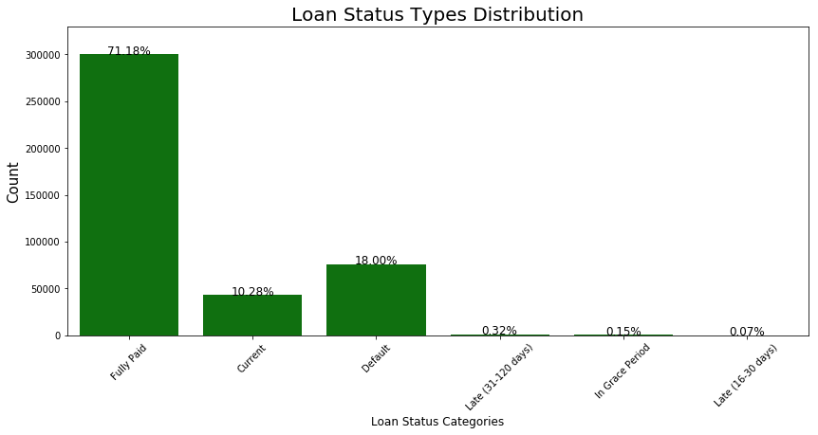
Loan Status Distribution

Slide 7
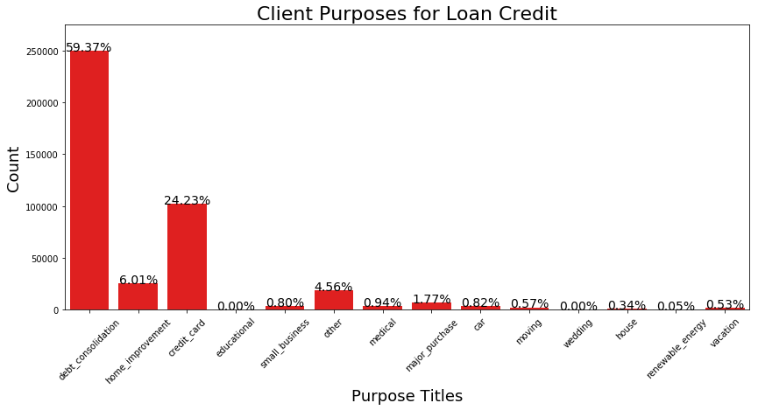
Purposes for Loans

Slide 8
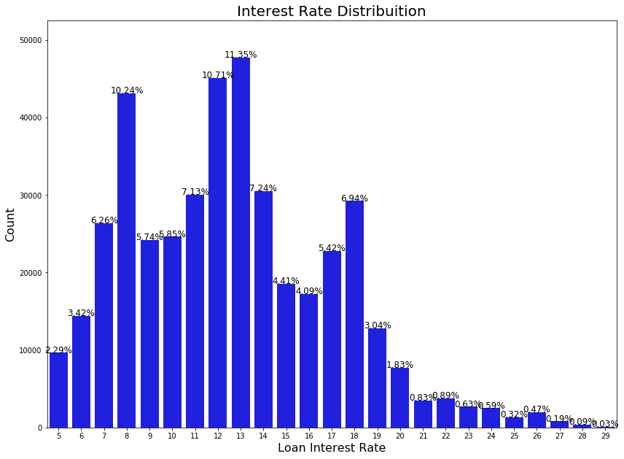
Interest Rate Range

Slide 9
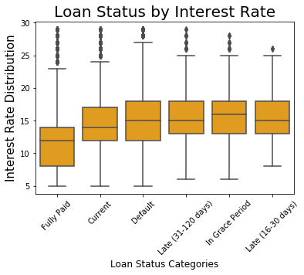
Impact of Interest Rate on Loan Status

Slide 10
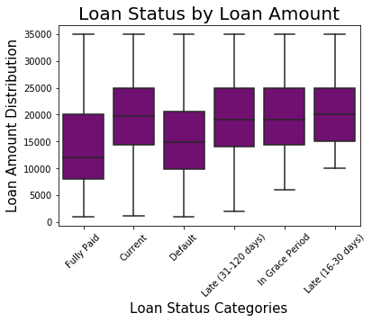
Impact of Amount Borrowed on Loan Status

Slide 11
Moving forward
Take advantage of my large dataset
Currently I used 2015
Data available for 2007-2018
Create better more enhanced visuals
Identify and highlight pertinent descriptive statistics
Analyze my finding to ensure I’m asking the best question
Create my data models

