Slide 2
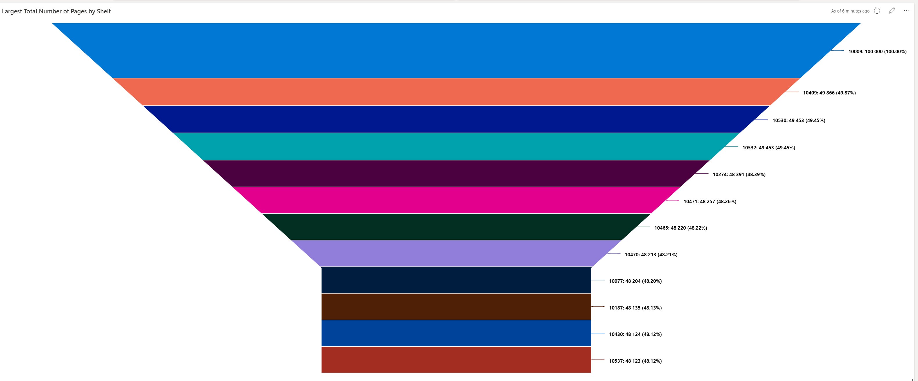
Largest Number of Total Pages by Shelf

