Slide 1
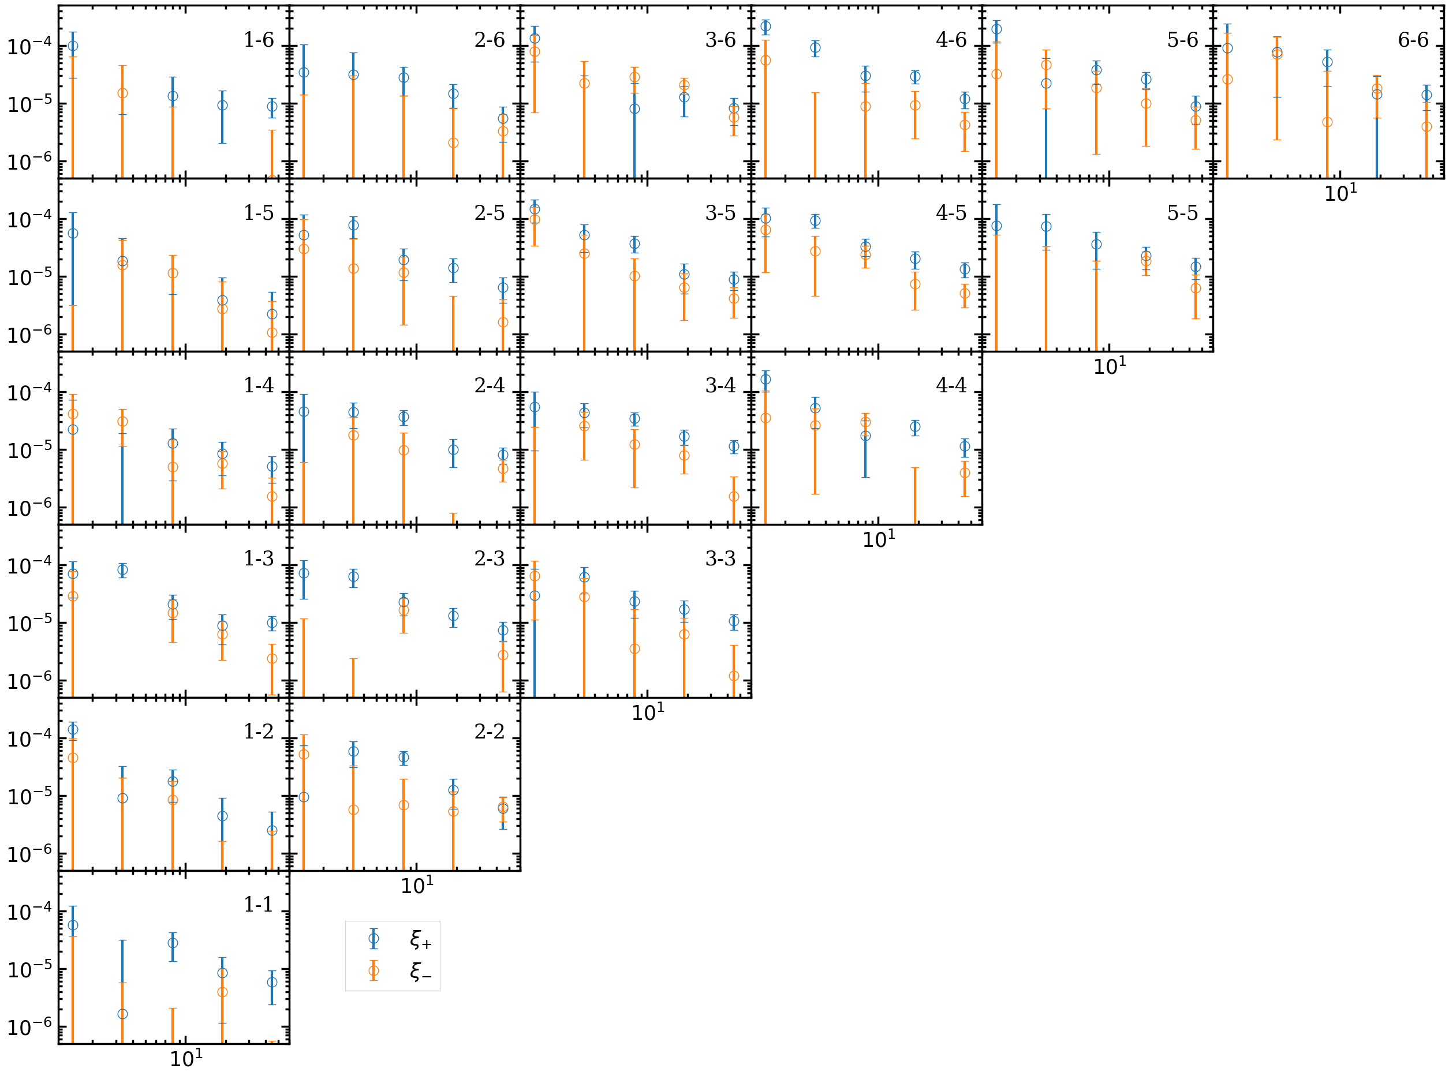

Slide 2
Fields
Exposures
…
Save the result of each exposure pair, exposure [i, j]
Total 1117 exposures, ~45000 exposure pairs
Exposures 0
Exposures 1
Exposures i
…
…
1
1
1
2
2
…
2
3
4
3
4

Slide 3
Exposure pair labels
Exposure pair [m, n]
1
1
1
.
.
…
CPU 0
CPU j
Save result [m, n]
2
3
4
.
.
request
Exposure pair [p, q]
while (true):
{
Send request to CPU 0;
Receive pair labels from CPU 0;
if labels >=0:
find galaxy pairs in the exposure pair;
save the result;
else:
break;
}
CPU_live = total CPU – 1;
pair_label = 0;
while ( CPU_live > 0):
{
Receive request from any CPU;
if pair_label < total pair num:
Send exposure label [p, q] to CPU i;
pair_label++;
else:
Send [-1, -1] to CPU i;
CPU_live --;
}
request
CPU i
Save result [p, q]

Slide 4
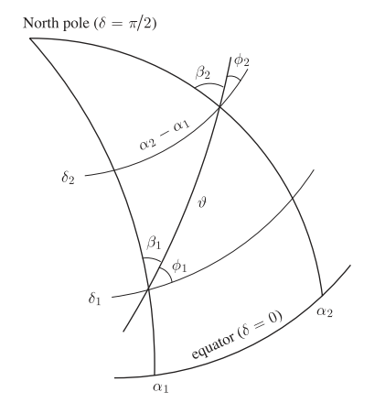



Search galaxy pairs
Find pairs by two brute for-loops
$$\text{For} \text{i}\text{:}$$
$$\text{For} \text{j}\text{:…}$$
Dec.
Rotate the pair
R.A.
PDF_SYM process
$$α_{2}−α_{1},at δ_{1}=α_{2}−α_{1}, at δ_{2}$$
$$dα\left(δ\right)=\left(α_{2}−α_{1}\right)\cos{δ}$$

Slide 5

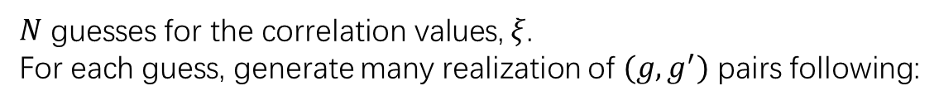



PDF_SYM process
$N$ guesses for the correlation values, $ξ$.
For each guess, generate many realization of $(g,g^{′})$ pairs following:
$$P\left(g,g^{′}\right)=A\exp\left[−\frac{1}{2}{\left(g,g^{′}\right)}^{T}⋅Σ^{−1}⋅\left(g,g^{′}\right)\right],Σ=\left[\begin{matrix}2ξ & ξ \\ ξ & 2ξ\end{matrix}\right]$$
For each galaxy pair at separation $θ$,
$G_{1/2}=G_{1/2}−g(N±U)$, $G_{1/2}^{′}=G_{1/2}^{′}−g^{′}(N±U)$
$N$ 2D bins
$$G_{1}^{′}$$
$$G_{1}^{′}$$
…
$$G_{1}$$
$$G_{1}$$

Slide 6













The result file, exposure-wise
$$n_{g}$$
$$n_{g}$$
$$n_{g}$$
$$n_{g}$$
$$n_{ ξ_{guess}}$$
$$n_{ ξ_{guess}}$$
$$n_{ θ}$$
$$n_{ θ}$$
$$z_{ij}=z_{ij}+z_{ji}, (j>i)$$
$$z_{ij}$$
$$z_{ij}$$
$${n_{z}×n}_{ z}$$
$$\frac{n_{ z}^{2}+n_{z}}{2}$$

Slide 7
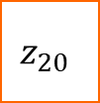

















































For example, $n_{z}=5$
$$z_{00}$$
$$z_{00}$$
$$z_{01}$$
$$z_{02}$$
$$z_{03}$$
$$z_{04}$$
$$z_{00}$$
$$z_{01}$$
$$z_{02}$$
$$z_{03}$$
$$z_{04}$$
$$z_{01}$$
$$z_{10}$$
$$z_{11}$$
$$z_{12}$$
$$z_{13}$$
$$z_{14}$$
$$z_{11}$$
$$z_{12}$$
$$z_{13}$$
$$z_{14}$$
$$z_{02}$$
$$z_{20}$$
$$z_{21}$$
$$z_{22}$$
$$z_{23}$$
$$z_{24}$$
$$z_{22}$$
$$z_{23}$$
$$z_{24}$$
$$z_{ij}=z_{ij}+z_{ji}, (j<i)$$
$$z_{03}$$
$$z_{30}$$
$$z_{31}$$
$$z_{32}$$
$$z_{33}$$
$$z_{34}$$
$$z_{33}$$
$$z_{34}$$
$$z_{04}$$
$$z_{40}$$
$$z_{41}$$
$$z_{42}$$
$$z_{43}$$
$$z_{44}$$
$$z_{44}$$
$$z_{11}$$
$$z_{12}$$
…
$$z_{44}$$

Slide 8
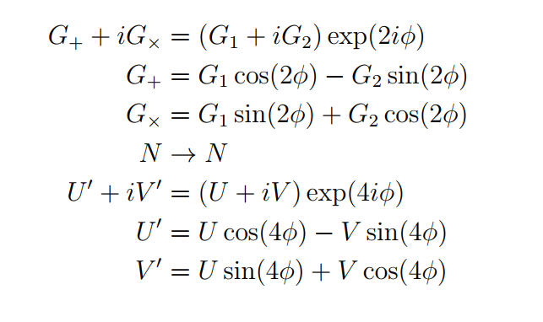








g1 g2 de h1 h2 G1, G2, N, U, V
$$G_{T}, N, U^{′}$$
$$γ_{1}$$
$$G_{T}Σ_{crit }\left(z_{s},z_{f}\right)−Δ\hat{Σ_{tan}}(N+U^{′})$$
N_s
$$G_{T}Σ_{crit }\left(z_{s},z_{f}\right)−Δ{\hat{Σ}}_{cross}(N−U^{′})$$
Ra, Dec, Z.
$$χ^{2}$$
$$ΔΣ$$
$$G_{1}−\hat{γ_{1}}\left(N+U\right),G_{2}−\hat{γ_{2}}(N−U)$$
$$Δ\hat{Σ}$$
$$<γ_{t}Σ_{c}>, <G_{T}Σ_{crit }\left(z_{s},z_{f}\right)>$$

