Slide 1
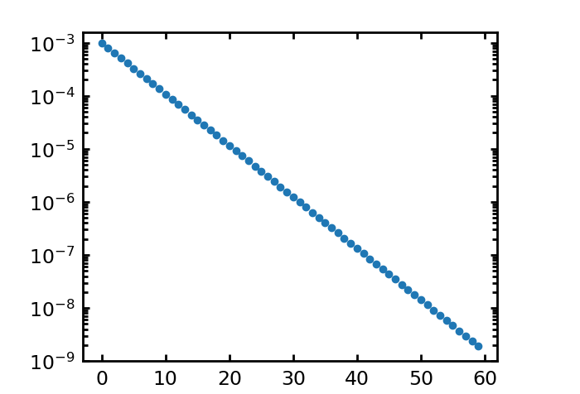
Algorithm
--about codes
$ξ_{±}$ = numpy.array([10**(-3)/1.25**i for i in range(60)])
The program run on each angular separation interval independently.
Input parameter: separation bin label
Since the signals are known(from other papers), so the signal guess can
constraint to a small range to save the computational time.
Input parameter: signal guess, [a, b], and the number of bins
Calculate the correlation function between different exposures.
Input parameter: exposure labels, a and b
There are 5 ~ 7 exposures.
Each field has a unique label: field labels (0 ~ n)
In the pair searching, to avoid the repetitive computation, it will only find the galaxy pairs from the fields
which has a bigger field label than that of the current field.
! Label the field.

Slide 2
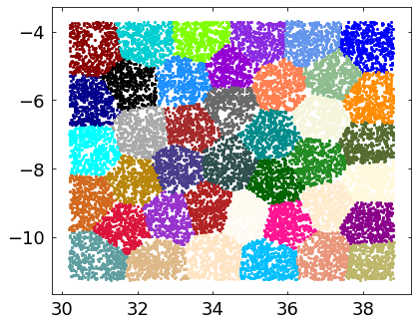
Area segment for jackknife
Package: Kmean_radec
Dec
N areas
Area label: [Ndata, ] ~ (0, N)
Ra

Slide 3
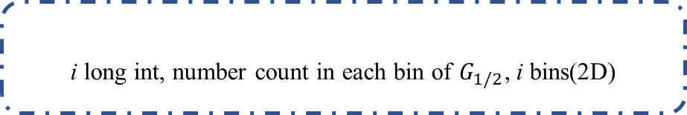
Data structure in memory
n areas, 0 ~ n
0
1
2
i
n-1
include all data points
……
……
n
……
……
……
i’th area
……
……
m blocks for m guesses of $ξ$, exclude data points of the i’th area
0
1
2
3
……
m-1
……
……
……
……
……
i long int, number count in each bin of $G_{1/2}$, i bins(2D)
0
1
2
3
……
i-1

Slide 4
Catalog data structure
n elements each row
Block: p row x q col
p x q elements each row
RA Dec
G1, G2, N, U, V
Block_start Block_end Num_in_block
Block_boundx Block_boundy
Block 0
0
i
……
……
……
……
……
……
Block 1
i
i+j
Block 2
j
j
…
…
…
Block i
k
k
…

Slide 5




Pair in same field:
Same Z bin, different exposures, search pairs in the blocks have a larger label that its
Different Z bin, all exposures, search pairs in all blocks
Pair in different field:
Same/different Z bin, all exposures, search pairs in all blocks

Slide 6
hist_2d_new(temp_x_tt, temp_y_tt, field_info->mg_bin, mg_bin_num,mg_bin_num1, mg_bin_num2, mg_bin_num3, ix_tt, iy_tt);
Slightly faster
hist_2d_new(temp_x_tt, temp_y_tt, field_info->mg_bin, bin_num_para, ix_tt, iy_tt);
Int bin_num_para[4] = [mg_bin_num,mg_bin_num1, mg_bin_num2, mg_bin_num3];
Time cost of parameter pass
Fun1(float *abcd); > Fun2(float a, float b, float c, float d); ~ 0.77 : 1
Passing a array is faster than passing many parameters when calling function.

Slide 7
Assignment statement is faster than IF statement (~2x).
a = b;
If(a == b){}

