Slide 1
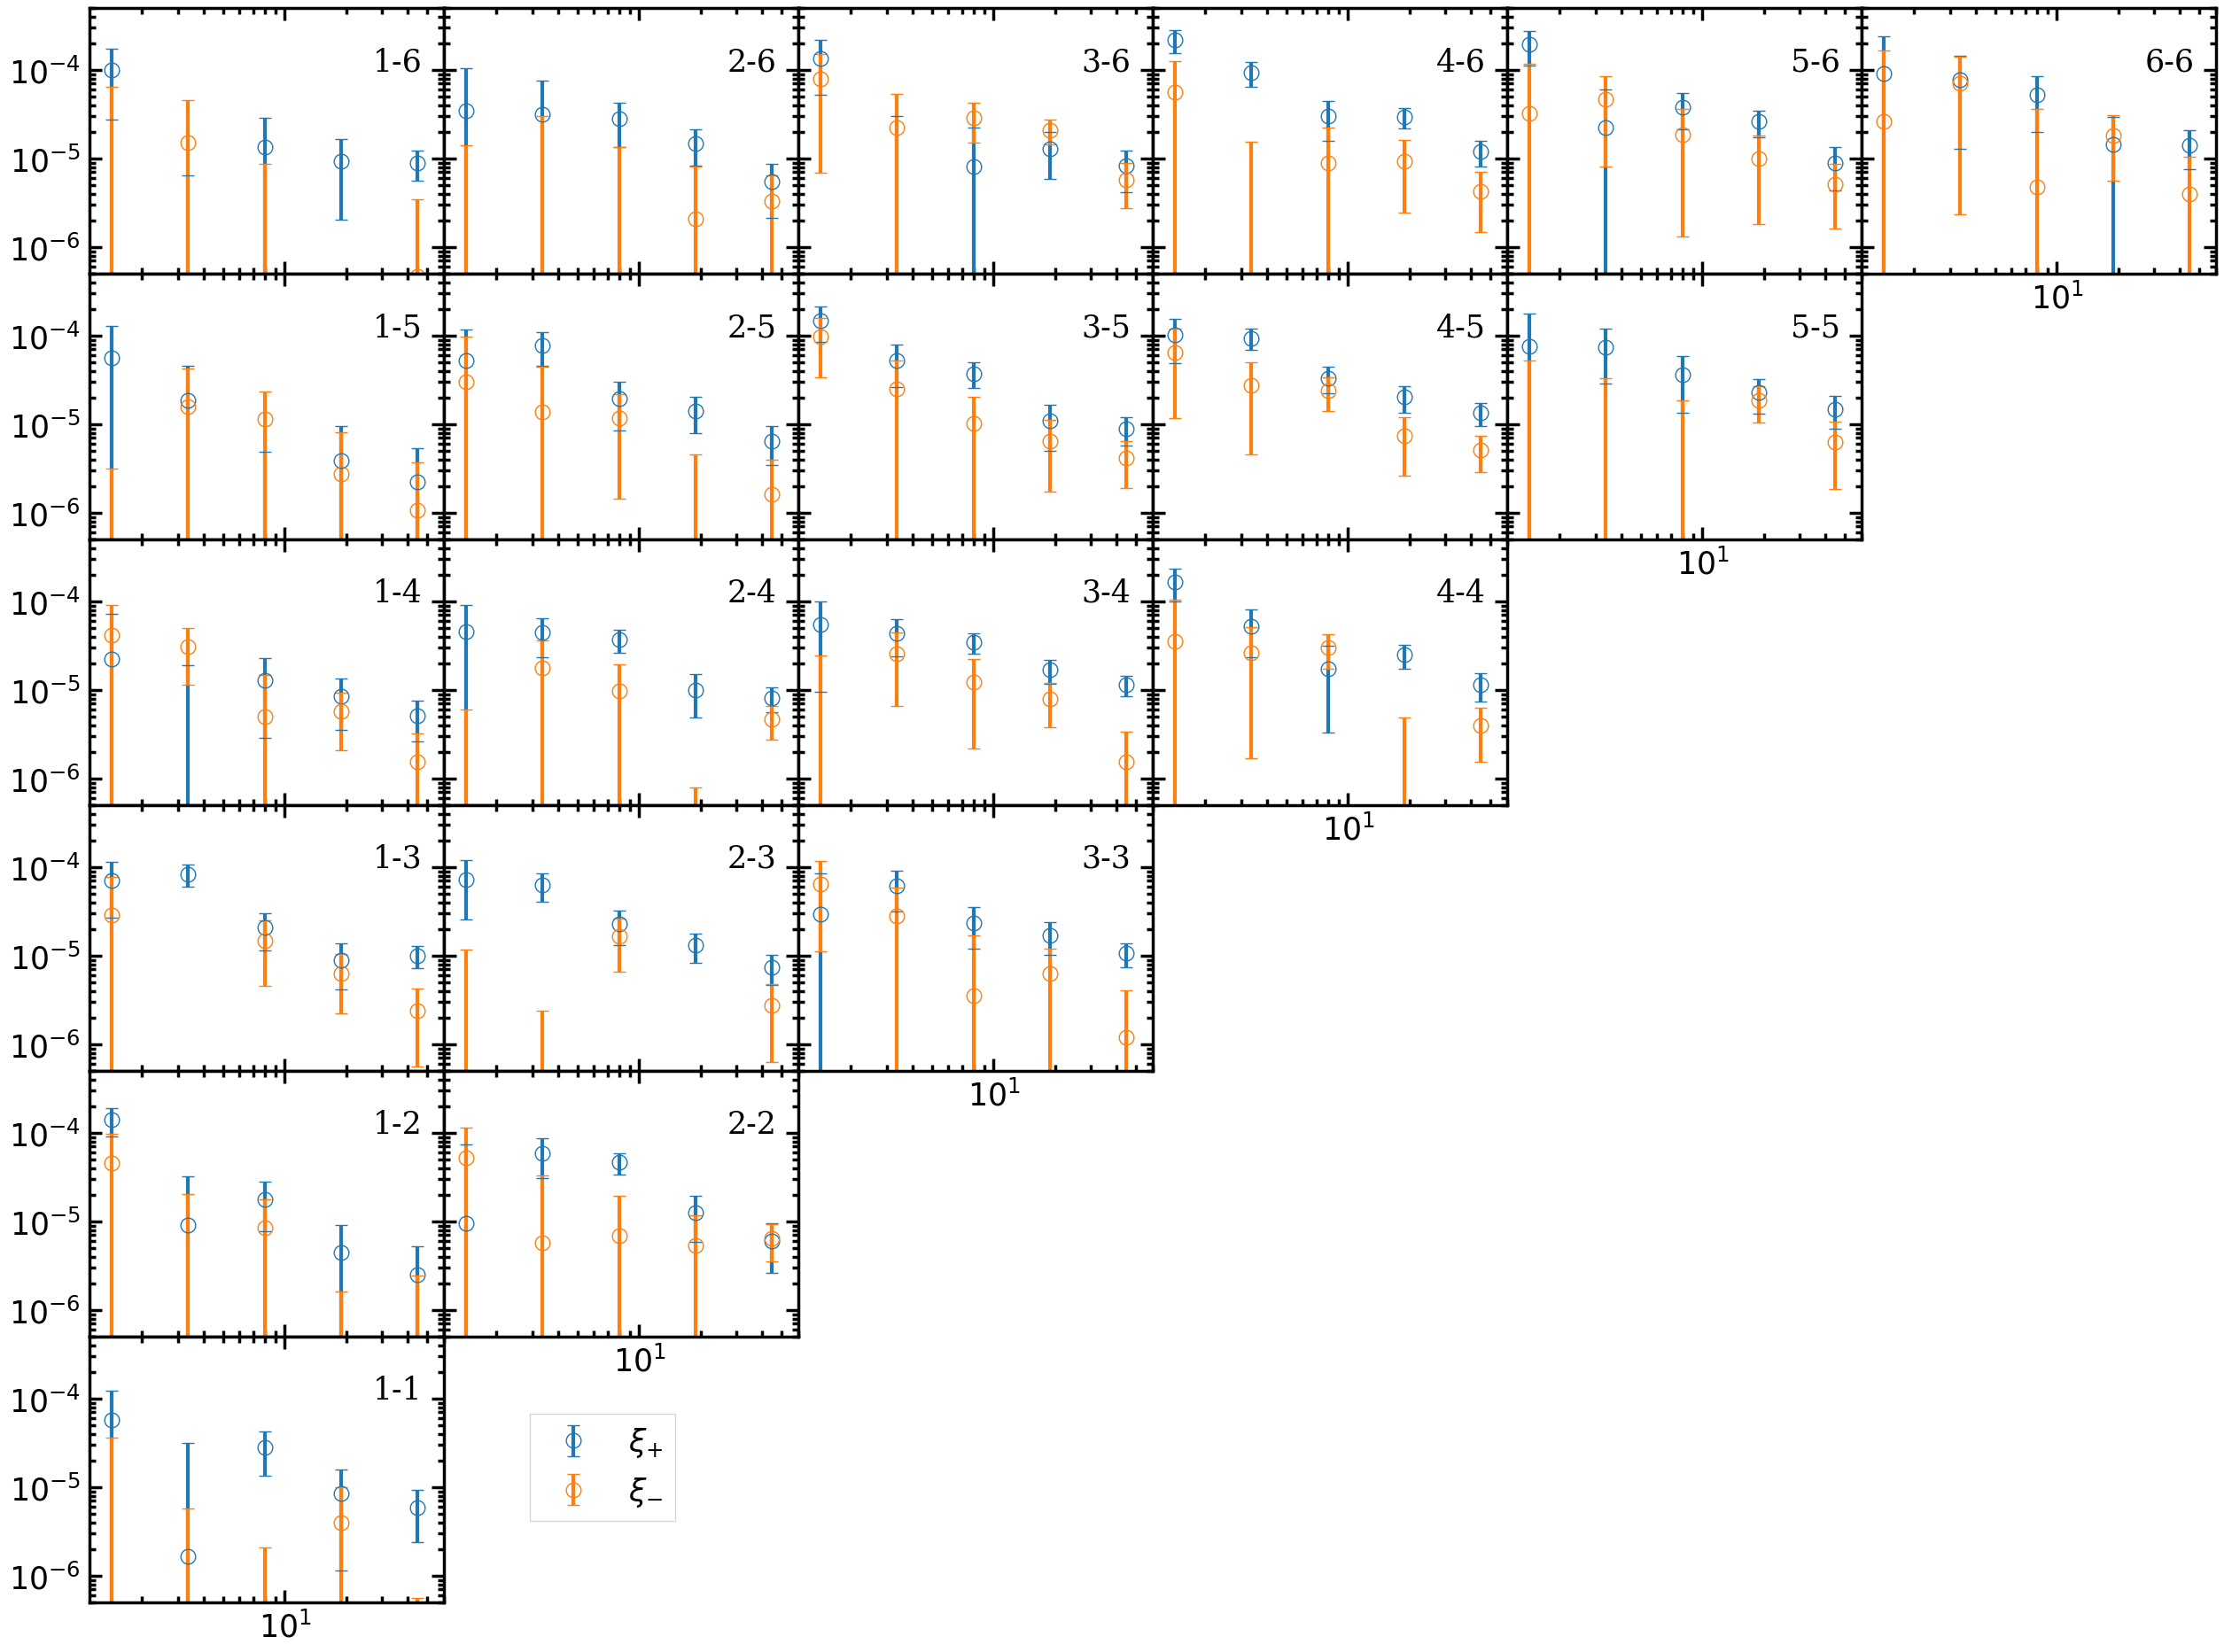

Slide 2
Fields
Exposures
…
Exposures 0
Exposures 1
Exposures i
…
…
Save the result of each exposure pair, exposure [i, j]
Total 1117 exposures, ~45000 exposure pairs

Slide 3
Exposure pair labels
Exposure pair [m, n]
1
1
1
.
.
…
CPU 0
CPU j
Save result [m, n]
2
3
4
.
.
request
Exposure pair [p, q]
while (true):
{
Send request to CPU 0;
Receive pair labels from CPU 0;
if labels >=0:
find galaxy pairs in the exposure pair;
save the result;
else:
break;
}
CPU_live = total CPU – 1;
while ( CPU_live > 0):
{
if exposure left >0:
Send exposure label [p, q] to CPU i;
else:
Send [-1, -1] to CPU I;
CPU_live --;
}
request
CPU i
Save result [p, q]

Slide 5













The result file, exposure-wise
like “w3m2m0-793065p_num_count.hdf5, w3m2m0-793065p_num_count_zstack.hdf5”
$$n_{g}$$
$$n_{g}$$
$$n_{g}$$
$$n_{g}$$
$$n_{ ξ_{guess}}$$
$$n_{ ξ_{guess}}$$
$$n_{ θ}$$
$$n_{ θ}$$
$$z_{ij}=z_{ij}+z_{ji}, (j>i)$$
$$z_{ij}$$
$${n_{z}×n}_{ z}$$
$$z_{ij}$$
$$\frac{n_{ z}^{2}+n_{z}}{2}$$

Slide 6
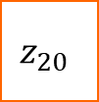

















































For example, $n_{z}=5$
$$z_{00}$$
$$z_{00}$$
$$z_{01}$$
$$z_{02}$$
$$z_{03}$$
$$z_{04}$$
$$z_{00}$$
$$z_{01}$$
$$z_{02}$$
$$z_{03}$$
$$z_{04}$$
$$z_{01}$$
$$z_{10}$$
$$z_{11}$$
$$z_{12}$$
$$z_{13}$$
$$z_{14}$$
$$z_{11}$$
$$z_{12}$$
$$z_{13}$$
$$z_{14}$$
$$z_{02}$$
$$z_{20}$$
$$z_{21}$$
$$z_{22}$$
$$z_{23}$$
$$z_{24}$$
$$z_{22}$$
$$z_{23}$$
$$z_{24}$$
$$z_{ij}=z_{ij}+z_{ji}, (j<i)$$
$$z_{03}$$
$$z_{30}$$
$$z_{31}$$
$$z_{32}$$
$$z_{33}$$
$$z_{34}$$
$$z_{33}$$
$$z_{34}$$
$$z_{04}$$
$$z_{40}$$
$$z_{41}$$
$$z_{42}$$
$$z_{43}$$
$$z_{44}$$
$$z_{44}$$
$$z_{11}$$
w3m2m0-793065p_num_count.hdf5
w3m2m0-793065p_num_count_zstack.hdf5
$$z_{12}$$
…
$$z_{44}$$

Slide 7
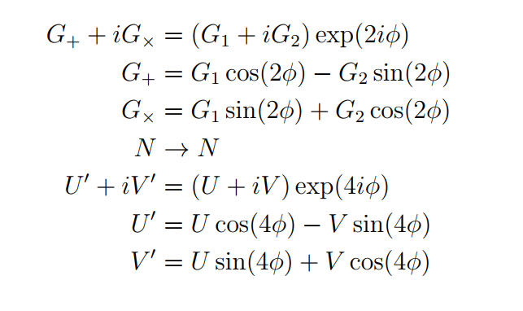








g1 g2 de h1 h2 G1, G2, N, U, V
$$G_{T}, N, U^{′}$$
$$γ_{1}$$
$$G_{T}Σ_{crit }\left(z_{s},z_{f}\right)−Δ\hat{Σ_{tan}}(N+U^{′})$$
N_s
$$G_{T}Σ_{crit }\left(z_{s},z_{f}\right)−Δ{\hat{Σ}}_{cross}(N−U^{′})$$
Ra, Dec, Z.
$$χ^{2}$$
$$ΔΣ$$
$$G_{1}−\hat{γ_{1}}\left(N+U\right),G_{2}−\hat{γ_{2}}(N−U)$$
$$Δ\hat{Σ}$$
$$<γ_{t}Σ_{c}>, <G_{T}Σ_{crit }\left(z_{s},z_{f}\right)>$$

