Slide 1
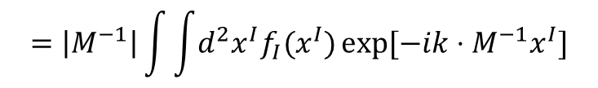

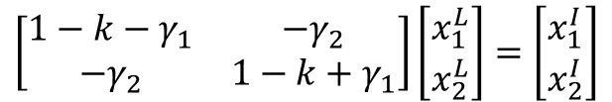
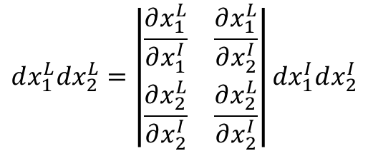

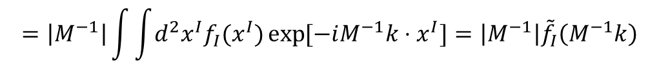

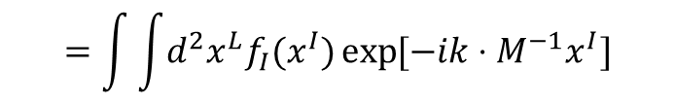
$$M=\left|\begin{matrix}1−k−γ_{1} & −γ_{2} \\ −γ_{2} & 1−k+γ_{1}\end{matrix}\right|=\frac{1}{1−k}\left[\begin{matrix}1−g_{1} & −g_{2} \\ −g_{2} & 1+g_{1}\end{matrix}\right]$$
$$M^{−1}=\left|\begin{matrix}1+k+γ_{1} & −γ_{2} \\ −γ_{2} & 1+k−γ_{1}\end{matrix}\right|=(1+k)\left[\begin{matrix}1+g_{1} & −g_{2} \\ −g_{2} & 1−g_{1}\end{matrix}\right]$$
$$\left[\begin{matrix}1−k−γ_{1} & −γ_{2} \\ −γ_{2} & 1−k+γ_{1}\end{matrix}\right]\left[\begin{matrix}x_{1}^{L} \\ x_{2}^{L}\end{matrix}\right]=\left[\begin{matrix}x_{1}^{I} \\ x_{2}^{I}\end{matrix}\right]$$
$$f_{L}\left(x^{L}\right)=f_{I}(x^{I})$$
$$x^{I}=Mx^{L}$$
$${\tilde{f}}_{L}\left(k\right)=\int{\int{d^{2}x^{L}f_{L}\left(x^{L}\right)\exp{[−ik⋅x^{L}]}}}$$
$$dx_{1}^{L}dx_{2}^{L}=\left|\begin{matrix}\frac{∂x_{1}^{L}}{∂x_{1}^{I}} & \frac{∂x_{1}^{L}}{∂x_{2}^{I}} \\ \frac{∂x_{2}^{L}}{∂x_{2}^{I}} & \frac{∂x_{2}^{L}}{∂x_{2}^{I}}\end{matrix}\right|dx_{1}^{I}dx_{2}^{I}$$
$$=\int{\int{d^{2}x^{L}f_{I}(x^{I})\exp{[−ik⋅M^{−1}x^{I}]}}}$$
$$=\left|M^{−1}\right|\int{\int{d^{2}x^{I}f_{I}(x^{I})\exp{[−ik⋅M^{−1}x^{I}]}}}$$
$$=\left|M^{−1}\right|\int{\int{d^{2}x^{I}f_{I}(x^{I})\exp{[−iM^{−1}k⋅x^{I}]}}}=\left|M^{−1}\right|{\tilde{f}}_{I}\left(M^{−1}k\right)$$

Slide 2

$$\left|\begin{matrix}k_{1} \\ k_{2}\end{matrix}\right|=\left|\begin{matrix}1−g_{1} & −g_{2} \\ −g_{2} & 1+g_{1}\end{matrix}\right|\left|\begin{matrix}k_{1}^{′} \\ k_{2}^{′}\end{matrix}\right|$$
$$k_{1}^{2}=\left(1+g_{1}^{2}−2g_{1}\right){k_{1}^{′}}^{2}+g_{2}^{2}{k_{2}^{′}}^{2}+2g_{2}\left(1−g_{1}\right)k_{1}^{′}k_{2}^{′}=\left(1−2g_{1}\right){k_{1}^{′}}^{2}+2g_{2}k_{1}^{′}k_{2}^{′}$$
$k_{2}^{2}=g_{2}^{2}{k_{1}^{′}}^{2}+\left(1+g_{1}^{2}+2g_{1}\right){k_{2}^{′}}^{2}+2g_{2}\left(1+g_{1}\right)k_{1}^{′}k_{2}^{′}=$ $\left(1+2g_{1}\right){k_{2}^{′}}^{2}+2g_{2}k_{1}^{′}k_{2}^{′}$
$$Exp\left[−β^{2}k^{2}\right]=\operatorname{Exp}{[−β^{2}[\left(1−2g_{1}\right){k_{1}^{′}}^{2}+2g_{2}k_{1}^{′}k_{2}^{′}+\left(1+2g_{1}\right){k_{2}^{′}}^{2}+2g_{2}k_{1}^{′}k_{2}^{′}]]}$$
$$≈Exp\left[−β^{2}{k^{′}}^{2}\right](1−4g_{2}β^{2}k_{1}^{′}k_{2}^{′}+2g_{1}β^{2}\left({k_{1}^{′}}^{2}−{k_{2}^{′}}^{2}\right))$$

