Slide 1
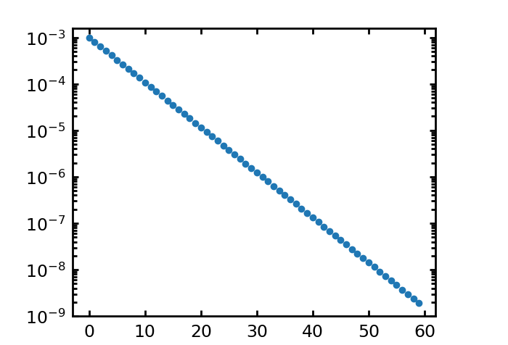
Algorithm
--about codes
$ξ_{±}$ = numpy.array([10**(-3)/1.25**i for i in range(60)])
The program run on each angular separation interval independently.
Input parameter: separation bin label
Since the signals are known(from other papers), so the signal guess can
constraint to a small range to save the computational time.
Input parameter: signal guess, [a, b], and the number of bins
Calculate the correlation function between different exposures.
Input parameter: exposure labels, a and b
There are 5 ~ 7 exposures.

