Slide 1

React Hooks & HOC
BDDF SOCLE - 2022

Slide 2
Outline
Hooks
useState
HOC
useEffect
useMemo
useCallback

Slide 3
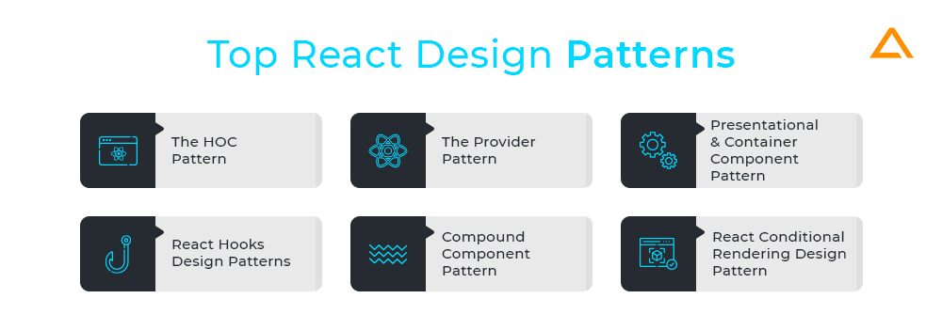
React Design Patterns : You Should Know in 2022
https://aglowiditsolutions.com/blog/react-design-patterns/

Slide 4

React Hooks
https://codesandbox.io/s/fragrant-sunset-pvsl54?file=/src/App.js

Slide 5
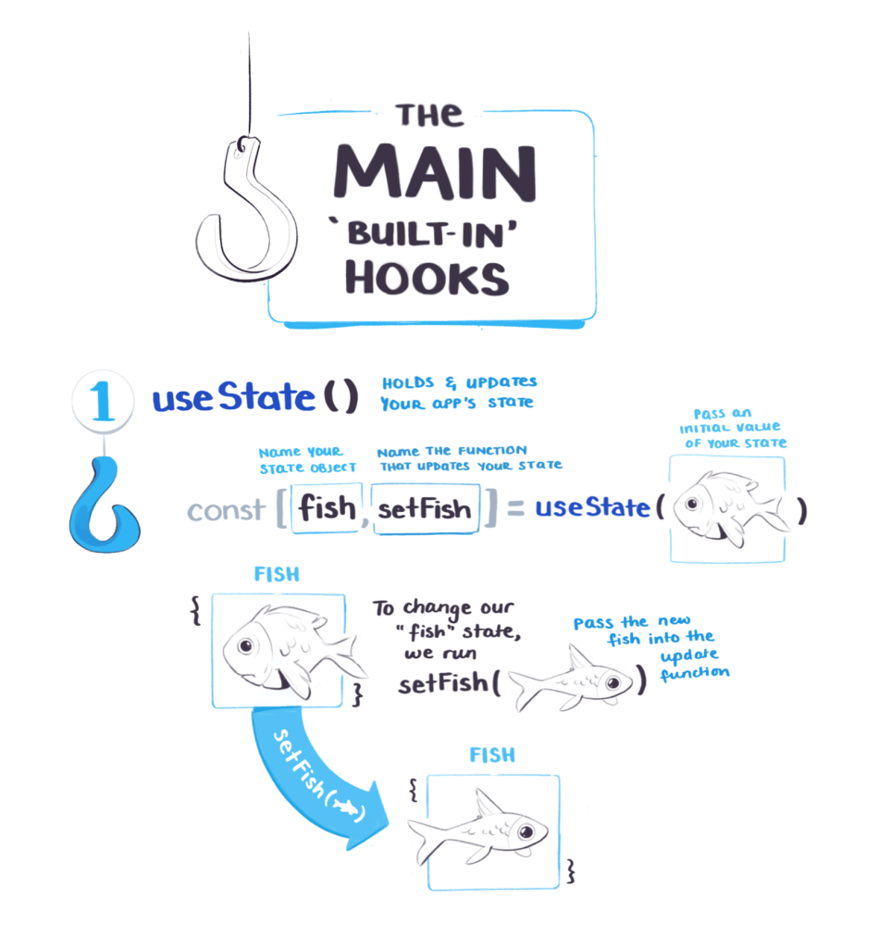
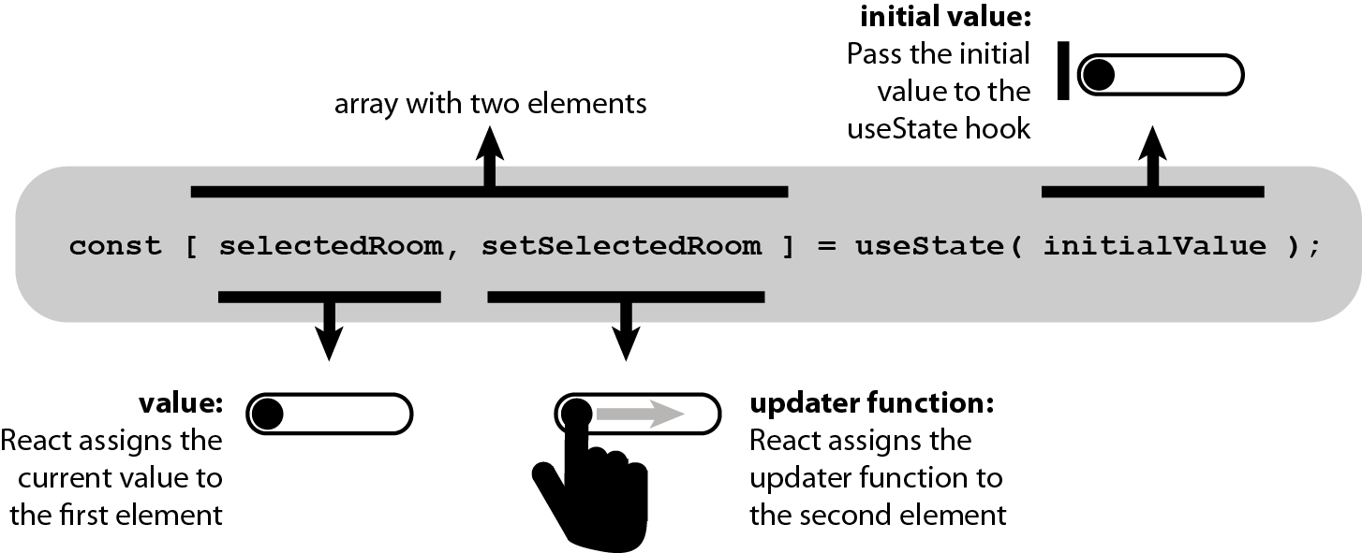
useState

Slide 6
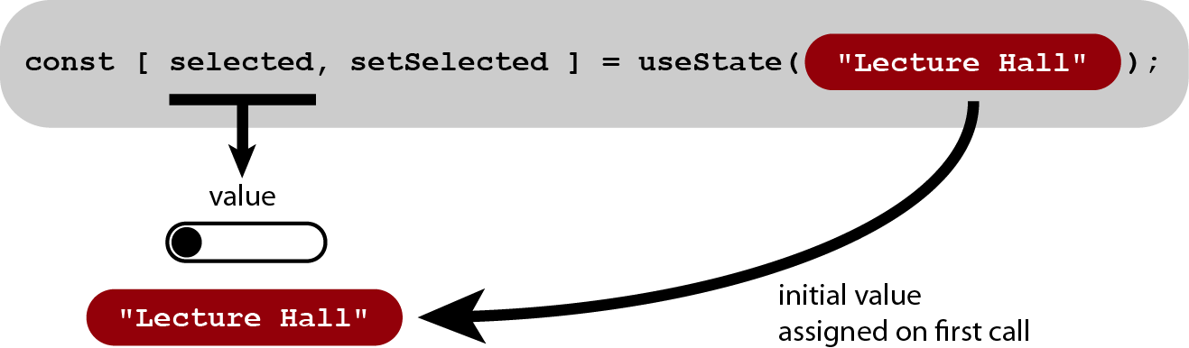
useState

Slide 7
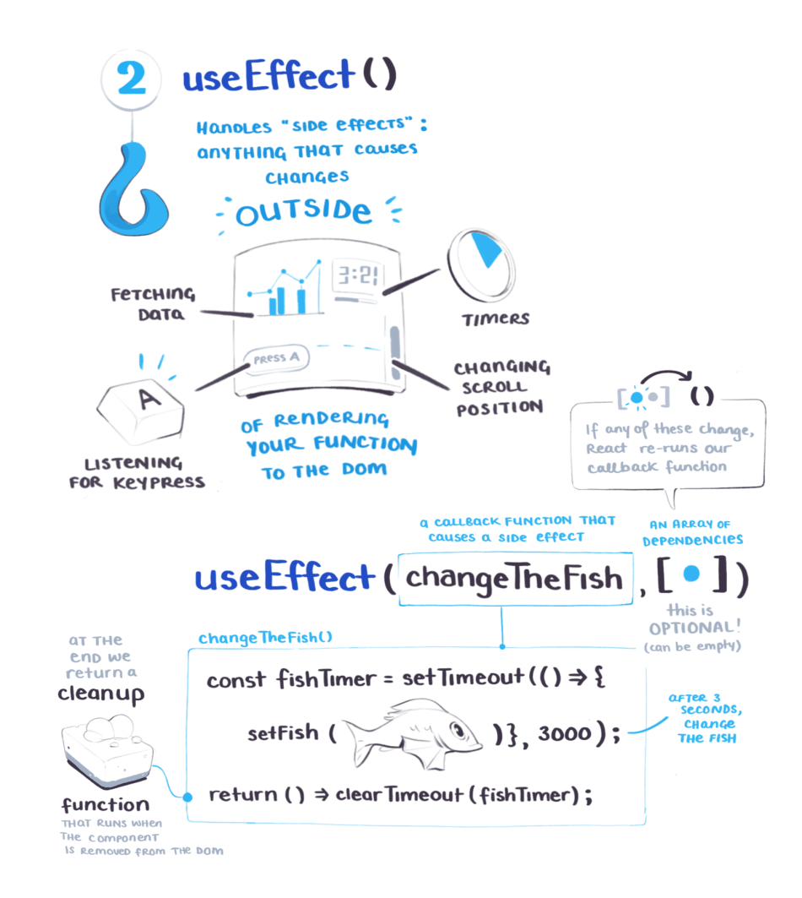
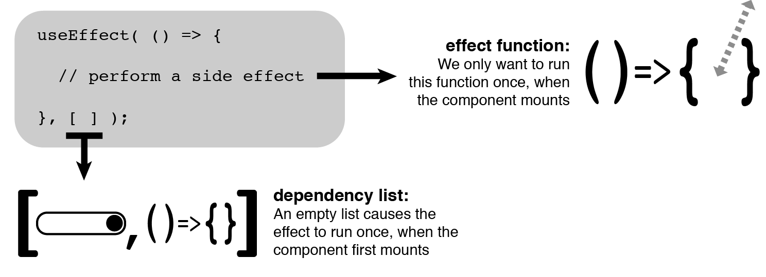
useEffect

Slide 8
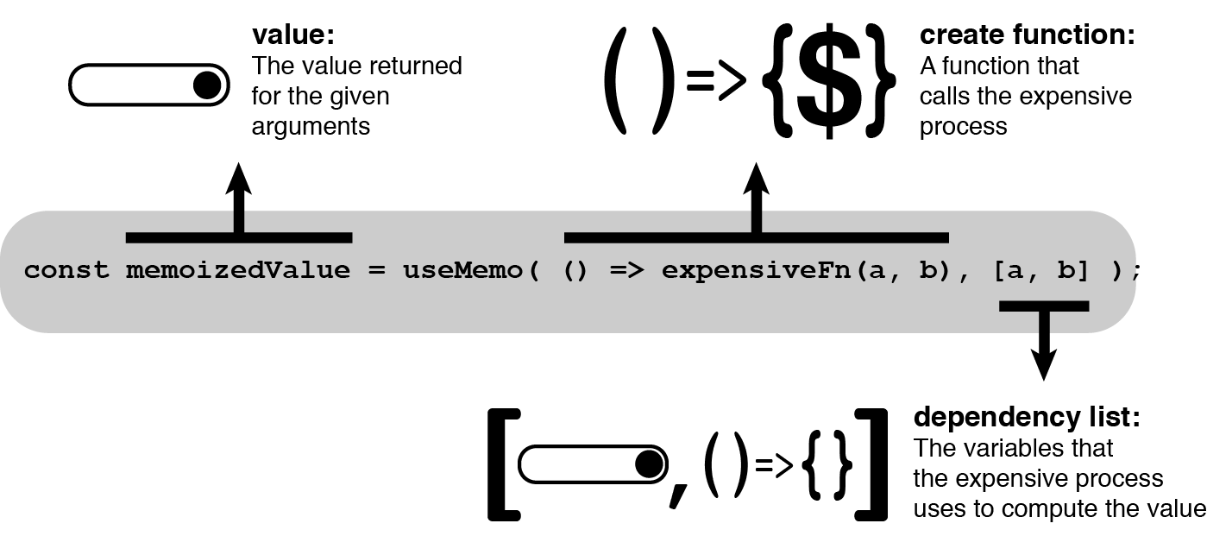
useMemo

Slide 9
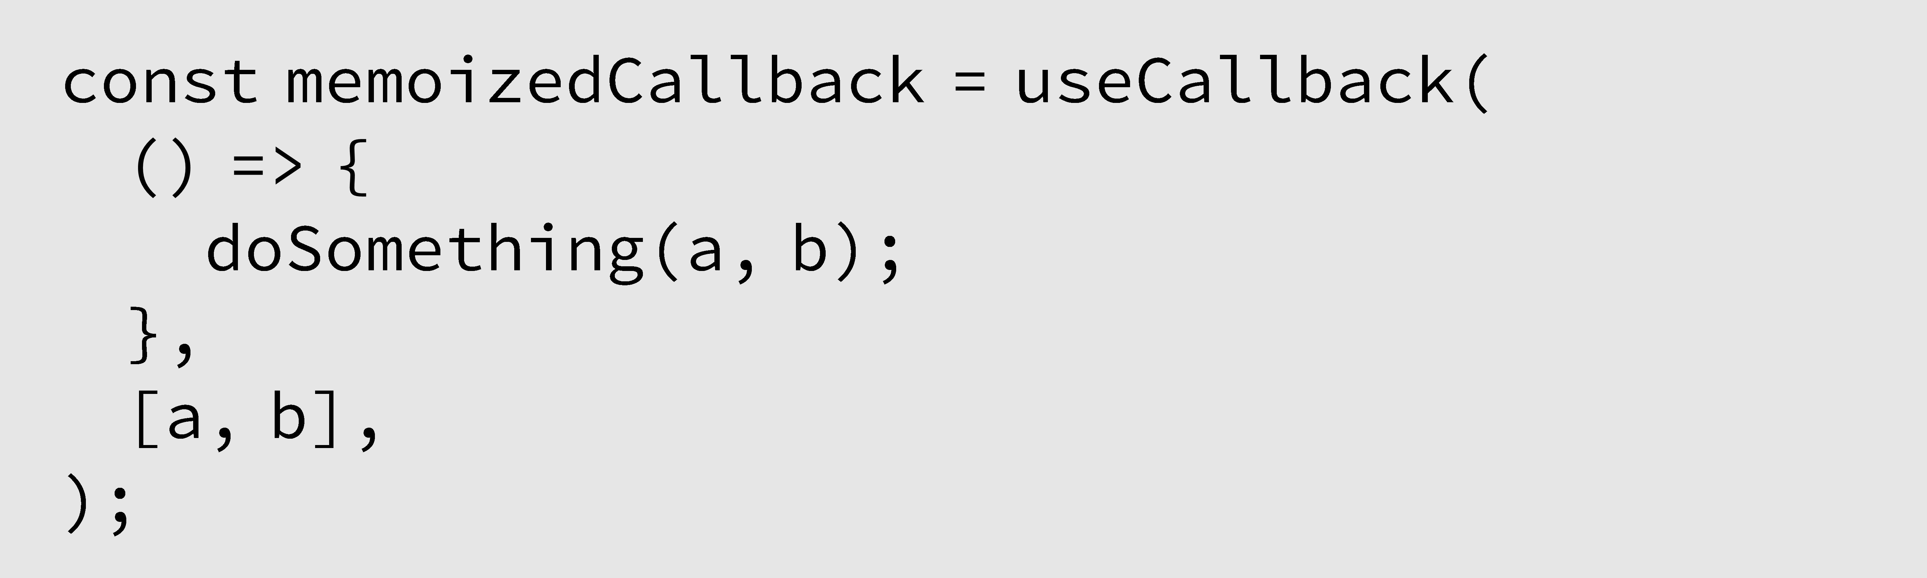
useCallback

Slide 10

React HOC

Slide 11
HOC
Adding Functionality to Existing Components
Reuse Logic
Compose
@withDecpFormSubmit({ nextStepPath: DECP_CONFIRM_PLAFOND_PATH, lastStepPath: DECP_EDIT_PLAFOND_PATH, }) @withSign(DecpSignParams) @withDecpTmsTracking() class DecpRecapPlafondPage extends Component
with

Slide 12
@withMediaLayout({ title: 'DEMAT_CODE_PIN_RAPPEL_MOBILE_TITLE', wrapperClassName: 'gkb_demat-pin_page', }) class DematCodePinRestitutionPage extends Component
/** * withMediaLayout HOC add a custom title for mobile device * @param title * @param wrapperClassName * @returns {function(*): function(*): *} */ const withMediaLayout = ({ title, wrapperClassName, }) => WrappedComponent => (props) => { const configuration = useSelector(state => state?.awtContext); const { words, } = props; const pageTitle = words?.[title] || title; return ( <div className={wrapperClassName}> <MediaComponent pageTitleLabel={pageTitle} PageContent={WrappedComponent} configuration={configuration} {...props} /> </div> ); };
@withMediaLayout({ title: 'DEMAT_CODE_PIN_RAPPEL_MOBILE_TITLE', wrapperClassName: 'gkb_demat-pin_page', }) class DematCodePinRappelSecuPage extends Component
Reuse logic

Slide 13
const withUserEligibility = () => (WrappedComponent) => { @Reduxify(state => ({ // define state to extract ...AwtContextFragment(state), ...DematCodePinUserEligibiliteFragment(state), }), { // define actions to execute ...DematCodePinDispatcher, }) class UserEligibilityComponent extends Component { // Default props static defaultProps = { ...DematCodePinDefaultProps, }; // Props types validation static propTypes = { ...DematCodePinPropTypes, }; // did mount staff componentDidMount() { this.initPage(); } initPage = () => { const { requestUserEligibilite, } = this.props; const { idPrestation, aliasCarte, } = dematCodePinNavigationParams(this.props) || {}; requestUserEligibilite({ idPrestation, aliasCarte, }); };
@withUserEligibility() class DematCodePinRappelSecuPage extends Component
@withUserEligibility() class DematCodePinRestitutionPage extends Component
Reuse logic
Extends Functionnality

Slide 14
@withSign(DematPinSignParams) class DematCodePinRappelSecuPage extends Component
const withSign = ({ tokenUrl, signTransactionUrl, signSensibilities, nativeSignParams, onSuccessCallback, onErrorCallback, ErrorComponent, }) => (WrappedComponent) => { @Reduxify(state => ({ // define state to extract ...AwtContextFragment(state), ...SignTokenFragment(state), ...SignTransactionFragment(state), }), { ...SignDispatcher, }) class SignComponent extends Component { // Default props static defaultProps = { ...SignPropTypes.defaultProps, }; // Props types validation static propTypes = { ...SignPropTypes.propTypes, }; // initial state state = { signError: null, }; componentDidMount() {}
@withSign(DecpSignParams) class DecpRecapPlafondPage extends Component
Reuse logic

Slide 15

Code once, Reuse multiple

Slide 16

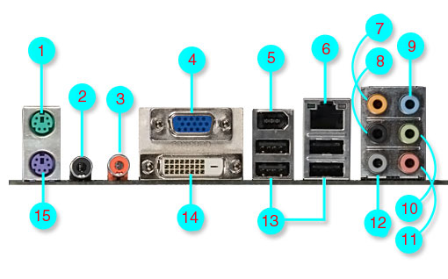
Decorate, Add new accessories, Compose

Slide 17
Thank you !
https://helabenkhalfallah.medium.com/

