Slide 1

React hooks & hoc
BDDF SOCLE 2023

Slide 2
Outline
Hooks
useState
HOC
useEffect
useMemo
useCallback
Declaration
Usage
Use Cases

Slide 3

React Hooks

Slide 4
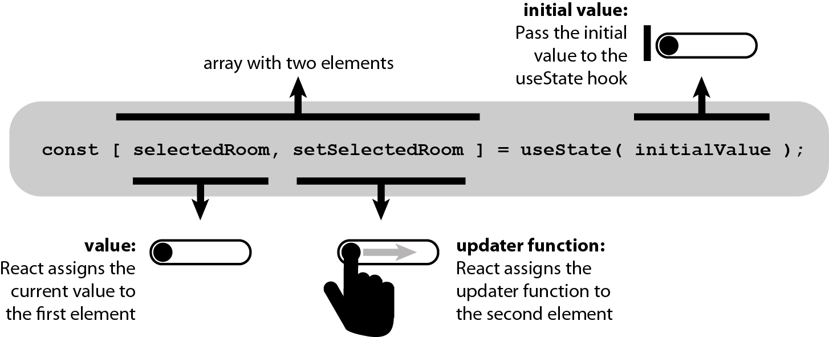
useState

Slide 5
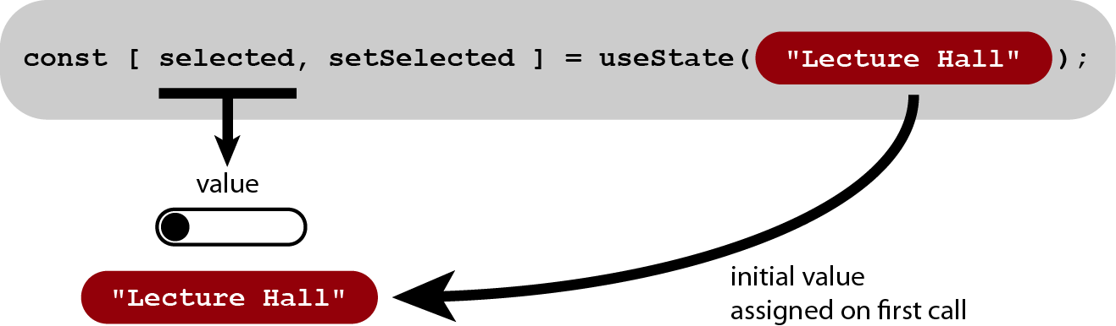
useState

Slide 6
const HouseJavaLibListView = ({ words, hideSearchBar, defaultAlphabeticFilterText, defaultSearchText, defaultJavaList, onOpenJavaLibDetailsClicked, }) => { const [ javaSearchText, setJavaSearchText, ] = useState(null); const [ javaAlphabeticFilterText, setJavaAlphabeticFilterText, ] = useState(null); return ( <Suspense fallback={<HouseLazyLoadingView />} > <> {!hideSearchBar && ( <HouseListSearchBar testpath="../js/commons/components/HouseListSearchBar" defaultSearchText={javaSearchText} onRechercheSimpleClicked={(searchText) => { setJavaSearchText(searchText); }} /> )} {!javaSearchText && ( <HouseAlphabeticFilter testpath="../js/commons/components/HouseAlphabeticFilter" defaultAlphabeticFilterText={javaAlphabeticFilterText} onAlphabeticFilterChanged={(filter) => { setJavaAlphabeticFilterText(filter); }} /> )} <HouseJavaLibList testpath="../js/components/java-lib/java-lib-list/HouseJavaLibList" defaultAlphabeticFilterText={javaAlphabeticFilterText} defaultSearchText={javaSearchText} defaultJavaList={defaultJavaList} onOpenJavaLibDetailsClicked={(java) => onOpenJavaLibDetailsClicked({ java, javaSearchText, javaAlphabeticFilterText, })} />
</> </Suspense> ); });
const HouseAwtEvolutionsView = ({ words, evolutions, }) => { const [ evolutionDetails, setEvolutionDetails, ] = useState({}); const [ showEvolutionDetails, setShowEvolutionDetails, ] = useState(false); return ( <Suspense fallback={<HouseLazyLoadingView />} > <> {isEmpty(evolutions) ? ( <HouseMessageView testpath="../js/commons/components/HouseMessageView" status="success" title={words.HOUSE_AWT_DETAILS_EVOLUTIONS_EMPTY_TITLE} message={words.HOUSE_AWT_DETAILS_EVOLUTIONS_EMPTY_MESSAGE} icon={( <SGIcon component={<SGAvenirStatusInfo />} size="xl" /> )} /> ) : ( <HouseAwtEvolutionsList testpath="../js/components/awt/awt-evolutions/HouseAwtEvolutionsList" evolutions={evolutions} onEvolutionClicked={(evolution) => { setEvolutionDetails(evolution); setShowEvolutionDetails(true); }} /> )} <HouseAwtEvolutionDetailsView testpath="../js/components/awt/awt-evolutions/HouseAwtEvolutionDetailsView" evolutionDetails={evolutionDetails} showEvolutionDetails={showEvolutionDetails} onCloseEvolutionDetails={() => setShowEvolutionDetails(false)} /> </> </Suspense> );

Slide 7
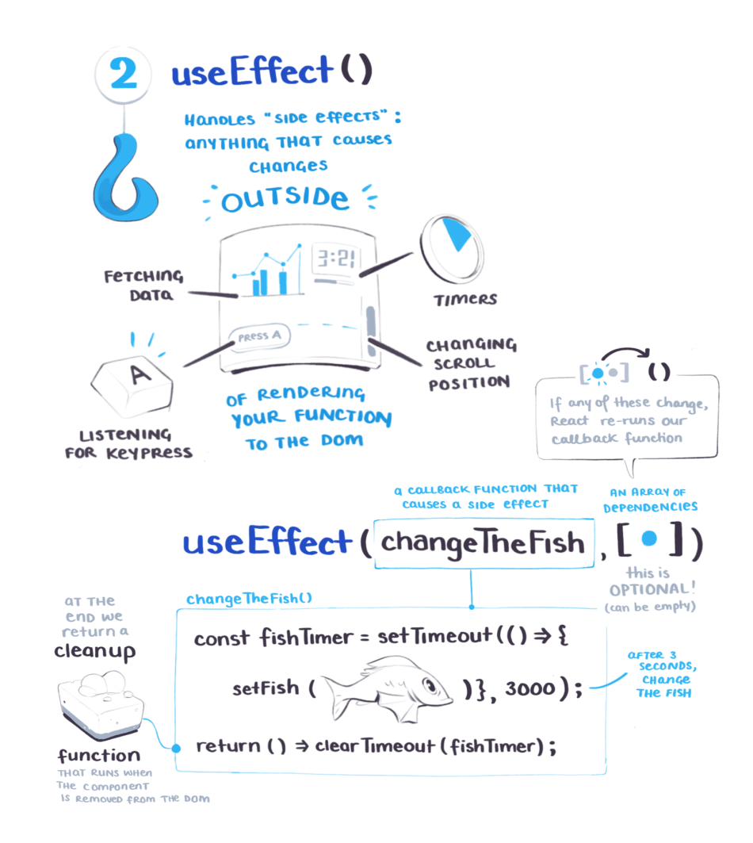
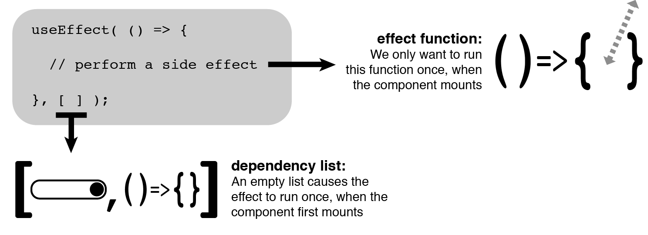
useEffect

Slide 8
Default state values
const HouseNpmLibListView = ({ words, hideSearchBar, defaultAlphabeticFilterText, defaultSearchText, defaultNpmList, onOpenNpmLibDetailsClicked, }) => { const [ npmSearchText, setNpmSearchText, ] = useState(null); const [ npmAlphabeticFilterText, setNpmAlphabeticFilterText, ] = useState(null); const [ npmCurrentNumber, setNpmCurrentNumber, ] = useState(0); useEffect(() => { setNpmSearchText(defaultSearchText); setNpmAlphabeticFilterText(defaultAlphabeticFilterText); }, [ defaultSearchText, defaultAlphabeticFilterText, ]); return ( <Suspense fallback={<HouseLazyLoadingView />} > <> <SGAlert type="info" message={words.HOUSE_LIB_ANALYSE_HELP_TITLE}
const HouseRechercheSimpleView = ({ defaultSearchText, defaultSelectedMenu, onBackClicked, onMenuChanged, onOpenAwtDetailsClicked, onOpenJavaLibDetailsClicked, onOpenNpmLibDetailsClicked, }) => { const [ searchCurrentMode, setSearchCurrentMode, ] = useState(null); useEffect(() => { const defaultActiveKey = ( defaultSelectedMenu || HOUSE_DASHBOARD_DATASOURCE[0].value ); setSearchCurrentMode(defaultActiveKey); }, [ defaultSelectedMenu, ]); return ( <Suspense fallback={<HouseLazyLoadingView />} > <SGTabs type="tile" activeKey={searchCurrentMode} onChange={(activeKey) => onMenuChanged(activeKey)} >

Slide 9
On mount change
useEffect(() => { const gaugeBoundingClientRect = gaugeref?.current?.getBoundingClientRect?.(); const current = tooltipRef?.current; const currentBoundingClientRect = current?.getBoundingClientRect?.(); const currentOffsetLeft = Math.ceil(gaugeBoundingClientRect?.left) - Math.ceil(currentBoundingClientRect?.left); const currentOffsetRight = Math.ceil(currentBoundingClientRect?.right) - Math.ceil(gaugeBoundingClientRect?.right); setToolipOffset({ left: currentOffsetLeft > 0 ? currentOffsetLeft : null, right: currentOffsetRight > 0 ? currentOffsetRight : null, }); }, []);

Slide 10
External change
const SGInputRangeHandle = ({ disabled = false, min = 0, max = 100, origin = null, prefixCls = null, tooltiprender = null, unitvalue = '€', value = null, }) => { const theme = useContext(ThemeContext); const [tooltipOverflow, setHandleOverflow] = useState({ left: true, right: false }); const inputRangeTooltipClasses = classNames( `${prefixCls}__tooltip`, { [`${prefixCls}__tooltip--overflow-left`]: tooltipOverflow.left, [`${prefixCls}__tooltip--overflow-right`]: tooltipOverflow.right, } ); const numberFormatter = (val) => `${val}`.match(/([0-9])+/)?.[0]?.replace(/\B(?=(\d{3})+(?!\d))/g, ' '); const handleRef = useRef();
useEffect(() => { const current = handleRef?.current; const tooltipOverflowWidth = Math.abs((current?.offsetWidth - current?.firstChild?.offsetWidth) / 2); setHandleOverflow({ left: tooltipOverflowWidth > current?.offsetLeft, right: tooltipOverflowWidth + current?.offsetLeft > current?.parentElement?.clientWidth, }); }, [value]);

Slide 11
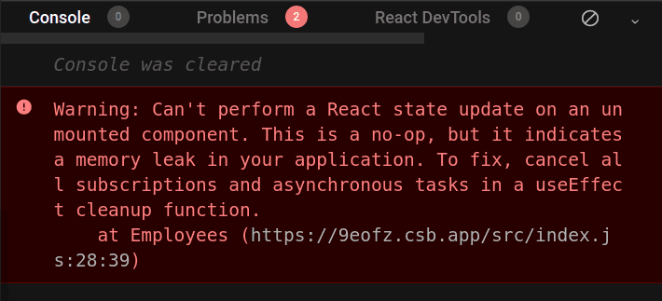
Clean timers & intervals
const MonComposant = () => { const [ count, setCount, ] = useState(0); useEffect(() => { const timer = setTimeout(() => { setCount('Timeout called!'); }, 1000); return () => clearTimeout(timer); }, []);
return ( <span> Current Count: {count} </span> ); }; export default MonComposant;
const MonComposant = () => { const [ countInterval, setCountInterval, ] = useState(0); useEffect(() => { const interval = setInterval(() => { setCountInterval(countInterval + 1); }, 1000); return () => clearInterval(interval); }, []); return ( <span> Current Count: {countInterval} </span> ); }; export default MonComposant;

Slide 12
Clean event listener
class MyComponent extends React.Component { constructor(){ super(props) this.handleClick = this.handleClick.bind(this) } handleClick = () => { //do something when we clicked } componentDidMount() { document.addEventListener("mousedown", this.handleClick); } componentWillUnMount() { document.removeEventListener("mousedown", this.handleClick); } render() { renturn ... } } export default MyComponent
import React, { useEffect, } from 'react'; const MonComposant = () => { const handleKeyDown = (event) => { console.log('A key was pressed', event.keyCode); }; useEffect(() => { window.addEventListener('keydown', handleKeyDown); // cleanup listener return () => { window.removeEventListener('keydown', handleKeyDown); }; }, []); return ( <span> Hello ! </span> ); }; export default MonComposant;
https://github.com/facebook/react/issues/12947

Slide 13
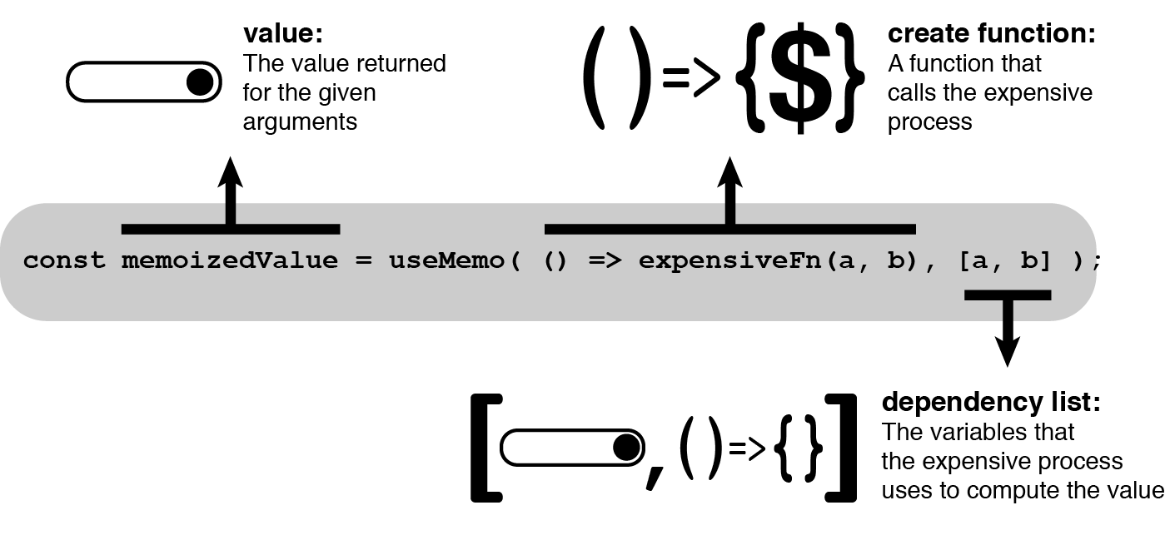
useMemo
https://react.dev/reference/react/useMemo

Slide 14
When to use ?
Referential Equality
Computationally expensive operations
Skipping re-rendering of components

Slide 15
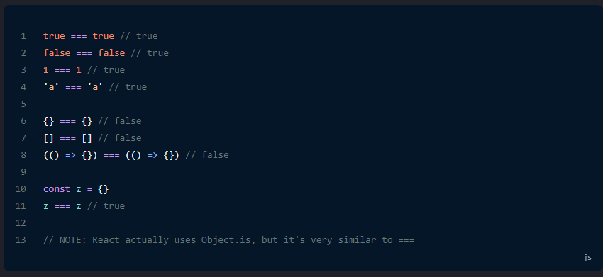
referential equality
In the lifecycle of a component, React re-renders the component when an update is made.
When React checks for any changes in a component, it may detect an unintended or unexpected change due to how JavaScript handles equality and shallow comparisons.
This change in the React application will cause it to re-render unnecessarily.

Slide 16
computationally expensive operations
Additionally, if a re-rendering is an expensive operation, like a long loop, it can hurt performance.
Expensive operations can be costly in either time, memory, or processing.
In addition to potential technical issues, this may lead to poor user experience.
const Blog = ({ signedIn }) => { const [updatedPosts, setUpdatedPosts] = useState(allPosts); const [localTime, setLocalTime] = useState(new Date().toLocaleTimeString()); const getLatestPosts = () => { const posts = fetchUpdatedPosts(); setUpdatedPosts(posts); }; const sortedPosts = sortPosts(updatedPosts); ....
const sortPosts = posts => { return posts.sort((a, b) => b.id - a.id); };

Slide 17
Usememo in action
-- const sortedPosts = sortPosts(updatedPosts);
++ const sortedPosts = useMemo(() => sortPosts(updatedPosts), [updatedPosts]);
useMemo() helps us memoize the value of sortPosts() when updatedPosts doesn't change.
const sortedPosts = useMemo(() => sortPosts(updatedPosts), []);
If we remove the dependency from useMemo(), sortPosts() will not be invoked when updatedPosts change.

Slide 18
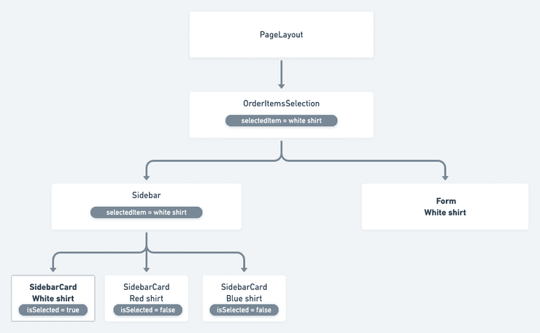
Skipping re-rendering of components
return useMemo(() => ( <Suspense fallback={<HouseLazyLoadingView />} > <> <SGBox span={10} textalign="center" margin={{ top: 'lg', }} > <div> <HouseFilterView testpath="../js/commons/components/HouseFilterView" filterItems={AWT_DETAILS_DEPS_FILTERS} checkedFilterItems={checkedFilters} onFilterItemSelected={(filter) => { let updatedFilters = []; if (checkedFilters.includes(filter.label)) { updatedFilters = []; } else { updatedFilters = [ filter.label, ]; } setCheckedFilters(updatedFilters); setFilteredDependencies(filterDependencies({ dependencies, searchPattern: filter.key, })); }} /> </div> </SGBox> <HouseAwtDependenciesList testpath="../js/components/awt/awt-dependencies/HouseAwtDependenciesList" type={type} dependencies={filteredDependencies} onDependencyClicked={(dependency) => { setShowDependencyHelp(true); setDependencyHelp(dependency); }} /> </> </Suspense> ), [ checkedFilters, filteredDependencies, showDependencyHelp, ]);
For the components at the bottom of the tree structure in particular.

Slide 19
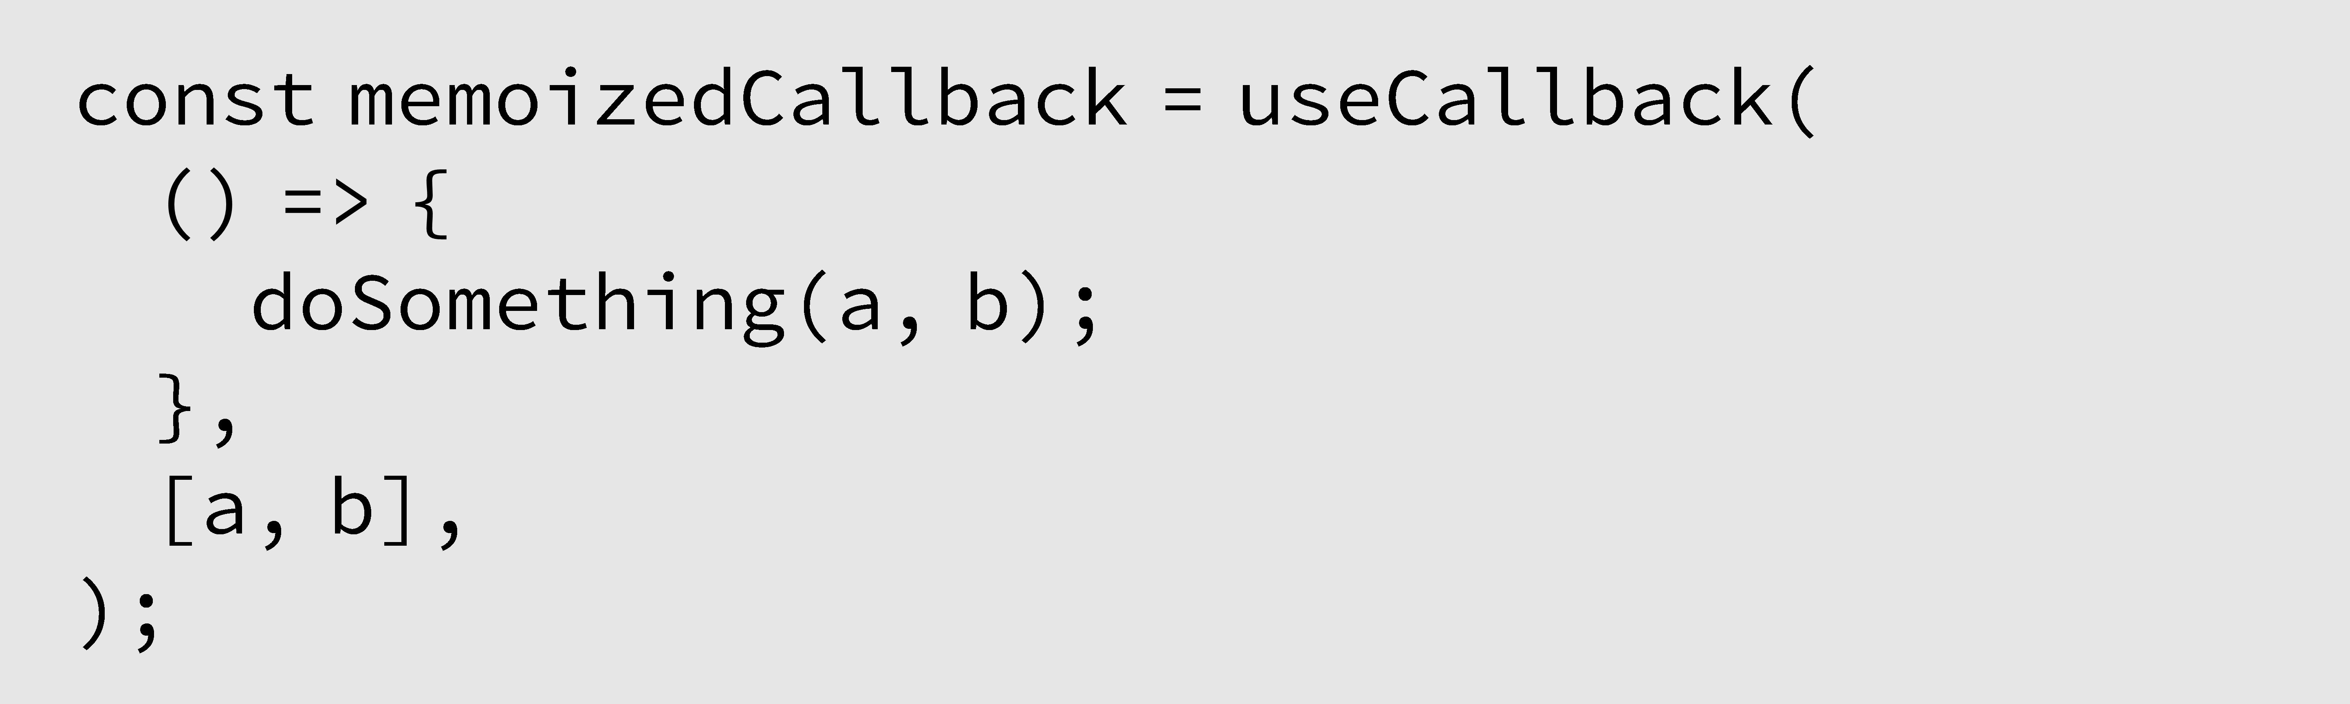
useCallback
https://react.dev/reference/react/useCallback

Slide 20
When to use ?
useMemo is good for memoizing: string, number, boolean, object, array.
useMemo isn’t good for memoizing callback.
useCallback is a React Hook that lets you cache a function definition between re-renders.
const onItemClick = useCallback(event => { console.log('You clicked ', event.currentTarget); }, [term]); return ( <MyBigList term={term} onItemClick={onItemClick} /> );

Slide 21
Usememo with usecallback
const App = () => { const [users, setUsers] = useState([ { id: "a", name: "Dan" }, { id: "b", name: "Steve" }, { id: "c", name: "Albert" } ]); const [text, setText] = useState(""); const handleText = (event) => { setText(event.target.value); }; const handleAddUser = () => { setUsers(users.concat({ id: uuidv4(), name: text })); }; /*useEffect(() => { // we must use setInterval inside useEffect // to clean up pinInterval after unmount // eslint-disable-next-line max-nested-callbacks const pinInterval = setInterval(() => { if (currentTimerPercent + step <= maxPercent) { setCurrentTimerPercent(currentTimerPercent + step); } else { clearInterval(pinInterval); } }, interval); return () => clearInterval(pinInterval); }, [currentTimerPercent]);*/ /*const handleRemove = (id) => { setUsers(users.filter((user) => user.id !== id)); };*/ // Lors d’un appel successif à useCallback, // et si la liste des dépendances n’a pas changé par rapport // au précédent appel, la fonction ne sera pas recalculée // et la même adresse sera ainsi retournée. const handleRemove = useCallback( (id) => setUsers(users.filter((user) => user.id !== id)), [users] ); return ( <div> <input type="text" value={text} onChange={handleText} /> <button type="button" onClick={handleAddUser}> Add User </button> <List list={users} onRemove={handleRemove} /> </div> ); };
// function are reference type f1 never equal to f1 const List = ({ list, onRemove }) => { return useMemo( () => ( <> {console.log("Render: List")} {list.map((item) => ( <ListItem key={item.id} item={item} onRemove={onRemove} /> ))} </> ), [list] ); }; const ListItem = ({ item, onRemove }) => { console.log("Render: ListItem : ", item); return ( <li> {item.name} <button type="button" onClick={() => onRemove(item.id)}> Remove </button> </li> ); };

Slide 22

Higher-Order Components

Slide 23
HOC – Declaration
component
to decorate
component’s props
HOC name
HOC params
const LocalizedFragment = (dicoFragment) => (WrappedComponent) => (props) => { const { words, } = props || {}; const allWords = { ...words, ...dicoFragment, }; return ( <WrappedComponent {...props} words={allWords} /> ); };

Slide 24
HOC – Usage
@<HocName>(params)
@LocalizedFragment(ExempleDico) class ExempleVersionDataPage extends Component { // default props static defaultProps = { ...ExempleVersionDataDefaultProps, requestVersionData: null, };
const ExempleVersionDataView = LocalizedFragment(ExempleDico)(({ versionData, versionDataError, versionDataLoading, words, }) => {
HocName(params)(({words, … } => (<MyAwesomeComponent
title={words?.COMPONENT_TITLE_LABEL}
/>) ))

Slide 25
HOC – Use case (simple)
const MarcheLocalizedFragment = (dicoFragment) => (WrappedComponent) => (props) => { const configuration = useSelector((state) => state?.awtContext?.awtContext); const marche = configuration?.context?.marche?.toUpperCase(); const defaultDico = dicoFragment?.PRI; const marcheDico = dicoFragment?.[marche] ? dicoFragment?.[marche] : defaultDico; return ( <WrappedComponent {...props} words={marcheDico} /> ); };
const ParcourswtrPriDico = { ...ParcourswtrMultiMarcheDico, WELCOME_PAGE_TITLE: 'Activation de ma Banque à Distance', }; const ParcourswtrProDico = { ...ParcourswtrMultiMarcheDico, WELCOME_PAGE_TITLE: 'Activation de votre Banque à Distance', }; const ParcourswtrEntDico = { ...ParcourswtrMultiMarcheDico, WELCOME_PAGE_TITLE: 'Connexion à votre nouvel Espace Client', }; const ParcourswtrDico = { ENT: ParcourswtrEntDico, PRI: ParcourswtrPriDico, PRO: ParcourswtrProDico, }; export default ParcourswtrDico;
@MarcheLocalizedFragment(ParcourswtrDico) class ParcourswtrConfirmationPage extends Component {
const ParcourswtrConfirmationView = MarcheLocalizedFragment(ParcourswtrDico)(({ words, configuration,

Slide 26
HOC – Use case (advanced)
render() { const { isUserEligible, isUserEligibleGMS, isUserTitulaire, isCarteActivee, isCarteBloquee, isCarteOpposee, userEligibiliteError, userEligibiliteLoading, } = this.props; return ( <> {(userEligibiliteLoading && ( <LoadingView /> )) || (userEligibiliteError && ( <DematCodePinErrorView error={userEligibiliteError} onErrorCallback={this.onErrorCallback} /> )) || (!isUserEligible && ( <DematCodePinEligibilityErrorView isUserEligibleGMS={isUserEligibleGMS} isUserTitulaire={isUserTitulaire} isCarteActivee={isCarteActivee} isCarteBloquee={isCarteBloquee} isCarteOpposee={isCarteOpposee} onSendMessageCallback={this.onSendMessageCallback} onBackCallback={this.onBackCallback} configuration={this.props} /> )) || ( <WrappedComponent {...this.props} /> )} </> ); }
const withUserEligibility = () => (WrappedComponent) => { @Reduxify(state => ({ // define state to extract ...AwtContextFragment(state), ...DematCodePinUserEligibiliteFragment(state), }), { // define actions to execute ...DematCodePinDispatcher, }) class UserEligibilityComponent extends Component { // Default props static defaultProps = { ...DematCodePinDefaultProps, }; // Props types validation static propTypes = { ...DematCodePinPropTypes, }; // did mount staff componentDidMount() { this.initPage(); }
@withUserEligibility() class DematCodePinRappelSecuPage extends Component {

Slide 27
HOC – Composition (inside page)
@withPageLayout({ page: 'confirmation', title: 'Activation de votre Banque à Distance', showFaq: true, }) @Reduxify((state) => ({ // define state to extract ...AwtContextFragment(state), ...DownloadCPCGFragment(state), ...DownloadConventionDePreuveFragment(state), ...IsPhoneSecuConfiguredFragment(state), ...NotificationSASFragment(state), }), { // define actions to execute ...ParcourswtrDispatcher, }) @MarcheLocalizedFragment(ParcourswtrDico)
class ParcourswtrConfirmationPage extends Component {
f( g ( h (x) ) )

Slide 28
HOC – Composition (inside HOC)
const withAppAccess = ({ page, }) => (WrappedComponent) => { @Reduxify((state) => ({ // define state to extract ...AwtContextFragment(state), ...CheckAppAccessFragment(state), }), { // define actions to execute ...CheckAppAccessDispatcher, }) @MarcheLocalizedFragment(CommonsDico)
class PageAccess extends Component {
f ( g (x) )

Slide 29
HOC - Summary
Add Functionality to Existing Components (decorate)
Reuse Logic
Compose
with
@withPageLayout({ page: 'welcome', title: '', showSteps: false, }) class ParcourswtrWelcomePage extends Component {

Slide 30

BDDF SOCLE 2023

