Slide 1
0: Something in the way she moves
1: Something in her smile she knows
2: Something in the things she shows me
Something, in, the, way, she, moves, her, smile,
knows, things, shows, me
 | Something | In | The | Way | She | Moves | Her | Smile | Knows | Things | Shows | Me
0 | 1 | 1 | 1 | 1 | 1 | 1 | 0 | 0 | 0 | 0 | 0 | 0
1 | 1 | 1 | 0 | 0 | 1 | 0 | 1 | 1 | 1 | 0 | 0 | 0
2 | 1 | 1 | 1 | 0 | 1 | 0 | 0 | 0 | 0 | 1 | 1 | 1

Slide 2
apple
app
apl
ple

Slide 3


ball
ball
match
computer
ball
ball
pizza
pasta
pasta
pizza
pizza
computer
pasta
ball
phone
phone
pizza
computer
phone
computer
80% Sports
10% Technology
80% Food
10% Sports
40% Food
20% Sports
40% Technology
20% Food
80% Technology

Slide 4





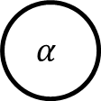


$$α$$
$$θ$$
$$z_{j, i}$$
$$w_{j, i}$$
φ
$$\text{β}$$
$$d_{j}$$
$$K$$
$$m$$

Slide 5




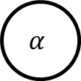


$$\text{β}$$
φ
$$K$$
$$α$$
$$θ$$
$$z_{j, i}$$
$$w_{j, i}$$
$$d_{j}$$
$$m$$

Slide 6
Training Set
Train
Test

Slide 7

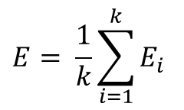




Training Set
Training Folds
Test Fold
1
$$E_{1}$$
2
$$E_{2}$$
$$E= \frac{1}{k}\sum_{i=1}^{k}{E_{i}}$$
3
$$E_{3}$$
$$k$$
$$E_{k}$$

