Slide 1


WhatsApp
Middleware
Platform
Capstone Project – Phase A
Helal Hammoud & Asrar Mghes
An Event-Driven, Scalable Middleware for
Real-Time Business Automation
Advisor: Dr. Ze'ev Frenkel
July 2026
1

Slide 2
Agenda
01
Background & Motivation
08
Use Case
02
Problem Definition
09
Algorithm
03
Existing Approaches & Gap
10
Activity Diagrams
04
Proposed Solution
11
User-System Dialogue
05
Goals & Expected Achievements
12
Tools & Technologies
06
System Architecture
13
Success Criteria
07
Main System Requirements
2

Slide 3





Background & Motivation
Current Situation
2B+
200M+
#1
WhatsApp monthly
active users
WhatsApp Business
monthly active users
Preferred business
communication channel
Small Business
Large Business
Customer requests are handled manually.
Employees process requests one by one.
Slow and difficult to scale.
Backend systems already exist.
WhatsApp requires custom integrations.
Expensive and difficult to reuse.
3
So, what exactly is the problem? → Let's look at it in the next slide.

Slide 4




Problem Definition
The lack of a reusable middleware layer that bridges WhatsApp customer communication and backend
Manual Handling
No Integration
Tight Coupling
No Scalability
Employees manually read and reply to each customer message.
No direct integration between WhatsApp and backend business systems.
Each business requires a custom integration, making reuse difficult.
Manual and custom solutions cannot scale with growing request volumes.
4

Slide 5

Existing Approaches & Gap Analysis
Approach
Advantage
Limitation
Selected?
Chatbot-based
Automates simple replies
Limited backend integration
✗
Direct Integration
Direct API access
Not reusable
✗
Middleware
Reusable, decoupled, scalable
Requires more design effort
✓
Key Gap Identified
Existing solutions are typically either chatbot-based or rely on custom point-to-point integrations.
Current solutions do not provide a reusable middleware platform for integrating WhatsApp with backend business systems across different businesses.
5

Slide 6



Proposed Solution
Reusable Middleware Platform
Middleware
Customer
Backend
Sends a request
via WhatsApp
Business systems
& operations
Reusable • Flexible • Scalable — one middleware platform for many businesses
6

Slide 7








Goals & Expected Achievements
Project Goals
Expected Achievements
Connect WhatsApp with backend business systems
Automated customer interactions through WhatsApp
Support predefined interaction templates
Reduced manual handling of customer requests
Enable workflow-driven customer interactions
Improved customer interaction management
Provide reusable middleware for multiple businesses
Flexible and scalable middleware platform
Each goal directly leads to a measurable achievement → Together they deliver a complete middleware solution
7

Slide 8
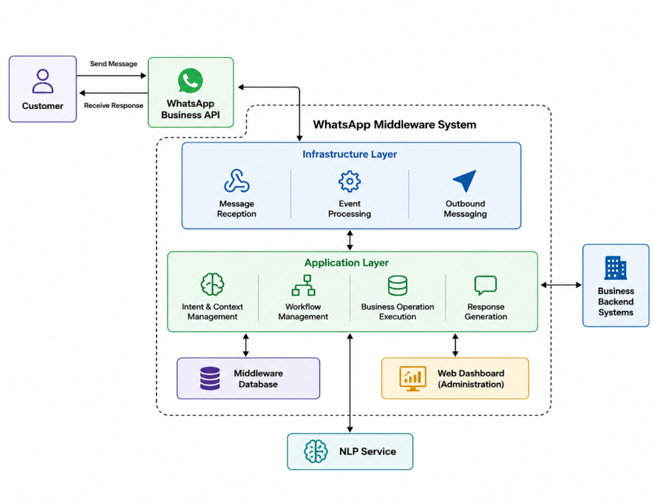
System Architecture
8

Slide 9






Main System Requirements
Functional Requirements
Non-Functional Requirements
WhatsApp API Integration
Scalability
Integration with WhatsApp Business API for receiving messages and events
Concurrent processing of multiple customer interactions without degradation in response time
Conversation State Management
Manage customer conversation state across multiple interactions
Reliability
Reliable processing and delivery of customer interactions
Workflow Management
Support workflow-based customer interaction management
Maintainability
Business Operation Execution
Separation between communication handling and business logic components
Execute business operations through external backend services
Workflow & Backend Config
Extensibility
Configure communication workflows and backend API integrations
Add new workflows and backend integrations without major modifications to the architecture
9

Slide 10
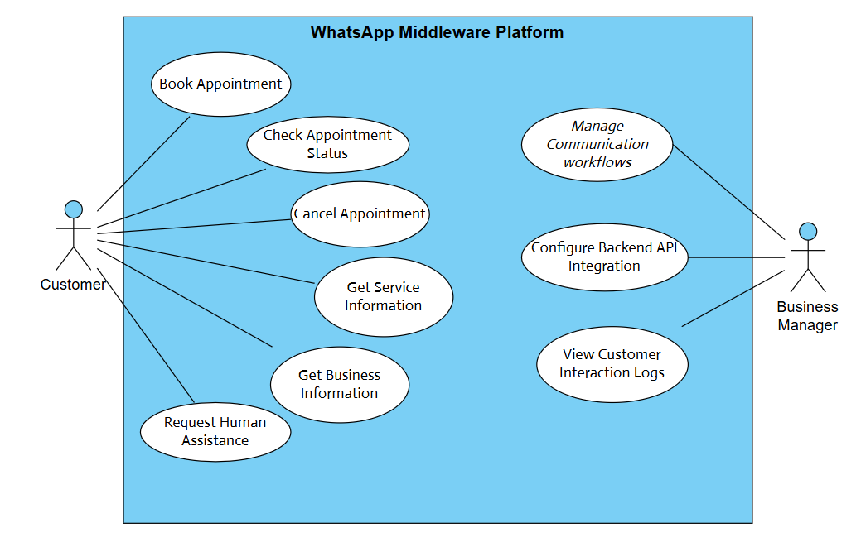
Use Case Diagram
Actors
Customer
Books appointments, checks status, requests support
Business Manager
Configures workflows, backend APIs, views logs
Key Use Cases
Book / Cancel / Check Appointment
Service Inquiry
Request Human Assistance
Configure Backend API Integration
View Customer Interaction Logs
10

Slide 11
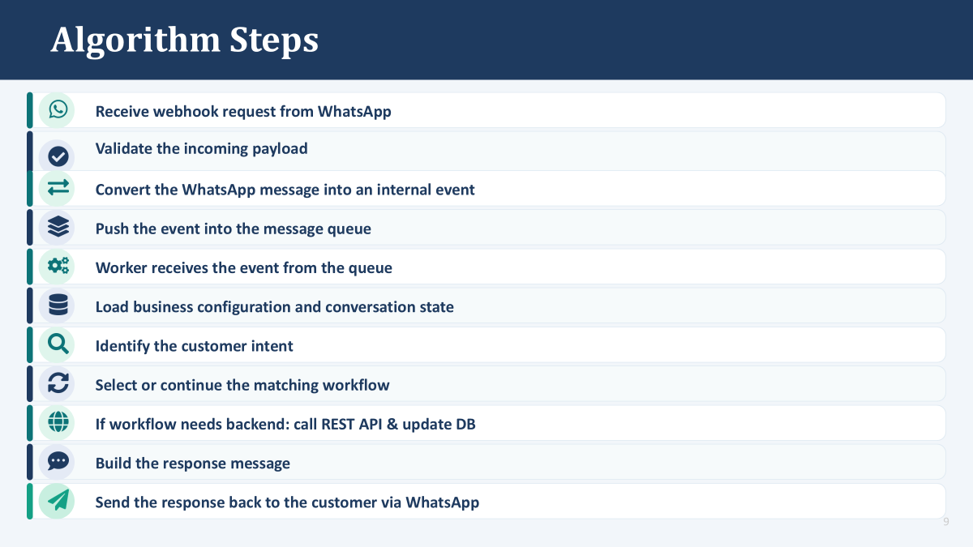
11

Slide 12
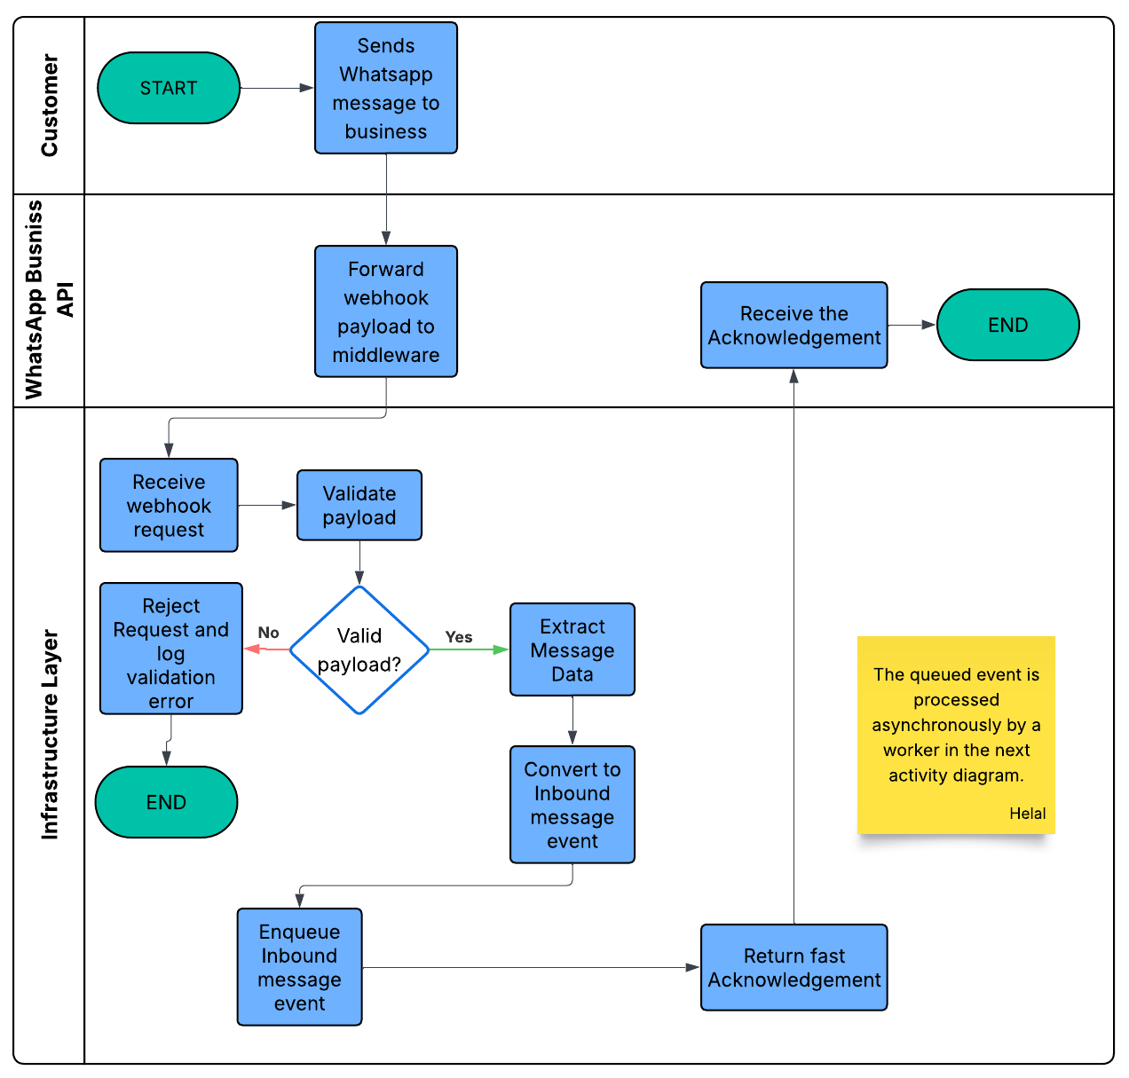
Activity Diagram: Incoming Message Handling
12

Slide 13
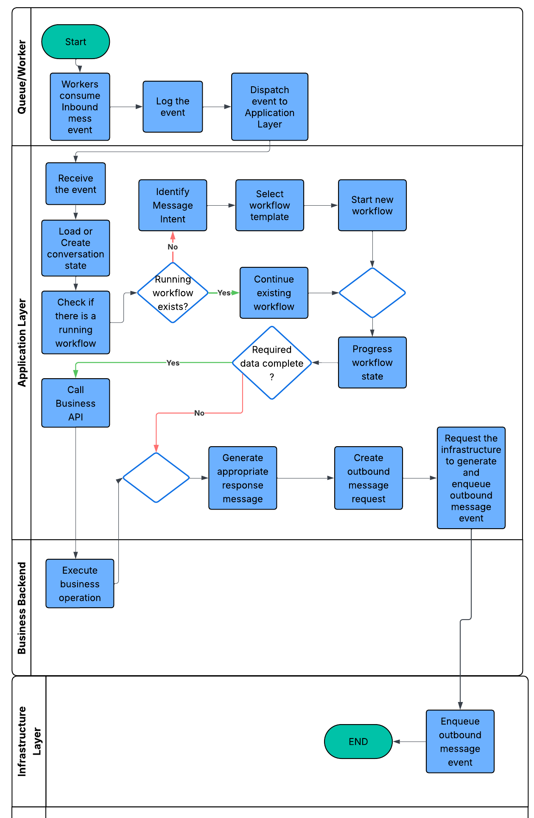
13

Slide 14




Example: User–System Dialogue & Database Updates
Database Updates
Customer
Initiate a workflow
Hi, I'd like to book an appointment.
System
Sure! What service do you need?
Save
Messages
Customer
Consultation.
System
When would you like it?
Update
State
Customer
Tomorrow at 10:00 AM.
System
✅ Your appointment has been booked.
Save
Appointment
Mark
Completed
14

Slide 15
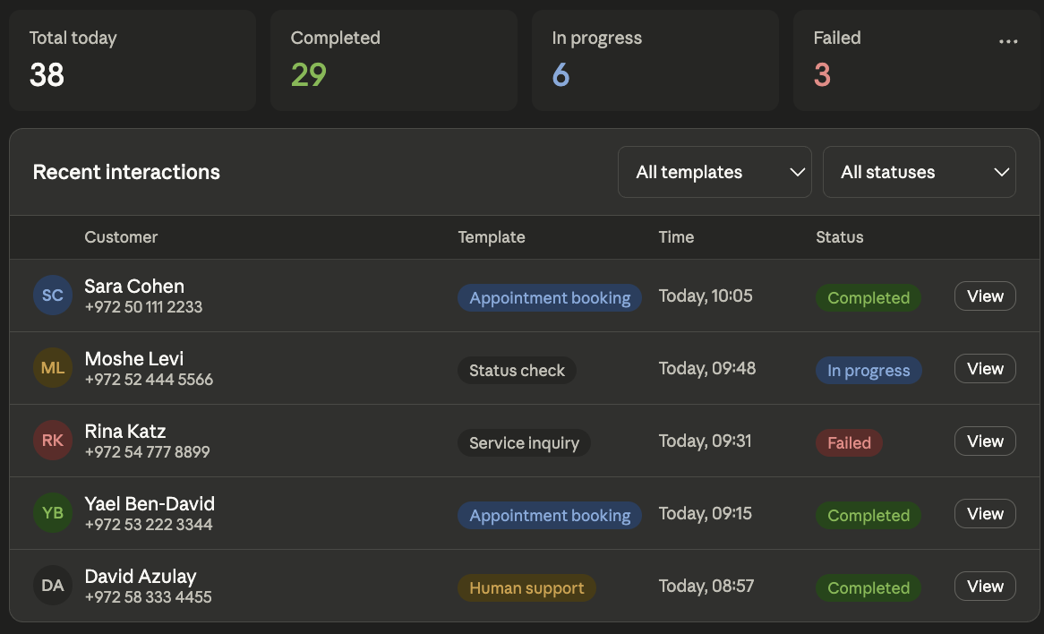
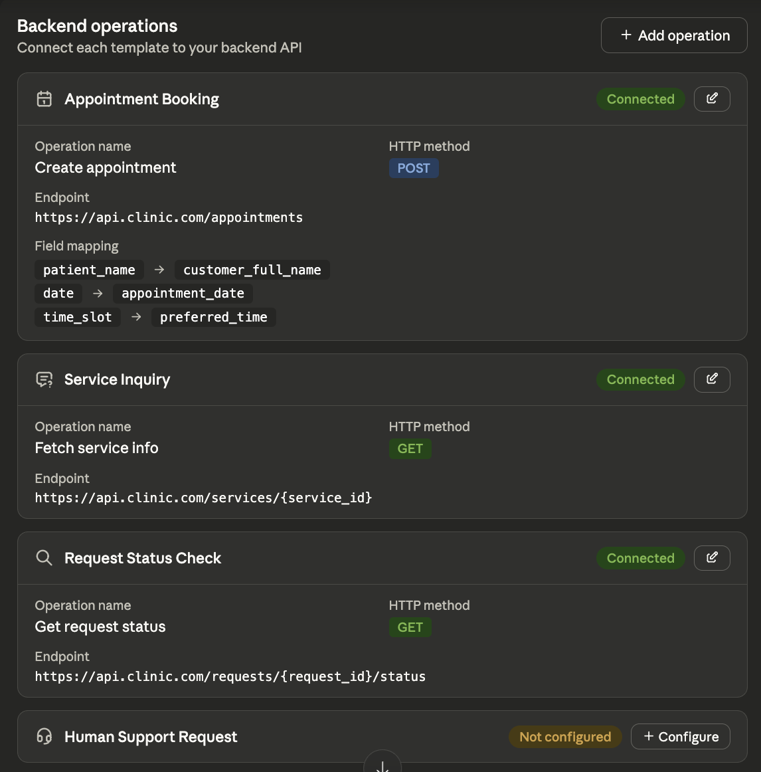
Product Interface
Business Monitoring Dashboard
Backend Operations Configuration
15

Slide 16








Tools & Technologies
Go
Python
WhatsApp Business API
REST APIs
MySQL
MongoDB
Redis
Github & VS Code
16

Slide 17



Success criteria
1. Functional Completeness
2. Backend Operation Execution
All four interaction templates are implemented:
Appointment Booking, Service Inquiry, Status Check, Human Support
• The system correctly maps collected fields to the business backend API requests
• Backend operations are executed using the configured endpoint, method, and request mapping
• Each template can complete an end-to-end customer flow
3. Reliability
4. Performance & Scalability
• Duplicate WhatsApp messages are not processed more than once
• Webhook requests are acknowledged quickly
• Failed backend calls are retried using retry logic
• Messages are processed asynchronously by workers
• Failed events can be moved to a dead-letter queue for later inspection
• The system can handle around 100 concurrent simulated customer messages
17

Slide 18
Thank You!
Any Questions?
Helal Hammoud & Asrar Mghes
Advisor: Dr. Ze'ev Frenkel | Braude College of Engineering | 5 July 2026
20

