Slide 1
WEEK 4
Robotic Arm
Pick & Place System
Weekly Progress Report · Mechatronics System Design 101
March 25 – March 31, 2025
Leen's Group · Leen · Mohamed · Helal

Slide 2
Week 4 — Snapshot
What we worked on this week
Status
CAD model update
Schedule
On track
01
Continued refining the arm model in Autodesk Inventor. Wrist joint and end effector mount still in progress — geometry for base, shoulder, and elbow is locked.
Scope
Defined
OpenCV — computer vision
02
CAD
In progress
Started setting up the OpenCV pipeline on the PC. Color/shape-based object detection approach being prototyped — no AI training required.
Hardware
Procured
Electrical components & code
03
Procured electrical components including Arduino R3, motor driver, and servo set. Began bench testing of Arduino code — basic servo PWM control verified and responding correctly.
Code
Testing
⚠ CAD wrist joint and end effector mount still require work — targeted for completion by Week 6.
Mechatronics System Design 101 · Leen's Group · Week 4

Slide 3
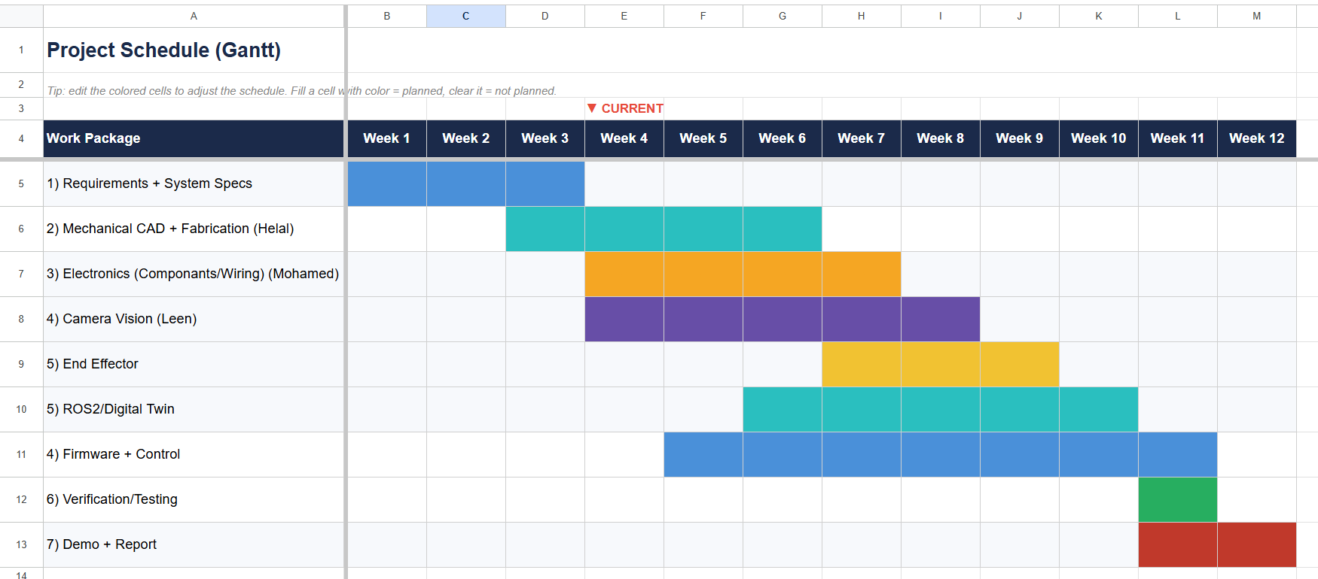
Project Schedule — Gantt Chart
[ Paste Gantt Chart Image Here ]
Mechatronics System Design 101 · Leen's Group · Week 4

Slide 4
Milestones & Deliverables
Deliverable
Target
Status
Progress this week
CAD model complete
Week 6
Base/shoulder/elbow done. Wrist & EE mount in progress.
In progress
Camera vision (OpenCV)
Week 8
Color/shape detection pipeline being prototyped on PC.
Started
End effector
Week 9
Custom design pending CAD completion. Pump/Comp TBD.
Planned
ROS2 & digital twin
Week 10
ROS2 environment set up. Gazebo simulation begun.
Started
Full assembly
Week 10
3D printing of parts started for early fit testing.
Planned
Control system integration
Week 11
PC + Arduino R4 serial comms. Arduino code prototyped.
Planned
✓ This week: electrical components procured, 3D printing of arm parts started, Arduino code testing begun.
Mechatronics System Design 101 · Leen's Group · Week 4

Slide 5
Issues, Risks & Actions
Current issues & risks
Actions & mitigations
Suction pump undecided
Medium
Pump selection
Pending
Still evaluating mini compressor vs micro diaphragm pump vs venturi. Affects end effector timeline.
Test available options in lab Week 5 — select based on suction force and size fit.
CAD wrist & end effector
Medium
CAD completion
In progress
Wrist joint and end effector mount geometry not yet finalised — blocking 3D print of those parts.
Wrist and EE mount to be finalised by Week 6. Scale and wiring routing to follow.
Team coordination
High
Team sync
In progress
Difficulty scheduling meetings and exchanging work between members due to conflicting availability.
Set a fixed weekly check-in slot. Use shared drive for exchanging files between members.
ROS2 learning curve
High
ROS2 ramp-up
In progress
ROS2 and Gazebo are new to the team — early stage setup taking longer than anticipated.
Team to follow ROS2 + Gazebo tutorials in parallel. Simple URDF model targeted for Week 6.
Mechatronics System Design 101 · Leen's Group · Week 4

Slide 6
Individual
Updates
What each member did, what they will do, what they need.
Leen
Mohamed
Helal
Group Leader
Member
Member

Slide 7
Leen — Group Leader · Vision & Detection
Accomplished (since last report)
OpenCV vs YOLOv4 — decision rationale
Secured and confirmed the camera to be used for the project
OpenCV ✓
Researched OpenCV vs YOLOv4 for object detection
No training required
Works with controlled lighting
Decided on OpenCV color/shape detection — no training needed, better fit for controlled lab environment
Simpler to implement & debug
In progress
YOLOv4 ✗
Setting up OpenCV detection pipeline on PC with connected camera
Requires training data & GPU
Overkill for a fixed lab setup
Next week plan
Help needed / questions
Begin implementing OpenCV detection script on PC
No blockers this week. Camera secured and detection approach confirmed — ready to begin coding pipeline.
Test camera feed and object detection on sample items
Integrate detection output with serial command pipeline
Mechatronics System Design 101 · Leen's Group · Week 4

Slide 8
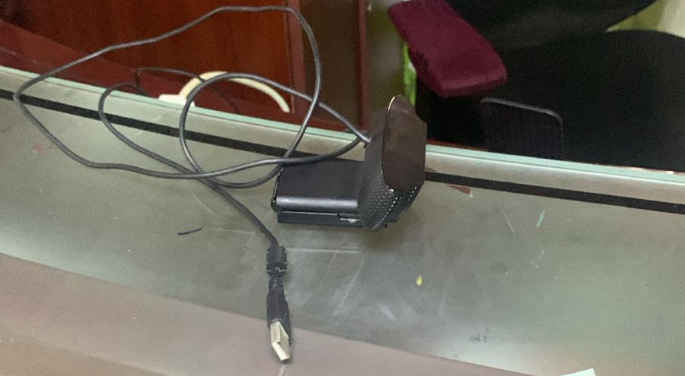
Leen — Group Leader · Vision & Detection
Mechatronics System Design 101 · Leen's Group · Week 4

Slide 9


Mohamed — Member
Components Purchased
Arduino Code
4× MG996R Servo Motors
2-DOF serial servo controller
Base & Shoulder joints (pins 9 & 10)
L293D Motor Shield (H-Bridge)
Serial command parsing
400mm Male-Male Jumper Wires
Input validation & status query
Week 4 • Mohamed • Robotic Arm Project

Slide 10
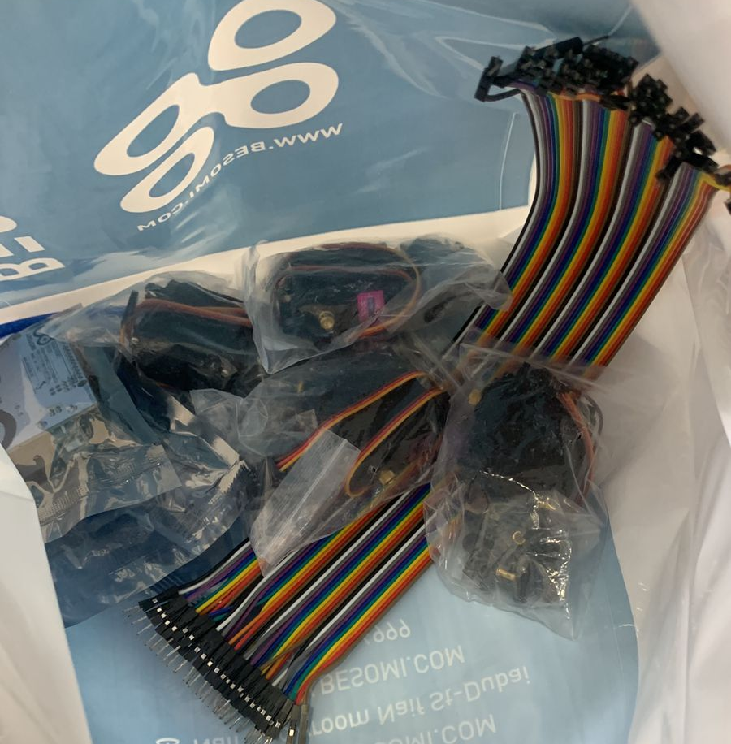
Mohamed — Member
Week 4 • Mohamed • Robotic Arm Project

Slide 11

Mohamed — Member
Components Purchased
MG996R Servo Motors ×4
L293D Motor Shield
400mm Jumper Wires (M-M)
Actuates the shoulder, elbow, wrist, and gripper joints
Interfaces servos and DC motor with the Arduino R4
Internal wiring between components on the arm
Torque: 9.4 kg·cm (4.8V) / 11 kg·cm (6V)
Dual H-Bridge driver (L293D chip)
Length: 400 mm
Speed: 0.17 s/60° at 4.8V
Servo headers on pins 9 & 10
Type: Male-to-Male
Angle range: 0°–180°
Supports up to 4 DC motors
Flexible routing for arm assembly
Protocol: PWM signal
Direct stacking on Arduino
Week 4 • Mohamed • Robotic Arm Project

Slide 12
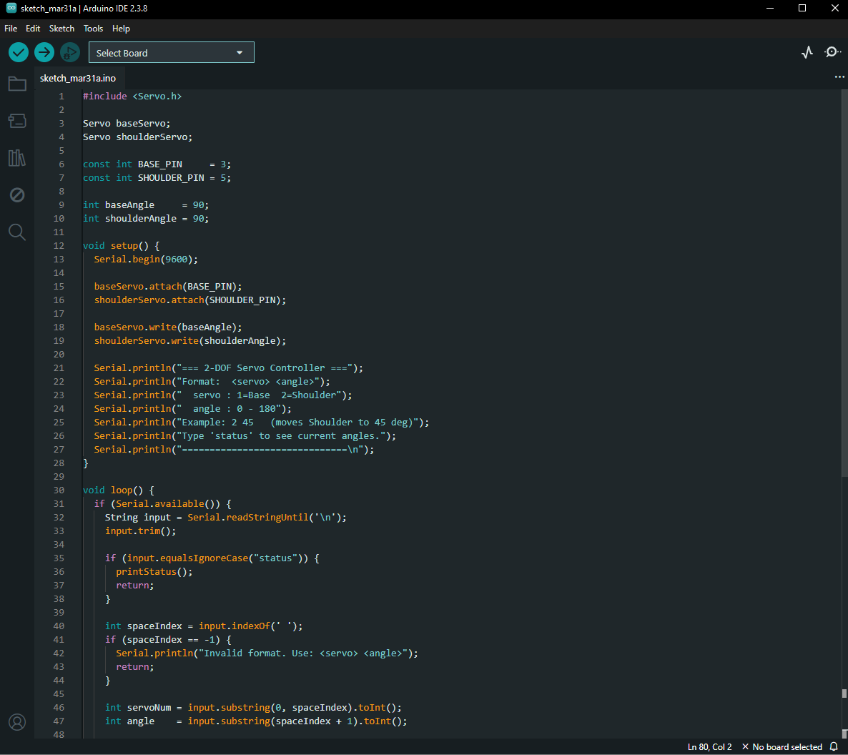
Mohamed — Member
Arduino Code — 2-DOF Servo Controller
Arduino Sketch
Serial Command Parsing
#include <Servo.h>
Servo baseServo, shoulderServo;
void setup() {
Serial.begin(9600);
baseServo.attach(9);
shoulderServo.attach(10);
}
void loop() {
// Parse serial command
// Format: <servo> <angle>
// e.g. 2 45
Accepts '<servo> <angle>' via USB serial from PC
Input Validation
Rejects invalid servo IDs and out-of-range angles (0–180°)
Status Query
Type 'status' to print current angles of both joints
L293D Shield
Servo headers on pins 9 (Base) & 10 (Shoulder)
Week 4 • Mohamed • Robotic Arm Project

Slide 13

Mohamed — Member
Next Steps
Expand Arduino code to control all 4 MG996R servo joints
Integrate base DC gearmotor (JGA25-370) with PID control loop
Develop Python serial interface on PC to send commands
Test serial communication between PC (Python) and Arduino R4
Begin physical assembly of servo joints on the arm structure
Mechatronics System Design • Week 4 • Mohamed

Slide 14
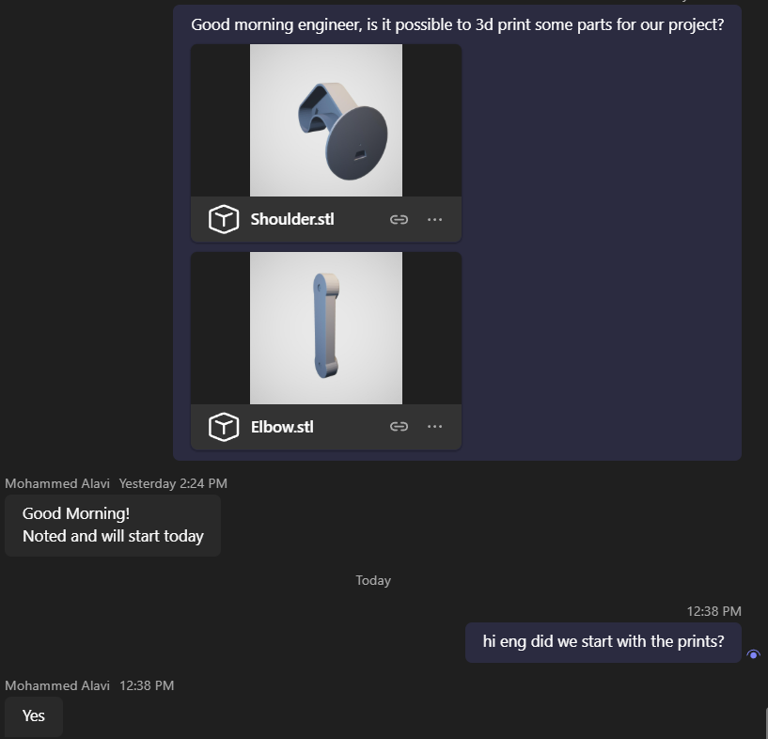
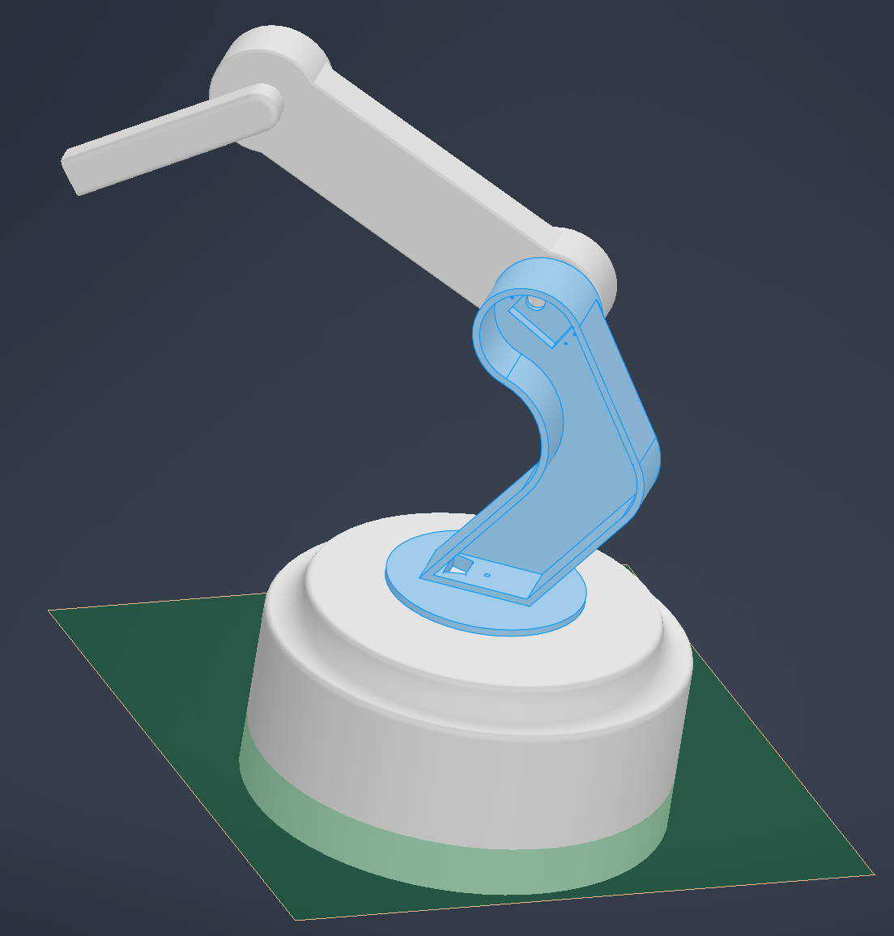

Helal — Member · CAD & 3D Printing
Accomplished (since last report)
Evidence (show, don't tell)
Scaled up part dimensions for better structural fit
Added motor mounting screw holes and alignment fittings
Designed internal wiring paths and cable channels
Began 3D printing of completed parts for fit testing
In progress
3D printing of arm link parts — ongoing as parts clear review
Help needed / questions
Next week plan
Finalising suction cup mount dimensions depends on pump selection — need pump decision to complete end effector CAD.
Complete wrist joint CAD model
Begin end effector CAD design
Mechatronics System Design 101 · Leen's Group · Week 4

Slide 15
Week 4
Wrap-up
✓
Camera secured — vision hardware confirmed
Looking ahead
Week 5
OpenCV pipeline + serial integration
✓
Detection approach decided: OpenCV, no AI training
Week 5
Pump testing & selection
✓
Electrical components procured, Arduino code tested
Week 6
CAD fully complete
✓
CAD updated — parts scaled, motor mounts & wiring channels added
Week 8
Camera vision system complete
⏳
CAD wrist joint & end effector still in progress (target Week 6)
Week 9
End effector complete
⏳
Suction pump selection still pending
Week 10
Assembly + digital twin (Gazebo)
Mechatronics System Design 101 · Leen's Group · Week 4

