Slide 1
WEEK 6
Robotic Arm
Pick & Place System
Weekly Progress Report · Mechatronics System Design 101
Leen's Group · Leen · Mohamed · Helal

Slide 2
Week 6 — Snapshot
What we worked on this week
Status
OpenCV — object detection
Schedule
Behind
01
Major progress: system can now detect and classify objects. Coordinate mapping to arm workspace not yet complete — commands cannot be sent until this is done.
OpenCV
Near done
Control system
Control
02
Major prog.
Major progress: Arduino now controllable via gamepad (manual) and Python input commands (auto). Once CV coordinate mapping is done, the pipeline will be fully connected.
IMU / EE
Working ✓
IMU — end effector levelling
03
ROS2
IMU sensor integrated and working. The wrist joint now actively corrects to keep the end effector pointing downward at all times during arm movement.
Just started
3D prints
Delayed
⚠ 3D prints delayed again — reprinting required. CV coordinate mapping remaining before full auto pipeline is active.
Mechatronics System Design 101 · Leen's Group · Week 6

Slide 3

Project Schedule — Gantt Chart
[ Paste Gantt Chart Image Here ]
Mechatronics System Design 101 · Leen's Group · Week 6

Slide 4
Milestones & Deliverables
Deliverable
Target
Status
This week
CAD model complete
Week 7
Behind
3D prints reprinting — parts delayed 2+ weeks
Camera vision (OpenCV)
Week 8
Near done
Detection & classification working. Coord. mapping remaining.
Control system
Week 8
Major prog.
Gamepad + Python commands both working on Arduino
IMU / end effector level
Week 8
Done ✓
Wrist joint auto-levels to keep cup pointing down
End effector design
Week 8
In progress
Pending CAD completion and pump selection
ROS2 / Digital twin
Week 10
Started
Ubuntu VM installed — beginning setup this week
Full assembly
Week 10
Blocked
Cannot assemble without 3D printed parts
Control system complete
Week 11
On track
Pipeline nearly ready pending CV mapping
Mechatronics System Design 101 · Leen's Group · Week 6

Slide 5
Issues, Risks & Action Items
Current issues & risks
Action items
3D prints delayed — again
High
Complete CV coordinate mapping
Week 7
Parts sent 2 weeks ago were printed incorrectly. Reprinting now in progress — blocking full physical assembly.
Leen
Follow up on 3D print status
Week 7
OpenCV coordinate mapping
Medium
Helal
Object detection works but workspace coordinate mapping is incomplete — auto pipeline cannot send commands yet.
Resume & finalise CAD model
Week 7
Helal
CAD still incomplete
Medium
Continue ROS2 environment setup
Week 7
Wrist joint and end effector mount not yet finalised — dependent on receiving 3D printed parts to verify fit.
All
Finalise end effector calculations
Week 7
Mohamed
ROS2 — early stage
Medium
Ubuntu VM installed this week — ROS2 setup just beginning. Must accelerate to meet Week 10 target.
Finalise suction pump selection
Week 7
Mohamed
Mechatronics System Design 101 · Leen's Group · Week 6

Slide 6
Individual
Updates
What each member did, what they will do, what they need.
Leen
Mohamed
Helal
Group Leader
Member
Member

Slide 7
Leen — Group Leader · Computer Vision
Object detection pipeline — Week 6
01
Roboflow
247 images of 5 objects collected with Logitech camera. Manually annotated with bounding boxes on Roboflow. Dataset split into train / val / test sets and augmented.
Dataset labelling & export
02
Google Colab
Downloaded dataset from Roboflow into Colab. Trained YOLOv11 for 50 epochs on free T4 GPU. Downloaded best.pt weights to local machine.
YOLOv11 model training
03
VS Code — live testing
Loaded best.pt in VS Code. Ran detection script against live Logitech camera feed. Confirmed Ball, Bolt, Compass, Egg, Screw detected with high confidence.
detect.py on camera feed
Mechatronics System Design 101 · Leen's Group · Week 6

Slide 8
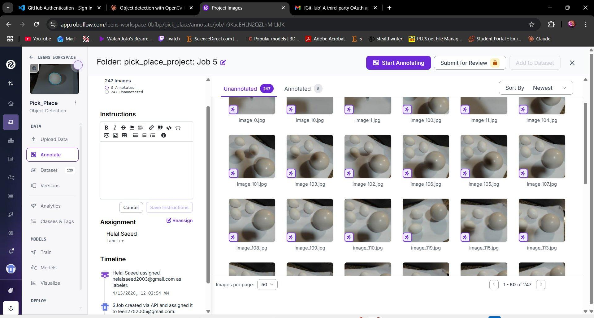
Step 1 — Roboflow: Dataset Labelling
Evidence ✓
What we did in Roboflow
247 images collected of 5 target objects
Objects: Ball, Bolt, Compass, Egg, Screw
Bounding boxes drawn manually per image
Class names assigned to each annotation
Dataset split: train / validation / test
Preprocessing: Auto-Orient, Resize, Auto-Contrast
Augmentation: Flip, Rotation, Brightness
Mechatronics System Design 101 · Leen's Group · Week 6

Slide 9
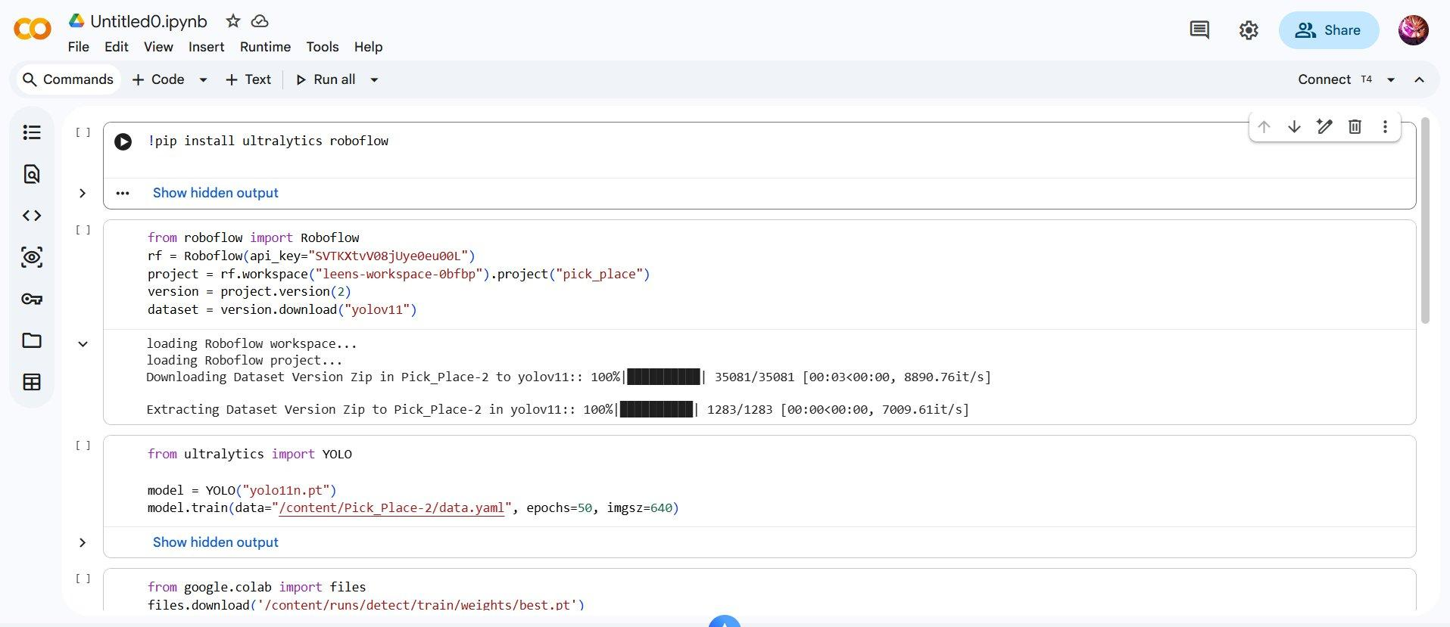
Step 2 — Google Colab: YOLOv11 Training
Evidence ✓
What we did in Colab
Why Colab?
Roboflow free plan doesn't allow model weight download
GPU
Free T4 cloud GPU — much faster than local CPU
Model
YOLOv11 (ultralytics)
Epochs
50
Image size
640 × 640
Dataset
Downloaded directly from Roboflow API
Output
best.pt weights downloaded to local machine
Mechatronics System Design 101 · Leen's Group · Week 6

Slide 10
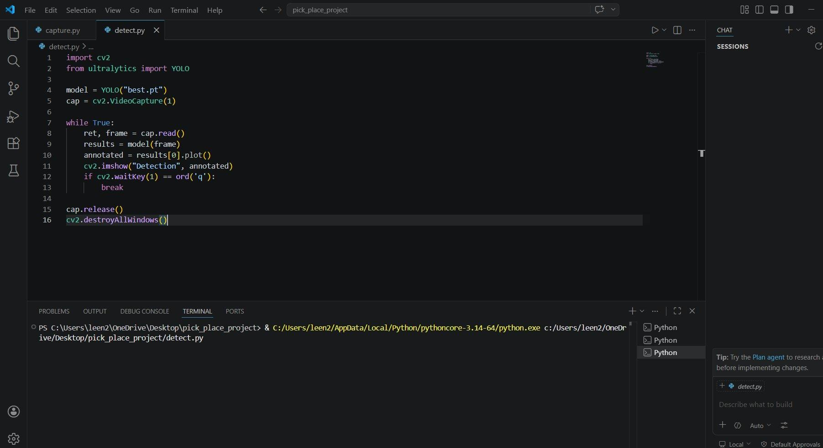
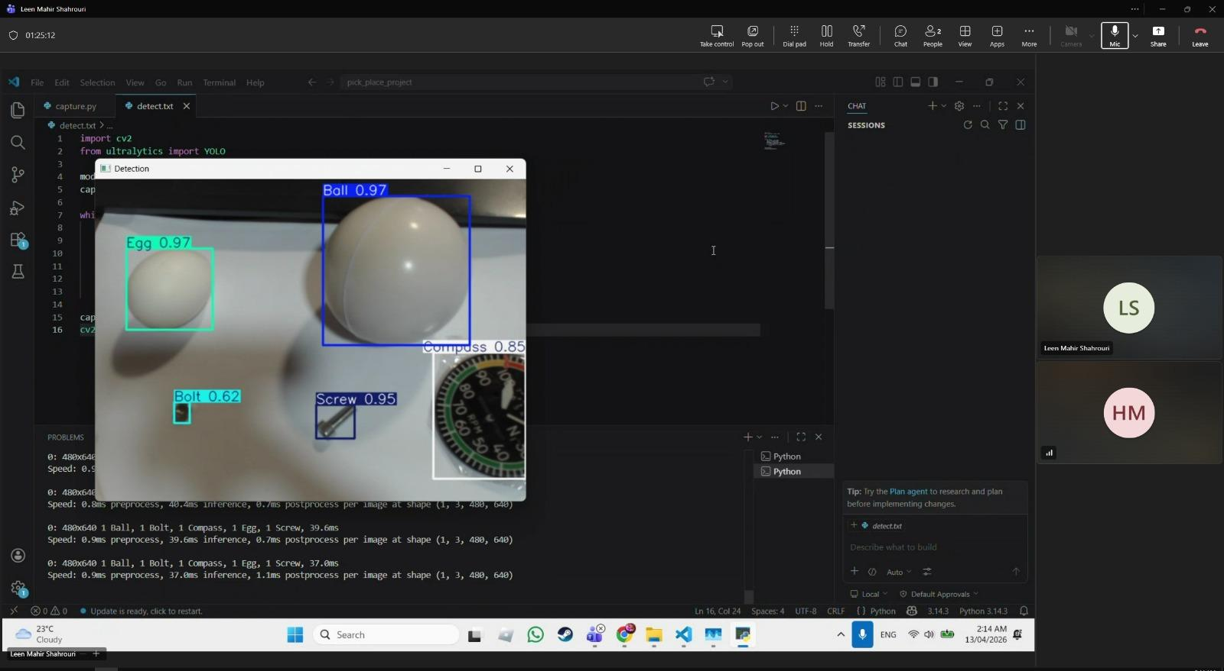
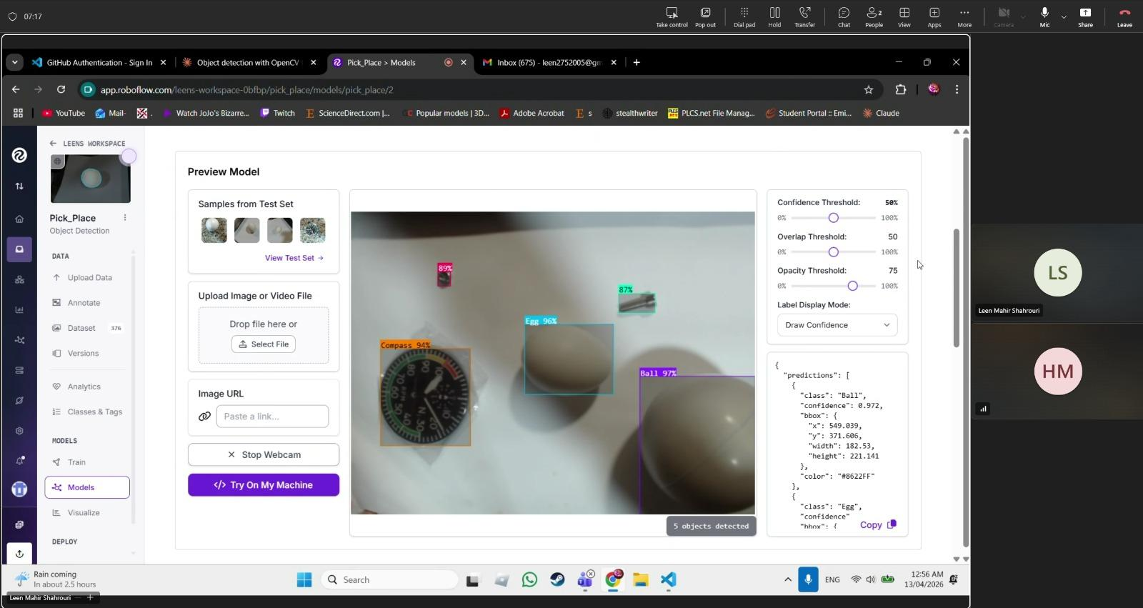
Step 3 — VS Code: Live Detection Testing
Working ✓
detect.py — the script
Live camera detection output
Detected: Ball 0.97 · Egg 0.97 · Screw 0.95 · Compass 0.85 · Bolt 0.62
Mechatronics System Design 101 · Leen's Group · Week 6

Slide 11
Mohamed — Member · Compressor Candidates Compared
Candidate | Vacuum Level | Flow Rate | Weight | Voltage | Noise | Selected?
Mini Piston Compressor | ~−60 kPa | Moderate | Heavy (>200 g) | 12–24V | High | ✗
Venturi Generator | ~−80 kPa | Needs air line | Very light | N/A (pneumatic) | Silent | ✗
12V DC Diaphragm Compressor | −70 to −85 kPa | 3–6 L/min | ~65 g | 12V shared rail | Low | ✓
★ Highlighted row = selected compressor

Slide 12
Mohamed — Member · Selected: 12V DC Diaphragm Compressor
Operating Voltage:
12V DC
DC 12V
Vacuum Level:
−70 to −85 kPa
DIAPHRAGM
COMPRESSOR
Flow Rate:
3–6 L/min
Weight:
~65 g
IN
OUT
Current Draw:
~0.3–0.5 A
Noise Level:
Low (oil-free)
↑ Illustrative diagram

Slide 13
Mohamed — Member · Selection Justification
Voltage Compatibility
Control Flow
01
Runs at 12V DC — shares the existing power rail with the JGA25-370 base motor, no extra supply needed.
Arduino R4
GPIO trigger signal
Sufficient Vacuum
▼
02
Achieves −70 to −85 kPa, well above the threshold needed to lift the project's lightweight flat-surfaced target objects.
MOSFET Switch
ON / OFF control
Compact & Lightweight
▼
03
12V Compressor
At ~65 g, it can mount near the end effector, cutting tube length and delivering faster suction response.
Generates vacuum
▼
Simple Arduino Control
Suction Cup
04
Switched via a MOSFET on an Arduino R4 digital GPIO pin — fits existing firmware without added complexity.
Grips the object

Slide 14
Mohamed — Member · Next Steps – Week 7
🛒 Procure Compressor
📐 CAD Integration
01
Order the selected 12V DC diaphragm compressor for assembly and integration.
02
Update Autodesk Inventor model to include compressor mounting bracket on the arm.
⚡ MOSFET Wiring Circuit
🧪 Suction Force Test
03
Design and build the switching circuit for Arduino R4 GPIO digital control of compressor ON/OFF.
04
Benchmark suction force against target objects to verify reliable grip before full integration.
PickMasters | MEC 483 – Spring 2026 | Abu Dhabi University

Slide 15
Helal — Member · Firmware & Control Integration
Accomplished (since last report)
Combined firmware — what it does
Wrote combined Arduino firmware merging manual gamepad control and automatic Python command input into a single unified sketch
Manual mode
Integrated IMU sensor readings into the Arduino code — wrist joint now auto-corrects to keep end effector pointing downward
Gamepad input via Bluetooth controller — each joint mapped to a stick/button
All three control modes (gamepad, Python auto, IMU levelling) run simultaneously without conflict
Auto mode
Python sends serial commands (e.g. S1:90) — Arduino receives and executes
In progress
CAD model — wrist joint and end effector mount still outstanding
IMU levelling
Reads IMU orientation continuously — adjusts wrist servo to keep cup level
Next week plan
Complete wrist joint CAD
Help needed / questions
Begin end effector CAD design
3D printed parts still not received — wrist and end effector CAD cannot be verified for fit until parts arrive.
Follow up on 3D print status
Mechatronics System Design 101 · Leen's Group · Week 6

Slide 16
Demo
IMU — End Effector Auto-Levelling
Helal — Week 6 · Wrist joint corrects in real time to keep suction cup pointing downward
To insert video:
Insert tab
→ Video
▶
→ This Device
Select file
Mechatronics System Design 101 · Leen's Group · Week 6

Slide 17
Week 6
Wrap-up
✓
Object detection & classification working in OpenCV
Looking ahead
✓
Arduino controllable via gamepad AND Python commands
Week 7
Complete CV coordinate mapping
✓
IMU integrated — end effector auto-levels to point downward
Week 7
CAD + 3D print resolved
✓
ROS2 Ubuntu VM installed — setup beginning
Week 7
Continue ROS2 setup
⚠
CV coordinate mapping not yet done — auto pipeline on hold
Week 7
Finalise end effector design
✗
3D prints delayed again — reprinting, blocking assembly
Week 8
Vision + control fully connected
Week 10
Assembly + Gazebo digital twin
Mechatronics System Design 101 · Leen's Group · Week 6

