Slide 1
WEEK 7
Robotic Arm
Pick & Place System
Weekly Progress Report · Mechatronics System Design 101
Leen's Group · Leen · Mohamed · Helal

Slide 2
Week 7 — Snapshot
What we worked on this week
Status
In-person meetup + 3D parts collected & fixed
Schedule
Recovering
01
First in-person session. Collected long-delayed 3D printed parts. Servo motor fittings were wrong dimensions — team manually cut and corrected the parts on the spot.
3D parts
Fixed ✓
OpenCV — mapping progress
OpenCV
02
Progressing
Through trial and error, camera vision now detects if an object is to the left or right and sends movement commands to the Arduino base motor accordingly.
ROS2
Running ✓
ROS2 installed and running
03
Assembly
After significant learning on the new Linux OS, ROS2 is now installed and operational on the Ubuntu system — ready to begin integration work.
Pending
CAD
On track
✓ Major win: team met in person, collected 3D parts, and corrected servo fittings on the day — assembly is now unblocked.
Mechatronics System Design 101 · Leen's Group · Week 7

Slide 3

Project Schedule — Gantt Chart
[ Paste Gantt Chart Image Here ]
Mechatronics System Design 101 · Leen's Group · Week 7

Slide 4
Milestones & Deliverables
Deliverable
Target
Status
This week
CAD model complete
Week 7
Nearly done
Parts corrected — final CAD to finish this week
New part prints
Week 8
Ordered
Corrected dimensions sent for reprint
Camera vision (OpenCV)
Week 8
Progressing
Left/right detection + base motor commands working
End effector + pump
Week 8
In progress
Pump being sourced this week
Control system
Week 8
On track
Gamepad + Python + CV commands all functional
ROS2 / Digital twin
Week 10
Running ✓
ROS2 installed and operational on Ubuntu
Full assembly
Week 10
Unblocked
Parts in hand — assembly begins once reprints arrive
Control system complete
Week 11
On track
CV pipeline sending commands to Arduino
Mechatronics System Design 101 · Leen's Group · Week 7

Slide 5
Issues, Risks & Action Items
Current issues & risks
Action items
Servo fittings — wrong dimensions
Resolved
Complete CAD model
Week 7
3D printed motor mounts did not fit. Team manually cut parts to correct on the day — new accurate parts sent for reprint.
Helal
Source and buy suction pump
Week 8
OpenCV mapping incomplete
Medium
Mohamed
Left/right detection working but full coordinate mapping to arm workspace not yet done — auto pick-and-place still pending.
Finish OpenCV coordinate mapping
Week 8
Leen
Assembly not yet tested
Medium
Begin ROS2 arm integration
Week 8
Physical assembly could not be completed this week due to fitting issues. Unblocked now — to proceed when reprints arrive.
All
Assemble arm once reprints arrive
Week 8
All
ROS2 integration not started
Low
ROS2 is installed and running. Integration with arm control pipeline yet to begin — must start Week 8.
Test full control pipeline end-to-end
Week 8
All
Mechatronics System Design 101 · Leen's Group · Week 7

Slide 6
Individual
Updates
What each member did, what they will do, what they need.
Leen
Mohamed
Helal
Group Leader
Member
Member

Slide 7
Leen — Group Leader · OpenCV & Arduino Control
Accomplished (since last report)
Control loop — how it works
Integrated OpenCV detection with Arduino motor control
1
Camera captures frame
Object detected on left → base motor turns left until centred
OpenCV processes live video feed
Object detected on right → base motor turns right until centred
2
Object position detected
Bounding box centre compared to frame centre
Closed-loop centering behaviour confirmed working
3
Left / right decision
If object is left → turn left. If right → turn right.
In progress
4
Command sent to Arduino
Camera producing too many false detections — collecting more training data
Serial command adjusts base servo until object is centred
Full x/y coordinate mapping to arm workspace
Current issue — false detections
Next week plan
The camera is detecting too many incorrect objects. This is a training data problem — the model has not seen enough examples to reliably distinguish the target objects from the background and other items. More labelled images need to be collected and the model retrained before the system can be used reliably for auto pick-and-place.
Gather and annotate more training data for camera
Improve detection accuracy — reduce false positives
Complete full coordinate mapping for auto pick-and-place
Mechatronics System Design 101 · Leen's Group · Week 7

Slide 8
Demo
OpenCV — Object Detection
Leen — Week 7 · Left/right detection sending base motor commands to Arduino
To insert video:
Insert tab
→ Video
▶
→ This Device
Select file
[ Insert video here ]
Mechatronics System Design 101 · Leen's Group · Week 7

Slide 9
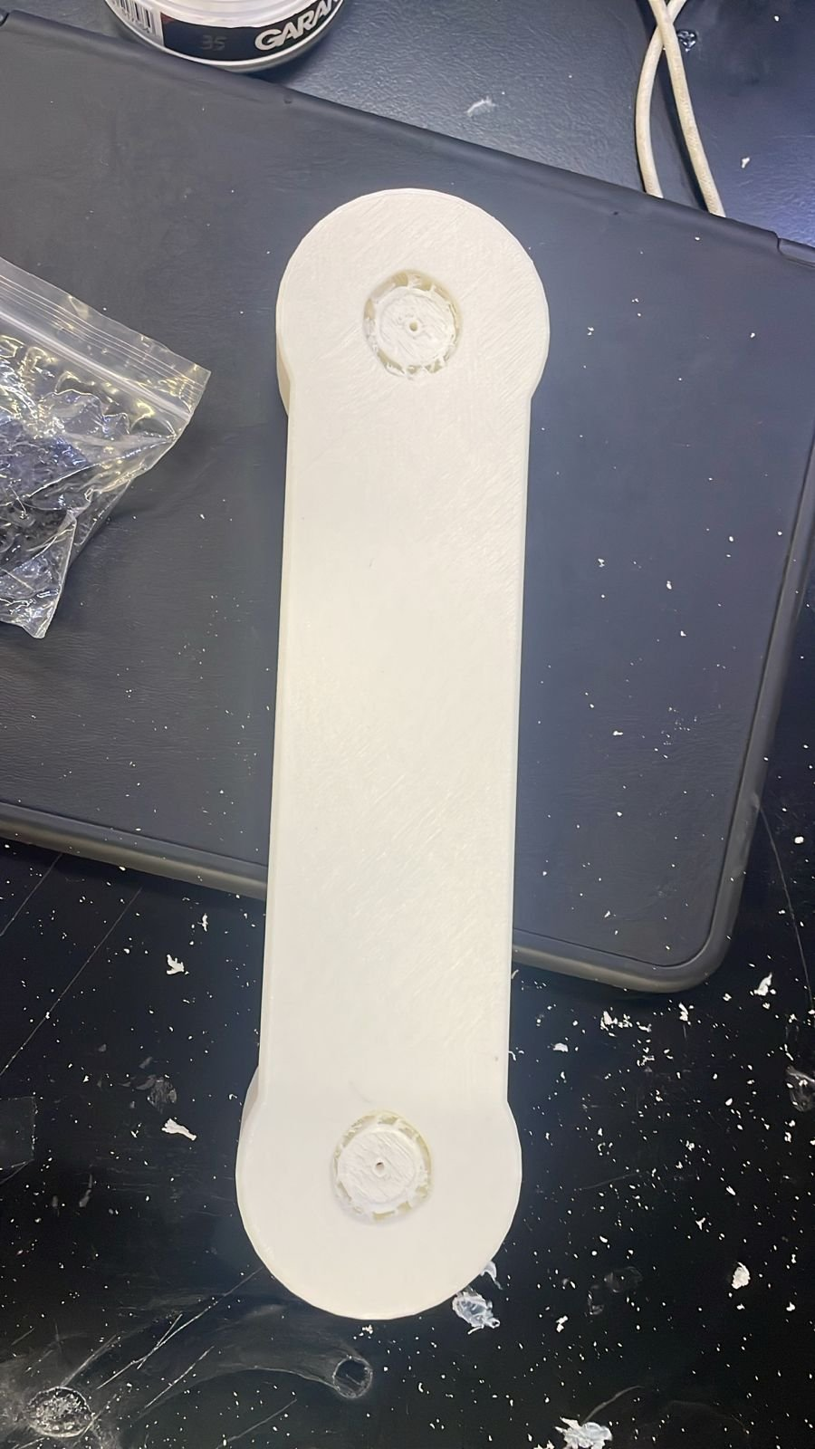
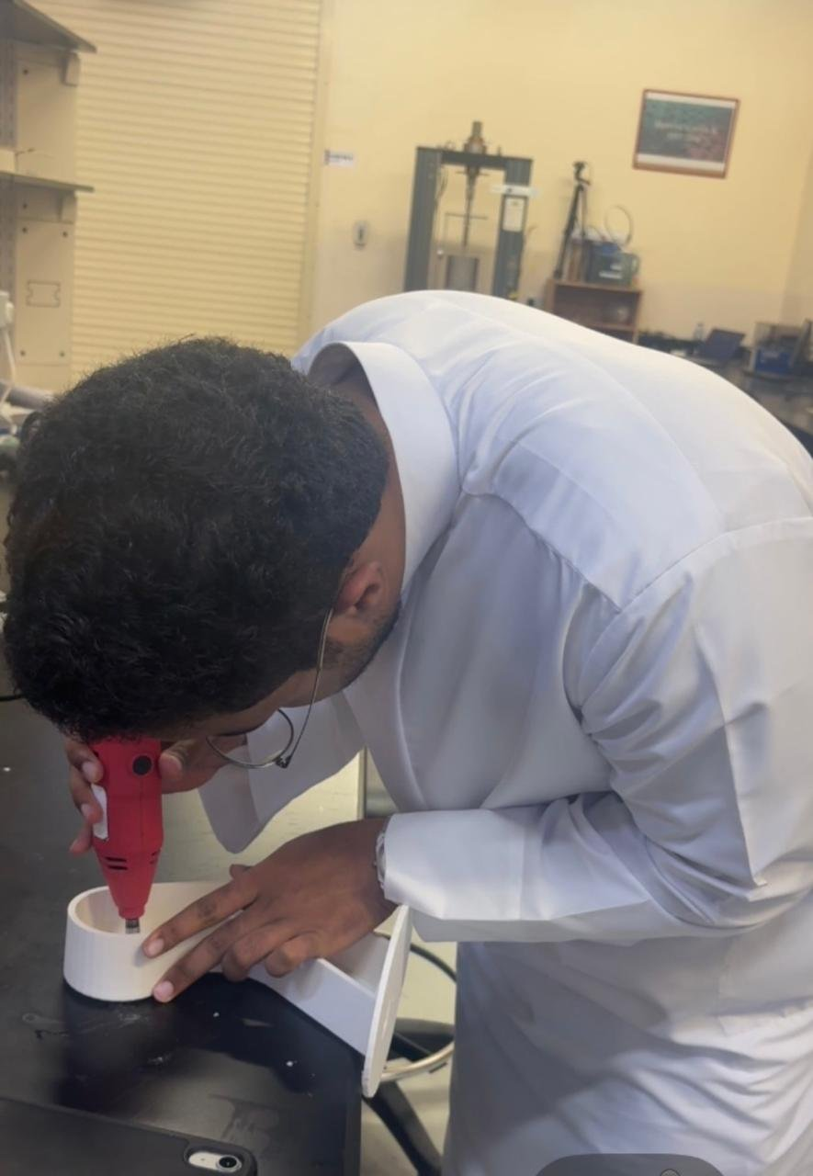
3D Printed Part Adjustments
Mohamed • Hardware & Firmware
Parts Adjusted
Base and shoulder 3D printed links were too tight for the servo motor shaft and required post-processing.
Method – Dremel
A Dremel rotary tool was used in the lab to widen the mounting holes and clean up the tight printed tolerances.
✅ Parts Fixed
Both parts are now fully adjusted and seat correctly on the servo shafts — no reprinting required.
3D Printed Arm Link
Dremel Adjustment in Lab

Slide 10
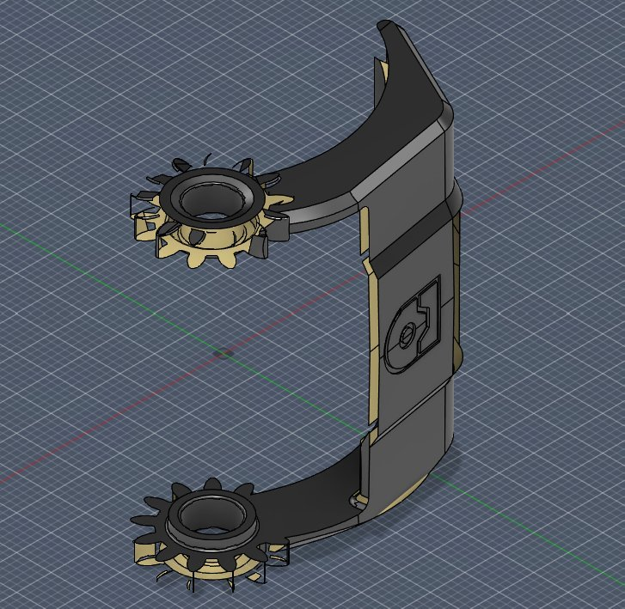
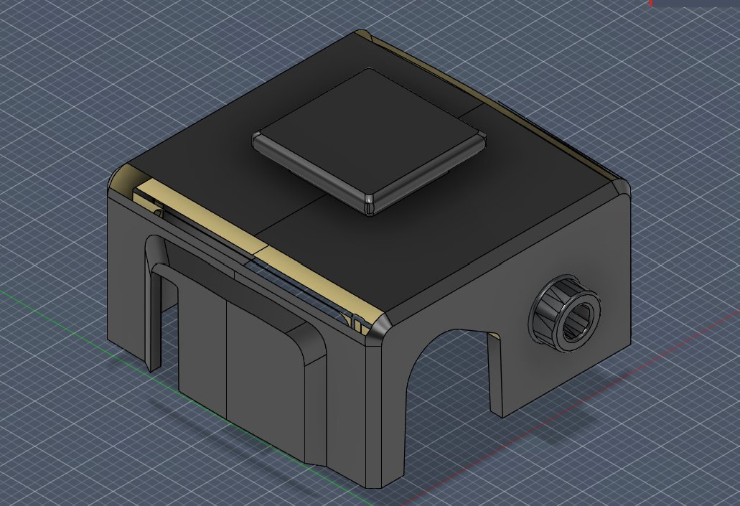
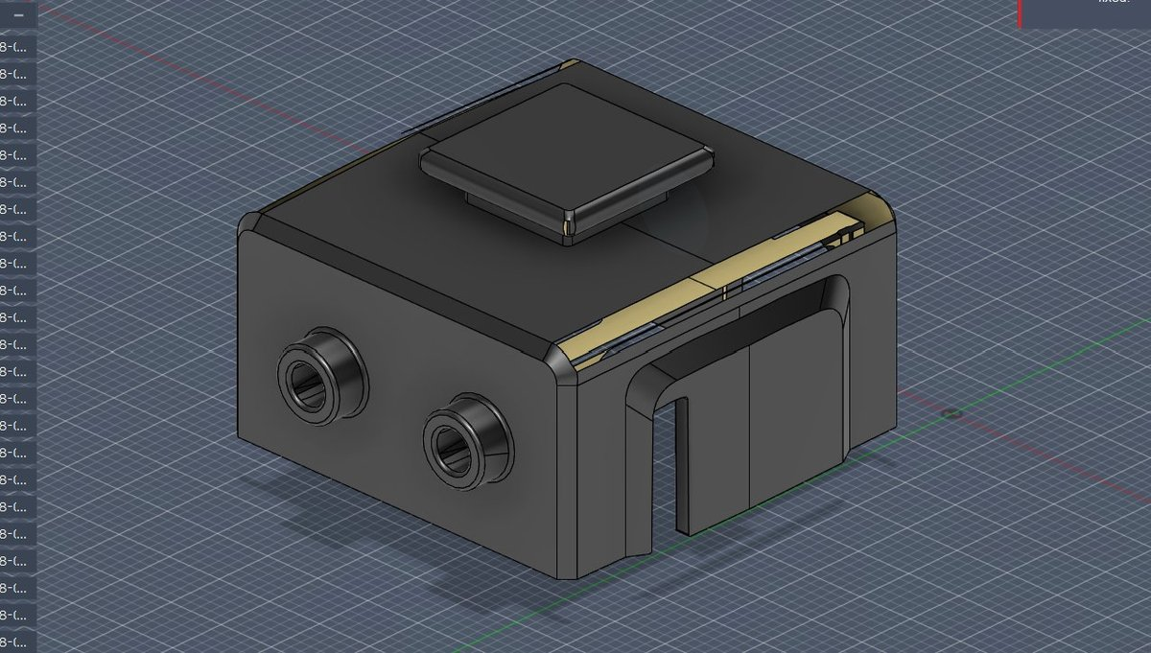
End Effector CAD – Hybrid Design
Hybrid mechanism: vacuum suction cup + gear-driven mechanical claws. Suction cup hole diameter TBD pending servo motor fitment confirmation.
Claw Mechanism
Housing – Side View
Housing – Front Port View
🦾 Gear-Driven Claws
💨 Suction Cup Port
🔩 Material & Mounting
Two symmetrical claws actuated by a gear mechanism grip the object securely from the sides.
Hole diameter TBD — pending servo motor fitment confirmation in next CAD revision.
3D printed PLA/PETG. Housing mounts directly onto the wrist joint of the arm.

Slide 11
Vacuum Pump – Market Research
Visited Besomi Electronics and a local electrical shop. Also searched online. Key challenge: most pumps do not list port diameter — critical for suction force calculation (F = P × A). Research ongoing.
Gikfun Mini DC 6V–12V R385 Diaphragm Pump
1
Amazon.ae • AED 36
Only option found with port dimensions clearly listed. Port ID of 5 mm gives a contact area of 19.6 mm², sufficient to lift the target objects at the compressor's operating vacuum.
370 Mini Vacuum Pump
2
DFRobot / Local • AED 26.20
Cheapest option available. Port specs are not provided — physical measurement would be required before confirming suitability for the required suction force.
Vacuum Pump – 12V
3
SparkFun / Local • AED 86.24
Most reputable brand with known reliability. Port specs unavailable online. Highest price and long lead time make this less practical for the current project timeline.

Slide 12
Pump Options – Specification Comparison
Pump | Voltage | Port ID | Contact Area | Price (AED) | Availability | Port Specs Listed?
Gikfun R385 (Amazon.ae) | 6–12V DC | 5 mm | 19.6 mm² | 36 | In stock | ✓ Yes
370 Mini Pump (DFRobot) | TBC | Not listed | Unknown | 26.20 | In stock | ✗ No
SparkFun 12V (Local) | 12V DC | Not listed | Unknown | 86.24 | 2–3 weeks | ✗ No
Suction Force Estimate – Gikfun R385 (only option with known Port ID)
F = P × A → Port ID = 5 mm → A = π/4 × (0.005)² = 19.6 mm² | At 70 kPa: F = 70,000 × 0.0000196 ≈ 1.37 N (~140 g) ✓ Sufficient for target objects.

Slide 13
Next Steps – Week 8
🔍 Continue Pump Research
📐 Finalise Suction Port Size
01
Visit more suppliers and search online for pumps with port specs listed. Finalise pump selection before procurement.
02
Confirm servo motor fit in CAD and determine suction cup hole diameter for the end effector housing.
🖨️ Begin Printing End Effector
🔩 Full Arm Assembly
03
Start 3D printing the end effector housing and claw components once suction port diameter is confirmed in CAD.
04
Assemble all joints with servos and test full range of motion across all 4 DOF before system integration.
PickMasters | MEC 483 – Spring 2026 | Abu Dhabi University

Slide 14
Helal — Member · ROS2, Linux & CAD
Accomplished (since last report)
ROS2 setup — where we are
Attended in-person session — collected 3D printed parts
Ubuntu VM
Installed & configured ✓
Helped identify and manually correct servo motor fitting dimensions on the day
ROS2
Installed and running ✓
Learned Linux OS fundamentals to support ROS2 workflow
Installed ROS2 successfully on Ubuntu virtual machine
RViz
Reached — setup in progress
Progressed through ROS2 setup — reached RViz configuration stage
URDF model
Arm model — not yet started
In progress
Joint control
ROS2 ↔ Arduino — not yet started
RViz setup and arm model visualisation — continuing next week
Next week plan
Help needed / questions
Complete RViz arm model setup
Linux and ROS2 are new tools — steep learning curve is slowing progress. More time needed on RViz and URDF modelling before arm integration can begin.
Begin ROS2 joint control integration
Finalise CAD model — wrist & end effector
Mechatronics System Design 101 · Leen's Group · Week 7

Slide 15
Week 7
Wrap-up
✓
First in-person session — team collaboration working
Looking ahead
✓
3D parts collected and servo fittings corrected on the day
Week 7
Finalise CAD model
✓
OpenCV: left/right detection sending base motor commands
Week 8
Corrected reprints arrive
✓
ROS2 installed and running on Ubuntu
Week 8
Full OpenCV coordinate mapping
⚠
Full coordinate mapping not yet done — auto pipeline pending
Week 8
Buy pump + begin end effector build
⚠
Assembly awaiting corrected reprint parts
Week 8
Begin ROS2 arm integration
Week 10
Full assembly + Gazebo digital twin
Mechatronics System Design 101 · Leen's Group · Week 7

