Slide 1
CONTAINERS
FROM SCRATCH TO PRODUCTION
Deep dive into kernel primitives and container runtimes
Technical Workshop | 2026

Slide 2
WHY DO WE NEED CONTAINERS?
Traditional Deployment Era
App
App
App
Operating System
Hardware
Traditional Deployment
Applications ran directly on physical servers with no way to define resource boundaries.
Problems:
→ Resource allocation conflicts
→ Underutilized servers
→ Expensive to maintain multiple servers

Slide 3
WHY DO WE NEED CONTAINERS?
Virtualized Deployment Era
App
App
App
Bin/Lib
Bin/Lib
Bin/Lib
App
App
App
Guest OS
Guest OS
Guest OS
→
Hypervisor
Operating System
Host OS
Hardware
Hardware
Traditional Deployment
Virtualized Deployment
VMs allow multiple virtual machines on a single physical server's CPU, providing isolation and better resource utilization.
Benefits:
→ Better resource utilization
→ Isolation between applications
→ Reduced hardware costs

Slide 4
WHY DO WE NEED CONTAINERS?
Container Deployment Era
App
App
App
Bin/Lib
Bin/Lib
Bin/Lib
App
App
App
App
App
App
Guest OS
Guest OS
Guest OS
Bin/Lib
Bin/Lib
Bin/Lib
Hypervisor
Container Runtime
Operating System
→
→
Host OS
Operating System
Hardware
Hardware
Hardware
Traditional Deployment
Virtualized Deployment
Container Deployment
Containers share the OS kernel, are lightweight, and provide isolation at the process level.
Benefits:
→ Lightweight (no Guest OS overhead)
→ Fast startup times
→ Consistent across environments
→ High density deployments

Slide 5
THE HISTORY OF CONTAINERS
From Unix origins to cloud-native orchestration
1979 - 2000
2002 - 2008
2013 - 2015
2014 - Present
Early Foundations
Linux Innovations
Docker Revolution
Cloud Native Era
1979 Unix V7 chroot
2002 Linux namespaces
2013 Docker released (dotCloud)
2014 Kubernetes (Google)
1982 chroot in BSD
2006 cgroups (Google)
2014 Docker 1.0, Docker Hub
2015 CNCF founded
2000 FreeBSD Jails
2008 LXC (Linux Containers)
2015 OCI founded, runc released
2017 containerd donated
NAMESPACES
CGROUPS
DOCKER'S CONTRIBUTION
Isolate what processes can see: PID, network, mount, user, UTS, IPC
Limit what processes can use: CPU, memory, I/O, network bandwidth
Developer UX, image format, registry, build tooling, ecosystem

Slide 6
WHAT IS A CONTAINER?
An isolated process with controlled access to system resources
NOT A VM
NOT MAGIC
NOT SECURE
Process on host kernel
Kernel features only
Depends on config
KEY COMPONENTS:
→ Namespaces: Isolate what a process can SEE
→ Cgroups: Limit what a process can USE
→ Union filesystems: Layer the filesystem
→ Capabilities: Fine-grained privilege control
Controlled execution environment with explicit boundaries

Slide 7
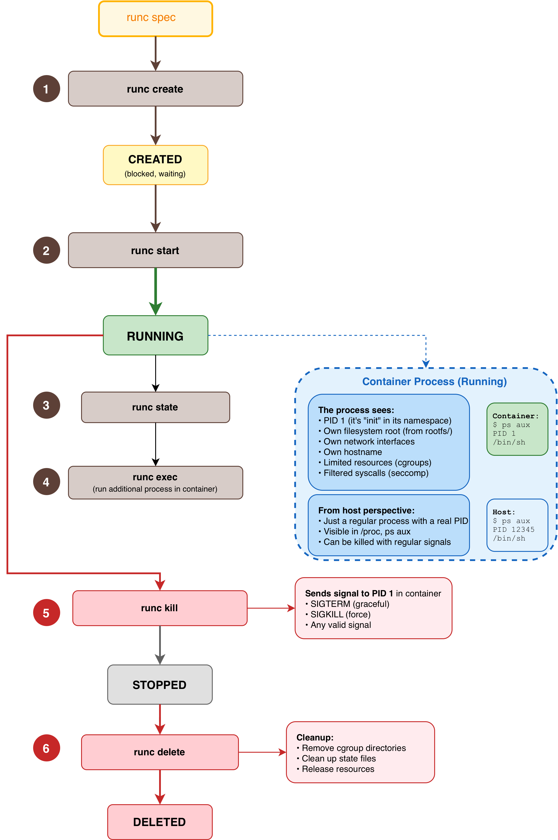
Container Lifecycle
runc + Linux Kernel

Slide 8
HOW CONTAINERS WORK
When you run a container, the following happens:
1
CLONE syscall with namespace flags
Creates new namespaces (PID, mount, network, etc.). Child process lives in isolated namespace view.
2
Cgroup setup
Process added to cgroup hierarchy. Resource limits enforced by kernel.
3
Filesystem preparation
Mount namespace established. Root filesystem pivoted (pivot_root). Union filesystem mounted.
4
Capabilities dropped
Process starts with reduced privileges. Even UID 0 inside has restricted capabilities.
5
Process exec
Container runtime execs your application. Application thinks it's alone on the system.
KEY INSIGHT: Your kernel is doing ALL the work
The container runtime just orchestrates syscalls. No hypervisor, no separate kernel.
Pure kernel feature orchestration

Slide 9
DEMO 1
BUILD A CONTAINER
FROM SCRATCH!
Building a minimal container runtime in Go
Linux
Go

Slide 10
DEMO 2
BUILD A CONTAINER
FROM SCRATCH!
Building a minimal container with runc
Linux
Go

Slide 11
CONTAINER RUNTIME LANDSCAPE
Docker is NOT containers. Docker is ONE implementation.
containerd
gVisor (runsc)
Docker's underlying runtime. CNCF graduated. What K8s uses.
User-space kernel. Intercepts syscalls. Security over performance.
CRI-O
Kata Containers
Built for Kubernetes. Implements K8s CRI. Minimal, focused.
Lightweight VMs that look like containers. Own kernel per container.
runc
Podman
Low-level OCI runtime. What containerd/CRI-O use underneath.
Daemonless. Docker CLI compatible. Rootless by default.
Most production systems use containerd or CRI-O, not Docker

Slide 12

OPEN CONTAINER INITIATIVE (OCI)
Why It Exists and Why You Should Care
WHERE OCI SITS IN THE STACK
THE PROBLEM OCI SOLVES
Before OCI, Docker was the de facto standard. This created vendor lock-in risks and fragmentation as alternatives emerged. The industry needed open standards for interoperability.
Container Platforms (Docker, Podman, K8s)
↓
High-Level Runtime (containerd, CRI-O)
WHAT IS OCI?
↓
Founded in 2015 by Docker, CoreOS, and others under the Linux Foundation. OCI creates open industry standards for container formats and runtimes.
OCI SPECS
Runtime + Image + Distribution
↓
THE THREE OCI SPECIFICATIONS
Runtime Spec
How to run containers
Low-Level Runtime (runc, crun, gVisor)
Image Spec
How to package containers
↓
Distribution Spec
How to distribute images
Linux Kernel (namespaces, cgroups)
OCI ensures your containers work everywhere, regardless of tooling

Slide 13
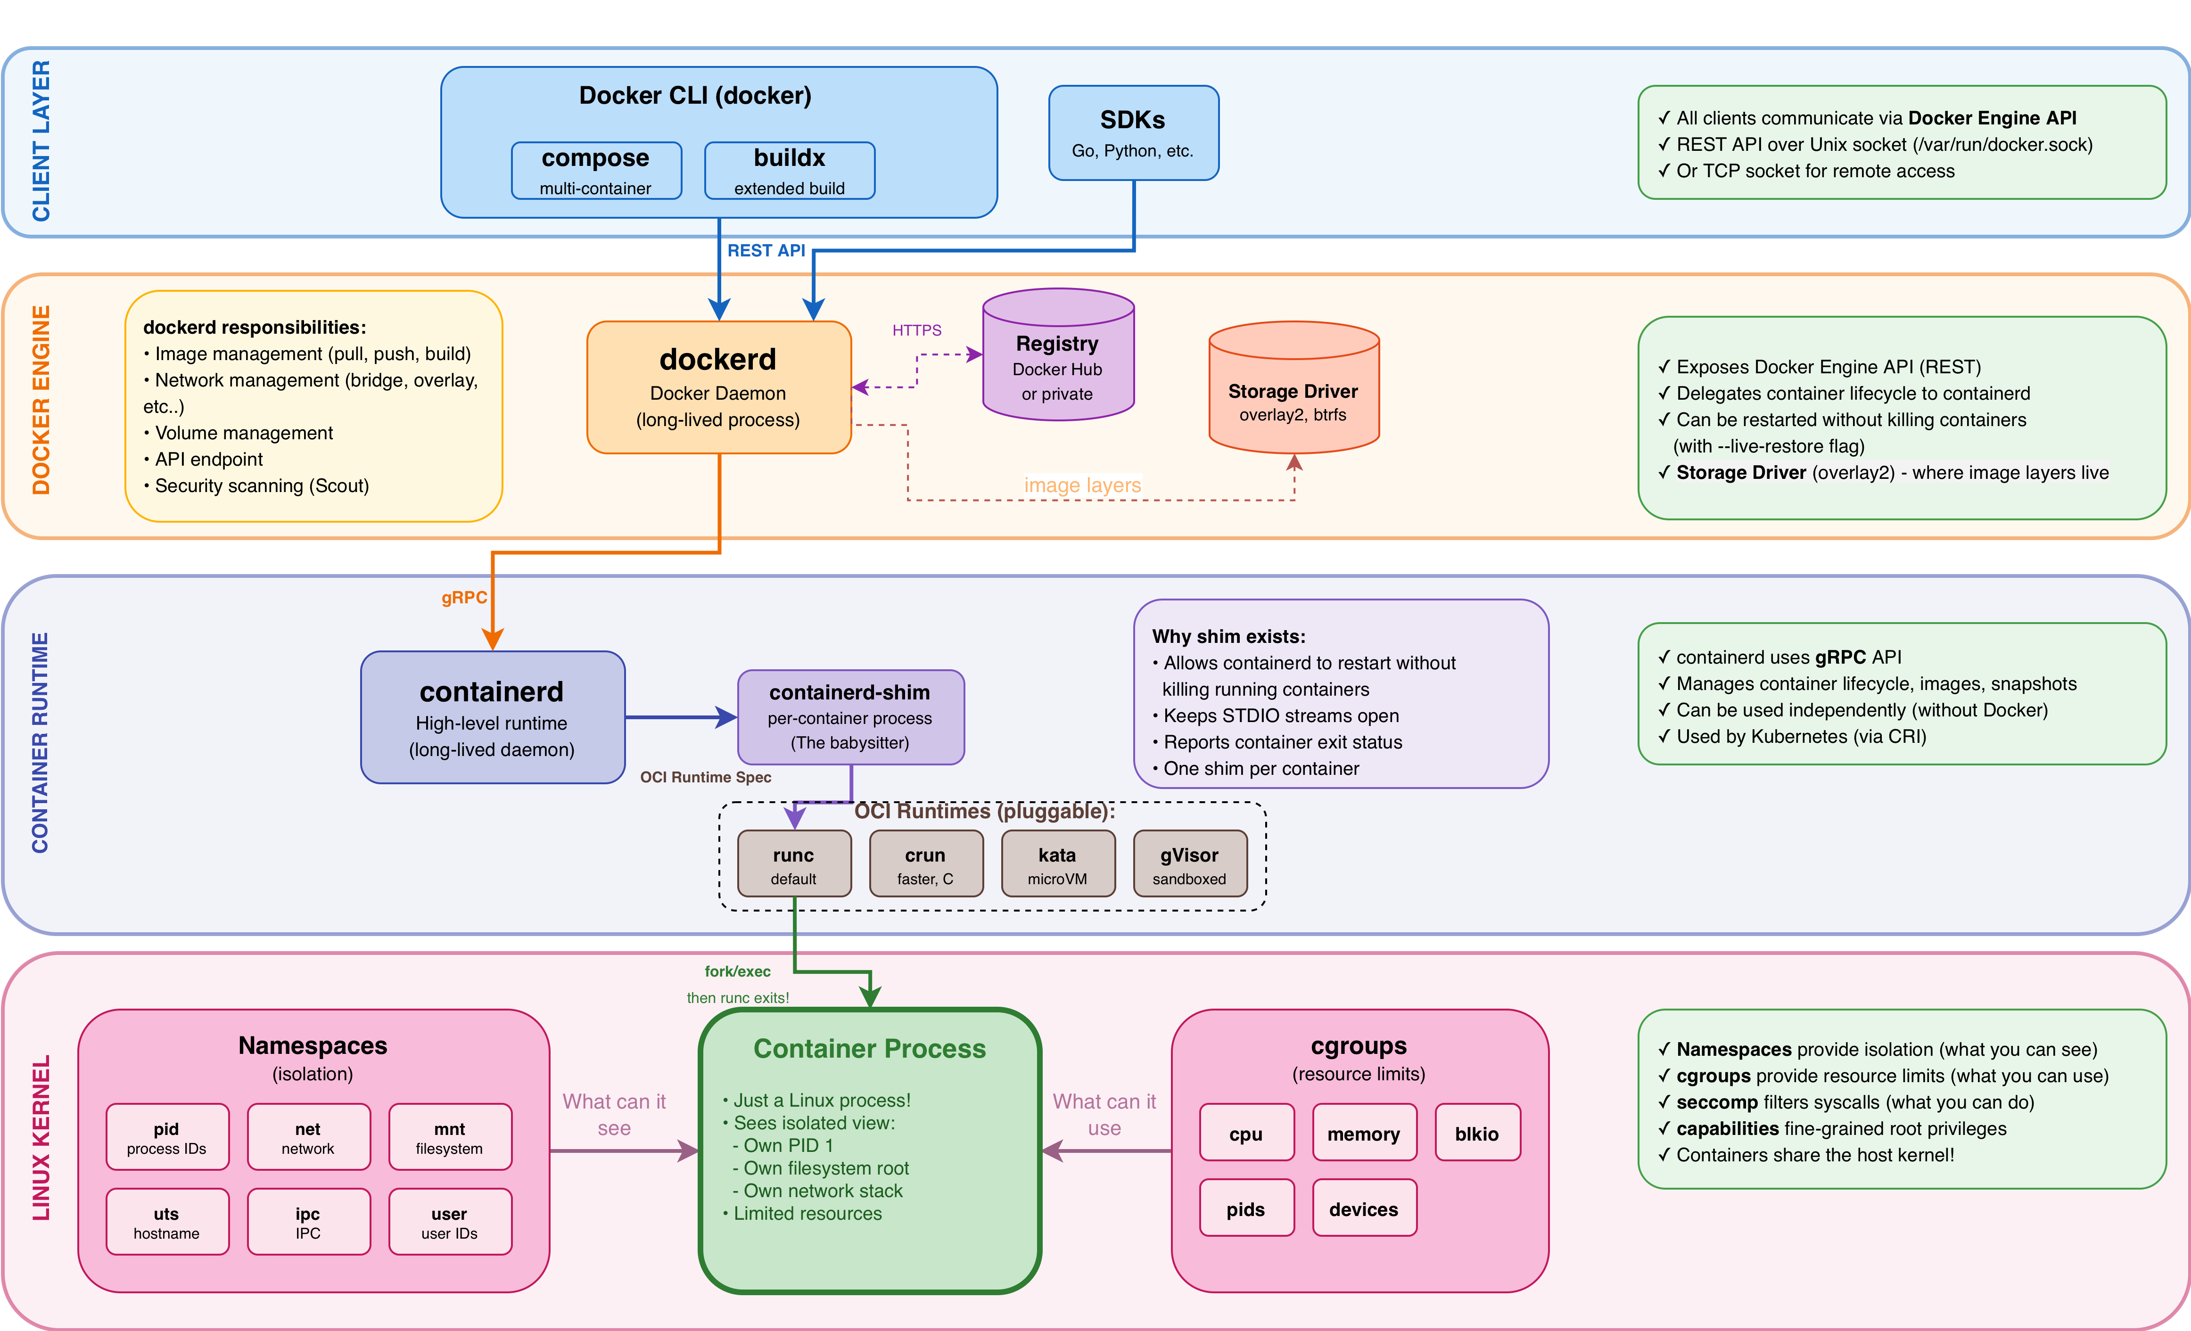
DOCKER ARCHITECTURE

Slide 14
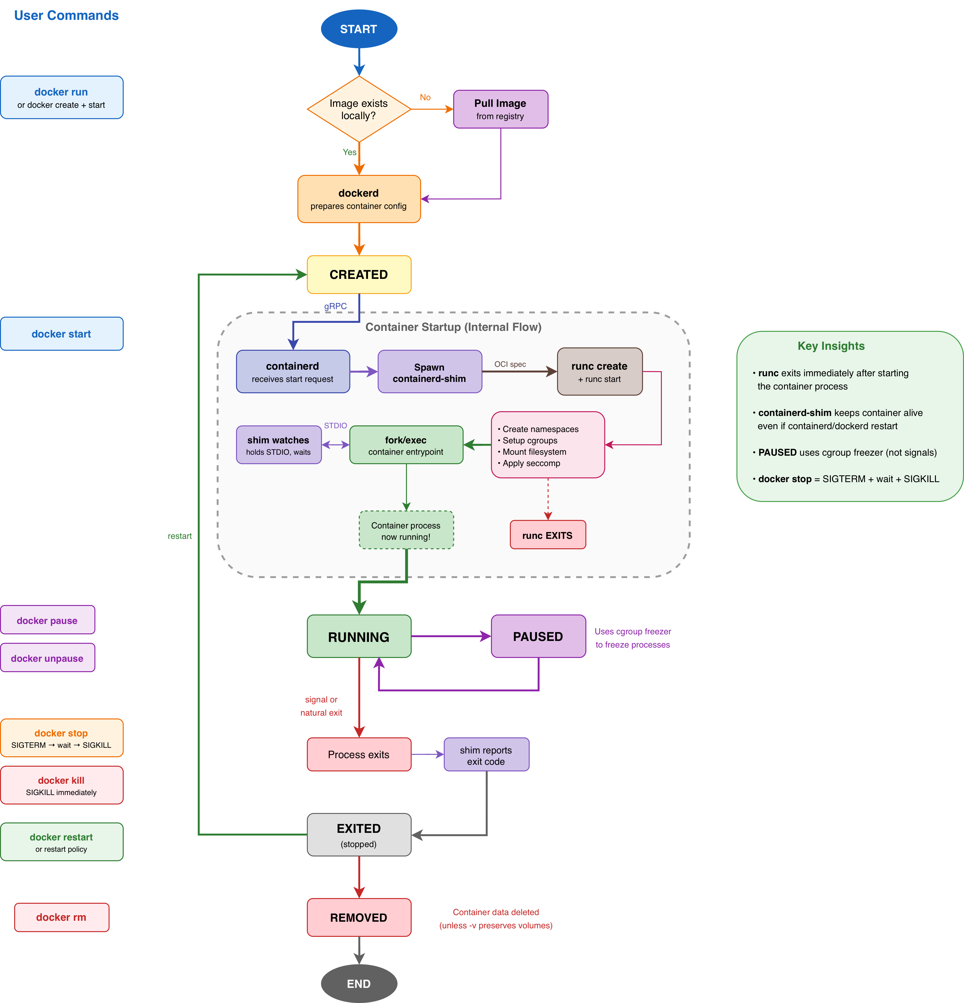
Container Lifecycle
Docker

Slide 15
ESSENTIAL DOCKER COMMANDS
LIFECYCLE
DEBUGGING
docker run -d --name web nginx
docker logs -f web
docker stop web
docker exec -it web /bin/bash
docker rm web
docker inspect web
IMAGES
NETWORKING
docker build -t app:v1 .
docker network create mynet
docker pull nginx:latest
docker run --network mynet app
Critical flags for docker run:
-d detached • -p 8080:80 port mapping • -v /host:/container volume • --memory 512m memory limit
Grouped by function for real-world workflows

Slide 16
DEMO 3
LET'S DOCKERIZE
AN APPLICATION!
Dockerize and Containerize mini-note app
Java
Docker

Slide 17
DOCKER COMPOSE
Define and run multi-container applications
docker-compose.yml
services:
my_app:
Single YAML file to define services, networks, and volumes
build:
ports: ["8080:8080"]
KEY FEATURES
→ Automatic service networking
depends_on: [database]
→ Volume and secret management
database_name:
→ Environment variable support
→ Service dependency ordering
image: postgres:15
COMMANDS
volumes: [db_data:/var/lib/postgresql]
up
down
logs
ps
build
volumes:
db_data:
Perfect for: Local dev, CI/CD, single-host
web
→
database
→
db_data
:8080
postgres
volume

Slide 18
DOCKERFILE DIRECTIVES
FROM
ENTRYPOINT vs CMD
Base image. Use specific versions, prefer alpine/distroless.
ENTRYPOINT: main executable. CMD: default args (easy override).
RUN
USER
Execute commands during build. Combine with && to reduce layers.
Switch user. Critical for security. Never run as root.
COPY vs ADD
EXPOSE
COPY: just copy (preferred). ADD: auto-extract tar + fetch URLs.
Documents port. Doesn't actually publish.
WORKDIR
VOLUME
Set working directory. Don't use RUN cd /app.
Mount point. Documents stateful data location.
ENV vs ARG
HEALTHCHECK
ENV: runtime + build. ARG: build-time only.
Container health verification command.
Pro tip: Use DOCKER_BUILDKIT=1 for better caching and parallelization
Each instruction creates a layer—minimize and order wisely

Slide 19
DOCKERFILE ANTI-PATTERNS
Common mistakes that bloat images and reduce security
PROBLEMS:
FROM ubuntu
✗ Large base image (ubuntu)
RUN apt-get update
✗ Multiple RUN layers (wastes space)
RUN apt-get install -y python3
✗ No layer caching optimization
RUN apt-get install -y pip
✗ Runs as root
COPY . /app
RUN pip install -r requirements.txt
✗ No .dockerignore
CMD python3 /app/main.py
✗ Build deps in final image
✗ No version pinning
Result: 500MB+ image with security vulnerabilities
Don't ship your build toolchain to production

Slide 20
DOCKERFILE BEST PRACTICES
Multi-stage build: Separate build from runtime
BUILD STAGE
BENEFITS:
FROM golang:1.21-alpine AS builder
✓ Final image < 10MB
WORKDIR /build
✓ No build tools in prod
COPY go.mod go.sum ./
RUN go mod download
✓ Layer caching optimized
COPY . .
✓ Non-root user
RUN CGO_ENABLED=0 go build -o app .
✓ Static binary
RUNTIME STAGE
✓ Minimal attack surface
KEY TECHNIQUES:
FROM scratch
COPY --from=builder /build/app /app
Copy deps before source (caching)
USER 65534:65534
FROM scratch or distroless base
ENTRYPOINT ["/app"]
Always specify USER directive
Ship only what you need to run, not what you needed to build

Slide 21
DOCKER NETWORKING
How containers communicate with each other and the outside world
bridge (default)
macvlan
Private internal network. NAT to host for external access.
Container gets MAC address. Appears as physical device.
host
none
Container uses host network stack directly. No isolation.
No networking. Complete isolation. Loopback only.
overlay
custom
Multi-host networking for Swarm. VXLAN encapsulation.
User-defined bridge. Built-in DNS. Network isolation.
Network drivers are pluggable - can write your own (CNI plugins)
Each driver trades off isolation vs performance vs complexity

Slide 22
BRIDGE NETWORK INTERNALS
Default Docker networking - veth pairs + Linux bridge + iptables NAT
1
Docker creates virtual bridge (docker0)
Acts like network switch. Default: 172.17.0.0/16 subnet.
2
Create veth pair for each container
vethXXX (host side) ↔ eth0 (container side). Virtual ethernet cable.
3
Attach vethXXX to docker0 bridge
Bridge forwards packets between containers on same network.
4
Move eth0 into container netns
Container only sees eth0 with private IP (172.17.0.2, .3, etc.)
5
iptables NAT for external traffic
MASQUERADE rule: container IPs → host IP for internet access.
ip link show • brctl show • iptables -t nat -L to inspect

Slide 23
PACKET FLOW: CONTAINER TO INTERNET
Container
eth0
172.17.0.2
vethXXX
docker0
172.17.0.1
iptables NAT
eth0
Internet
Source NAT:
172.17.0.2:8080 → 10.0.2.15:12345

Slide 24
PORT PUBLISHING (-p / -P)
Forwarding traffic from host port to container port
SYNTAX:
IPTABLES RULES:
-p 8080:80
Host 8080 → Container 80
DOCKER chain in nat table:
DNAT tcp --dport 8080
-p 127.0.0.1:8080:80
to 172.17.0.2:80
Only localhost can access
Traffic flow:
-p 80
1. Packet arrives at host:8080
Random host port → 80
2. DNAT changes dest IP:port
3. Routes to 172.17.0.2:80
-P
4. Bridge forwards to container
Publish all EXPOSE'd ports
Docker automatically manages iptables rules - don't edit manually
Check rules: iptables -t nat -L -n | grep DOCKER

Slide 25
DNS & SERVICE DISCOVERY
Containers find each other by name, not IP
DEFAULT BRIDGE:
HOW IT WORKS:
NO automatic DNS
/etc/resolv.conf in container:
Must use --link (deprecated)
nameserver 127.0.0.11
Or hardcode IPs (bad)
Points to embedded DNS resolver
USER-DEFINED BRIDGE:
Resolution order:
Built-in DNS server
1. Check container name on network
Container name = hostname
2. Check network aliases
Network aliases supported
3. Forward to external DNS
docker run --network mynet --name api backend:v1
Other containers: curl http://api:8080

Slide 26
DEMO 4
NETWORK INSPECTION
For Docker
Examine Docker networking primitives in action
Linux
bash

Slide 27
Key Insight
Containers aren't new.
Docker made them accessible.
Kubernetes made them scalable.
OCI made them portable.

Slide 28
RESOURCES
https://labs.iximiuz.com/skill-paths?category=containers Docker networking: https://docs.docker.com/network/ https://learn.kodekloud.com/user/courses/docker-training-course-for-the-absolute-beginner https://learn.kodekloud.com/user/courses/docker-certified-associate-exam-course https://www.udemy.com/course/complete-docker-kubernetes https://github.com/nicolaka/netshoot https://github.com/helayoty/cloud-native-in-arabic

Slide 29
THANK YOU!
𝕏
Questions? Let's discuss!
@helayoty

